Slide 1
Analysis of Algorithms CS 477/677
Instructor: Monica Nicolescu
Lecture 13

Slide 2
Augmenting Data Structures
Let’s look at two new problems:
Dynamic order statistic
Interval search
It is unusual to have to design all-new data structures from scratch
Typically: store additional information in an already known data structure
The augmented data structure can support new operations
We need to correctly maintain the new information without loss of efficiency

Slide 3
Dynamic Order Statistics
Def.: the i-th order statistic of a set of n elements, where i ∈ {1, 2, …, n} is the element with the i-th smallest key.
We can retrieve an order statistic from an unordered set:
Using:
In:
We will show that:
With red-black trees we can achieve this in O(lgn)
Finding the rank of an element takes also O(lgn)
RANDOMIZED-SELECT
O(n) time

Slide 4
Order-Statistic Tree
Def.: Order-statistic tree: a red-black tree with additional information stored in each node
Node representation:
Usual fields: key[x], color[x], p[x], left[x], right[x]
Additional field: size[x] that contains the number of (internal) nodes in the subtree rooted at x (including x itself)
For any internal node of the tree:
size[x] =
size[left[x]] + size[right[x]] + 1

Slide 5
Example: Order-Statistic Tree
key
10
7
size
8
15
3
3
4
9
11
19
1
1
1
1

Slide 6
OS-SELECT
Goal:
Given an order-statistic tree, return a pointer to the node containing the i-th smallest key in the subtree rooted at x
Idea:
size[left[x]] = the number of nodes
that are smaller than x
rank’[x] = size[left[x]] + 1
in the subtree rooted at x
If i = rank’[x] Done!
If i < rank’[x]: look left
If i > rank’[x]: look right
10
7
8
15
3
3
4
9
11
19
1
1
1
1

Slide 7
OS-SELECT(x, i)
r ← size[left[x]] + 1
if i = r
then return x
elseif i < r
then return OS-SELECT(left[x], i)
else return OS-SELECT(right[x], i - r)
Initial call: OS-SELECT(root[T], i)
Running time: O(lgn)
► compute the rank of x within the subtree rooted at x

Slide 8
Example: OS-SELECT
OS-SELECT(root, 3)
10
r = 3 + 1 = 4
OS-SELECT(‘8’, 3)
7
r = 1 + 1 = 2
OS-SELECT(‘9’, 1)
8
15
3
3
4
9
11
19
1
1
1
1
r = 1
Found!

Slide 9
OS-RANK
Goal:
Given a pointer to a node x in an order-statistic tree, return the rank of x in the linear order determined by an inorder walk of T
Its parent plus the left
subtree if x is a right child
10
7
x
Idea:
Add elements in the left
subtree
Go up the tree and
if a right child: add
the elements in the left
subtree of the parent + 1
8
15
3
3
4
9
11
19
1
1
1
1
The elements in the left subtree

Slide 10
OS-RANK(T, x)
r ← size[left[x]] + 1
y ← x
while y ≠ root[T]
do if y = right[p[y]]
then r ← r + size[left[p[y]]] + 1
y ← p[y]
return r
Add to the rank the elements in
its left subtree + 1 for itself
Set y as a pointer that will traverse the tree
If a right child add the size of the parent’s left subtree + 1 for the parent
Running time: O(lgn)

Slide 11
Example: OS-RANK
26
20
y = root[T]
r = r + 12 + 1 = 17
17
12
41
7
y
r = r = 4
r = r + 1 + 1 = 4
14
7
21
4
y
30
5
47
1
x
y = x
10
4
16
2
19
2
21
1
28
1
38
3
r = 1 + 1 = 2
7
2
12
1
14
1
20
1
35
1
39
1
3
1

Slide 12
Maintaining Subtree Sizes
We need to maintain the size field during INSERT and DELETE operations
Need to maintain them efficiently
Otherwise, might have to recompute all size fields, at a cost of 𝝮(n)

Slide 13
Maintaining Size for OS-INSERT
Insert in a red-black tree has two stages
Perform a binary-search tree insert
Perform rotations and change node colors to restore red-black tree properties

Slide 14
OS-INSERT
Idea for maintaining the size field during insert
Phase 1 (going down):
Increment size[x] for each node x on the traversed path from the root to the leaves
The new node gets a size of 1
Constant work at each node, so still O(lgn)
10
7
8
15
3
3
4
9
11
19
1
1
1
1

Slide 15
OS-INSERT
Idea for maintaining the size field during insert
Phase 2 (going up):
During RB-INSERT-FIXUP there are:
O(lgn) changes in node colors
At most two rotations
Rotations affect the subtree sizes !!
42
x
93
y
size[y] = size[x]
19
19
LEFT-ROTATE(T, x)
6
93
y
42
x
7
12
size[x] = size[left[x]] +
size[right[x]] + 1
11
4
7
6
4
Maintain size in: O(lgn)

Slide 16
Augmenting a Data Structure
Choose an underlying data structure
Determine additional information to maintain
Verify that we can maintain additional information for existing data structure operations
Develop new operations
⇒ Red-black trees
⇒ size[x]
⇒ Shown how to maintain size during modifying operations
⇒ Developed OS-RANK and OS-SELECT

Slide 17
Augmenting Red-Black Trees
Theorem: Let f be a field that augments a red-black tree. If the contents of f for a node can be computed using only the information in x, left[x], right[x] ⇒ we can maintain the values of f in all nodes during insertion and deletion, without affecting their O(lgn) running time.

Slide 18
Examples
Can we augment a RBT with size[x]?
Yes: size[x] = size[left[x]] + size[right[x]] + 1
Can we augment a RBT with height[x]?
Yes: height[x] = 1 + max(height[left[x]], height[right[x]])
Can we augment a RBT with rank[x]?
No, inserting a new minimum will cause all n rank values to change

Slide 19
Interval Trees
Def.: Interval tree = a red-black tree that maintains a dynamic set of elements, each element x having associated an interval int[x].
Operations on interval trees:
INTERVAL-INSERT(T, x)
INTERVAL-DELETE(T, x)
INTERVAL-SEARCH(T, i)

Slide 20
Interval Properties
Intervals i and j overlap iff:
low[i] ≤ high[j] and low[j] ≤ high[i]
Intervals i and j do not overlap iff:
high[i] < low[j] or high[j] < low[i]
i
i
i
i
j
j
j
j
i
j
j
i

Slide 21
Interval Trichotomy
Any two intervals i and j satisfy the interval trichotomy: exactly one of the following three properties holds:
i and j overlap,
i is to the left of j (high[i] < low[j])
i is to the right of j (high[j] < low[i])

Slide 22
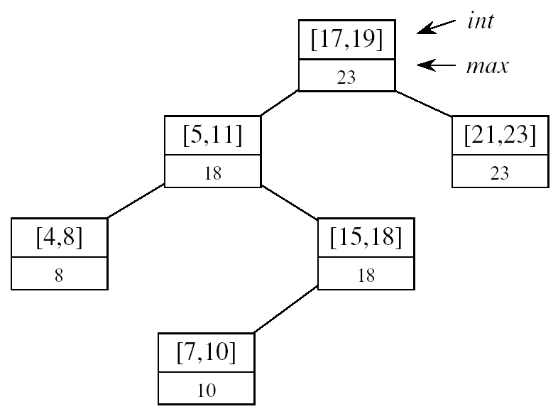
Designing Interval Trees
Underlying data structure
Red-black trees
Each node x contains: an interval int[x], and the key: low[int[x]]
An inorder tree walk will list intervals sorted by their low endpoint
Additional information
max[x] = maximum endpoint value in subtree rooted at x
Maintaining the information
max[x] =
Constant work at each node, so still O(lgn) time
high[int[x]]
max max[left[x]]
max[right[x]]

Slide 23
Designing Interval Trees
Develop new operations
INTERVAL-SEARCH(T, i):
Returns a pointer to an element x in the interval tree T, such that int[x] overlaps with i, or NIL otherwise
Idea:
Check if int[x]
overlaps with i
Max[left[x]] ≥ low[i]
Go left
Otherwise,
go right
low
high
[16, 21]
30
[22, 25]
[8, 9]
23
[25, 30]
30
[5, 8]
10
[15, 23]
23
[17, 19]
20
[26, 26]
26
[0, 3]
3
[6, 10]
10
[19, 20]
20

Slide 24
Example
i = [11, 14]
[16, 21]
30
x
i = [22, 25]
x
[8, 9]
23
[25, 30]
30
x
[5, 8]
10
[15, 23]
23
[17, 19]
20
[26, 26]
26
[0, 3]
3
[6, 10]
10
x = NIL
[19, 20]
20

Slide 25
INTERVAL-SEARCH(T, i)
x ← root[T]
while x ≠ nil[T] and i does not overlap int[x]
do if left[x] ≠ nil[T] and max[left[x]] ≥ low[i]
then x ← left[x]
else x ← right[x]
return x

Slide 26
Readings
Chapters 14, 15

