Slide 1
Analysis of Algorithms CS 477/677
Instructor: Monica Nicolescu
Lecture 14

Slide 2
Midterm Exam
Tuesday, October 16 in classroom
75 minutes
Exam structure:
TRUE/FALSE questions
short questions on the topics discussed in class
homework-like problems
All topics discussed so far, including red-black trees, basic coverage of OS-TREES, Interval trees

Slide 3
General Advice for Study
Understand how the algorithms are working
Work through the examples we did in class
“Narrate” for yourselves the main steps of the algorithms in a few sentences
Know when or for what problems the algorithms are applicable
Do not memorize algorithms

Slide 4
Analyzing Algorithms
Alg.: MIN (a[1], …, a[n])
m ← a[1];
for i ← 2 to n
if a[i] < m
then m ← a[i];
Running time:
the number of primitive operations (steps) executed before termination
T(n) =1 [first step] + (n) [for loop] + (n-1) [if condition] +
(n-1) [the assignment in then] = 3n - 1
Order (rate) of growth:
The leading term of the formula
Expresses the asymptotic behavior of the algorithm
T(n) grows like n

Slide 5
Asymptotic Notations
A way to describe behavior of functions in the limit
Abstracts away low-order terms and constant factors
How we indicate running times of algorithms
Describe the running time of an algorithm as n grows to ∞
O notation: asymptotic “less than”: f(n) “≤” g(n)
𝝮 notation: asymptotic “greater than”: f(n) “≥” g(n)
Θ notation: asymptotic “equality”: f(n) “=” g(n)

Slide 6
Exercise
Order the following 6 functions in increasing order of their growth rates:
nlogn, log²n, n², 2^{n}, , n.
log²n
n
nlogn
n²
2^{n}

Slide 7
Running Time Analysis
Algorithm Loop2(n)
p=1
for i = 1 to 2n
p = p*i
Algorithm Loop3(n)
p=1
for i = 1 to n²
p = p*i
O(n)
O(n²)

Slide 8
Running Time Analysis
Algorithm Loop4(n)
s=0
for i = 1 to 2n
for j = i to 2n
s = s + i
O(n²)

Slide 9
Recurrences
Def.: Recurrence = an equation or inequality that describes a function in terms of its value on smaller inputs, and one or more base cases
Recurrences arise when an algorithm contains recursive calls to itself
Methods for solving recurrences
Substitution method
Iteration method
Recursion tree method
Master method
Unless explicitly stated choose the simplest method for solving recurrences

Slide 10
Example Recurrences
T(n) = T(n-1) + n Θ(n²)
Recursive algorithm that loops through the input to eliminate one item
T(n) = T(n/2) + c Θ(lgn)
Recursive algorithm that halves the input in one step
T(n) = T(n/2) + n Θ(n)
Recursive algorithm that halves the input but must examine every item in the input
T(n) = 2T(n/2) + 1 Θ(n)
Recursive algorithm that splits the input into 2 halves and does a constant amount of other work

Slide 11
Analyzing Divide and Conquer Algorithms
The recurrence is based on the three steps of the paradigm:
T(n) = running time on a problem of size n
Divide the problem into a subproblems, each of size n/b: takes
Conquer (solve) the subproblems: takes
Combine the solutions: takes
Θ(1) if n ≤ c
T(n) =
D(n)
aT(n/b)
C(n)
aT(n/b) + D(n) + C(n) otherwise

Slide 12
Master’s method
Used for solving recurrences of the form:
where, a ≥ 1, b > 1, and f(n) > 0
Compare f(n) with n^{log}_{b}ª:
Case 1: if f(n) = O(n^{log}_{b}^{a - 𝛆}) for some 𝛆 > 0, then: T(n) = Θ(n^{log}_{b}ª)
Case 2: if f(n) = Θ(n^{log}_{b}ª), then: T(n) = Θ(n^{log}_{b}ª lgn)
Case 3: if f(n) = 𝝮(n^{log}_{b}^{a +𝛆}) for some 𝛆 > 0, and if
af(n/b) ≤ cf(n) for some c < 1 and all sufficiently large n, then:
T(n) = Θ(f(n))
regularity condition

Slide 13
Problem 1
Two different divide-and-conquer algorithms A and B have been designed for solving the problem P. A partitions P into 4 subproblems each of size n/2, where n is the input size for P, and it takes a total of Θ(n^{1.5}) time for the partition and combine steps.
B partitions P into 4 subproblems each of size n/4, and it takes a total of Θ(n) time for the partition and combine steps.
Which algorithm is preferable? Why?
A: , ⇒ (case 1) ⇒
B: , ⇒ (case 2) ⇒

Slide 14
Sorting
Insertion sort
Design approach:
Sorts in place:
Best case:
Worst case:
n² comparisons, n² exchanges
Bubble Sort
Design approach:
Sorts in place:
Running time:
n² comparisons, n² exchanges
incremental
Yes
Θ(n)
Θ(n²)
incremental
Yes
Θ(n²)

Slide 15
Sorting
Selection sort
Design approach:
Sorts in place:
Running time:
n² comparisons, n exchanges
Merge Sort
Design approach:
Sorts in place:
Running time:
incremental
Yes
Θ(n²)
divide and conquer
No
Θ(nlgn)

Slide 16
Quicksort
Quicksort
Idea:
Design approach:
Sorts in place:
Best case:
Worst case:
Partition
Running time
Randomized Quicksort
Partition the array A into 2 subarrays A[p..q] and A[q+1..r], such that each element of A[p..q] is smaller than or equal to each element in A[q+1..r]. Then sort the subarrays recursively.
Divide and conquer
Yes
Θ(nlgn)
Θ(n²)
Θ(n)
Θ(nlgn) – on average
Θ(n²) – in the worst case

Slide 17
Randomized Algorithms
The behavior is determined in part by values produced by a random-number generator
RANDOM(a, b) returns an integer r, where a ≤ r ≤ b and each of the b-a+1 possible values of r is equally likely
Algorithm generates randomness in input
No input can consistently elicit worst case behavior
Worst case occurs only if we get “unlucky” numbers from the random number generator

Slide 18
Problem
a) TRUE FALSE
Worst case time complexity of QuickSort is Θ(nlgn).
b) TRUE FALSE
If and , then
c) TRUE FALSE
If and , then

Slide 19
Medians and Order Statistics
General Selection Problem:
select the i-th smallest element from a set of n distinct numbers
Algorithms:
Randomized select
Idea
Worst-case
Partition the input array similarly with the approach used for Quicksort (use RANDOMIZED-PARTITION)
Recurse on one side of the partition to look for the i-th element depending on where i is with respect to the pivot
O(n)

Slide 20
Problem
a) What is the difference between the MAX-HEAP property and the binary search tree property?
The MAX-HEAP property states that a node in the heap is greater than or equal to both of its children
the binary search property states that a node in a tree is greater than or equal to the nodes in its left subtree and smaller than or equal to the nodes in its right subtree
b) What is the lowest possible bound on comparison-based sorting algorithms?
nlgn
c) Assuming the elements in a max-heap are distinct, what are the possible locations of the second-largest element?
The second largest element has to be a child of the root

Slide 21
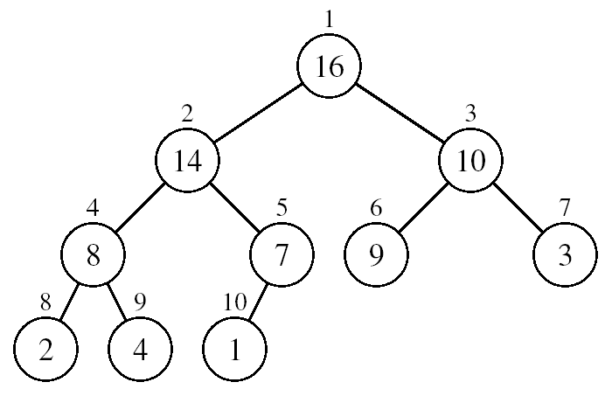
Questions
What is the effect of calling MAX-HEAPIFY(A, i) when:
The element A[i] is larger than its children?
Nothing happens
i > heap-size[A]/2?
Nothing happens
Can the min-heap property be used to print out the keys of an n-node heap in sorted order in O(n) time?
No, it doesn’t tell which subtree of a node contains the element to print before that node
In a heap, the largest element smaller than the node could be in either subtree

Slide 22
Questions
What is the maximum number of nodes possible in a binary search tree of height h?
- max number reached when all levels are full

Slide 23
Problem
Let x be the root node of a binary search tree (BST). Write an algorithm BSTHeight(x) that determines the height of the tree.
Alg: BSTHeight(x)
if (x==NULL)
return -1;
else
return max (BSTHeight(left[x]), BSTHeight(right[x]))+1;

Slide 24
Red-Black Trees Properties
Binary search trees with additional properties:
Every node is either red or black
The root is black
Every leaf (NIL) is black
If a node is red, then both its children are black
For each node, all paths from the node to leaves contain the same number of black nodes

Slide 25
Order-Statistic Tree
Def.: Order-statistic tree: a red-black tree with additional information stored in each node
size[x] contains the number of (internal) nodes in the subtree rooted at x
(including x itself)
10
7
8
15
3
3
4
9
11
19
1
1
1
1
size[x] = size[left[x]] + size[right[x]] + 1

Slide 26
Operations on Order-Statistic Trees
OS-SELECT
Given an order-statistic tree, return a pointer to the node containing the i-th smallest key in the subtree rooted at x
Running time O(lgn)
OS-RANK
Given a pointer to a node x in an order-statistic tree, return the rank of x in the linear order determined by an inorder walk of T
Running time O(lgn)

Slide 27
Exercise
In an OS-tree, the size field can be used to compute the rank’ of a node x, in the subtree for which x is the root. If we want to store this rank in each of the nodes, show how can we maintain this information during insertion and deletion.
Insertion
add 1 to rank’[x] if z is inserted within x’s left subtree
leave rank’[x] unchanged if z is inserted within x’s right subtree
Deletion
subtract 1 from rank’[x] whenever the deleted node y had been in x’s left subtree.
rank’[x] = size[left] + 1

Slide 28
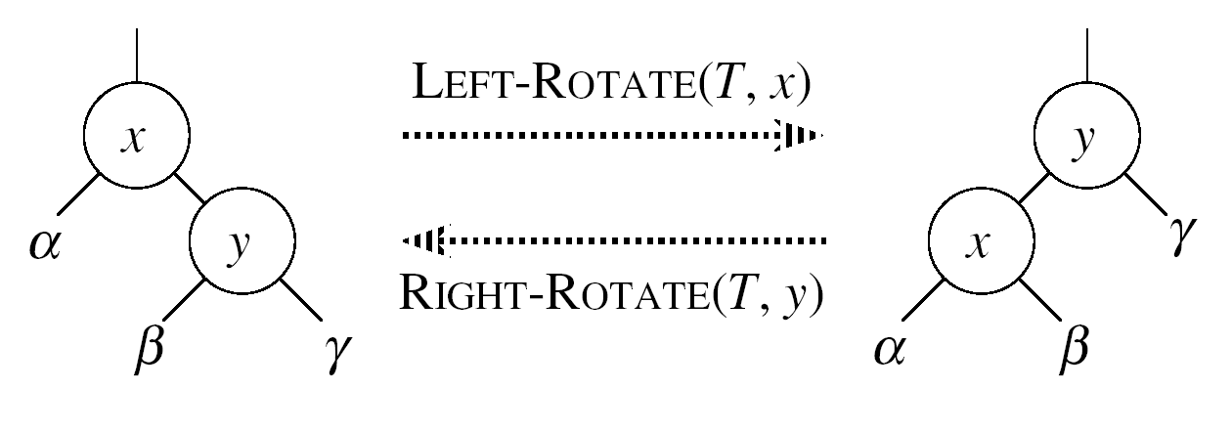
Exercise (cont.)
We also need to handle the rotations that occur during insertion and deletion
rank’(y) = r_{y} + rank’(x)
rank’(x) = r_{x}
rank’(y) = r_{y}
rank’(x) = r_{x}

Slide 29
Question
TRUE FALSE
The depths of nodes in a red-black tree can be efficiently maintained as fields in the nodes of the tree.
No, because the depth of a node depends on the depth of its parent
When the depth of a node changes, the depths of all nodes below it in the tree must be updated
Updating the root node causes n - 1 other nodes to be updated

Slide 30
Readings
Chapters 14, 15

