Slide 1
Analysis of Algorithms CS 477/677
Instructor: Monica Nicolescu
Lecture 15

Slide 2
Designing Interval Trees
Develop new operations
INTERVAL-SEARCH(T, i):
Returns a pointer to an element x in the interval tree T, such that int[x] overlaps with i, or NIL otherwise
Idea:
Check if int[x]
overlaps with i
Max[left[x]] ≥ low[i]
Go left
Otherwise,
go right
low
high
[16, 21]
30
[22, 25]
[8, 9]
23
[25, 30]
30
[5, 8]
10
[15, 23]
23
[17, 19]
20
[26, 26]
26
[0, 3]
3
[6, 10]
10
[19, 20]
20

Slide 3
Theorem
At the execution of interval search: if the search goes right, then either:
There is an overlap in right subtree, or
There is no overlap in either subtree
Similar when the search goes left
It is safe to always proceed in only one direction

Slide 4
Theorem
Proof: If search goes right:
If there is an overlap in right subtree, done
If there is no overlap in right ⇒ show there is no overlap in left
Went right because:
left[x] = nil[T] ⇒ no overlap in left, or
max[left[x]] < low[i] ⇒ no overlap in left
i
max[left[x]]
low[x]

Slide 5
Theorem - Proof
If search goes left:
If there is an overlap in left subtree, done
If there is no overlap in left, show there is no overlap in right
Went left because:
low[i] ≤ max[left[x]] = high[j] for some j in left subtree
int[root]
max
max[left]
[low[j], high[j]]
max[j]
[low[k], high[k]]
max[k]
i
j
i
k
No overlap!
high[i] < low[k]
high[i] < low[j]
high[j] < low[i]
low[j] < low[k]

Slide 6
Dynamic Programming
An algorithm design technique for optimization problems (similar to divide and conquer)
Divide and conquer
Partition the problem into independent subproblems
Solve the subproblems recursively
Combine the solutions to solve the original problem

Slide 7
Dynamic Programming
Used for optimization problems
Find a solution with the optimal value (minimum or maximum)
A set of choices must be made to get an optimal solution
There may be many solutions that return the optimal value: we want to find one of them

Slide 8
Dynamic Programming
Applicable when subproblems are not independent
Subproblems share subsubproblems
E.g.: Fibonacci numbers:
Recurrence: F(n) = F(n-1) + F(n-2)
Boundary conditions: F(1) = 0, F(2) = 1
Compute: F(5) = 3, F(3) = 1, F(4) = 2
A divide and conquer approach would repeatedly solve the common subproblems
Dynamic programming solves every subproblem just once and stores the answer in a table

Slide 9
Dynamic Programming Algorithm
Characterize the structure of an optimal solution
Recursively define the value of an optimal solution
Compute the value of an optimal solution in a bottom-up fashion
Construct an optimal solution from computed information

Slide 10
Elements of Dynamic Programming
Optimal Substructure
An optimal solution to a problem contains within it an optimal solution to subproblems
Optimal solution to the entire problem is built in a bottom-up manner from optimal solutions to subproblems
Overlapping Subproblems
If a recursive algorithm revisits the same subproblems again and again ⇒ the problem has overlapping subproblems

Slide 11
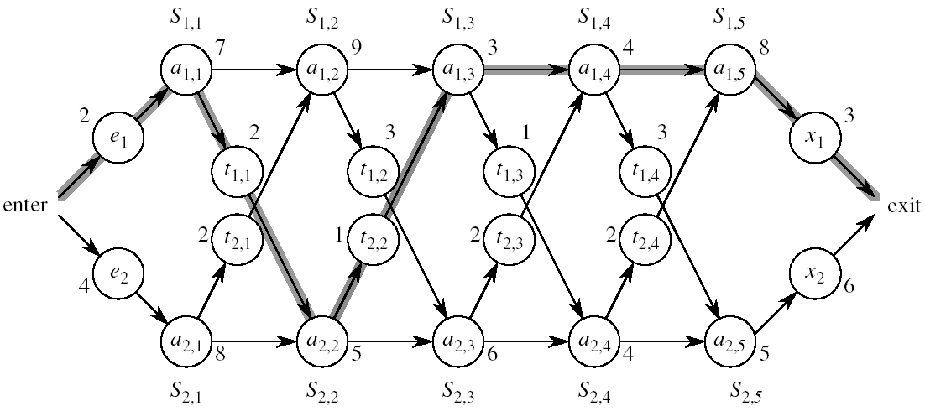
Assembly Line Scheduling
Automobile factory with two assembly lines
Each line has n stations: S_{1,1}, . . . , S_{1,n} and S_{2,1}, . . . , S_{2,n}
Corresponding stations S_{1, j} and S_{2, j} perform the same function but can take different amounts of time a_{1, j} and a_{2, j}
Times to enter are e₁ and e₂ and times to exit are x₁ and x₂

Slide 12
Assembly Line
After going through a station, the car can either:
stay on same line at no cost, or
transfer to other line: cost after S_{i,j} is t_{i,j} , i = 1, 2, j = 1, . . . , n-1

Slide 13
Assembly Line Scheduling
Problem:
What stations should be chosen from line 1 and what from line 2 in order to minimize the total time through the factory for one car?

Slide 14
One Solution
Brute force
Enumerate all possibilities of selecting stations
Compute how long it takes in each case and choose the best one
There are 2^{n} possible ways to choose stations
Infeasible when n is large
1
2
3
4
n
1
0
0
1
1
0 if choosing line 2
at step j (= 3)
1 if choosing line 1
at step j (= n)

Slide 15
Readings
Chapters 14, 15

