Slide 1
Analysis of Algorithms CS 477/677
Instructor: Monica Nicolescu
Lecture 16

Slide 2
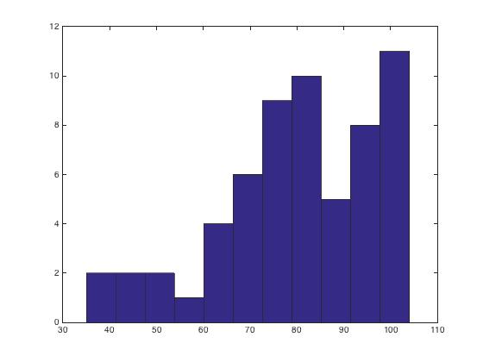
Mid-Term Results – CS 477
Max = 104 Min = 35 Avg. = 80.25

Slide 3
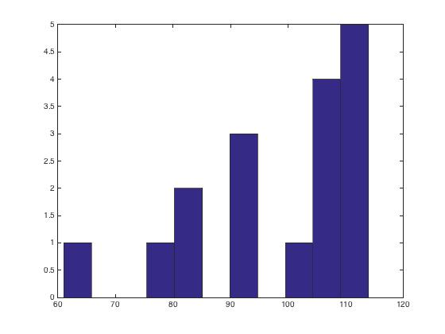
Mid-Term Results – CS 677
Max = 114 Min = 61 Avg. = 99

Slide 4
Dynamic Programming
Used for optimization problems
Find a solution with the optimal value (minimum or maximum)
A set of choices must be made to get an optimal solution
There may be many solutions that return the optimal value: we want to find one of them

Slide 5
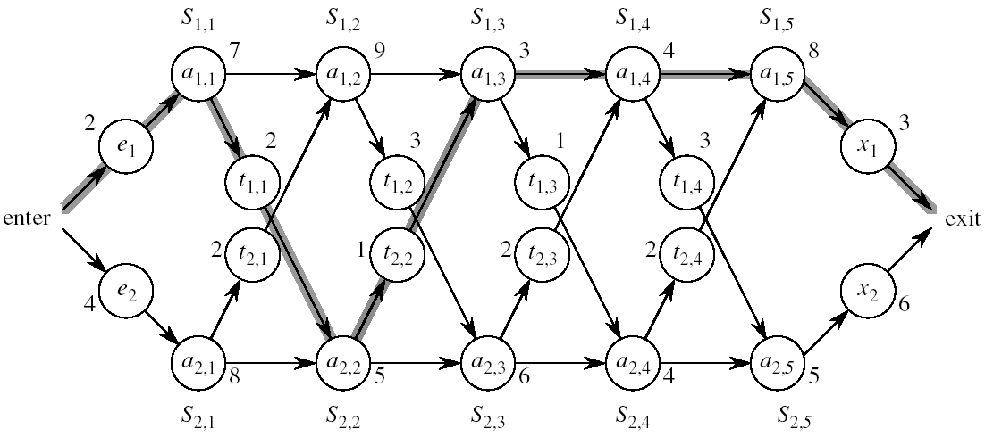
Assembly Line Scheduling
Automobile factory with two assembly lines
Each line has n stations: S_{1,1}, . . . , S_{1,n} and S_{2,1}, . . . , S_{2,n}
Corresponding stations S_{1, j} and S_{2, j} perform the same function but can take different amounts of time a_{1, j} and a_{2, j}
Times to enter are e₁ and e₂ and times to exit are x₁ and x₂

Slide 6
Assembly Line
After going through a station, the car can either:
stay on same line at no cost, or
transfer to other line: cost after S_{i,j} is t_{i,j} , i = 1, 2, j = 1, . . . , n-1

Slide 7
Assembly Line Scheduling
Problem:
What stations should be chosen from line 1 and what from line 2 in order to minimize the total time through the factory for one car?

Slide 8
One Solution
Brute force
Enumerate all possibilities of selecting stations
Compute how long it takes in each case and choose the best one
There are 2^{n} possible ways to choose stations
Infeasible when n is large
1
2
3
4
n
1
0
0
1
1
0 if choosing line 2
at step j (= 3)
1 if choosing line 1
at step j (= n)

Slide 9
1. Structure of the Optimal Solution
How do we compute the minimum time of going through the station?

Slide 10
1. Structure of the Optimal Solution
Let’s consider all possible ways to get from the starting point through station S_{1,j}
We have two choices of how to get to S_{1, j}:
Through S_{1, j - 1}, then directly to S_{1, j}
Through S_{2, j - 1}, then transfer over to S_{1, j}
S_{1,j-1}
S_{1,j}
a_{1,j-1}
a_{1,j}
t_{2,j-1}
a_{2,j-1}
S_{2,j-1}

Slide 11
1. Structure of the Optimal Solution
Suppose that the fastest way through S_{1, j} is through S_{1, j – 1}
We must have taken the fastest way from entry through S_{1, j – 1}
If there were a faster way through S_{1, j - 1}, we would use it instead
Similarly for S_{2, j – 1}
S_{1,j-1}
S_{1,j}
a_{1,j-1}
a_{1,j}
t_{2,j-1}
a_{2,j-1}
S_{2,j-1}

Slide 12
Optimal Substructure
Generalization: an optimal solution to the problem find the fastest way through S_{1, j} contains within it an optimal solution to subproblems: find the fastest way through S_{1, j - 1} or S_{2, j - 1}.
This is referred to as the optimal substructure property
We use this property to construct an optimal solution to a problem from optimal solutions to subproblems

Slide 13

2. A Recursive Solution
Define the value of an optimal solution in terms of the optimal solution to subproblems
Assembly line subproblems
Finding the fastest way through each station j on each line i
(i = 1,2, j = 1, 2, …, n)

Slide 14
2. A Recursive Solution
f* = the fastest time to get through the entire factory
f_{i}[j] = the fastest time to get from the starting point through station S_{i,j}
f* = min (f₁[n] + x₁, f₂[n] + x₂)

Slide 15
2. A Recursive Solution
f_{i}[j] = the fastest time to get from the starting point through station S_{i,j}
j = 1 (getting through station 1)
f₁[1] = e₁ + a_{1,1}
f₂[1] = e₂ + a_{2,1}

Slide 16
2. A Recursive Solution
Compute f_{i}[j] for j = 2, 3, …,n, and i = 1, 2
Fastest way through S_{1, j} is either:
the way through S_{1, j - 1} then directly through S_{1, j}, or
f₁[j - 1] + a_{1,j}
the way through S_{2, j - 1}, transfer from line 2 to line 1, then through S_{1, j}
f₂[j -1] + t_{2,j-1} + a_{1,j}
f₁[j] = min(f₁[j - 1] + a_{1,j} ,f₂[j -1] + t_{2,j-1} + a_{1,j})
S_{1,j-1}
S_{1,j}
a_{1,j-1}
a_{1,j}
t_{2,j-1}
a_{2,j-1}
S_{2,j-1}

Slide 17
2. A Recursive Solution
e₁ + a_{1,1} if j = 1
f₁[j] =
min(f₁[j - 1] + a_{1,j} ,f₂[j -1] + t_{2,j-1} + a_{1,j}) if j ≥ 2
e₂ + a_{2,1} if j = 1
f₂[j] =
min(f₂[j - 1] + a_{2,j} ,f₁[j -1] + t_{1,j-1} + a_{2,j}) if j ≥ 2

Slide 18
3. Computing the Optimal Value
f* = min (f₁[n] + x₁, f₂[n] + x₂)
f₁[j] = min(f₁[j - 1] + a_{1,j} ,f₂[j -1] + t_{2,j-1} + a_{1,j})
Solving top-down would result in exponential running time
1
2
3
4
5
f₁[j]
f₁(1)
f₁(2)
f₁(3)
f₁(4)
f₁(5)
f₂[j]
f₂(1)
f₂(2)
f₂(3)
f₂(4)
f₂(5)
4 times
2 times

Slide 19
3. Computing the Optimal Value
For j ≥ 2, each value f_{i}[j] depends only on the values of f₁[j – 1] and f₂[j - 1]
Compute the values of f_{i}[j]
in increasing order of j
Bottom-up approach
First find optimal solutions to subproblems
Find an optimal solution to the problem from the subproblems
increasing j
1
2
3
4
5
f₁[j]
f₂[j]

Slide 20
4. Construct the Optimal Solution
We need the information about which line has been used at each station:
l_{i}[j] – the line number (1, 2) whose station (j - 1) has been used to get in fastest time through S_{i,j}, j = 2, 3, …, n
l* – the line number (1, 2) whose station n has been used to get in fastest time through the exit point
increasing j
2
3
4
5
l₁[j]
l₂[j]

Slide 21
FASTEST-WAY(a, t, e, x, n)
f₁[1] ← e₁ + a_{1,1}
f₂[1] ← e₂ + a_{2,1}
for j ← 2 to n
do if f₁[j - 1] + a_{1,j} ≤ f₂[j - 1] + t_{2, j-1} + a_{1, j}
then f₁[j] ← f₁[j - 1] + a_{1, j}
l₁[j] ← 1
else f₁[j] ← f₂[j - 1] + t_{2, j-1} + a_{1, j}
l₁[j] ← 2
if f₂[j - 1] + a_{2, j} ≤ f₁[j - 1] + t_{1, j-1} + a_{2, j}
then f₂[j] ← f₂[j - 1] + a_{2, j}
l₂[j] ← 2
else f₂[j] ← f₁[j - 1] + t_{1, j-1} + a_{2, j}
l₂[j] ← 1
Compute initial values of f₁ and f₂
Compute the values of
f₁[j] and l₁[j]
Compute the values of
f₂[j] and l₂[j]

Slide 22
FASTEST-WAY(a, t, e, x, n) (cont.)
if f₁[n] + x₁ ≤ f₂[n] + x₂
then f* = f₁[n] + x₁
l* = 1
else f* = f₂[n] + x₂
l* = 2
Compute the values of
the fastest time through the
entire factory

Slide 23
Example
e₁ + a_{1,1}, if j = 1
f₁[j] = min(f₁[j - 1] + a_{1,j} ,f₂[j -1] + t_{2,j-1} + a_{1,j}) if j ≥ 2
1
2
3
4
5
f₁[j]
9
18^{[1]}
20^{[2]}
24^{[1]}
32^{[1]}
f* = 35^{[1]}
f₂[j]
12
16^{[1]}
22^{[2]}
25^{[1]}
30^{[2]}

Slide 24
4. Construct an Optimal Solution
Alg.: PRINT-STATIONS(l, n)
i ← l*
print “line ” i “, station ” n
for j ← n downto 2
do i ←l_{i}[j]
print “line ” i “, station ” j - 1
line 1, station 5
line 1, station 4
line 1, station 3
line 2, station 2
line 1, station 1
1
2
3
4
5
f₁[j] ^{l1[j]}
9
18^{[1]}
20^{[2]}
24^{[1]}
32^{[1]}
l* = 1
f₂[j] ^{l2[j]}
12
16^{[1]}
22^{[2]}
25^{[1]}
30^{[2]}

Slide 25
Dynamic Programming Algorithm
Characterize the structure of an optimal solution
Fastest time through a station depends on the fastest time on previous stations
Recursively define the value of an optimal solution
f₁[j] = min(f₁[j - 1] + a_{1,j} ,f₂[j -1] + t_{2,j-1} + a_{1,j})
Compute the value of an optimal solution in a bottom-up fashion
Fill in the fastest time table in increasing order of j (station #)
Construct an optimal solution from computed information
Use an additional table to help reconstruct the optimal solution

Slide 26
Readings
Chapters 14, 15

