Slide 1
Analysis of Algorithms CS 477/677
Instructor: Monica Nicolescu
Lecture 5

Slide 2
The recursion-tree method
Convert the recurrence into a tree:
Each node represents the cost incurred at that level of recursion
Sum up the costs of all levels
Used to “guess” a solution for the recurrence

Slide 3
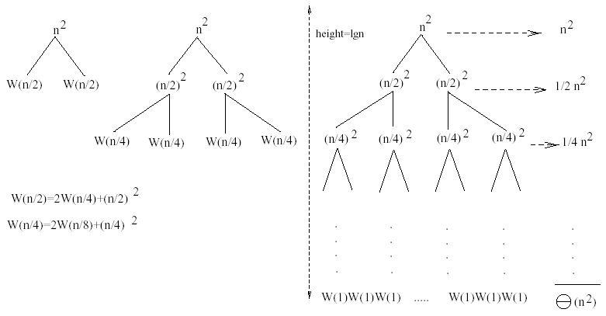
Example 1
W(n) = 2W(n/2) + n²
Subproblem size at level i is: n/2^{i}
Subproblem size hits 1 when 1 = n/2^{i} ⇒i = lgn
Cost of the problem at level i = (n/2^{i})² No. of nodes at level i = 2^{i}
Total cost:
⇒ W(n) = O(n²)

Slide 4
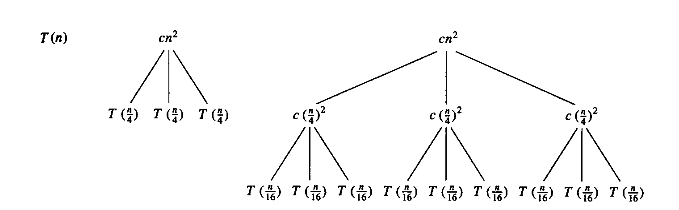
Example 2
E.g.: T(n) = 3T(n/4) + cn²
Subproblem size at level i is: n/4^{i}
Subproblem size hits 1 when 1 = n/4^{i} ⇒i = log₄n
Cost of a node at level i = c(n/4^{i})²
Number of nodes at level i = 3^{i} ⇒last level has 3^{log}₄^{n} = n^{log}₄³ nodes
Total cost:
⇒T(n) = O(n²)

Slide 5
Example 2 - Substitution
T(n) = 3T(n/4) + cn²
Guess: T(n) = O(n²)
Induction goal: T(n) ≤ dn², for some d and n ≥ n₀
Induction hypothesis: T(n/4) ≤ d (n/4)²
Proof of induction goal:
T(n) = 3T(n/4) + cn²
≤ 3d (n/4)² + cn²
= (3/16) d n² + cn²
= d n² + cn² + (3/16) d n² - d n²
= d n² + cn² - (13/16) d n²
≤ d n² if: cn² - (13/16) d n² ≤ 0
d ≥ (16/13)c
Therefore: T(n) = O(n²)

Slide 6
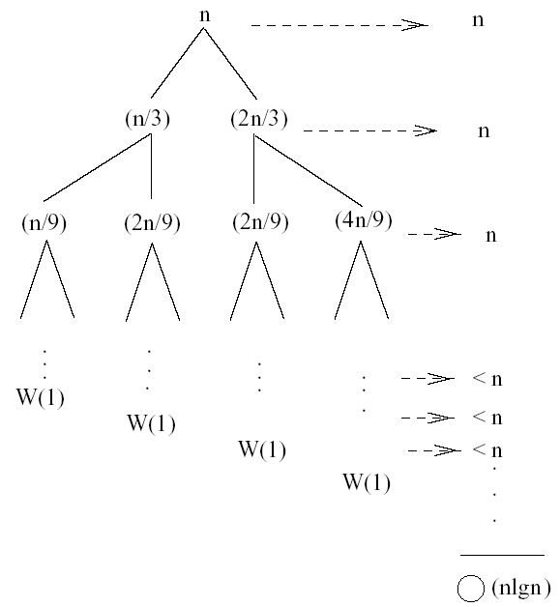
Example 3
W(n) = W(n/3) + W(2n/3) + n
The longest path from the root to a leaf is: n → (2/3)n →(2/3)² n →… →1
Subproblem size hits 1 when 1 = (2/3)^{i}n ⇔ i=log_{3/2}n
Cost of the problem at level i = n
Total cost:
⇒W(n) = O(nlgn)
for all levels

Slide 7
Example 3 - Substitution
W(n) = W(n/3) + W(2n/3) + n
Guess: W(n) = O(nlgn)
Induction goal: W(n) ≤ dnlgn, for some d and n ≥ n₀
Induction hypothesis: W(k) ≤ d klgk for any k < n (n/3, 2n/3)
Proof of induction goal:
Try it out as an exercise!!

Slide 8
Master’s method
“Cookbook” for solving recurrences of the form:
where, a ≥ 1, b > 1, and f(n) > 0
Idea: compare f(n) with n^{log}_{b}ª
f(n) is asymptotically smaller or larger than n^{log}_{b}ª by a polynomial factor n^{ℇ}
f(n) is asymptotically equal with n^{log}_{b}ª

Slide 9
Master’s method
“Cookbook” for solving recurrences of the form:
where, a ≥ 1, b > 1, and f(n) > 0
Case 1: if f(n) = O(n^{log}_{b}^{a -ℇ}) for some ℇ > 0, then: T(n) = 𝚹(n^{log}_{b}ª)
Case 2: if f(n) = 𝚹(n^{log}_{b}ª), then: T(n) = 𝚹(n^{log}_{b}ª lgn)
Case 3: if f(n) = 𝛀(n^{log}_{b}^{a + ℇ}) for some ℇ > 0, and if
af(n/b) ≤ cf(n) for some c < 1 and all sufficiently large n, then:
T(n) = 𝚹(f(n))
regularity condition

Slide 10
Why n^{log}_{b}ª?
Case 1:
If f(n) is dominated by n^{log}_{b}ª:
T(n) = 𝚹(n^{log}_{b}^{n})
Case 3:
If f(n) dominates n^{log}_{b}ª:
T(n) = 𝚹(f(n))
Case 2:
If f(n) = 𝚹(n^{log}_{b}ª):
T(n) = 𝚹(n^{log}_{b}ª logn)
Assume n = b^{k} ⇒k = log_{b}n
At the end of iterations, i = k:

Slide 11
Examples
T(n) = 2T(n/2) + n
a = 2, b = 2, log₂2 = 1
Compare n^{log}₂² with f(n) = n
⇒ f(n) = 𝚹(n) ⇒ Case 2
⇒ T(n) = 𝚹(nlgn)

Slide 12
Examples
T(n) = 2T(n/2) + n²
a = 2, b = 2, log₂2 = 1
Compare n with f(n) = n²
⇒ f(n) = 𝛀(n^{1+ℇ})
Case 3 ⇒ verify regularity cond.: a f(n/b) ≤ c f(n)
⇒ 2 n²/4 ≤ c n² ⇒ c = ½ is a solution (c<1)
⇒ T(n) = 𝚹(n²)

Slide 13
Examples (cont.)
T(n) = 2T(n/2) +
a = 2, b = 2, log₂2 = 1
Compare n with f(n) = n^{1/2}
⇒ f(n) = O(n^{1-ℇ}) Case 1
⇒ T(n) = 𝚹(n)

Slide 14
Examples
T(n) = 3T(n/4) + nlgn
a = 3, b = 4, log₄3 = 0.793
Compare n^{0.793} with f(n) = nlgn
f(n) = 𝛀(n^{log}₄^{3+ℇ})
Case 3: check regularity condition:
3(n/4)lg(n/4) ≤ (3/4)nlgn = c f(n), c=3/4
⇒ T(n) = 𝚹(nlgn)

Slide 15
Examples
T(n) = 2T(n/2) + nlgn
a = 2, b = 2, log₂2 = 1
Compare n with f(n) = nlgn
seems like case 3 should apply
f(n) must be polynomially larger by a factor of n^{ℇ}
In this case it is only larger by a factor of lgn

Slide 16
Readings
Chapter 4

