Slide 1
Analysis of Algorithms CS 477/677
Instructor: Monica Nicolescu
Lecture 6

Slide 2
The Sorting Problem
Input:
A sequence of n numbers a₁, a₂, . . . , a_{n}
Output:
A permutation (reordering) a₁’, a₂’, . . . , a_{n}’ of the input sequence such that a₁’ ≤ a₂’ ≤ · · · ≤ a_{n}’

Slide 3
Why Study Sorting Algorithms?
There are a variety of situations that we can encounter
Do we have randomly ordered keys?
Are all keys distinct?
How large is the set of keys to be ordered?
Need guaranteed performance?
Does the algorithm sort in place?
Is the algorithm stable?
Various algorithms are better suited to some of these situations

Slide 4
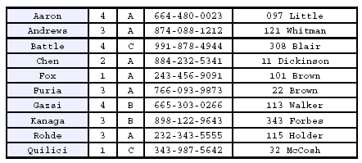
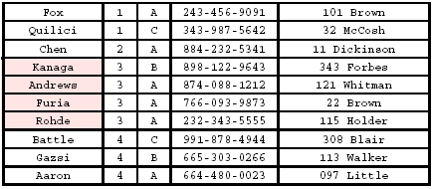
Stability
A STABLE sort preserves relative order of records with equal keys
Sort file on first key:
Sort file on second key:
Records with key value 3 are not in order on first key!!

Slide 5
Insertion Sort
Idea: like sorting a hand of playing cards
Start with an empty left hand and the cards facing down on the table
Remove one card at a time from the table, and insert it into the correct position in the left hand
compare it with each of the cards already in the hand, from right to left
The cards held in the left hand are sorted
these cards were originally the top cards of the pile on the table

Slide 6
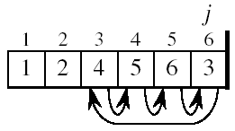
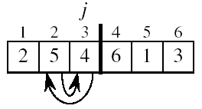
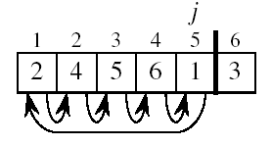
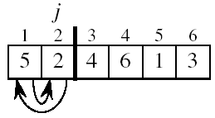

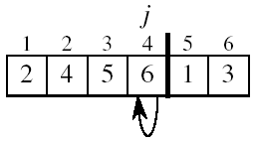
Example

Slide 7
INSERTION-SORT
Alg.: INSERTION-SORT(A)
for j ← 2 to n
do key ← A[ j ]
Insert A[ j ] into the sorted sequence A[1 . . j -1]
i ← j - 1
while i > 0 and A[i] > key
do A[i + 1] ← A[i]
i ← i – 1
A[i + 1] ← key
Insertion sort – sorts the elements in place
1
2
3
4
5
6
7
8
a₁
a₂
a₃
a₄
a₅
a₆
a₇
a₈
key

Slide 8
Loop Invariant for Insertion Sort
Alg.: INSERTION-SORT(A)
for j ← 2 to n
do key ← A[ j ]
Insert A[ j ] into the sorted sequence A[1 . . j -1]
i ← j - 1
while i > 0 and A[i] > key
do A[i + 1] ← A[i]
i ← i – 1
A[i + 1] ← key
Invariant: at the start of each iteration of the for loop, the elements in A[1 . . j-1] are in sorted order

Slide 9
Proving Loop Invariants
Proving loop invariants works like induction
Initialization (base case):
It is true prior to the first iteration of the loop
Maintenance (inductive step):
If it is true before an iteration of the loop, it remains true before the next iteration
Termination:
When the loop terminates, the invariant gives us a useful property that helps show that the algorithm is correct

Slide 10
Loop Invariant for Insertion Sort
Initialization:
Just before the first iteration, j = 2:
the subarray A[1 . . j-1] = A[1], (the element originally in A[1]) – is sorted

Slide 11
Loop Invariant for Insertion Sort
Maintenance:
the while inner loop moves A[j -1], A[j -2], A[j -3], and so on, by one position to the right until the proper position for key (which has the value that started out in A[j]) is found
At that point, the value of key is placed into this position.

Slide 12
Loop Invariant for Insertion Sort
Termination:
The outer for loop ends when j = n + 1 ⇒ j-1 = n
Replace n with j-1 in the loop invariant:
the subarray A[1 . . n] consists of the elements originally in A[1 . . n], but in sorted order
The entire array is sorted!
j - 1
j

Slide 13
Analysis of Insertion Sort
INSERTION-SORT(A)
for j ← 2 to n
do key ← A[ j ]
Insert A[ j ] into the sorted seq. A[1 . . j -1]
i ← j - 1
while i > 0 and A[i] > key
do A[i + 1] ← A[i]
i ← i – 1
A[i + 1] ← key
cost times
c₁ n
c₂ n-1
0 n-1
c₄ n-1
c₅
c₆
c₇
c₈ n-1
Notes:
₇

Slide 14
Best Case Analysis
The array is already sorted
A[i] ≤ key upon the first time the while loop test is run (when i = j -1)
t_{j} = 1
T(n) = c₁n + c₂(n -1) + c₄(n -1) + c₅(n -1) + c₈(n-1) = (c₁ + c₂ + c₄ + c₅ + c₈)n - (c₂ + c₄ + c₅ + c₈)
= an + b = Θ(n)
“while i > 0 and A[i] > key”

Slide 15
Worst Case Analysis
The array is reversely sorted
Always A[i] > key in while loop test
Have to compare key with all elements to the left of the j-th position ⇒ compare with j-1 elements ⇒ t_{j} = j
a quadratic function of n
T(n) = Θ(n²) order of growth in n²
“while i > 0 and A[i] > key”

Slide 16
Comparisons and Exchanges in Insertion Sort
INSERTION-SORT(A)
for j ← 2 to n
do key ← A[ j ]
Insert A[ j ] into the sorted sequence A[1 . . j -1]
i ← j - 1
while i > 0 and A[i] > key
do A[i + 1] ← A[i]
i ← i – 1
A[i + 1] ← key
cost times
c₁ n
c₂ n-1
0 n-1
c₄ n-1
c₅
c₆
c₇
c₈ n-1
≈n²/2 comparisons
≈n²/2 exchanges

Slide 17
Insertion Sort - Summary
Idea: like sorting a hand of playing cards
Start with an empty left hand and the cards facing down on the table.
Remove one card at a time from the table, and insert it into the correct position in the left hand
Advantages
Good running time for “almost sorted” arrays Θ(n)
Disadvantages
Θ(n²) running time in worst and average case
≈n²/2 comparisons and n²/2 exchanges

Slide 18
Bubble Sort
Idea:
Repeatedly pass through the array
Swaps adjacent elements that are out of order
Easier to implement, but slower than Insertion sort
i
1
2
3
n
8
4
6
9
2
3
1
j

Slide 19
Example
8
4
6
9
2
3
1
1
8
4
6
9
2
3
i = 1
j
i = 2
j
8
4
6
9
2
1
3
1
2
8
4
6
9
3
i = 1
j
i = 3
j
8
4
6
9
1
2
3
1
2
3
8
4
6
9
i = 1
j
i = 4
j
8
4
6
1
9
2
3
1
2
3
4
8
6
9
i = 1
j
i = 5
j
8
4
1
6
9
2
3
1
2
3
4
6
8
9
i = 1
j
i = 6
j
8
1
4
6
9
2
3
1
2
3
4
6
8
9
i = 1
j
i = 7
1
8
4
6
9
2
3
j
i = 1
j

Slide 20
Bubble Sort
Alg.: BUBBLESORT(A)
for i ← 1 to length[A]
do for j ← length[A] downto i + 1
do if A[j] < A[j -1]
then exchange A[j] ⟺A[j-1]
i
8
4
6
9
2
3
1
i = 1
j

Slide 21
Bubble-Sort Running Time
Alg.: BUBBLESORT(A)
for i ←1 to length[A]
do for j ←length[A] downto i + 1
do if A[j] < A[j -1]
then exchange A[j] ⟺A[j-1]
Comparisons: ≈n²/2
Exchanges: ≈n²/2
T(n) =
c₁(n+1) +
c₂
c₃
c₄
= Θ(n) +
(c₂ + c₃ + c₄)
T(n) = Θ(n²)

Slide 22
Selection Sort
8
4
6
9
2
3
1
Idea:
Find the smallest element in the array
Exchange it with the element in the first position
Find the second smallest element and exchange it with the element in the second position
Continue until the array is sorted
Invariant:
All elements to the left of the current index are in sorted order and never changed again
Disadvantage:
Running time depends only slightly on the amount of order in the file

Slide 23
Example
8
4
6
9
2
3
1
1
2
3
4
9
6
8
1
4
6
9
2
3
8
1
2
3
4
6
9
8
1
2
6
9
4
3
8
1
2
3
4
6
8
9
1
2
3
9
4
6
8
1
2
3
4
6
8
9

Slide 24
Selection Sort
Alg.: SELECTION-SORT(A)
n ← length[A]
for j ← 1 to n - 1
do smallest ← j
for i ← j + 1 to n
do if A[i] < A[smallest]
then smallest ← i
exchange A[j] ⟺ A[smallest]
8
4
6
9
2
3
1

Slide 25
Analysis of Selection Sort
Alg.: SELECTION-SORT(A)
n ← length[A]
for j ← 1 to n - 1
do smallest ← j
for i ← j + 1 to n
do if A[i] < A[smallest]
then smallest ← i
exchange A[j] ↔ A[smallest]
cost times
c₁ 1
c₂ n
c₃ n-1
c₄
c₅
c₆
c₇ n-1
≈n²/2
comparisons
≈n exchanges
T(n) = Θ(n²)

Slide 26
Divide-and-Conquer
Divide the problem into a number of subproblems
Similar sub-problems of smaller size
Conquer the sub-problems
Solve the sub-problems recursively
Sub-problem size small enough ⇒ solve the problems in straightforward manner
Combine the solutions to the sub-problems
Obtain the solution for the original problem

Slide 27
Merge Sort Approach
To sort an array A[p . . r]:
Divide
Divide the n-element sequence to be sorted into two subsequences of n/2 elements each
Conquer
Sort the subsequences recursively using merge sort
When the size of the sequences is 1 there is nothing more to do
Combine
Merge the two sorted subsequences

Slide 28
Merge Sort
p
q
r
1
2
3
4
5
6
7
8
Alg.: MERGE-SORT(A, p, r)
if p < r Check for base case
then q ← ⎣(p + r)/2⎦ Divide
MERGE-SORT(A, p, q) Conquer
MERGE-SORT(A, q + 1, r) Conquer
MERGE(A, p, q, r) Combine
Initial call: MERGE-SORT(A, 1, n)
5
2
4
7
1
3
2
6

Slide 29
Example – n Power of 2
Example
1
2
3
4
5
6
7
8
5
2
4
7
1
3
2
6
q = 4
1
2
3
4
5
6
7
8
5
2
4
7
1
3
2
6
1
2
3
4
5
6
7
8
5
2
4
7
1
3
2
6
1
2
3
4
5
6
7
8
5
2
4
7
1
3
2
6

Slide 30
Readings
Chapter 4

