Slide 1
Analysis of Algorithms CS 477/677
Instructor: Monica Nicolescu
Lecture 7

Slide 2
Merge Sort Approach
To sort an array A[p . . r]:
Divide
Divide the n-element sequence to be sorted into two subsequences of n/2 elements each
Conquer
Sort the subsequences recursively using merge sort
When the size of the sequences is 1 there is nothing more to do
Combine
Merge the two sorted subsequences

Slide 3
Merge Sort
p
q
r
1
2
3
4
5
6
7
8
Alg.: MERGE-SORT(A, p, r)
if p < r Check for base case
then q ← ⎣(p + r)/2⎦ Divide
MERGE-SORT(A, p, q) Conquer
MERGE-SORT(A, q + 1, r) Conquer
MERGE(A, p, q, r) Combine
Initial call: MERGE-SORT(A, 1, n)
5
2
4
7
1
3
2
6

Slide 4
Merging
p
q
r
1
2
3
4
5
6
7
8
2
4
5
7
1
2
3
6
Input: Array A and indices p, q, r such that p ≤ q < r
Subarrays A[p . . q] and A[q + 1 . . r] are sorted
Output: One single sorted subarray A[p . . r]

Slide 5
Merging
Idea for merging:
Two piles of sorted cards
Choose the smaller of the two top cards
Remove it and place it in the output pile
Repeat the process until one pile is empty
Take the remaining input pile and place it face-down onto the output pile

Slide 6
Merge - Pseudocode
p
q
r
Alg.: MERGE(A, p, q, r)
Compute n₁ and n₂
Copy the first n₁ elements into L[1 . . n₁ + 1] and the next n₂ elements into R[1 . . n₂ + 1]
L[n₁ + 1] ← ∞; R[n₂ + 1] ← ∞
i ← 1; j ← 1
for k ← p to r
do if L[ i ] ≤ R[ j ]
then A[k] ← L[ i ]
i ←i + 1
else A[k] ← R[ j ]
j ← j + 1
1
2
3
4
5
6
7
8
2
4
5
7
1
2
3
6
n₁
n₂
p
q
L
2
4
5
7
∞
q + 1
r
R
1
2
3
6
∞

Slide 7
Running Time of Merge
Initialization (copying into temporary arrays):
Θ(n₁ + n₂) = Θ(n)
Adding the elements to the final array (the for loop):
n iterations, each taking constant time ⇒ Θ(n)
Total time for Merge:
Θ(n)

Slide 8
Analyzing Divide and Conquer Algorithms
The recurrence is based on the three steps of the paradigm:
T(n) – running time on a problem of size n
Divide the problem into a subproblems, each of size n/b: takes D(n)
Conquer (solve) the subproblems: takes aT(n/b)
Combine the solutions: takes C(n)
Θ(1) if n ≤ c
T(n) = aT(n/b) + D(n) + C(n) otherwise

Slide 9
MERGE – SORT Running Time
Divide:
compute q as the average of p and r: D(n) = Θ(1)
Conquer:
recursively solve 2 subproblems, each of size n/2 ⇒ 2T (n/2)
Combine:
MERGE on an n-element subarray takes Θ(n) time ⇒ C(n) = Θ(n)
Θ(1) if n =1
T(n) = 2T(n/2) + Θ(n) if n > 1

Slide 10
Solve the Recurrence
T(n) = c if n = 1
2T(n/2) + cn if n > 1
Use Master’s Theorem:
Compare n with f(n) = cn
Case 2: T(n) = Θ(nlgn)

Slide 11
Merge Sort - Discussion
Running time insensitive of the input
Advantages:
Guaranteed to run in Θ(nlgn)
Disadvantage
Requires extra space ≈N
Applications
Maintain a large ordered data file
How would you use Merge sort to do this?

Slide 12
Quicksort
A[p…q]
≤
A[q+1…r]
Sort an array A[p…r]
Divide
Partition the array A into 2 subarrays A[p..q] and A[q+1..r], such that each element of A[p..q] is smaller than or equal to each element in A[q+1..r]
The index (pivot) q is computed
Conquer
Recursively sort A[p..q] and A[q+1..r] using Quicksort
Combine
Trivial: the arrays are sorted in place ⇒ no work needed to combine them: the entire array is now sorted

Slide 13
QUICKSORT
Alg.: QUICKSORT(A, p, r)
if p < r
then q ← PARTITION(A, p, r)
QUICKSORT (A, p, q)
QUICKSORT (A, q+1, r)

Slide 14
Partitioning the Array
Idea
Select a pivot element x around which to partition
Grows two regions
A[p…i] ≤ x
x ≤A[j…r]
For now, choose the value of the first element as the pivot x
A[p…i] ≤ x
x ≤ A[j…r]
i
j

Slide 15
Example
A[p…r]
5
3
2
6
4
1
3
7
5
3
2
6
4
1
3
7
i
j
i
j
3
3
2
6
4
1
5
7
3
3
2
6
4
1
5
7
i
j
i
j
A[p…q]
A[q+1…r]
3
3
2
1
4
6
5
7
3
3
2
1
4
6
5
7
i
j
j
i

Slide 16
Partitioning the Array
Alg. PARTITION (A, p, r)
x ←A[p]
i ←p – 1
j ←r + 1
while TRUE
do repeat j ←j – 1
until A[j] ≤ x
repeat i ←i + 1
until A[i] ≥ x
if i < j
then exchange A[i] ⟺A[j]
else return j
p
r
A:
5
3
2
6
4
1
3
7
i
j
A[p…q]
≤
A[q+1…r]
A:
a_{p}
a_{r}
j=q
i
Running time: Θ(n)
n = r – p + 1

Slide 17
Performance of Quicksort
Worst-case partitioning
One region has 1 element and one has n – 1 elements
Maximally unbalanced
Recurrence
T(n) = T(n – 1) + T(1) + Θ(n)
=
n
n
1
n - 1
n
1
n - 2
n - 1
n
1
n - 3
n - 2
1
2
3
1
1
2
Θ(n²)

Slide 18
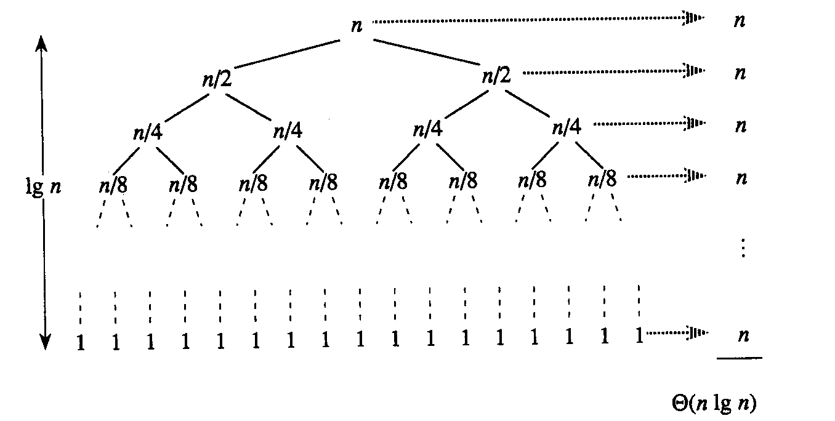
Performance of Quicksort
Best-case partitioning
Partitioning produces two regions of size n/2
Recurrence
T(n) = 2T(n/2) + Θ(n)
T(n) = Θ(nlgn) (Master theorem)

Slide 19
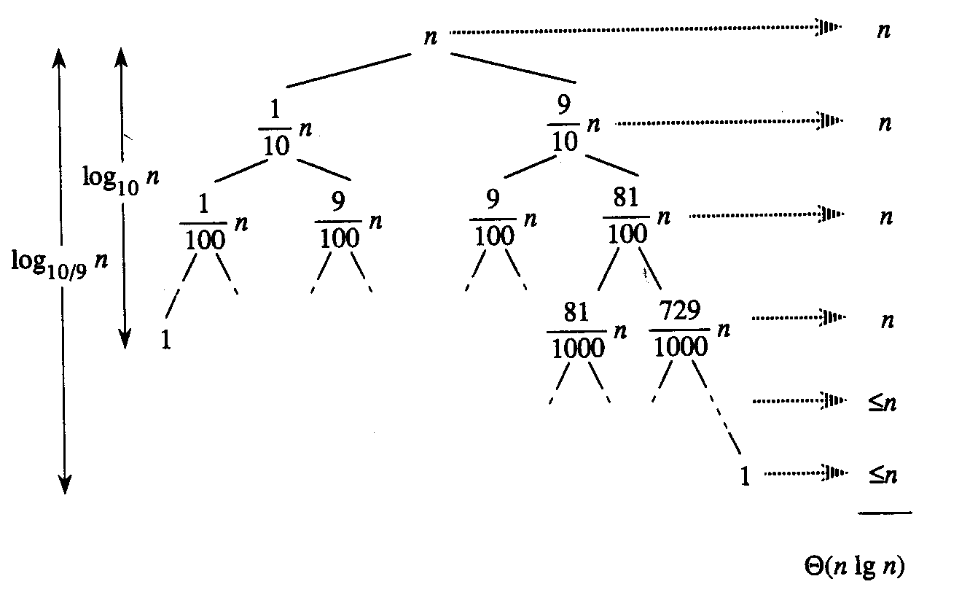
Performance of Quicksort
Balanced partitioning
Average case is closer to best case than to worst case
(if partitioning always produces a constant split)
E.g.: 9-to-1 proportional split
T(n) = T(9n/10) + T(n/10) + n

Slide 20
Performance of Quicksort
Average case
All permutations of the input numbers are equally likely
On a random input array, we will have a mix of well balanced and unbalanced splits
Good and bad splits are randomly distributed throughout the tree
n
combined cost:
2n-1 = Θ(n)
n
combined cost:
n = Θ(n)
1
n - 1
(n – 1)/2 + 1
(n – 1)/2
(n – 1)/2
(n – 1)/2
Alternation of a bad
and a good split
Nearly well
balanced split
Running time of Quicksort when levels alternate between good and bad splits is O(nlgn)

Slide 21
Randomizing Quicksort
Randomly permute the elements of the input array before sorting
Modify the PARTITION procedure
First we exchange element A[p] with an element chosen at random from A[p…r]
Now the pivot element x = A[p] is equally likely to be any one of the original r – p + 1 elements of the subarray

Slide 22
Randomized Algorithms
The behavior is determined in part by values produced by a random-number generator
RANDOM(a, b) returns an integer r, where a ≤ r ≤ b and each of the b-a+1 possible values of r is equally likely
Algorithm generates randomness in input
No input can consistently elicit worst case behavior
Worst case occurs only if we get “unlucky” numbers from the random number generator

Slide 23
Randomized PARTITION
Alg.: RANDOMIZED-PARTITION(A, p, r)
i ← RANDOM(p, r)
exchange A[p] ⟷ A[i]
return PARTITION(A, p, r)

Slide 24
Randomized Quicksort
Alg. : RANDOMIZED-QUICKSORT(A, p, r)
if p < r
then q ← RANDOMIZED-PARTITION(A, p, r)
RANDOMIZED-QUICKSORT(A, p, q)
RANDOMIZED-QUICKSORT(A, q + 1, r)

Slide 25
Worst-Case Analysis of Quicksort
T(n) = worst-case running time
T(n) = max (T(q) + T(n-q)) + Θ(n)
^{1 ≤ q ≤ n-1}
Use substitution method to show that the running time of Quicksort is O(n²)
Guess T(n) = O(n²)
Induction goal: T(n) ≤ cn²
Induction hypothesis: T(k) ≤ ck² for any k ≤ n

Slide 26
Worst-Case Analysis of Quicksort
Proof of induction goal:
T(n) ≤ max (cq² + c(n-q)²) + Θ(n) =
^{1 ≤ q ≤ n-1}
= c × max (q² + (n-q)²) + Θ(n)
^{1 ≤ q ≤ n-1}
The expression q² + (n-q)² achieves a maximum over the range 1 ≤ q ≤ n-1 at the endpoints of this interval
max (q² + (n - q)²) = 1² + (n - 1)² = n² – 2(n – 1)
^{1 ≤ q ≤ n-1}
T(n) ≤ cn² – 2c(n – 1) + Θ(n)
≤ cn²

Slide 27
Another Way to PARTITION
A[p…i] ≤ x
A[i+1…j-1] > x
Given an array A, partition the
array into the following subarrays:
A pivot element x = A[q]
Subarray A[p..q-1] such that each element of A[p..q-1] is smaller than or equal to x (the pivot)
Subarray A[q+1..r], such that each element of A[p..q+1] is strictly greater than x (the pivot)
Note: the pivot element is not included in any of the two subarrays
p
i
i+1
j-1
j
r
unknown
pivot

Slide 28
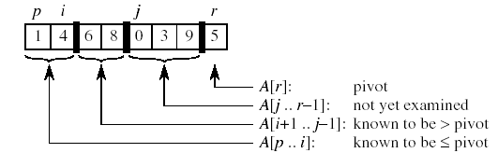








Example

Slide 29
Another Way to PARTITION
Alg.: PARTITION(A, p, r)
x ← A[r]
i ← p - 1
for j ← p to r - 1
do if A[ j ] ≤ x
then i ← i + 1
exchange A[i] ↔ A[j]
exchange A[i + 1] ↔ A[r]
return i + 1
A[p…i] ≤ x
A[i+1…j-1] > x
p
i
i+1
j-1
j
r
unknown
pivot
Chooses the last element of the array as a pivot
Grows a subarray [p..i] of elements ≤ x
Grows a subarray [i+1..j-1] of elements >x
Running Time: Θ(n), where n=r-p+1

Slide 30
Loop Invariant
A[p…i] ≤ x
A[i+1…j-1] > x
p
i
i+1
j-1
r
x
unknown
pivot
All entries in A[p . . i] are smaller than the pivot
All entries in A[i + 1 . . j - 1] are strictly larger than the pivot
A[r] = pivot
A[ j . . r -1] elements not yet examined

Slide 31
Loop Invariant
i
p,j
r
x
unknown
pivot
Initialization: Before the loop starts:
A[r] is the pivot
subarrays A[p . . i] and A[i + 1 . . j - 1] are empty
All elements in the array are not examined

Slide 32
Loop Invariant
A[p…i] ≤ x
A[i+1…j-1] > x
p
i
i+1
j-1
r
x
unknown
pivot
Maintenance: While the loop is running
if A[ j ] ≤ pivot, then i is incremented, A[ j ] and A[i +1] are swapped and then j is incremented
If A[ j ] > pivot, then increment only j

Slide 33
Maintenance of Loop Invariant
If A[j] > pivot:
only increment j
If A[j] ≤ pivot:
i is incremented, A[j] and A[i] are swapped and then j is incremented
p
i
j
r
>x
x
≤ x
> x
p
i
j
r
x
≤ x
> x
p
i
j
r
≤x
x
≤ x
> x
p
i
j
r
x
≤ x
> x

Slide 34
Loop Invariant
A[p…i] ≤ x
A[i+1…j-1] > x
p
i
i+1
j-1
j=r
x
pivot
Termination: When the loop terminates:
j = r ⇒ all elements in A are partitioned into one of the three cases: A[p . . i ] ≤ pivot, A[i + 1 . . r - 1] > pivot, and A[r] = pivot

Slide 35
Readings
Chapter 7

