Slide 1
Analysis of Algorithms CS 477/677
Instructor: Monica Nicolescu
Lecture 9

Slide 2
Selection
General Selection Problem:
select the i-th smallest element form a set of n distinct numbers
that element is larger than exactly i - 1 other elements
The selection problem can be solved in O(nlgn) time
Sort the numbers using an O(nlgn)-time algorithm, such as merge sort
Then return the i-th element in the sorted array

Slide 3
General Selection Problem
Select the i-th order statistic (i-th smallest element) form a set of n distinct numbers
Idea:
Partition the input array similarly with the approach used for Quicksort (use RANDOMIZED-PARTITION)
Recurse on one side of the partition to look for the i-th element depending on where i is with respect to the pivot
We will show that selection of the i-th smallest element of the array A can be done in Θ(n) time
p
q
r
k = q – p + 1
A
i < k ⇒ search
in this partition
i > k ⇒ search
in this partition

Slide 4
Randomized Select
p
q-1
q
q+1
r
Alg.: RANDOMIZED-SELECT(A, p, r, i )
if p = r
then return A[p]
q ←RANDOMIZED-PARTITION(A, p, r)
k ← q - p + 1
if i = k pivot value is the answer
then return A[q]
elseif i < k
then return RANDOMIZED-SELECT(A, p, q-1, i )
else return RANDOMIZED-SELECT(A, q + 1, r, i-k)
i < k ⇒ search
in this partition
i > k ⇒ search
in this partition
pivot

Slide 5
Analysis of Running Time
Worst case running time:
If we always partition around the largest/smallest remaining element
Partition takes Θ(n) time
T(n) = Θ(1) (compute k) + Θ(n) (partition) + T(n-1)
= 1 + n + T(n-1) = Θ(n²)
Θ(n²)
p
r
q
n-1 elements

Slide 6
Analysis of Running Time
Expected running time (on average)
Let T(n) be a random variable denoting the running time of RANDOMIZED-SELECT
RANDOMIZED-PARTITION is equally likely to return any element of A as the pivot ⇒
For each k such that 1 ≤ k ≤ n, the subarray A[p . . q] has k elements (all ≤ pivot) with probability 1/n
p
q
r
k elements

Slide 7
Analysis of Running Time
When we call RANDOMIZED-SELECT we could have three situations:
The algorithm terminates with the answer (i = k), or
The algorithm recurses on the subarray A[p..q-1], or
The algorithm recurses on the subarray A[q+1..r]
The decision depends on where the i-th smallest element falls relative to A[q]
To obtain an upper bound for the running time T(n):
assume the i-th smallest element is always in the larger subarray

Slide 8
Analysis of Running Time (cont.)
Probability that T(n)
takes a value
The value of the random variable T(n)
×
Summed over all possible values
since select recurses only on the larger partition
PARTITION
T(n) = O(n) (prove by substitution)

Slide 9
A Better Selection Algorithm
Can perform Selection in O(n) Worst Case
Idea: guarantee a good split on partitioning
Running time is influenced by how “balanced” are the resulting partitions
Use a modified version of PARTITION
Takes as input the element around which to partition

Slide 10
Selection in O(n) Worst Case
A:
x₁
x₂
x₃
x_{⎡n/5⎤}
x
k – 1 elements
x
n - k elements
Divide the n elements into groups of 5 ⇒⎡n/5⎤ groups
Find the median of each of the ⎡n/5⎤ groups
Use insertion sort, then pick the median
Use SELECT recursively to find the median x of the ⎡n/5⎤ medians
Partition the input array around x, using the modified version of PARTITION
There are k-1 elements on the low side of the partition and n-k on the high side
If i = k then return x. Otherwise, use SELECT recursively:
Find the i-th smallest element on the low side if i < k
Find the (i-k)-th smallest element on the high side if i > k

Slide 11
Example
Find the 11th smallest element in the array:
A = {12, 34, 0, 3, 22, 4, 17, 32, 3, 28, 43, 82, 25, 27, 34, 2 ,19 ,12 ,5 ,18 ,20 ,33, 16, 33, 21, 30, 3, 47}
Divide the array into groups of 5 elements
12
34
0
3
22
4
17
32
3
28
43
82
25
27
34
2
19
12
5
18
20
33
16
33
21
30
3
47

Slide 12
Example (cont.)
Sort the groups and find their medians
Find the median of the medians
12, 12, 17, 21, 34, 30
0
3
12
34
22
4
3
17
32
28
25
27
34
43
82
2
5
12
19
18
20
16
21
33
33
3
30
47

Slide 13
Example (cont.)
Partition the array around the median of medians (17)
First partition:
{12, 0, 3, 4, 3, 2, 12, 5, 16, 3}
Pivot:
17 (position of the pivot is q = 11)
Second partition:
{34, 22, 32, 28, 43, 82, 25, 27, 34, 19, 18, 20, 33, 33, 21, 30, 47}
To find the 6-th smallest element we would have to recurse our search in the first partition.

Slide 14
Analysis of Running Time
Step 1: making groups of 5 elements takes
Step 2: sorting n/5 groups in O(1) time each takes
Step 3: calling SELECT on ⎡n/5⎤ medians takes time
Step 4: partitioning the n-element array around x takes
Step 5: recursion on one partition takes
O(n)
O(n)
T(⎡n/5⎤)
O(n)
depends on the size of the partition!!

Slide 15
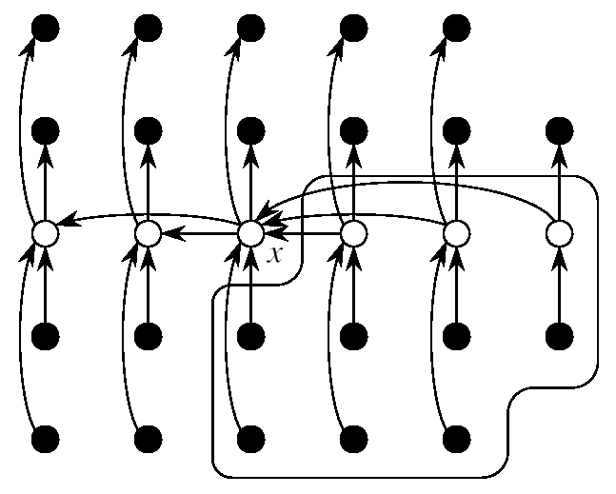
Analysis of Running Time
First determine an upper bound for the sizes of the partitions
See how bad the split can be
Consider the following representation
Each column represents one group of 5 (elements in columns are sorted)
Columns are sorted by their medians

Slide 16
Analysis of Running Time
At least half of the medians found in step 2 are ≥ x:
All but two of these groups contribute 3 elements > x
groups with 3 elements > x
At least elements greater than x
SELECT is called on at most elements

Slide 17
Recurrence for the Running Time
Step 1: making groups of 5 elements takes
Step 2: sorting n/5 groups in O(1) time each takes
Step 3: calling SELECT on ⎡n/5⎤ medians takes time
Step 4: partitioning the n-element array around x takes
Step 5: recursion on one partition takes
T(n) = T(⎡n/5⎤) + T(7n/10 + 6) + O(n)
We will show that T(n) = O(n)
O(n)
O(n)
T(⎡n/5⎤)
O(n)
time ≤ T(7n/10 + 6)

Slide 18
Substitution
T(n) = T(⎡n/5⎤) + T(7n/10 + 6) + O(n)
Show that T(n) ≤ cn for some constant c > 0 and all n ≥ n₀
T(n) ≤ c ⎡n/5⎤ + c (7n/10 + 6) + an
≤ cn/5 + c + 7cn/10 + 6c + an
= 9cn/10 + 7c + an
= cn + (-cn/10 + 7c + an)
≤ cn if: -cn/10 + 7c + an ≤ 0
c ≥ 10a(n/(n-70))
choose n₀ > 70 and obtain the value of c

Slide 19
How Fast Can We Sort?
Insertion sort, Bubble Sort, Selection Sort
Merge sort
Quicksort
What is common to all these algorithms?
These algorithms sort by making comparisons between the input elements
To sort n elements, comparison sorts must make 𝝮(nlgn) comparisons in the worst case
Θ(n²)
Θ(nlgn)
Θ(nlgn)

Slide 20
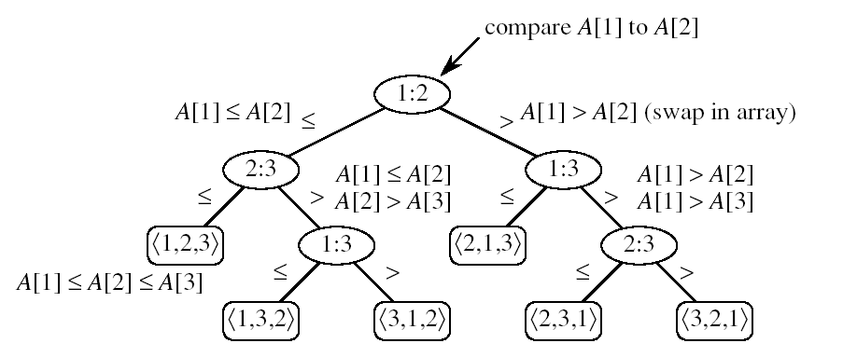
Decision Tree Model
Represents the comparisons made by a sorting algorithm on an input of a given size: models all possible execution traces
Control, data movement, other operations are ignored
Count only the comparisons
Decision tree for insertion sort on three elements:
one execution trace
node
leaf:

Slide 21
Readings
Chapter 6, 7, 8

