Slide 1

Busfor.ua
testing
QA engineer:
Haisiuk Hanna

Slide 2

Test suite Web version

Slide 3
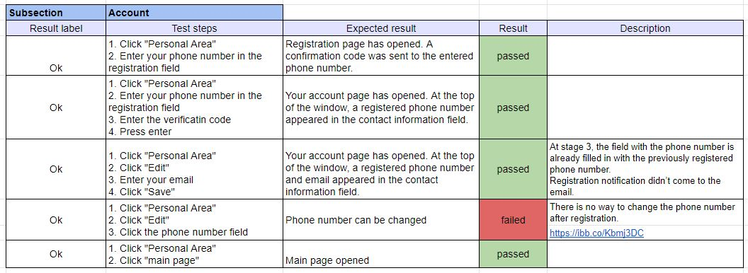

Slide 4
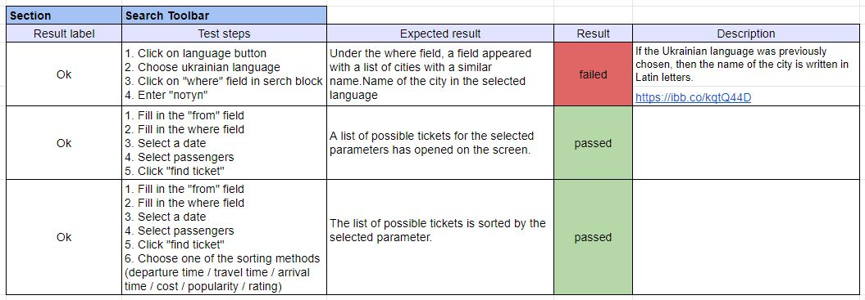

Slide 5
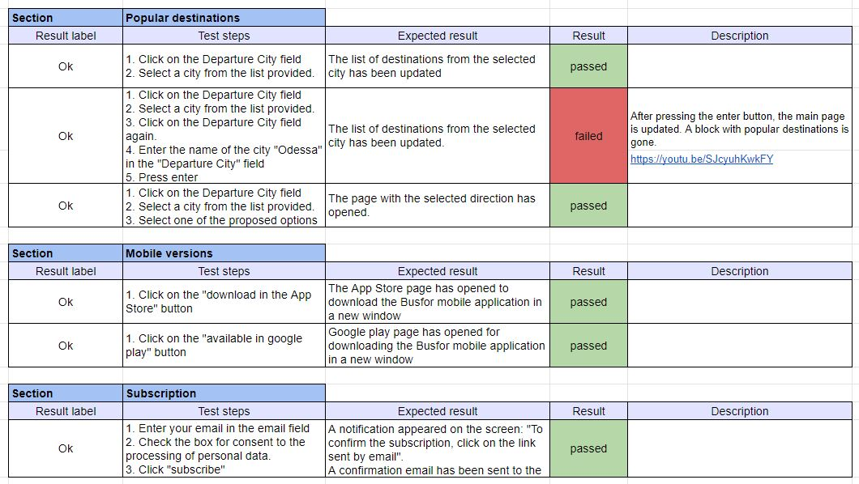

Slide 6
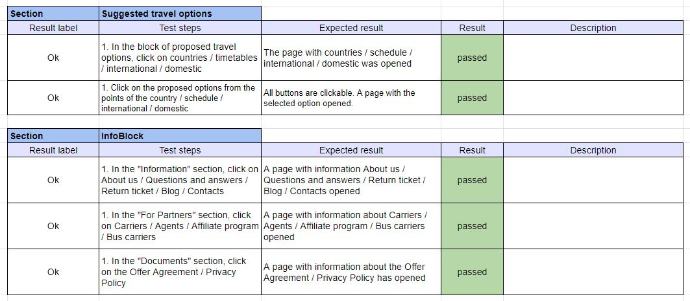

Slide 7


Slide 8
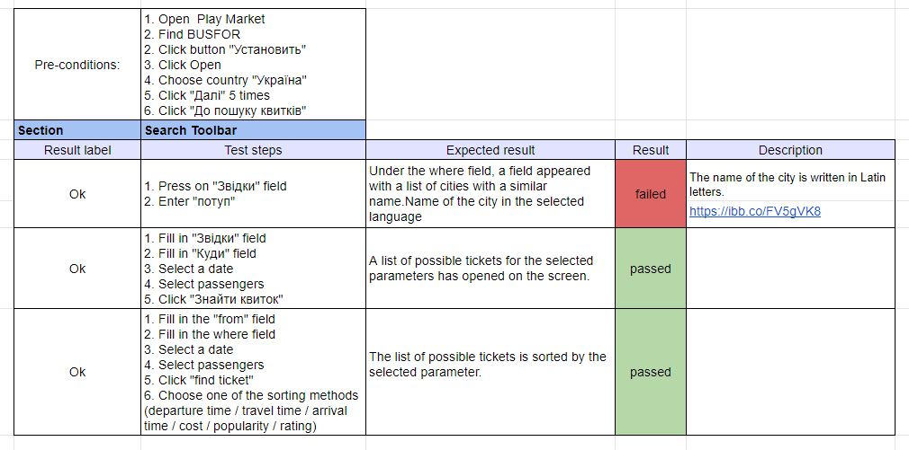
Test suite Mobile version

Slide 9
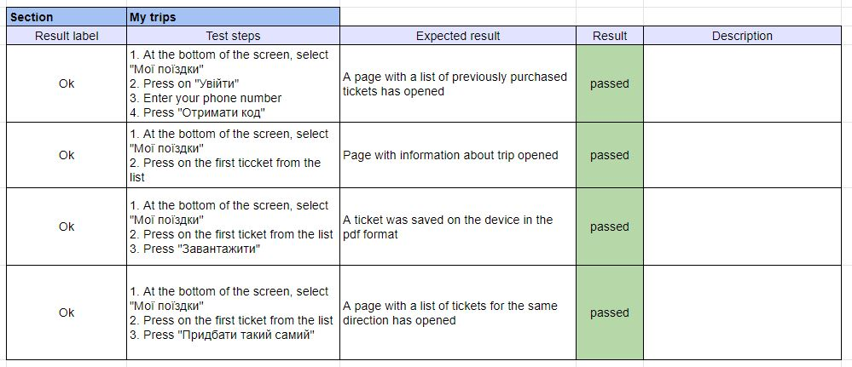

Slide 10
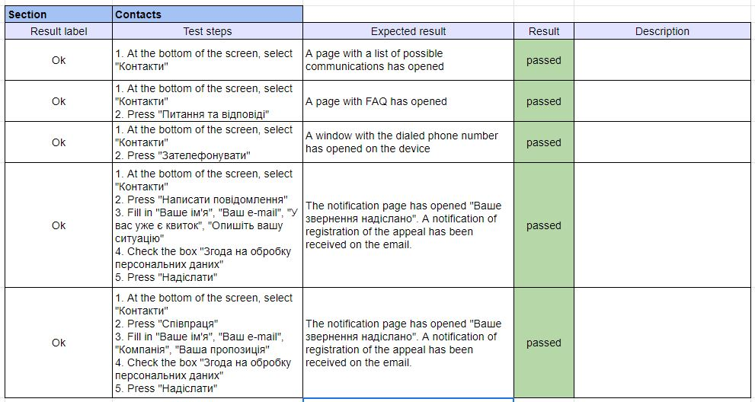

Slide 11
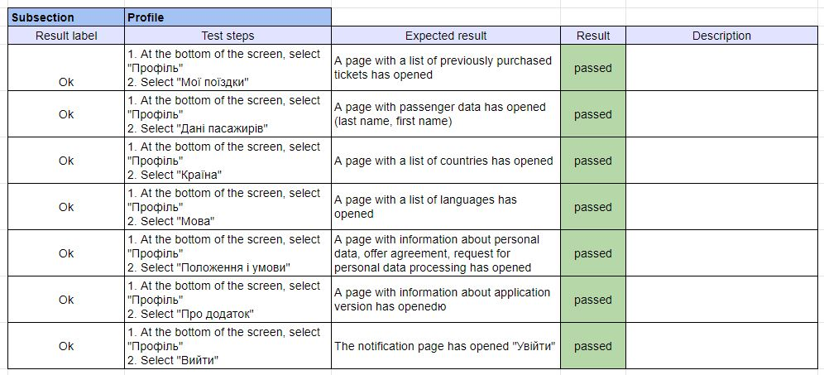

Slide 12
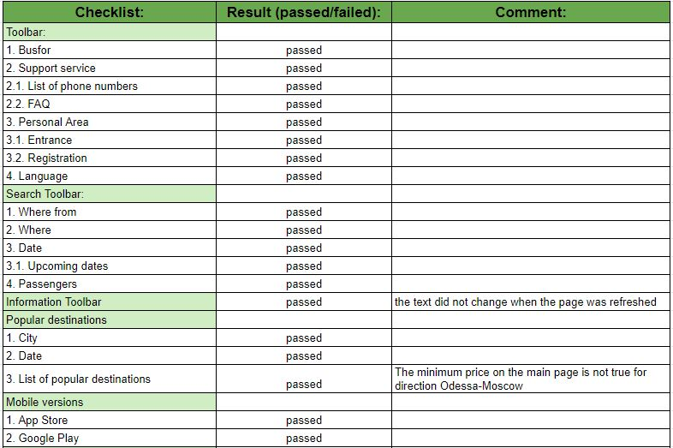
Check list Web version
Browser: Google Chrome v78.0.3904.108
Link: https://busfor.ua/

Slide 13
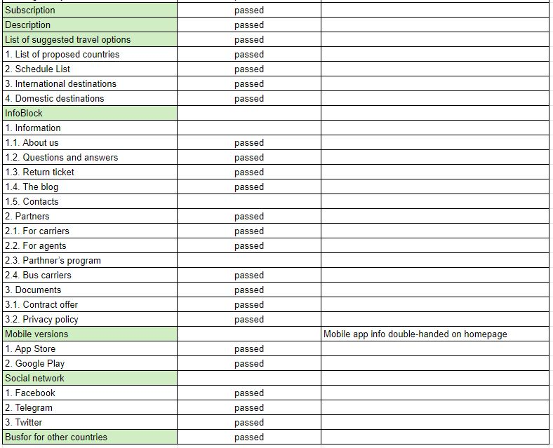

Slide 14

Load Testing

Slide 15
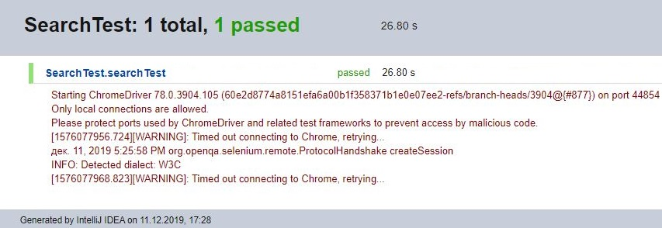
Automation

Slide 16
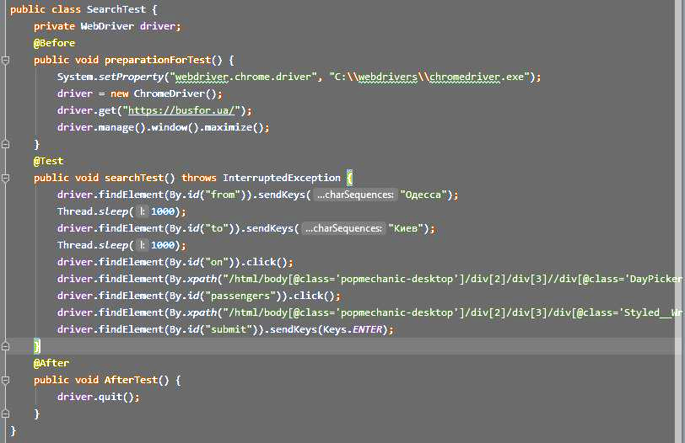
Automation

Slide 17
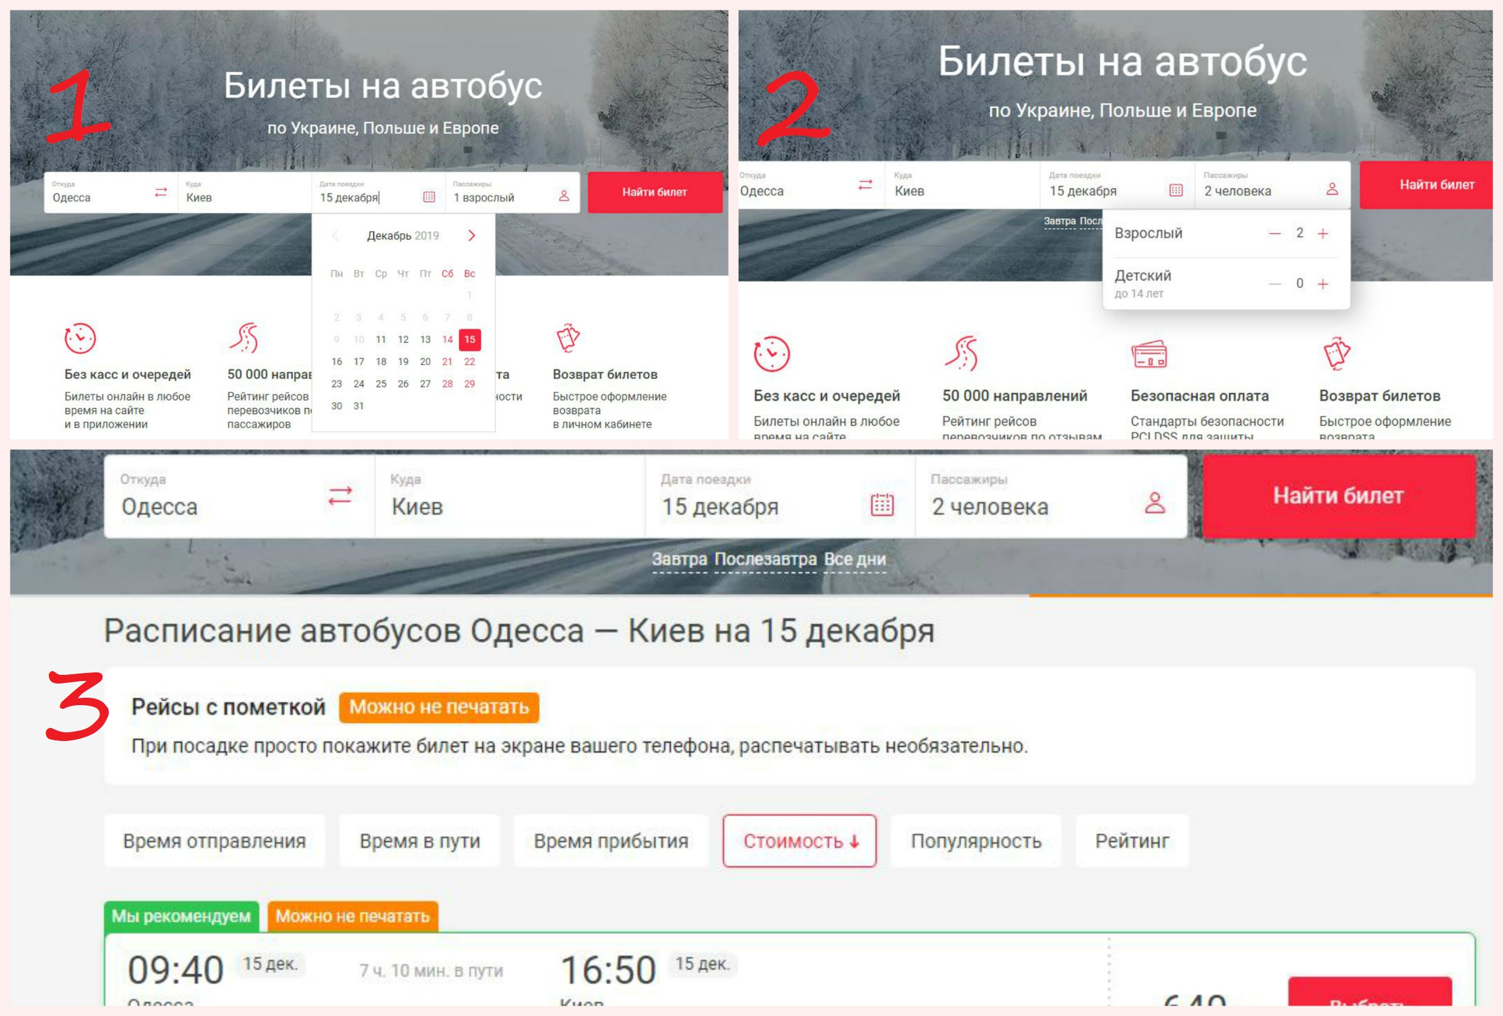
Automation

