Slide 1


GStar Bootcamp
Fade, Don't Forget
Low-bit attention memory for hybrid reasoning models
Student:
Vu Hai An
Notes:
Title slide.

Slide 2


Approach: blur old thoughts, don't delete them
Problem: the attention cache grows
What attention keeps of a 32K trace
Hybrid LLMs (Qwen3.5, Kimi Linear): mostly linear layers with a fixed-size state, plus a few attention layers for exact recall.
analytic memory at 32K
Full attention
1,073 MiB
Qwen3.5-9B: 32 layers
pattern 3 : 1, repeated 8×
P
exact (16-bit)
StreamingLLM-8K
305 MiB
Gated DeltaNet
Gated DeltaNet
Gated DeltaNet
Full attention
dropped, including the prompt
last 8K
24 layers: fixed-size state
49 MiB in total, at any length
KV cache grows
32 KiB / token
8K window + prompt
305 MiB
P
dropped
last 8K
Memory per sample at 32K tokens (analytic)
attention KV: 1 GiB (95%)
GDN: 49 MiB
Fade (ours)
248–368 MiB
P
older tokens at 2–4 bits
2K
Fade compresses only this cache. No training.
exact
2–4 bits
dropped
P = prompt
Notes:
Reasoning models think for tens of thousands of tokens. New models like Qwen3.5 and Kimi Linear are hybrids: most layers are linear recurrences with a fixed-size state, and a few attention layers keep exact recall. In Qwen3.5 it is three Gated DeltaNet layers, then one full-attention layer, repeated eight times. The DeltaNet layers keep a fixed state, 49 megabytes. The eight attention layers keep every token's keys and values, so at 32K tokens that cache is a gigabyte, 95 percent of the memory. That cache is what Fade targets. Our earlier project tried forgetting: keep only the prompt and recent tokens. Accuracy fell 40 points, and every attention head turned out to read far back. So Fade keeps everything, but blurs it: the prompt and the last 2K tokens stay exact, and older keys and values are stored at 2 or 4 bits. No training, and the DeltaNet layers are untouched.

Slide 3
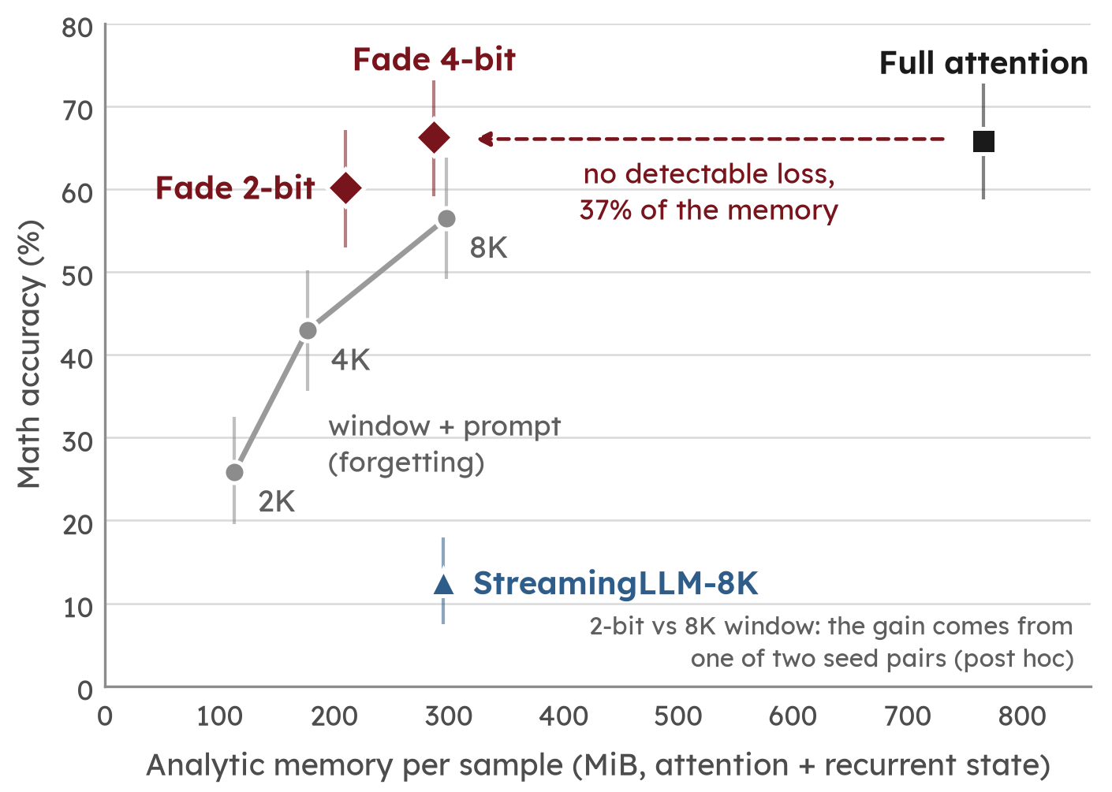
Results: Fade vs full attention and StreamingLLM
Setup
Model
Qwen3.5-9B (hybrid)
Data
AIME 2025 · AIME 2026 · HMMT 2025
MATH-500 level 5 · 30 each, 120 total
Decode
32K cap · 4 samples (StreamingLLM: 2)
Compare
full attention · windows · StreamingLLM
Analysis
pre-registered · memory checked on A100
Future work
Systems
fused low-bit kernel for speed
Training
QAT / distillation for 2 and 1 bit
Scope
more baselines, hybrids and tasks
A hybrid's attention can't forget its old thoughts, but it can blur them (one model, math).
Notes:
On 120 competition math problems, pre-registered: full attention gets 66 percent. Four-bit Fade also gets 66, with no detectable loss, at 37 percent of the memory. Forgetting, the grey line, falls fast as the window shrinks. Two-bit Fade beats an 8K window that keeps the prompt by about 4 points with 30 percent less memory, a modest gain, and all of it comes from one of our two seed pairs. StreamingLLM-8K, the standard way to cap the cache, drops the prompt too: it gets 12.5 percent on two samples per problem, and 2-bit Fade beats it by 49 points with less memory. When 2-bit Fade fails, it is not wrong answers; runs just hit the token limit. The memory on the chart is computed, and a benchmark with real packed 2- and 4-bit storage agrees within 10 percent; our prototype is slower than full attention, so no speed claim. Next: a fused low-bit kernel for speed, training to close the 2-bit gap, comparisons with more baselines such as R-KV and KVQuant, and more models and tasks. So: don't forget. Fade.

