Slide 1
The Convex Hulls
Implementation of Two-dimensional Convex Hull Algorithms and Comparing Their Performances
Zeynep Nur Öztürk

Slide 2
Outline
1.Introduction
2. Background for Convex Hulls
3. Progress
3. Result
4. Demo

Slide 3
1. Introduction

Slide 4
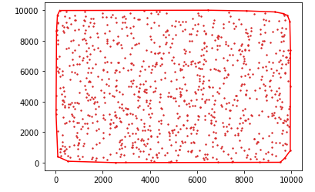
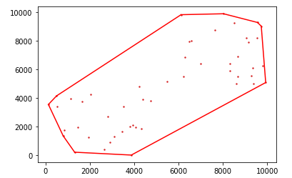
What is Convex Hull?
Convex hull is the smallest convex set which contains all the points in it.

Slide 5
Why Convex Hull?
It has wide application like in
Math-> analyze asymptotic beh. of poynomials
Statistic -> visualize the spread of 2D sample points
Economic -> When actual data non-complex, made convex
Geometric modeling -> In Bezier curve, quickly detecting intersections of curves

Slide 6
2. Background

Slide 7
Algorithms
In general, most of the algorithms can be solved in time O(nlogn) for 2D or 3D
Graham Scan -> O(nlogn)
Gift wrapping ( Jarvis March ) -> O(nlogn)
Quickhull -> ave. O(nlogn) -> wor. O(n^2)
Divide & Conquer -> O(nlogn)

Slide 8
Graham Scan
Ronald Graham 1972
O(nlogn)
First order vertices based on polar angle
By left test, move around the points
If left test is true add to stack or delete from until it is true

Slide 9
Jarvis March
R. A. Jarvis-1973
O(nh)
It takes smallest point based on x or y.
Sort all points based on polar angle
Beside Graham, only calculates the points on the convex hull.

Slide 10
Quickhull
Bradford Barber-1996
Worst case O(n^2) Average case O(nlogn)
Divides points into 2
Find farthest point by calculating triangle area as recursive until no points left on recursive function

Slide 11
Divide and Conquer
Quickhull recursively
Then Merge them

Slide 12
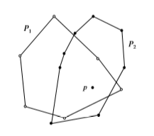
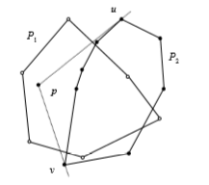
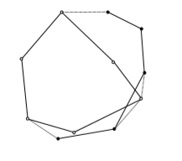
Merge Hull ( Merging Process of D&C)
P1 & P2 are convex hulls, find p internal P1
If p internal P2 -> step 3 Else -> step 4
Sort based on polar for p
Find u and v and eliminate middle chain in P2
Graham Scan
Merge: p1 -> m p2-> n So, O(m+n)=O(N)
In Total O(NlogN)

Slide 13
3. Progress

Slide 14
Language & Libraries
Python 3 for coding
The libraries:
random for point generation
math for tan calculations
numpy as array
time for timing calculations
matplotlib to show visual results

Slide 15
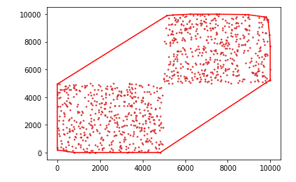
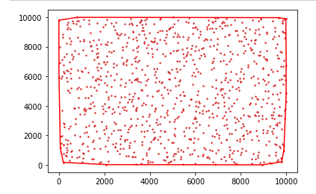
Features
Clustered and non-clustered points
from 1000 to 10.000.000 random point size
Time calculation

Slide 16
4. Results

Slide 17
Graham Scan | Uniform(s) | Clustered(s) | Expected
1,000 | 0.00348 | 0.00343 | O(nlogn)=3,000
10,000 | 0.04643 | 0.04083 | O(nlogn)=40,000
100,000 | 1.26024 | 0.48540 | O(nlogn)=500,000
1,000,000 | 7.10247 | 7.25312 | O(nlogn)=6,000,000
2,000,000 | 14.91750 | 14.30834 | O(nlogn)=12,602,060
3,000,000 | 23.81629 | 23.92488 | O(nlogn)=19,431,363
4,000,000 | 31.19035 | 30.92443 | O(nlogn)=26,408,240
5,000,000 | 40.74763 | 38.05435 | O(nlogn)=33,494,850
10,000,000 | 87.29779 | 80.77861 | O(nlogn)=70,000,000

Slide 18
Jarvis’ March | Uniform(s) | Clustered(s) | Expected
1,000 | 0.01776 h = 23 | 0.01535 h = 18 | u->O(nh)=23,000 c->O(nh)=18,000
10,000 | 0.23531 h = 26 | 0.25829 h = 26 | u->O(nh)=260,000 c->O(nh)=260,000
100,000 | 5.52423 h = 37 | 4.01435 h = 35 | u->O(nh)=3,700,000 c->O(nh)=3,500,000
1,000,000 | 66.89897 h = 33 | 69.90606 h = 41 | u->O(nh)=33,000,000 c->O(nh)=41,000,000
2,000,000 | 174.11069 h = 47 | 115.76362 h = 44 | u->O(nh)=94,000,000 c->O(nh)=88,000,000
3,000,000 | 244.66016 h = 45 | 295.58773 h = 48 | u->O(nh)=135,000,000 c->O(nh)=144,000,000
4,000,000 | 340.58623 h = 40 | 414.12098 h = 48 | u->O(nh)=160,000,000 c->O(nh)=192,000,000
5,000,000 | 353.88278 h = 47 | 469.60794 h = 44 | u->O(nh)=235,000,000 c->O(nh)=220,000,000
10,000,000 | 356.32224 h=50 | 1145.9719 h=66 | u->O(nh)=500,000,000 c->O(nh)=660,000,000

Slide 19
Quickhull | Uniform(s) | Clustered(s) | Expected
1,000 | 0.00512 | 0.00384 | O(nlogn)=3,000 O(n*n)=10^6
10,000 | 0.05689 | 0.03930 | O(nlogn)=40,000 O(n*n)= 10^8
100,000 | 0.71644 | 0.55157 | O(nlogn)=500,000 O(n*n)=10^10
1,000,000 | 5.52458 | 5.60349 | O(nlogn)=6,000,000 O(n*n)=10^12
2,000,000 | 11.87036 | 11.54690 | O(nlogn)=12,602,060 O(n*n)=4*10^12
3,000,000 | X | 17.12558 | O(nlogn)=19,431,363 O(n*n)=9*10^12
4,000,000 | X | X | O(nlogn)=26,408,240 O(n*n)=16*10^12
5,000,000 | X | X | O(nlogn)=33,494,850 O(n*n)=25*10^12
10,000,000 | X | X | O(nlogn)=70,000,000 O(n*n)=10^14

Slide 20
Merge Hull | Uniform(s) | Clustered(s) | Expected
1,000 | 0.00414 | 0.00391 | O(nlogn)=3,000
10,000 | 0.04171 | 0.03664 | O(nlogn)=40,000
100,000 | 0.52161 | 0.44887 | O(nlogn)=500,000
1,000,000 | 6.18138 | 6.00312 | O(nlogn)=6,000,000
2,000,000 | 12.24851 | 13.15488 | O(nlogn)=12,602,060
3,000,000 | 17.88851 | 26.40263 | O(nlogn)=19,431,363
4,000,000 | 25.77283 | 31.05477 | O(nlogn)=26,408,240
5,000,000 | 32.26809 | 42.65405 | O(nlogn)=33,494,850
10,000,000 | X | X | O(nlogn)=70,000,000

Slide 21
Clustered | Graham | Jarvis | Quickhull | Merge
1,000,000 | 7.25312 | 69.90606 h = 41 | 5.60349 | 6.00312
2,000,000 | 14.30834 | 115.76362 h = 44 | 11.54690 | 13.15488
3,000,000 | 23.92488 | 295.58773 h = 48 | 17.12558 | 26.40263
4,000,000 | 30.92443 | 414.12098 h = 48 | X | 31.05477
5,000,000 | 38.05435 | 469.60794 h = 44 | X | 42.65405
10,000,000 | 80.77861 | 1145.9719 h=66 | X | X

Slide 22
Uniform | Graham | Jarvis | Quickhull | Merge
1,000,000 | 7.10247 | 66.89897 h = 33 | 5.52458 | 6.18138
2,000,000 | 14.91750 | 174.11069 h = 47 | 11.87036 | 12.24851
3,000,000 | 23.81629 | 244.66016 h = 45 | X | 17.88851
4,000,000 | 31.19035 | 340.58623 h = 40 | X | 25.77283
5,000,000 | 40.74763 | 353.88278 h = 47 | X | 32.26809
10,000,000 | 87.29779 | 356.32224 h=50 | X | X

Slide 23
Demo

