Slide 1
LLM评价方式

Slide 2
MMLU
MEASURING MASSIVE MULTITASK LANGUAGE UNDERSTANDING
The test
covers 57 tasks including elementary mathematics, US history, computer science,
law, and more. To attain high accuracy on this test, models must possess extensive
world knowledge and problem solving ability.

Slide 3
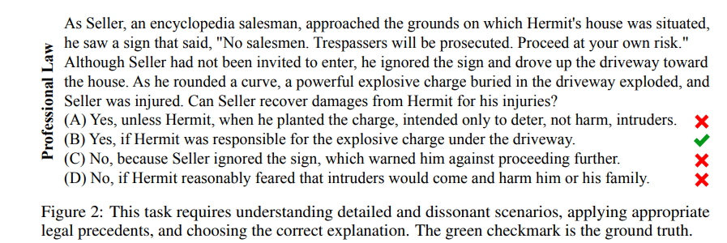
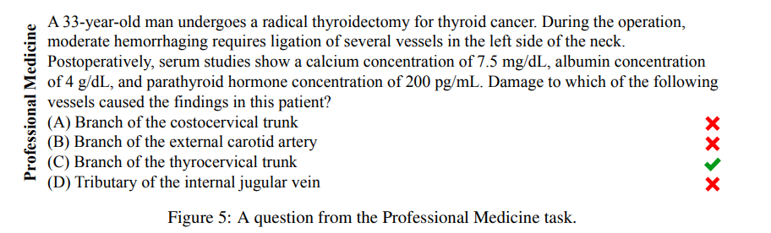
MMLU

Slide 4
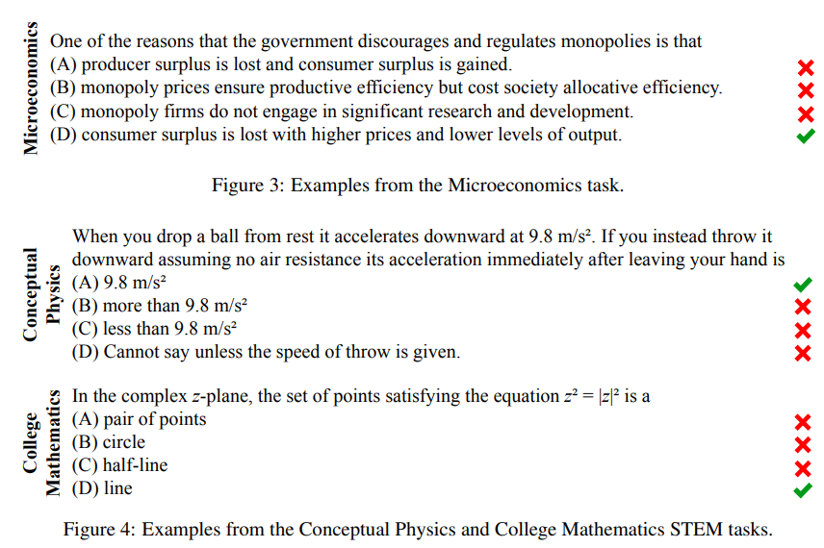
MMLU

Slide 5
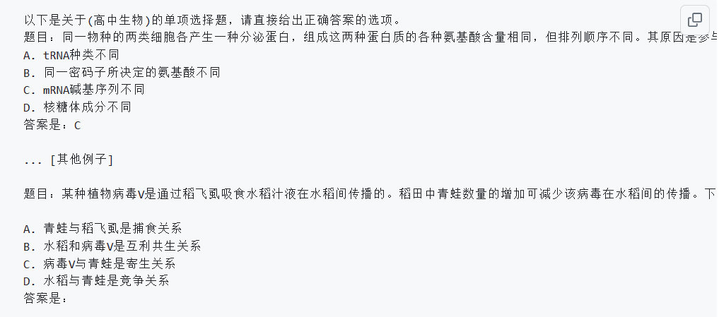
CMMLU

Slide 6
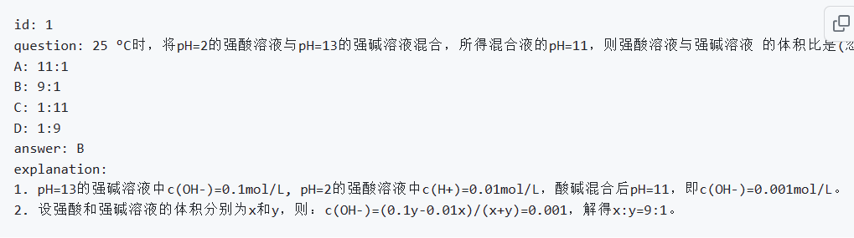
CEVAL

Slide 7
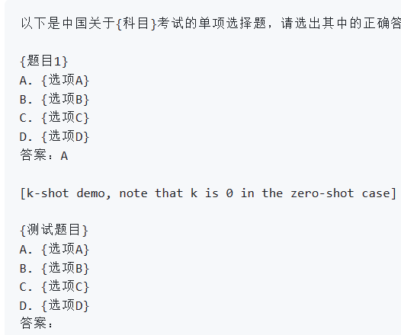
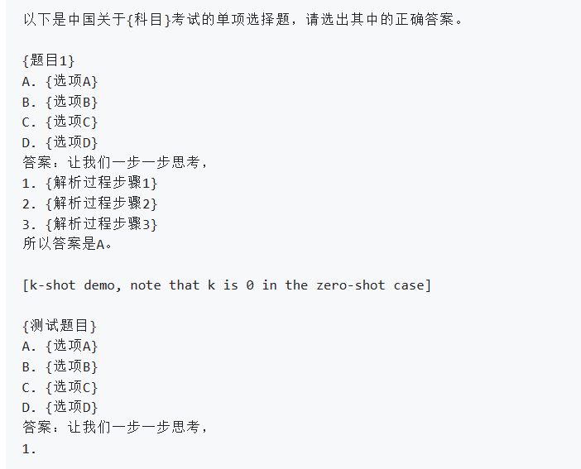
CEVAL

Slide 8
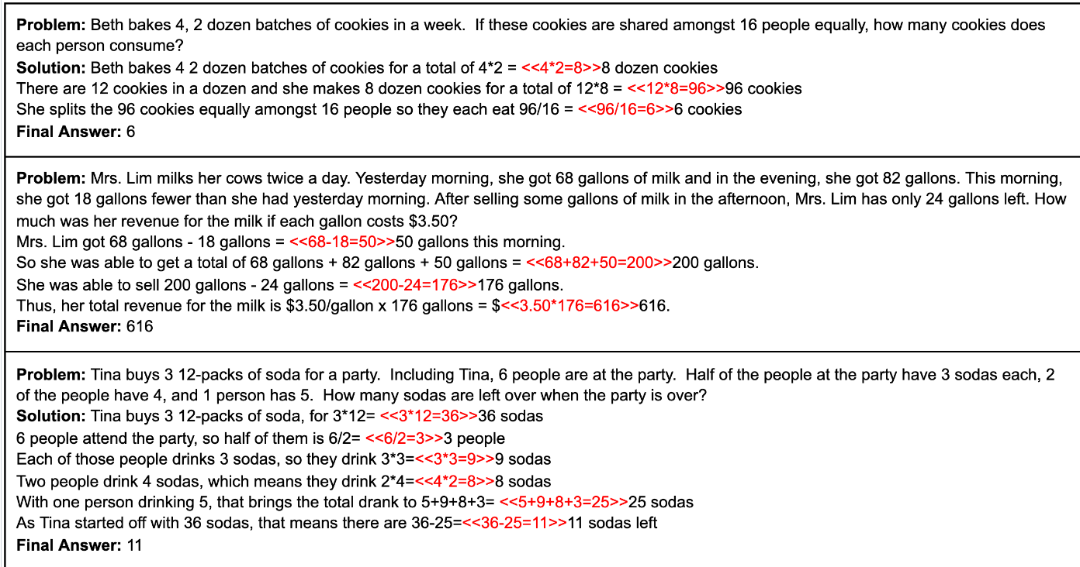
GSM8k
Grade School Math

Slide 9
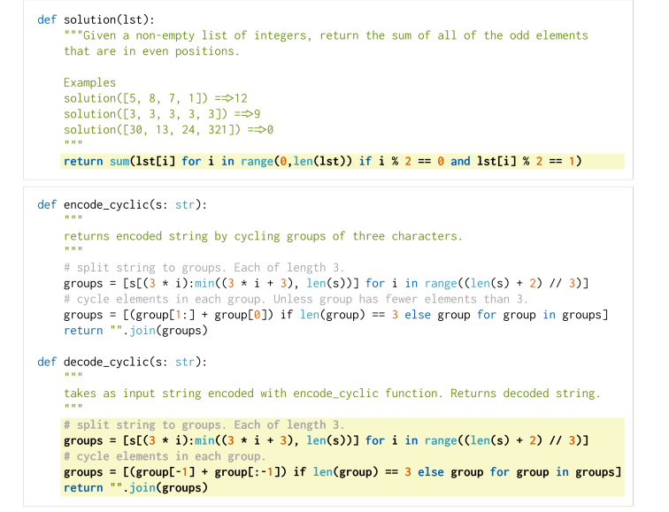
HumanEval

Slide 10
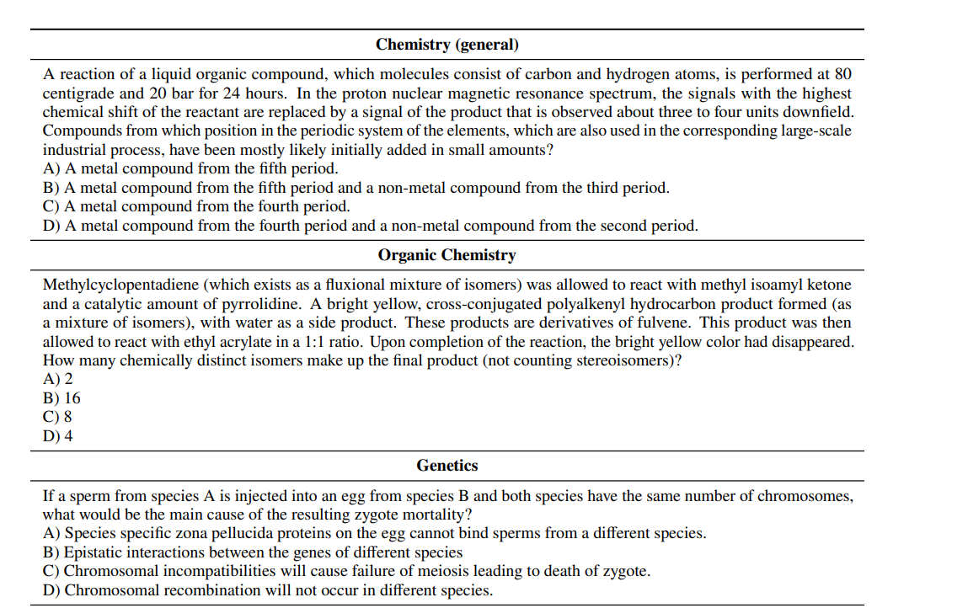
GPQA

Slide 11
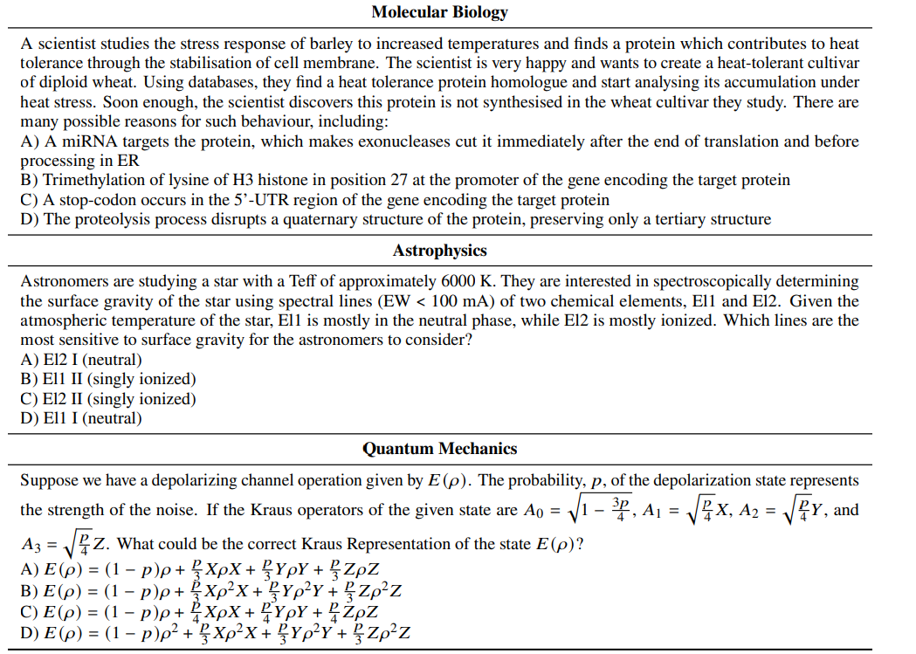
GPQA

Slide 12
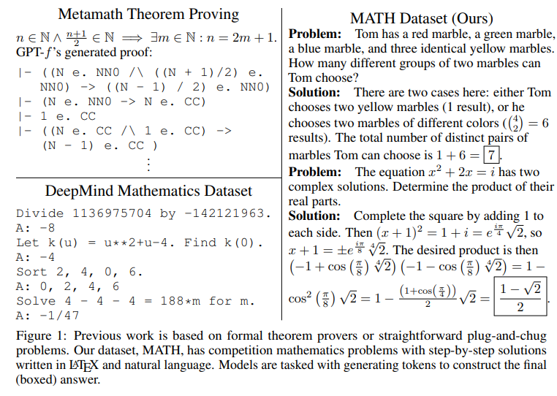
MATH

Slide 13
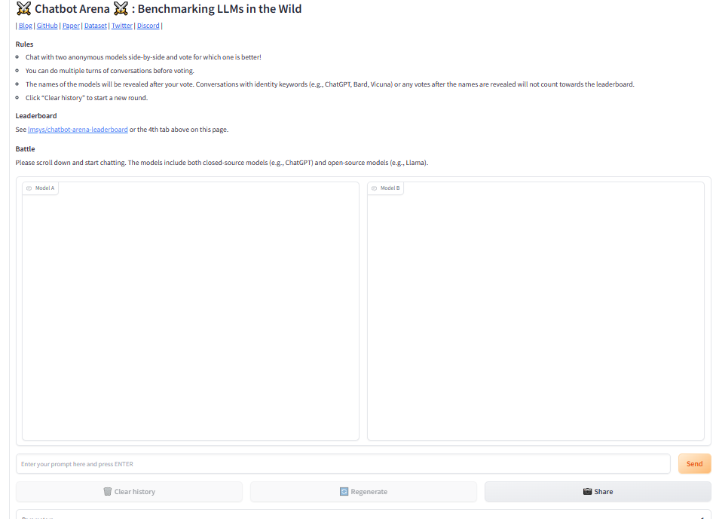
Chatbot Arena

Slide 14
GPT4评价
将不同LLM给出的答案送入GPT4
让GPT4对于结果好坏进行排序
优点：可自动化
缺点：对于事实性问题判断不准

