Slide 1
Introduction to the command line
(Please feel free to print, distribute, cite, mangle or otherwise use these materials. Just remember to give your old friend, Derek Bickhart, a shout-out on occasion)

Slide 2
Lesson Plan
Introduction and syllabus
Command Line introduction
Navigation and orientation on the command line
ls, pwd, cd
Text file viewing
head, tail, cat
Simple executable submission and who you are as a user
Unix Wildcards

Slide 3
Why am I doing this?
There are 18.5 million professional programmers in the world as of 2014 (Evans Data’s Global Developer Population and Demographic study)
~0.3% of the global workforce
Median salary of programmers: $79,530 in 2015 (Bureau of Labor Statistics)
Not uncommon to be above $200k!
There are many underrepresented groups in the world of computer programming
I really dislike seeing people mangle huge datasets in excel
No, really! It upsets me!

Slide 4
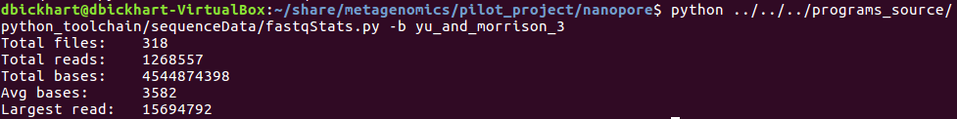
An example of how programming will improve your life and make you popular™
The problem: I had 318 sequence data files and I needed to get the following information.
Read count
Total number of sequence bases
The longest read in the file.
The solution: Write a script to process them all!
You can do this! Remember that time you had to count entries manually? Pssh! We don’t have to do that again.
The script name
The folder containing the files

Slide 5

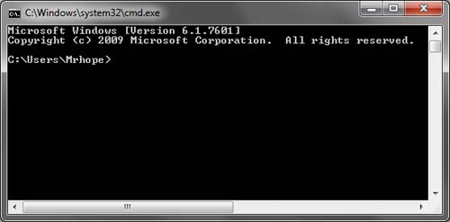
Before you learn to run…
We will learn to use and navigate the Unix command line
What is the command line, and how is it different from what I’m currently used to with Windows/Mac systems?
Command line

Slide 6
Can’t I do everything with a GUI?
Sometimes. GUIs are great for:
Single commands
Visualization
Ease of access to complicated programs/data
Mouse support!
GUIs tend to fail here:
Repetitive or large tasks
Speed of tasks
Writing your own programs/tools! (way more complicated!)
The Unix command line is the preferred medium for scientific computing

Slide 7

But I’m pretty attached to moving around with a mouse and keyboard. How will I survive?
The Unix command line has several commands that make your life easier!
There are two essential ones:
cd <- “Change directory”
ls <- “List files”
There are some that are useful to learn to help orient yourself:
pwd <- “Print working directory”
man (command) <- “Manual”
exit <- “get the hell out of dodge!”

Slide 8

Key Mantra of Unix Systems
Everything is a file! Text files are king on Unix systems
File extensions (the “.doc” or “.xls” after your file) do not mean anything in Unix
Files are series of “bytes” or binary code that can be used to represent anything from text, special characters (emoticons?) or instructions to the CPU.
A Text file! Windows would freak out
but Unix is totally fine here!

Slide 9
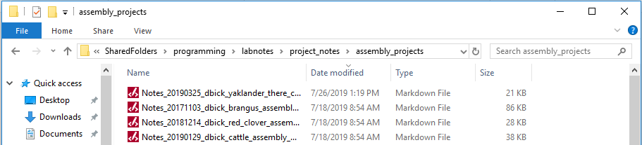
The majority of your time on Unix will be spent navigating
You’ve probably been doing this without thinking on Windows systems:
Unix navigation will be the same, but you must instruct the command line to move around in folders! No Mouse!
The “Path” to the files
The
Files

Slide 10
Command prompt!
After you login all the text floats by, you should have a command prompt:
Anatomy of the command prompt (above): User name , server , folder (or location)
Unix users have their very own folder called the “Home” folder. It’s so important that it has it’s own special short-cut symbol: “~”
The command prompt (in the unix bash shell this is the $ above) is what you will use to navigate the system and run commands!
Commands are entered with the “return” key after being typed!!

Slide 11
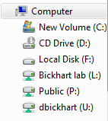
Important note: directory structure
You’re all probably used to “folders,” “directories,” and “subdirectories” by now. On Windows, these are all organized under “drives” on your “computer” like so:
So, if I told you a file was located at “C:\MyProject\SubDir”, you’d know the drive, the main folder and the subfolder.
Unix is similar, but subtly different. All folders originate from the “root” directory, and the delimiter of folders is a forward slash “/” rather than the Windows back slash “\”.
Let’s demonstrate this by showing the “root” directory, a main folder and two subfolders here: /home/derek.bickhart/important_stuff
You can specify the location of ANY file on the system by typing the full “path” using folder delimiters and starting with the first “root” forward slash.

Slide 12
Tarballs -- not what you were thinking!
Just to get things rolling, I’d like to give you all some interactive learning materials™. You will start to learn more about the command line by actually “typing” commands than by listening to me drone on, so let’s start with your first command! This one’s a big one, so just follow along first and I’ll explain later.
To help move files around, Unix has a command called tar. This command allows you to package folders into an archive file, similar to “zip” files on Windows. The compressed files are affectionately called “tarballs” by the Unix community (or maybe just me?). Type the following and hit enter to unpack your first tarball (note the spaces):

Slide 13
Lab SubLessonA: Navigating unix and checking files
Now let’s orient ourselves. Are you on the command line? Let’s try “pwd” (print working directory) first:
Now, let’s check out the directory that we’re in first before we do anything crazy. Run“ls” (list):
Fancy that! There’s a folder for our first lesson! Let’s see what’s inside:
Where I am
Directory delimiters

Slide 14
The “ls” executable
Executables are “commands” that execute functions
“ls” stands for “list” and has several nuances and shortcuts
If you type “ls” and hit enter, it assumes:
You mean to use “ls” in your current directory
You just want the list of files and directories, nothing more!
You can pass folders to “ls” like we just did, and it will tell you file contents

Slide 15


Command line arguments and flags
What is an argument (apart from a spirited discussion)? In the command line parlance, an argument is an additional series of characters delimited by spaces that you feed into an executable.
“ls” has several useful arguments called “flags”. Let’s demonstrate one, shall we?
The “-a” argument (written with a space after “ls”) is a flag that tells “ls” to print ALL files, even hidden files. Try this now!
That’s not all! “ls” can accept flags and folder locations as well (it’s smart like that). Just type this on the prompt:

Slide 16

A couple useful ls arguments/combos
That’s not all that “ls” can do! Here’s a table with all of the useful combos with flags that I use on a regular basis.
NOTE: multiple “flags” can be concatenated together! This: is synonymous with this:
LS combo | Description
ls –a [folder] | Show hidden files
ls –l [folder] | Display in a list
ls –hal [folder] | Show hidden, in a list, in human-readable format
ls –t [folder] | Order files by time of creation
ls –halt [folder] | [Practical] what does this do?

Slide 17

Phew, that was allot! But how could you know all this in advance? Help messages!
The most important training I can give you is how to find out how to get help. First, try to find out how a command works via a built-in help message. Type the following:
Usually, help messages are displayed via a “- - help” or a “-h” flag. Note the two dashes for the long-form of the flag and the single dash for the short-form.
Sometimes commands have “manual pages,” which you can access using the “man” (manual) command:
You can even “man” the “man” command! The “woman” command has yet to be written, but it promises to do everything the “man” command can do, but even better.

Slide 18
Before we go ahead with the lesson, let’s recap
Executables are the commands that you use on the command line, and they are the FIRST thing that you type in the syntax.
Arguments are the parameters you pass to the executable to let it know what to do (some are optional). They come after the executable
Easy, right? If this were a sentence, the executable would be the subject and the arguments would be the predicates.
We’re now going to tool around in your folders using three helpful unix executables: “pwd” (print working directory), “ls” and “cd” (change directory). If you remember these you’ll rarely be lost!

Slide 19
Lab SubLessonA: Navigating unix and checking files
Let’s check what’s inside that SubLessonA directory:
Now that we see that there’s nothing dangerous in there, let’s move to that new, exciting, SubLessonA directory:
Just to confirm that we’re in the right directory, and that we haven’t been tricked, let’s test it out with an “ls” and a “pwd”
What is that????

Slide 20
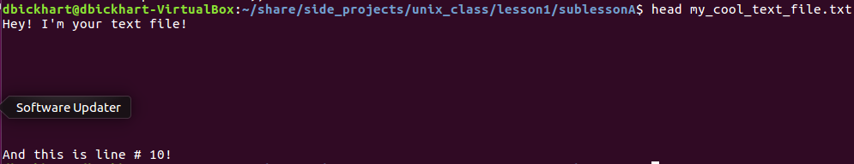
Lab SubLessonA: Navigating unix and checking files
Now that we’re in a directory with a file, let’s see what’s inside the file. Unix has several tools designed to let you view text files:
head <- “head of the file” prints out the first 10 lines of the first argument file
tail <- “tail of the file” prints out the last 10 lines
cat <- “concatenate” prints out the files contents to terminal
more <- “Controlled reading of file” prints out the file as long as you hit the “return” key
wc <- “word count” prints the number of words and lines of the file
Let’s see the top of the file using “head”:

Slide 21
Lab SubLessonA: Navigating unix and checking files
Now, I want you to take a closer look at the file using the following commands:
tail
wc
Can we see all of the file using just head and tail? Try one of the other commands, like “cat” or “more.”

Slide 22
Running Nano
Starting nano is just as easy as the following:
So, the first argument is the file you want to edit or create! Easy, right? Let’s look at the user interface together. Go to the sublessonD folder and type the following:
You’ll see a big screen with text along the top and bottom. Let me break it down in the next slide so you understand what’s going on!

Slide 23
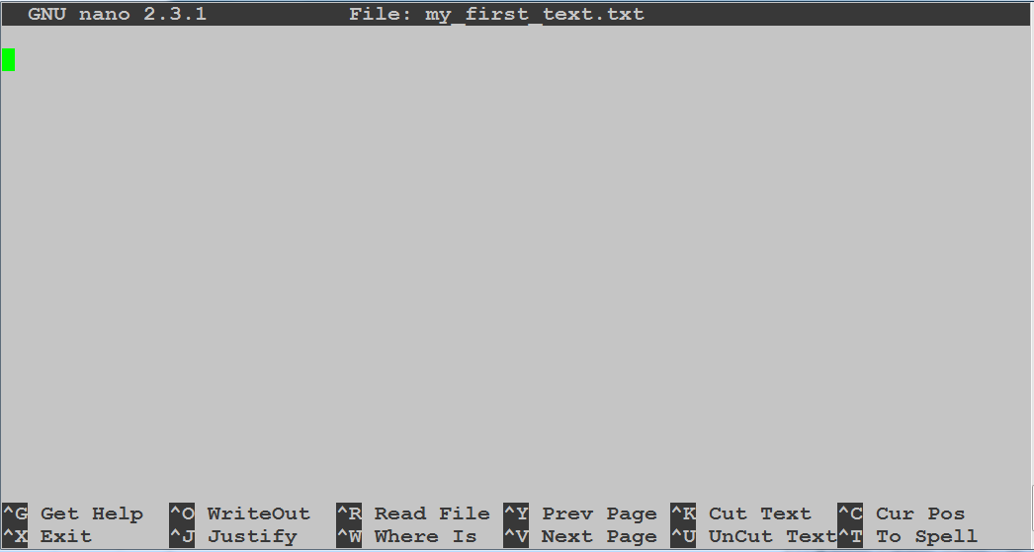
Title bar! Contains your file name
The bottom of the screen just shows you the commands you can run on the file! They are all prefixed by a “Control” key (the “^”), so to “get help,” you’d hold “control” and type “g” (the case doesn’t matter).
The important commands are “^O” (Save or “WriteOut”) and “^X” (Exit).

Slide 24
Testing your new wheels out
I’d like you all to write yourself a little message. Keep out the TMI please!
Save the file with “^O” (hit enter to keep the same file name when prompted!) and then exit the nano editor with “^X”.
Check it out! Try a cat on your new file:
Alright, with that simple lesson, you now know enough to be dangerous!

Slide 25
Lab SubLessonB: Directory navigation and executing commands
You’ve already executed some commands. Let’s see where they reside on the system. To do this, we use the “which” command!
So, this means that the “head” command is actually a program that resides in the usr->bin directory.
This is a special directory that contains system bin (or “binary”) files for common use.
You just need to know that any program in this directory is recognized by default by the operating system as a command you can execute
But what about commands in your own directory?

Slide 26
Lab SubLessonB: Directory navigation and executing commands
To get to the next directory, let’s test out special unix codes for this directory and the previous directory. These are shortcuts that will make your life easier, I promise!
“..” <- two periods = the previous directory
“.” <- one period = the current directory that you’re in.
Let’s test this out with our good friend, “ls”:
Now, “cd” to the next lesson folder (sublessonB) using the appropriate shortcut! Make sure to “ls” as soon as you’re there (it’s a good habit!)

Slide 27
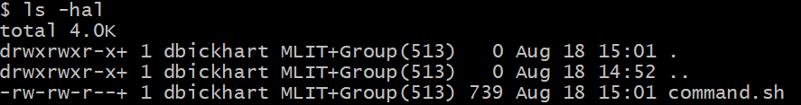
Lab SubLessonB: Directory navigation and executing commands
You may see a text file in the middle of the directory called “command.sh”
This is a script, or a text file that gives instructions to a programming language! In this case, we’re going to use a shell script that takes advantage of unix commands, but we can’t run it right now!
We need to tell the operating system that it is executable! Let’s check first with our good friend, ls -hal:
Owner
Group
Files
Everyone else’s permissions
Group permissions
Owner permissions
Directory? “d” if yes

Slide 28

This raises an important question: who am I?
Existentialism notwithstanding, you are a user and you belong to specific groups on the system!
To validate your self-worth (and see what your username is) type “whoami”:
To see which groups you belong to, type “groups”
With respect to each file, you can have read (“r”), write (“w”) or execute (“x”) permissions. This means that you can hide files from everyone or show them to everyone! (please be modest, though)
What permissions do you have for this file if you are the owner?

Slide 29
Now, get over yourself and run that command!
We’re going to have to turn that file into an executable first! Thankfully, Unix has a command to do this: “chmod” (permissions modification)
Remember what we said about arguments? The first argument tells chmod how to modify the file, while the second argument is the file itself!
Do an “ls –hal” on the directory. Notice anything different? Also notice how I’m subliminally tricking you to use “ls” allot? Get in that habit!
Now, run the file! But how? We need to specify that we want to run the file by specifying its location first, like so:

Slide 30
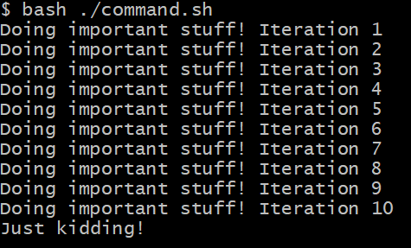
And here’s what you should have seen
So, things were happening (were they?) in this folder. What should your first instinct be?
If you said, “use ls to find out what happened,” you get a gold star!

Slide 31
Look at the mess you made!
You just made so many silly folders! It’s all your fault and you should feel ashamed!
Here is what an “ls” tells us is now in the directory:
If you do not have different colored highlighting, then the blue text denotes folders! Let’s see what’s in the folder, “test1,” shall we?
Gulp! This got more complex! Within each folder there are 10 sub folders! It’ll take us ages to see what’s in each folder!! What ever will we do?

Slide 32


Wildcard selection!
Good thing for us, unix has commands that allow us to select multiple files all at once! It’s context sensitive too. You could select all files that contain an “a” followed by five letters, or all files that end in “.txt”.
In order to select a file that has a (or multiple) variable character(s), use the question mark (“?”). For a large number of variable characters in a row, use the asterisk (“*”). For a set “range” of characters, you can use square brackets (“[]”)
Let’s test this out on your new subfolders. Use an “ls” to select all subfolders using the following commands:

Slide 33

Wildcards as a word puzzle
Use them to automate analysis or to “group select” a bunch of files. You can use the context of the words in your search to make your grouping more specific or less specific.
Try this command and let’s talk about the nuances:
Now try the following three commands and tell me which one is not like the others:
A.
B.
C.

Slide 34
Recap and More learning
You should have learned how to navigate the command line and execute simple commands. This is half the battle! Good job!
Now you know how directories are organized and how files can be found on the system.
More self-learning materials:
http://linuxcommand.org/
Learning the shell link
https://mason.gmu.edu/~montecin/UNIXpermiss.htm

