Slide 1
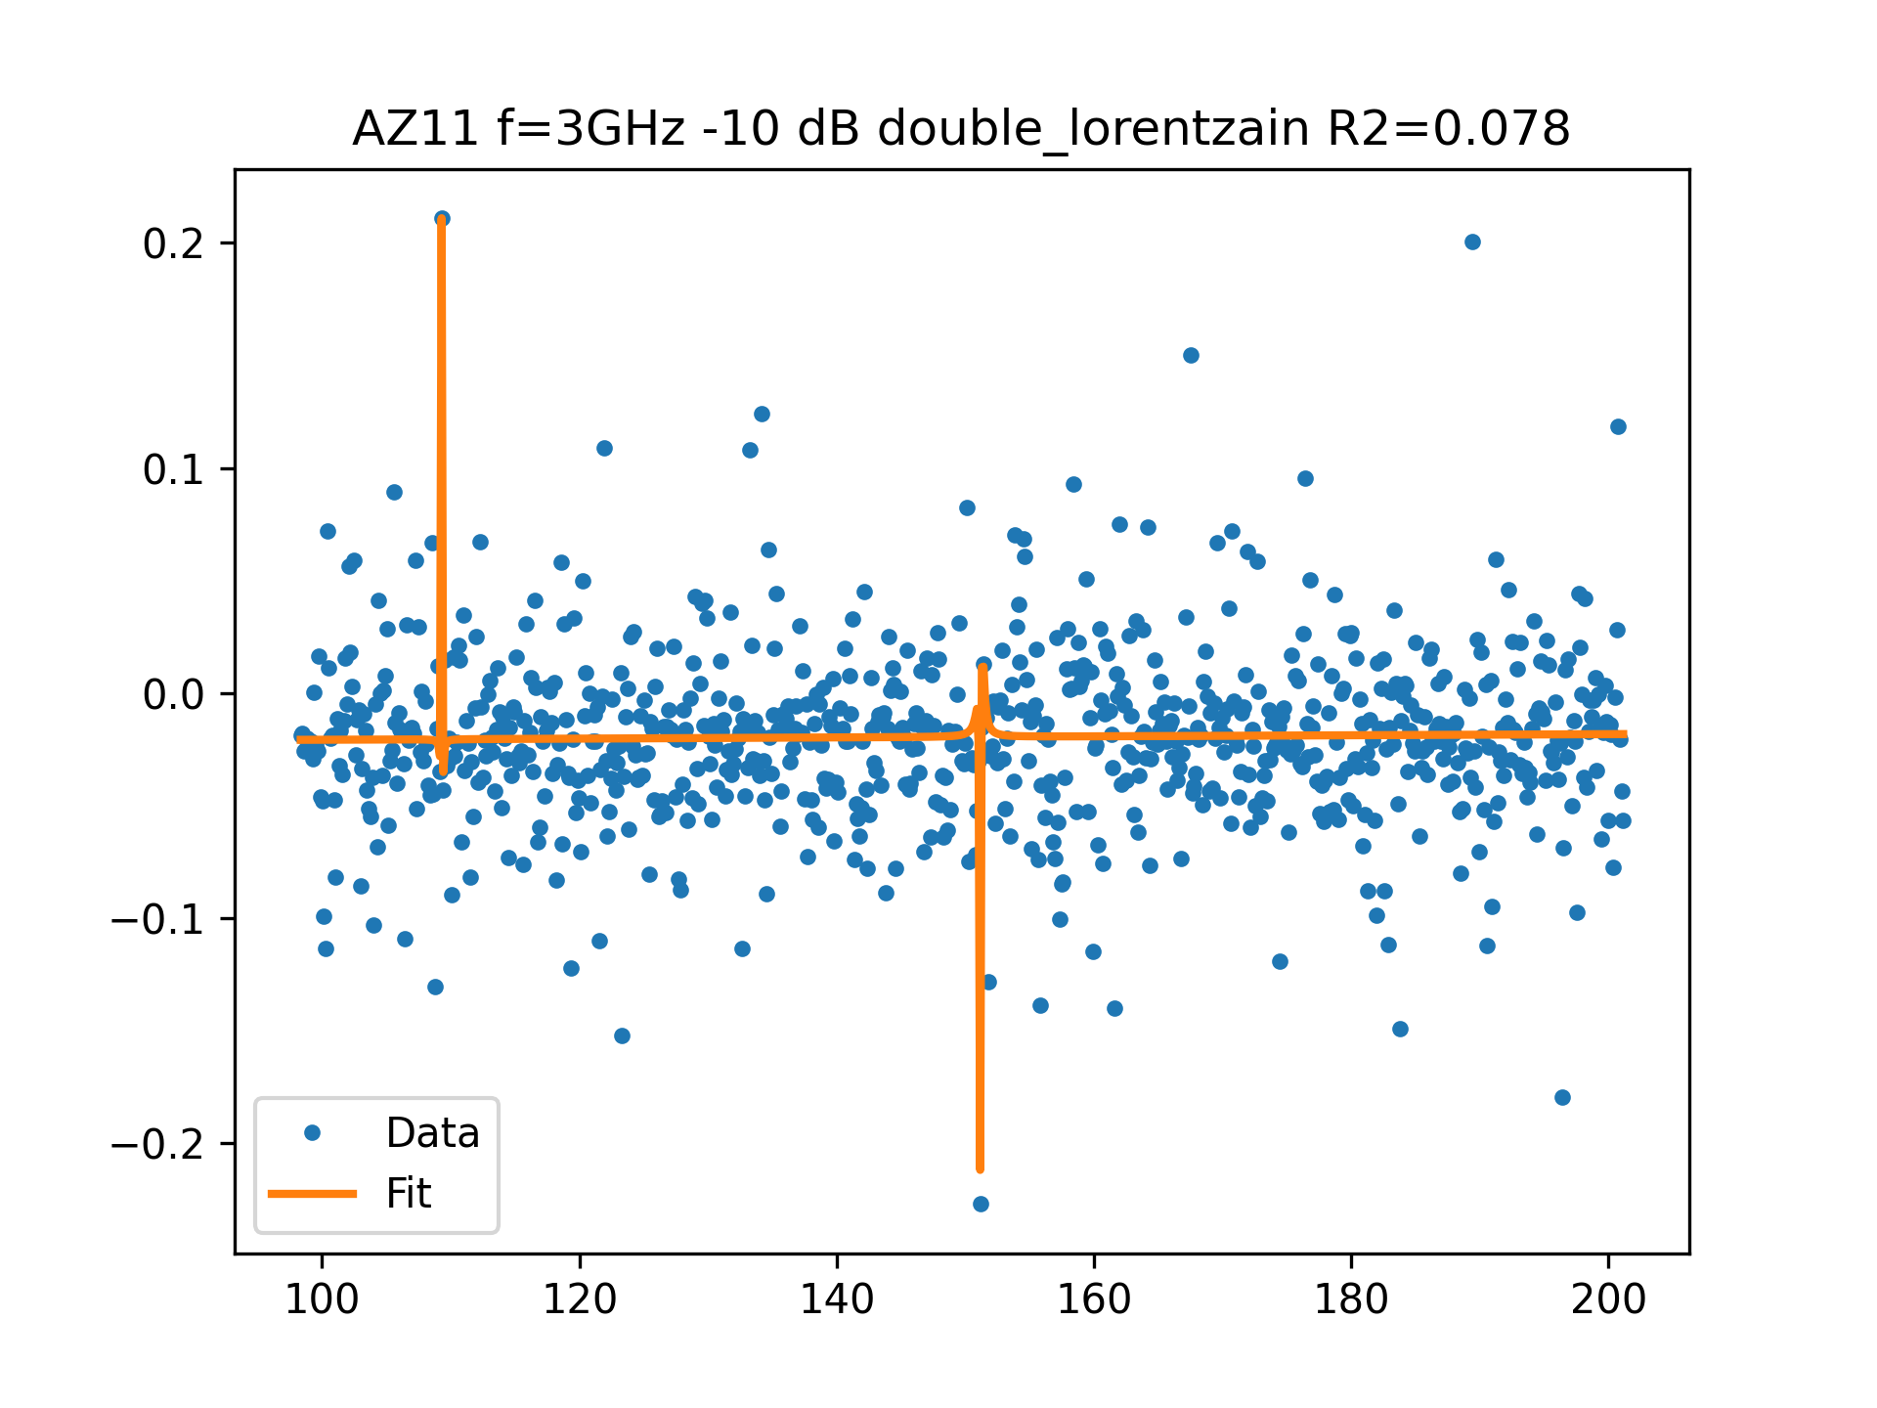
AZ11 f=3GHz -10 dB FIT

