Slide 1
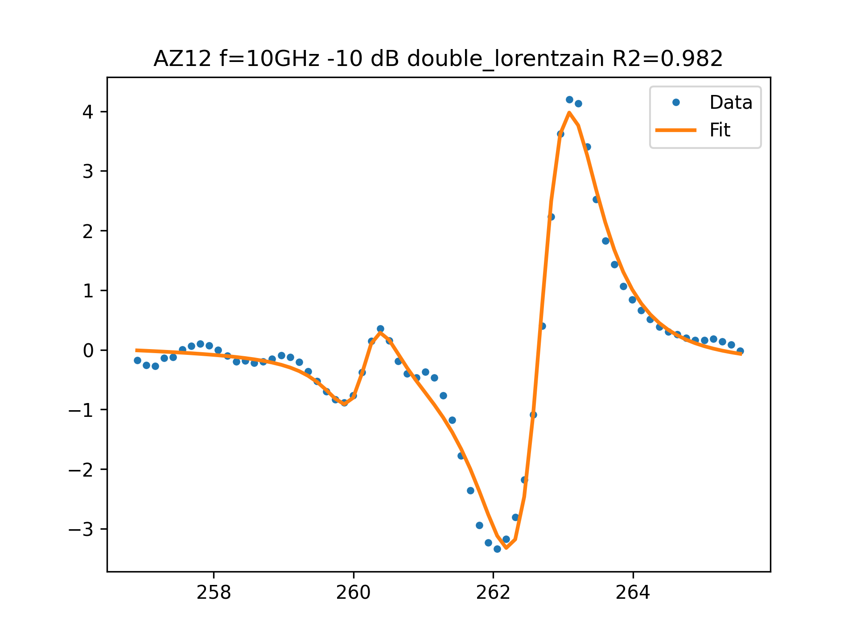
AZ12 f=10GHz -10 dB FIT

Slide 2
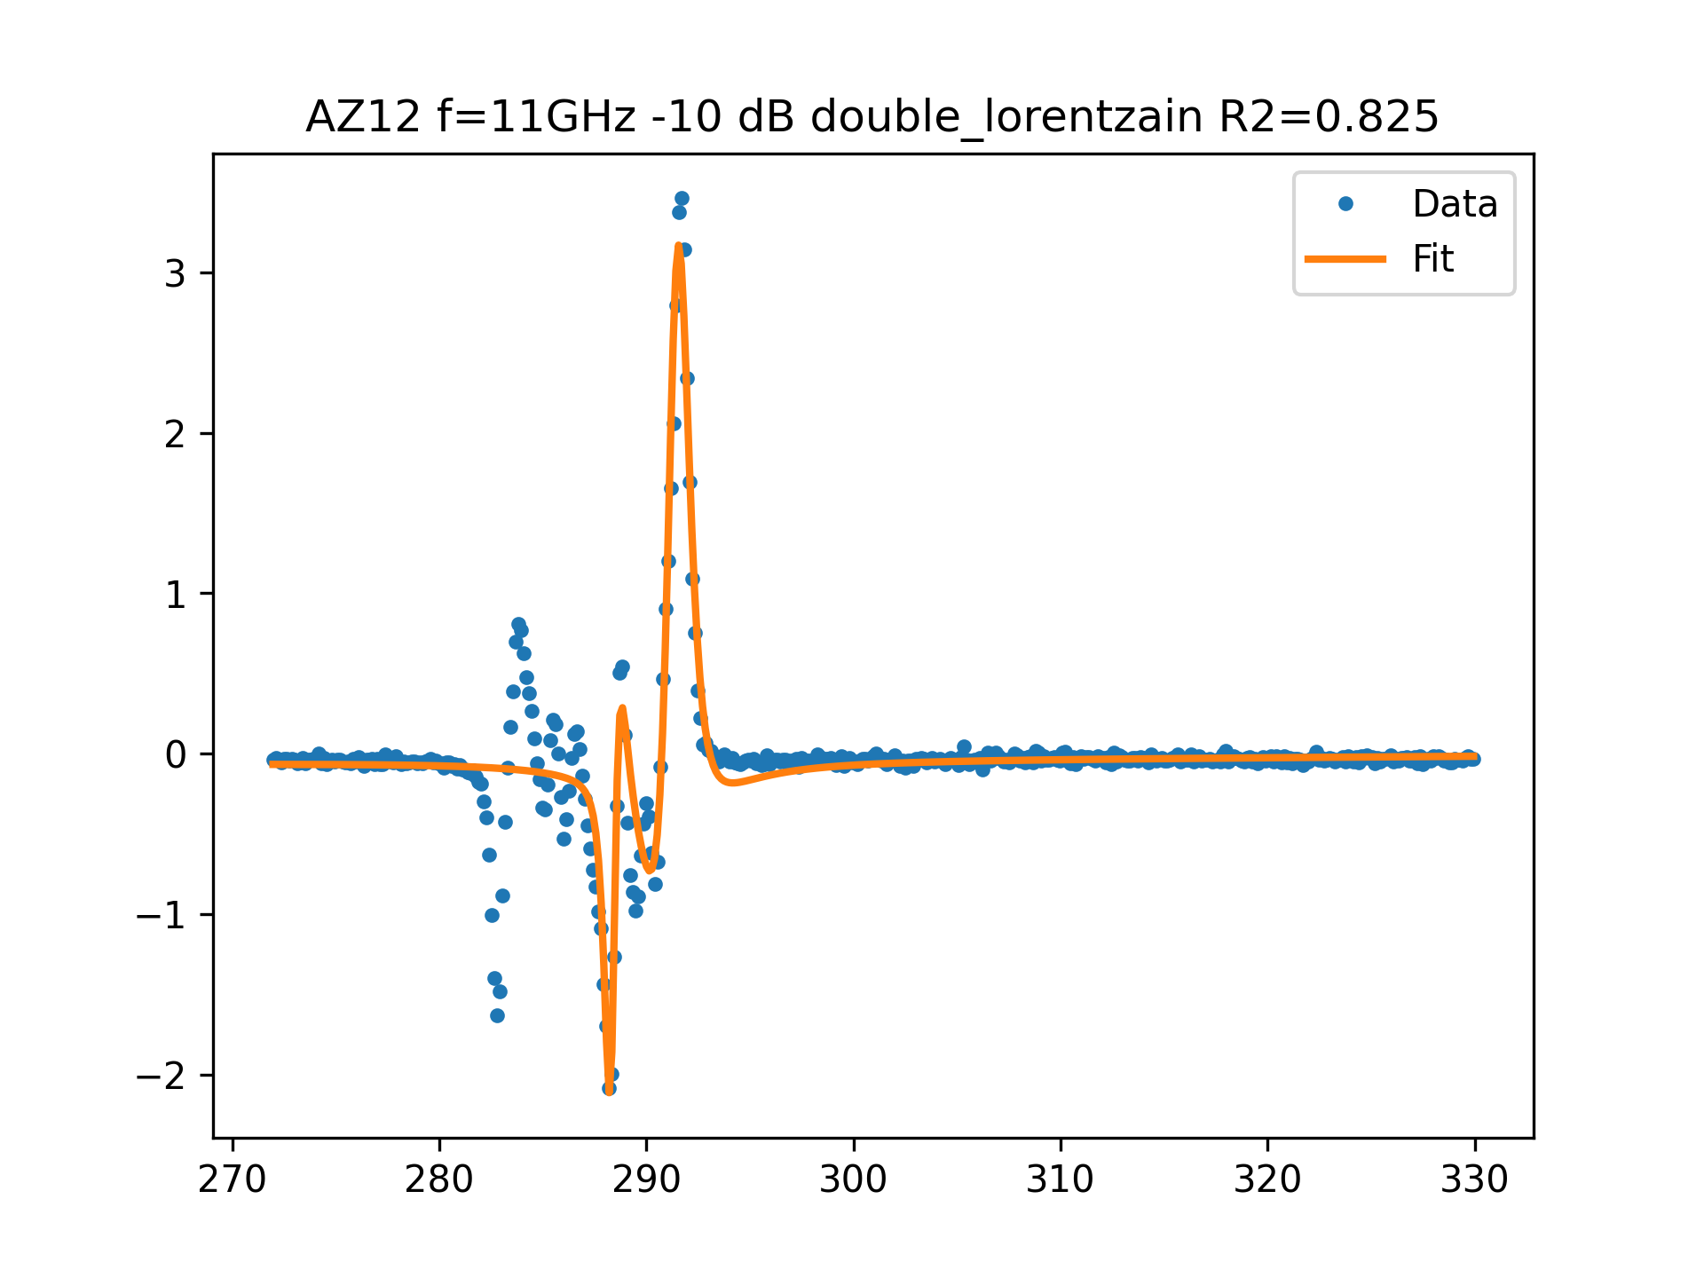
AZ12 f=11GHz -10 dB FIT

Slide 3
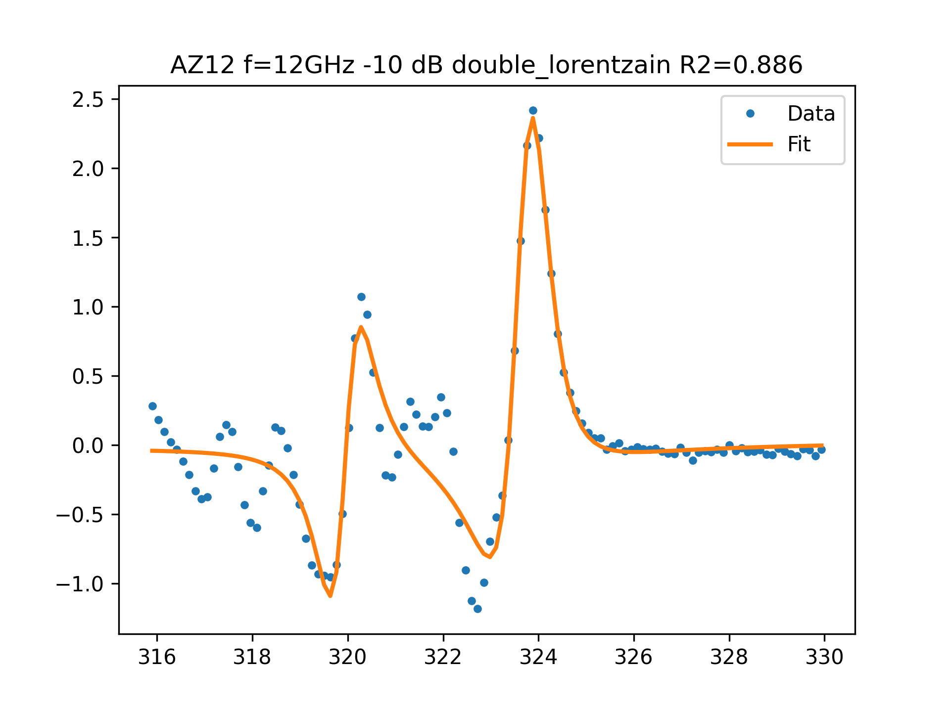
AZ12 f=12GHz -10 dB FIT

Slide 4
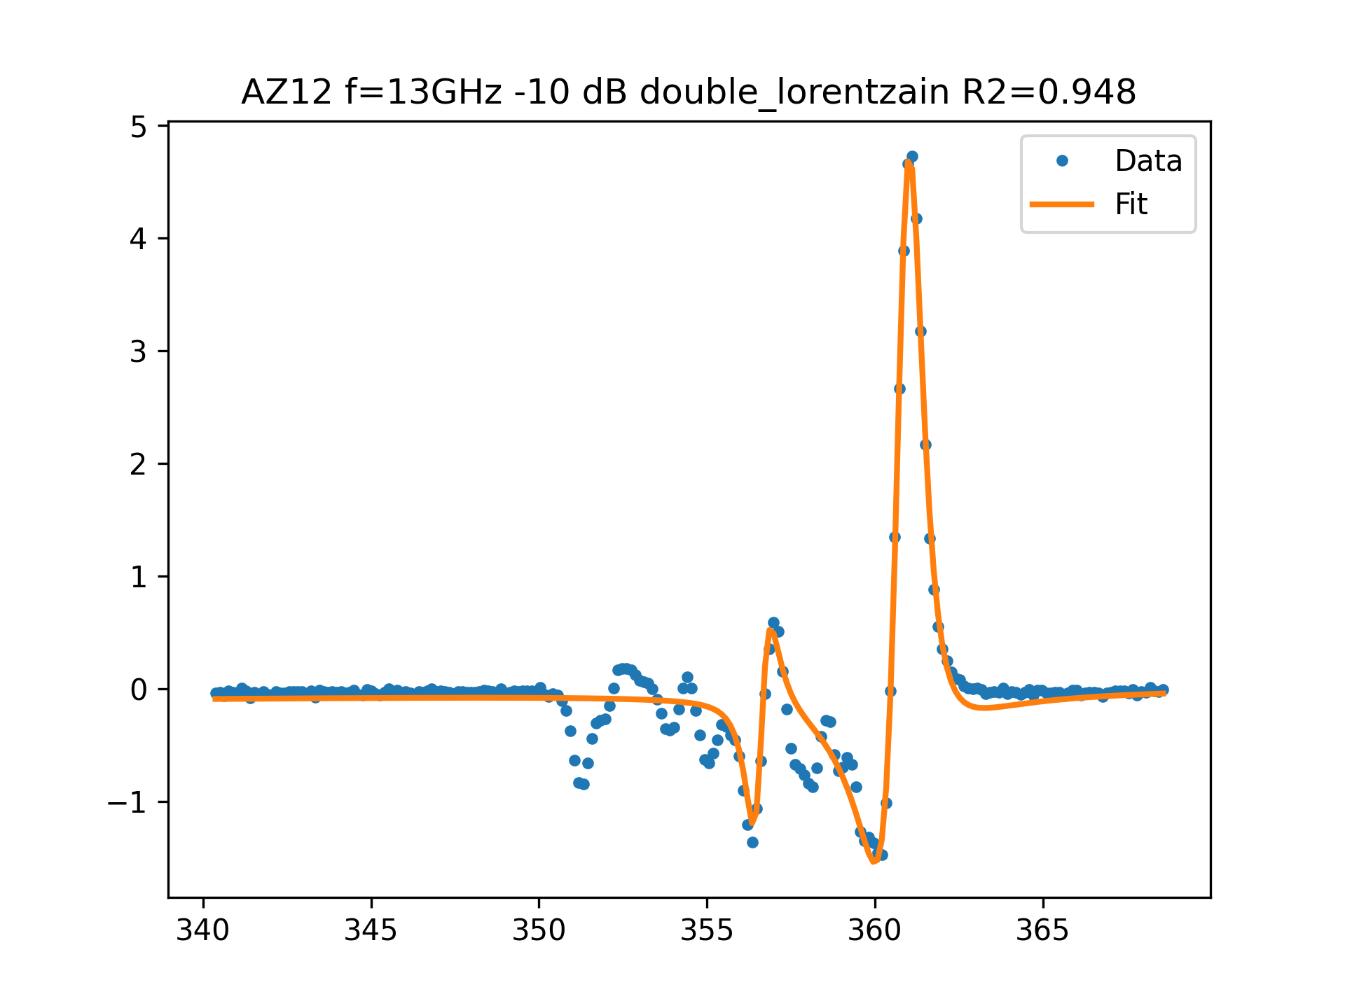
AZ12 f=13GHz -10 dB FIT

Slide 5
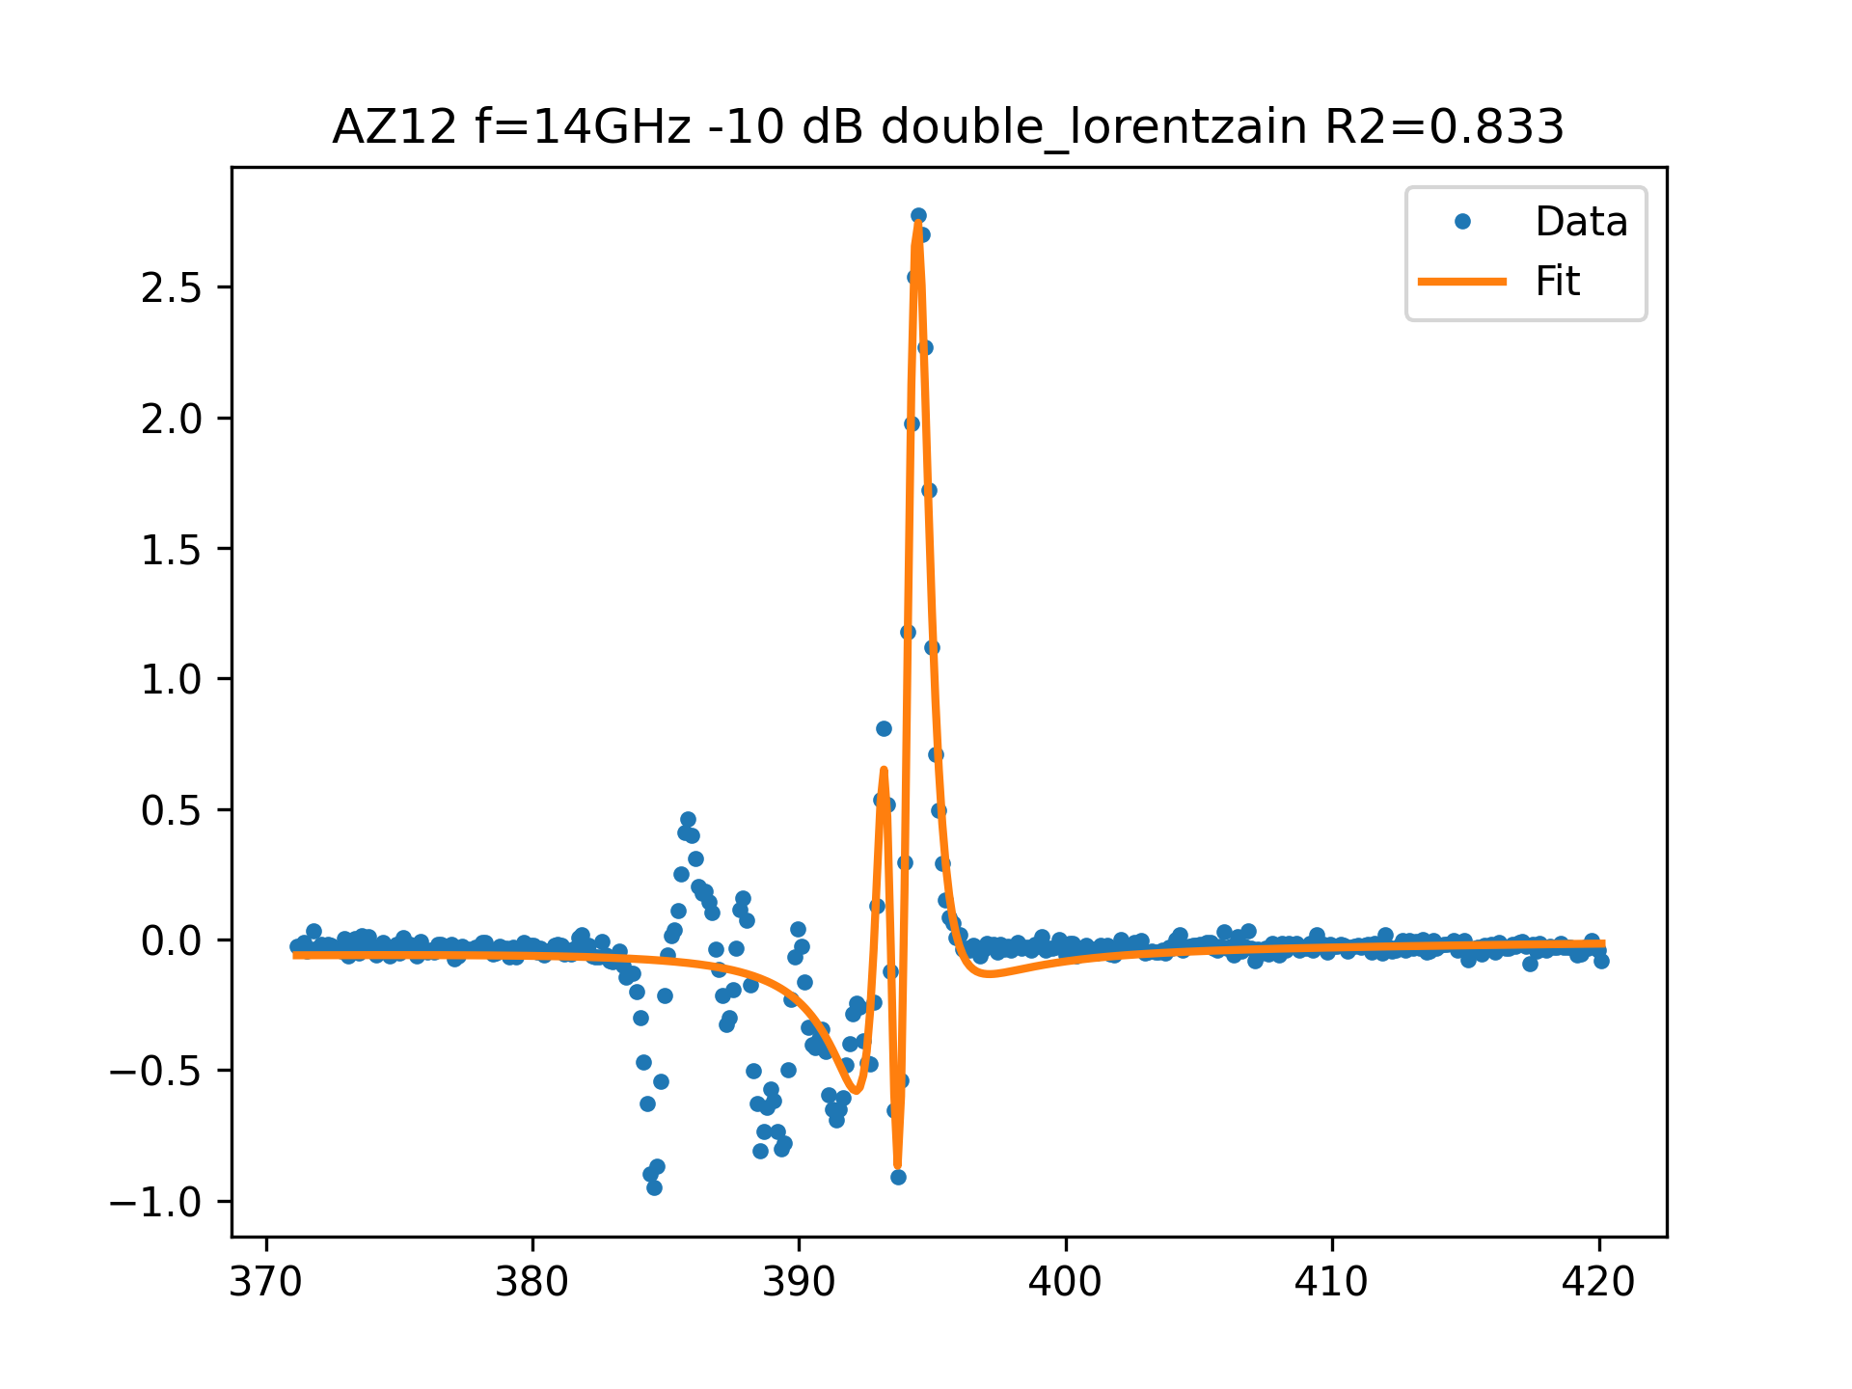
AZ12 f=14GHz -10 dB FIT

Slide 6
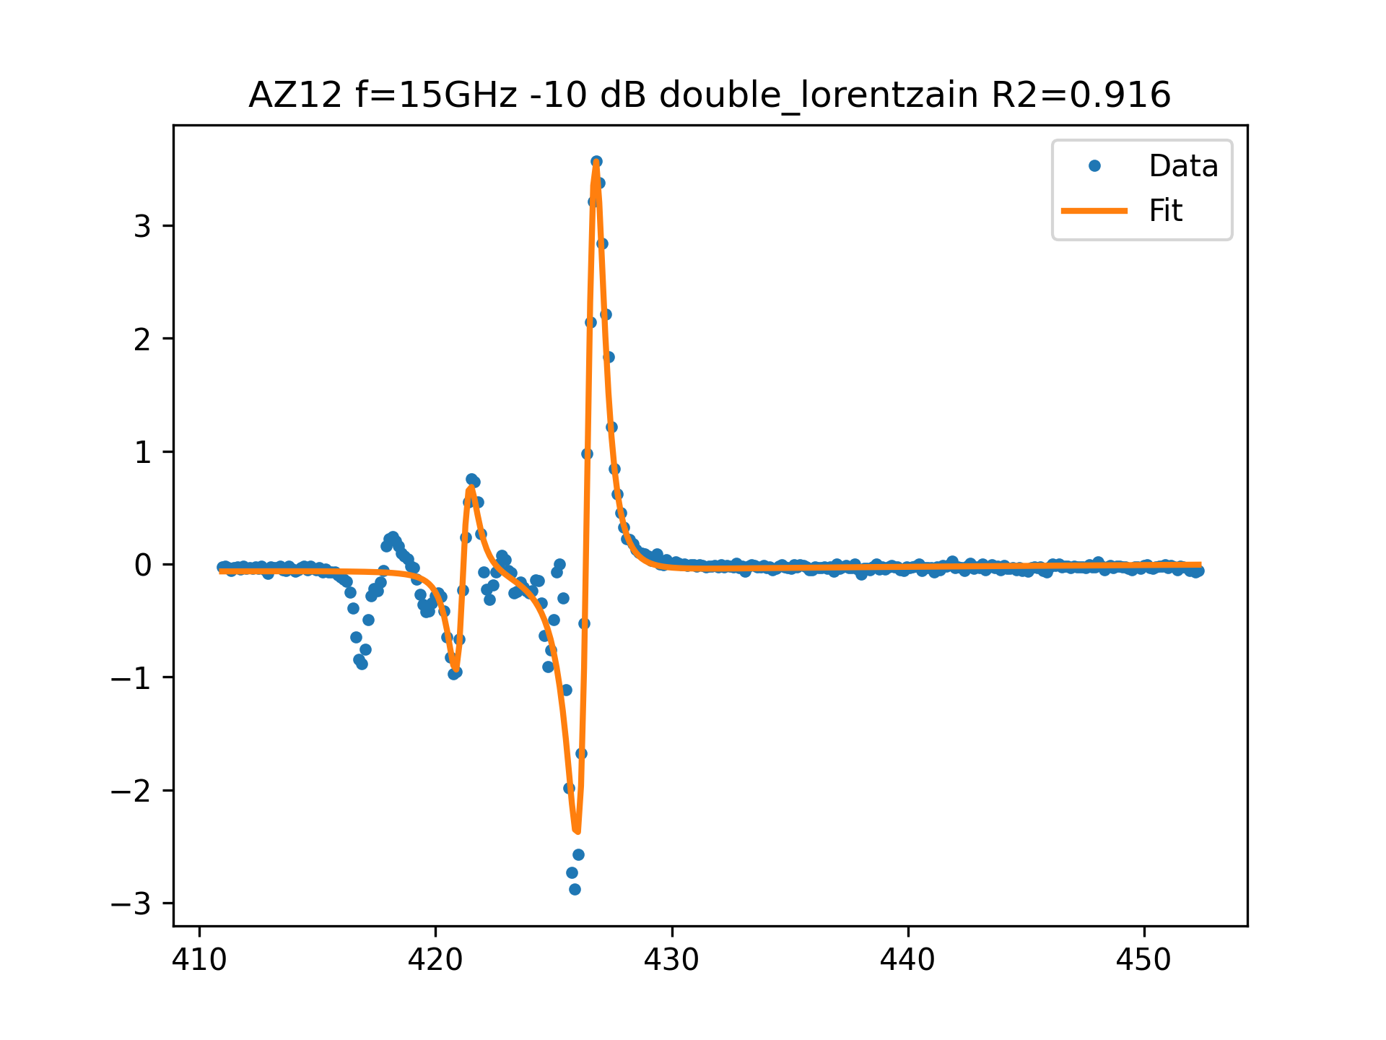
AZ12 f=15GHz -10 dB FIT

Slide 7
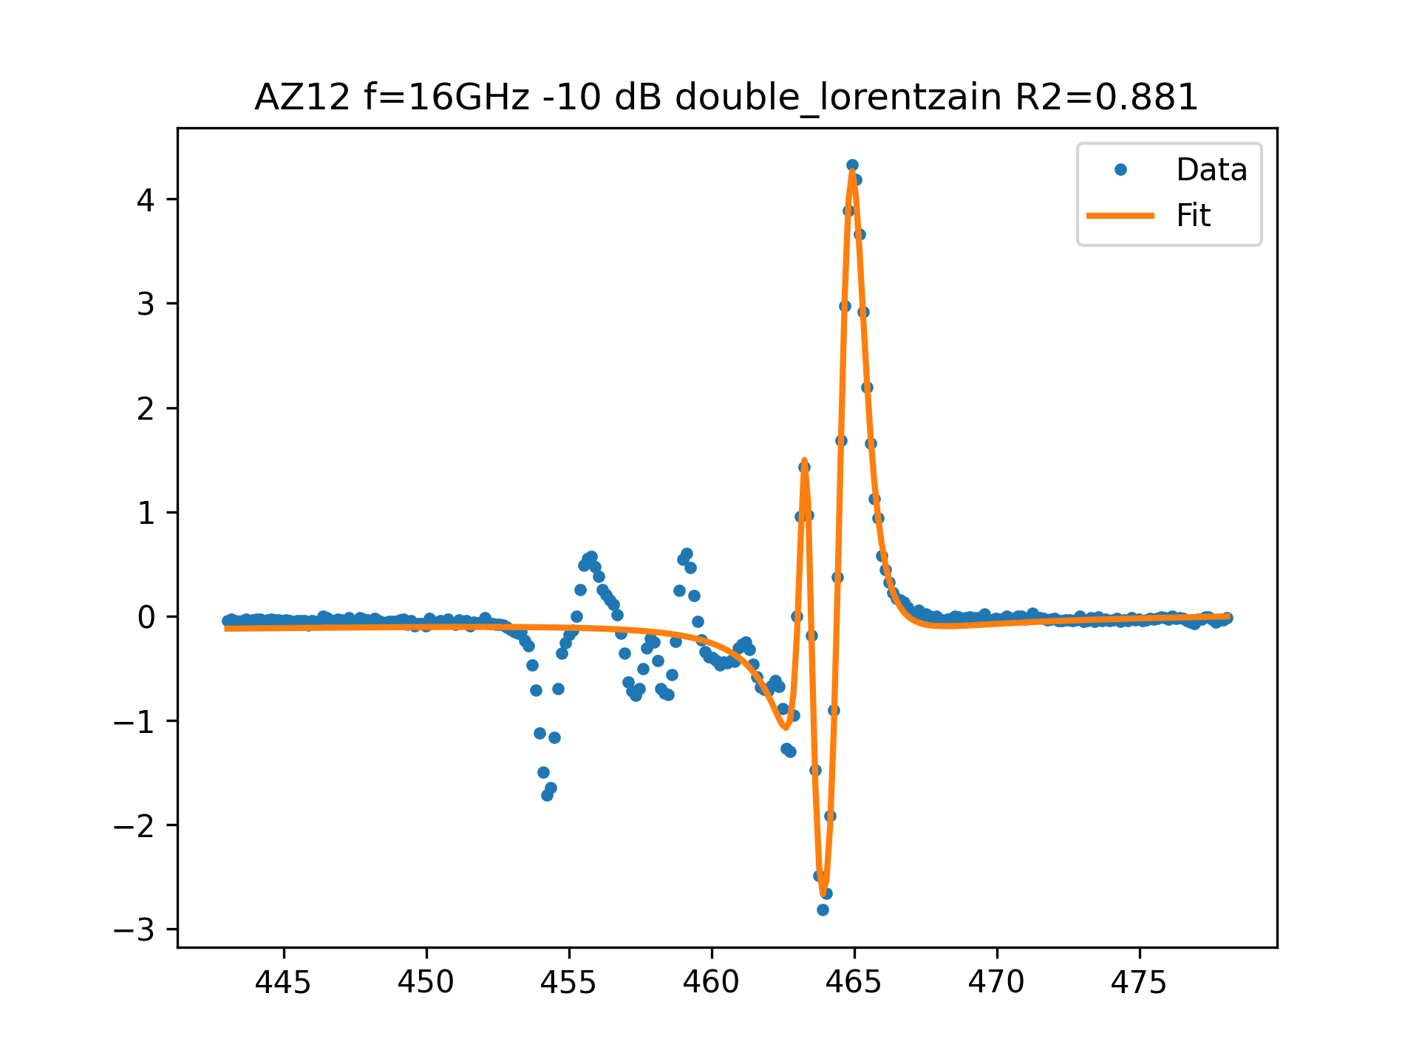
AZ12 f=16GHz -10 dB FIT

Slide 8
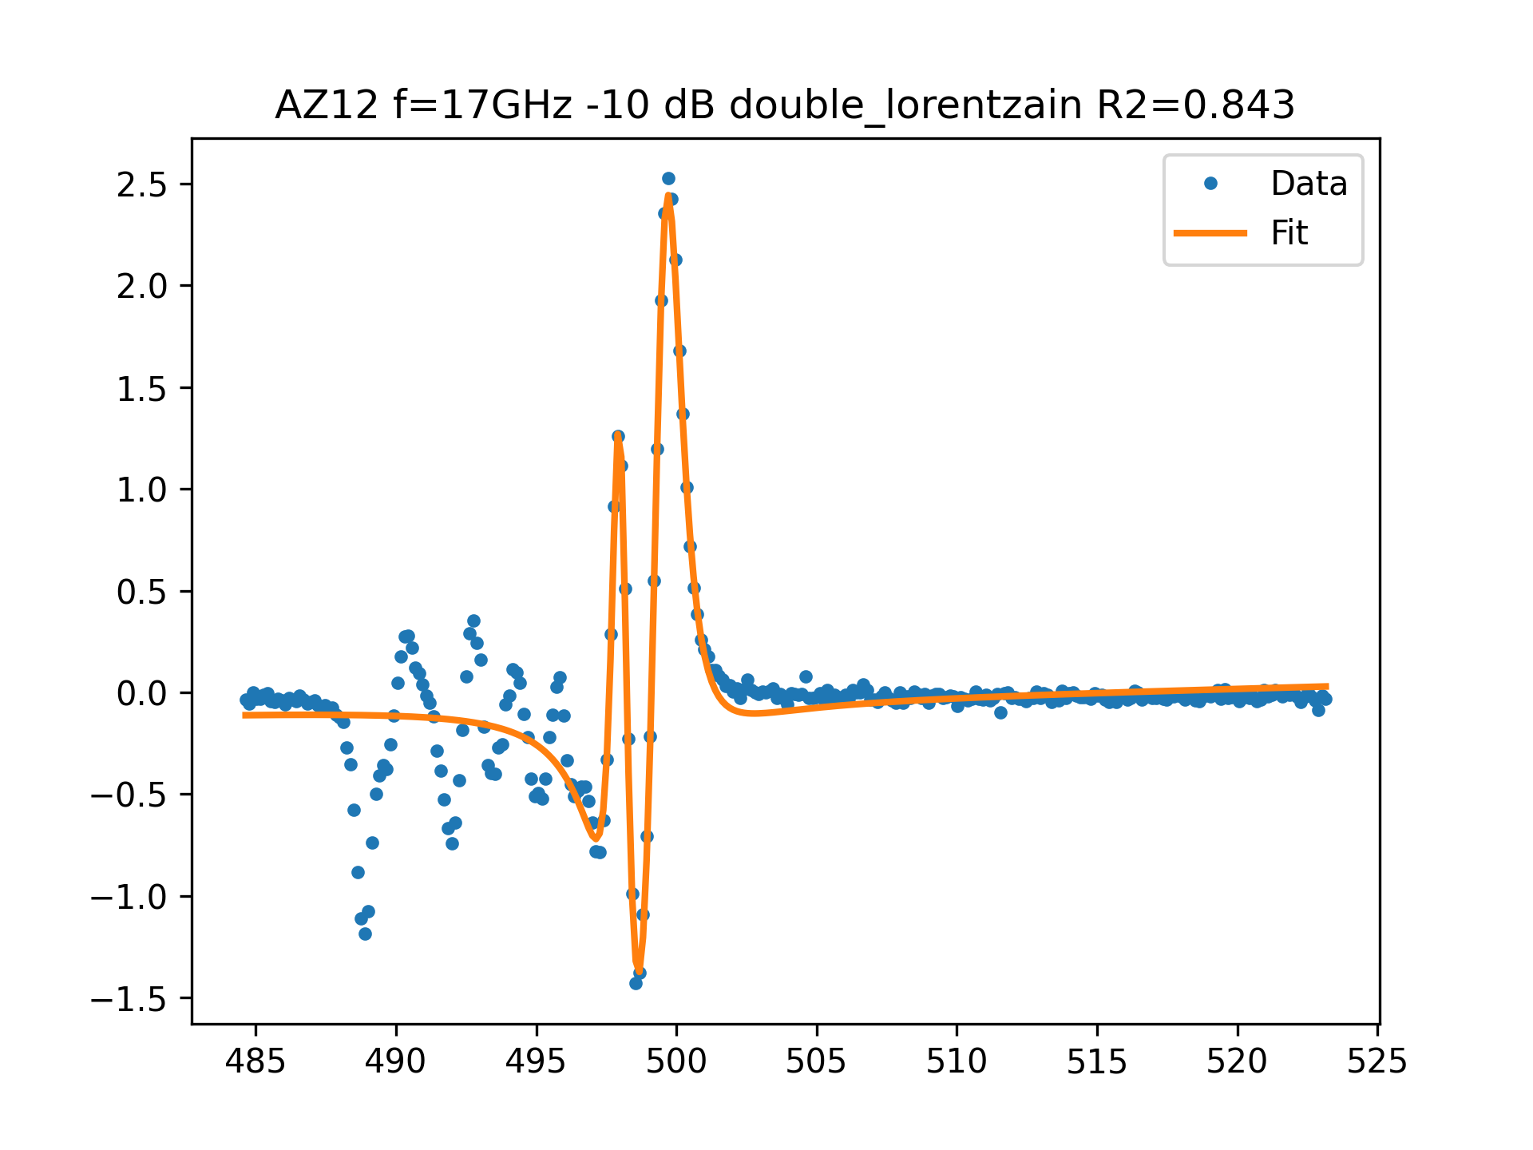
AZ12 f=17GHz -10 dB FIT

Slide 9
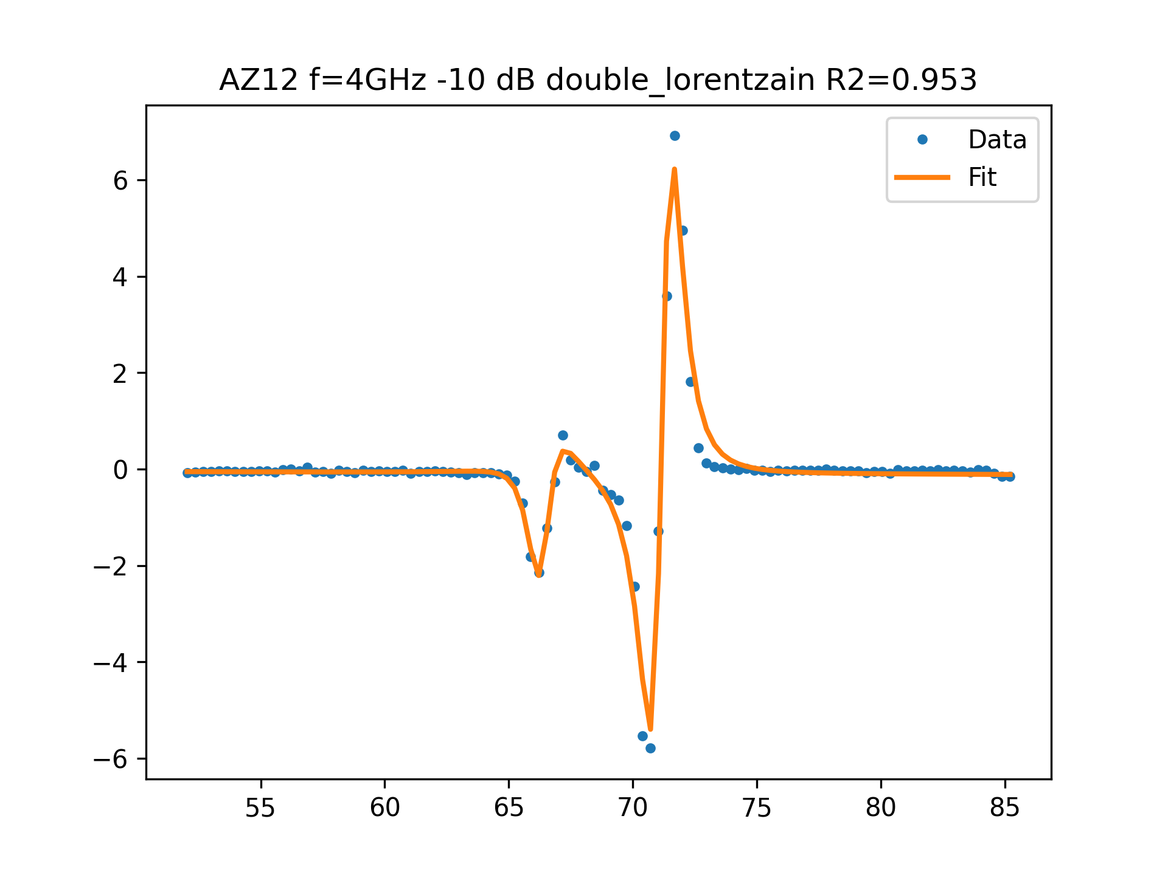
AZ12 f=4GHz -10 dB FIT

Slide 10
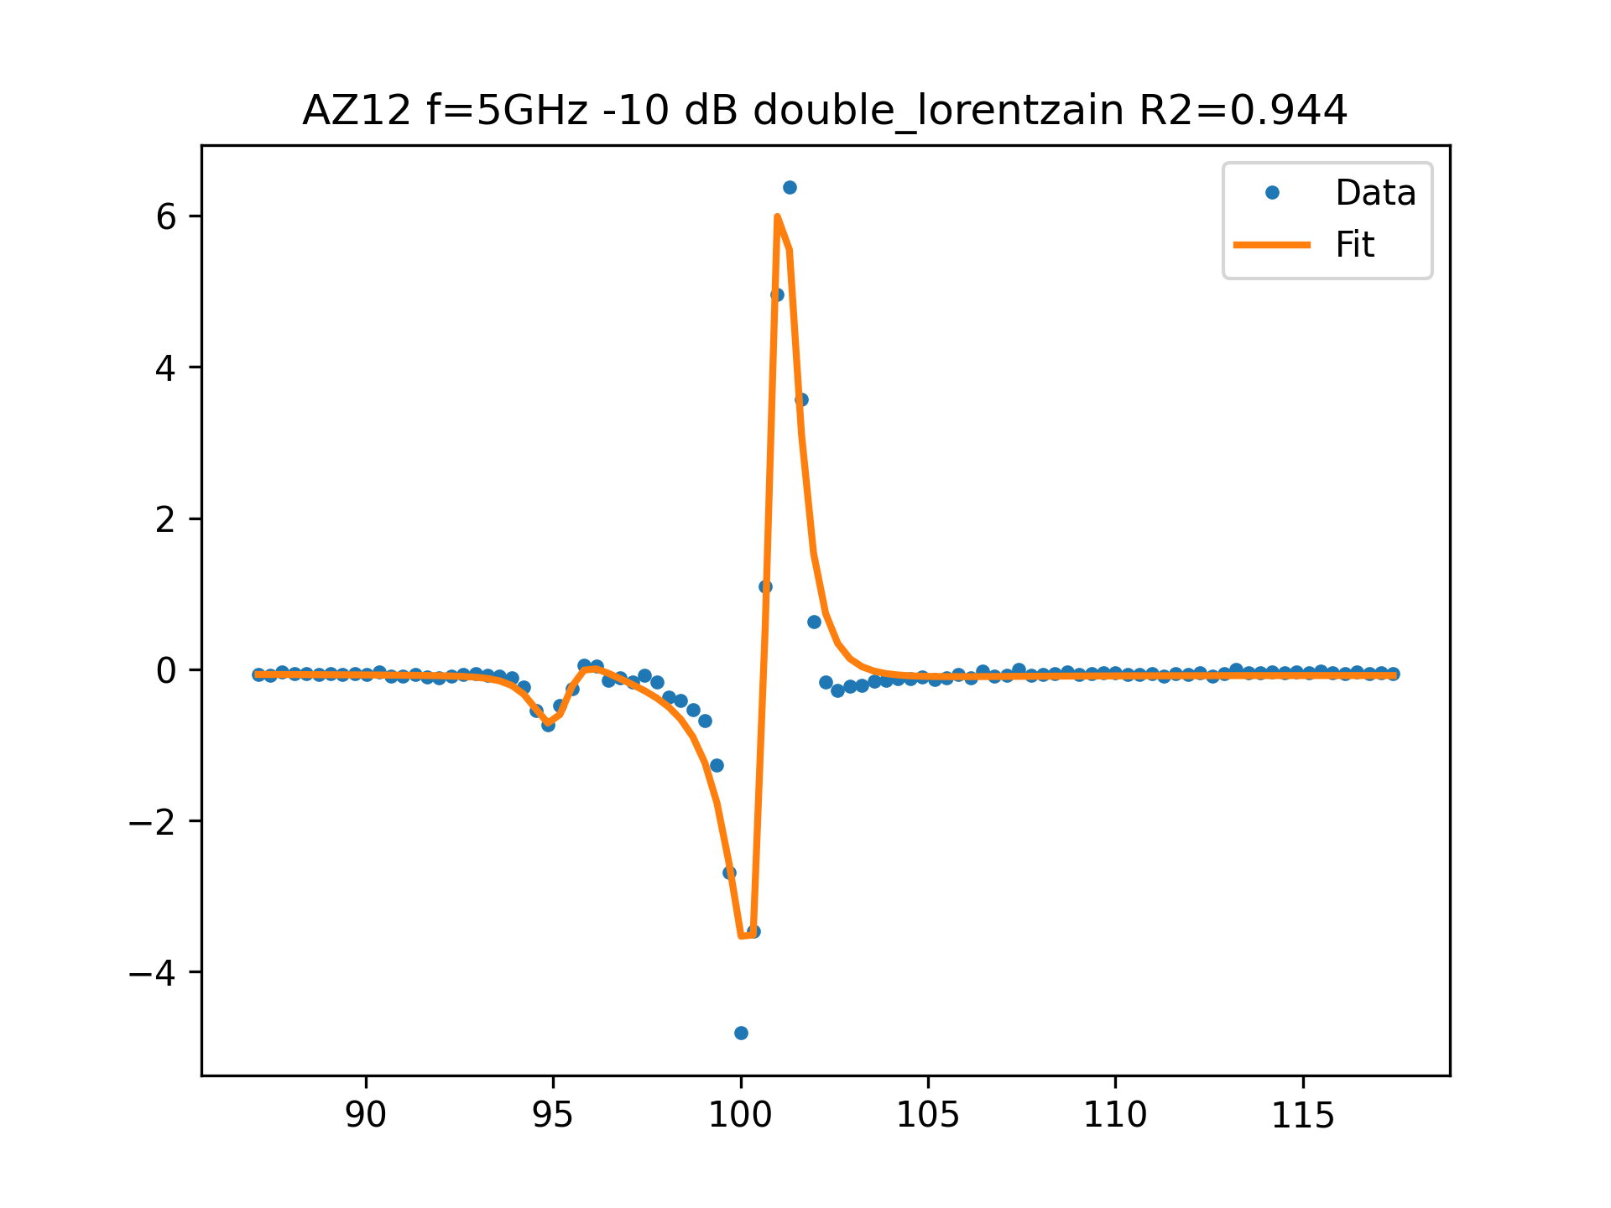
AZ12 f=5GHz -10 dB FIT

Slide 11
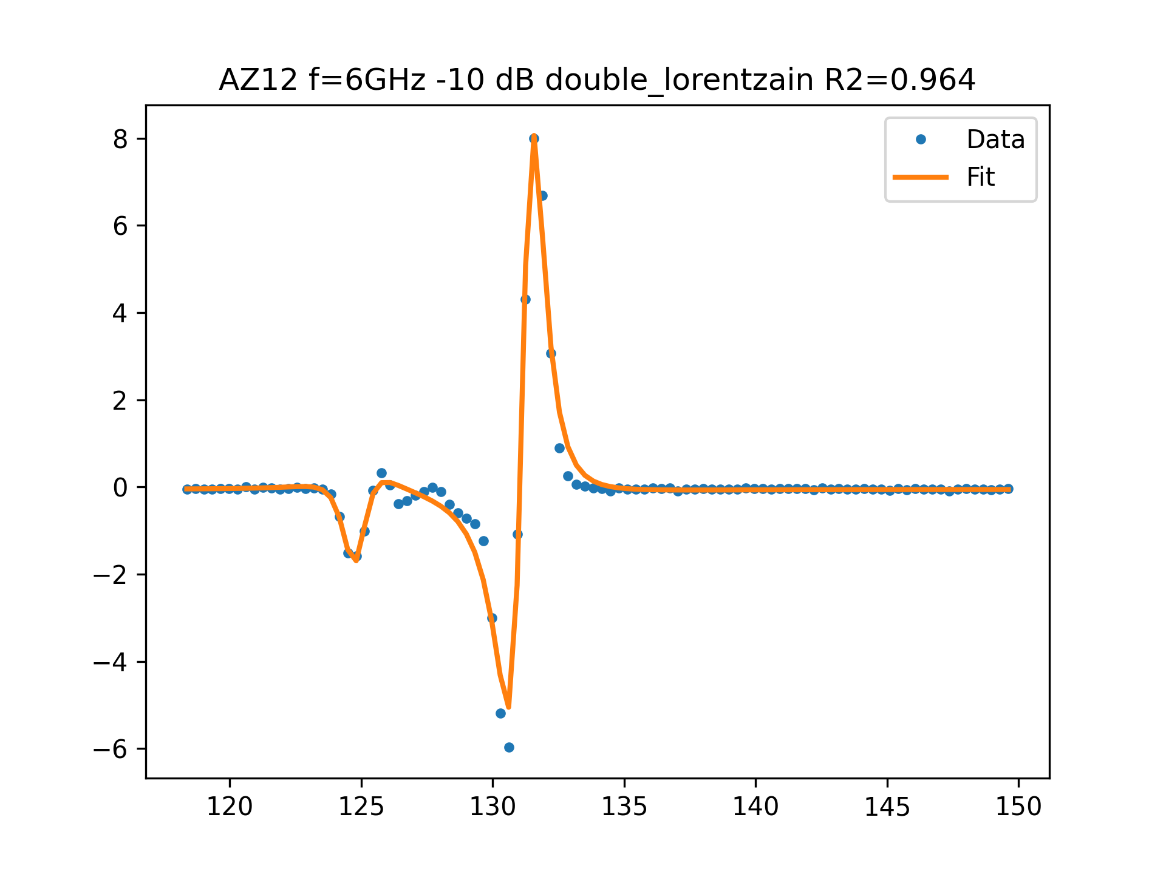
AZ12 f=6GHz -10 dB FIT

Slide 12
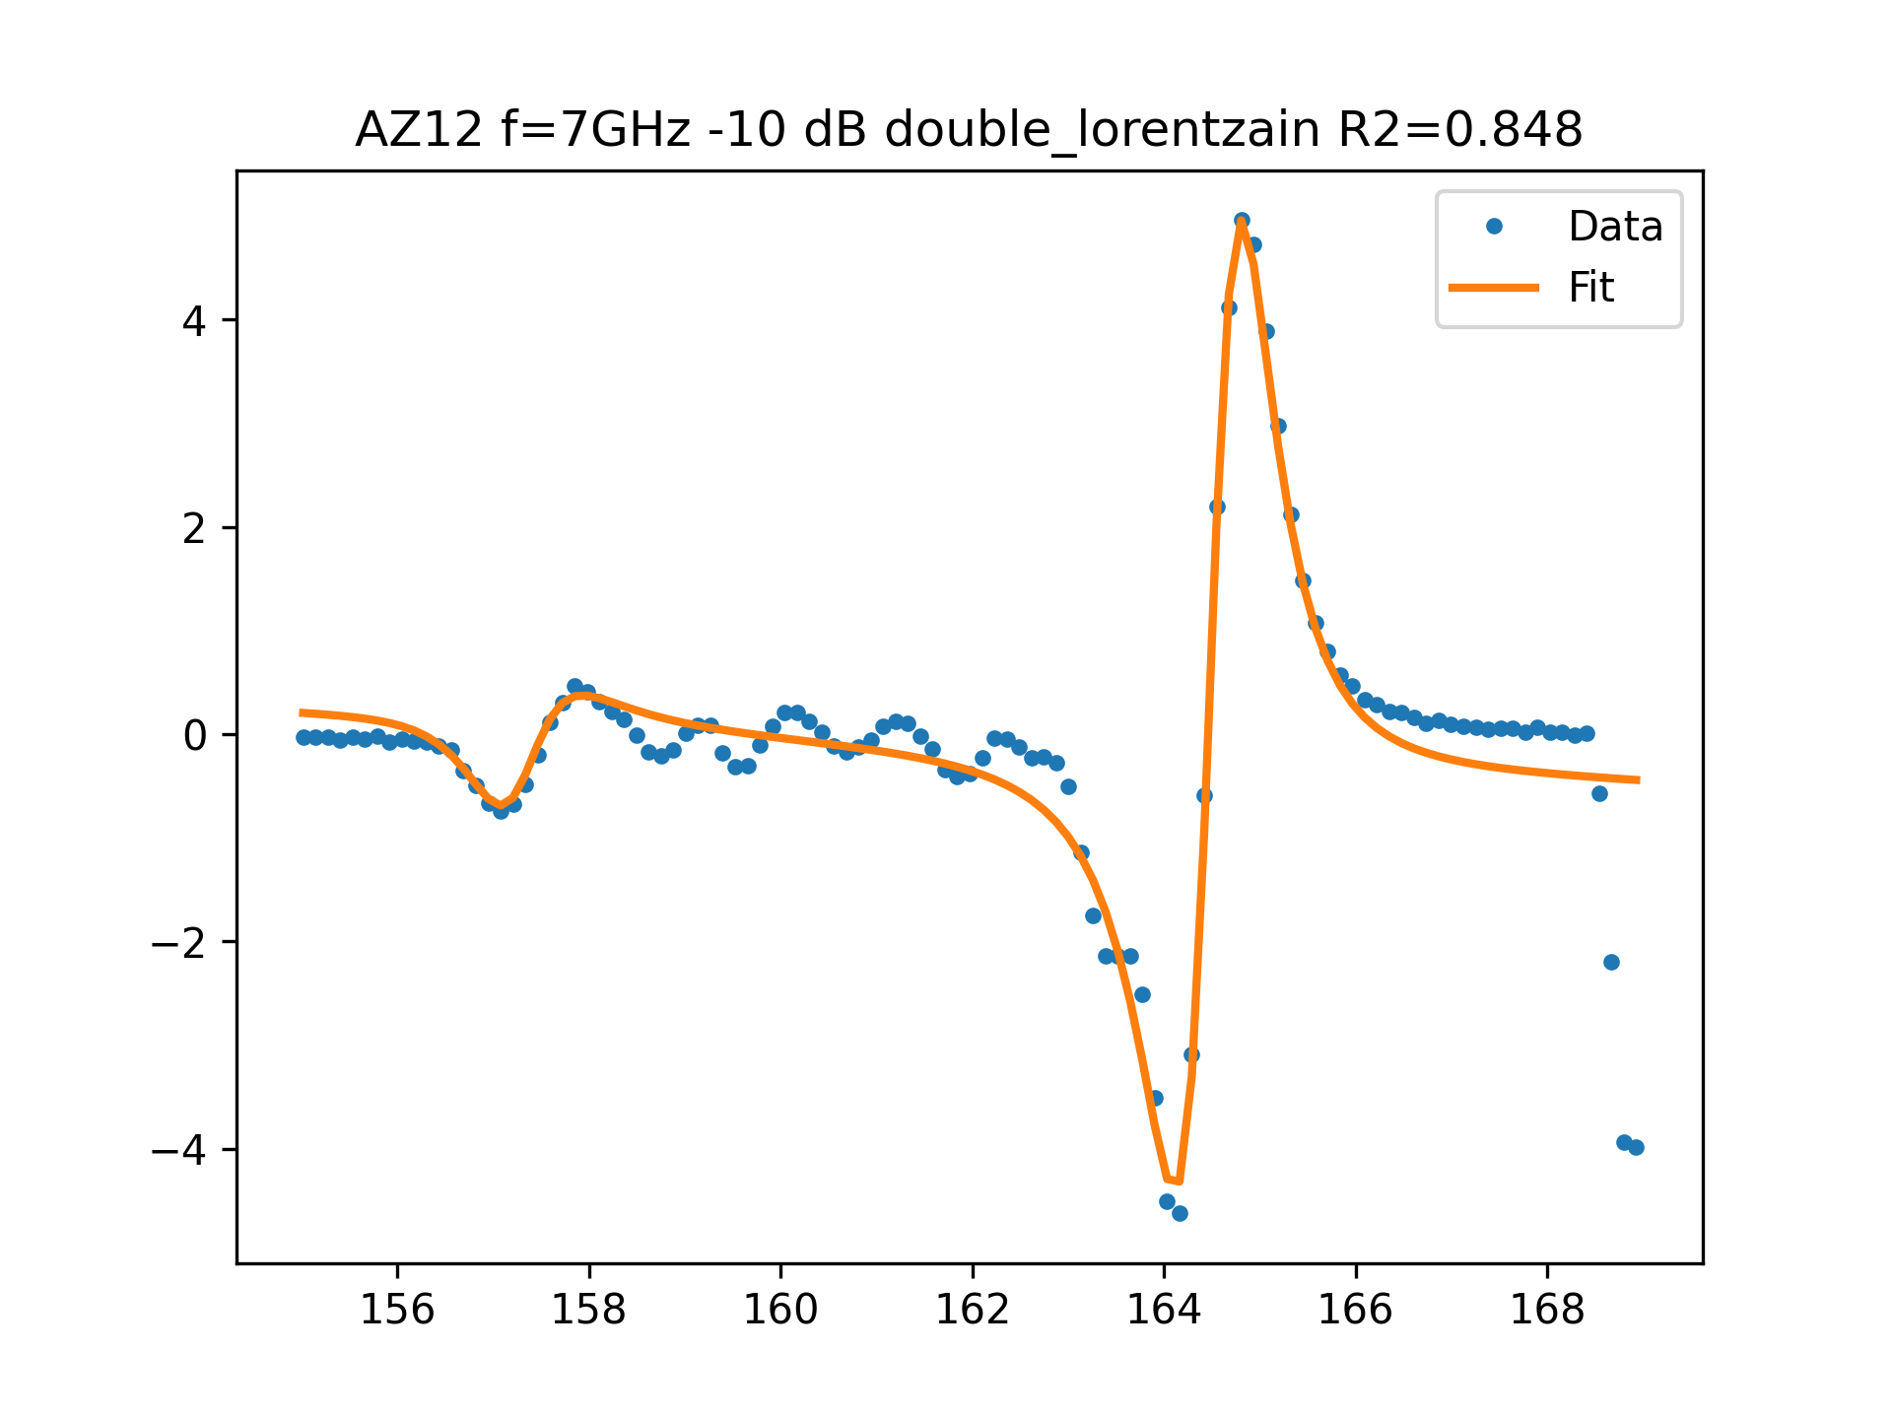
AZ12 f=7GHz -10 dB FIT

Slide 13
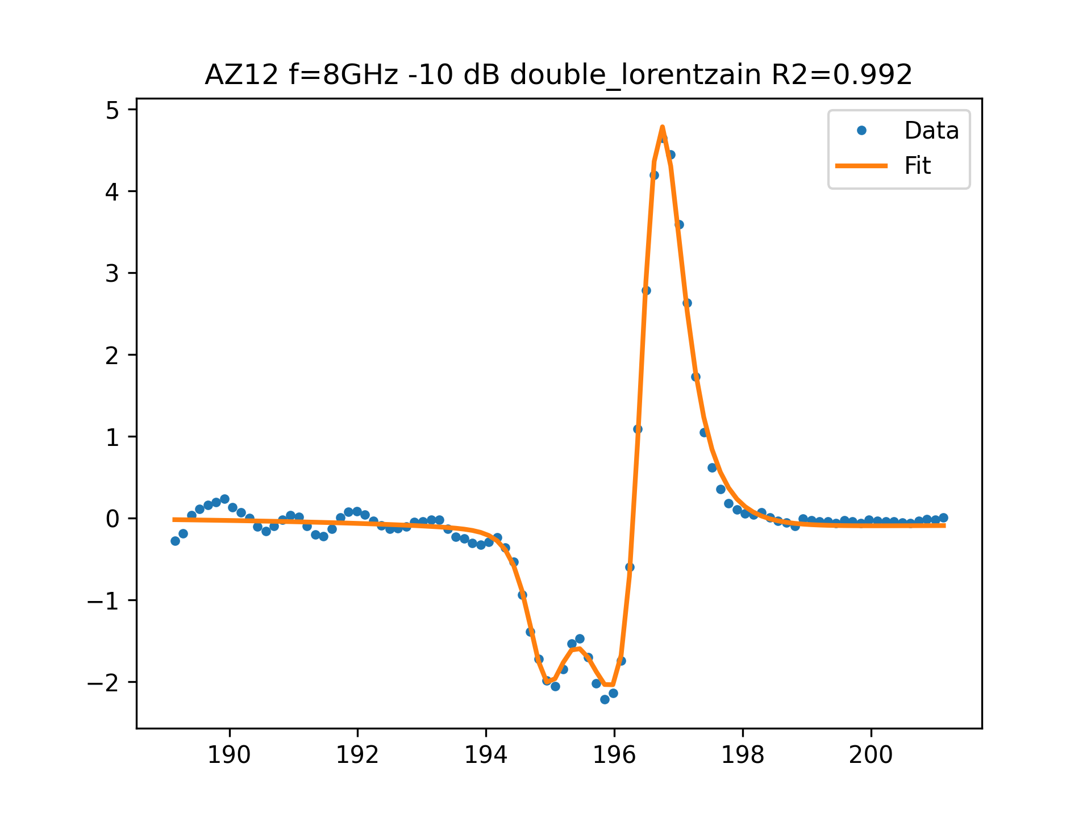
AZ12 f=8GHz -10 dB FIT

Slide 14
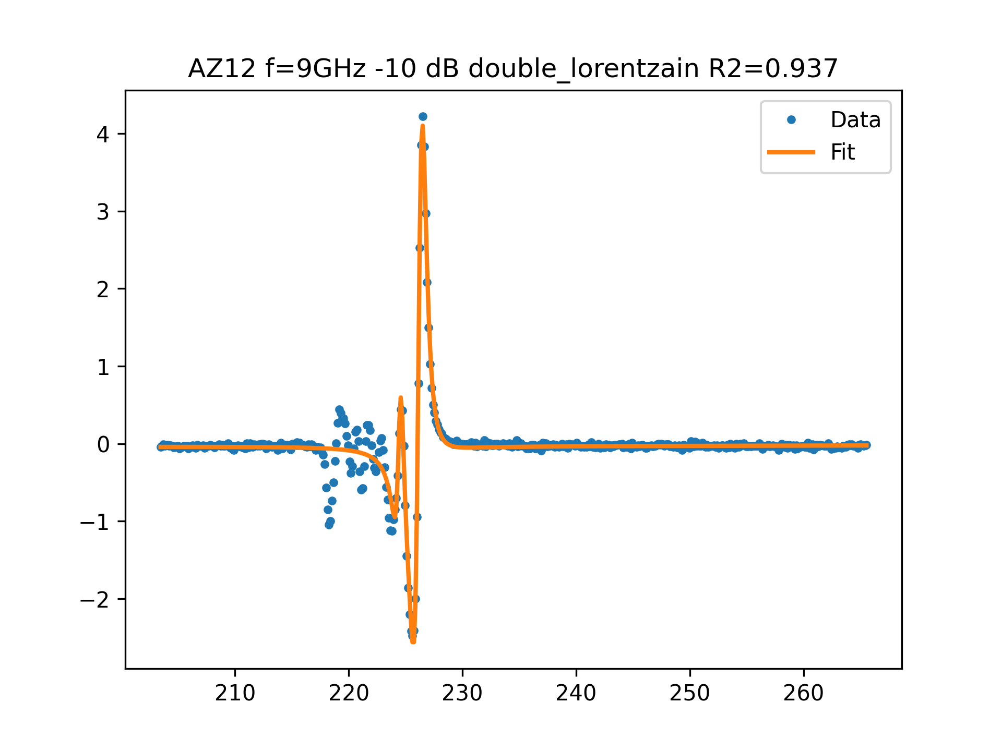
AZ12 f=9GHz -10 dB FIT

