Slide 1
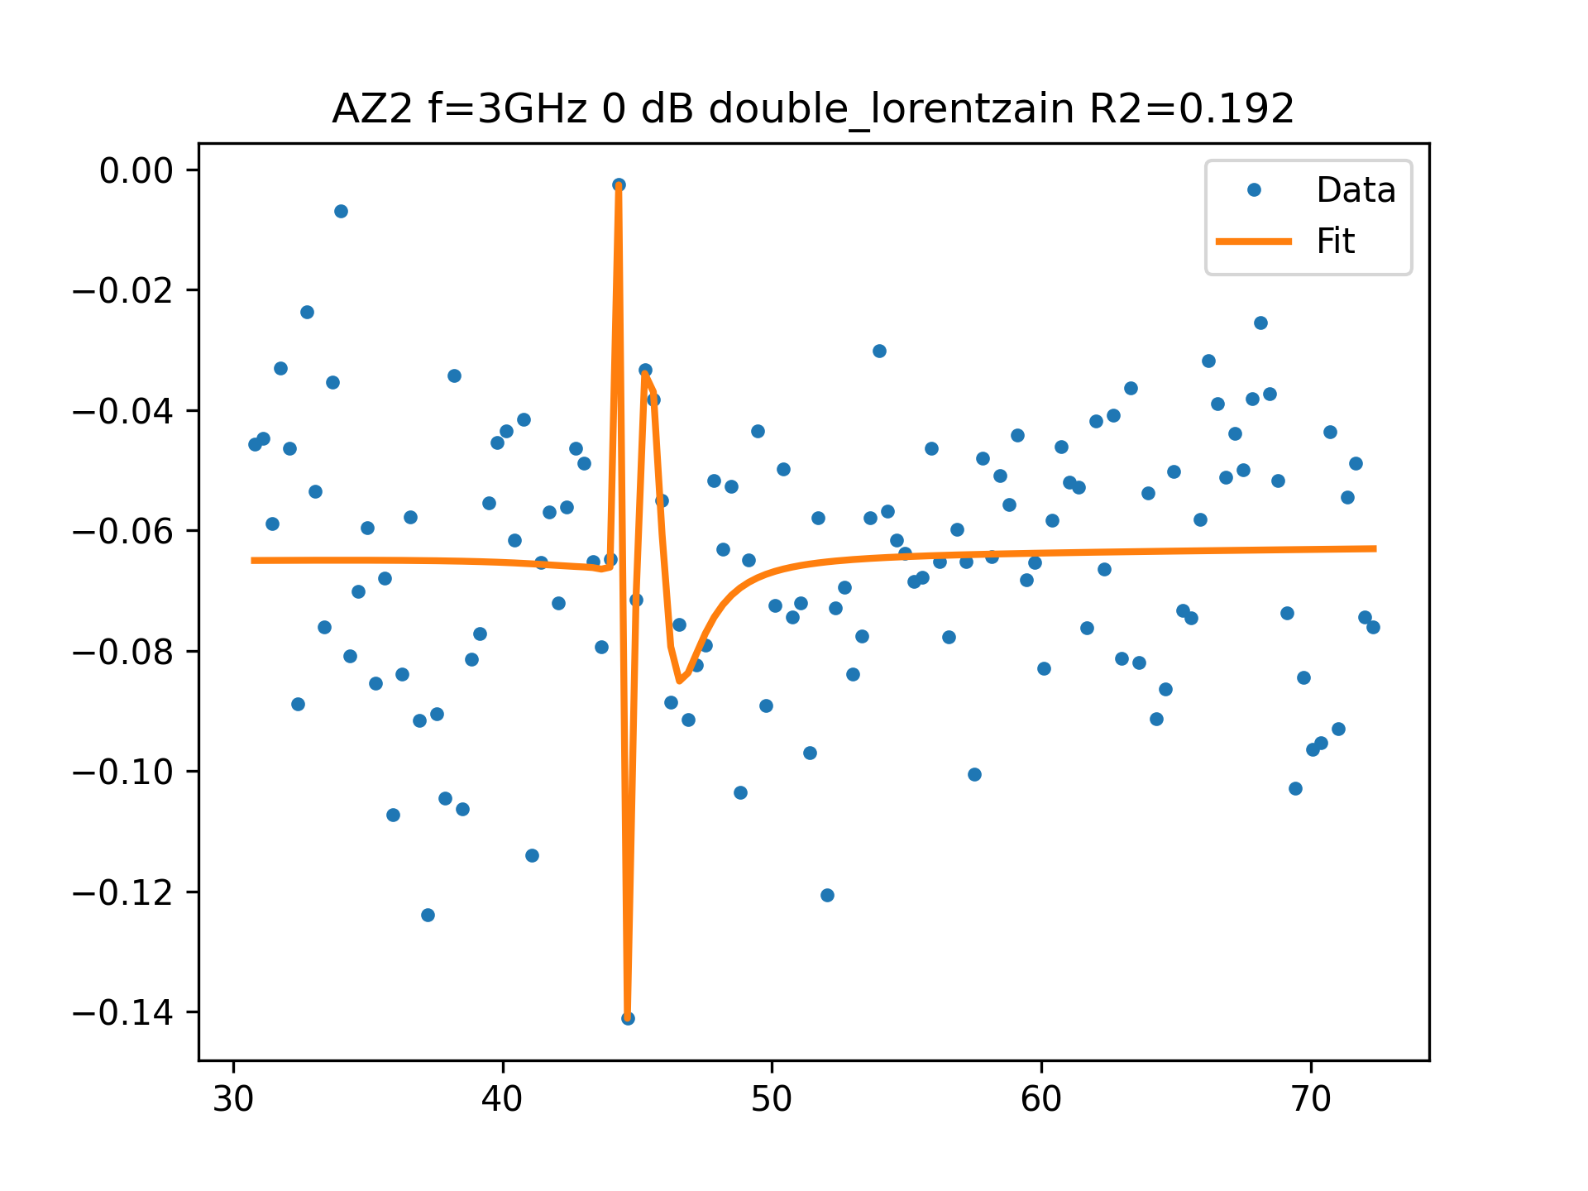
AZ2 f=3GHz 0 dB FIT

