Slide 1
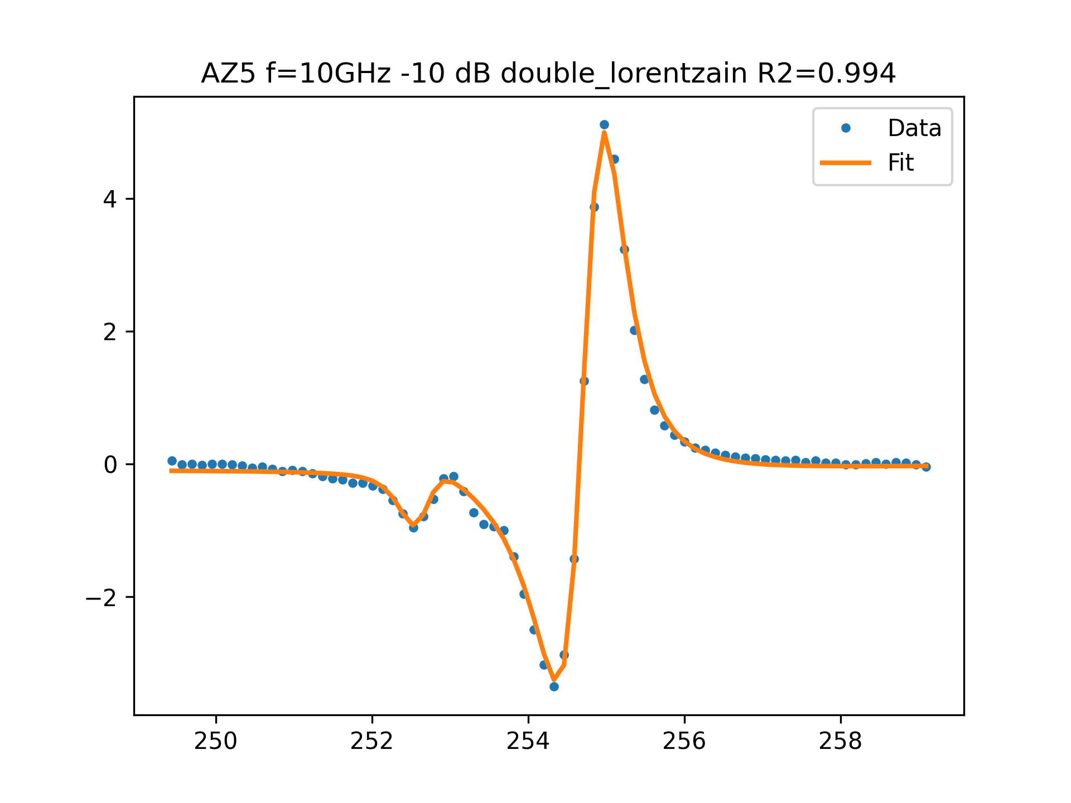
AZ5 f=10GHz -10 dB FIT

Slide 2
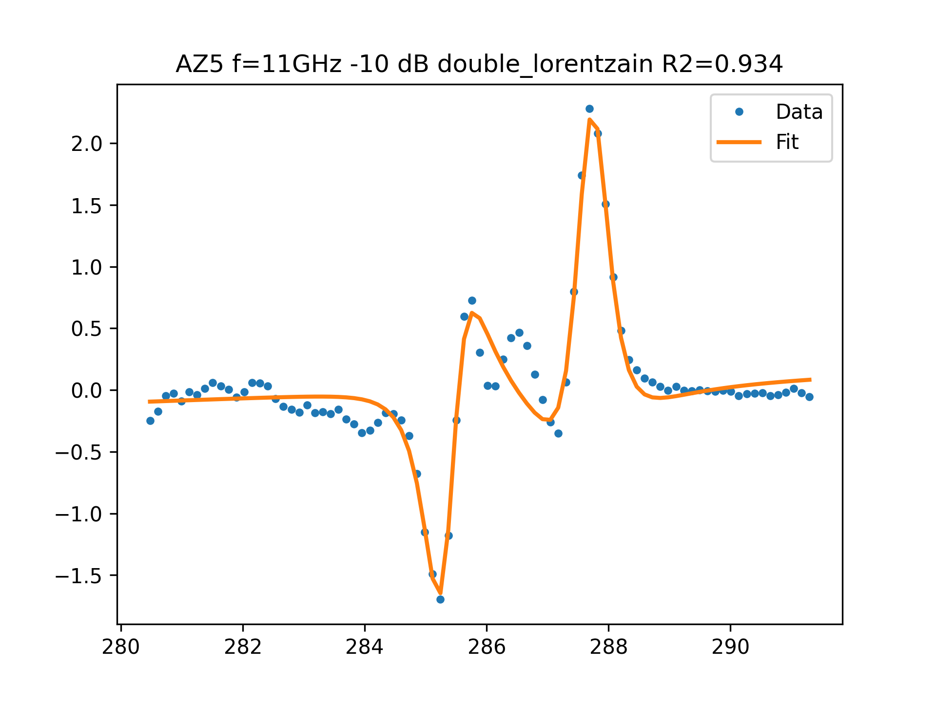
AZ5 f=11GHz -10 dB FIT

Slide 3
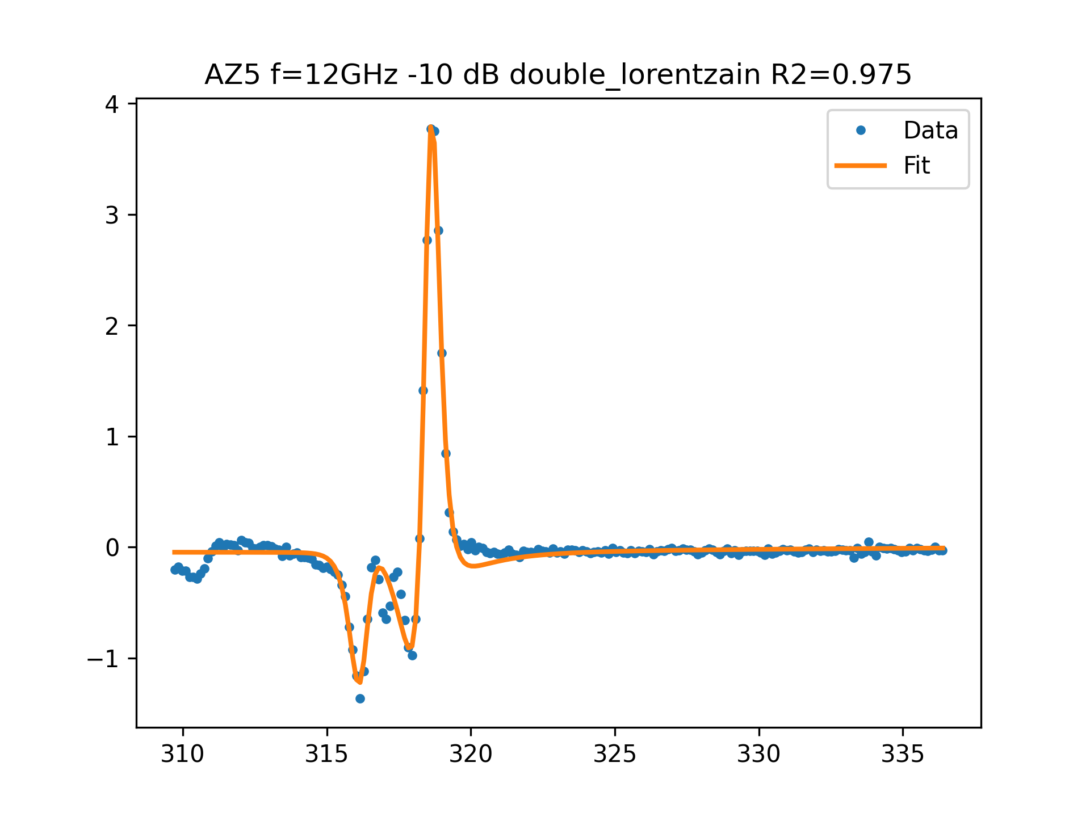
AZ5 f=12GHz -10 dB FIT

Slide 4
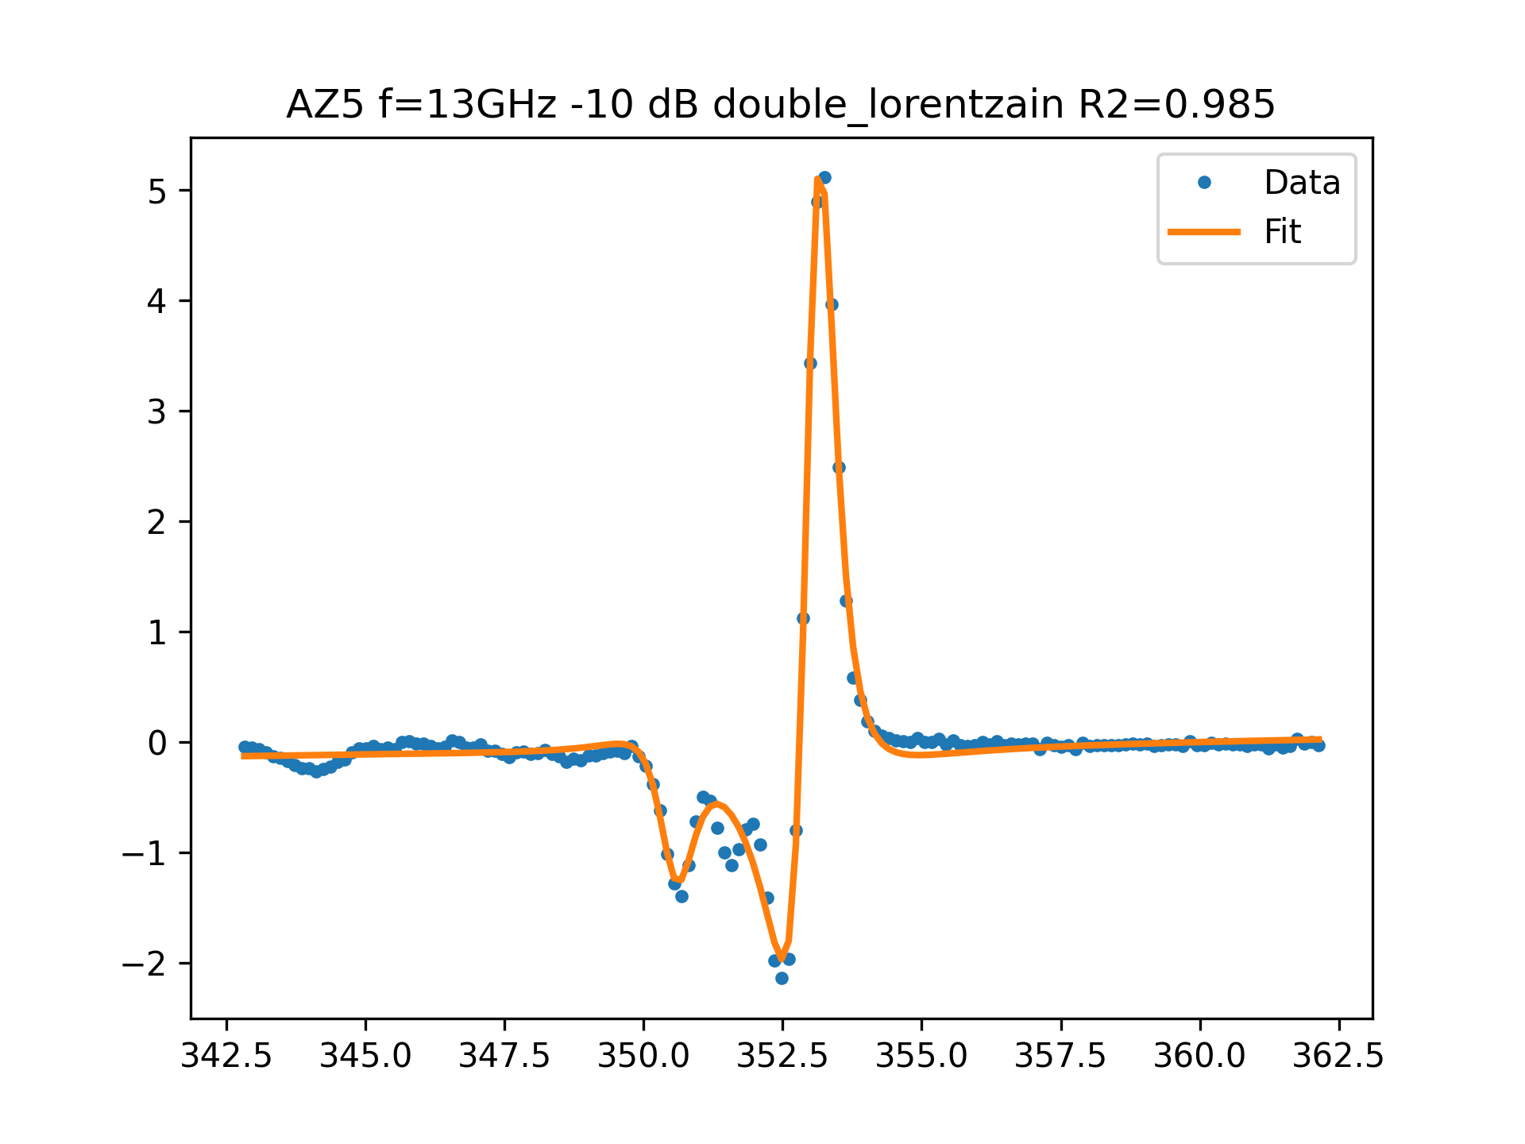
AZ5 f=13GHz -10 dB FIT

Slide 5
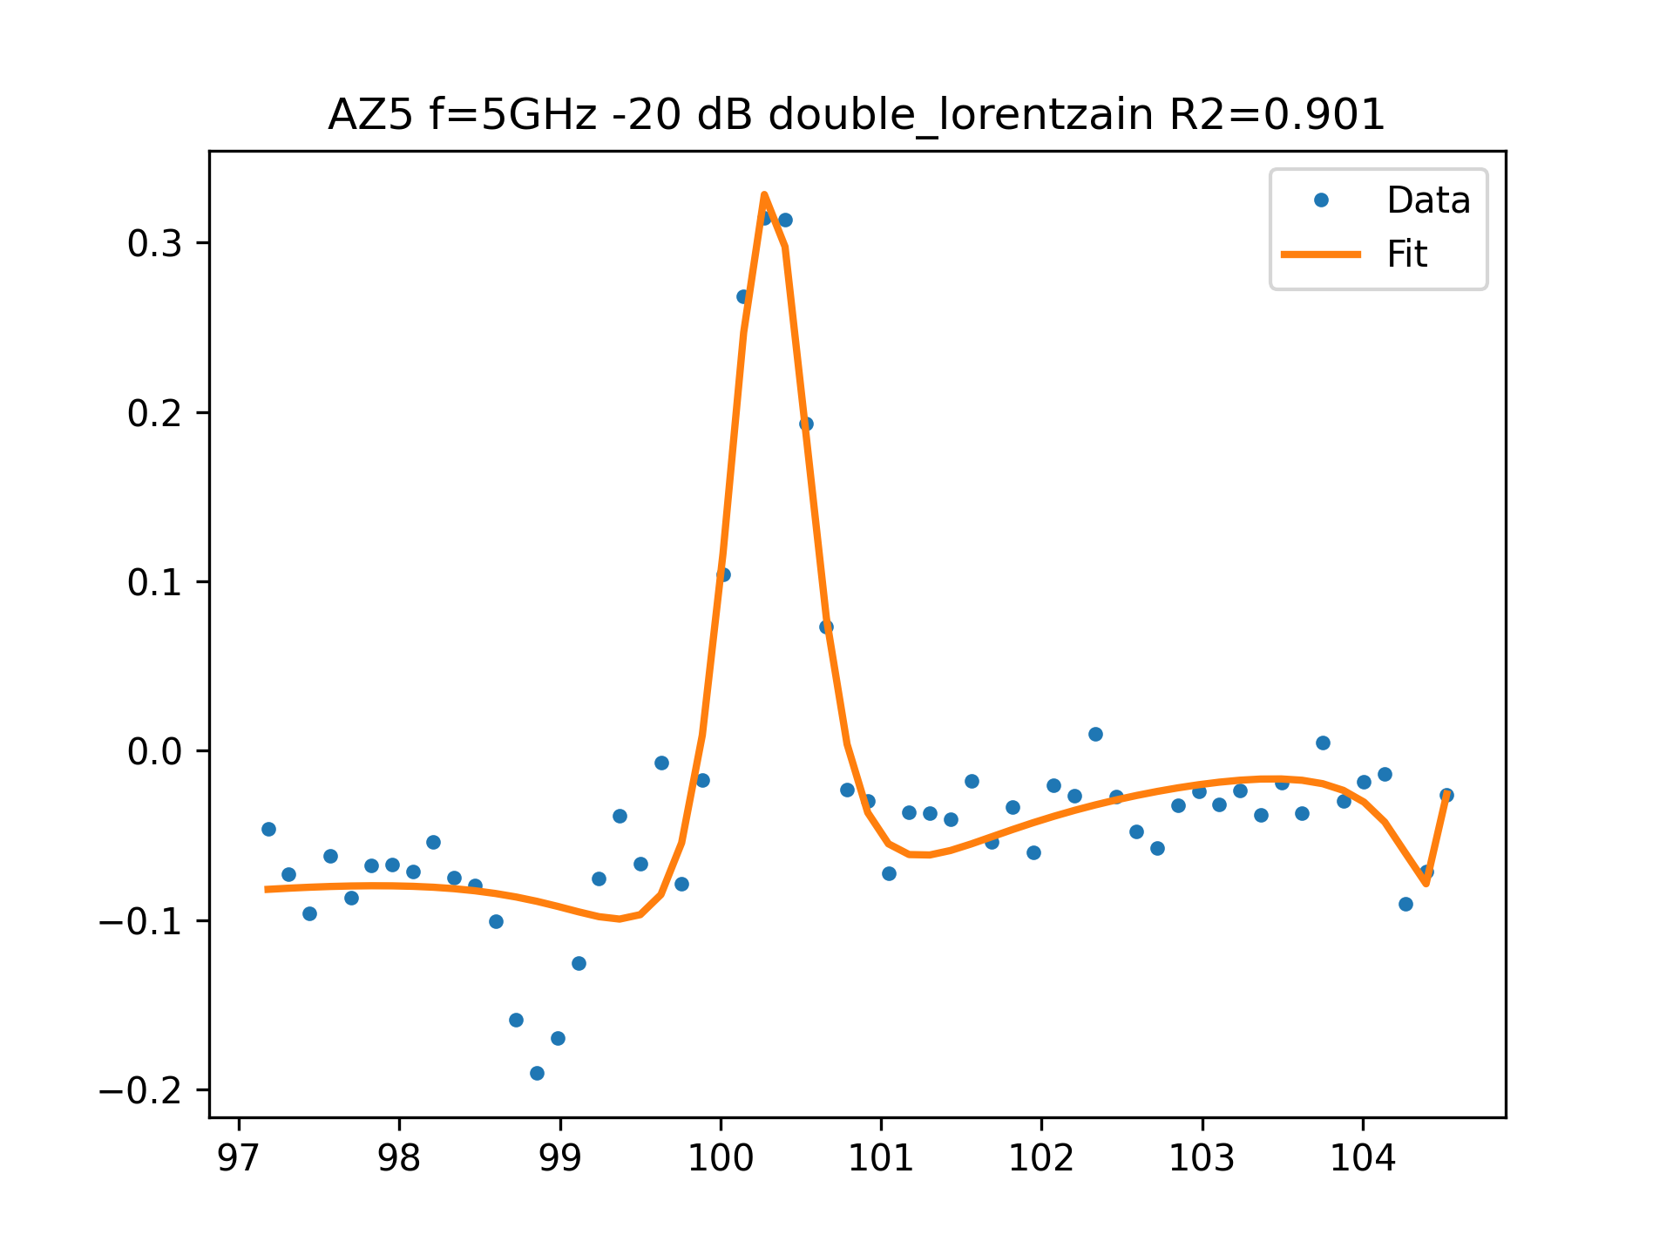
AZ5 f=5GHz -20 dB FIT

Slide 6
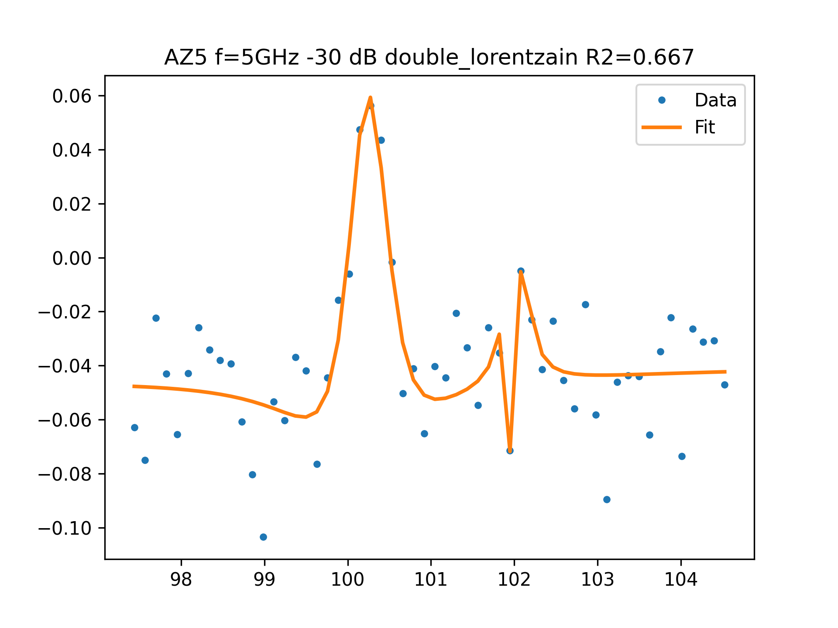
AZ5 f=5GHz -30 dB FIT

Slide 7
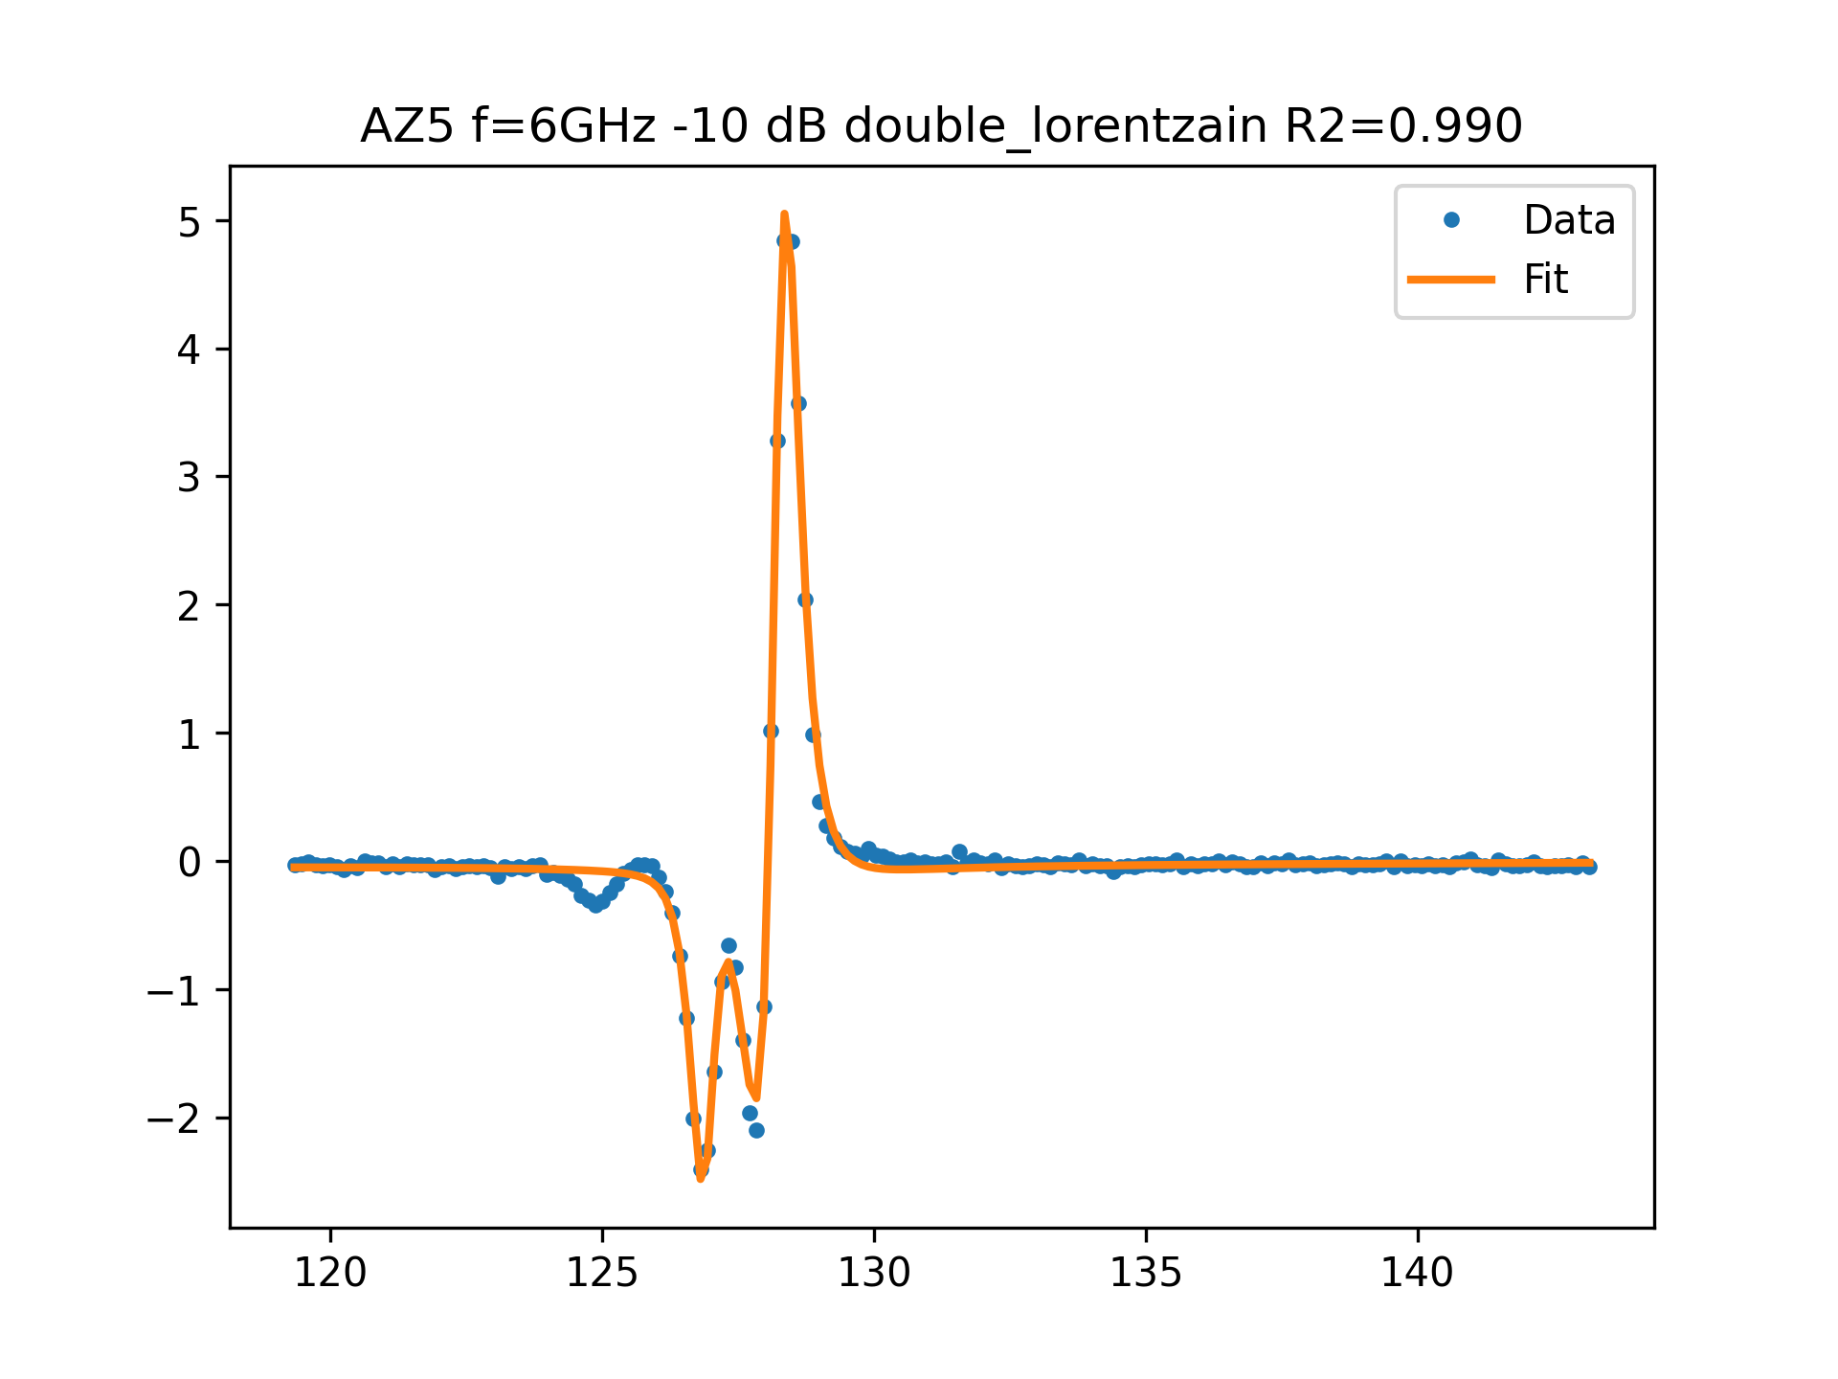
AZ5 f=6GHz -10 dB FIT

Slide 8
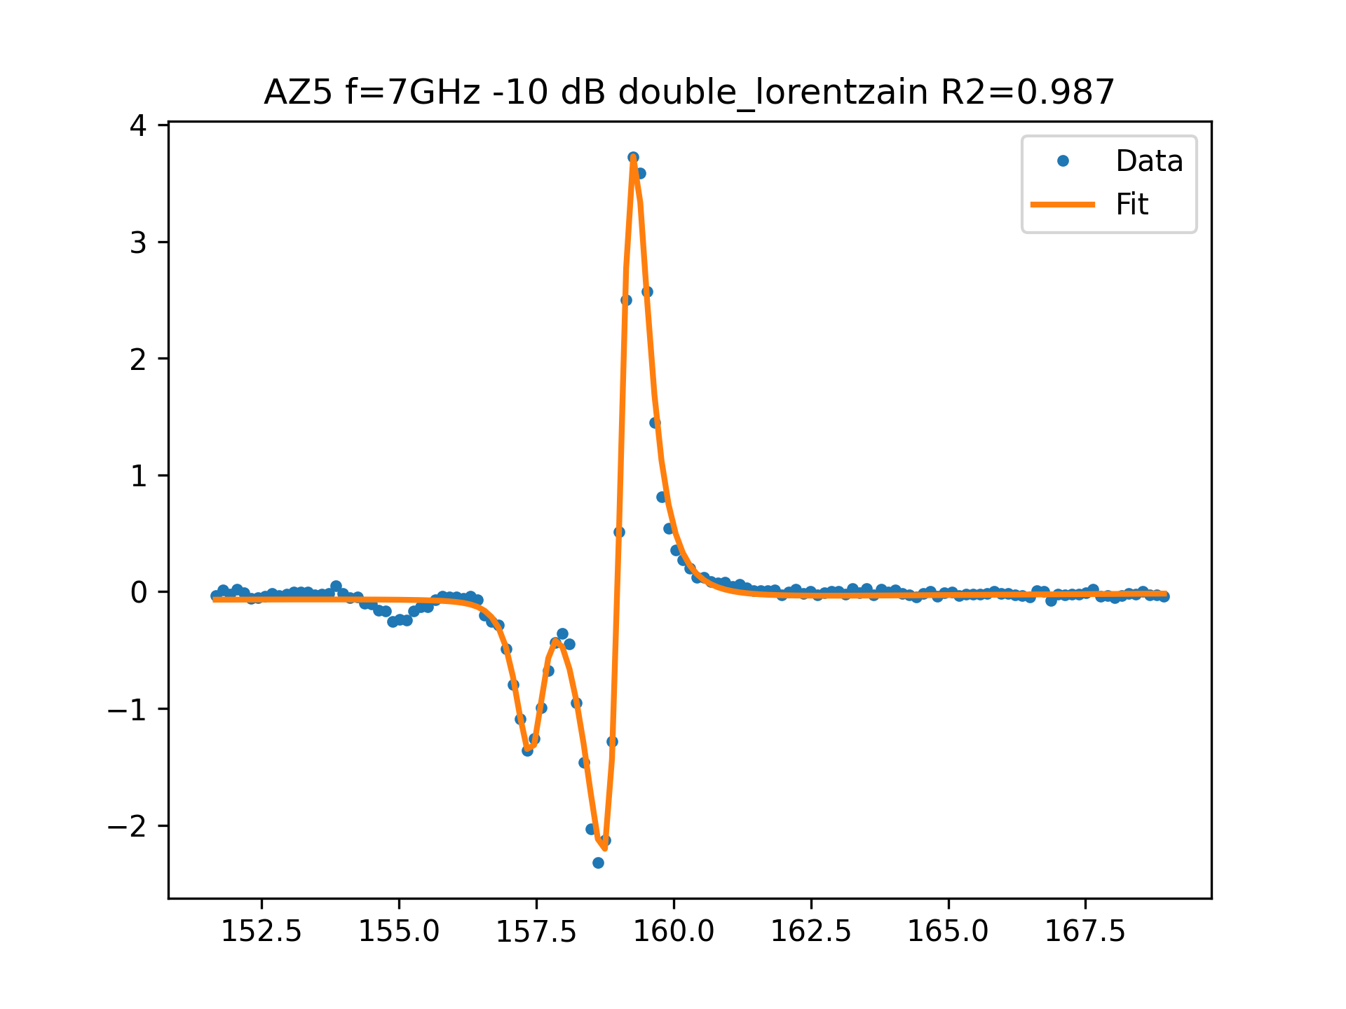
AZ5 f=7GHz -10 dB FIT

Slide 9
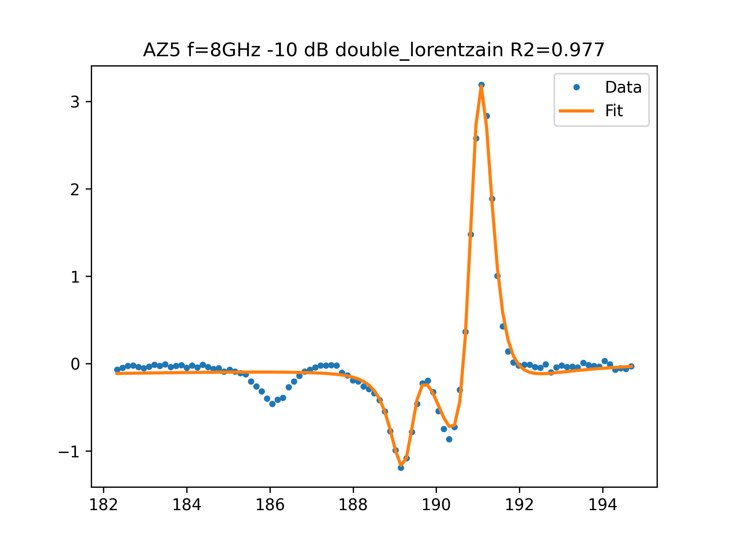
AZ5 f=8GHz -10 dB FIT

Slide 10
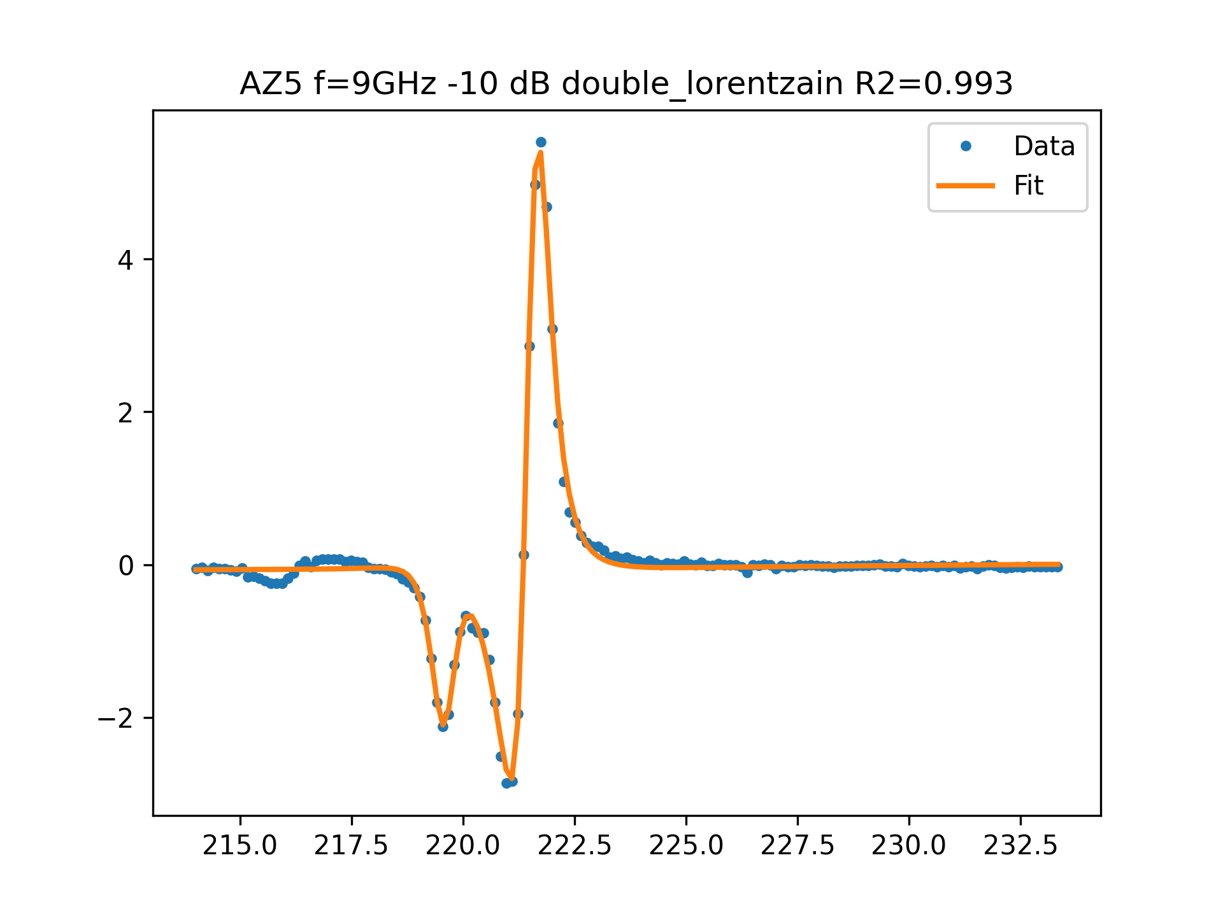
AZ5 f=9GHz -10 dB FIT

