Slide 1
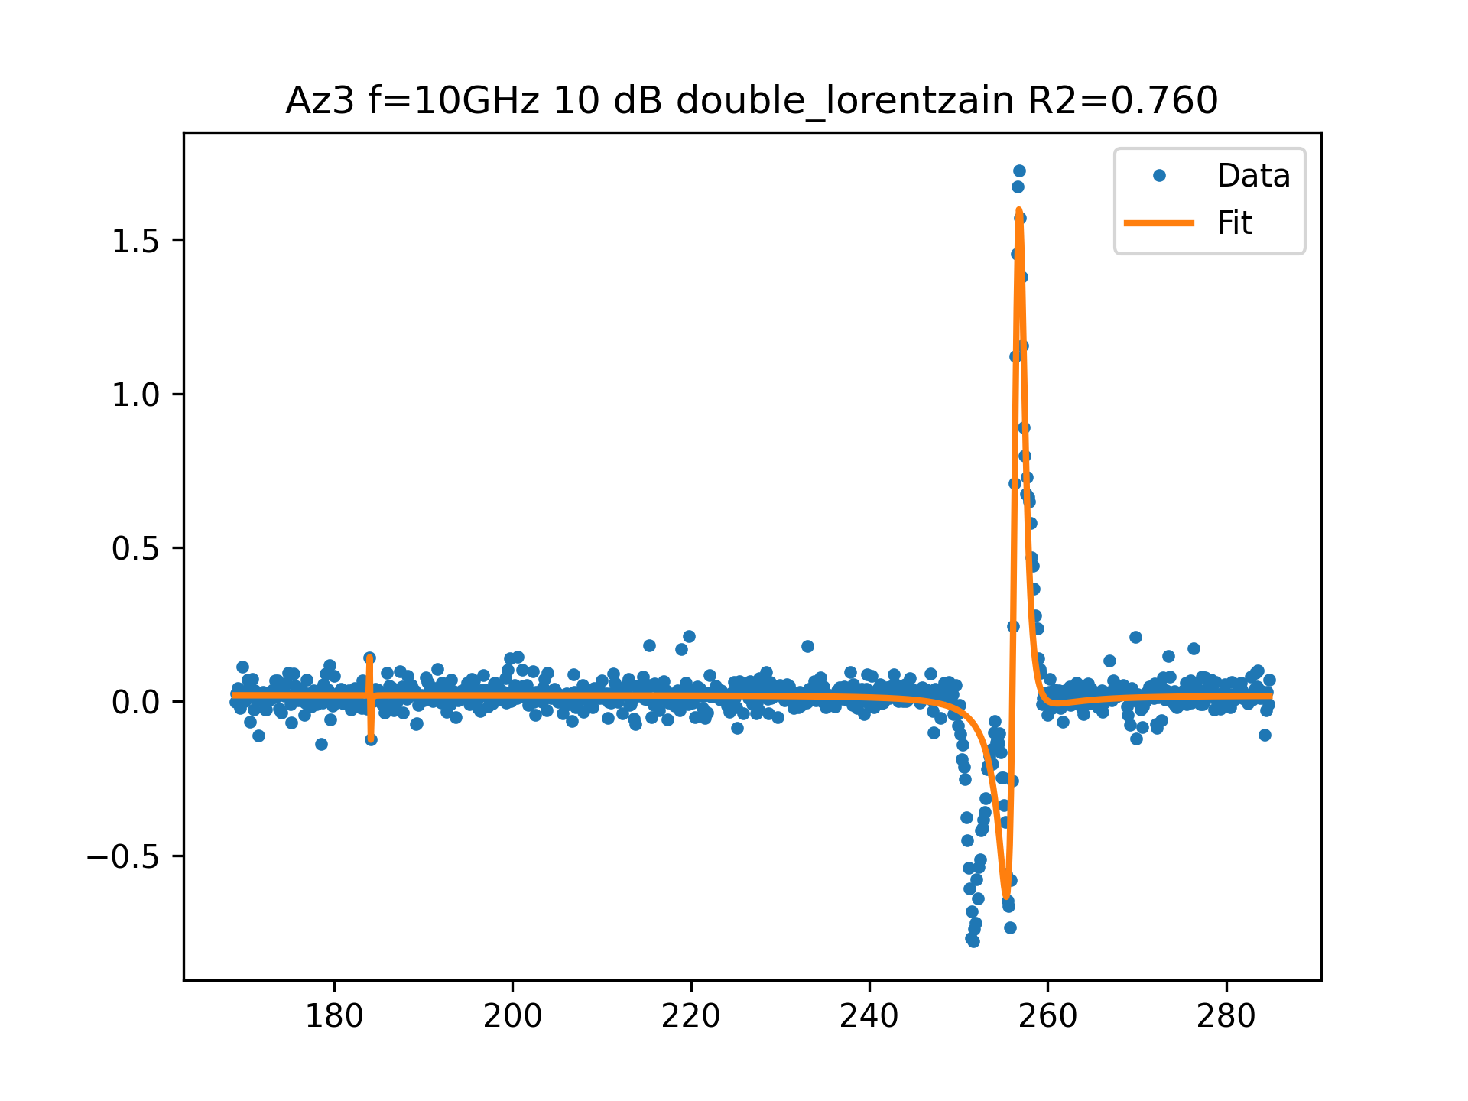
Az3 f=10GHz 10 dB FIT

Slide 2
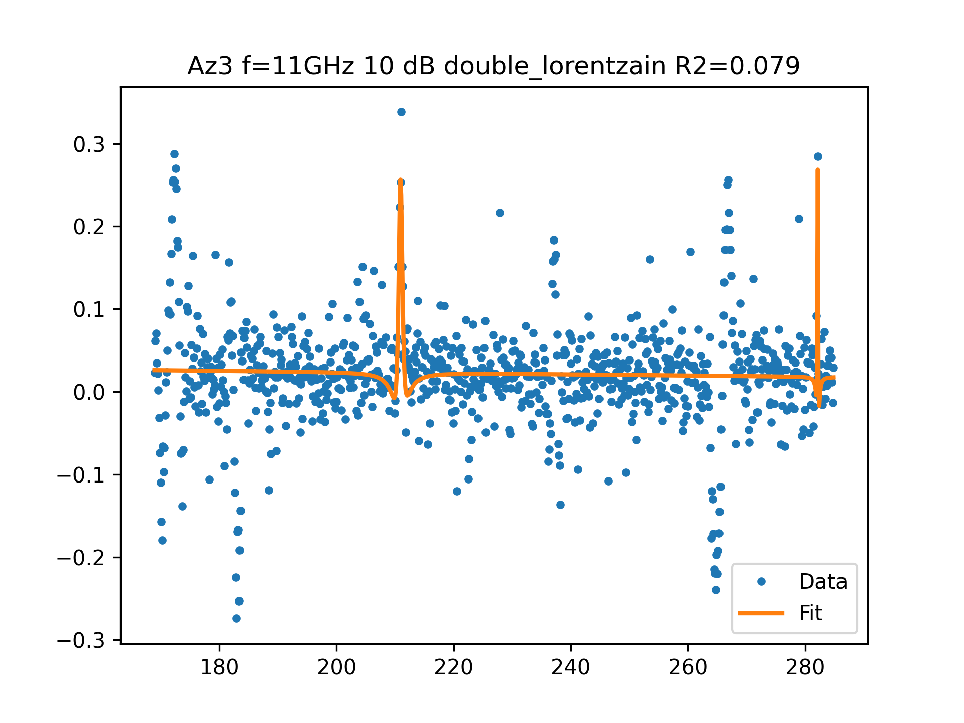
Az3 f=11GHz 10 dB FIT

Slide 3
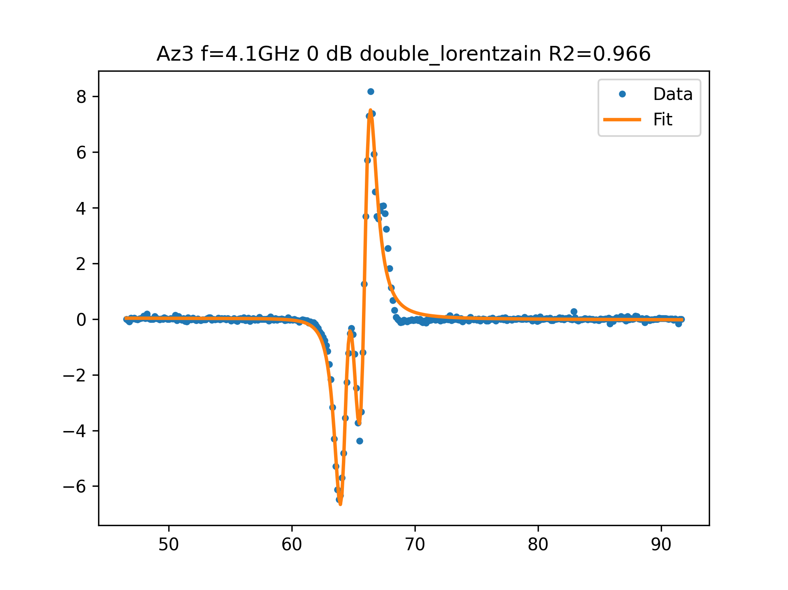
Az3 f=4.1GHz 0 dB FIT

Slide 4
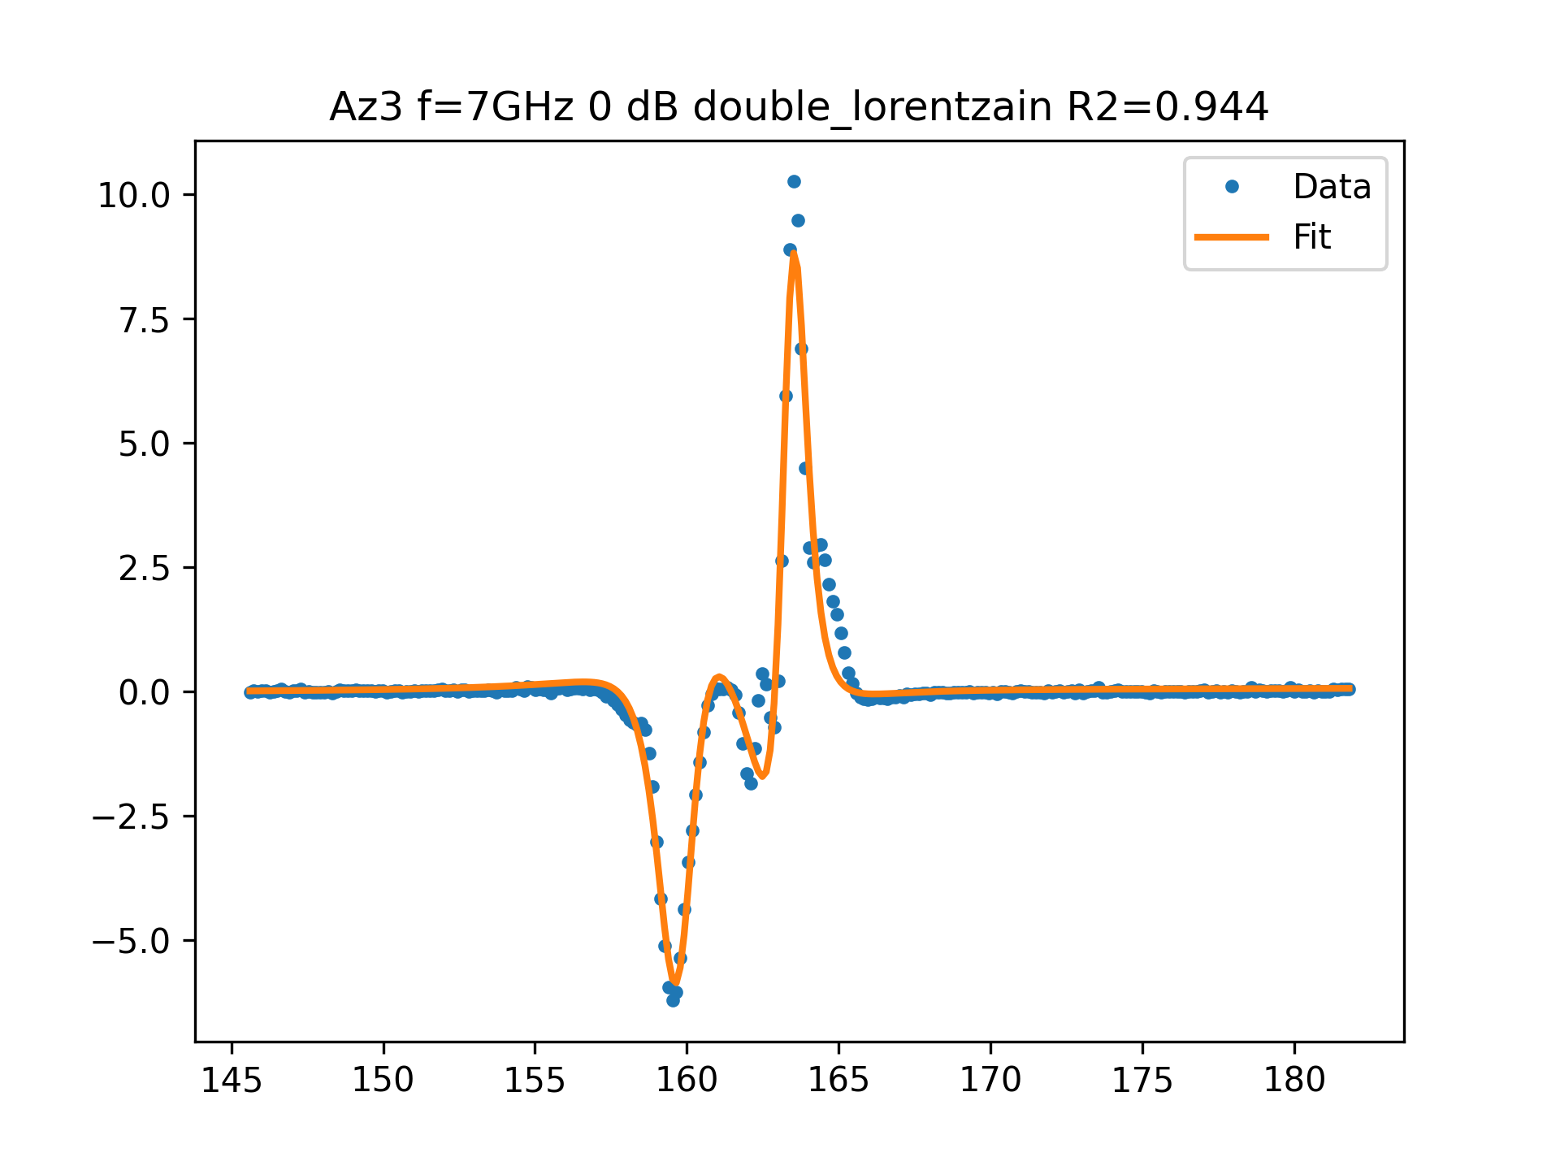
Az3 f=7GHz 0 dB FIT

Slide 5
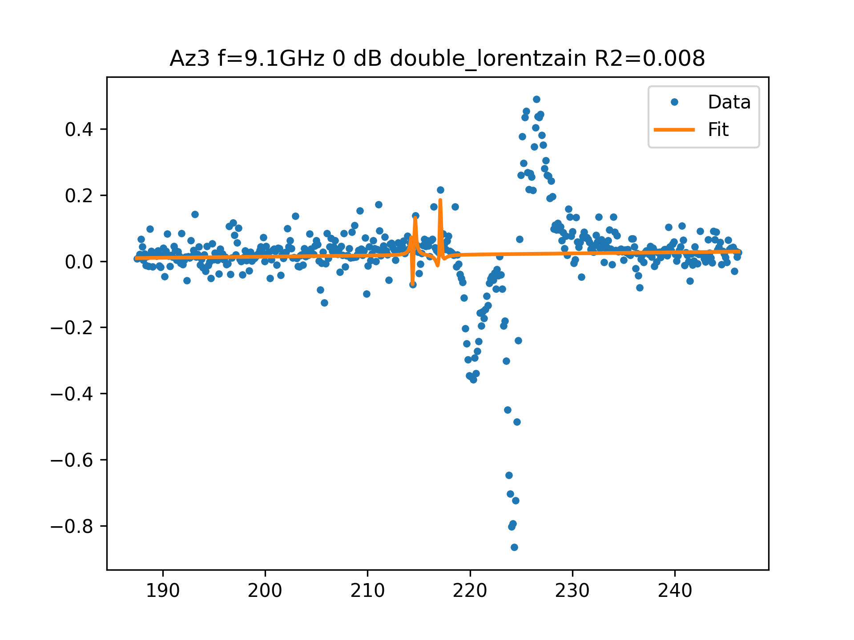
Az3 f=9.1GHz 0 dB FIT

Slide 6
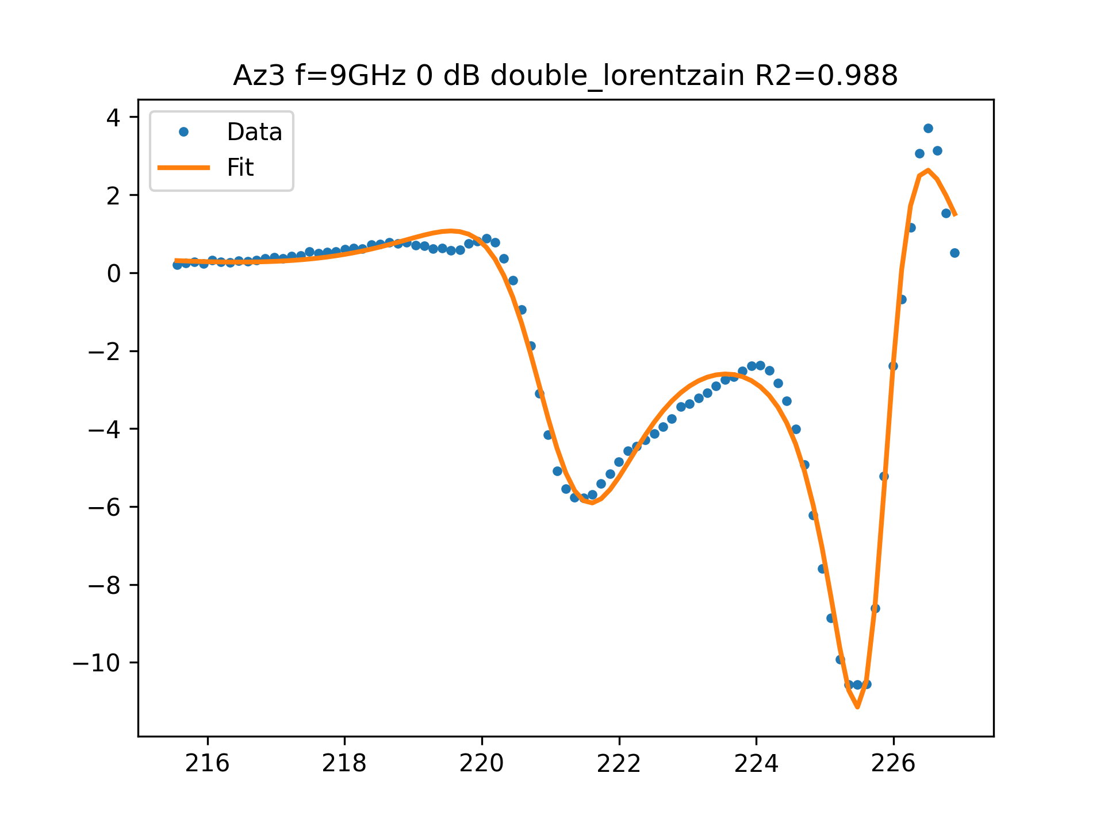
Az3 f=9GHz 0 dB FIT

