Slide 1
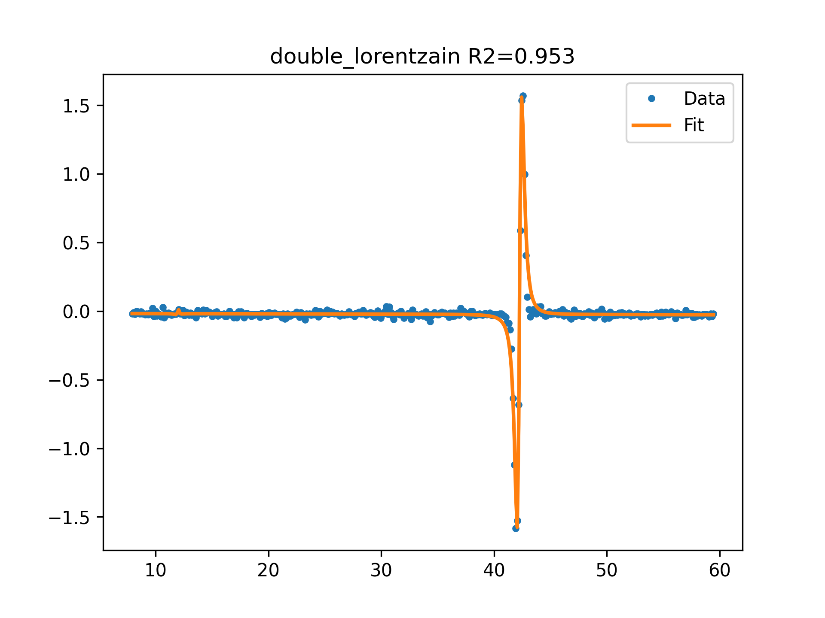
AZ3 f=3GHz 0 dB FIT

Slide 2
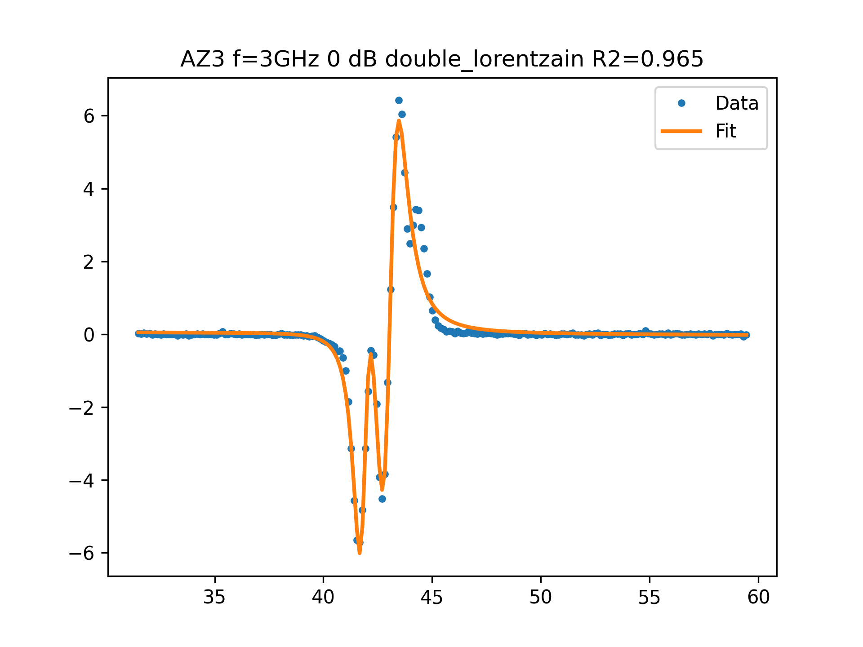
AZ3 f=3GHz 0 dB FIT

Slide 3
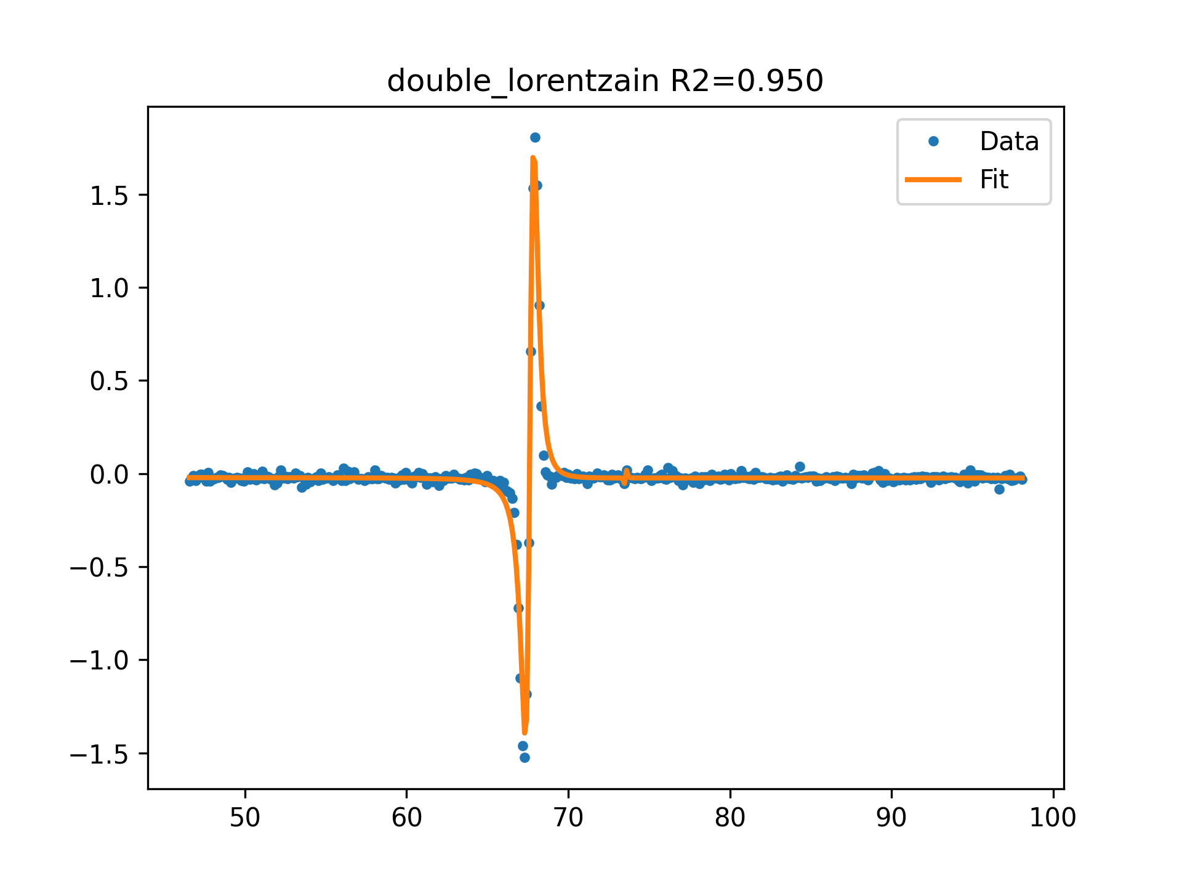
AZ3 f=4GHz 0 dB FIT

Slide 4
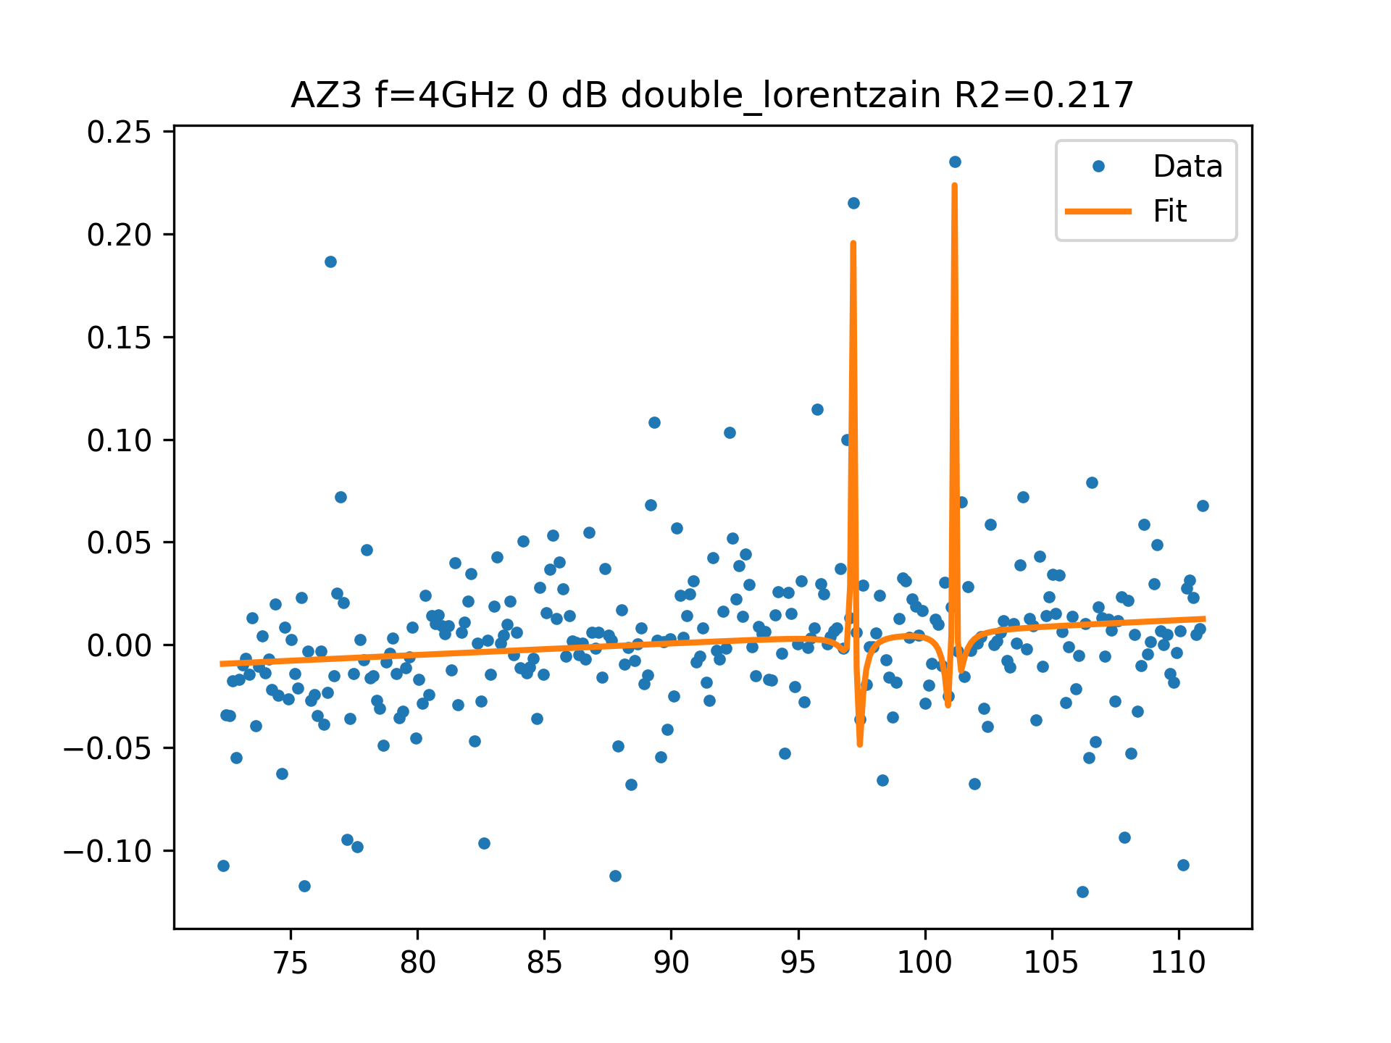
AZ3 f=4GHz 0 dB FIT

Slide 5
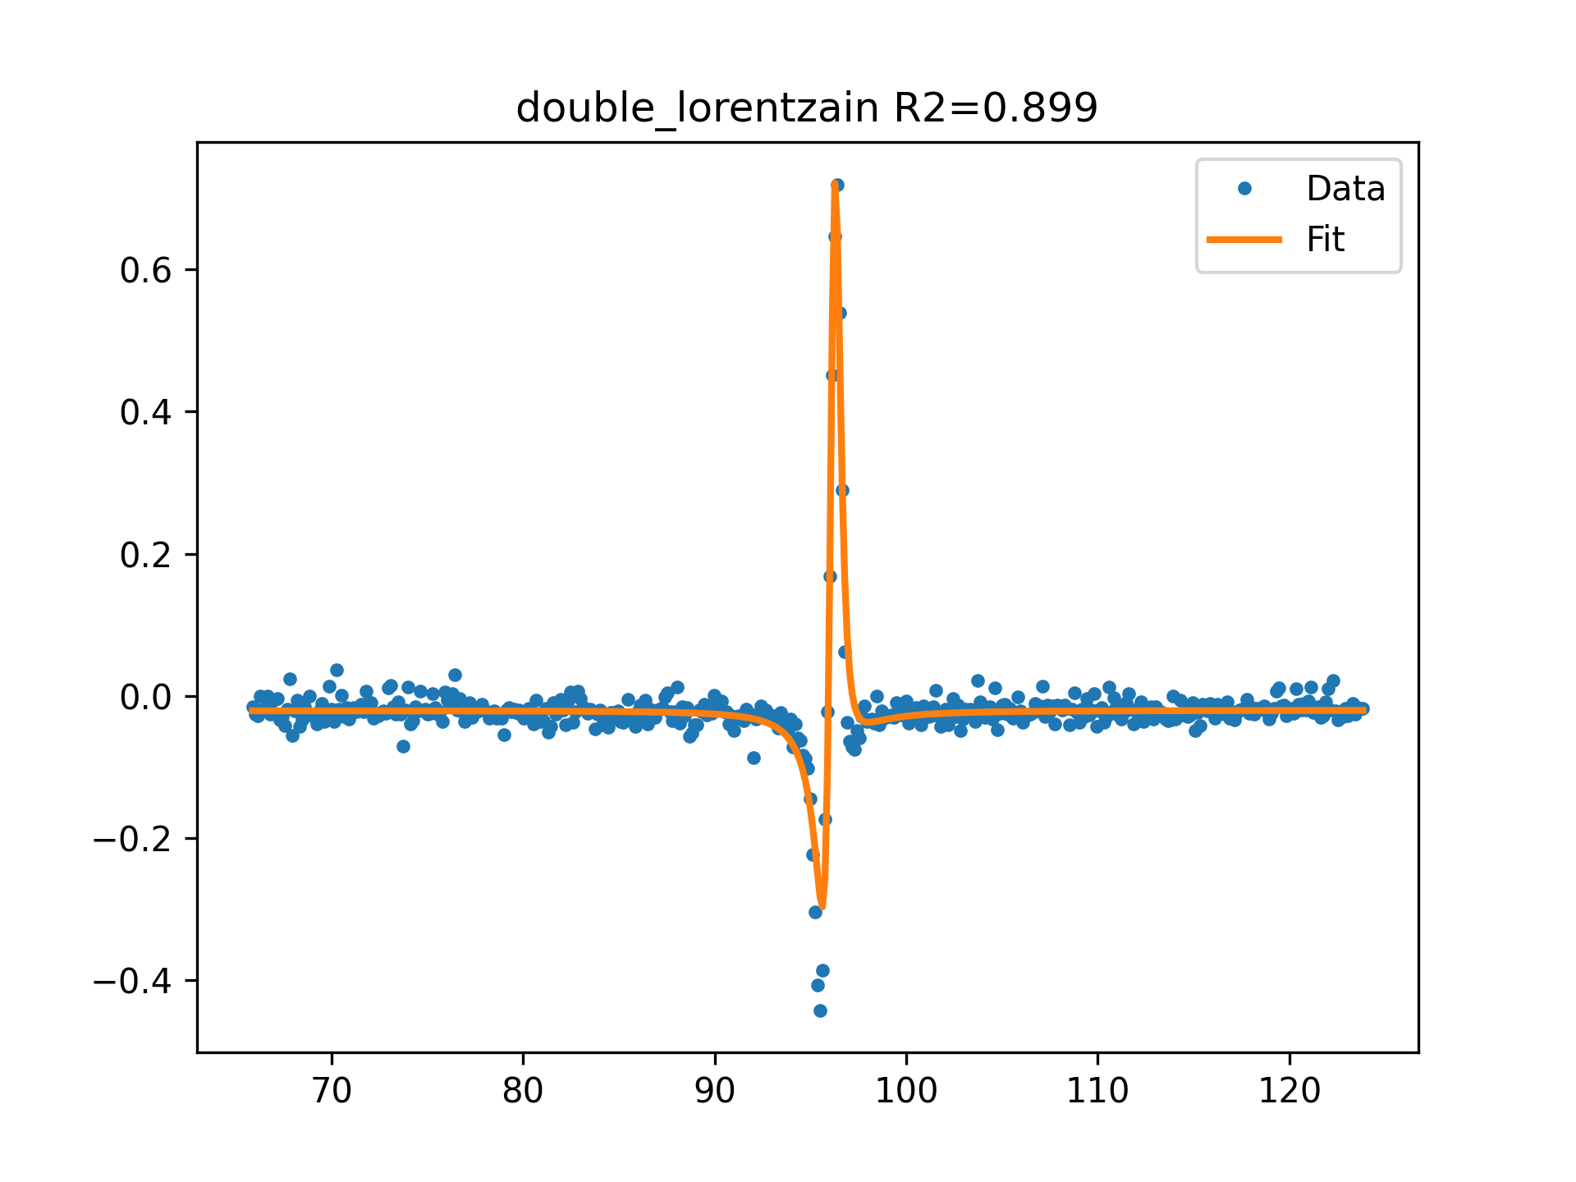
AZ3 f=5GHz 0 dB FIT

Slide 6
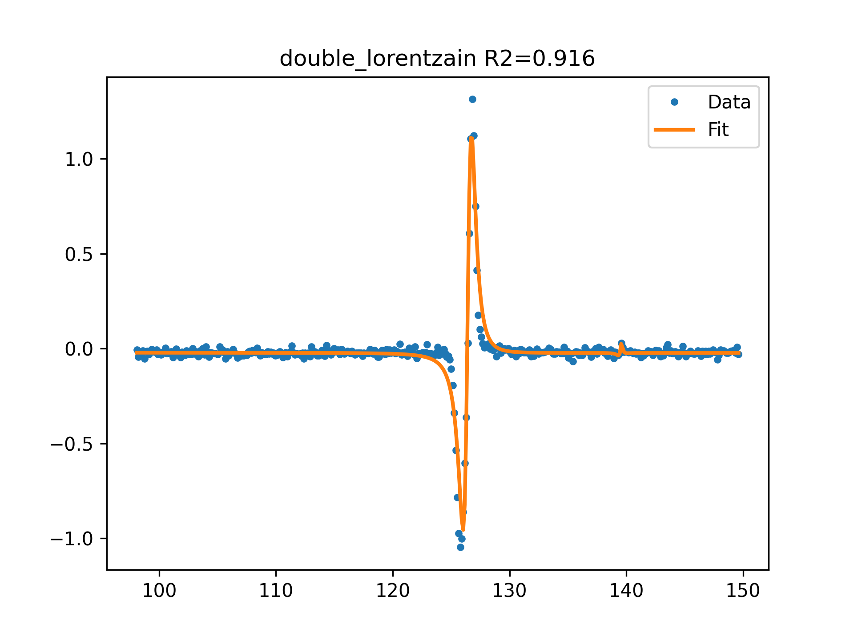
AZ3 f=6GHz 0 dB FIT

Slide 7
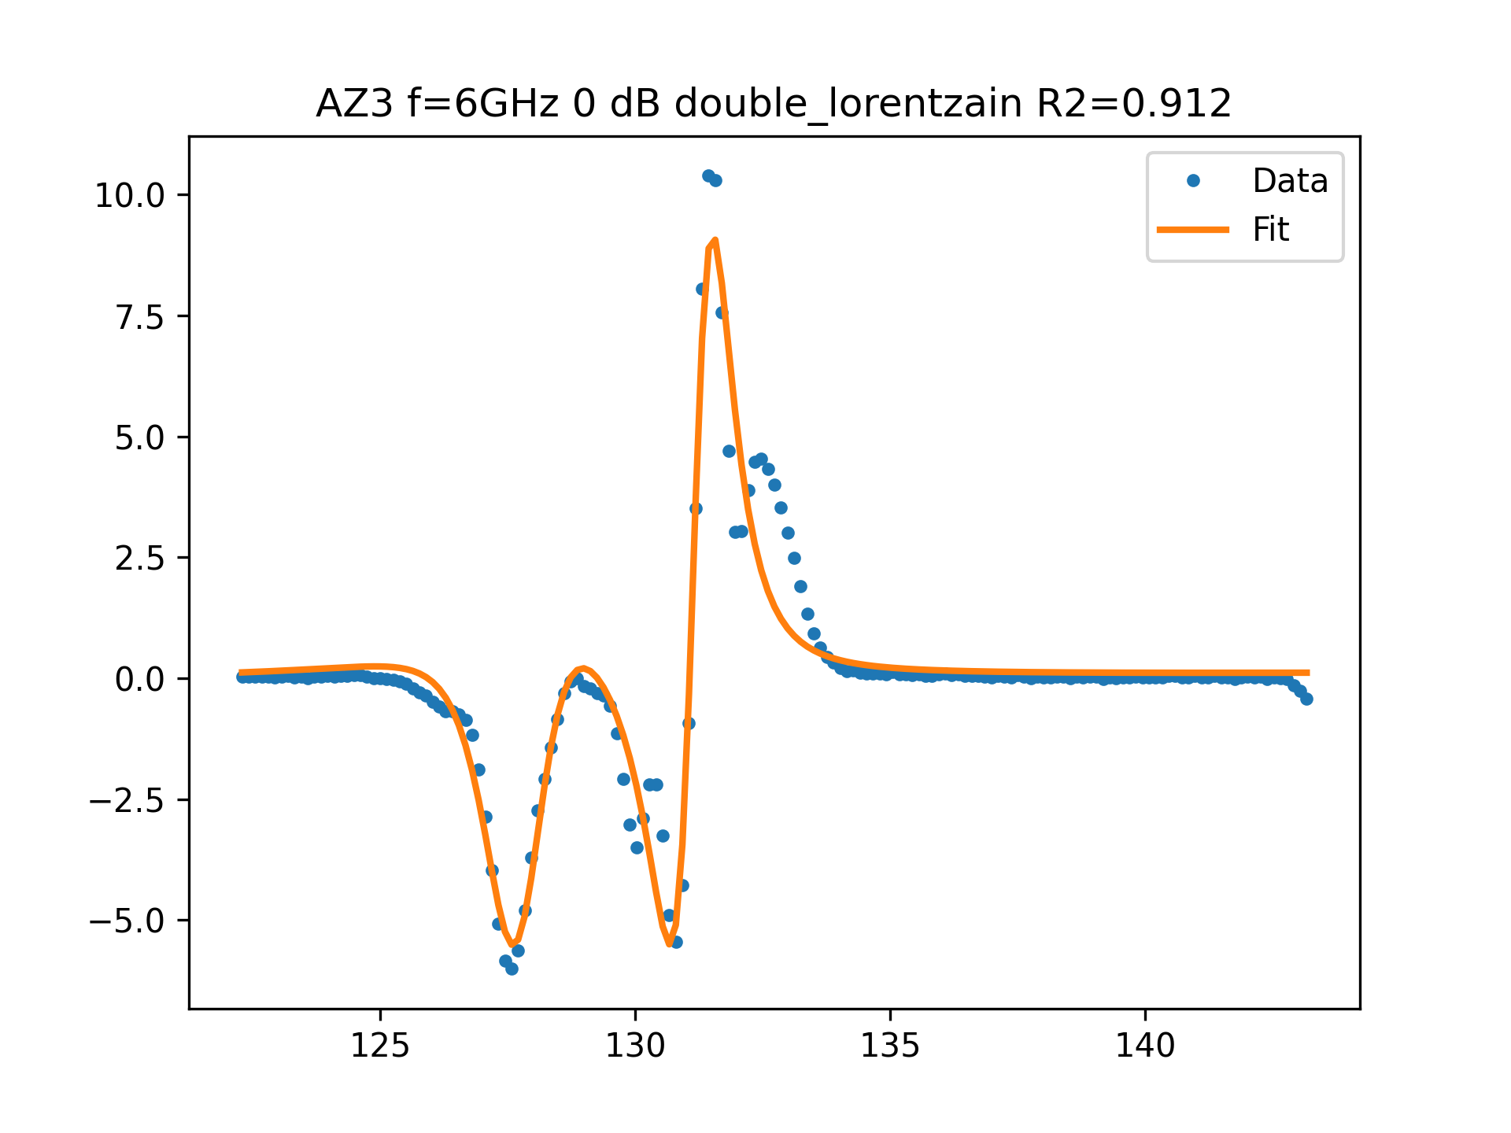
AZ3 f=6GHz 0 dB FIT

Slide 8
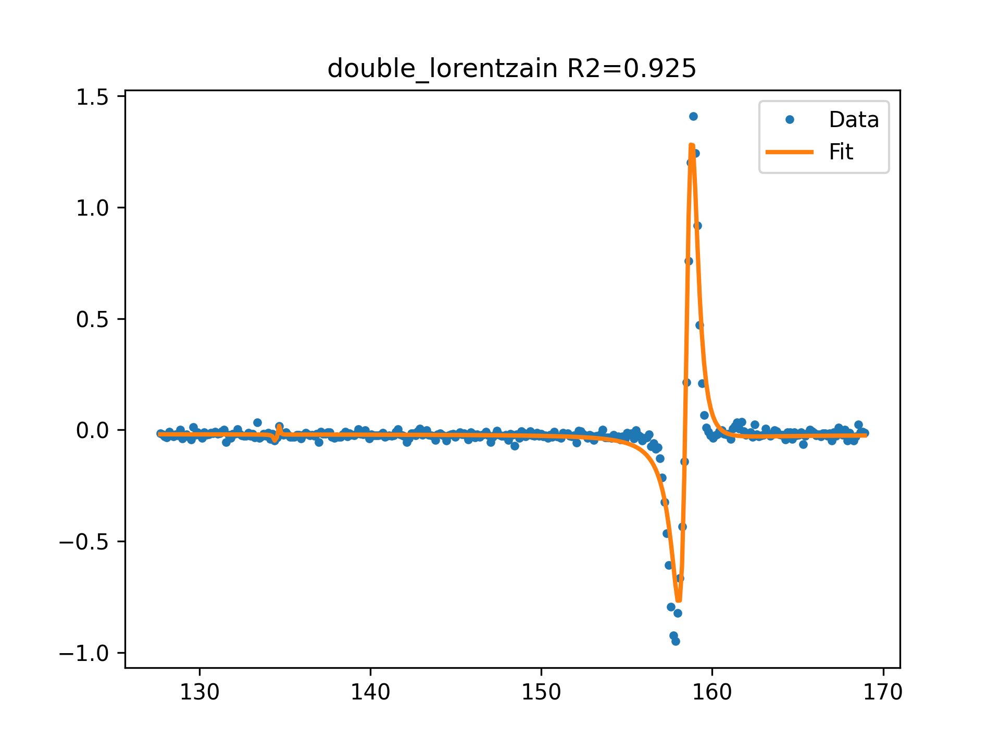
AZ3 f=7GHz 0 dB FIT

Slide 9
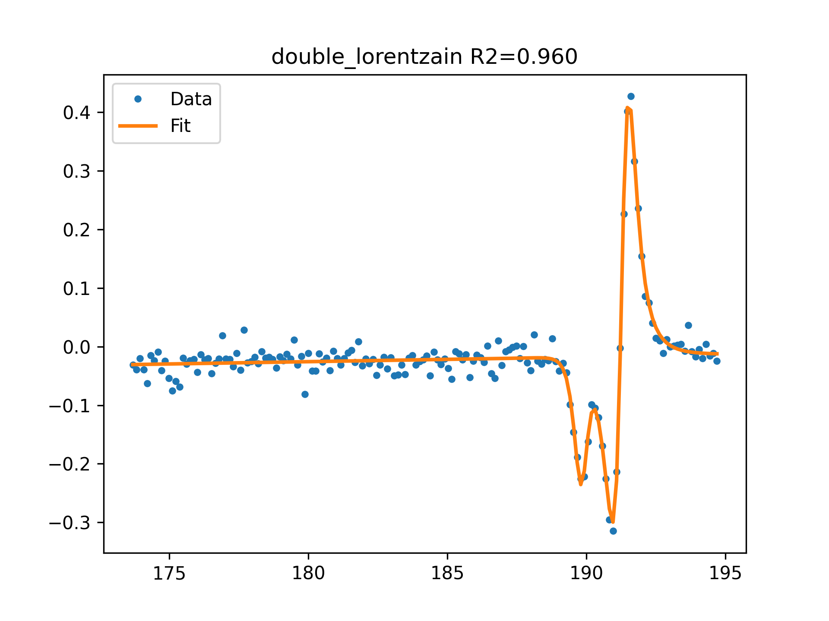
AZ3 f=8GHz 0 dB FIT

Slide 10
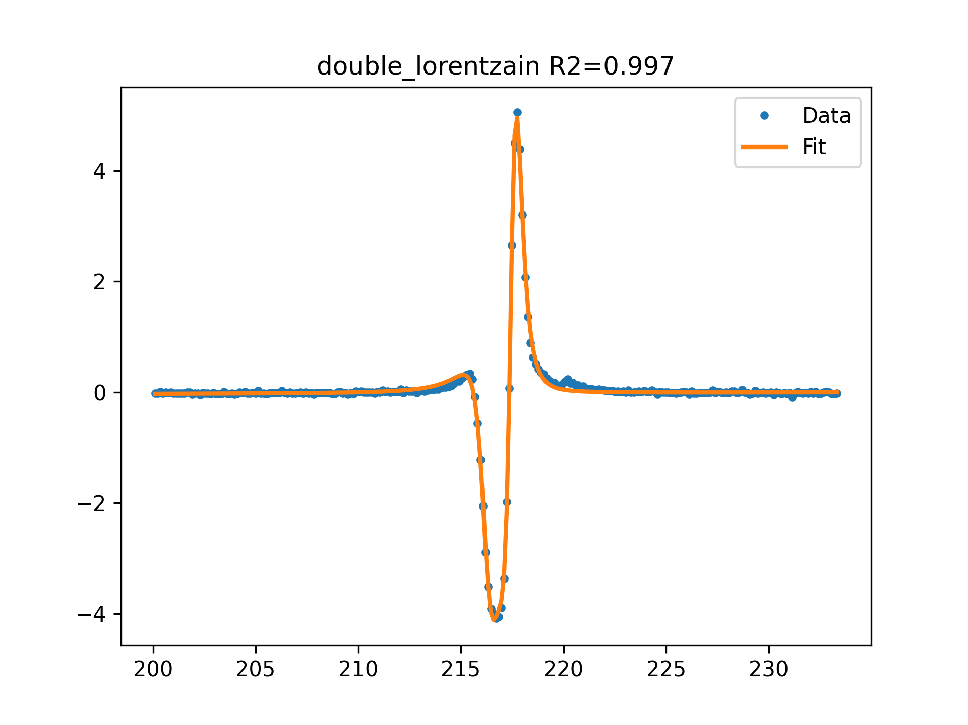
AZ3 f=9GHz 0 dB FIT

Slide 11
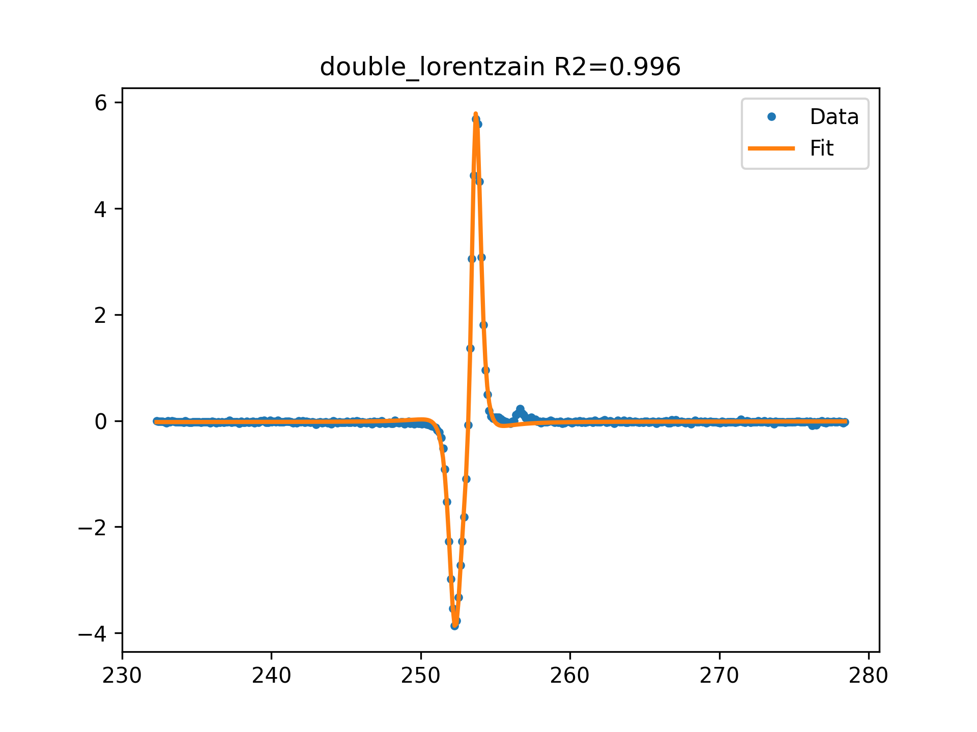
AZ3 f=10GHz 0 dB FIT

Slide 12
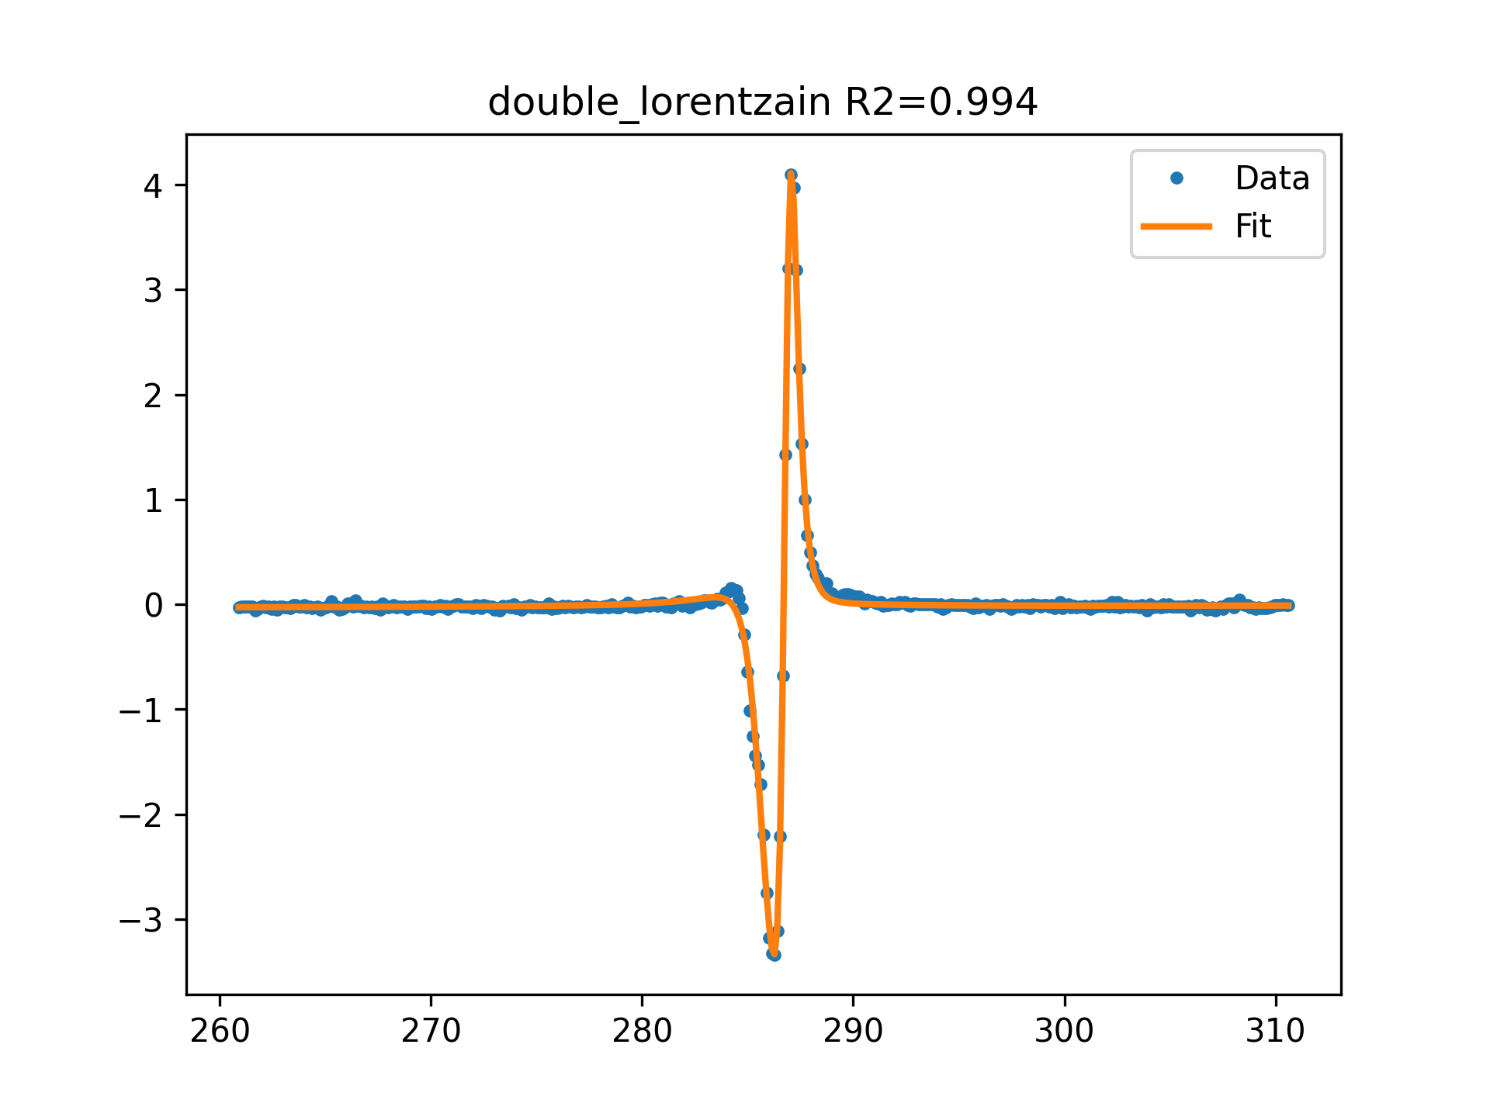
AZ3 f=11GHz 0 dB FIT

Slide 13
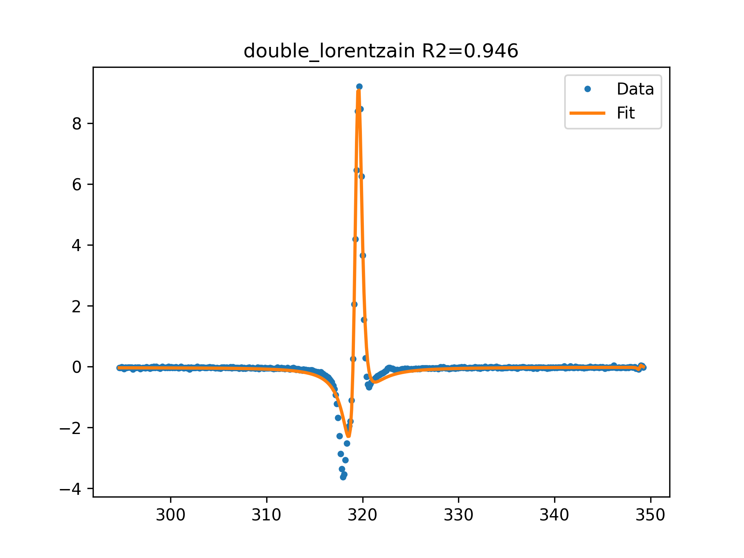
AZ3 f=12GHz 0 dB FIT

Slide 14
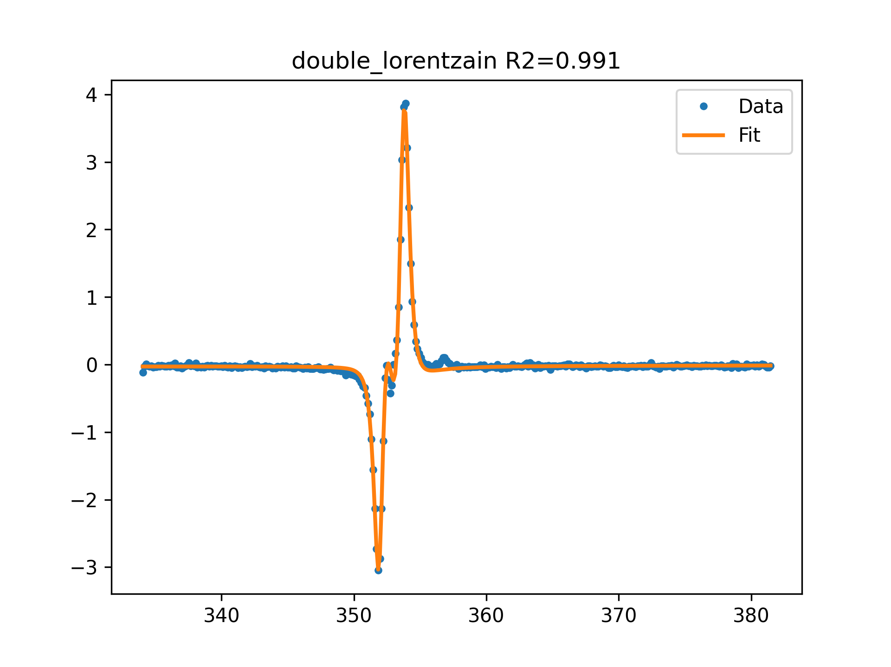
AZ3 f=13GHz 0 dB FIT

Slide 15
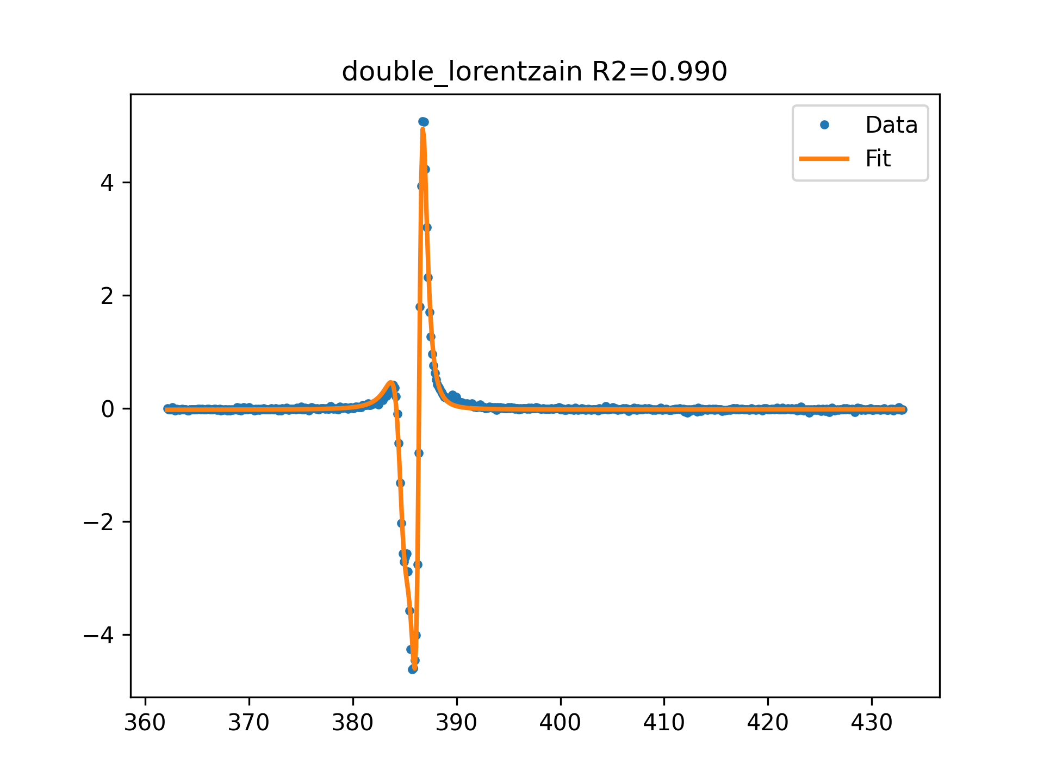
AZ3 f=14GHz 0 dB FIT

Slide 16
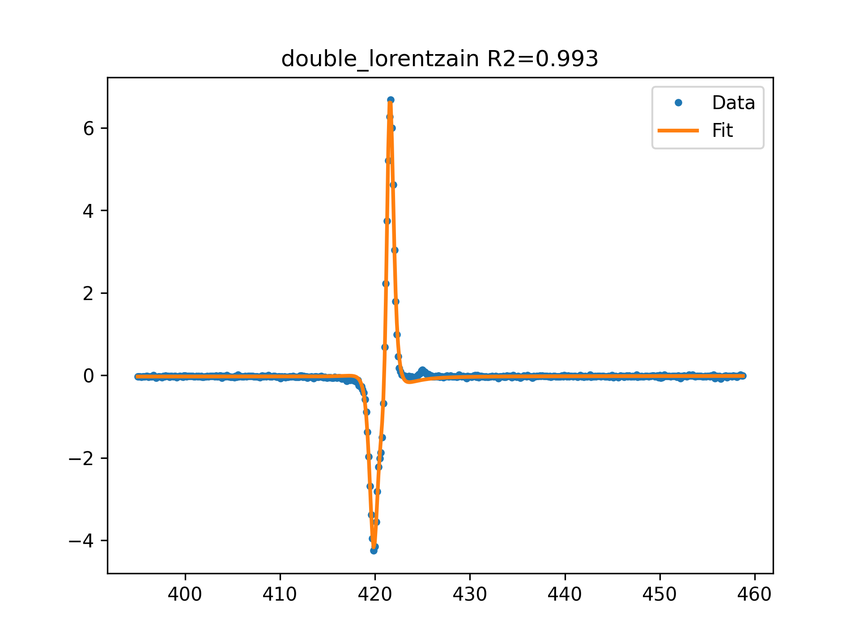
AZ3 f=15GHz 0 dB FIT

Slide 17
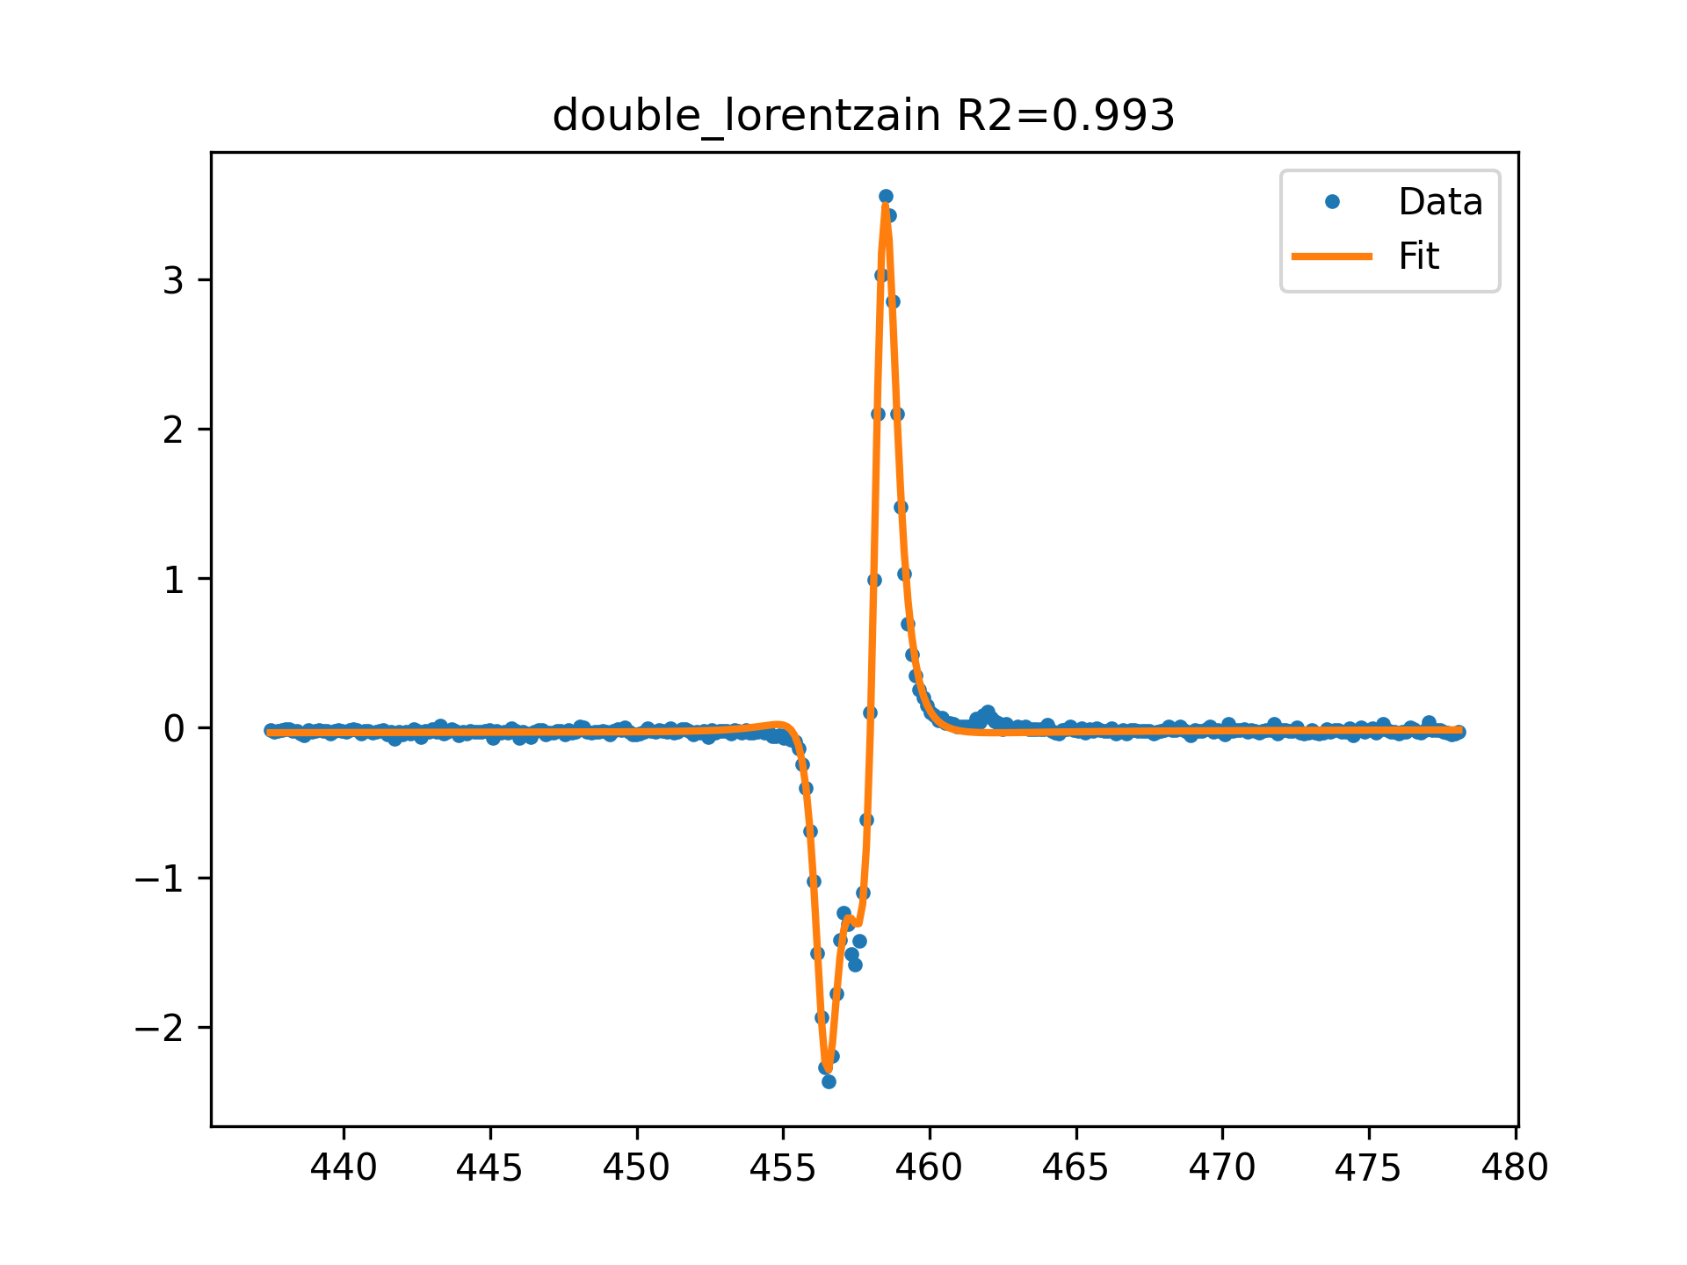
AZ3 f=16GHz 0 dB FIT

Slide 18
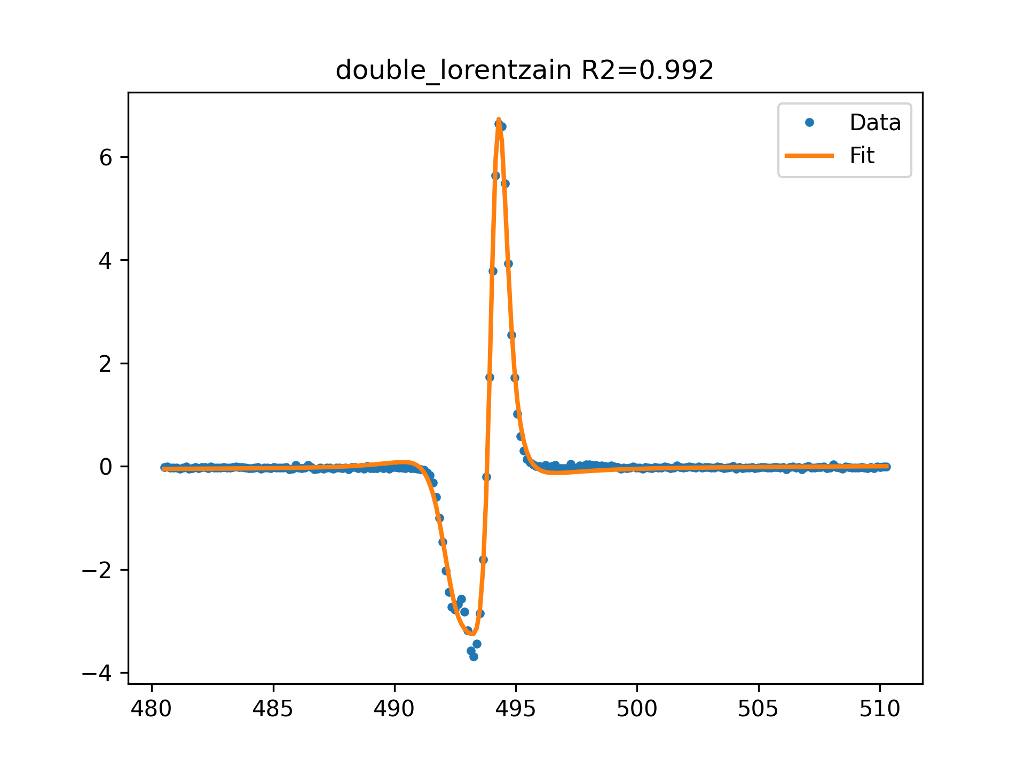
AZ3 f=17GHz 0 dB FIT

