Slide 1

IILM UNIVERSITY
STUDENT CREDENTIALS
Haidar Raj Ali
VIRTUALWORKS LAB INTERNSHIP
Data Analytics
Enrollment / Roll No. 25SCS1003004846
Program B.Tech (CSE)
An Internship Presentation Report
INTERNSHIP DURATION 08 August 2026 – 07 September 2026
HOST ORGANIZATION VirtualWorks Lab by Noivrn

Slide 2

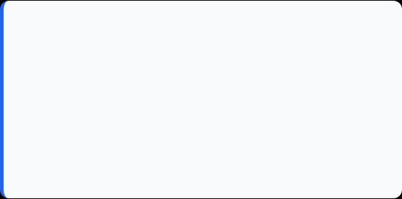
Candidate & Program Overview
Candidate Details
Internship Profile
Student Name: HAIDAR RAJ ALI
Program Name: VirtualWorks Lab Internship
Roll Number: 25SCS1003004846
Specialization Domain: Data Analytics
Degree: B.Tech (Computer Science & Engineering)
Duration: 08 Aug 2026 – 07 Sep 2026
Internship ID: VWX-AUG26TOSEP26-834
Academic Batch: 2026-2027
Total Hours: 155 Hours
University: IILM University, Greater Noida, U.P.

Slide 3

Organization Profile: VirtualWorks Lab
VirtualWorks Lab is an educational initiative by Noivrn. The supplied internship certificate verifies successful completion in the Data Analytics domain.
Internship Period: 08 August 2026 – 07 September 2026.
Total Engagement: 155 hours of internship work.
Credential: Certificate of Completion + Performance Evaluation Report.

Slide 4

Problem Statement & Internship Context
The Analytics Challenge
The Internship Scope
The recorded internship tasks required working across data cleaning, dashboards, geospatial analysis, customer churn, and web traffic analytics.
The five recorded project areas cover data preparation, visualization-oriented presentation, and analytical study of geographic, customer, and web activity data.
The practical challenge was to transform datasets into reliable, interpretable analytical outputs and document the work clearly.
The supplied credential does not specify the software stack; exact tools can be added by the student before submission.

Slide 5








Core Internship Objectives
Data Preparation
Data Visualization
Analytical Applications
Performance & Delivery
Problem Solving • Documentation • Timeliness
Data Cleaning & Structural Validation
Interactive Dashboard Development
Geospatial • Customer Churn • Web Traffic

Slide 6





Technologies & Tools Used
Visualization
Data Preparation
Analytics
Documentation
Interactive dashboard-oriented work
Data cleaning & structural validation
Geospatial • Churn • Web Traffic
Project records and evaluation evidence
Exact tools/software:
Phyton, Numpy & Excel & SQL
Exact tools/software:
Microsoft PowerPoint & Microsoft Word
Exact tools/software:
Power BI & Tableau
Exact tools/software:
Microsoft Excel & Phyton and Pandas

Slide 7
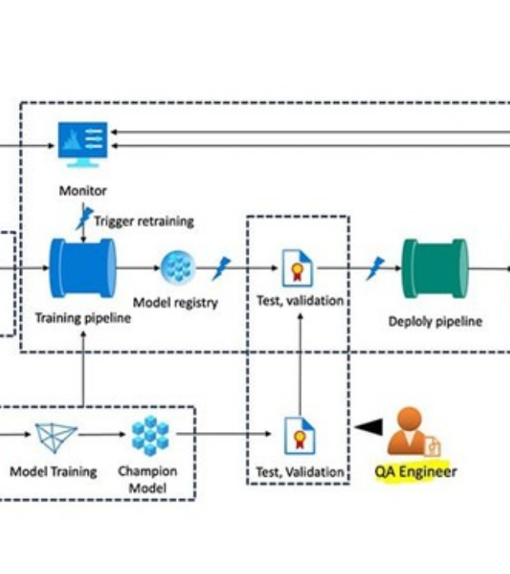
Data Analytics Workflow
Data Input: Source datasets / records.
Cleaning & Validation: Data quality and structural checks.
Analysis: Geospatial, churn and web traffic tasks.
Visualization: Interactive dashboard development.
Insights: Findings documented for academic evaluation.

Slide 8
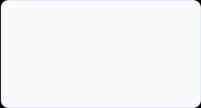
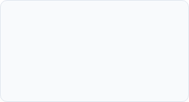
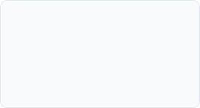
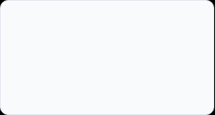
Internship Task Portfolio (1–4)
Task 2
Task 4
Docker & CI/CD Dockerfiles, container volumes, networking, and automated CI/CD for machine learning.
AI Agents & Automation LangChain, LlamaIndex, agent orchestration using LangGraph workflows.
Task 1
Task 3
AI Deployment & FastAPI AI lifecycle, MLOps terminology, async API endpoints, and production readiness.
Cloud AI & GenAI SageMaker, Vertex AI, Azure ML, vLLM serving, and model quantization techniques.

Slide 9
Task Portfolio & Evaluation
Evaluation
Hours
Kubernetes & Observability Container orchestration, Pods, Services, Prometheus, and Grafana logging.
Applied Capstone End-to-end full-stack RAG app deployment, business automation AI agents.
Task 5
Grade
Security & App Integration Streamlit/Gradio apps, model security, privacy, and bias mitigation strategies.
Optimization & Drift Evidently AI drift detection, auto-retraining, Advanced RAG, and Vector DBs.

Slide 10
Key Projects & Demonstrated Skills
Interactive Dashboard Development: Completed as a recorded internship project (Grade A).
Geospatial Data Analysis: Completed as a recorded internship project (Grade A).
Customer Churn Analysis: Completed as a recorded internship project (Grade B).
Web Traffic Analytics: Completed as a recorded internship project (Grade B).
Data Cleaning & Structural Validation: Completed as a recorded internship project (Grade A).

Slide 11
Performance Evaluation & Verification
Verification Metric | Official Record
Internship ID | VWX-AUG26TOSEP26-834
Domain | Data Analytics
Duration | 08 Aug 2026 – 07 Sep 2026
Total Hours | 155 Hours
Final Score | 92 / 100
Overall Grade | A (Excellent)

Slide 12
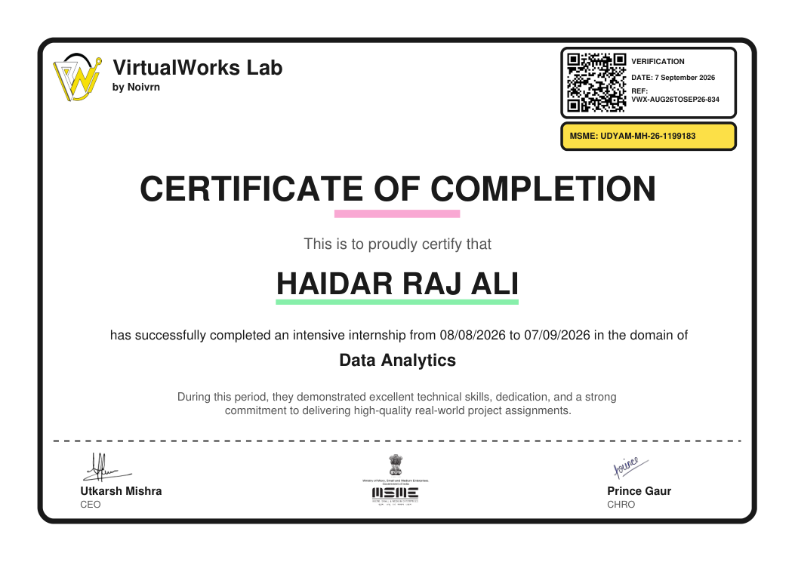
Certification & Official Verification

Slide 13
Thank You!
Haidar Raj Ali
School of Computer Science & Engineering
Roll No: 25SCS1003004846
IILM University, Greater Noida, U.P.

