Slide 1

Data-Driven Thermal Modelling of a Residential Building
R-C models that predict indoor temperature from weather and heating power
Rami Haidar
Building Thermal Modelling
TUM School of Engineering and Design
Munich, 11 June 2026
QR
Scan to download all code & data

Slide 2
Outline
OVERVIEW
1
The task and the three questions
2
Question 1 - Reading the data: how the two years compare
3
Question 2 - R-C models of increasing complexity
4
Question 3 - Which model predicts best, and why
5
Conclusion - From model to control
QR

Slide 3
SETTING THE SCENE
Background and the task
QR

Slide 4
Why model building thermal dynamics?
BACKGROUND
~30%
of global final energy is used in buildings
~78%
of EU home energy goes to space + water heating
largest
single end-use in homes is space heating (~63%)
Accurate, fast thermal models are the precondition for an energy-management system that cuts demand and shifts load.
QR
Sources: IEA (buildings energy use); Eurostat 2023 (EU households: 62.5% space + 15.1% water heating).

Slide 5
The task: model a building's indoor temperature
BACKGROUND · THE TASK
Setting: one single-family house in London, two years of 15-min data - indoor & outdoor temperature, heating power, solar (no occupancy or cooling)
1
Compare the two years
Which characteristics and differences appear between year 1 and year 2? Causes? How to visualise?
2
Build R-C models
Models of different complexity for indoor temperature from outside weather + heating power; train on year 1, test on year 2.
3
Evaluate and choose
Prediction performance on a winter and a summer window of year 2, across inference horizons: which model is best, and why?
QR

Slide 6
QUESTION 1
Reading the data
How do the two years compare?
QR

Slide 7
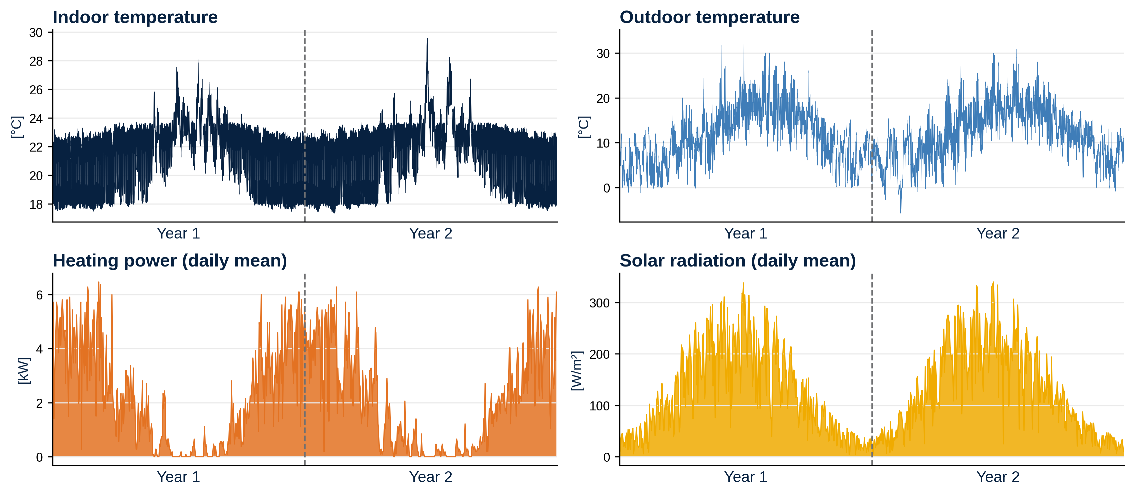
The data at a glance
QUESTION 1 · READING THE DATA
Two clean years at 15-min resolution; no gaps, no flatlines; indoor held near 22 °C
Heating-only (peaks ~9 kW, ~18–19 MWh/yr); summer indoor rise is passive solar gain, no cooling
QR

Slide 8
Two years compared
QUESTION 1 · READING THE DATA
Annual heating energy (single-family homes)
Metric | Year 1 | Year 2 | Change
Indoor mean | 21.6 C | 21.7 C | ~ same
Outdoor mean | 11.4 C | 11.8 C | +0.4 C
Outdoor minimum | -1.2 C | -5.7 C | colder
Heating energy | 19.2 MWh | 17.9 MWh | -7%
Heating-degree-days | 1785 | 1635 | -8%
≈ 20 MWh/yr
Old, poorly-insulated home
≈ 18.5 MWh/yr
This house (measured heating)
≈ 6-9 MWh/yr
New, efficient build
Aggregates barely move - year 2 is simply a milder weather year.
QR
Sources: Ofgem TDCV; BEAMA by property type.

Slide 9
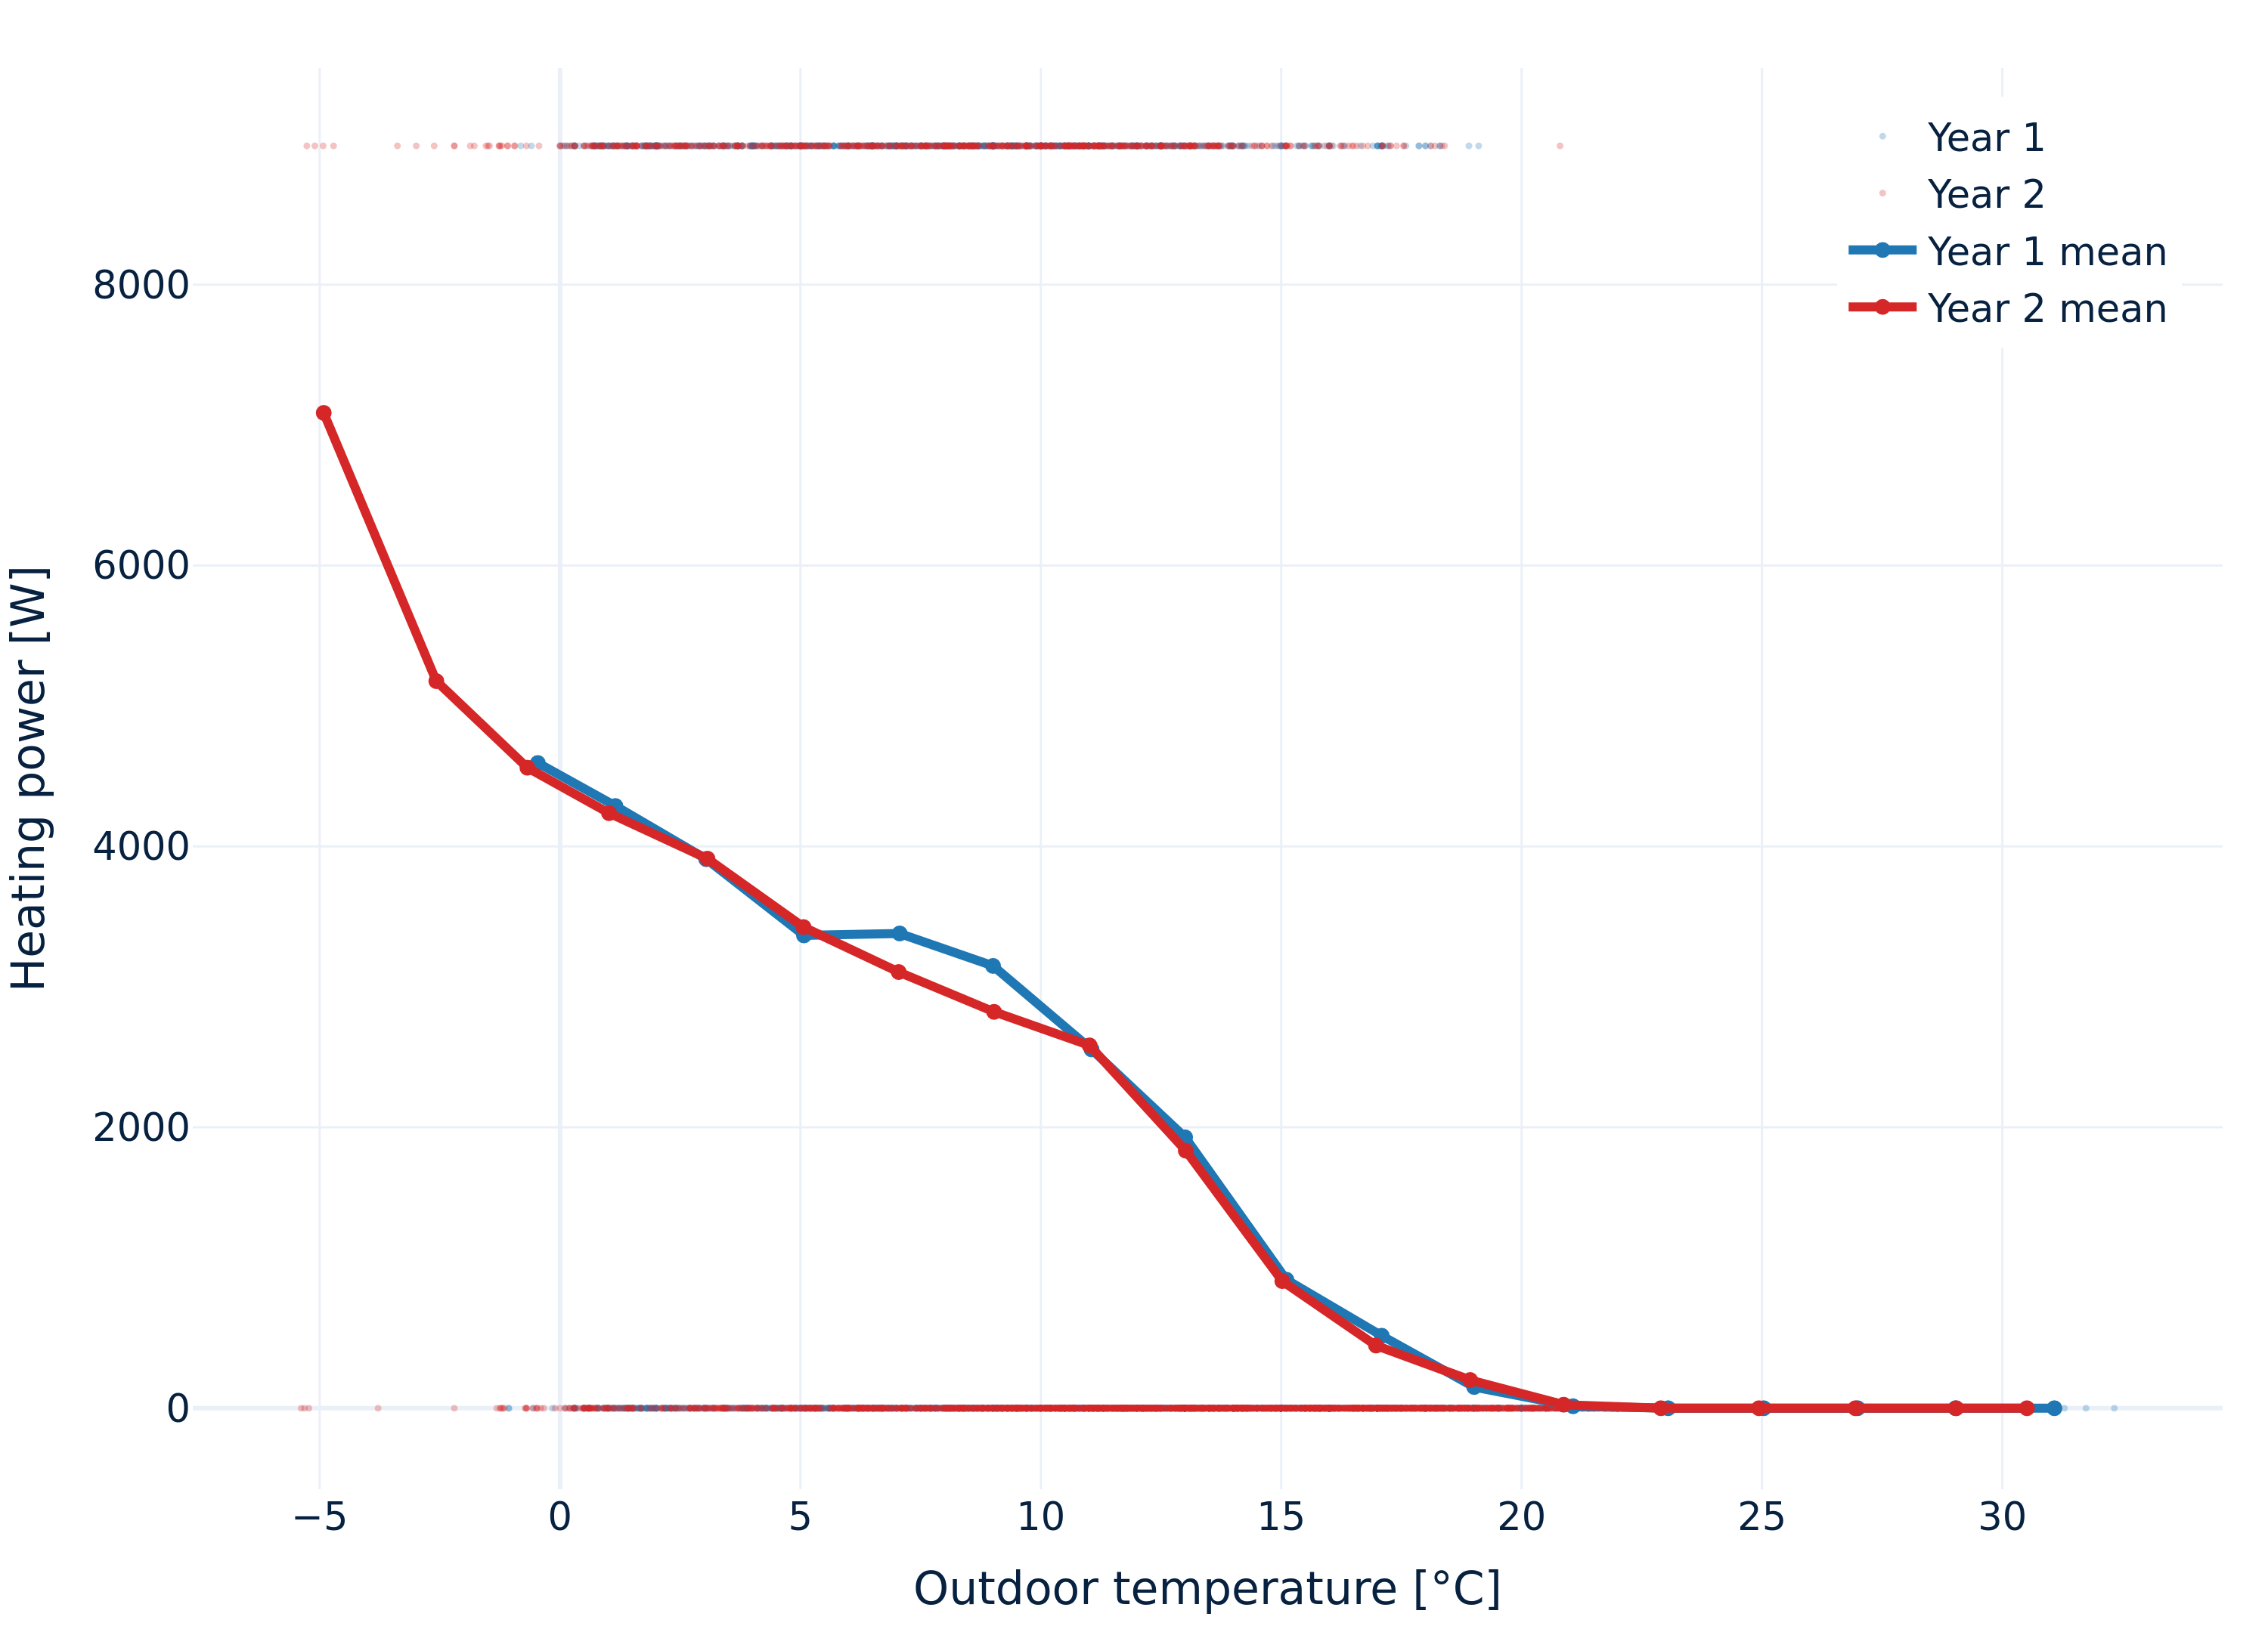
Year 1 vs. year 2: Weather changed
QUESTION 1 · READING THE DATA
Same heating fingerprint and thermal 'memory' in both years → envelope and control unchanged
Only the weather changed. Because the building is unchanged (a necessary condition), so a year 1 model generalizes to year 2.
Caveat: year 2 is colder than any year 1 day → mild extrapolation.
More in the notebook: box-plots, heat-maps, autocorrelation, seasonal scatter.
QR
Notes:
(Lag) von k: $$\hat{ρ_{k}}=\frac{\sum_{t=k+1}^{n}{\left(y_{t}−y\right)\left(y_{t−k}−y\right)}}{\sum_{t=1}^{n}{{\left(y_{t}−y\right)}^{2}}}$$

Slide 10
QUESTION 2
R-C models
Of increasing complexity
QR

Slide 11
Grey-box modelling: the electric analogy
QUESTION 2 · R-C MODELS
Structure from physics, parameters from data: temperature ~ voltage, heat flow ~ current, R = insulation, C = thermal mass
Other approaches: white-box (needs construction details) or a black-box
R-C model (simplest form)
Ti
Solar Φs
R
Φh
(+ Ai Φs)
+
C
indoor Ti
To
_
heating Φh
outdoor To
QR

Slide 12
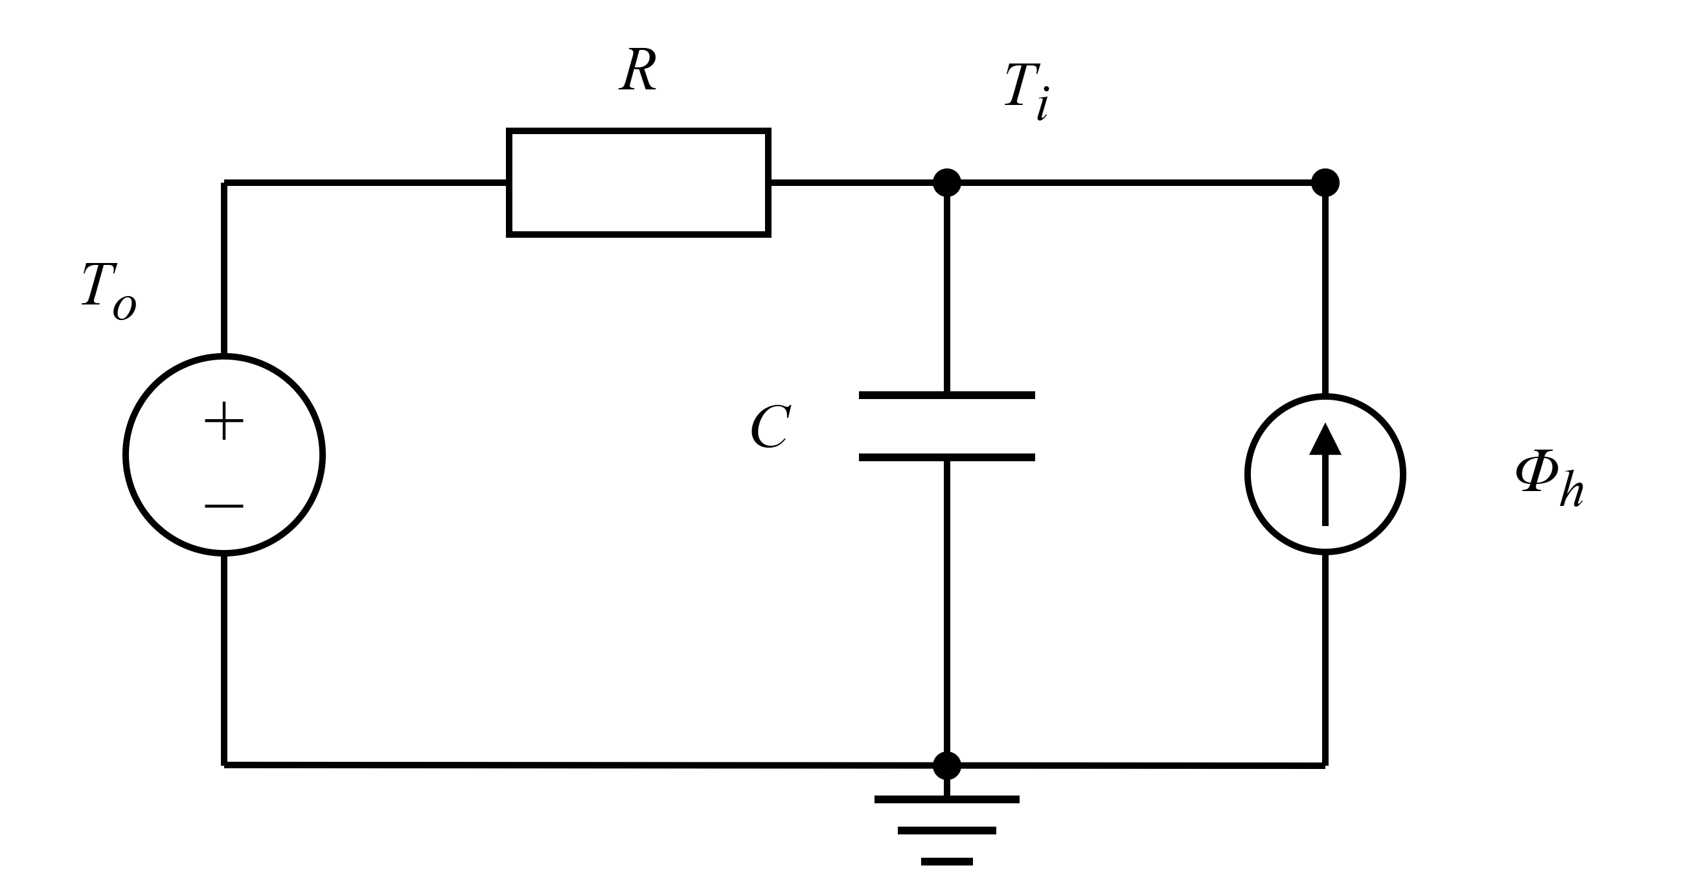
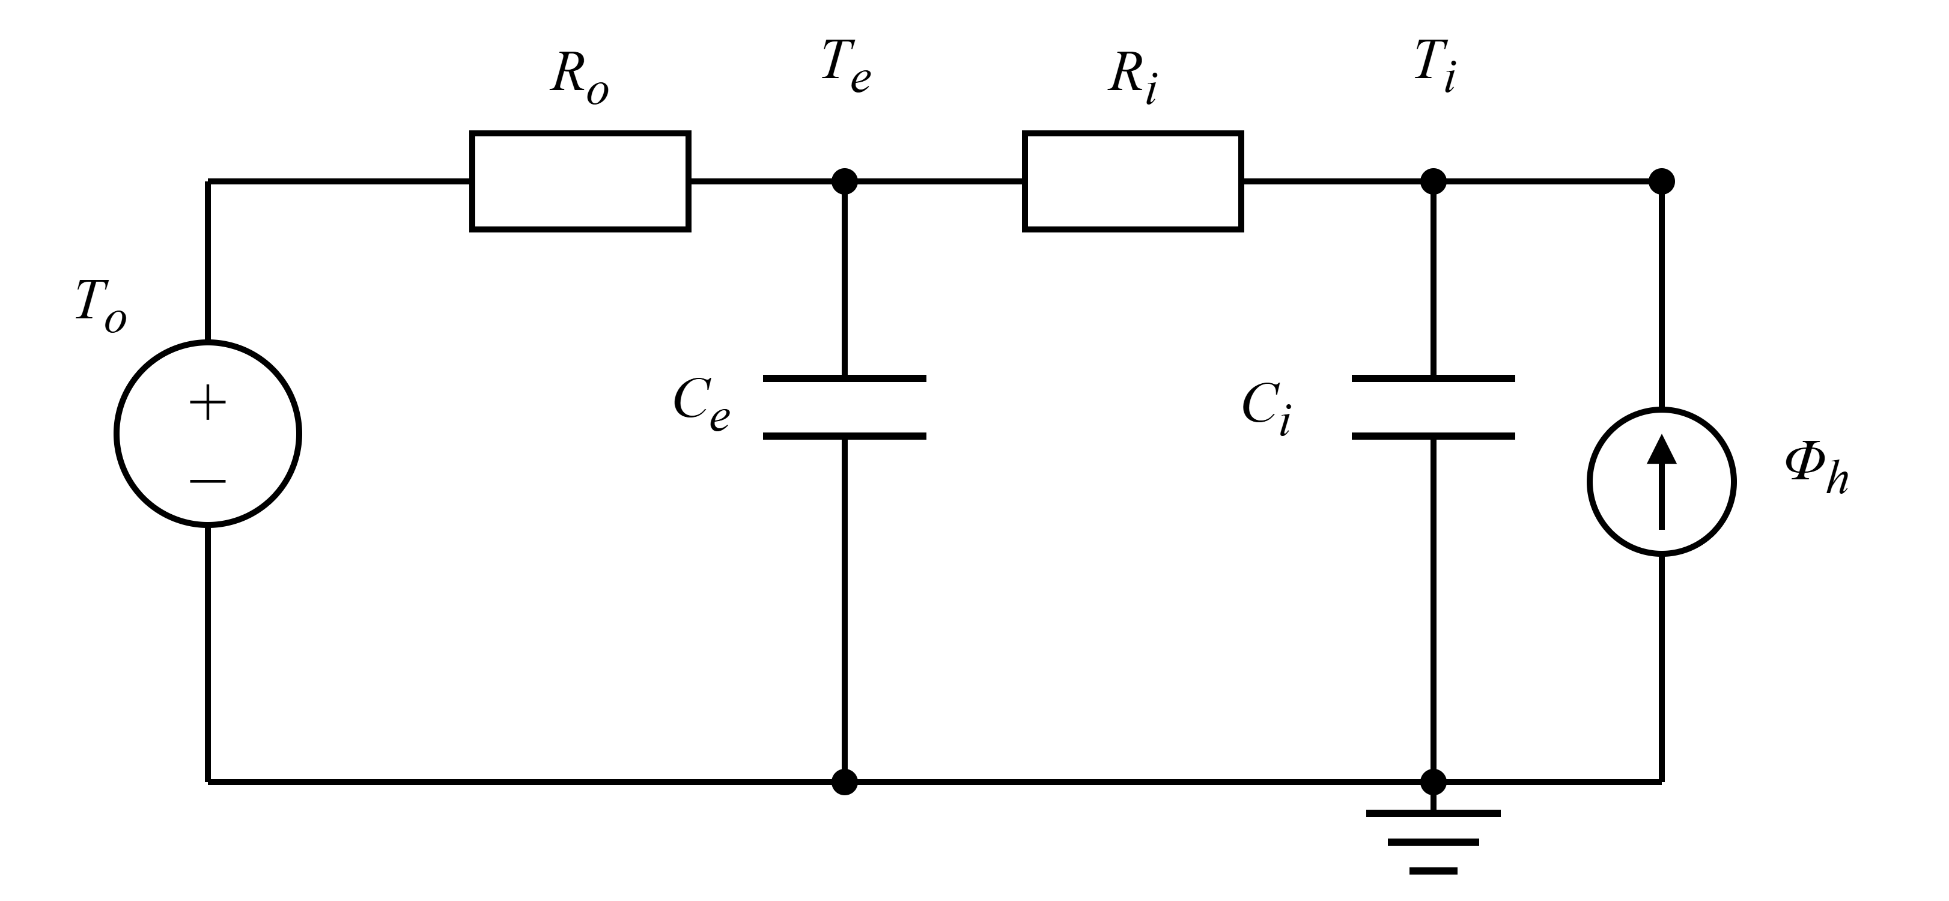
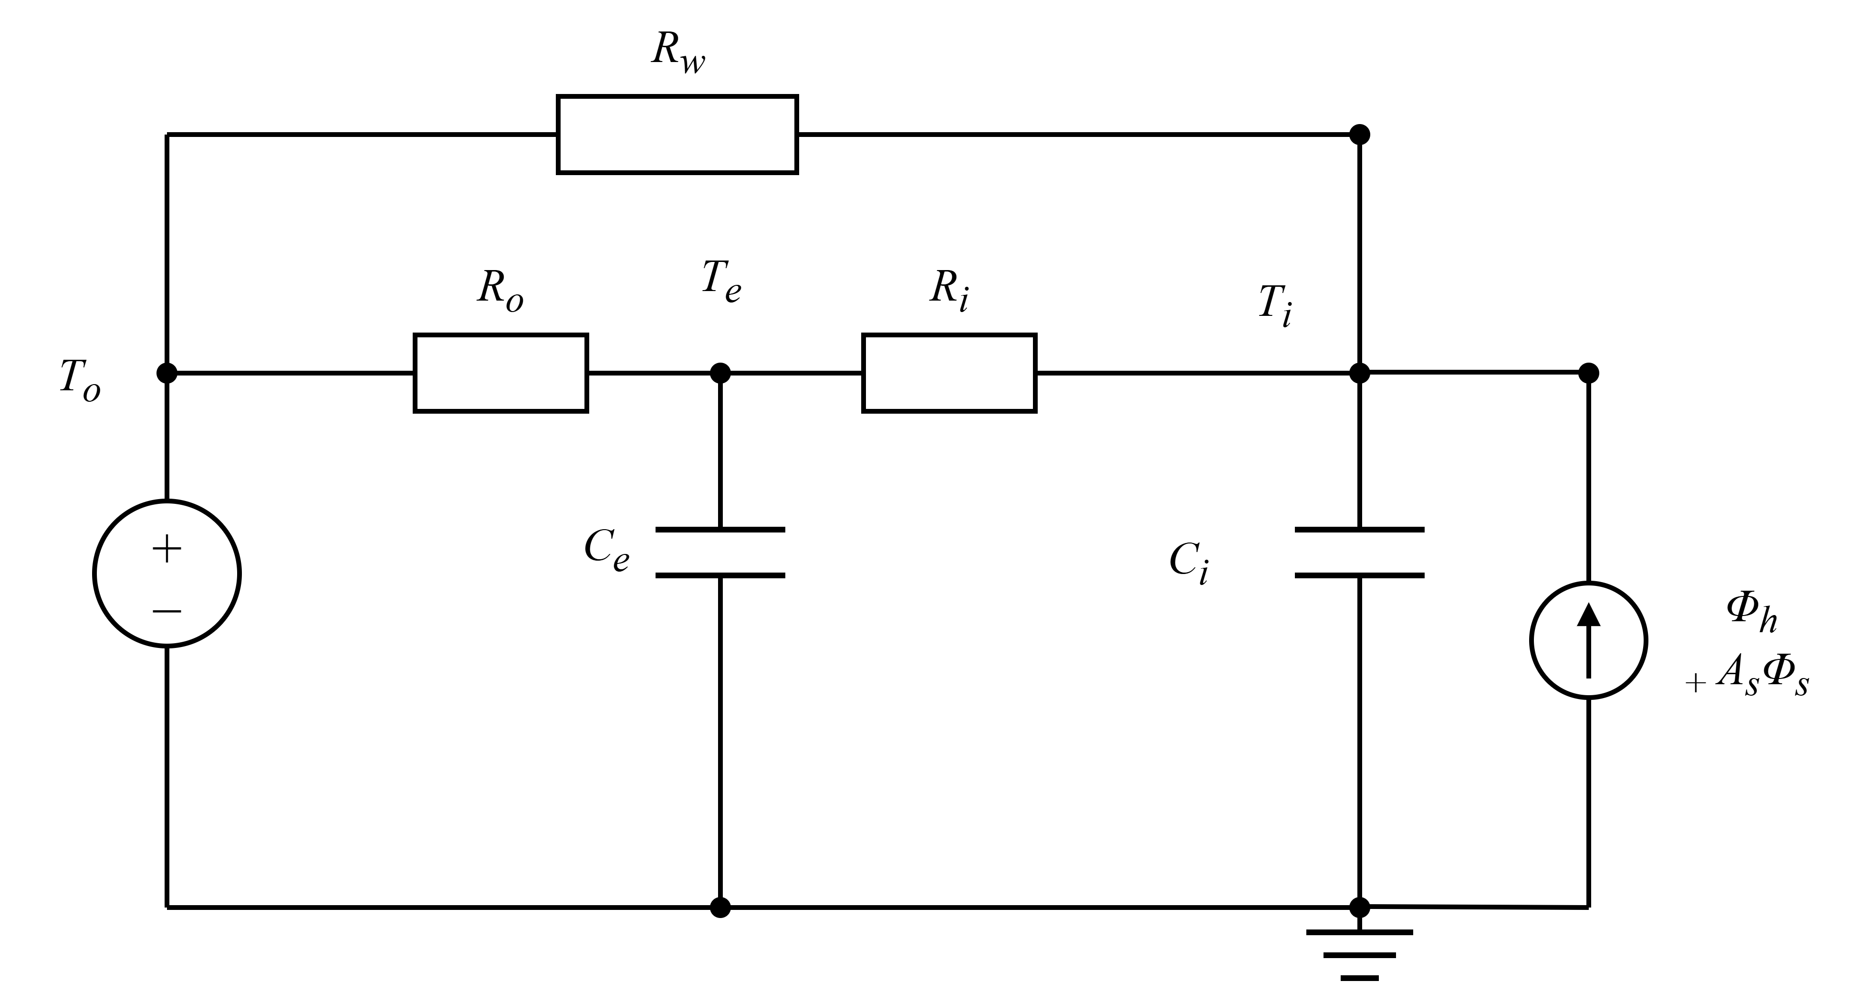

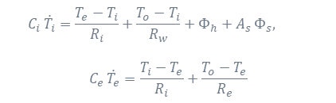

Three models, increasing complexity
QUESTION 2 · R-C MODELS
From one lump (A) to a wall/mass node (B) to a window path + solar (C)
Model A
Model B
Model C
1R1C – Indoor Air Only
2R2C – + Slow Wall / Mass Node
3R2C – + Window Path, Solar
$$C_{i} \dot{T_{i}}=\underset{\text{heat} \text{lost} \text{to} \text{outside}}{\underbrace{\frac{T_{o}−T_{i}}{R_{i}}}}+\underset{\text{heating}}{\underbrace{Φ_{h}}}$$
$$C_{i} \dot{T_{i}}=\frac{T_{e}−T_{i}}{R_{i}}+Φ_{h},$$
$$C_{e} \dot{T_{e}}=\frac{T_{i}−T_{e}}{R_{i}}+\frac{T_{o}−T_{e}}{R_{e}}$$
$$C_{i} \dot{T_{i}}=\frac{T_{e}−T_{i}}{R_{i}}+\frac{T_{o}−T_{i}}{R_{w}}+Φ_{h}+A_{s} Φ_{s},$$
$$C_{e} \dot{T_{e}}=\frac{T_{i}−T_{e}}{R_{i}}+\frac{T_{o}−T_{e}}{R_{e}}$$
QR
Notes:
(time constant $\tau = R_i C_i$) and a single overall heat-loss number $UA = 1/R_i$ (watts lost
per degree of temperature difference)
- **UA (W/K)** — the overall heat loss: how many watts the house loses per degree of indoor–outdoor difference.
- **time constant (h)** — roughly how many hours the building takes to react (its slowest "speed").
For a medium detached UK house we would expect **UA ≈ 150–350 W/K**, a slowest time constant of **about 1–3 days**, and
an effective solar window area of a few up to ~10 m².
What least_squares minimizes
It minimizes:
the sum of squared residuals over all prediction steps
across all windows and across all three horizons
So the training error is essentially:
minimize Σ (prediction - measurement)^2
over the concatenated residuals from the 30-min, 1-day, and 3-day forecast blocks.
Important nuance
It does not directly minimize RMSE or MAE
It minimizes squared errors, which is equivalent to least-squares fitting
The error is on the indoor temperature only (x[0] in the model state)

Slide 13
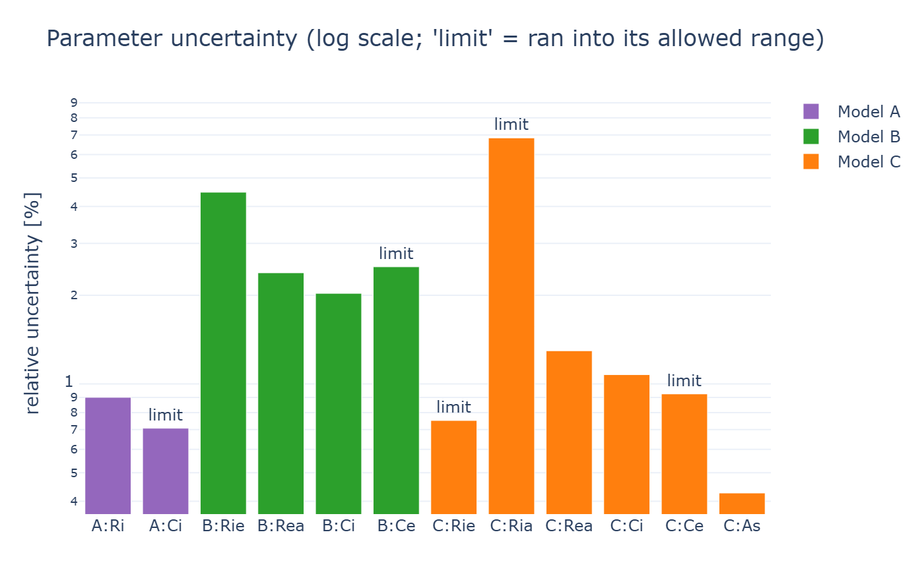
Fitting on year 1
QUESTION 2 · R-C MODELS
Train on year 1 only, no shuffling; constrained least-squares keeps every parameter physical
Prediction-error fit with multiple shooting (naive free-run diverges for a thermostat-controlled house; heating power is not an independent input)
Fit is done by minimizing squared temperature prediction errors (least-squares optimisation on the indoor temperature residuals).
More in the notebook: state-space matrices, per-parameter std-errors.
QR
Notes:
What least_squares minimizes
over the concatenated residuals from the 30-min, 1-day, and 3-day forecast blocks.
Keeping the parameters physical. Resistances and capacitances must be positive, so we fit their logarithms
(which can never go negative); the same trick keeps Model C's solar window area between 0.01 and 30 m². The fit itself
is a least-squares optimisation.
Resistances Ri, Rie, Ria, Rea:
actual range: 5e-4 to 3e-2 (K/W)
optimizer bounds: log(5e-4) to log(3e-2)
Capacitances Ci, Ce:
actual range: 1e6 to 1e8 (J/K)
optimizer bounds: log(1e6) to log(1e8)
Solar window area As (Model C only):
actual range: 0.01 to 30.0 (m²)
optimizer bounds: log(0.01) to log(30.0)
The relative uncertainty is derived from the local covariance of the least-squares fit. It tells how strongly the measured data constrains each fitted parameter around the optimum. Small values mean locally well-determined parameters. Large values or parameters at bounds mean weak identifiability.
A small bar means:
The objective function changes clearly when this parameter changes. The data contains enough information to determine it locally.
It is based on:
$$\text{Cov}\left(z\right)≈σ^{2}{\left(J^{T}J\right)}^{−1}$$
This is a local linear approximation. It assumes residuals behave nicely, are roughly independent, and that the optimum is not constrained by bounds. In your case, residuals are autocorrelated time-series errors, the model is nonlinear in parameters, and some parameters hit bounds.
So the best wording is:
The uncertainty bars are an approximate local identifiability diagnostic, not exact confidence intervals.
Residual variance:
sigma2 = (r^T r) / dof
where r = sol.fun is the residual vector
and dof = number of residuals − number of fitted parameters
Covariance of the log-parameters:
cov = sigma2 * (J^T J)^{-1}
rel_std_i = sqrt(σ² * ((J^T J)^{-1})_{ii})

Slide 14
QUESTION 3
Which model is best?
...and why?
QR

Slide 15
How we test: two windows, two ways to predict
QUESTION 3 · EVALUATION
Windows (year 2): winter = days 1-10, summer = days 200-209.
Baseline = persistence.
Metrics: RMSE, MAE, bias.
One-step (15 min): reset to the real measurement every step - easy
each step starts from a fresh measurement
Multi-step open-loop: start once, then run on the model's own predictions - the honest, harder test
QR
errors can build up the further ahead we predict

Slide 16
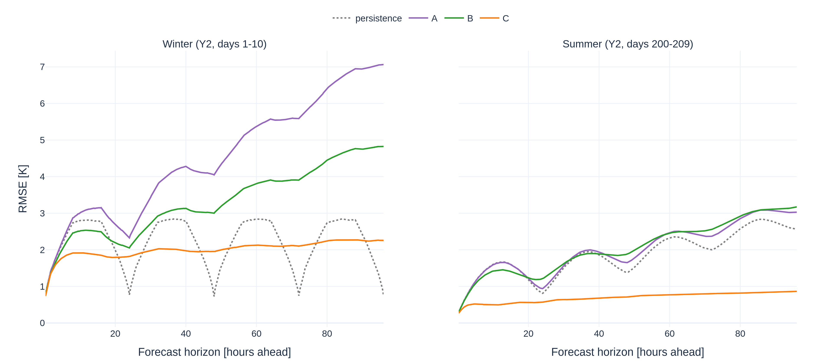
Error vs. forecast horizon
QUESTION 3 · EVALUATION
Short horizons tie, even persistence, because the building barely moves in 15 min (high inertia)
Persistence dips at 24/48/72 h is a daily-cycle artefact; beyond a few hours Model C is lowest and flat
QR
Notes:
Notice the curves are **not smoothly increasing** — they rise to a bump around 6–12 hours and dip again near 24 hours.
96 h up to 4 days
"persistence" = assume the temperature stays at its last measured value
So for 24 hours ahead:
meas[a] is the current temperature at anchor time a
meas[a + 96] is the actual measured temperature 24 hours later
because 96 steps × 15 minutes = 24 hours

Slide 17
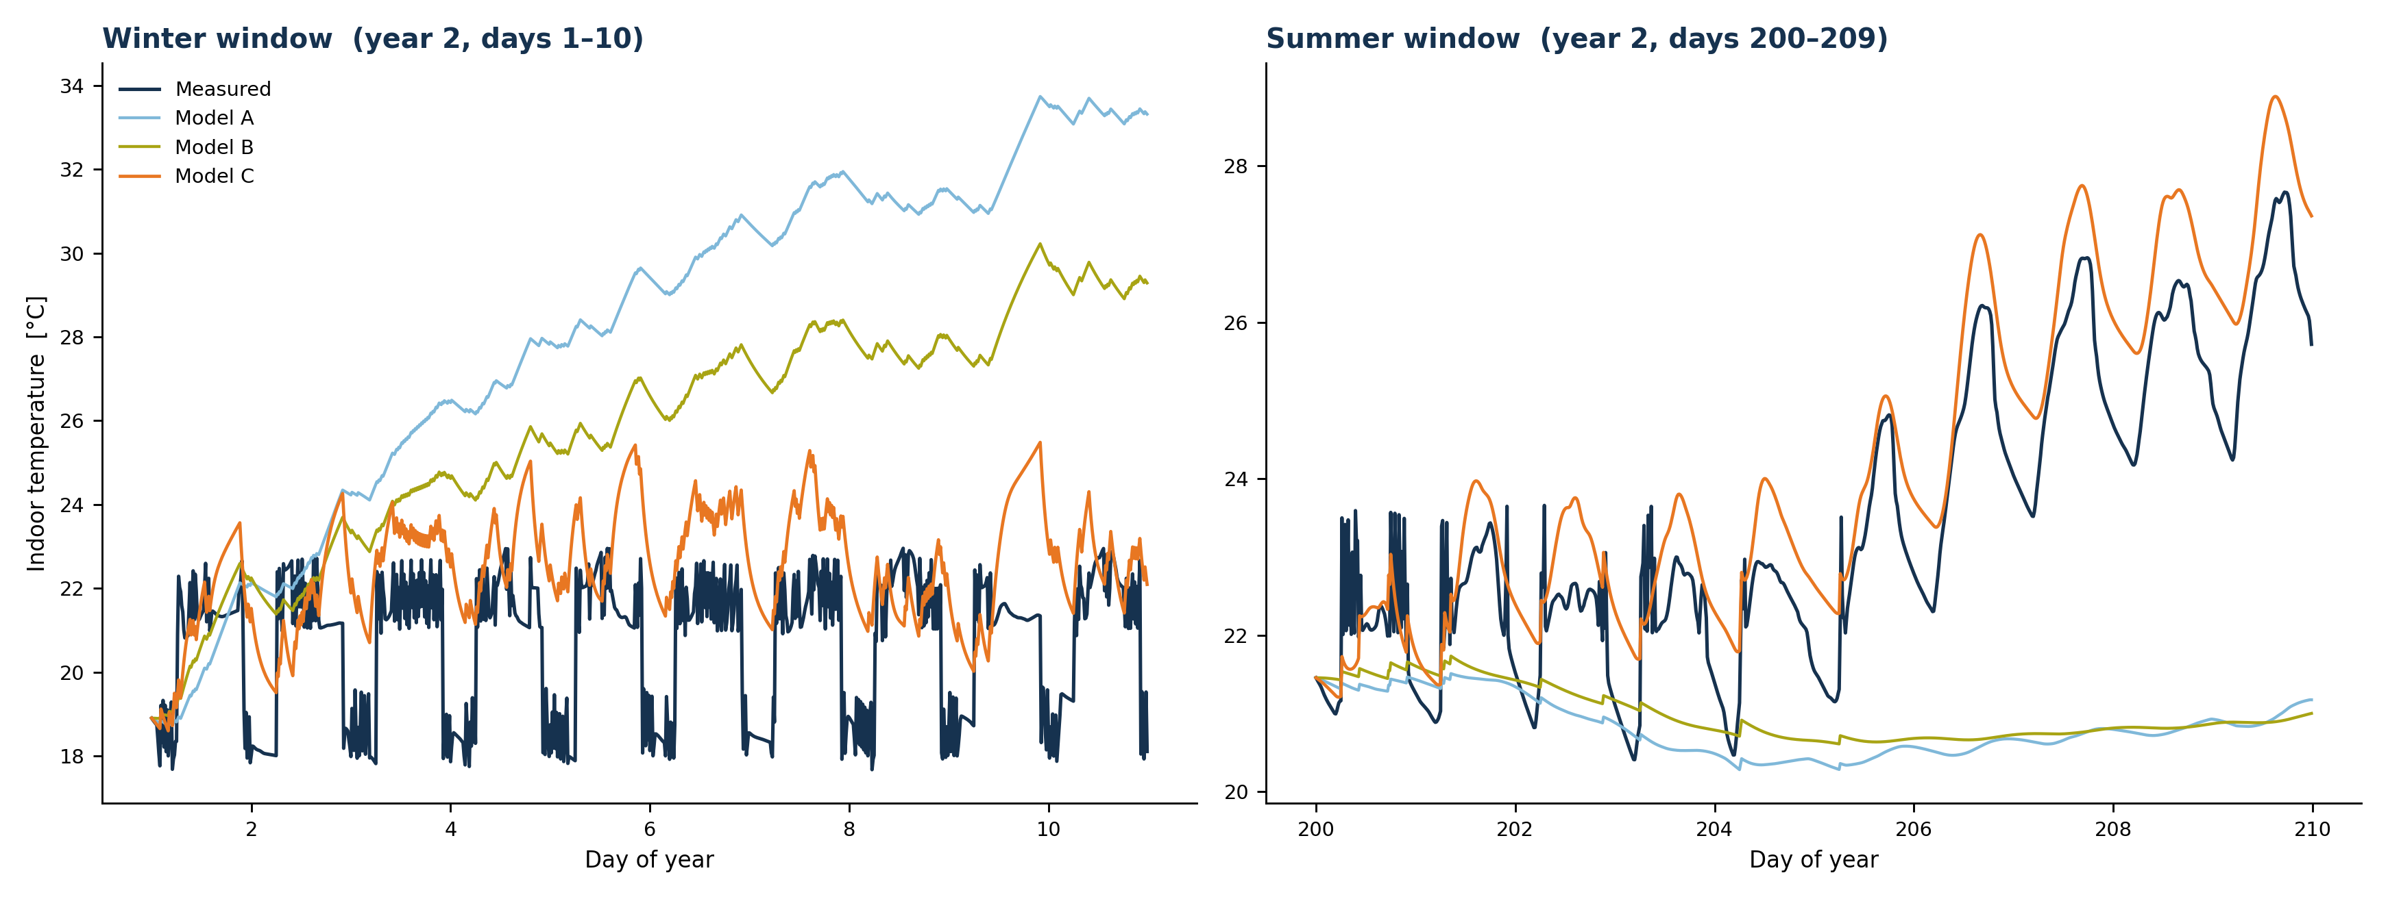
Ten-day free-run: A and B drift, C tracks
QUESTION 3 · EVALUATION
Started once, run 10 days: A/B drift (too warm in winter, too cool in summer); C stays close in both
10-day RMSE - winter: C ~2.5 K vs A 8.6 / B 5.9; summer: C ~0.95 K vs A/B ~3.2 K
QR

Slide 18
Why C wins: robust & lowest error
QUESTION 3 · EVALUATION
Models A and B have no solar term, so they drift in summer; only C captures solar gain
Result: C has the lowest multi-step error in BOTH winter and summer
10-day free-run RMSE [K]
No single winner. <=1 h all tie (use A); for control horizons C is best & uniquely robust.
More in the notebook: residual-vs-solar diagnostic, per-horizon error tables, MAE & bias by season.
QR
C is lowest in both seasons.
Notes:
How we score the forecasts (RMSE, MAE, bias) - **RMSE** (root-mean-square error): the typical error size, but it punishes big mistakes extra hard.
- **MAE** (mean absolute error): the average error size, easier to read and less sensitive to outliers.
- **Bias** (mean of predicted − measured): the *direction* of the error. Positive means the model runs too warm,
negative too cold. A model can have a small RMSE but a worrying bias, so we always look at it too.

Slide 19
WRAPPING UP
Conclusion
From model to control
QR

Slide 20
The best model depends on the use
CONCLUSION
A
C
Short horizon (<= 1 h)
All models tie with persistence → pick the simplest. Complexity buys nothing.
Control horizon (6-24 h+)
Best, and the only one robust across both seasons (it has the solar term).
QR

Slide 21
From model to control
CONCLUSION · OUTLOOK
Weather forecast
MPC optimiser plan next hours
Heating schedule → building
R-C model (the predictor)
measurements feed back (re-initialise the forecast)
QR

Slide 22
Take-home
CONCLUSION
1
2
Three interpretable grey-box models; complexity helps only for multi-step forecasting
The two years differ only in weather, so a year-1 model transfers
3
Model C wins for control horizons - uniquely robust through its solar term
4
The R-C model is the interpretable prediction engine an EMS / MPC builds on
QR

Slide 23
References
REFERENCES
Brastein, O. M. et al. (2018). Parameter estimation for grey-box models of building thermal behaviour. Energy & Buildings 169, 58-68.
buildingenergygeeks.com - A simple R-C model (state-space building thermal modelling).
Drgona, J. et al. (2020). All you need to know about model predictive control for buildings. Annual Reviews in Control 50.
Raisch, F. et al. (2025). GenTL: A general transfer-learning model for building thermal dynamics.
Zollner, S. - Practical Session: Model Predictive Control for Buildings (TUM EMT, ML in Energy Management).
IEA - Buildings & Space heating data. Eurostat (2023) - Energy consumption in households. Ofgem - TDCV. BEAMA - UK home gas consumption.

