Slide 1
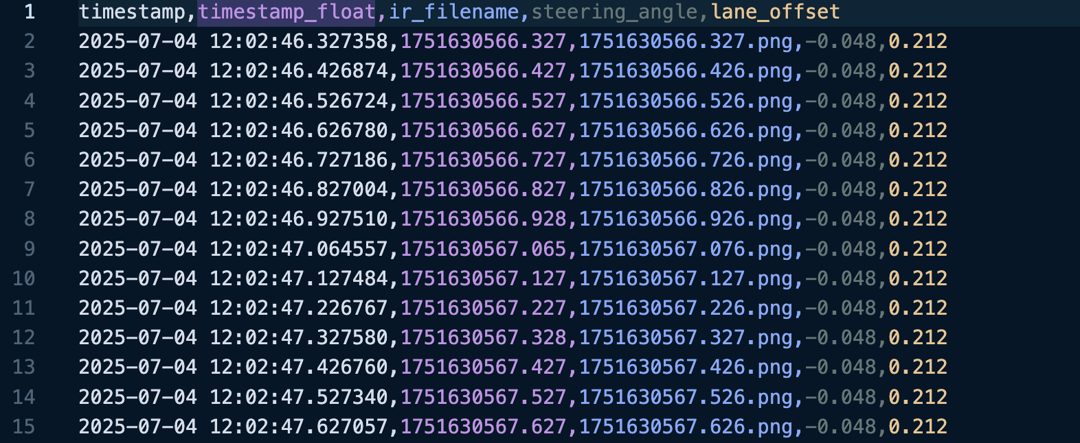
Feature Extraction - Vehicle Data(CARLA)
Node Architecture
Node Name: online_feature_node
Subscribes to: /data_capture/data (std_msgs/String)
Publishes to: /features_carla (Float32MultiArray)
60s sliding window, recomputed every 20s.
Fig 1 :- Input csv data for offline feature extraction for 1 person.

Slide 2
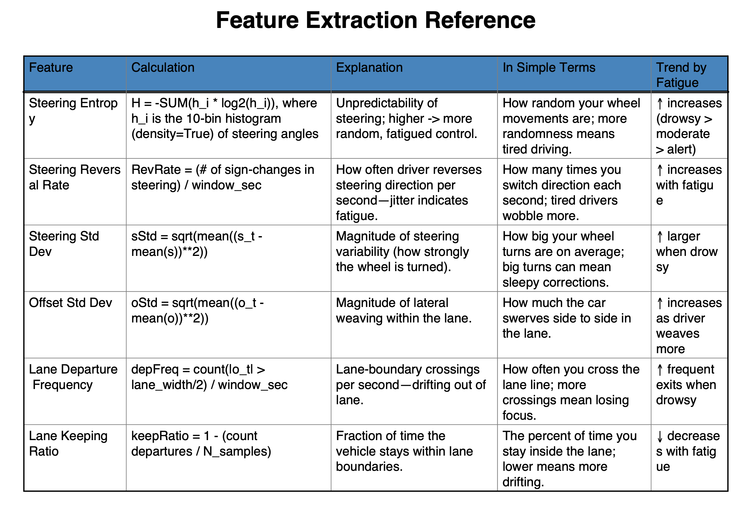
Extracted Features
Table 1:
1. Steering Entropy
2. Steering Reversal Rate (SRR)
3. Std. Dev. of Steering
4. Std. Dev. of Lateral Offset
5. Lane Departure Frequency
6. Lane Keeping Ratio
7. Lane Change Count

Slide 3
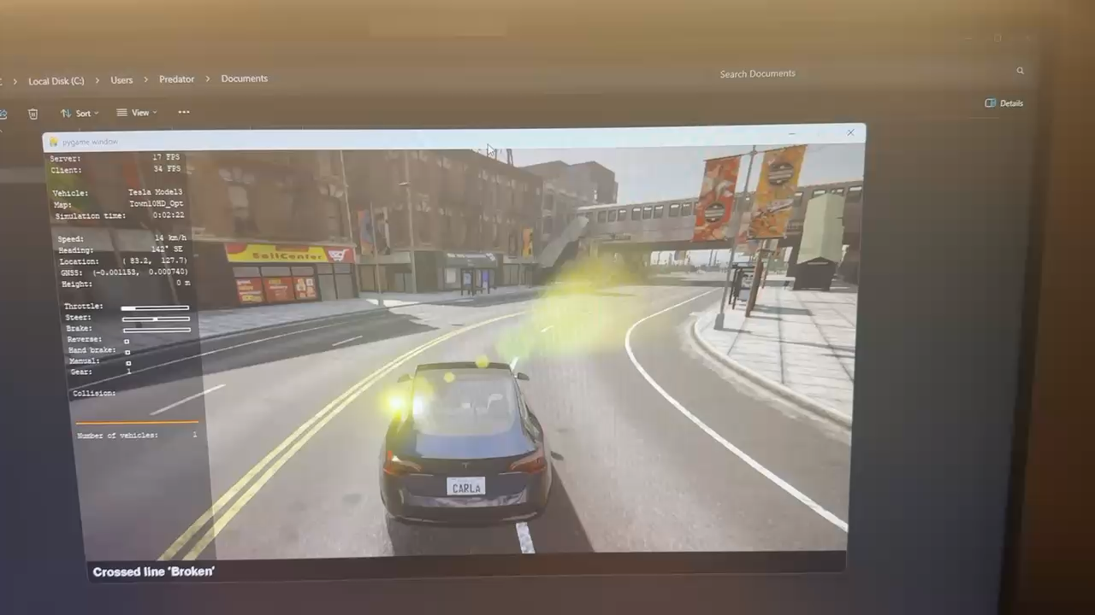
Sliding Window Mechanism
Maintains last 60 seconds of driving data.
Every 20 seconds:
– Cleans old data
– Computes new features
– Publishes output for downstream modules
Video 1 :- Visualization of how the waypoints and vehicle position is calculated

Slide 4
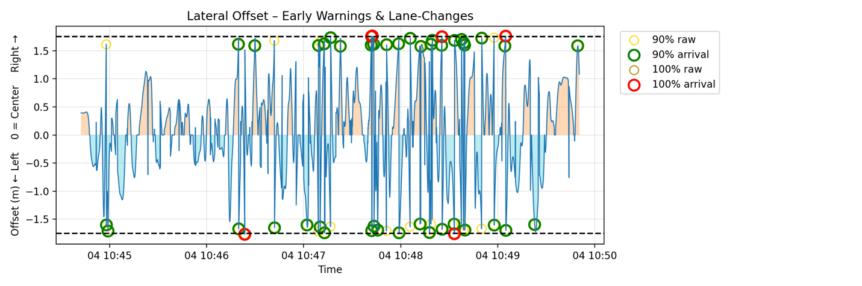
Lane Deviation Logic
• Early Warning: Offset ≥ 90% of lane half-width (±1.575 m)
• True Departure: Offset ≥ full lane half-width (±1.75 m)
• Enhances lane change and drowsiness detection accuracy
Fig 2 :- Lateral offset data of 1 test person for kss_5

Slide 5
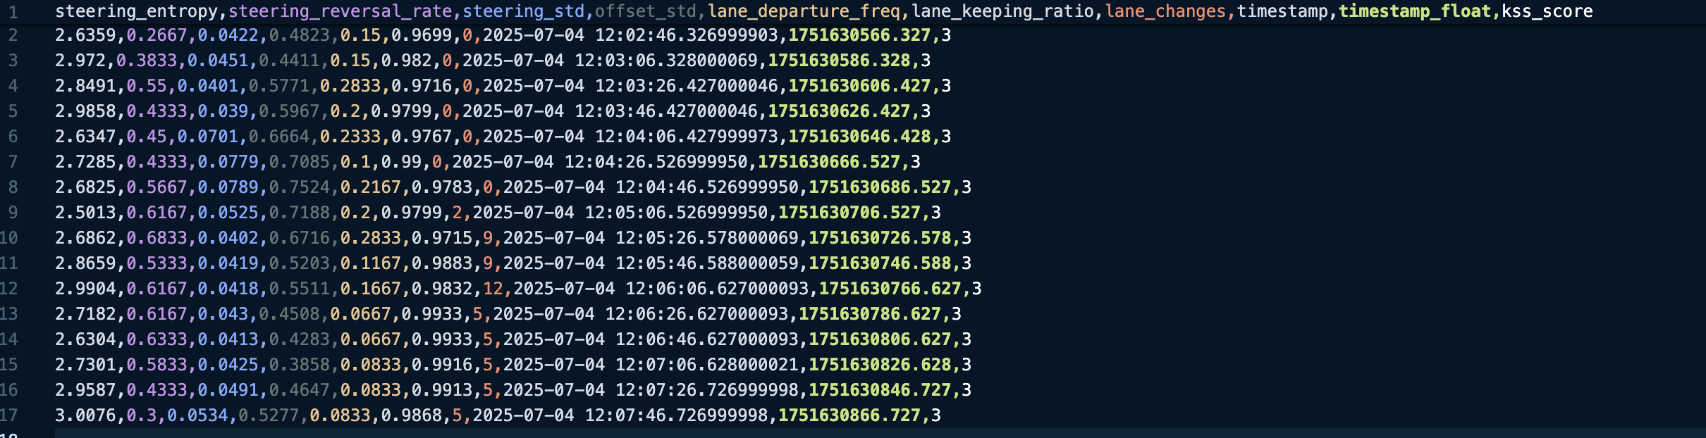
Publishing Format
• Output Type: Float32MultiArray
• Published every 20 seconds
• Order:
1. Steering Entropy
2. SRR
3. Std(Steering)
4. Std(Offset)
5. Lane Departure Freq.
6. Lane Keeping Ratio
7. Lane Changes
Fig 3 :- Final Feature Vectors for Hamza_Kss_3

Slide 6
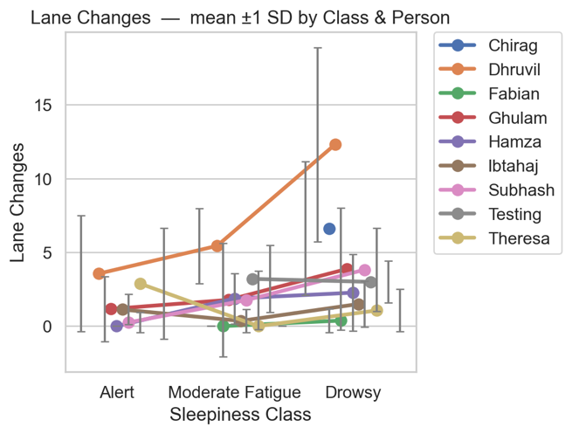
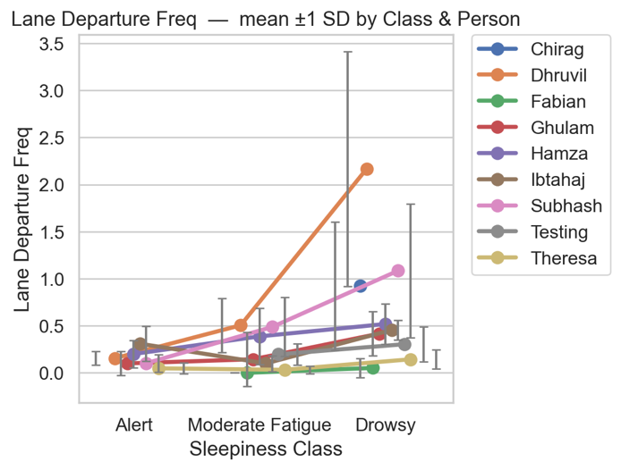
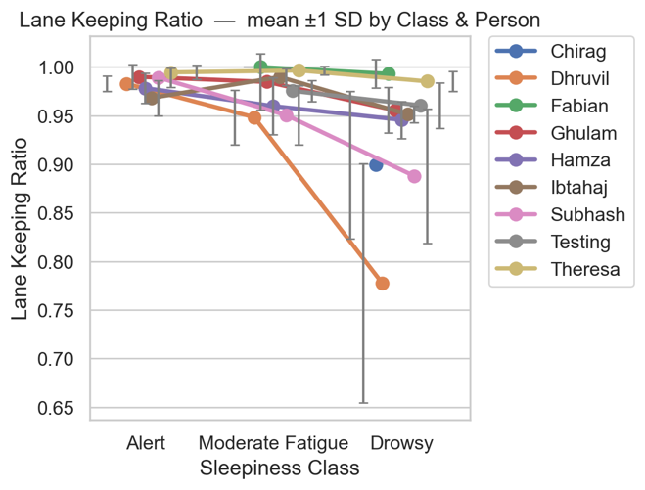
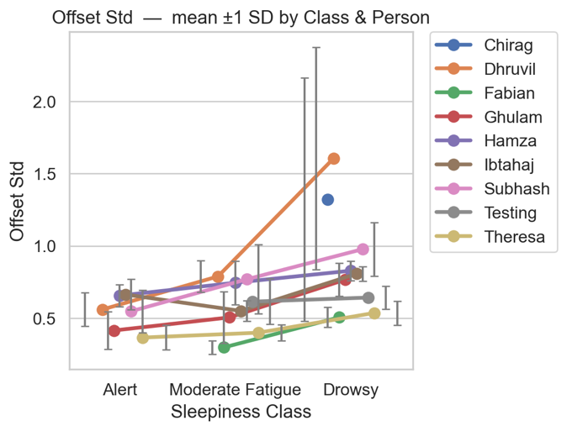
Driving Behavior Metrics vs. Sleepiness Levels

Slide 7
