Slide 1
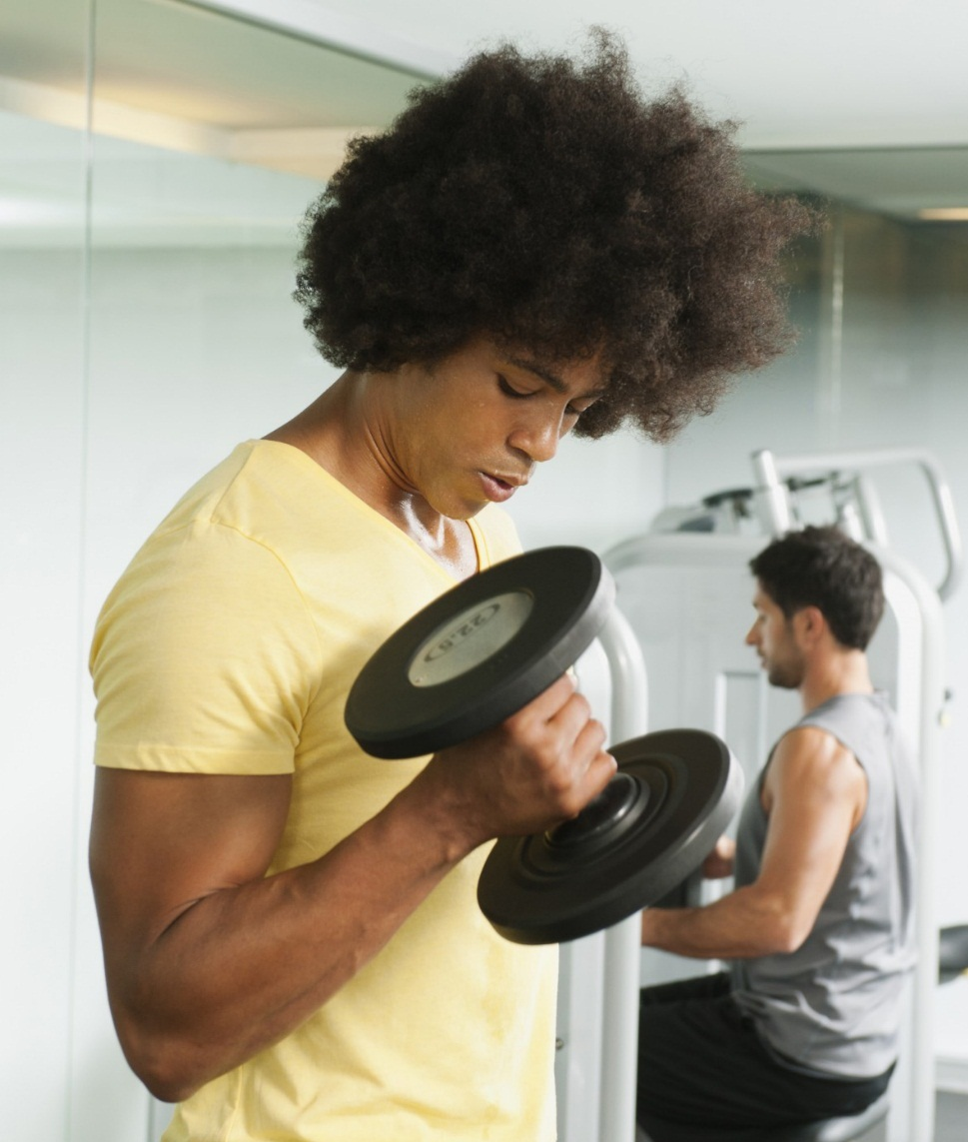
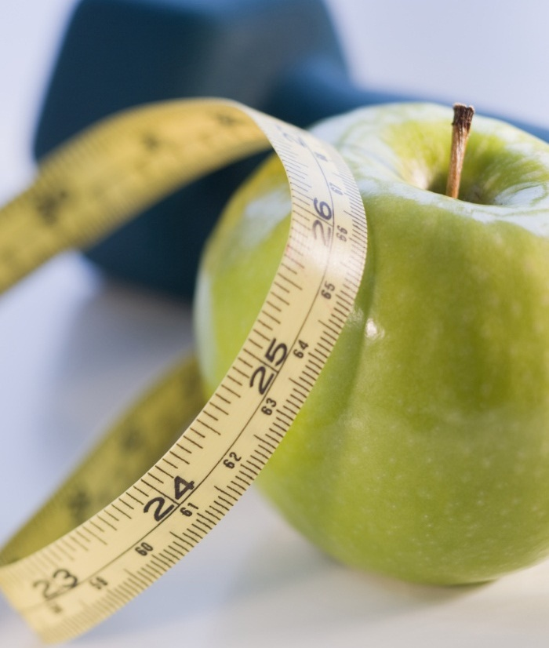
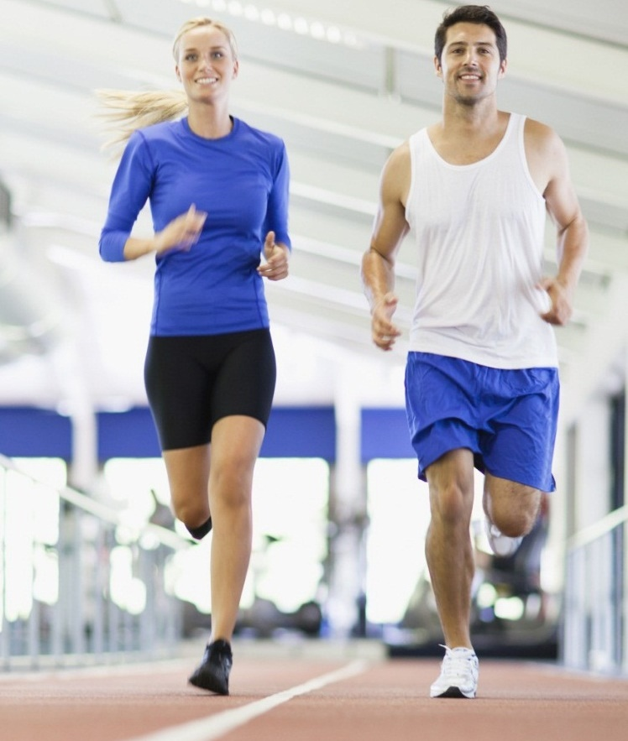
FitzBit
Your personal workout APP

Slide 2
Your fitness partner
this app will help you to get your fitness goals

Slide 3
INTRODUCTION
▪ Development of Fitness application is mainly required by People to make sure that their health is going well through the use of smart phone and tablets. The main aim of this project is to facilitate People in fitness, Exercising and improving their knowledge regarding trainings. Our app provides them workout plans and tips on nutrition. We designed the application to facilitate the users to be able to stay fit and get their desired body look using professional workout plans targeting different muscle of whole body.

Slide 4
MOTIVATION
In this fast track career driven generation people want flexibility of time and place so for its solution we’re making this app which will provide custom workout plans which can be performed in anywhere without or some equipments at the ease of the user

Slide 5
Scope
Choose workout plan as per your age criteria
Get notified about workout time
▪ Administrative Task
▪ Add or delete Exercise
▪ Easy way to test your health.
▪ User friendly- app for easy understanding.
▪ Can reduce usage of time.

Slide 6
Features
Custom Workout planner with all the exercise
Your personal trainer, visual graphics tutorial on how to perform exercises
Sets Counter and Timer
Tips on Nutrition and Quotes for daily workout
Daily Reminder and Sound Notification
60 days Workout Planner and progress tracker
Send Notification to users about new trends

Slide 7
Methodology
Android Studio
Java
Gradle
Firebase
Flutter

Slide 8
How It works

Slide 9
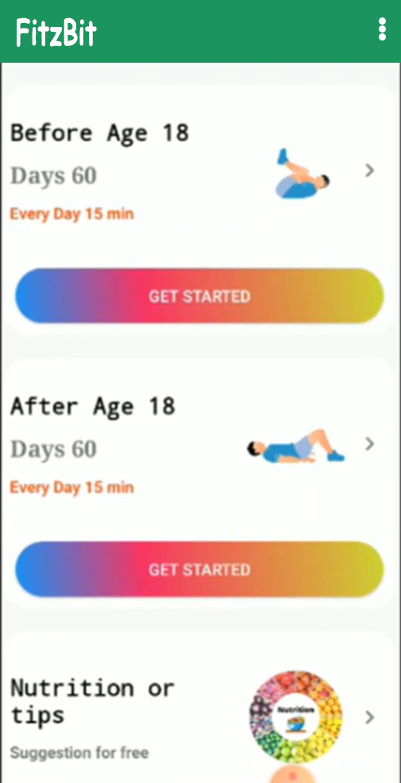
User Interface
Upon entering the App User will have to select their age criteria
They will be then provided with different categories
Beginner
Intermediate
Expert
Base on their selection of choices a customized workout will be created for user which can be customized by end user as per their liking

Slide 10
User Interface
There will be a Nutrition or Tips page in which nutritional suggestions and tips for healthy diet and workout plan will be shown

Slide 11
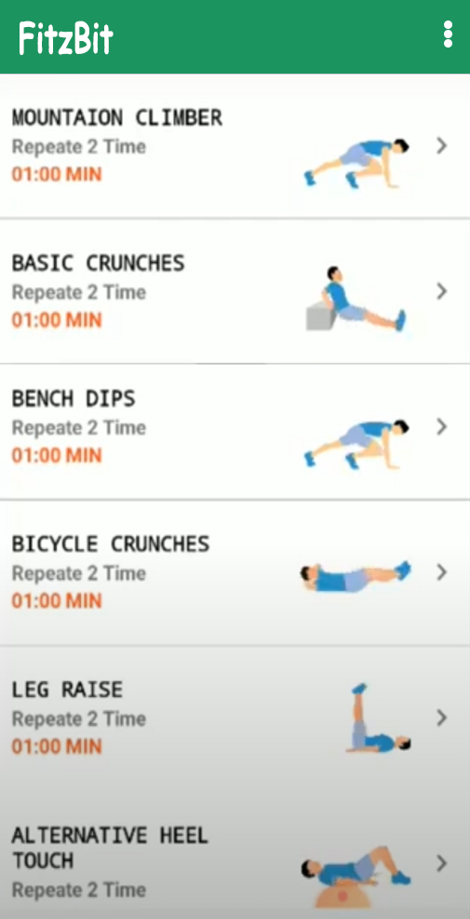
Flow of app
User Opens the app
Select age Criteria
Select Workout Intensity
Customize Workout
Duration of Workout (e.g. 60 days)
Start The Workout Challenge
Track Your Progress
Calculate Your BMI
Track your workout Through your app
Nutritional Diets and tips

Slide 12
Flow of app
User will get notification for workout (to set during creation of plan)
On starting the workout a timer along with set of exercises will start
An example on how to perform the Exercise will be shown and there will be a button to get detailed instructions on how to perform the exercise

Slide 13
Thank you

