Slide 1
MCT-241: Modelling & Stimulation
Modeling, Simulation, and Control of a Four-Bar Mechanism with a Brushless Servo Motor
Submitted By:
Muhammad Haider Ali
Department of Mechatronics & Control Engineering, University of Engineering & Technology, Lahore

Slide 2
Objectives
To obtain the mathematical model of the four-bar mechanism and motor system.
To study the variation of system parameters and analyze their effects.
To model and simulate the system using MATLAB/Simulink.
To design a control strategy to achieve precise motion control.
To evaluate the system's response under different conditions and optimize performance.
Introduction
Imagine a mechanical arm connected to a motor that allows it to move in a controlled manner. This arm setup, known as a four-bar mechanism, is common in machines that need to transfer rotational motion into a specific type of movement, like robotic arms or vehicle suspension systems. By modeling and simulating this setup on a computer, we can understand how the system behaves under different conditions and tweak the motor's performance to ensure it moves just right.

Slide 3
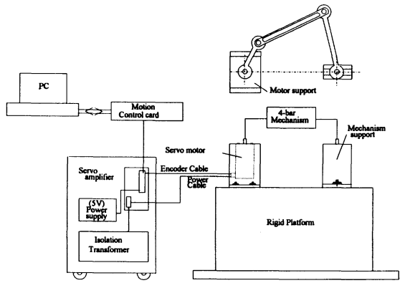
Block Diagram

Slide 4
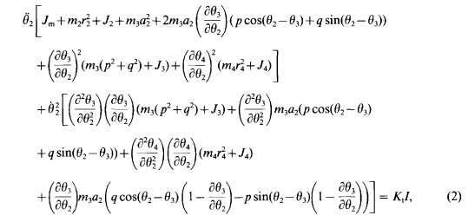
Mathematical Model of Entire System

Slide 5
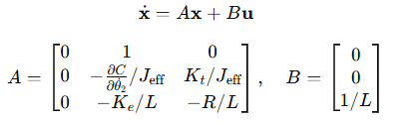
State-Space Representation

Slide 6
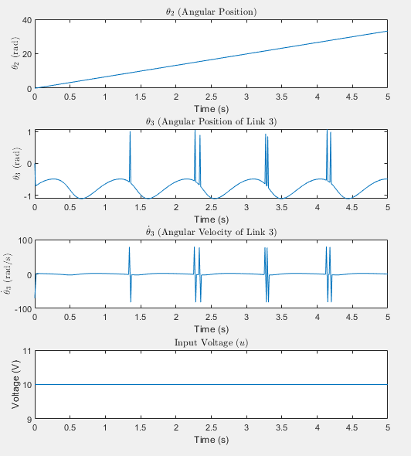
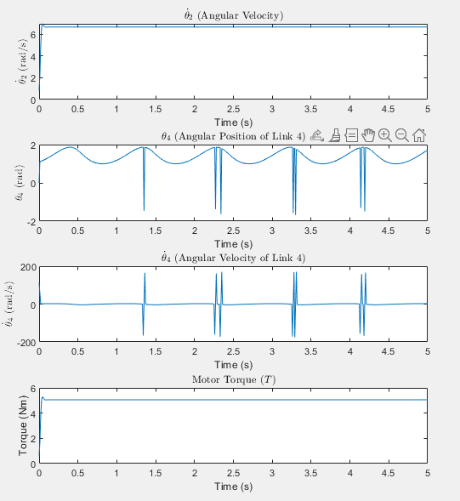
Stimulated Graphs

Slide 7
Conclusion
This project modeled and analyzed a servo motor coupled to a four-bar mechanism using linear and nonlinear approaches. While the linear model provided simplicity and efficiency for steady-state analysis, the nonlinear model captured intricate dynamics and offered high-fidelity results. Graphical outputs revealed the significant impact of nonlinear effects on performance, highlighting their necessity for realistic simulations. This work provides a foundation for advanced control strategies and system optimization.

