Slide 1

MCT-453L · MACHINE VISION
Design and Evaluation of a Deep Learning-Based
Vehicle Detection and Classification System
Using EfficientNet-B0 for Classification and YOLOv8n for Object Detection
SUBMITTED TO
Dr. Zulqarnain Naqvi
DEPARTMENT
Mechatronics & Control Engineering, UET Lahore
SUBMITTED BY — GROUP 6
Muhammad Bilal Afzal Awan 2022-MC-41
Muhammad Haider Ali 2022-MC-45
Muhammad 2022-MC-48
Muhammad Abdullah 2022-MC-50
Azmeer Ali 2022-MC-53
Faiq Ahmad Zia 2022-MC-59
Daies Ali Shah 2022-MC-67

Slide 2

CHAPTER 1 · EXECUTIVE SUMMARY
Automated Vehicle Detection at Scale
Manual monitoring of traffic cameras is neither scalable nor cost-effective for modern intelligent transportation needs.
This project designs and benchmarks a six-phase deep learning pipeline that automatically detects and classifies six vehicle categories — bus, car, microbus, motorbike, pickup-van, and truck.
Two architectures are implemented and compared head-to-head: EfficientNet-B0 (classification via transfer learning) and YOLOv8n (real-time object detection).
9,211 annotated traffic images from Roboflow underpin dataset engineering, training, optimization, deployment, and critical analysis.
9,211
6
Annotated Images
Vehicle Classes
81.2%
73.0%
EfficientNet-B0 Val. Accuracy
YOLOv8n mAP@50
Both models achieve near-identical ~37ms GPU inference; larger vehicles (bus, truck) are consistently easier to detect than motorbikes and microbuses.
MCT-453L · MACHINE VISION · VEHICLE DETECTION & CLASSIFICATION
02

Slide 3







CHAPTER 2 · INTRODUCTION
Problem Definition & Motivation
Problem Definition
Motivation
Traffic-scene imagery is formulated both as a classification task and an object-detection task. The pipeline must automatically detect and classify six vehicle types directly from real-world camera footage — replacing slow, costly manual review with automated, repeatable inference.
Underpins intelligent transportation: toll collection, traffic density estimation, and urban planning.
Adapts pre-trained architectures to a domain-specific problem under real-world constraints.
Ultimately motivated by engineering ethics: reducing road-rage related accidents and protecting vulnerable road users through reliable automated monitoring.
Engineering Constraints
Class imbalance across the six vehicle types
Occlusion and viewpoint variation
Limited compute resources for training
Classification Task
Detection Task
Toll Collection
Traffic Density
Urban Planning
Road Safety
MCT-453L · MACHINE VISION · VEHICLE DETECTION & CLASSIFICATION
03

Slide 4

CHAPTER 2 · INTRODUCTION
Related Work
1
2
3
EfficientNet
YOLO Family
Prior Traffic-Vision Work
Tan & Le, ICML 2019
Redmon et al., CVPR 2016
Domain literature
Compound scaling of depth, width, and resolution yields strong accuracy with fewer parameters — well-suited for transfer learning on constrained hardware.
Evolved from two-stage pipelines toward fast single-stage detection; YOLOv8n (Ultralytics) represents the current state of the art for resource-constrained deployment.
Fine-tuned CNNs perform well on curated traffic datasets but degrade under occlusion, lighting variation, and class imbalance — directly addressed here via augmentation and regularization.
MCT-453L · MACHINE VISION · VEHICLE DETECTION & CLASSIFICATION
04

Slide 5

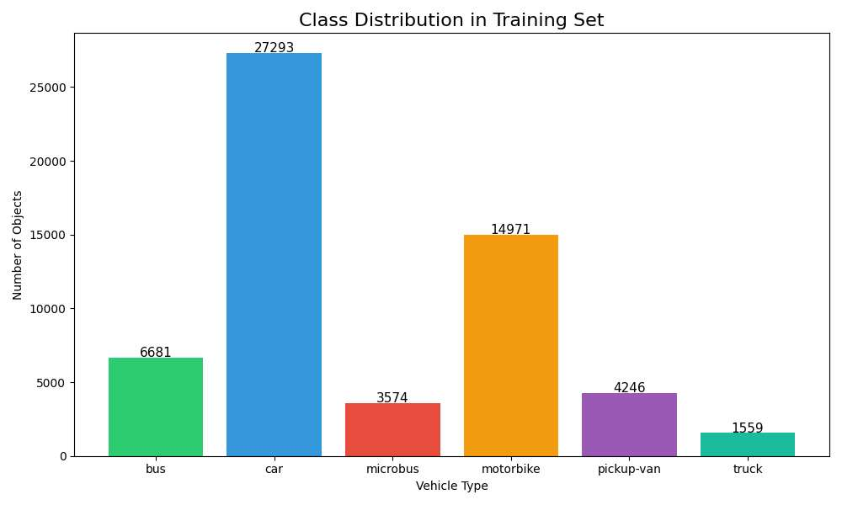
CHAPTER 3 · METHODOLOGY
Dataset Overview
Source: Roboflow Vehicle Detection Dataset v3 (CC BY 4.0), downloaded in YOLOv8 format.
9,211 annotated images across six vehicle classes.
Fixed random seed of 42 for a reproducible 70 / 15 / 15 split.
Significant class imbalance: car has 18.8× more test instances than truck (4,295 vs. 229).
6,449
1,381
1,381
Train (70%)
Validation (15%)
Test (15%)
Figure: Class distribution in training set — car and motorbike dominate; truck and microbus are under-represented.
MCT-453L · MACHINE VISION · VEHICLE DETECTION & CLASSIFICATION
05

Slide 6

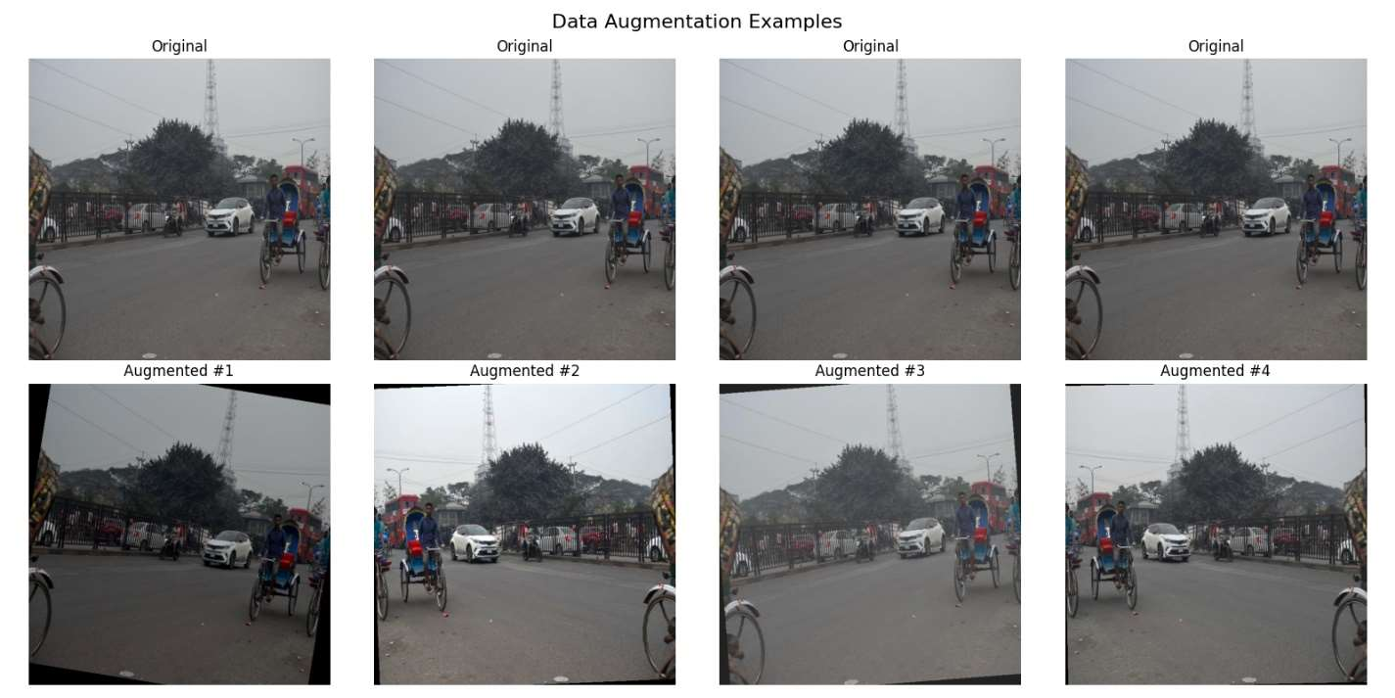
CHAPTER 3 · METHODOLOGY
Data Augmentation Pipeline
Random Horizontal Flip (p=0.5) — simulates bidirectional traffic.
Random Rotation (±10°) — accounts for camera tilt.
Color Jitter (brightness, contrast, saturation) — simulates lighting variation.
Random Grayscale (p=0.1) — simulates low-quality or IR cameras.
Normalize with ImageNet mean / std — required for the pretrained backbone.
EfficientNet crops 40,466 training instances from full scenes using bounding-box coordinates; YOLOv8 trains directly on full scene images at 640×640.
MCT-453L · MACHINE VISION · VEHICLE DETECTION & CLASSIFICATION
06

Slide 7
CHAPTER 3 · METHODOLOGY
EfficientNet-B0 — Classification Baseline
Input
224×224×3
EfficientNet-B0
Backbone (frozen)
ImageNet-pretrained
Dropout
p = 0.3
Linear
1,280 → 6
6 Class
Probabilities
All backbone layers are frozen — only the classifier head is replaced and fine-tuned.
7,686
224×224
1,280 → 6
12
Trainable Parameters
Input Resolution
Classifier Head Mapping
Training Epochs
MCT-453L · MACHINE VISION · VEHICLE DETECTION & CLASSIFICATION
07

Slide 8
CHAPTER 3 · METHODOLOGY
YOLOv8n — Advanced Detection Architecture
Input
640×640×3
CSPDarknet
Backbone
PANet Neck
Multi-scale fusion
Decoupled
Detection Head
Boxes + Scores
+ Class Labels
A single-stage detector that predicts bounding boxes, scores, and class labels in one forward pass — pretrained on COCO, fine-tuned on the vehicle dataset.
73
3.0M
640×640
8.1
Layers
Parameters
Input Resolution
GFLOPs
MCT-453L · MACHINE VISION · VEHICLE DETECTION & CLASSIFICATION
08

Slide 9

CHAPTER 3 · METHODOLOGY
Training Configuration
Parameter | EfficientNet-B0 | YOLOv8n
Epochs | 12 | 12
Batch Size | 32 | 32
Learning Rate | 1e-4 | 0.001 (auto)
Optimizer | AdamW | AdamW
Scheduler | CosineAnnealingLR | Default (linear warmup)
Dropout | 0.3 | 0.0
Input Size | 224 × 224 | 640 × 640
Weight Decay | 1e-4 | 5e-4
Loss Function | CrossEntropyLoss | Box + Cls + DFL
Training Time
EfficientNet-B0
42.4 minutes
YOLOv8n
21.6 minutes
Both trained on a Tesla T4 GPU via Google Colab, with early stopping (patience = 5) applied to YOLOv8n.
MCT-453L · MACHINE VISION · VEHICLE DETECTION & CLASSIFICATION
09

Slide 10

CHAPTER 4 · RESULTS & ANALYSIS
EfficientNet-B0 — Classification Results
Class | Precision | Recall | F1-Score | Support
bus | 0.839 | 0.764 | 0.800 | 998
car | 0.785 | 0.906 | 0.841 | 4295
microbus | 0.767 | 0.277 | 0.407 | 606
motorbike | 0.837 | 0.907 | 0.871 | 2391
pickup-van | 0.659 | 0.368 | 0.472 | 726
truck | 0.722 | 0.533 | 0.613 | 229
Overall (weighted) | 0.792 | 0.798 | 0.781 | 9245
78.0%
Test Accuracy (9,245 crops)
0.871
0.407
Best F1 — Motorbike
Worst F1 — Microbus
Training loss fell steadily from 1.11 to 0.71 over 12 epochs; validation loss converged at 0.61, with no sign of overfitting.
MCT-453L · MACHINE VISION · VEHICLE DETECTION & CLASSIFICATION
10

Slide 11
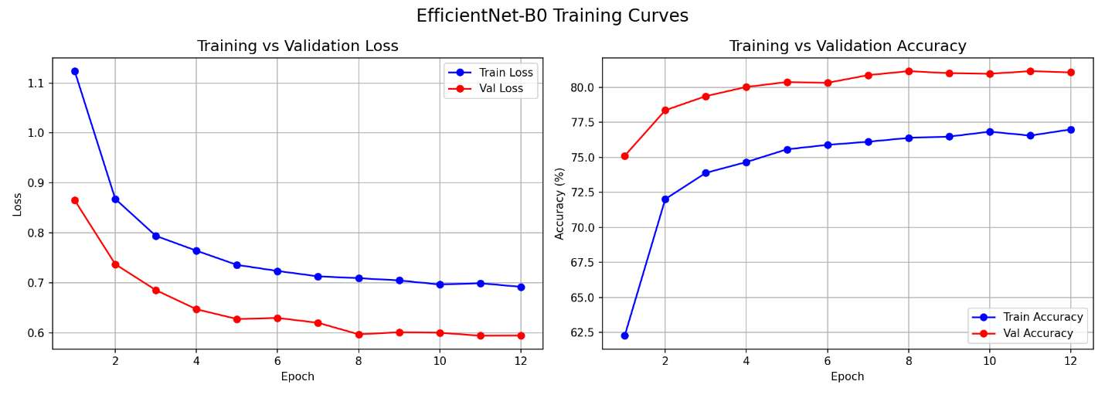
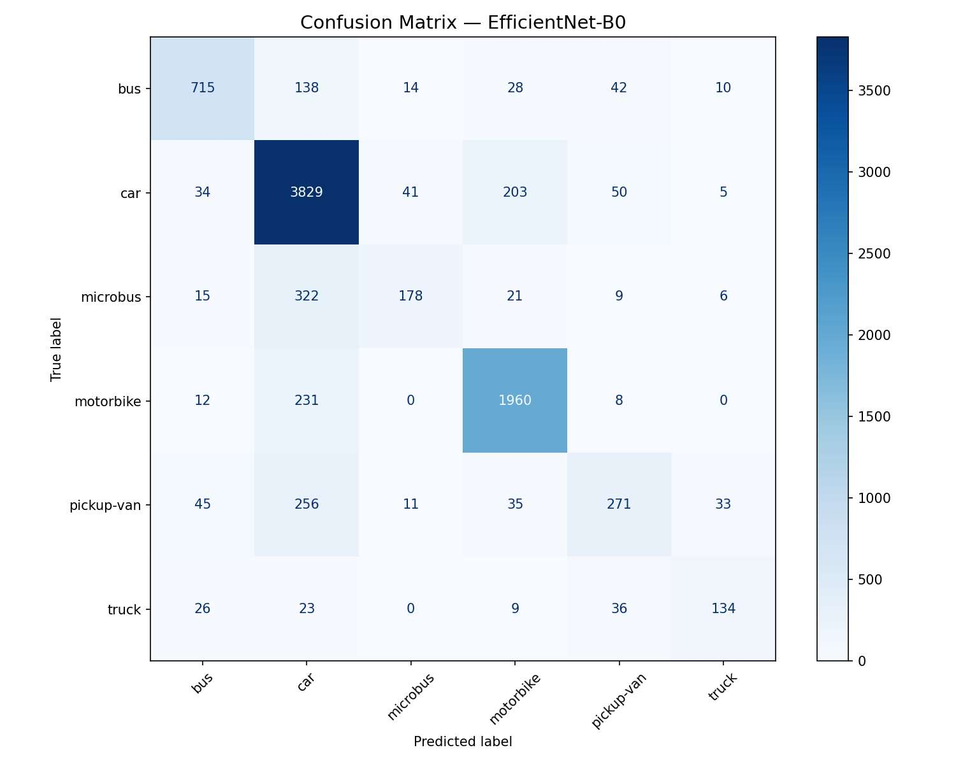
CHAPTER 4 · RESULTS & ANALYSIS
EfficientNet-B0 — Training Curves & Confusion Matrix
Train / Validation Loss & Accuracy
Car is most frequently confused with motorbike (203 instances) and bus (138 instances) — visually adjacent classes.
Microbus shows substantial leakage into car (322 instances), explaining its weak recall.
Confusion Matrix
MCT-453L · MACHINE VISION · VEHICLE DETECTION & CLASSIFICATION
11

Slide 12
CHAPTER 4 · RESULTS & ANALYSIS
YOLOv8n — Object Detection Results
Class | AP@50 | Precision | Recall
bus | 0.865 | 0.740 | 0.856
car | 0.725 | 0.620 | 0.725
microbus | 0.698 | 0.641 | 0.679
motorbike | 0.633 | 0.659 | 0.558
pickup-van | 0.640 | 0.661 | 0.562
truck | 0.760 | 0.725 | 0.668
0.727 mAP@50 · 0.416 mAP@50-95
Overall Detection Performance
0.865
0.633
Best AP@50 — Bus
Worst AP@50 — Motorbike
Overall test-set Precision: 0.69 · Recall: 0.68. Bus benefits from its large, distinct bounding box; motorbike suffers from small size and frequent occlusion in dense traffic.
MCT-453L · MACHINE VISION · VEHICLE DETECTION & CLASSIFICATION
12

Slide 13
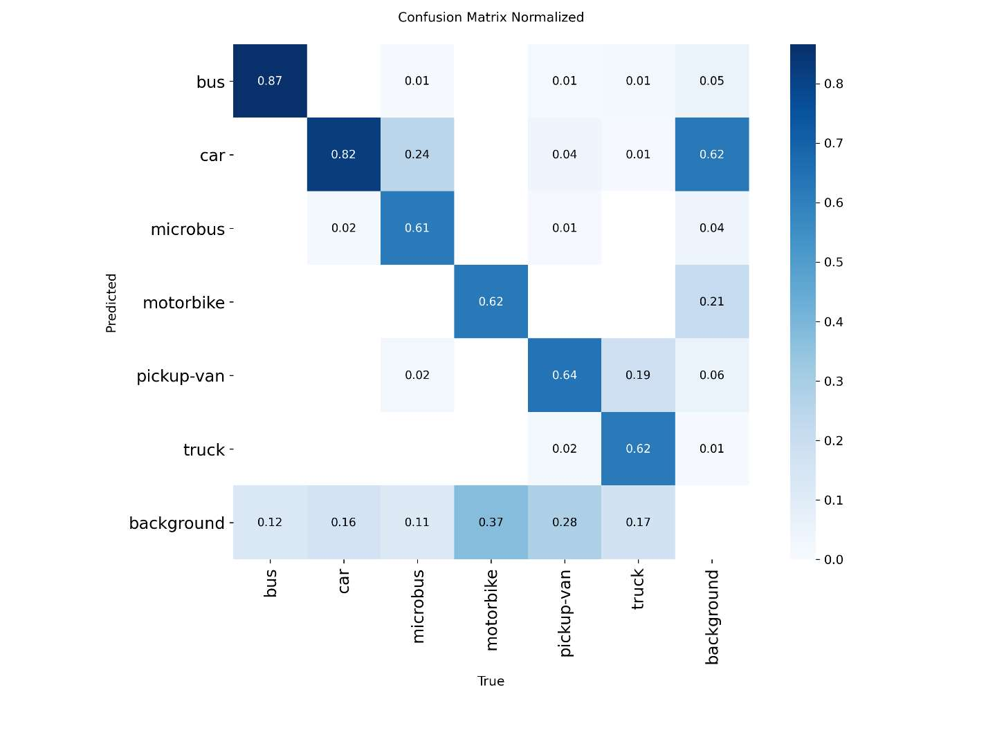
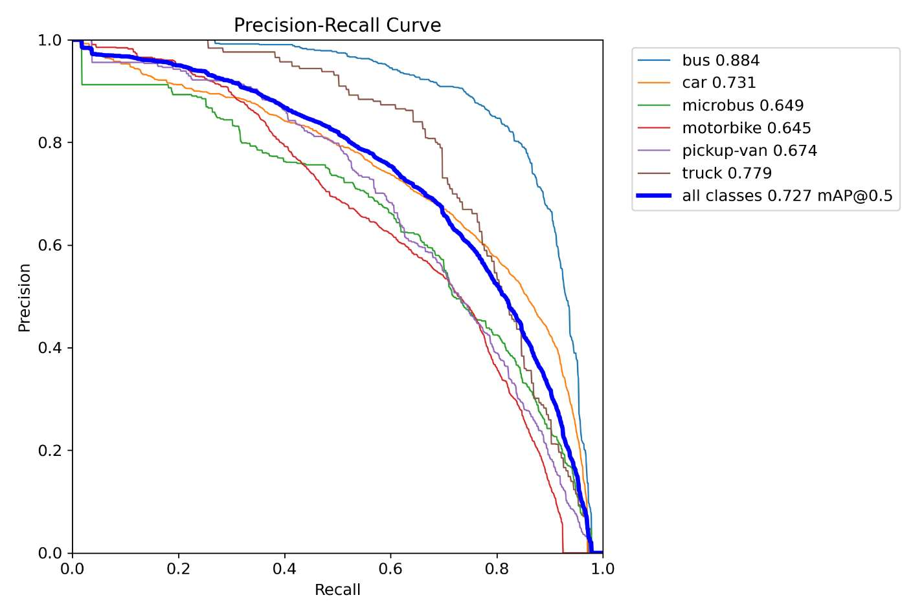
CHAPTER 4 · RESULTS & ANALYSIS
YOLOv8n — Confusion Matrix & Precision-Recall
Normalized Confusion Matrix
Precision-Recall Curve (mAP@50 = 0.727)
MCT-453L · MACHINE VISION · VEHICLE DETECTION & CLASSIFICATION
13

Slide 14

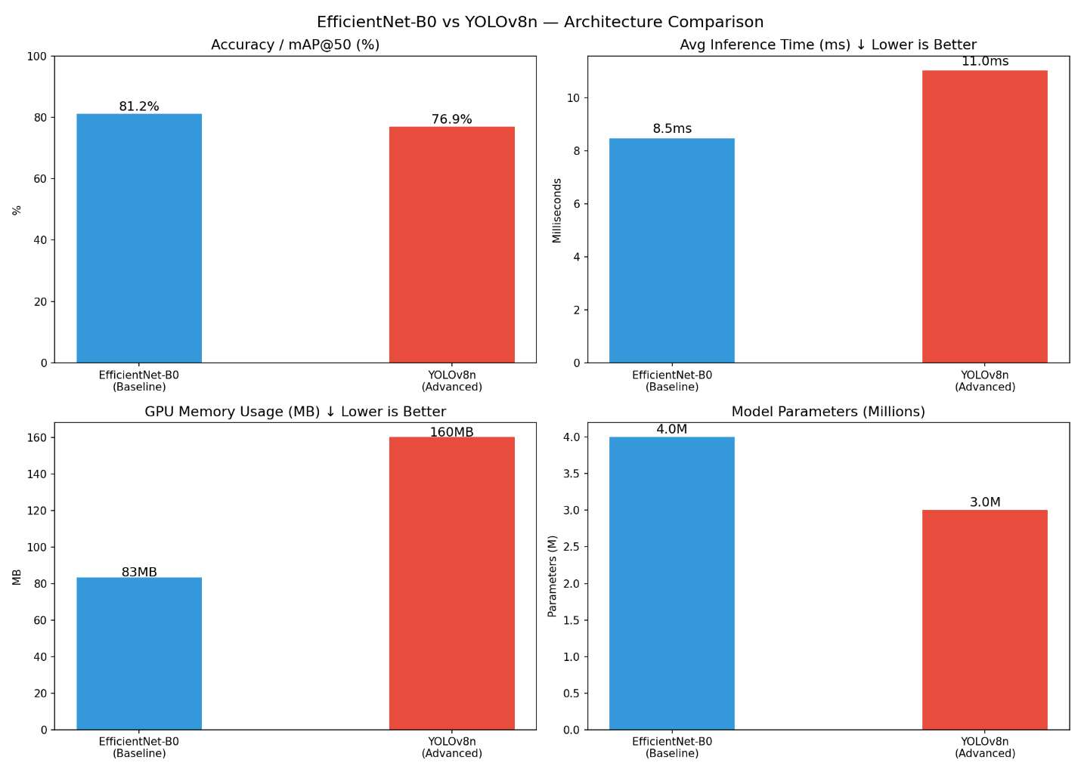
CHAPTER 4 · RESULTS & ANALYSIS
Comparative Analysis
Property | EfficientNet-B0 | YOLOv8n
Task | Classification | Object Detection
Accuracy / mAP@50 | 81.2% | 73.0%
Inference Time | 36.8 ms | 36.6 ms
GPU Memory | ~84 MB | ~170 MB
Input Size | 224 × 224 | 640 × 640
Bounding Boxes | No | Yes
Multi-vehicle / image | No | Yes
Best For | Single crop | Full scene
EfficientNet leads on raw classification accuracy, but the comparison isn't strictly equivalent — it classifies pre-cropped patches, while YOLOv8 detects and classifies in full scenes, making it the more practically capable model for real-world traffic monitoring.
MCT-453L · MACHINE VISION · VEHICLE DETECTION & CLASSIFICATION
14

Slide 15

CHAPTER 4-6 · CRITICAL EVALUATION
Error Analysis & Dataset Bias
Common Failure Patterns
Dataset Bias
1
Microbus misclassified as car or bus — visually intermediate vehicle, recall as low as 0.277 in EfficientNet.
1
Class imbalance: car has 18.8× more test instances than truck, inflating overall metrics while masking minority-class failures.
2
Pickup-van confused with truck or car depending on viewing angle and cropping.
2
Geographic bias: dataset reflects a specific regional traffic context — may not generalize elsewhere.
3
Motorbike missed by YOLOv8 in dense clusters — small bounding boxes, frequent overlap.
3
Viewpoint bias: images are predominantly fixed overhead/roadside; dashcam or drone footage would likely degrade performance.
4
Truck underperforms in EfficientNet (F1: 0.613) due to low training sample count (229 instances).
4
Crop bias: EfficientNet trained on tight crops degrades with background clutter or partial occlusion.
MCT-453L · MACHINE VISION · VEHICLE DETECTION & CLASSIFICATION
15

Slide 16

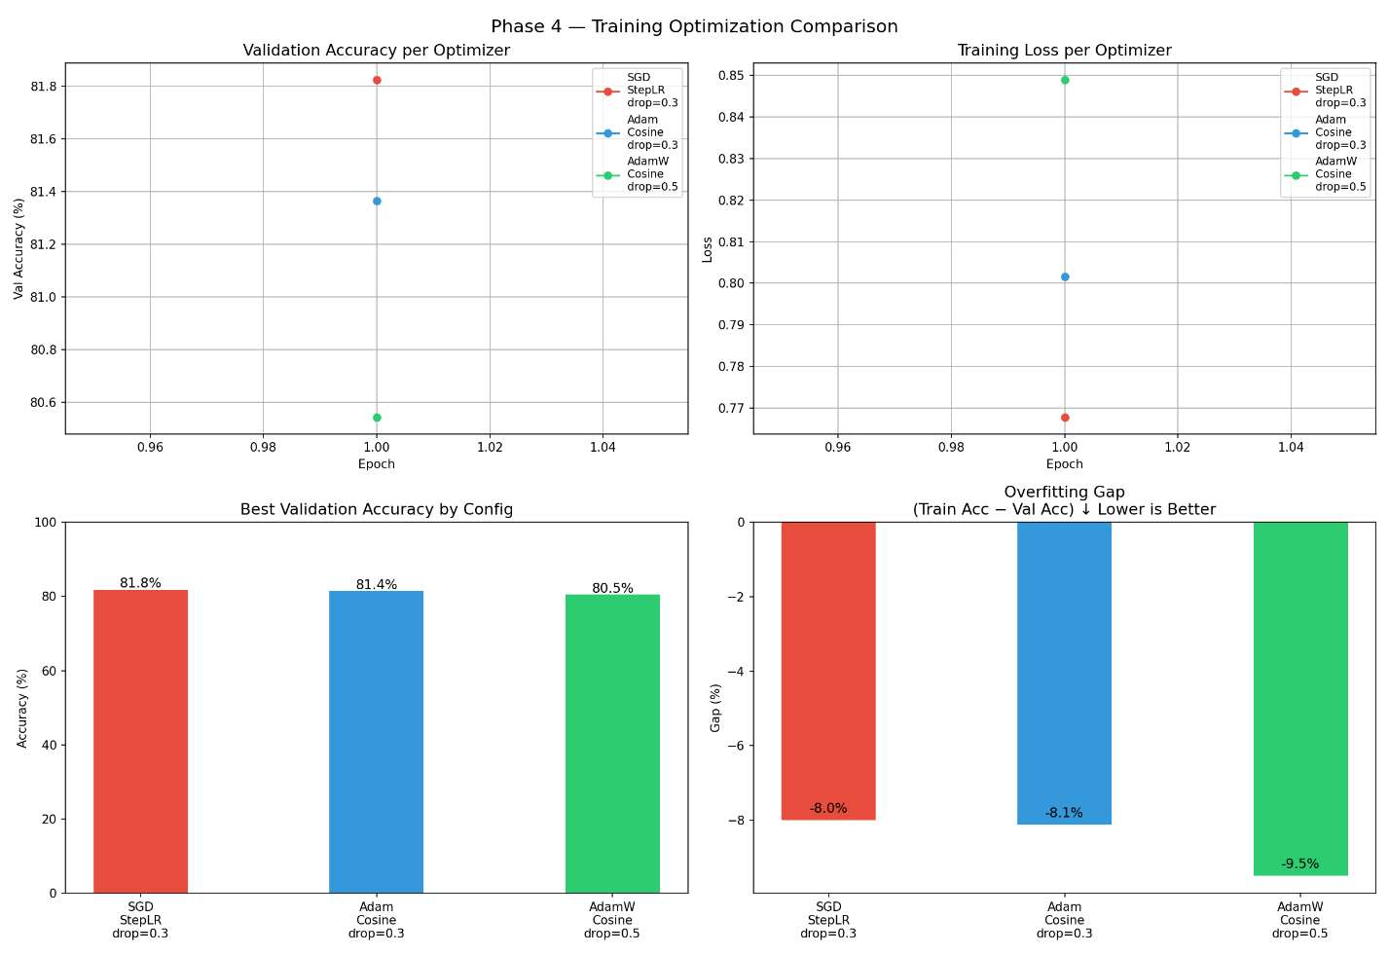
PHASE 4 · TRAINING OPTIMIZATION
Optimizer, Scheduler & Dropout Experiments
Config | Best Val Acc | Overfit Gap | Time (min)
Baseline — AdamW + Cosine + drop 0.3 | 80.94% | N/A | ~45
SGD + StepLR + drop 0.3 | 81.92% | -7.93% | 3.2
Adam + Cosine + drop 0.3 | 80.72% | -7.26% | 3.2
AdamW + Cosine + drop 0.5 | 80.72% | -9.74% | 3.2
SGD + StepLR achieved the highest validation accuracy (81.92%), marginally outperforming the AdamW baseline.
Negative overfitting gaps indicate validation accuracy exceeded training accuracy — the frozen pretrained backbone generalizes well even with limited fine-tuning.
AdamW + dropout 0.5 showed the largest negative gap, confirming higher dropout reduces overfitting at a small accuracy cost.
MCT-453L · MACHINE VISION · VEHICLE DETECTION & CLASSIFICATION
16

Slide 17

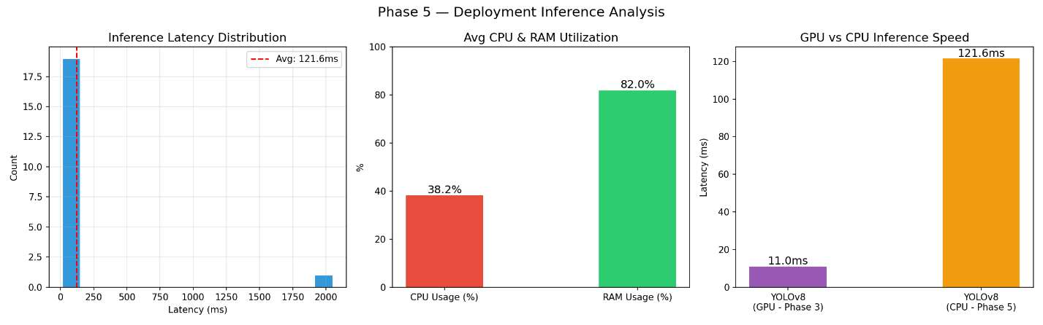
PHASE 5 · DEPLOYMENT
Computational Performance
Metric | EfficientNet-B0 | YOLOv8n
Avg Latency (ms) | 77.3 | 298.8
P95 Latency (ms) | 106.8 | 390.7
Throughput (FPS) | 12.9 | 3.3
CPU Usage | 38.6% | 38.6%
RAM Used | 2.1 GB | 2.1 GB
~36 ms
4-8×
CPU-mode benchmark (100 images, Phase 5). GPU acceleration provides roughly 4–8× speedup over CPU-only inference for both models.
GPU Inference (both models)
GPU vs CPU Speedup
MCT-453L · MACHINE VISION · VEHICLE DETECTION & CLASSIFICATION
17

Slide 18

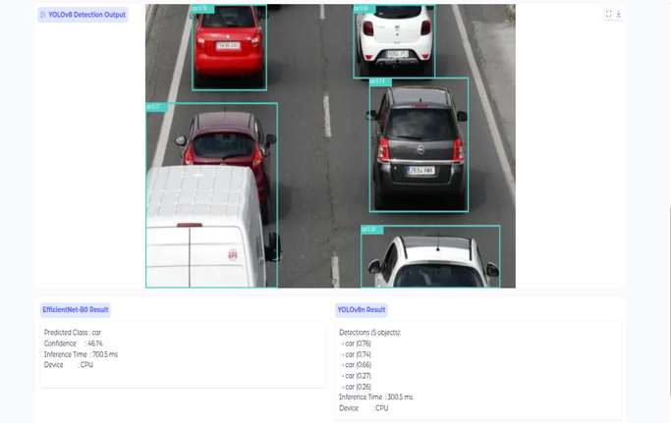
PHASE 5 · DEPLOYMENT
System Deployment — Gradio Interface
How It Works
A Gradio interface, deployed on Google Colab via a public shareable link, accepts a single uploaded traffic image of any resolution.
Both models run in parallel: YOLOv8 returns an annotated image with bounding boxes; EfficientNet returns top-1 class and confidence.
Results display per-model confidence scores and inference latency side by side, with no tunneling required.
Live dual-model inference on a single uploaded traffic image
MCT-453L · MACHINE VISION · VEHICLE DETECTION & CLASSIFICATION
18

Slide 19
CHAPTER 4 · ENGINEERING ANALYSIS
Ethical Considerations
Surveillance Risk
Fairness
Accountability
Data Privacy
Transparency
The system could be misused for mass movement tracking; deployment requires clear data retention and access governance.
Misclassification of motorbikes is more common in lower-income commuting and could create inequitable enforcement outcomes.
Automated decisions such as toll charging or violation ticketing must include human review given non-trivial error rates.
Real-world images may contain license plates and faces; anonymization is required before training or deployment.
Affected parties should be informed whenever automated vision systems are in use.
MCT-453L · MACHINE VISION · VEHICLE DETECTION & CLASSIFICATION
19

Slide 20

CHAPTER 5 · CONCLUSION
Conclusions & Future Work
Key Findings
Future Work
Transfer learning is highly effective even with a fully frozen backbone (7,686 trainable parameters).
SGD with StepLR slightly outperformed adaptive optimizers on validation accuracy.
Class imbalance is the primary driver of per-class performance degradation across both models.
CPU inference is insufficient for real-time deployment without further optimization.
Address class imbalance via weighted loss, oversampling (SMOTE), or balanced data collection.
Extend to video inference with multi-object tracking (DeepSORT, ByteTrack) for temporal context.
Apply INT8 quantization and pruning to enable real-time CPU or edge deployment.
Fine-tune larger YOLOv8 variants (m / l) and collect night, rain, and high-density traffic data.
81.2%
73.0%
6
2
Live
Final EfficientNet-B0 Accuracy
Final YOLOv8n mAP@50
Project Phases Delivered
Architectures Benchmarked
Public Gradio Demo
MCT-453L · MACHINE VISION · VEHICLE DETECTION & CLASSIFICATION
20

