Slide 1
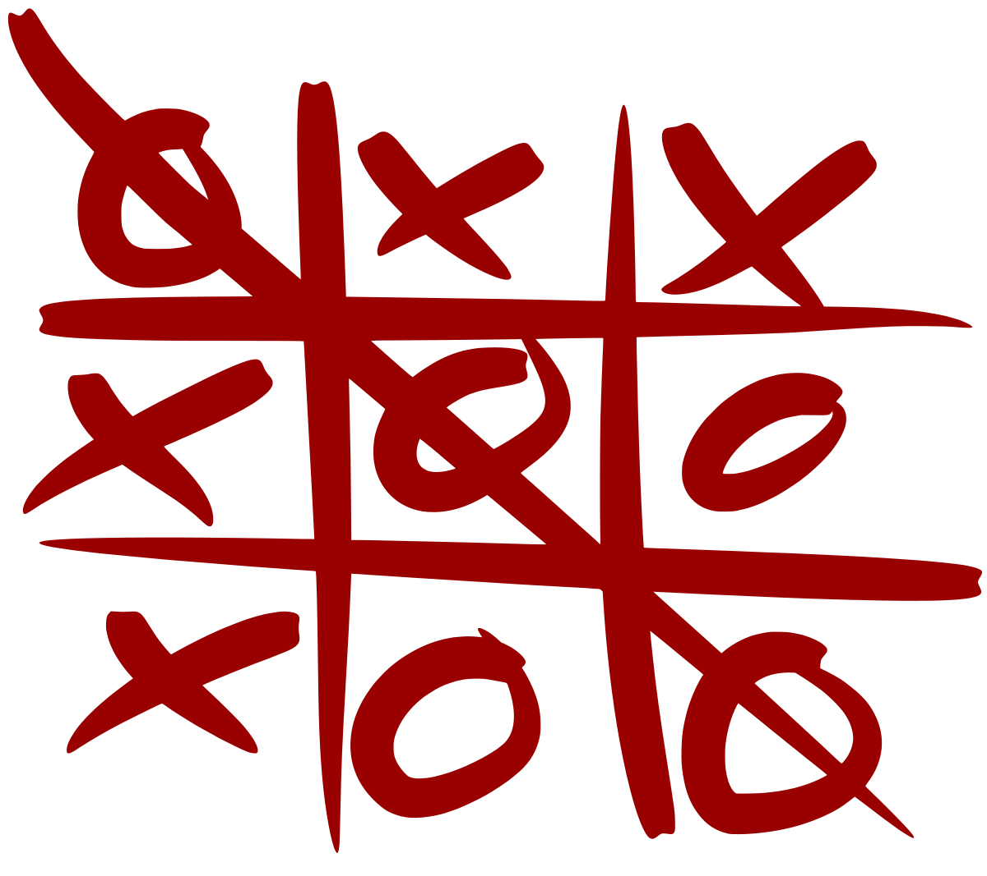
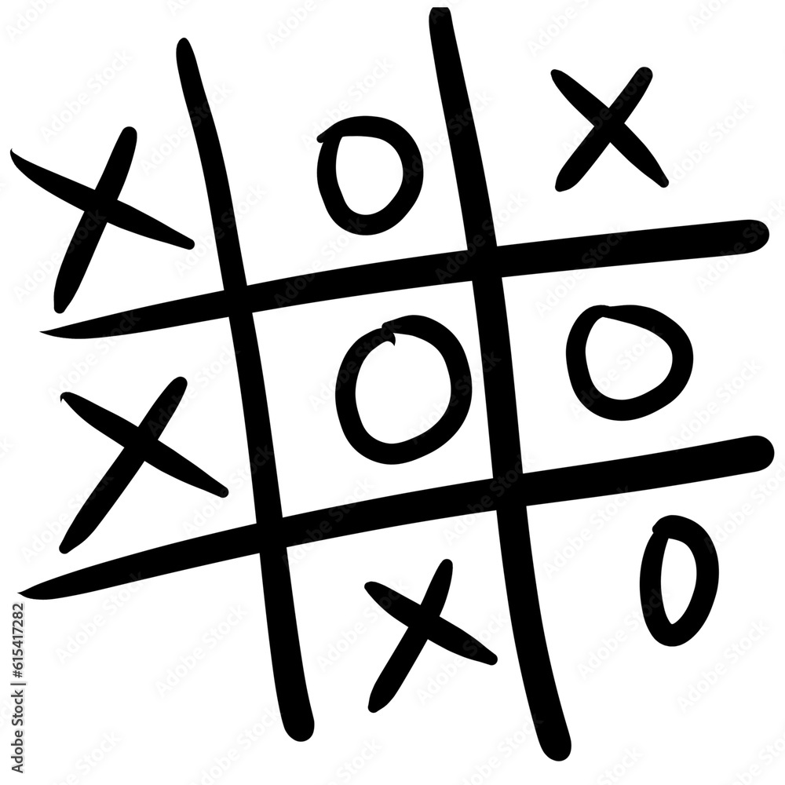
Tic-Tac-Toe AI Using Minimax Algorithm and Alpha-Beta Pruning for Optimal Decision-Making
Course: CSE440
Section- 1
Presented to:
Mohammad Shifat-E-Rabb (MSRb)
Presented by: Nandini Das 2031326642 Syed Riaz Us Salatin Yeasin 2031061642 Tousif Iqbal – 2012814642 Nafiz Haider Chowdhury 1721587642

Slide 2
Introduction
Objective: Develop an AI that plays Tic-Tac-Toe optimally.
Key Features:
The AI Uses the Minimax Algorithm for decision-making.
The AI will be Optimized with Alpha-Beta Pruning for efficiency.
It Ensures the AI never loses if played optimally..

Slide 3
Why Tic-Tac-Toe?
It is a simple game that provides a perfect environment to apply game tree search techniques.
It helps us understand decision-making in artificial intelligence.

Slide 4
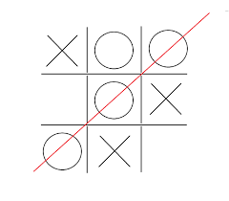
Game Rules (Brief)
The game will be played on a 3x3 board.
Players place ‘X’ (This will be done by AI) and ‘O’ (by Human).
The first player who will be able to align three marks horizontally, vertically, or diagonally wins.
If the game does not have any winners, the game ends in a draw.

Slide 5
Methodology
The principles of adversarial search, decision tree traversal, and optimization of computational efficiency guided the development of the Tic-Tac-Toe AI. This section outlines the representation of the game, the logic behind player turns, and the integration of the core algorithms-Minimax, Alpha-Beta Pruning and Heuristic Evaluation.
The game board is a one-dimensional list of nine elements, corresponding to the 3x3 Tic-Tac-Toe grid. Each component can hold one of three values: 'X' (player move), 'O' (AI move), or ' ' (space). The list structure allows easy indexing and manipulation of the game state.
The game begins by prompting the player to choose a symbol ( X or O ). Turn order follows standard rules: X always starts first. A loop alternates turns between the human and the AI until a win or draw condition is detected using the check_winner() function.

Slide 6
Role of Minimax Algorithm
Minmax is a recursive decision-making algorithm used in two-player games.
How Minmax Works:
The AI (Maximizer) selects the move with the highest possible advantage.
The opponent (Minimizer) tries to counteract by selecting moves that minimize the AI’s advantage.
Game State Scoring:
If the AI wins, the score will be +1. If the human wins, the score will be -1. If it’s a draw, the score will be 0.
Ensures that the AI always selects the best possible move.

Slide 7
Role of Alpha-Beta Pruning
It is computationally expensive without pruning
Alpha-Beta pruning makes the AI more efficient by eliminating unnecessary calculations
How It Works:
Alpha represents the best choice for the AI (Maximizer).
Beta represents the best choice for the opponent (Minimizer).
If a move doesn’t improve the outcome, further exploration of that branch is skipped.
Performance Gain:
Performance Gain Reduces the number of nodes evaluated by almost 40-50%, speeding up decision-making.

Slide 8
Role of Heuristic Evaluation
Purpose: Heuristic Evaluation enhances AI decision-making when a full Minimax search is limited by depth, improving speed while maintaining strategy.
How It Works:
+10: Two AI marks + one empty (potential win)
+1: One AI mark + two empties (minor advantage)
−8: Two opponent marks + one empty (threat block)
Benefits: 1) Allows players to play more strategically under limited search depth 2) Simulates difficulty levels 3) Blocks threats and seeks wins without full game tree traversal
Heuristics make the AI fast, strategic, and adaptable. This is essential when optimal play isn't computationally practical.

Slide 9
Observations and limitations
Observations:
1) The AI never lost a game when allowed to compute with full-depth Minimax.
2) It correctly blocked immediate threats (e.g., when the opponent had two in a row).
3) It prioritized winning moves when available. It could force a draw in situations where a win was not possible.
Limitations:
Scalability: The current Minimax implementation is not optimized for larger boards (e.g., 4x4 or 5x5) due to exponential growth in possible states.
No learning capability: The AI does not adapt or learn from games; it follows static evaluation logic.
Lack of GUI: User experience is limited to a text-based interface.

Slide 10
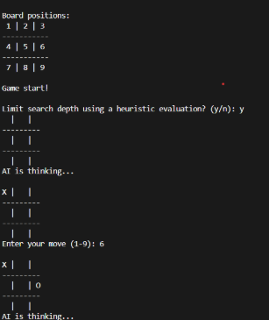
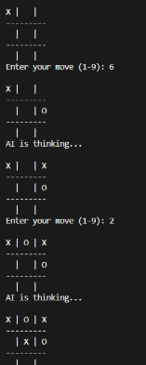
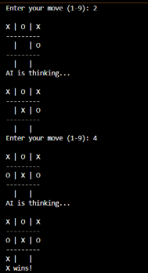
OUTPUT OF TIC TAC TOE

Slide 11
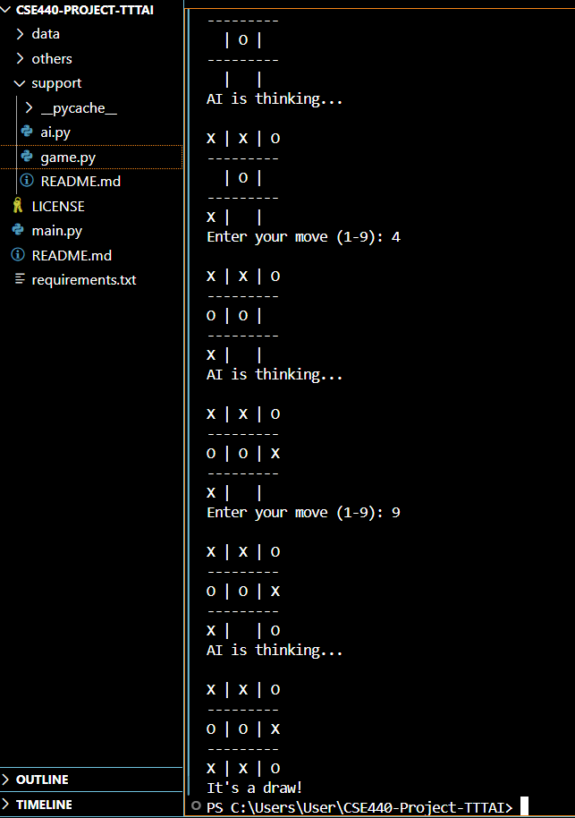
Update and Results
The Minimax algorithm has been successfully implemented, and the AI can now play Tic-Tac-Toe optimally.
The AI consistently makes the best moves, ensuring a win or draw while efficiently blocking opponent strategies.

Slide 12
Thank you

