Slide 1
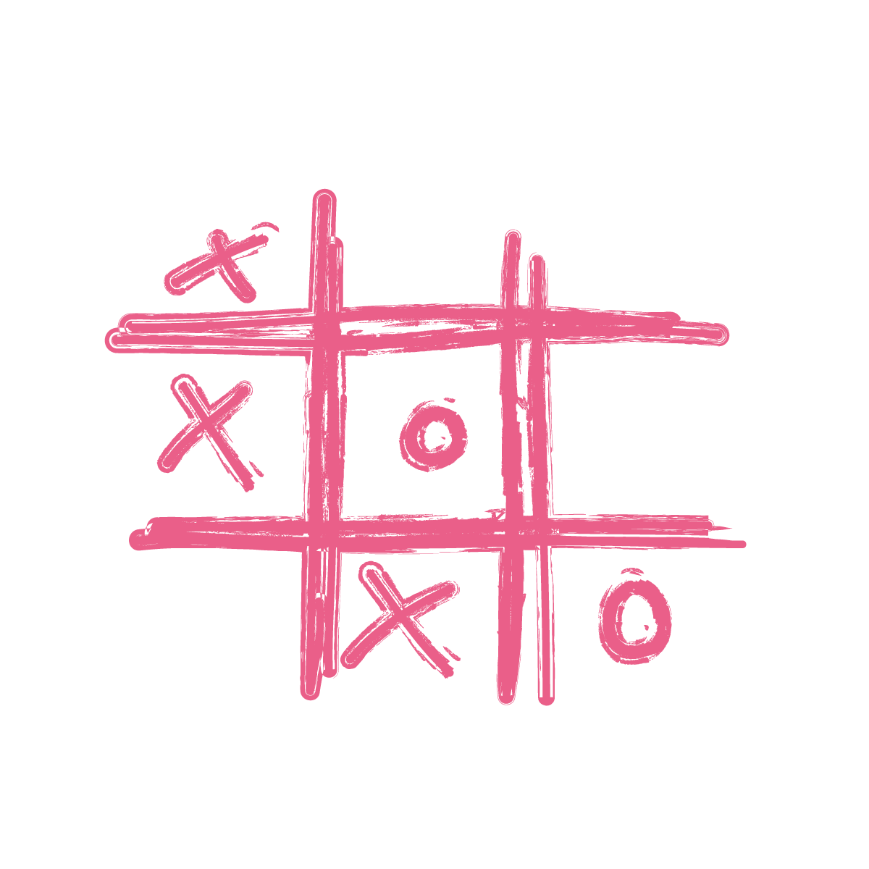
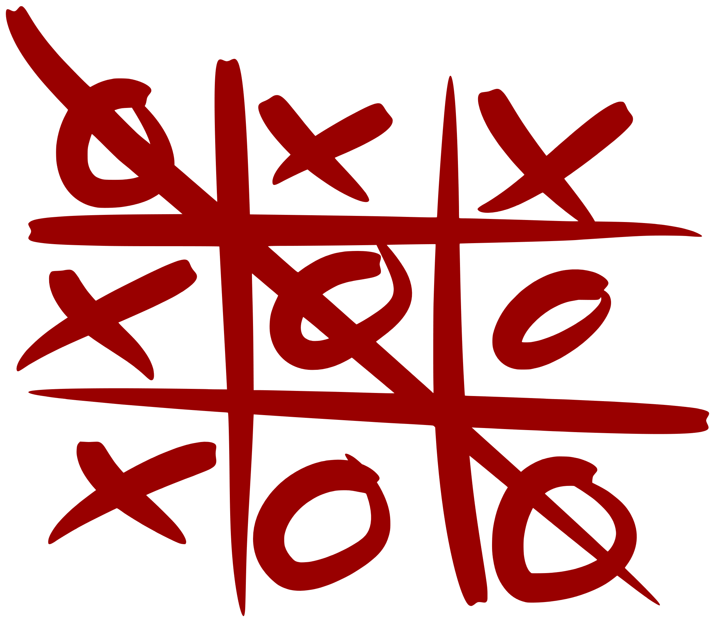
Tic-Tac-Toe AI Using Minimax Algorithm and Alpha-Beta Pruning for Optimal Decision-Making
CSE440
Section 1
Presented to:
Mohammad Shifat-E-Rabb (MSRb)
Presented by: Nandini Das - 2031326642 Syed Riaz Us Salatin Yeasin - 2031061642 Tousif Iqbal – 2012814642 Nafiz Haider Chowdhury - 1721587642

Slide 2
Introduction
Objective: Develop an AI that plays Tic-Tac-Toe optimally.
Key Features:
Uses the Minimax algorithm for decision-making.
Alpha-Beta Pruning speeds up move selection.
Heuristic evaluation handles limited-depth play.
AI aims to never lose—always wins or draws.

Slide 3
Why Tic-Tac-Toe?
Simple yet strategic – Easy rules, but supports deep decision-making.
Ideal for AI testing – Small state space, clear outcomes.
Turn-based structure – Perfect for Minimax and pruning.
Easy performance check – Win/loss/draw is clearly measurable.

Slide 4
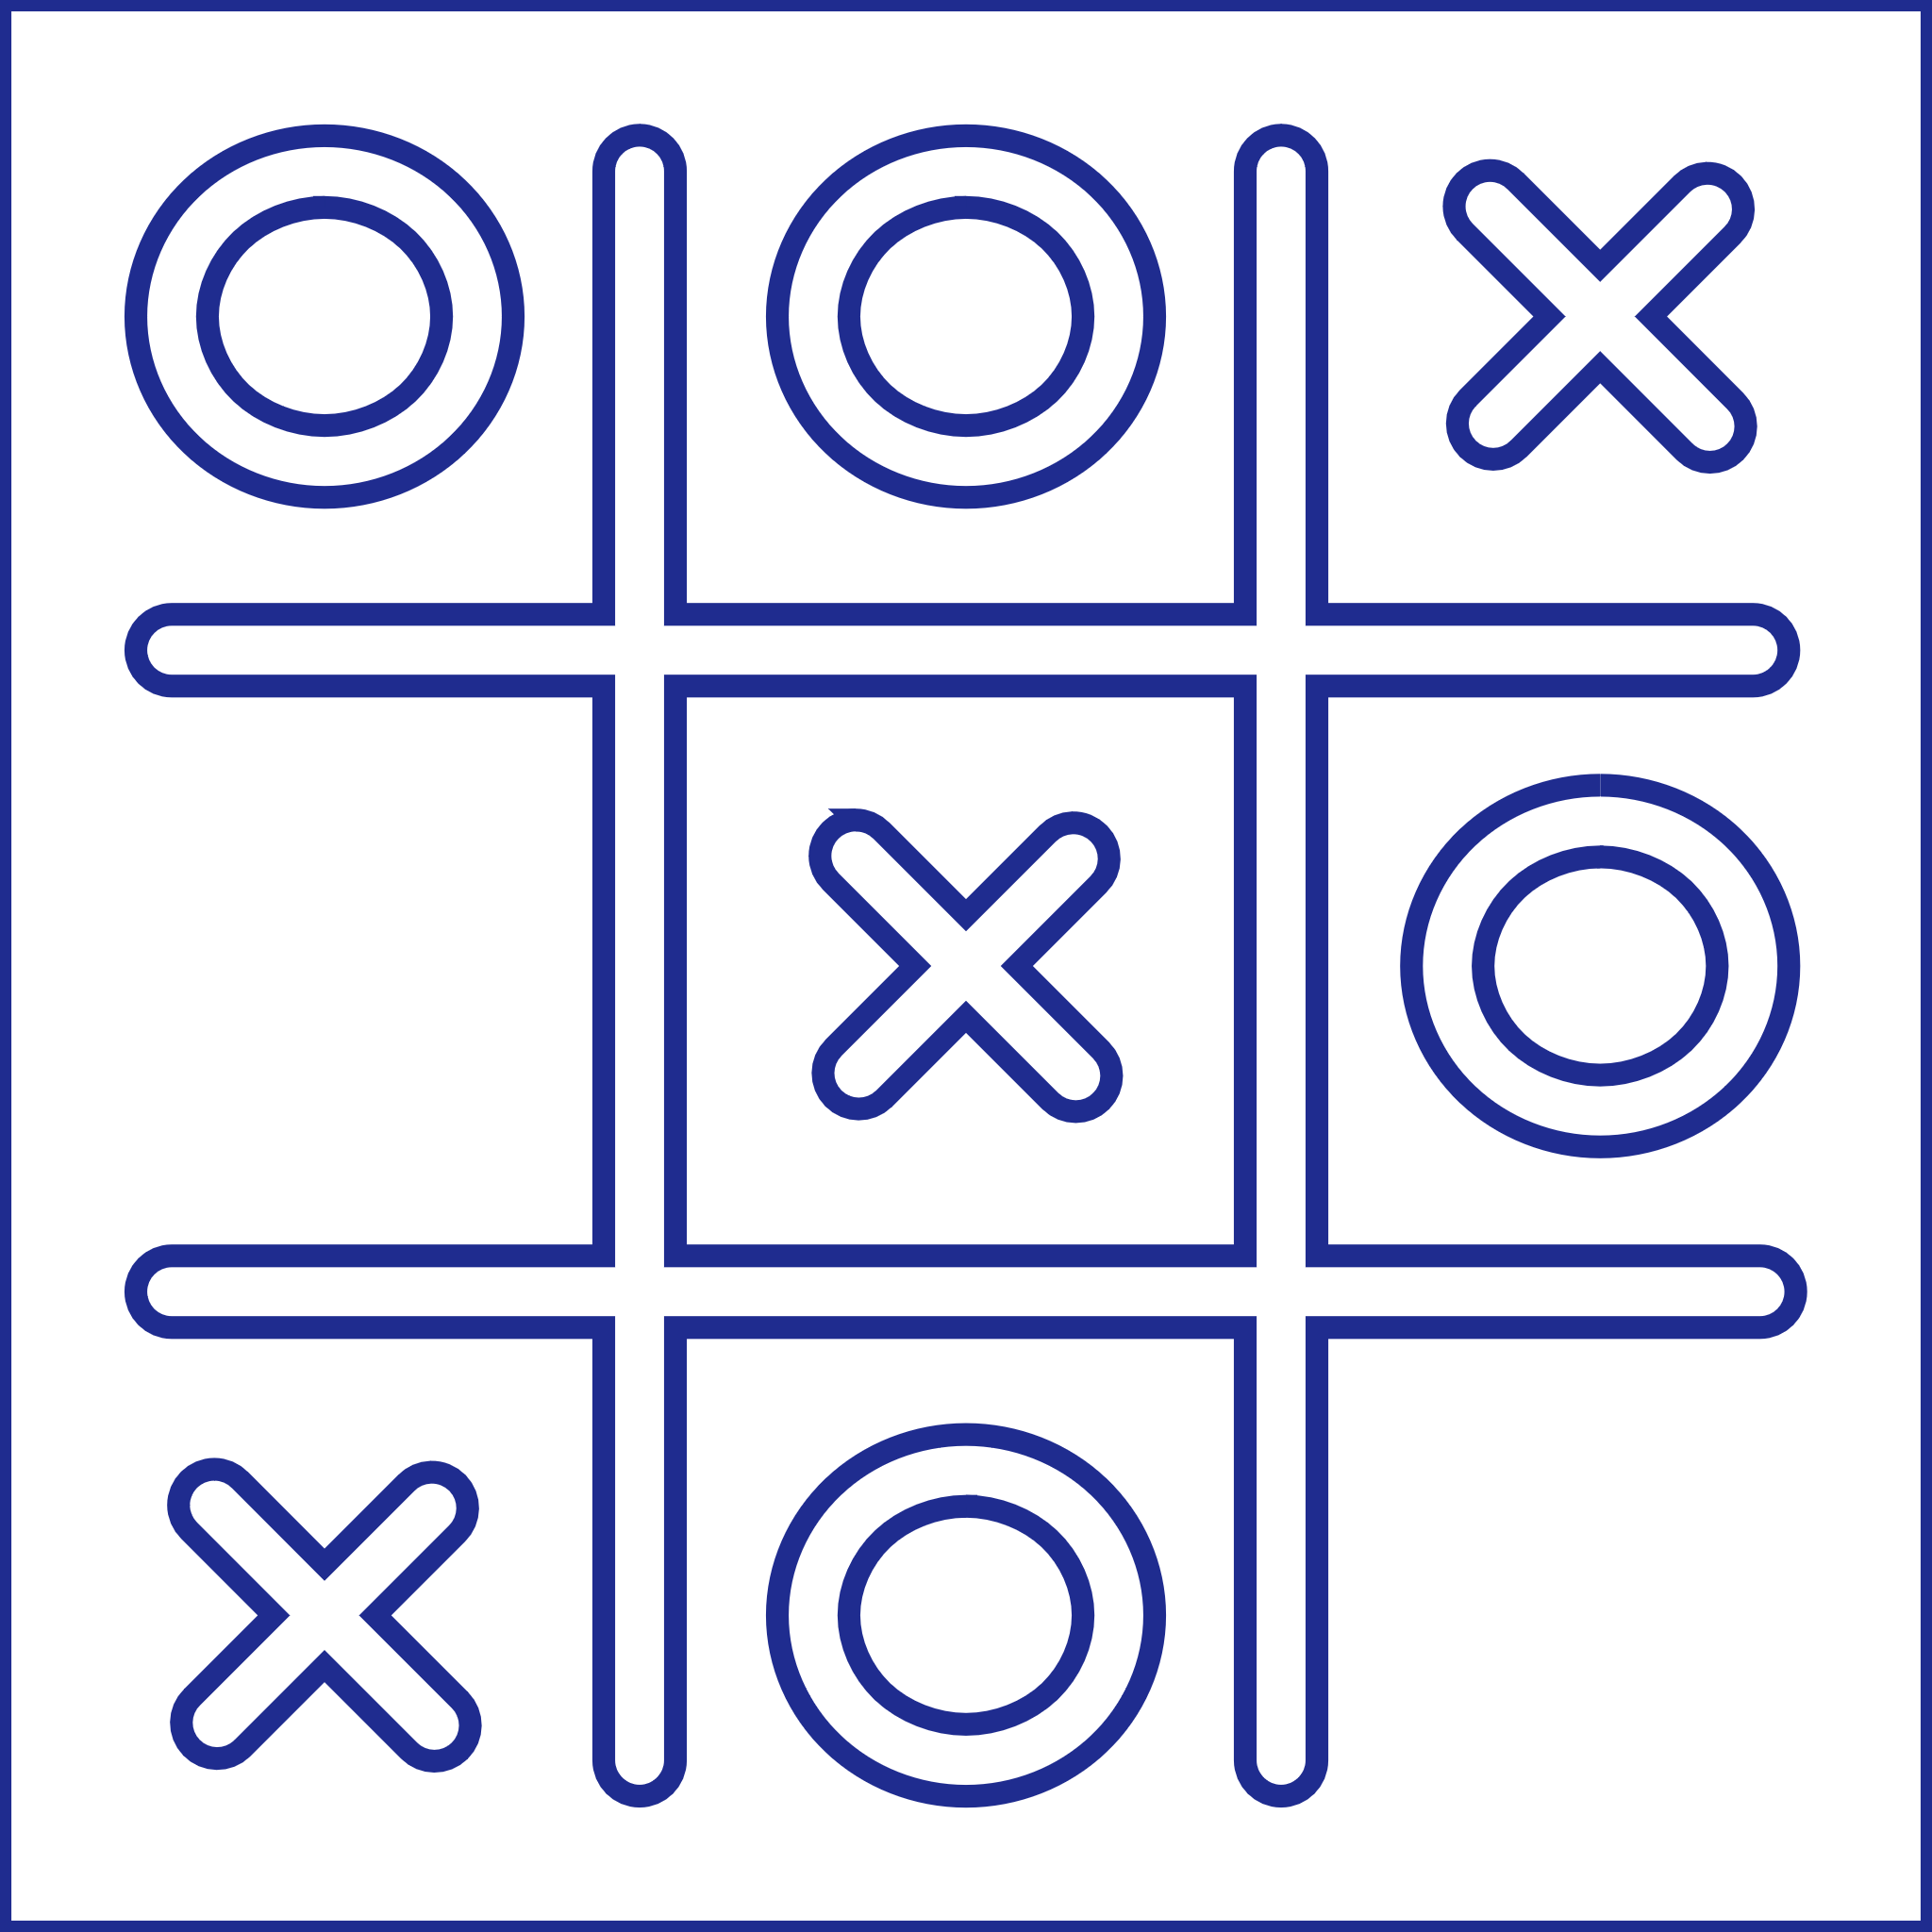
Game Rules (Brief)
Played on a 3x3 grid.
You choose to play as X or O.
X always starts first.
Players take turns placing their mark.
First to align three in a row (horizontal, vertical, or diagonal) wins.
If the board fills with no winner → Draw.

Slide 5
Methodology
Based on adversarial search and game tree traversal.
Game board is a 1D list of 9 elements ([' ', 'X', 'O']).
AI and player take alternating turns.
AI uses:
Minimax to simulate all possible moves.
Alpha-Beta Pruning to skip unnecessary branches.
Heuristic Evaluation for depth-limited decisions.
Win/draw is checked after every move.
Input is validated for legal moves and user errors.

Slide 6
Role of Minimax Algorithm
Minimax is a recursive algorithm used in two-player games.
It simulates all possible future moves and outcomes.
The AI acts as the maximizer, trying to get the highest score.
The human is the minimizer, trying to reduce the AI’s score.
Scoring system:
+1 → AI wins
−1 → Human wins
0 → Draw
The AI chooses the move that ensures the best worst-case outcome.
Guarantees optimal play—AI always wins or draws, never loses.

Slide 7
Role of Alpha-Beta Pruning
Enhances the Minimax algorithm by reducing unnecessary calculations.
Uses two values:
Alpha (α): Best score the AI (maximizer) can secure.
Beta (β): Best score the player (minimizer) can secure.
If α ≥ β, further exploration of that branch is stopped (pruned).
Why it matters:
Avoids exploring moves that won’t affect the final decision.
Makes the AI faster without reducing accuracy.
Performance gain:
Can prune up to 75% of nodes.
Reduces time per move from ~90ms to ~30ms.

Slide 8
Role of Heuristic Evaluation
Used when full Minimax search is depth-limited.
Assigns scores to non-terminal (unfinished) board states.
Scoring logic:
+10 → Two AI marks + one empty (strong win chance)
+1 → One AI mark + two empties (minor advantage)
−8 → Two opponent marks + one empty (threat to block)
Benefits:
Enables strategic play even with limited search.
Blocks threats, creates opportunities.
Simulates AI difficulty levels (e.g., easy, hard).
Makes AI faster and adaptable when full-depth search isn't feasible.

Slide 9
Implementation Overview
Language: Python
Modular structure for clarity and scalability
main.py – Handles game loop and user input
game.py – Manages board rendering and move validation
ai.py – Contains Minimax, Alpha-Beta Pruning, and Heuristic logic
Board: 1D list of 9 elements ([' ', 'X', 'O'])
Game loop:
Displays board
Takes player input (validated)
Calls AI move
Checks for win/draw after each turn
Input Handling:
Validates range (1–9)
Prevents illegal/repeated moves
Handles invalid inputs gracefully

Slide 10
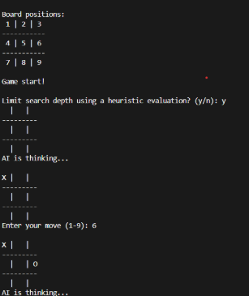
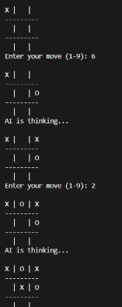
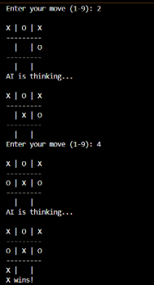
OUTPUT OF TIC TAC TOE

Slide 11
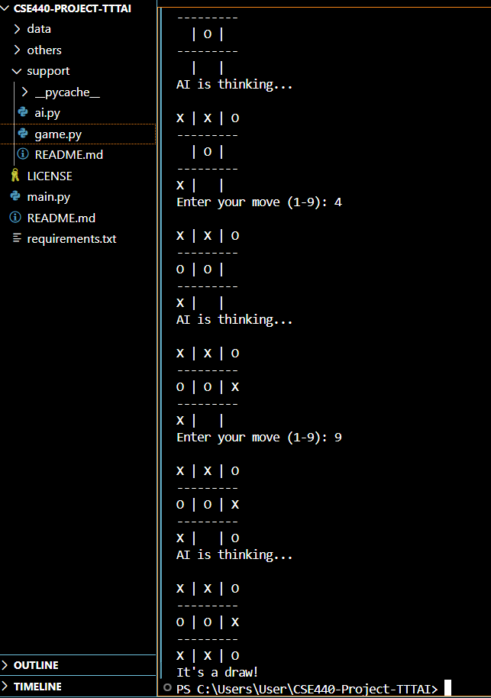
Results
AI never lost with full-depth Minimax
Always blocked threats and prioritized winning moves
Forced a draw when a win wasn’t possible

Slide 12
Performance
Alpha-Beta Pruning Impact
Up to 75% fewer nodes, much faster response
Heuristic Evaluation Results
Mode | Avg. Nodes Evaluated | Time per Move
Minimax (no pruning) | ~5500 | 70–90 ms
Minimax + Pruning | ~1200 | 15–30 ms
Depth Limit | Win Rate vs Random | Behavior
Full (9) | 100% | Always optimal
3 + Heuristic | ~85% | Strong, may miss setups
2 + Heuristic | ~70% | Defensive, blocks threats

Slide 13
Observations
AI never lost when using full-depth Minimax
Blocked immediate threats (e.g., two in a row) effectively
Recognized and took winning moves when available
Forced draws in unwinnable scenarios
Pruning made gameplay smoother with faster move response
Heuristic evaluation allowed strong play even with depth limits
Modular code made testing, debugging, and extending the AI easy

Slide 14
Limitations
No learning – AI doesn't adapt or improve over time
Fixed board size – Only supports 3x3, not scalable to 4x4 or 5x5
No GUI – Text-based interface only; lacks visual interaction
Static behavior – Plays perfectly every time, no difficulty variation without heuristic tuning
Limited challenge – Becomes predictable for experienced players

Slide 15
Future Work
Add GUI
Use Tkinter, Pygame, or Kivy for a visual interface
Enable click-based gameplay and highlight moves
AI Learning & Adaptation
Implement Q-learning or Reinforcement Learning
Let AI learn from past games and improve
Support Larger Boards
Extend to 4x4, 5x5, etc.
Optimize Minimax using iterative deepening or MCTS
Performance Profiling
Use tools like cProfile to identify and fix bottlenecks

Slide 16
Thank you

