Slide 1
BE and SM Analysis
3.18.2023

Slide 2
Overall data by the numbers
BE data:
5788 mutants made by 2811 guides
Out of 5788 mutants, 717 mutants are in the kinase
717 mutants predicted to be made by 349 guides
Out of 717 BE kinase mutants, 298 are seen by SM

Slide 3
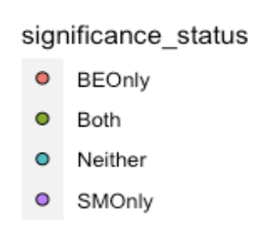
All possible mutants by all sgRNAs: ABE
 |  | BE Data
 |  | Significant | Not Significant
SM Data | Significant | 33 | 26
 | Not Significant | 56 | 88
Correlation: 0.26
FET Pval: 0.03

Slide 4
All possible mutants by all sgRNAs: CBE
 |  | BE Data
 |  | Significant | Not Significant
SM Data | Significant | 5 | 36
 | Not Significant | 14 | 107
Correlation: -0.04
FET Pval: 1

Slide 5
Predicting most likely mutants by sgRNA
As mentioned in slide 2, 349 sgRNAs are predicted to make a max of 717 mutants (298 are seen in both SM and BE)
I wrote a script that figures out the mutant that’s closest to position 5 after the PAM.
So each sgRNA gets a single mutant based on distance
Assumed a normal distribution centered around position 5. i.e. mutants at position 4 and at position 6 get the same weight
If two distinct mutants were both at the likeliest distance for a given sgRNA, I kept both mutants
Removed any mutant that was at not the likeliest distance
MNVs get the same weight as single nucleotide variants.

Slide 6
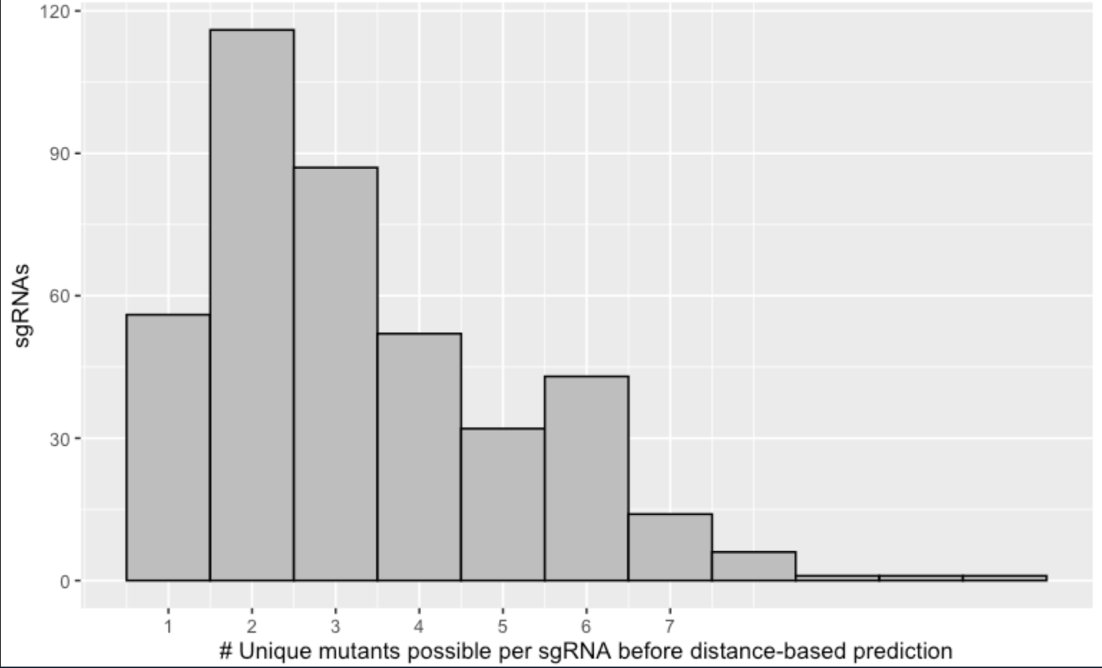
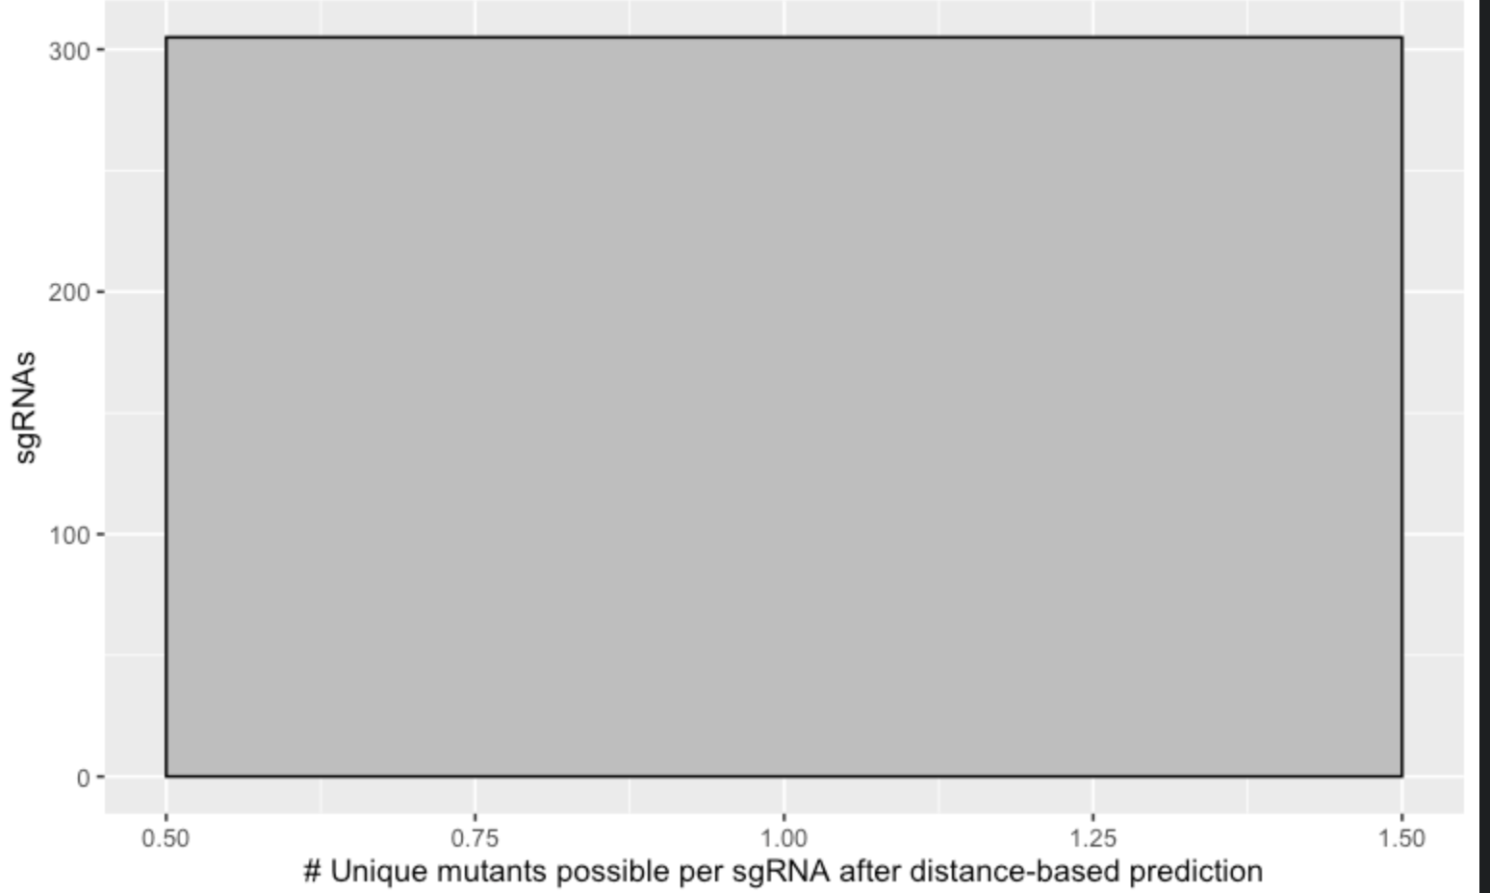
My script assigns a single mutant to each sgRNA
Before
After

Slide 7
But…
The caveat is that this reduces the total “possible” mutants from 298 to 179. i.e. around 120 mutants were not the highest priority mutant for their associated sgRNA

Slide 8
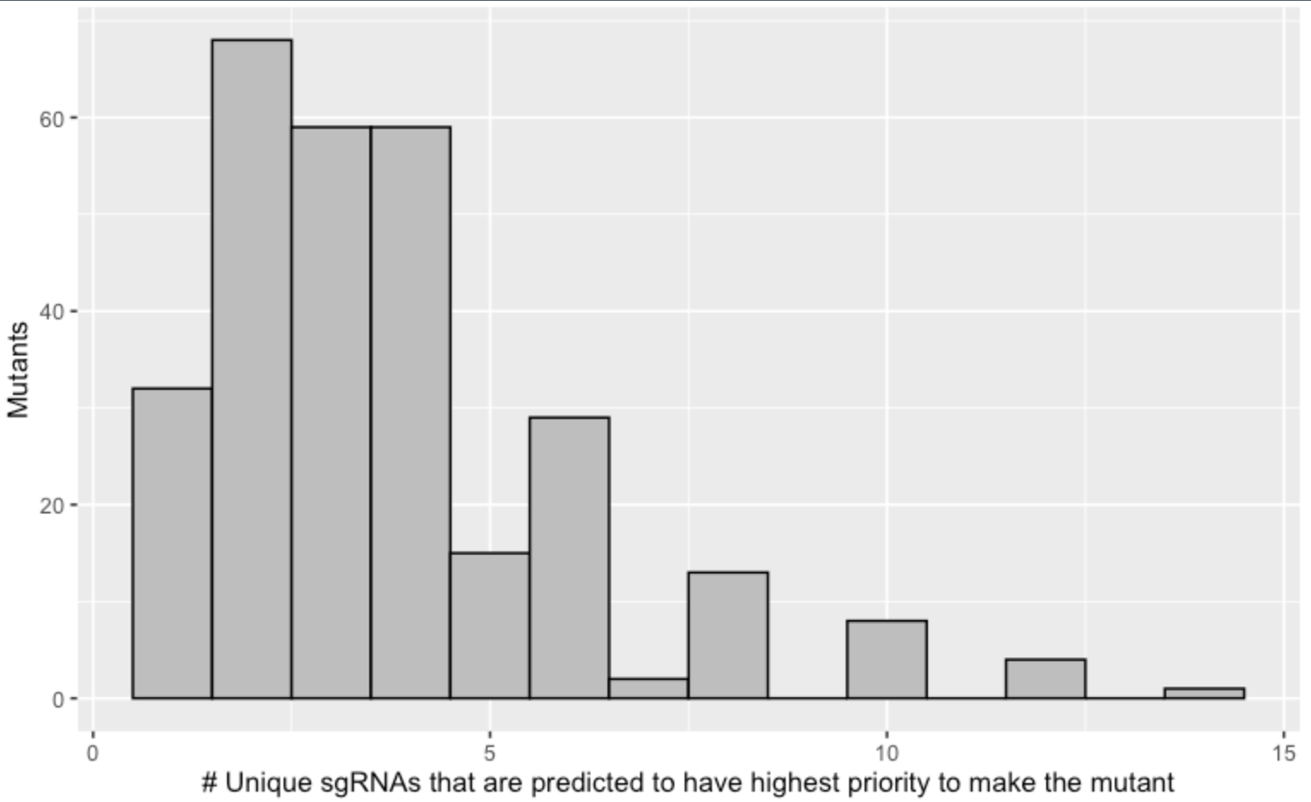
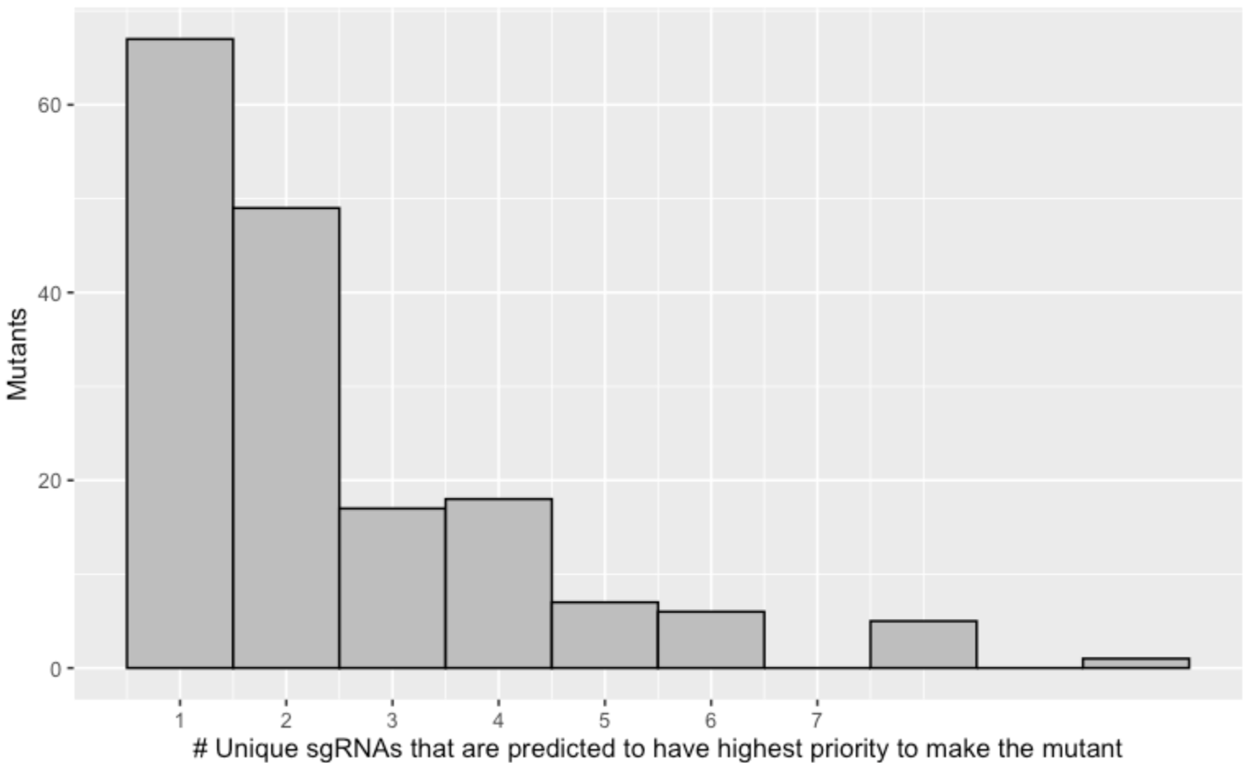
Number of sgRNAs predicted to make the same mutant
Before
After
Distribution shifts leftwards after I do the sgRNA-mutant predictions
If there are multiple sgRNAs predict the same mutant, I take the mean of their BE sgRNA LFC score

Slide 9
Likely Mutants Only: ABE
 |  | BE Data
 |  | Significant | Not Significant
SM Data | Significant | 18 | 12
 | Not Significant | 25 | 47
Correlation: 0.32
FET Pval: 0.027

Slide 10
Likely Mutants Only: CBE
 |  | BE Data
 |  | Significant | Not Significant
SM Data | Significant | 1 | 19
 | Not Significant | 7 | 59
Correlation: 0.1
FET Pval: 0.67

Slide 11
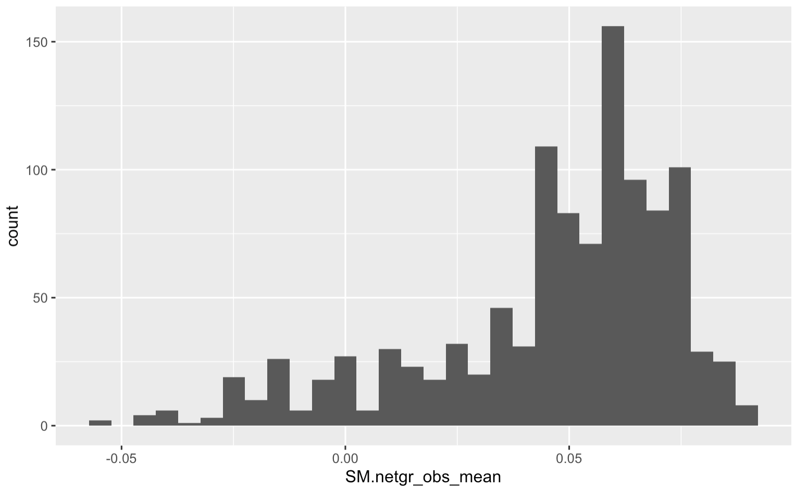
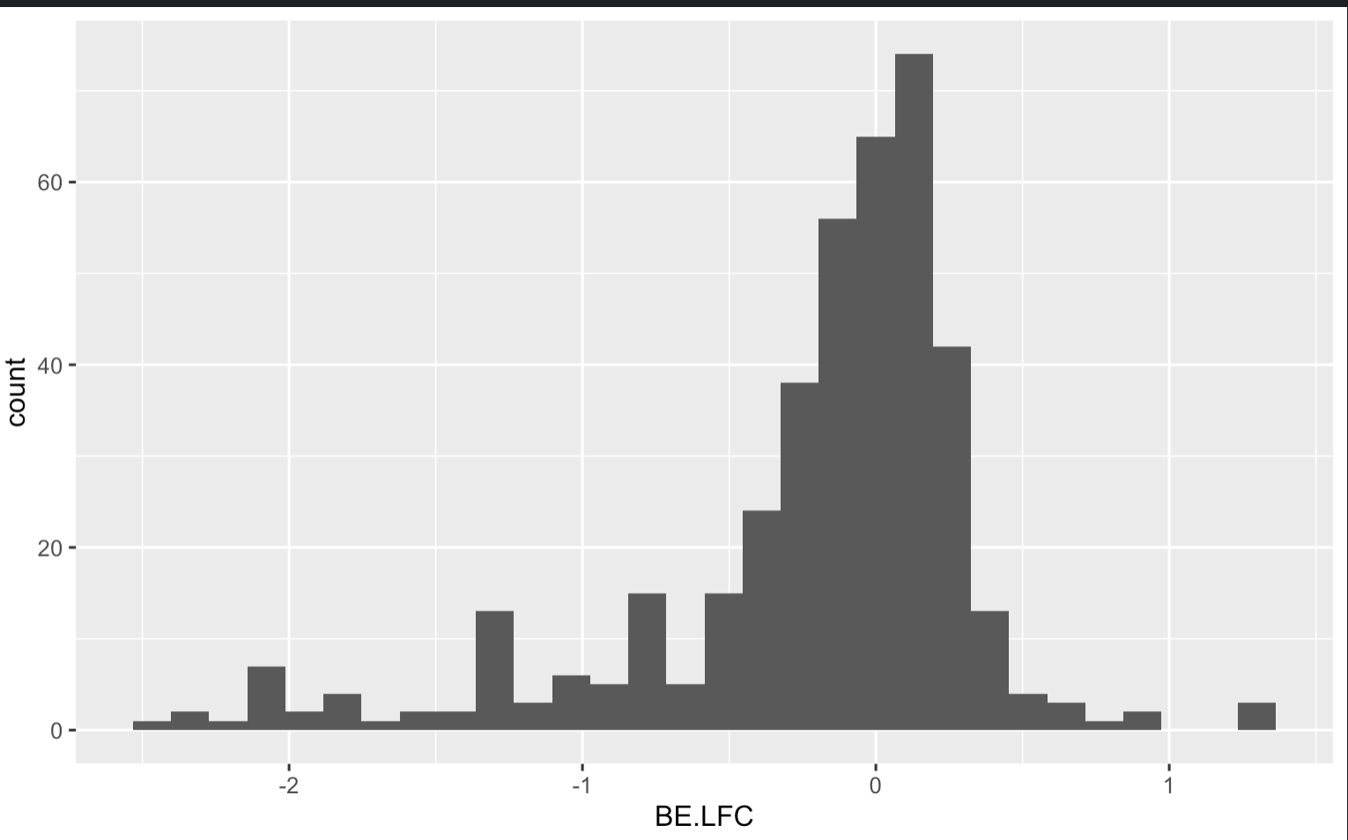
Plotting overall distributions of Enrichment/Depletion

Slide 12
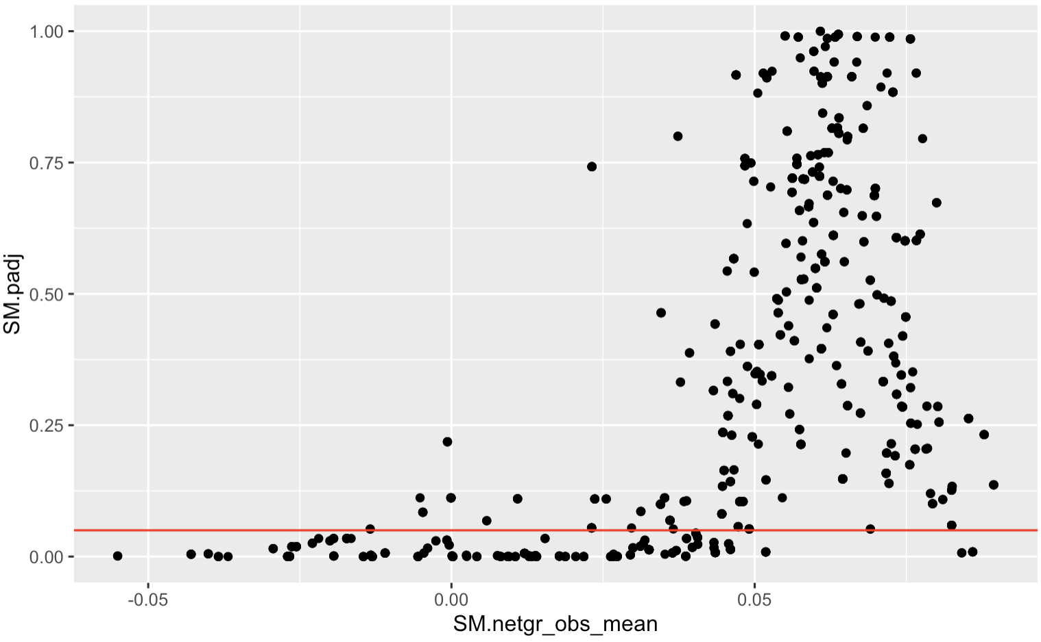
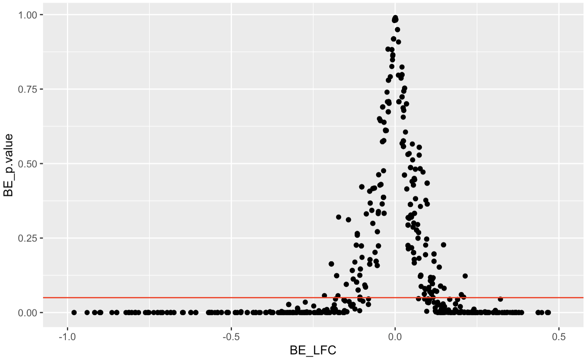
Pval of 0.05 doesn’t always make sense as a significance threshold

Slide 13
Choosing the right significance threshold matters for FET results, CBE is not significant regardless of threshold
ABE
CBE
FET
p value: 0.05

Slide 14
Catalytic Lysine

Slide 15
Next step: False negatives for depletion in BE
Why do some SM mutants score but not in BE
Low editing efficiency guide?
Can use some of the CBE data as positive control for low editing efficiency?
It looks like the CBE data (compare slide 9 vs 10) has a lot more of the purple datapoints (aka mutants predicted to deplete by SM but not depleting by BE)
For ABE, 18/30 (71%) guides that deplete significantly in SM also deplete in BE
For CBE, 1/20 (5%) guides that deplete significantly in SM also deplete in BE
Bad sgRNA (ask Ivan to add metric of sgRNA efficiency)
Positional probability effect of position in sgRNA?

Slide 16
Next steps
Do the sgRNA predictions improve if we give higher likelihood to MNVs over SNVs?
How many of the sgRNAs predicting the “BEOnly or SMOnly” mutants are SNVs vs MNVs? How many sgRNAs would be better correlated with the SM data if we give higher priority to MNVs?
Question to consider: do we expect the mnv noise to affect BEOnly mutants more or SMOnly mutants more? i.e. is the mnv noise going to increase false negative error or the false positive error? My guess is both
Question to consider: would an mnv just take priority over an snv at the associated position? Or would an mnv take priority over snvs at all positions?
For example, if ABL residue 317 is at nucleotide position 5 and ABL 315 is at nucleotide position 2 away from an sgRNA, would T315M (mnv) take priority over T315I (snv) and F317L (snv) or would T315M take priority over T315I only?

Slide 17
Next steps
Order guides in sgRNAs in the red and the purple region (maybe green as well)… Deep sequence the individual sgRNA clones and see how many mutants/mnvs etc those clones are made of… a single duplex sequencing sample can probably help us quantify the data from 5-10 guides as long as there’s no crosstalk between the guides (i.e. they’re well-spaced apart)
Look at the correlation in the BE data between K562s and BaF3s and see how much of the noise is because of splice sites
Is the running average of the fitness effect similar between SM and BE? i.e. on a domain level
For Haider: Look at the duplex sequencing data of the BE library. Look at the MNV vs SNV signature in the base edited population… With MNVs, you would expect to see a lot of out-of-codon MNVs as well… do you see those in the data?

Slide 18
For red mutants (depleting by BE but not SM), the hypothesis is that those guides are making many mutants. Therefore, a mutant that looks like it’s depleting is actually not depleting because the sgRNA is making something else
Questions to ask: what % of the sgRNAs that only make a single mutant are in the red region? You would expect not a lot a lot in the red region?
Already answered: the mean sgRNAs per mutant and the mean mutants per sgRNA are the same in the red region as in the green region… Also looked at whether the PAM was any different… didn’t see a signal. Maybe could look at the trinucleotide context preference (Fig 1i of this paper) of ABE8e and the preceding nucleotide preference (Fig 2A of this paper) of ABE8e to see if there’s any of that going on here.
Could also look at off-target efficiencies
For purple mutants, the hypothesis is that those guides are making not enough mutants, i.e. that guide is present, but the mutant isn’t present. That would make it look like a neutral mutant but the reality is that the mutant isn’t even being made.
Already answered: The mean mutants per sgRNA in the purple region is not lower than that in the green region.
Look at the trinucleotide context here… maybe the mutants are poorly edited
What % of the sgRNAs here are probably making a secondary mutant that is neutral? Is this % higher than the one in the green region?

