Slide 1

Preprocessing Techniques for AI
Preprocessing is a crucial step in the AI pipeline, transforming raw data into a format that can be effectively used by machine learning models. These techniques help improve model performance and ensure accurate, unbiased results.
Presented By: Kumail Haider (2022-CS-23)
Instructor: Numan Shafi

Slide 2
Binning: Grouping Numeric Data
Binning Overview
Use Cases
Implementation
Binning divides a continuous numeric feature into a set of discrete bins or ranges. This helps reduce the influence of outliers and noise in the data.
Binning is useful for handling skewed distributions, encoding categorical variables, and preparing data for visualization and analysis.
Bin edges can be determined using equal-width, equal-frequency, or custom methods based on domain knowledge.

Slide 3

Logarithmic Transformation: Handling Skewed Distributions
Skewness Challenge
Logarithmic Transformation
Many real-world datasets exhibit skewed distributions, which can negatively impact model performance.
This technique applies the natural logarithm function to the data, reducing skewness and bringing the distribution closer to normal.
Improved Modeling
Interpretability
Logarithmic transformation helps satisfy assumptions of many statistical and machine learning models, leading to better fit and accuracy.
The transformed data can also be more interpretable, as the logarithmic scale provides a natural way to understand multiplicative relationships.

Slide 4

Square Root Transformation: Normalizing Data
1
Normalization Needs
2
Square Root Transformation
Many machine learning algorithms assume the data follows a normal distribution, which is not always the case in real-world datasets.
This technique applies the square root function to the data, reducing skewness and bringing the distribution closer to normal.
3
Improved Model Performance
Normalized data helps ensure the assumptions of linear models are met, leading to better fit and prediction accuracy.

Slide 5




Rounding and Floor Division: Discretizing Continuous Features
Rounding
Rounds continuous values to the nearest discrete value, reducing the number of unique values and improving model interpretability.
Floor Division
Divides continuous values by a fixed interval and returns the integer part, effectively discretizing the feature.
Discretization
These techniques convert continuous features into discrete bins, which can be more suitable for certain machine learning models.

Slide 6

Augmentation Techniques for AI
Data Augmentation
Transfer Learning
Generating new, synthetic training samples to increase the diversity and size of the dataset.
Leveraging pre-trained models to initialize model weights and fine-tune on a specific task or dataset.
1
2
3
Regularization
Applying techniques like dropout and weight decay to prevent overfitting and improve model generalization.

Slide 7

Data Shuffling: Randomizing the Dataset
Importance of Randomization
Preventing Biases
Unshuffled data can lead to biases in model training and evaluation, compromising the model's performance and generalization.
Shuffling the dataset ensures that the training, validation, and test sets are representative of the overall data distribution.
Improved Generalization
Data shuffling helps the model learn more robust and generalizable patterns, improving its ability to make accurate predictions on new, unseen data.

Slide 8
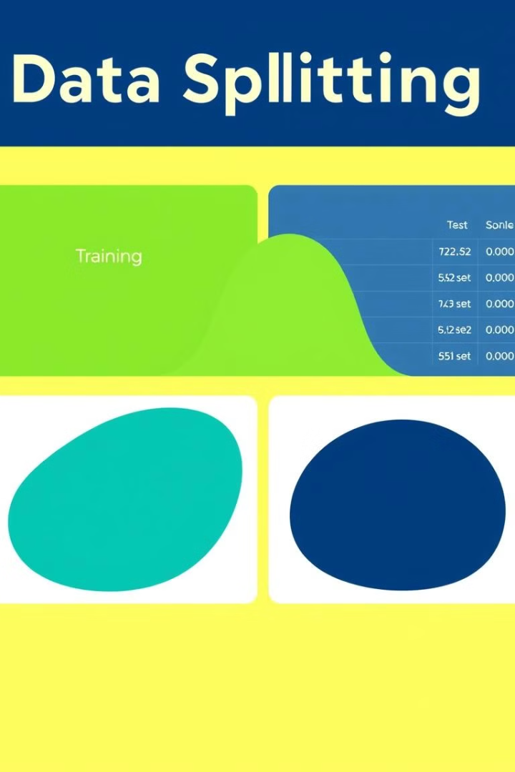



Data Splitting: Separating Training and Evaluation Sets
Training Set
The largest portion of the dataset used to train the machine learning model.
Validation Set
A smaller set used to tune hyperparameters and monitor model performance during training.
Test Set
A held-out set used to evaluate the final model's performance on unseen data.

Slide 9

Any Questions?

