Slide 1
SUGAR COSMETICS
Instagram Performance Analytics
Data-driven social media strategy from 50,000 posts (Apr 2024 - Apr 2025)
Digital Marketing | Social Media Analytics | Business Intelligence

Slide 2
Objective and approach
What we set out to answer
Evaluate account performance on engagement and reach
Find the best content types, hashtags and posting days
Understand audience interaction and growth trends
Recommend strategy for the marketing team
Dataset
50,000 posts, 14 columns, no missing values
Formats: Image, Reel, Story, Video
5 hashtags, 5 campaign types
Engagement rate = (likes + comments + shares + saves) / reach
Tools: Python for cleaning, Tableau Public for dashboard
Sugar Cosmetics | Instagram Performance Analytics

Slide 3
Overview: the account is large and consistent
How is the overall account performing?
50,000
147.7M
18.5M
987.4M
18.54%
Total posts
Total likes
Total comments
Total reach
Avg engagement rate
Summed reach is 77% of impressions (impressions include repeat views; reach is not unique people)
Shares (8.1M) and saves (8.9M) are under 1% of reach; likes are 81% of all interactions
8.9M follows against 29.6M profile visits (29.9% exploratory follow rate)
Sugar Cosmetics | Instagram Performance Analytics

Slide 4
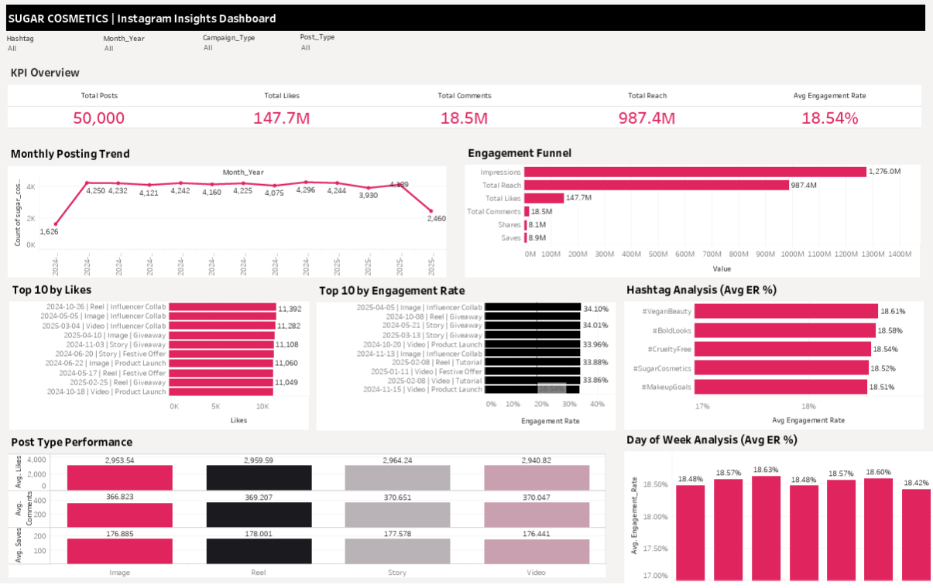
Interactive dashboard
Filters for Post Type, Month, Hashtag and Campaign; click any bar to cross-filter
Replace this picture with your own Tableau dashboard PNG (right-click > Change Picture)
Sugar Cosmetics | Instagram Performance Analytics

Slide 5
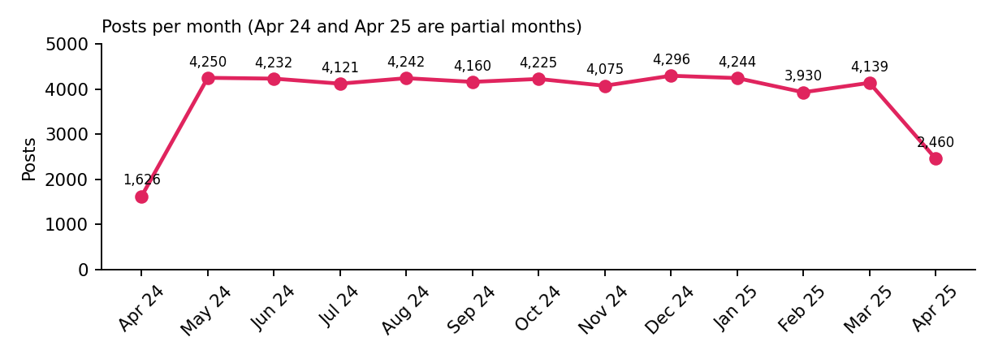
Posting is steady; top posts are alike
Monthly trend and top 10 posts
About 4,000-4,300 posts every full month (about 137 per day); April 2024 and April 2025 are partial months
Top 10 posts by likes: 11,043 to 11,392 likes, all on posts with the widest reach
Top 10 by engagement rate: 33.8% to 34.1%, often with modest reach (hidden gems)
Reach and engagement rate are almost uncorrelated (r = 0.004)
Sugar Cosmetics | Instagram Performance Analytics

Slide 6
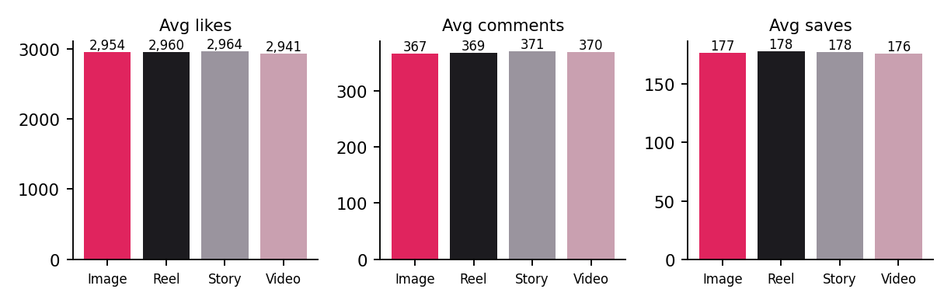
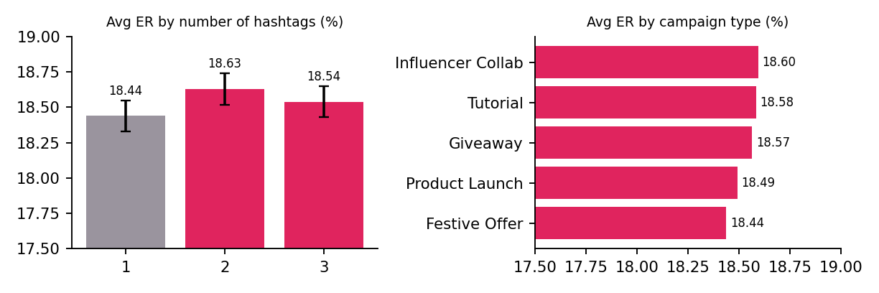
Format, weekday and hashtag: very small differences
No segment is statistically different from the average
Reels (18.61%) and Stories (18.60%) lead; Image trails (18.43%): a 0.18 point gap
Best day Wednesday 18.63% vs Sunday 18.42%
All 5 hashtags sit between 18.51% and 18.61%
Two or three hashtags beat one (18.63% / 18.54% vs 18.44%)
Influencer Collab leads campaigns (18.60%); Festive Offer is last (18.44%)
Sugar Cosmetics | Instagram Performance Analytics

Slide 7
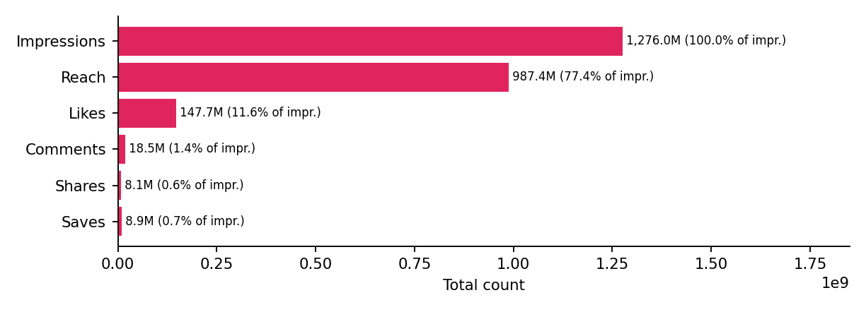
Engagement funnel: depth is the gap
Impressions to Reach to Likes to Comments to Shares to Saves
1.28B impressions led to 987M summed reach (77.4% of impressions)
Likes: 15.0% of reach; comments 1.9%; shares 0.8%; saves 0.9%
Shares and saves signal virality and purchase intent, and are the weakest steps
Profile visits are 3.0% of reach; exploratory follow rate is 29.9% of visits
Sugar Cosmetics | Instagram Performance Analytics

Slide 8
Recommendations
What the marketing team should do
Timing and frequency
Content and hashtags
Engagement and growth
Post every day; keep about 4,000+ posts a month. No weekday needs to be dropped. Add posting time to the data to test hours.
Keep all four formats, lean to Reels and Stories. Use 2-3 hashtags. Default to Influencer Collab and Tutorial campaigns.
Add save and share prompts (tutorials, shade guides). Add a profile call to action on top-reach posts (profile visits are only 3% of reach). Check paid vs organic spend.
Sugar Cosmetics | Instagram Performance Analytics

Slide 9
Data gaps and campaign ideas
Where to look next
Gaps to close
Campaign and test ideas
No caption column: add it to analyse themes and CTAs
No follower count or posting hour: add both
137 posts/day and an 18.5% reach-based rate are unusually high: confirm the source and definition
Partial months in Apr 2024 and Apr 2025
"Save the Look" tutorial series (Reel + Story) aimed at saves
Cruelty-free influencer drops built on #CrueltyFree and #VeganBeauty
Rebuild Festive Offer creative, the weakest campaign
Four-week A/B tests: hashtag count, CTA wording, posting hour
Sugar Cosmetics | Instagram Performance Analytics

