Slide 1
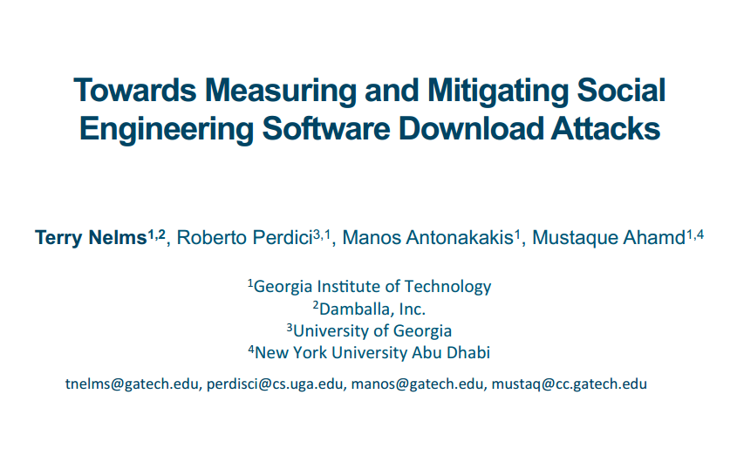
小组成员：潘凌翔（汇报）、苟建国、彭岩、张祺、谢莹、韩丹
EMAIL: 13552386672@139.com

Slide 2
汇报大纲
作者及所属单位
研究背景与意义
研究现状与趋势
论文研究内容
对比相关论文

Slide 3

作者及所属单位
姓名：Terry Nelms
单位：Georgia Institute of Technology
Damballa, Inc
电子邮箱：tnelms@gatech.edu
个人主页：https://www.researchgate.net/profile/Terry_Nelms
研究方向：
基于多核处理器的网络数据高速处理
网络数据包的内容审查
浏览器交互过程的重构
恶意软件下载的检测

Slide 4
作者及所属单位
近期相关论文：
Nelms T, Perdisci R, Antonakakis M, et al. WebWitness: investigating, categorizing, and mitigating malware download paths[C]//24th USENIX Security Symposium (USENIX Security 15). 2015: 1025-1040.
Neasbitt C, Perdisci R, Li K, et al. Clickminer: Towards forensic reconstruction of user-browser interactions from network traces[C]//Proceedings of the 2014 ACM SIGSAC Conference on Computer and Communications Security. ACM, 2014: 1244-1255.
Battestilli L, Nelms T, Hunter S W, et al. High-performing scale-out solution for deep packet processing via adaptive load-balancing[C]//Local & Metropolitan Area Networks (LANMAN), 2011 18th IEEE Workshop on. IEEE, 2011: 1-6.
Nelms T, Ahamad M. Packet scheduling for deep packet inspection on multi-core architectures[C]//Proceedings of the 6th ACM/IEEE Symposium on Architectures for Networking and Communications Systems. ACM, 2010: 21.

Slide 5

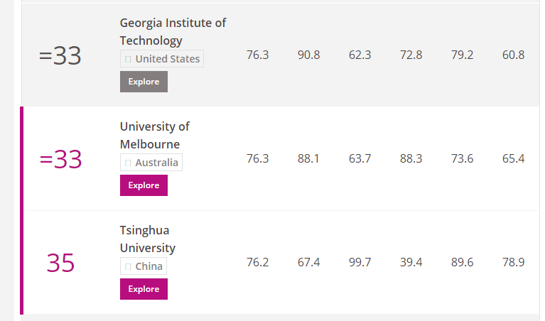
作者及所属单位
单位信息
在2017泰晤士高等教育世界大学排名中
Georgia Institute of Technology排名世界第33
清华大学排名第35
在网络安全领域，
该校在美国排名第9

Slide 6

作者及所属单位
单位信息
Damballa is an American computer security company focused on advanced cyber threats such as zero-day attacks and advanced persistent threats (APT).
The company's system uses massive data sets and machine learning to identify malicious activity based on network behavior, content analysis and threat intelligence. The system constantly “trains” on new data, which enables it to detect previously unknown threats.

Slide 7

作者及所属单位
姓名：Robnerto Perdisci
职称：Associate Professor
单位：Department of Computer Science,
Georgia Institute of Technology
电子邮箱：perdisci@cs.uga.edu
个人主页：http://roberto.perdisci.com/
研究方向：
基于浏览器的网络攻击
浏览器访问踪迹的重构
恶意软件下载的检测

Slide 8

作者及所属单位
姓名：Manos Antonakakis
职称：Associate Professor
单位：School of Electrical and Computer Engineering,
Georgia Institute of Technology
电子邮箱：manos@anTonaKakiS.oRg
个人主页：http://www.antonakakis.org/
研究方向：
DSN安全
恶意软件下载的检测

Slide 9

作者及所属单位
姓名：Mustaque Ahamad
职称：Professor
单位：College of Computing,
Georgia Institute of Technology
电子邮箱：mustaq@cc.gatech.edu
个人主页：http://www.cc.gatech.edu/mustaq/
研究方向：
电子医疗数据的安全性
恶意软件下载的检测

Slide 10
研究背景与意义
Most modern malware infections happen via the browser, typically triggered by social engineering
Because social engineering (SE) attacks target users, rather than systems, current defense solutions are often unable to accurately detect them.
shed light on the tactics used in modern attacks
gather precious information that may be used to better train users against future SE attacks

Slide 11
研究现状与趋势

Slide 12
研究现状与趋势

Slide 13
论文研究内容
Categorizing SE Download Tactics
Collecting and Labeling SE Attacks
Measuring SE Download Properties
Detecting SE Download Attacks

Slide 14
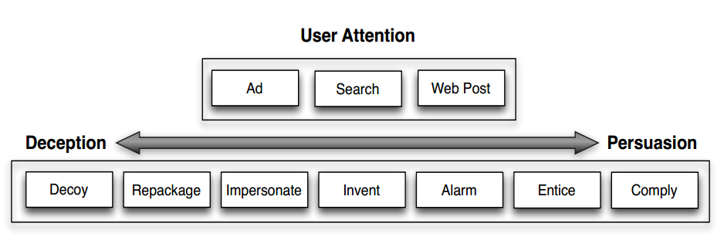
论文研究内容
Categorizing SE Download Tactics

Slide 15
论文研究内容
Collecting and Labeling SE Attacks
Data Collection Approach
monitor all web traffc at the edge of a large network
on a large academic network serving tens of thousands users for a period of two months
recording all traffc related to the download of exe fles
automatic download path traceback
a conservative whitelist
collected a total of 35,638 executable downloads

Slide 16
论文研究内容
Collecting and Labeling SE Attacks
Automatic Data Filtering
identify and flter out update downloads
examine the length of the download path
review the useragent string observed in the HTTP requests on the download path
a total of 13,762 software download events (the exe files and download paths) that required further analysis

Slide 17
论文研究内容
Collecting and Labeling SE Attacks
Analysis of Software Download Events
identify a number of statistical features to identify and automatically clusters similar download events
to reduce the time needed to further analyze
minimize the impact of possible noise
Filename Similarity
File Size Similarity
URL Structure Similarity
HTTP Response Header Similarity
Domain Name Similarity
Shared Domain Predecessor
Shared Hosting
This process produced 1,205 clusters

Slide 18
论文研究内容
Collecting and Labeling SE Attacks
Labeling SE Download Attacks
each cluster was manually reviewed by randomly sampling 10%
performing a detailed manual analysis in this sample set
make use of antivirus (AV) labels for confrmation purposes
SE download attack
benign downloads
malware downloads triggered by drive-by downloads
benign software updates
malicious software updates
we labeled 136 clusters as social engineering, these clusters included a total of 2,004 SE download attacks

Slide 19
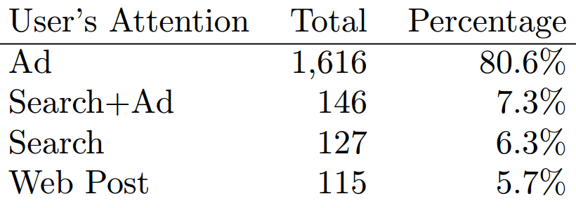
论文研究内容
Measuring SE Download Properties
Popularity of SE Download Attacks
Popularity of SE Tactics for Gaining the User‘s Attention

Slide 20
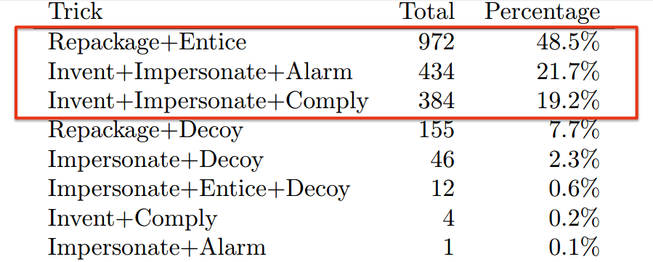
论文研究内容
Measuring SE Download Properties
Popularity of SE Download Attacks
Popularity of SE Tactics for Tricking the User

Slide 21
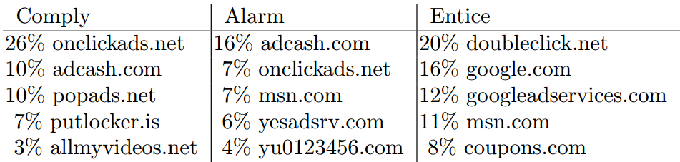
论文研究内容
Measuring SE Download Properties
Ad-based SE Download Delivery Paths
Top 5 Ad Entry Point Domains

Slide 22
论文研究内容
Measuring SE Download Properties
Ad-based SE Download Delivery Paths
Top 5 ad-driven SE download domains
measure the “age” of these domains by a DNS database (pDNS-DB)

Slide 23
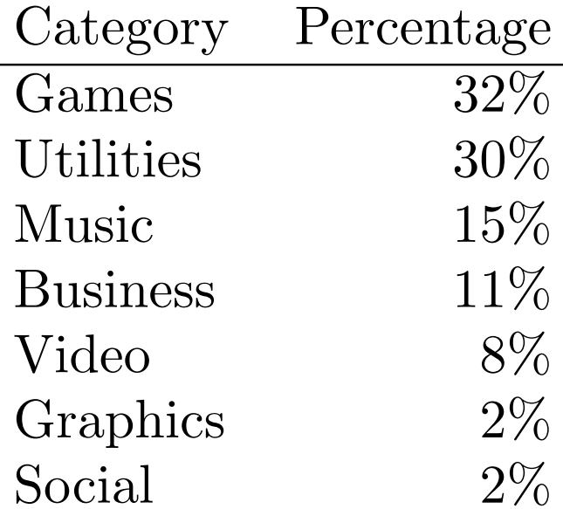
论文研究内容
Measuring SE Download Properties
Benign Ad Based Downloads
If an AdBlock rule matches the download path, we label that benign software download as ad-driven
7% of all benign downloads
are ad-based
40% chance that an ad-based
download is benign

Slide 24
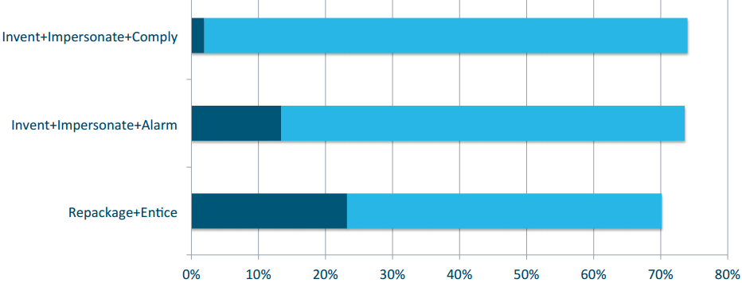
论文研究内容
Detecting SE Download Attacks
Antivirus Detection

Slide 25
论文研究内容
Detecting SE Download Attacks
SE Detection Classifer
devise a set of statistical features that can be used to accurately detect ad-driven SE downloads
translate the download path into a feature vector
train a statistical classifer using the Random Forest algorithm
Ad Chain Features
Ad-Driven
Minimum Ad Domain Age
Maximum Ad Domain Popularity
Download URL Features
Download Domain Age
Download Domain Alexa Rank

Slide 26
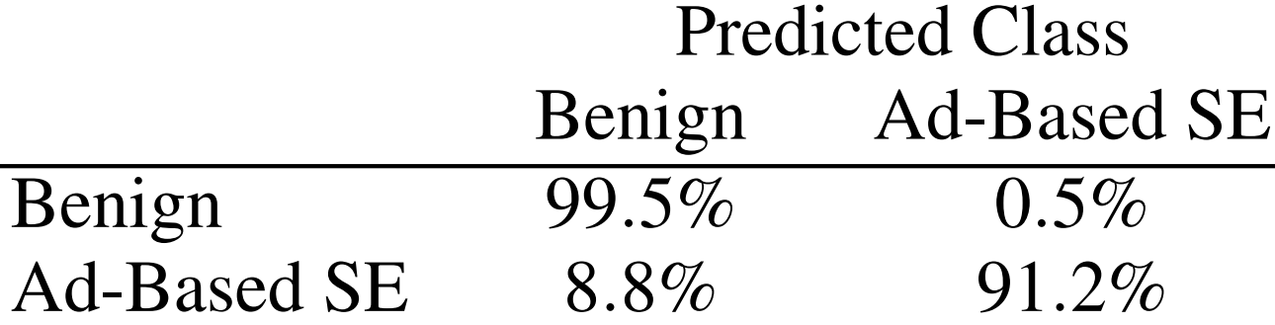
论文研究内容
Detecting SE Download Attacks
Evaluating the SE Detection Classifer
First Dataset, train the classifer
Second Dataset, test the classifer
collected from the same deployment network

Slide 27
对比相关论文
ABRAHAM, S., AND CHENGALUR-SMITH, I. An overview of social engineering malware: Trends, tactics, and implications. Technology in Society 32, 3 (2010), 183-196.
NELMS, T., PERDISCI, R., ANTONAKAKIS, M., AND AHAMAD, M. Webwitness: Investigating, categorizing, and mitigating malware download paths. In Proceedings of the 24th USENIX Conference on Security Symposium (Berkeley, CA, USA, 2015), SEC‘15, USENIX Association, pp. 1025-1040.
RAJAB, M. A., BALLARD, L., LUTZ, N., MAVROMMATIS, P., AND PROVOS, N. Camp: Content-agnostic malware protection.

Slide 28
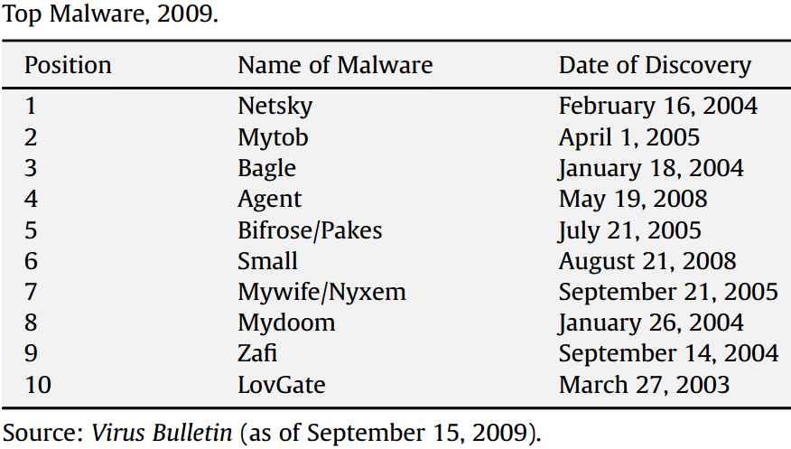
对比相关论文
An overview of social engineering malware
all of them relied on social engineering to be activated！

Slide 29
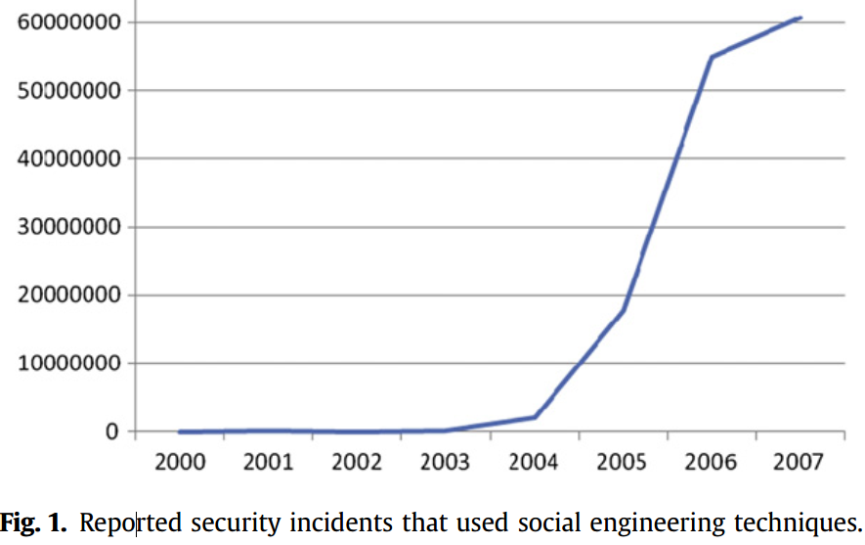
对比相关论文
An overview of social engineering malware

Slide 30
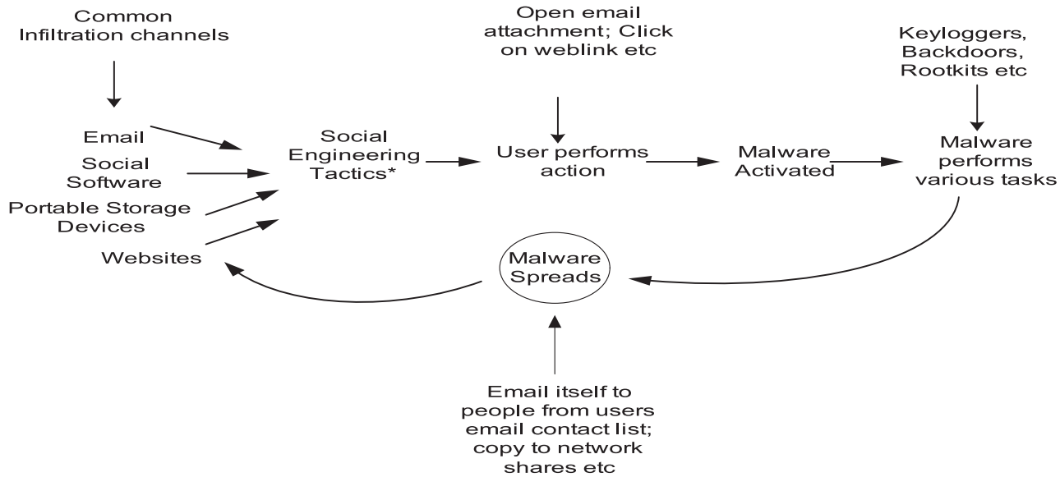
对比相关论文
An overview of social engineering malware

Slide 31
对比相关论文
An overview of social engineering malware
Social engineering tactics
Psychological ploys
Curiosity, empathy, and excitement
Fear
Greed
Targeted attacks
College students
Corporate executives
Countries, religious groups, and sects
Technical tactics
Combating existing protection mechanisms
Fast-Flux
Deactivating security tools

Slide 32
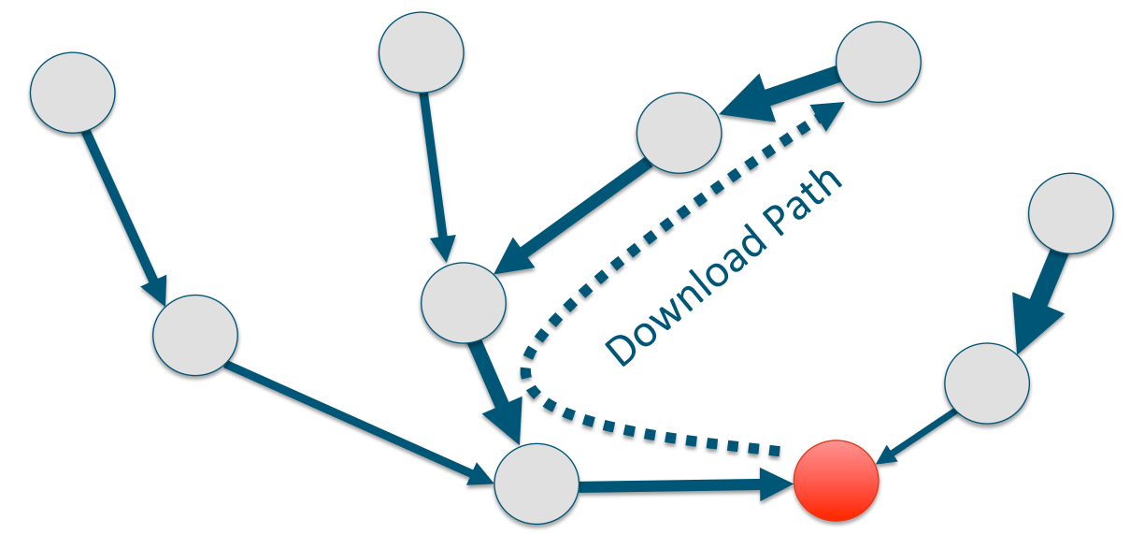
对比相关论文
Investigating, categorizing, and mitigating malware download paths
The trace-back algorithm
Automatically provide context to attacks
Reconstruct download path
Identify download cause

Slide 33
对比相关论文
Investigating, categorizing, and mitigating malware download paths
The trace-back algorithm
construct a weighted directed graph
The vertices are HTTP transactions
The edges represent the relation “probable source of” for pairs of HTTP transactions
Each edge has a weight that expresses the level of confidence we have on the “link” between two nodes
use a greedy algorithm to construct an “backtrace path”

Slide 34
对比相关论文
Investigating, categorizing, and mitigating malware download paths
The trace-back algorithm
an edge is created if any of the seven features is satisfied
associate a weight to each of the seven features
Location ( we = 7 )
Referrer ( we = 6 )
Domain-in-URL ( we = 5 )
URL-in-Content ( we = 4 )
Same-Domain ( we = 3 )
Commonly Exploitable Content ( we = 2 )
Ad-to-Ad ( we = 1 )

Slide 35
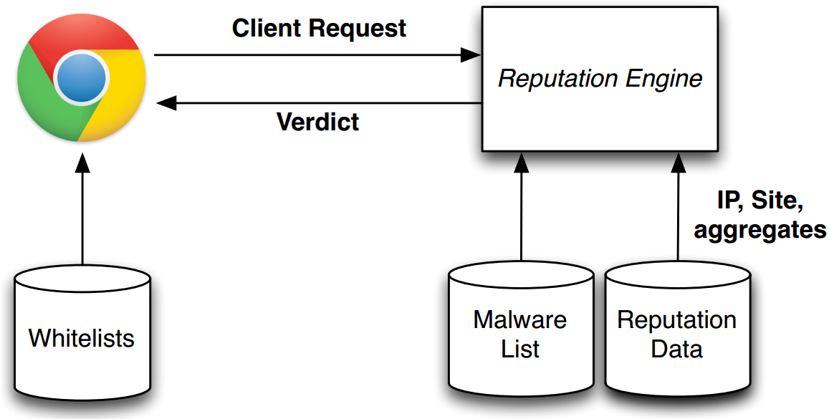
对比相关论文
Content-agnostic malware protection
System Architecture

Slide 36
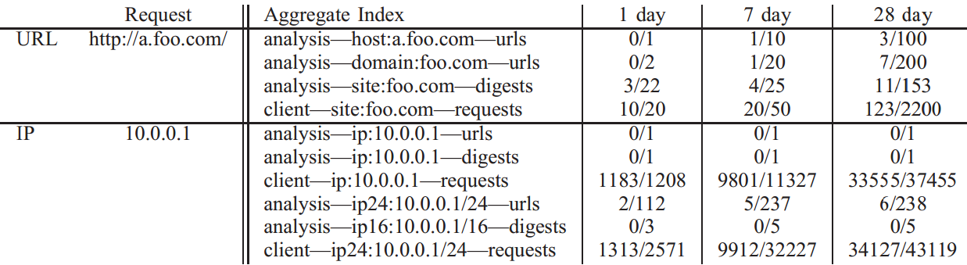
对比相关论文
Content-agnostic malware protection
REPUTATION SYSTEM
Feature Extraction
IP addresses
URL-based
signature-based
Aggregate Computation
Reputation Decision

Slide 37
Questions?
Categorizing SE Download Tactics
Collecting and Labeling SE Attacks
Measuring SE Download Properties
Detecting SE Download Attacks

