Slide 1
现代密码学理论与实践 第5章 AES密码
Fifth Edition by William Stallings
苗付友
mfy@ustc.edu.cn
2016年10月

Slide 2
高级加密标准AES要点
AES是一种分组密码，用以取代DES的商业应用。其分组长度为128位，密钥长度为128位、192位或256位
AES没有使用Feistel结构。每轮由四个独立的运算组成：字节代换、置换、有限域上的算术运算，以及与密钥的异或运算

Slide 3
本章目录
5.1 AES概述
5.2 The AES Cipher – Rijndael
5.3 AES 的一轮加密过程
1）字节代替变换
2）行移位变换
3）列混淆变换
4）轮密钥加变换

Slide 4
AES的评估准则
AES的起源
因为DES的不安全，建议用3DES，密钥168位，抵御密码分析攻击。但是3DES用软件实现速度较慢，分组短，仅64位。
美国国家标准技术协会NIST在1997年征集新标准，要求分组128位，密钥128、192或256
15候选算法在1998年6月通过了第一轮评估，仅有5个候选算法在1999年8月通过了第二轮评估
2000年10月，NIST选择Rijndael作为AES算法， Rijndael的作者是比利时的密码学家Joan Daemen博士和Vincent Rijmen博士
2001年11月，NIST完成评估并发布了最终标准 FIPS PUB 197

Slide 5
AES Requirements
Private key symmetric block cipher
128-bit data, 128/192/256-bit keys
Stronger and faster than Triple-DES
Active life of 20-30 years (+ archival use)
Provide full specification and design details
Both C and Java implementations
NIST have released all submissions and unclassified analyses

Slide 6
AES Shortlist
After testing and evaluation, shortlist in Aug-99:
MARS (IBM) - complex, fast, high security margin
RC6 (USA) - v. simple, v. fast, low security margin
Rijndael (Belgium) - clean, fast, good security margin
Serpent (Euro) - slow, clean, v. high security margin
Twofish (USA) - complex, v. fast, high security margin
Notes:
The shortlist is as shown. Note mix of commercial (MARS, RC6, Twofish) verses academic (Rijndael, Serpent) proposals, sourced from various countries.
All were thought to be good – came down to best balance of atatributes to meet criteria.

Slide 7
AES的评估
AES评估准则的三大类别
安全性：指密码分析方法分析一个算法所需的代价
成本：期望AES能够广泛应用于各种实际应用，计算效率要高
算法和执行特征：算法灵活性、适合于多种硬件和软件方式的实现、简洁性，便于分析安全性

Slide 8
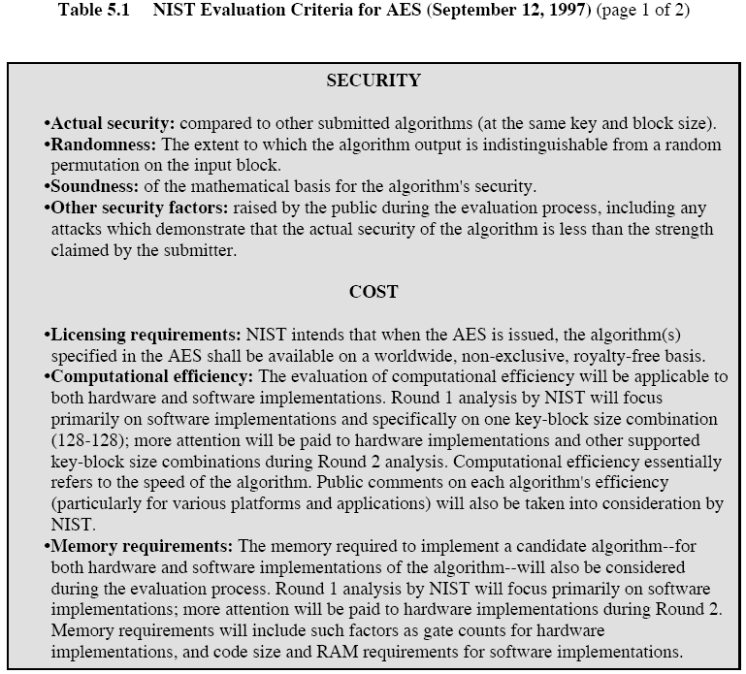

Slide 9
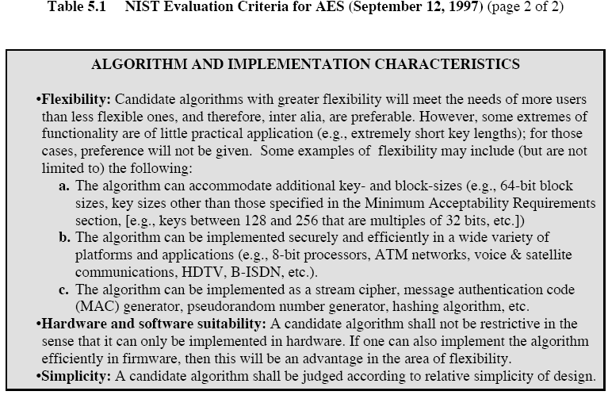

Slide 10
AES评估准则
一般安全性
依赖于密码学界的公共安全分析
软件实现
软件执行速度，跨平台执行能力及密钥长度改变时速度变化
受限空间环境
在诸如智能卡中的应用
硬件实现
硬件实现时能够提高执行速度或缩短代码长度
抵御密码分析攻击
密钥灵活性
快速改变密钥长度的能力
其他的多功能性和灵活性
指令级并行执行的潜力

Slide 11
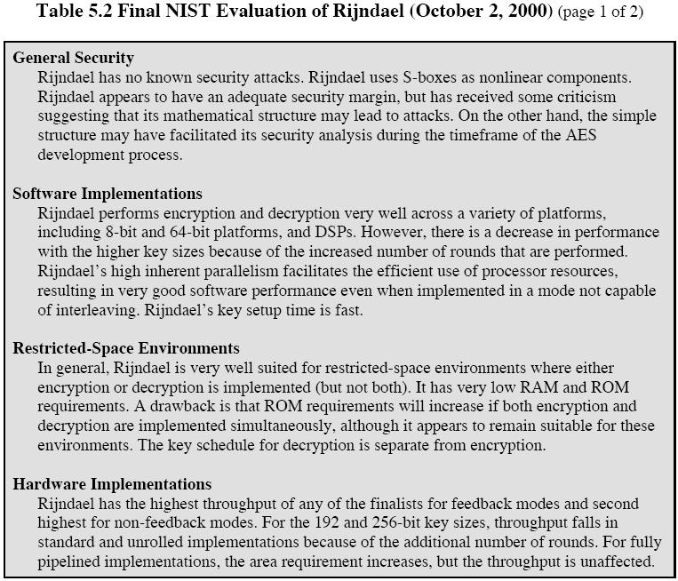

Slide 12
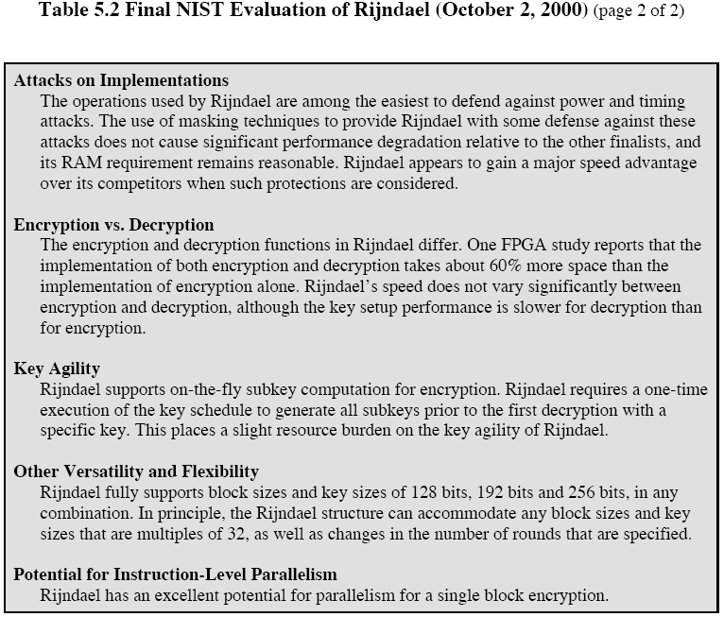

Slide 13
5.2 The AES Cipher - Rijndael
Designed by Rijmen-Daemen in Belgium
Has 128/192/256 bit keys, 128 bit data
An iterative rather than Feistel Cipher
treats data in 4 groups of 4 bytes
operates an entire block in every round
Designed to be:
resistant against known attacks
speed and code compactness on many CPUs
design simplicity
Notes:
Rijndael is an academic submission, based on the earlier Square cipher, from Belgium academics Dr Joan Daemen and Dr Vincent Rijmen.
It is an iterative cipher (operates on entire data block in every round) rather than feistel (operate on halves at a time). cf IDEA cipher

Slide 14
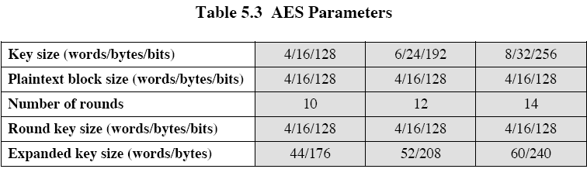
AES Parameters

Slide 15
Rijndael
Processes data as 4 groups of 4 bytes (state)
Has 9/11/13 rounds in which state undergoes:
byte substitution (1 S-box used on every byte)
shift rows (permute bytes between groups/columns)
mix columns (subs using matrix multiply of groups)
add round key (XOR state with key material)
Initial XOR key material & incomplete last round
All operations can be combined into XOR and table lookups - hence very fast & efficient
Notes:
Data is written into the state matrix by columns; this matrix is manipulated at stage of the en/decryption process, and is then finally copied to the output.
The key is expanded into 44/52/60 lots of 32-bit words (see later), with 4 used in each round.
The data computation then consists of an “add round key” step, then 9/11/13 rounds with all 4 steps, and a final 10th/12th/14th step of byte subs + mix cols + add round key. All steps are easily reversed.
Note only the “add round key” step makes use of the key and obscures the result, hence MUST be used at start and end of each round, since otherwise could undo effect of other steps. But the other steps provide confusion/diffusion/non-linearity. ie can look at cipher as a series of XOR with key then scramble/permute block repeated. This is efficient and highly secure it is believed.

Slide 16
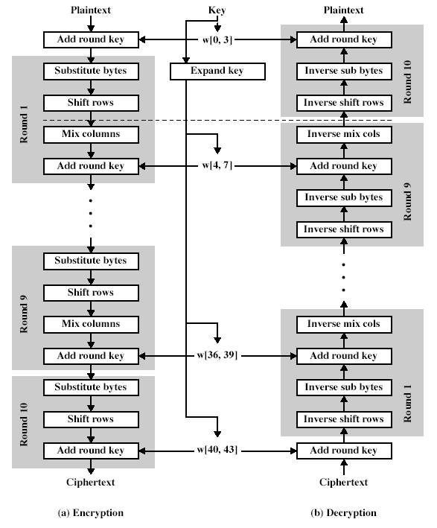

Slide 17
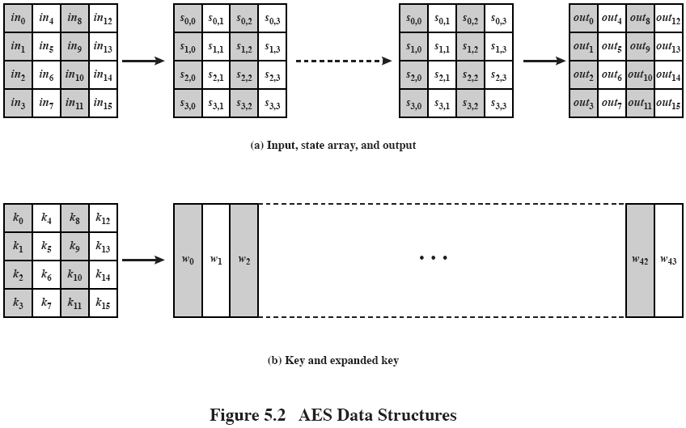
AES的数据结构

Slide 18
5.2 AES的结构
非Feistel结构
密钥被扩展成由44个32位字组成的数组w[i]
一个混淆和三个代换
字节代换：用一个S盒完成分组中的按字节代换
行移位：一个简单的置换
列混淆：利用在域GF(2⁸)上的算术特性的代换
轮密钥加：利用当前分组和扩展密钥的一部分进行按位XOR
算法结构简单
仅在轮加密阶段中使用密钥
轮密钥加配合其他三个混淆的交替使用提供了安全性
每个阶段均可逆
解密按逆序方式使用扩展密钥，但是算法不一样
一旦将四个阶段求逆，可以证明解密函数可以恢复明文
加密和解密过程的最后一轮均只包括三个阶段

Slide 19
5.3 AES 的一轮加密过程

Slide 20
1）字节代替变换
A simple substitution of each byte
Uses one table of 16x16 bytes containing a permutation of all 256 8-bit values
Each byte of state is replaced by byte in row (left 4-bits) & column (right 4-bits)
eg. byte {95} is replaced by row 9 col 5 byte
which is the value {2A}
Notes:
There is a single 8-bit wide S-box used on every byte. This S-box is a permutation of all 256 8-bit values, constructed using a transformation which treats the values as polynomials in GF(2⁸) – however it is fixed, so really only need to know the table when implementing. Decryption requires the inverse of the table.

Slide 21
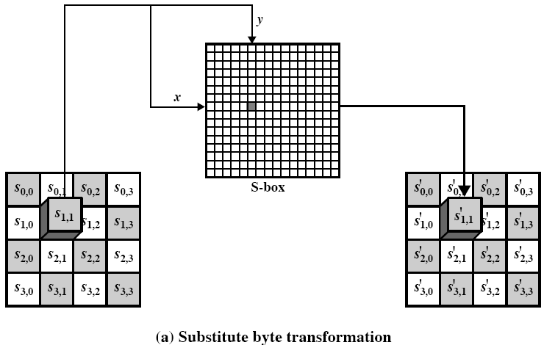
字节代换变换

Slide 22
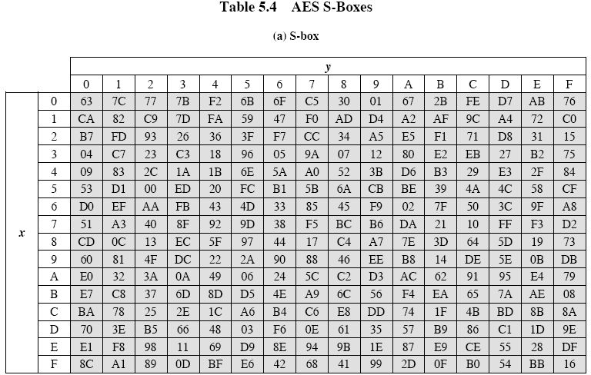

Slide 23
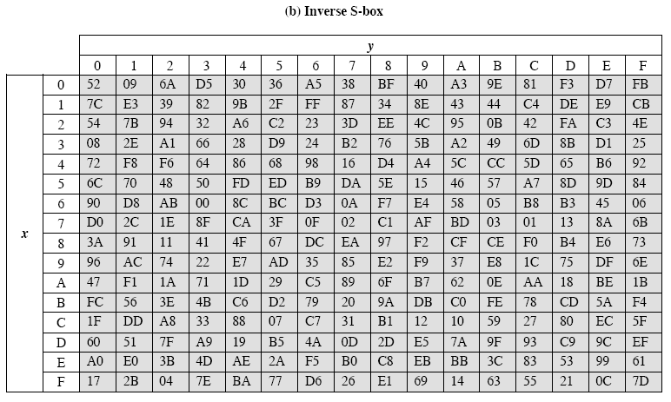

Slide 24
2）行移位变换
A circular byte shift in each
1st row is unchanged
2nd row does 1 byte circular shift to left
3rd row does 2 byte circular shift to left
4th row does 3 byte circular shift to left
Decrypt does shifts to right
Since state is processed by columns, this step permutes bytes between the columns
Notes:
This step provides “permutation” of the data, whereas the other steps involve substitutions.

Slide 25
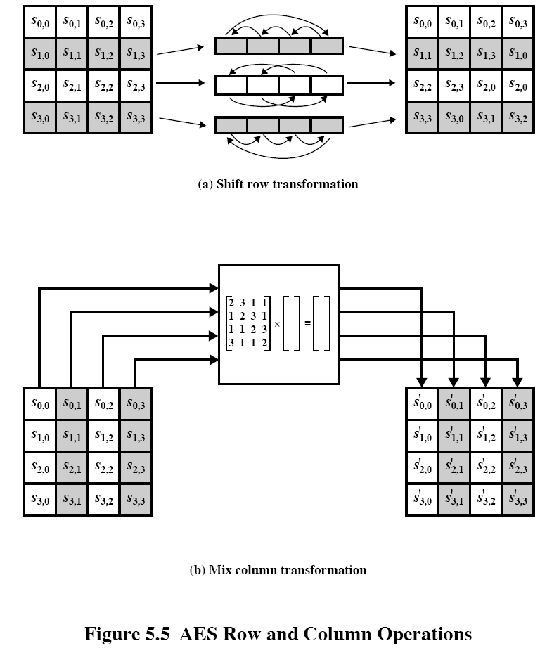

Slide 26

3）列混淆变换
Each column is processed separately
Each byte is replaced by a value dependent on all 4 bytes in the column
Effectively a matrix multiplication in GF(2⁸) using prime poly m(x) =x⁸+x⁴+x³+x+1
Notes:
This step is also a substitution, but one involving ALL values in a column. Designed as a matrix multiplication where each byte is treated as a polynomial in GF(2⁸). The inverse used for decryption involves a different set of constants.
The constants used are based on a linear code with maximal distance between code words – this gives good mixing of the bytes within each column. Combined with the “shift rows” step provides good avalanche, so that within a few rounds, all output bits depend on all input bits.

Slide 27
4）轮密钥加变换
XOR state with 128-bits of the round key
Again processed by column (though effectively a series of byte operations)
Inverse for decryption is identical since XOR is own inverse, just with correct round key
Designed to be as simple as possible

Slide 28
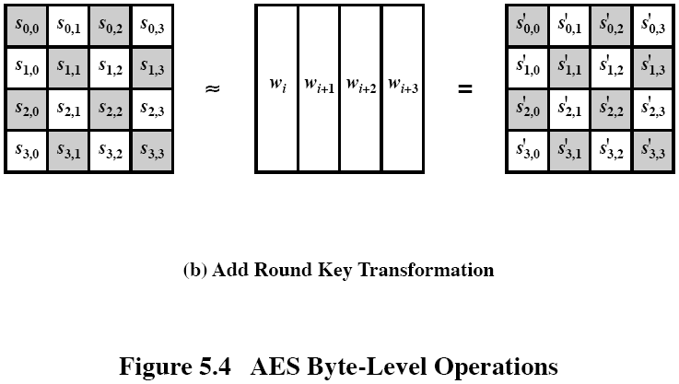
轮密钥加变换

Slide 29
5 ）AES 的密钥扩展
Takes 128-bit (16-byte) key and expands into array of 44/52/60 32-bit words
Start by copying key into first 4 words
Then loop creating words that depend on values in previous & 4 places back
in 3 of 4 cases just XOR these together
every 4th has S-box + rotate + XOR constant of previous before XOR together
Designed to resist known attacks
Notes:
Key expansion is designed to be simple to implement, but by using round constants break symmetries, and make it much harder to deduce other key bits if just some are known (but once have as many consecutive bits as are in key, can then easily recreate the full expansion).

Slide 30
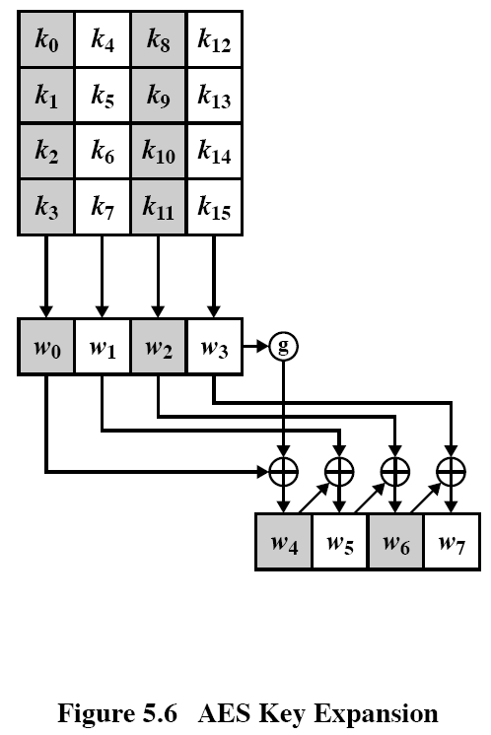

Slide 31
对应的逆算法
AES decryption is not identical to encryption since steps done in reverse
But can define an equivalent inverse cipher with steps as for encryption
but using inverses of each step
with a different key schedule
Works since result is unchanged when
swap byte substitution & shift rows
swap mix columns & add (tweaked) round key
Notes:
By constructing an equivalent inverse cipher with steps in same order as for encryption, can derive a more efficient implementation. Clearly swapping the byte substitutions and shift rows has no effect, since work just on bytes. Swapping the mix columns and add round key steps requires the inverse mix columns step be applied to the round keys first – this makes the decryption schedule a little more complex with this construction.

Slide 32
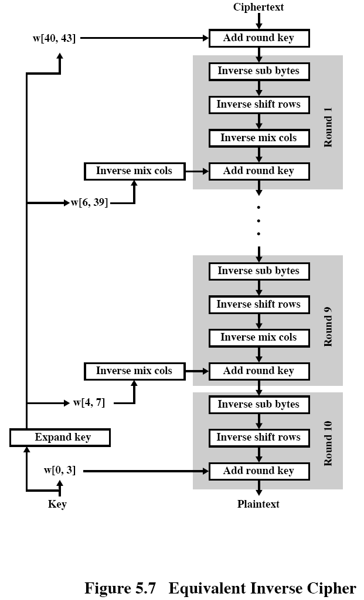

Slide 33
AES的实现
Can efficiently implement on 8-bit CPU
byte substitution works on bytes using a table of 256 entries
shift rows is simple byte shifting
add round key works on byte XORs
mix columns requires matrix multiply in GF(2⁸) which works on byte values, can be simplified to use a table lookup

Slide 34
AES的实现
Can efficiently implement on 32-bit CPU
redefine steps to use 32-bit words
can precompute 4 tables of 256-words
then each column in each round can be computed using 4 table lookups + 4 XORs
at a cost of 16Kb to store tables
Designers believe this very efficient， implementation was a key factor in its selection as the AES cipher

Slide 35
Summary
We have considered:
the AES selection process
the details of Rijndael – the AES cipher
looked at the steps in each round
the key expansion
implementation aspects

