Slide 1

WAREHOUSE APP v 1.0
Author: Marko Haiduk AKA avg9999. 2026, all rights reserved

Slide 2
Navigation
What is this, main purpose, key motivation to create it and the app`s main concept
How does it work?
Types of logistics operations
Schema of the application
Chapter 0. Log in
Chapter 1. Logistics
Chapter 2. Inventory
Chapter 3. Goods registry
Chapter 4. Personnel
Chapter 5. My account
Chapter 6. Change password
Author: Marko Haiduk AKA avg9999. 2026, all rights reserved

Slide 3
What is this, main purpose, key motivation to create it and the app`s main concept.
The application for warehouse logistics and inventory operations performing.
Suitable for small warehouses (up to 10-15 personnel).
The key motivation was to create a quick and user-friendly platform which, with further updates, will be able to compete with professional logistics apps (such as ERP), and to let each employee immediately update goods logistics from his own device.
The main concept implemented for the app functionality, is coding all the calculation operations and permission/restriction functions and triggers directly in SQL database, which is the main storage of all the app`s data. It unloads the vast amount of code off the Backend models, controllers and routes.

Slide 4
How does it work?
The app is multi-user and permits to each warehouse employee to log in to his personal account. The initial login credentials and employee data are created by a manager, then it remains possible to adjust personal password.
The employees are divided into three classes:
- Manager: has full access to all types of logistics operations, goods registry items adding and updating, personnel info editing.
- Receiver: has full access to all types of logistics operations, without permission to edit goods data and employees info.
- General worker: restricted only to perform goods departure/utilization operation (with no access to receive goods from outside supplier), also restricted to edit goods/employees info as well as a receiver.
The authorization is performed by governmental ID number and password of each employee.

Slide 5
Types of logistic operations:
Group 10 – goods receiving:
10 – received from the outside supplier;
11 – refused receiving by incompatibility;
12 – refused receiving by expiry;
13 – refused receiving by damage;
14 – refusing receiving by hazard
Group 20 – goods departure:
20 – departed;
21 – departure returned by incompatibility;
22 – departure returned by expiry;
23 – departure returned by damage;
24 – departure returned by hazard
Group 30 – goods utilization:
32 – utilized by expiry;
33 – utilized by damage;
34 – utilized by hazard;
35 – utilized by theft (report mandatory!);
36 – utilized by other reason (report mandatory!)

Slide 6
Schema of the application:
0. LOGGING IN PAGE
LOGISTICS
- view logistics operations (view all or choose by code, name, operation code, goods type (foods/general (e.g. non-food)), ID of a responsible for the logistic operation, operation date);
- log new logistic operation;
2. FOODS INVENORY / GENERAL INVENTORY
- check the amount of goods in foods or general inventory; possible to view all or choose by code, name or measuring unit;
3. GOODS REGISTRY
- check all existing goods in goods registry (to get item`s code, name, type (foods/general), or measuring unit). A manager is also authorized to add/update items to goods registry.
4. PERSONNEL (available for manager only!)
- add, dismiss or return back dismissed employees. The employees, either active or dismissed, remain in the database to have actual info of all staff performed logistic operations;
5. MY ACCOUNT (available for manager only!)
- change the own credentials: ID, name, date of birth, password.
6. CHANGE PASSWORD (available for receiver / general worker)
- change the own account`s password. The rest of employee data is changed by request to a manager.

Slide 7
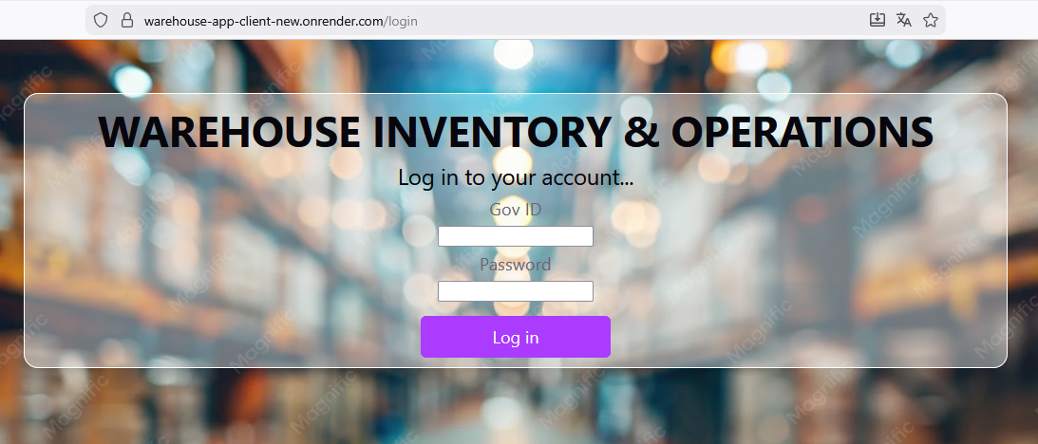
CHAPTER 0. LOG IN
Logging in is pretty simple: enter your gov_id and password since they are created by a manager and press Log In button. After logging in you can change your password (see chapter 5).

Slide 8
CHAPTER 1. LOGISTICS
There are three types of dashboards:
- manager dashboard
- receiver dashboard
- general worker dashboard.

Slide 9
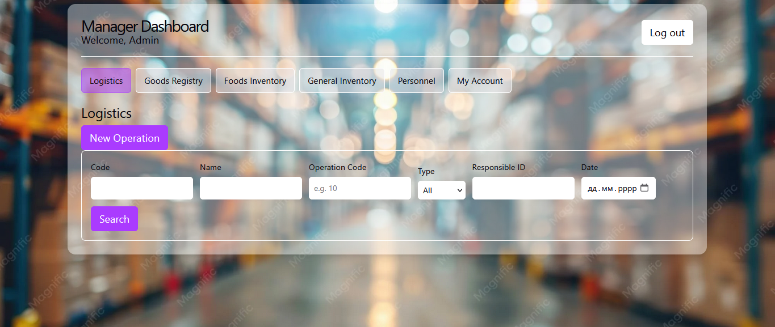
Manager dashboard

Slide 10
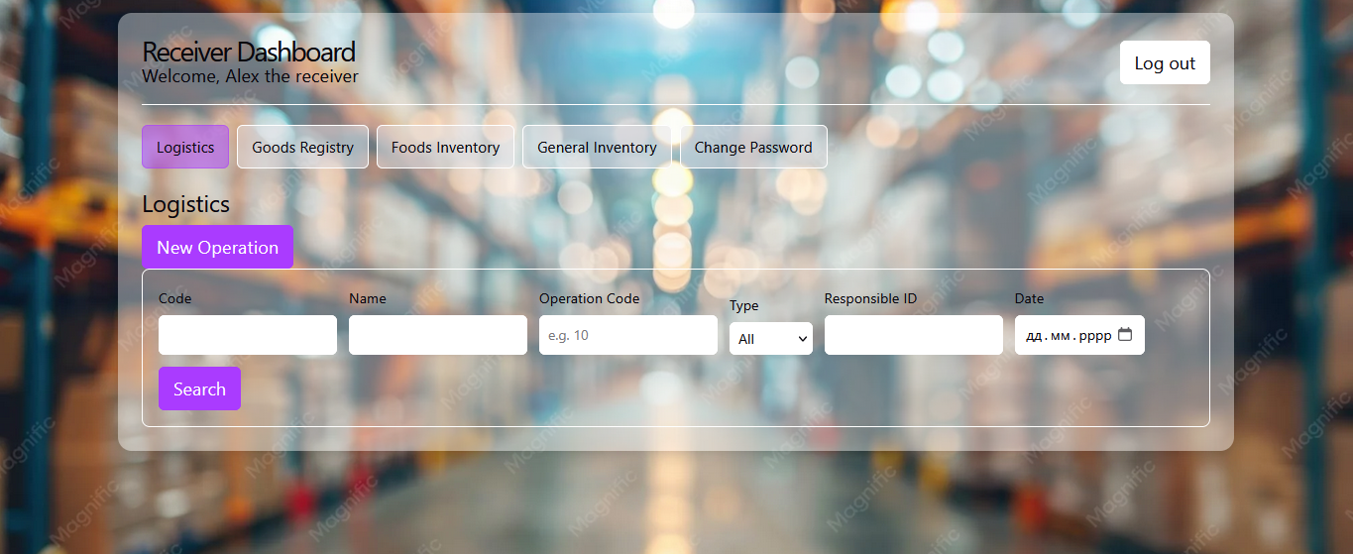
Receiver dashboard

Slide 11
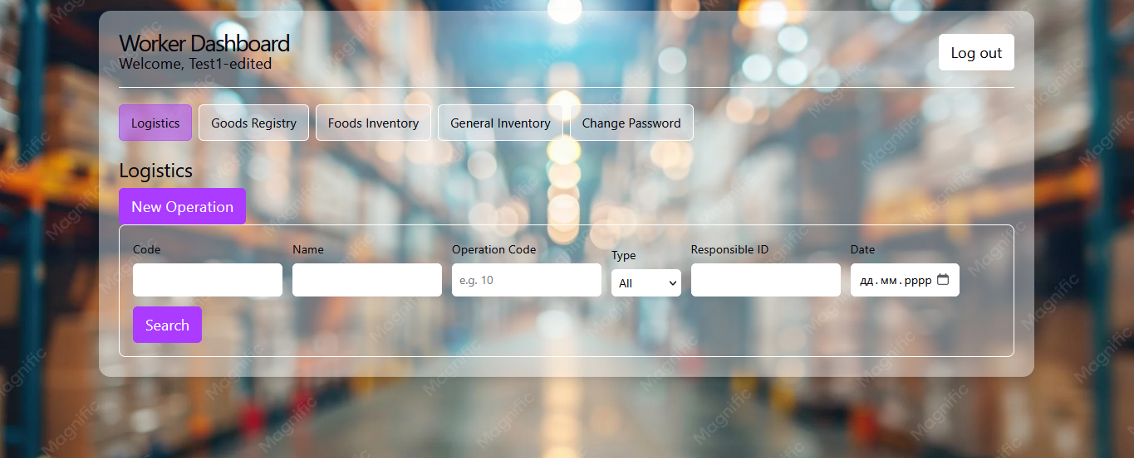
General worker dashboard

Slide 12
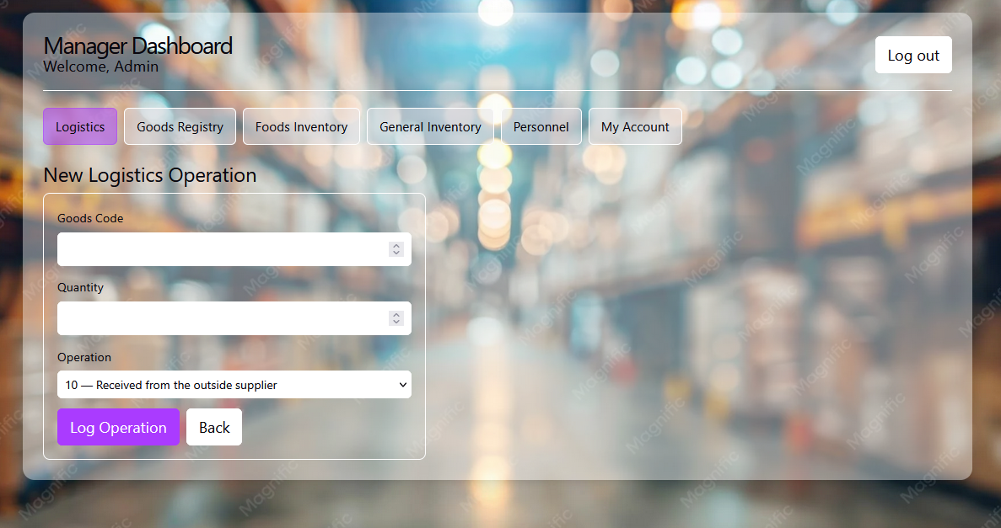
New logistic operation

Slide 13
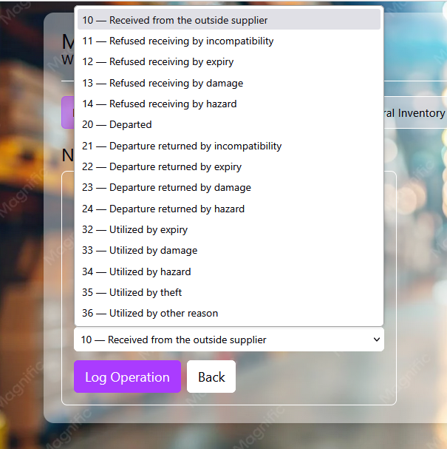
Logistic operation types
10-14: receiving
20-24: departure
32-36: utilizing
IMPORTANT! Operations 10-14 are not available in Worker dashboard!

Slide 14
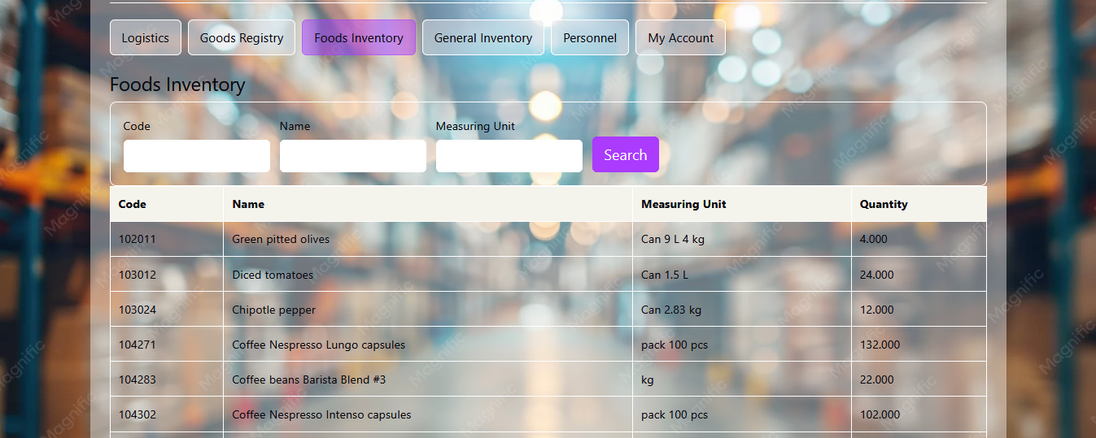
CHAPTER 2. INVENTORY
2.1. Foods inventory
The inventory table is activated by “Search” button. There are Foods Inventory tab (displays foods available in the warehouse) and General Inventory tab

Slide 15
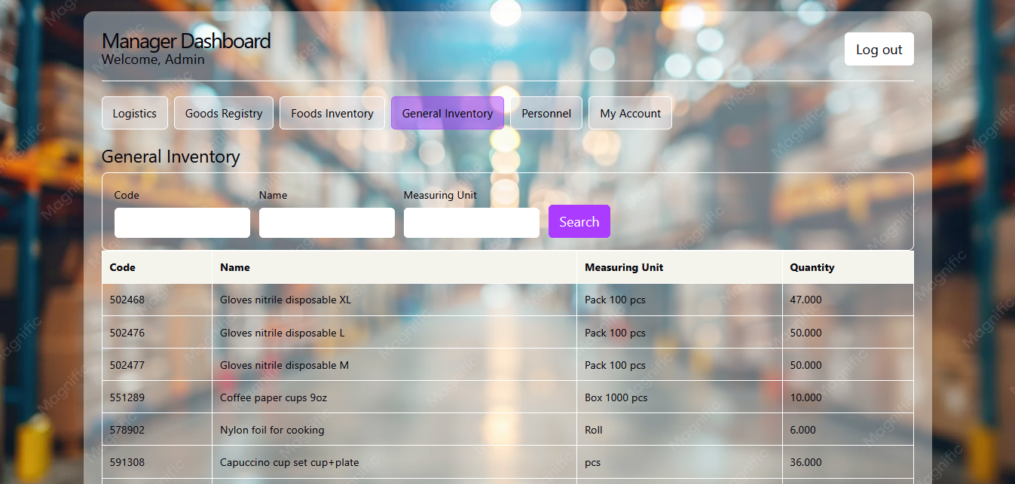
2.2. General Inventory

Slide 16
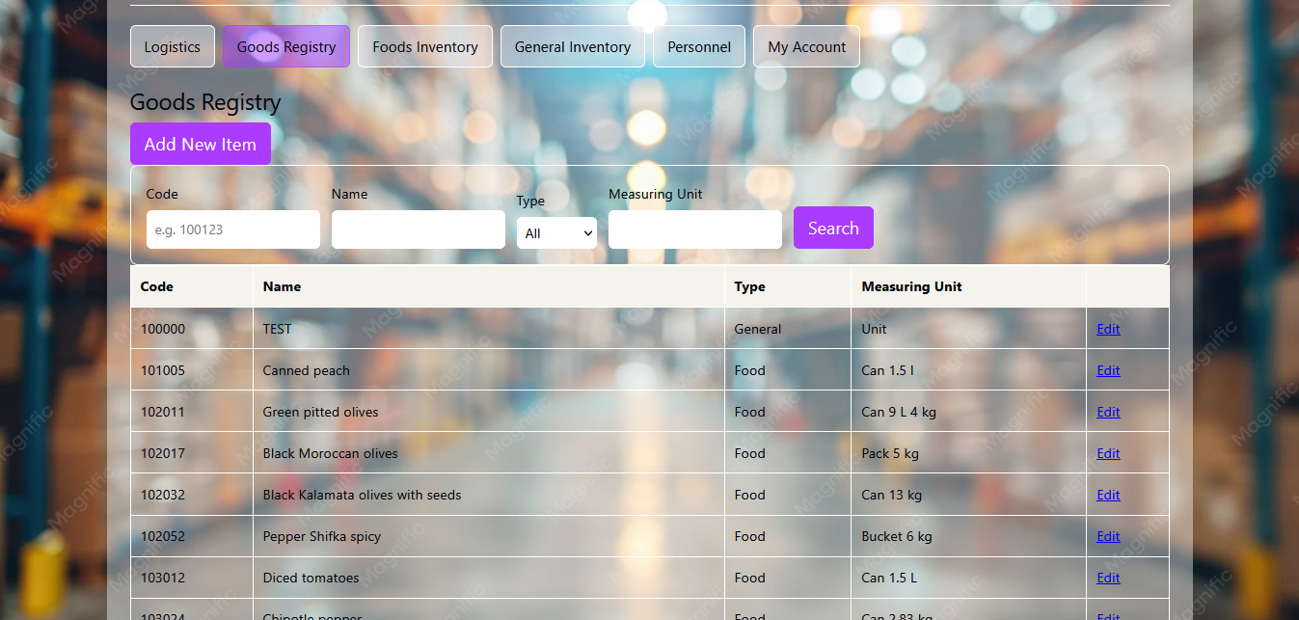
CHAPTER 3. GOODS REGISTRY
Contains all existing goods which are used in operations. The goods are defined by code, name, type (foods/general) and measuring unit, and can be sorted by these units. To add a new item click the button “Add New Item”. Goods registry units can be added or updated only from the manager dashboard (e.g. “Add new item” and “Edit” button are missing in Receiver / Worker dashboards)

Slide 17
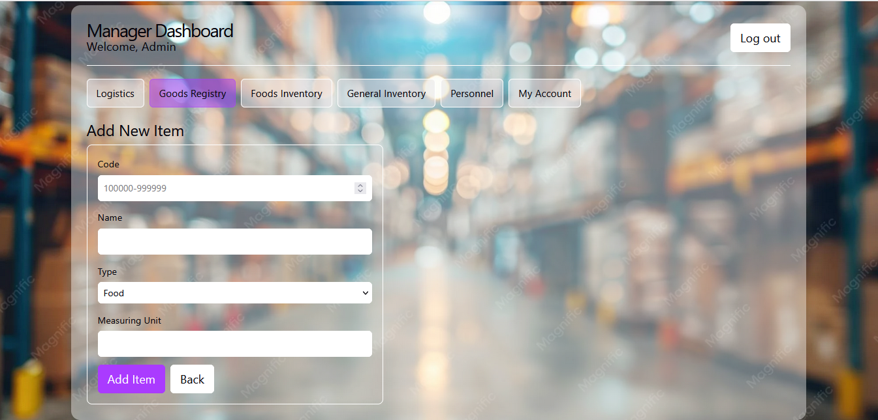
Goods registry – add new item
To add a new item, define a 6-digit code, a unit name, type (Food/General) and measuring unit, and then press “Add Item” button. A new item will be stored in Goods Registry and will be available for logistic operations.

Slide 18
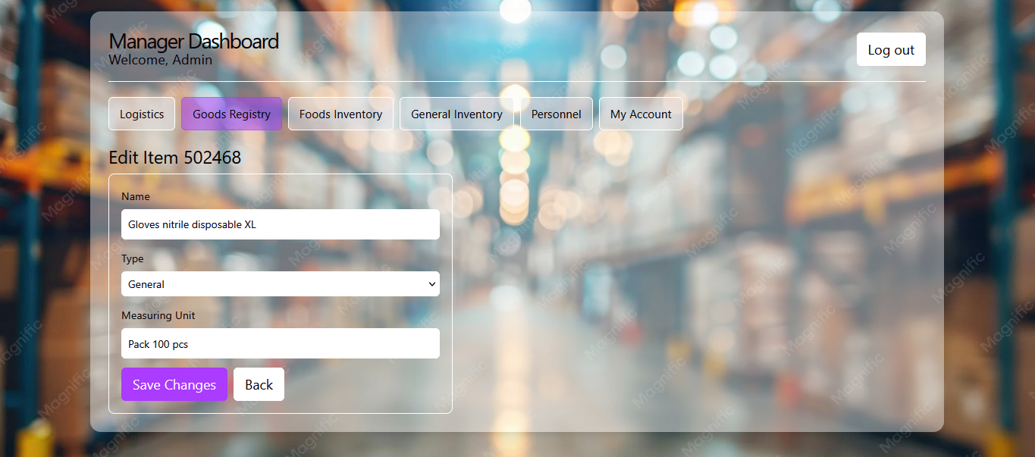
Goods registry – edit an item
An item name, type and measuring unit are changeable. It`s impossible to change the code, because it violates foreign key constraint in the database (goods registry and inventory tables are tied to Logistics table by an item code; this issue to be updated in future versions). As it was mentioned before, only a manager can edit the goods registry items.

Slide 19
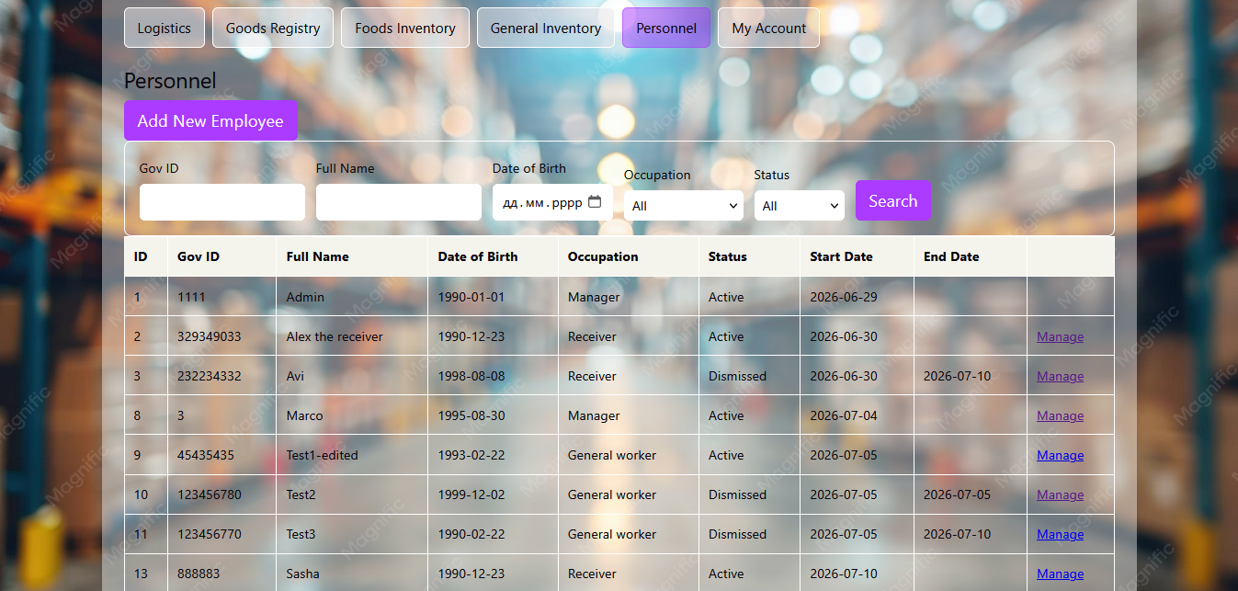
CHAPTER 4. PERSONNEL
Personnel table is expanded while ‘Search’ button is pressed (as well as in any other table). To sort the personnel, you can search by Gov ID, Full Name, Date of Birth, Occupation and Status (active or not). To add new employee, press ‘Add New Employee’ button, to edit an employee`s info, press ‘Manage’ button at the last table`s column.

Slide 20
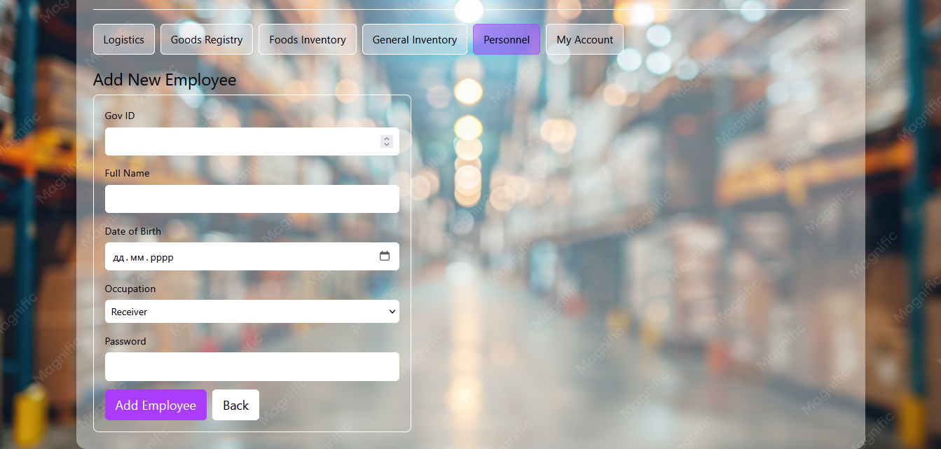
Personnel – add new employee
To add a new employee to the list, fill all required fieds, create a password and press “Add employee” button. Please note, there are three occupation types available: Manager, Receiver and General Worker. Since an account is created, transfer the account`s login credentials to an employee to let him log in and change the initial password to it`s own personal.

Slide 21
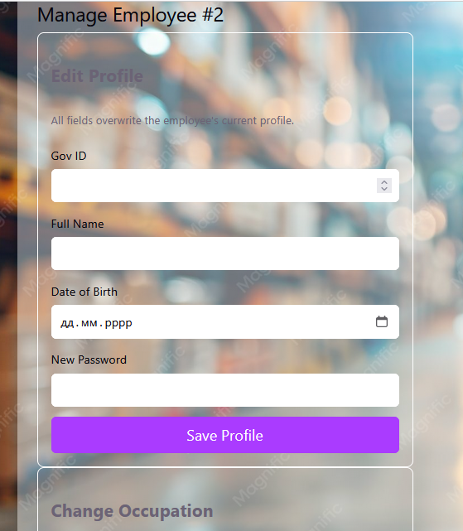
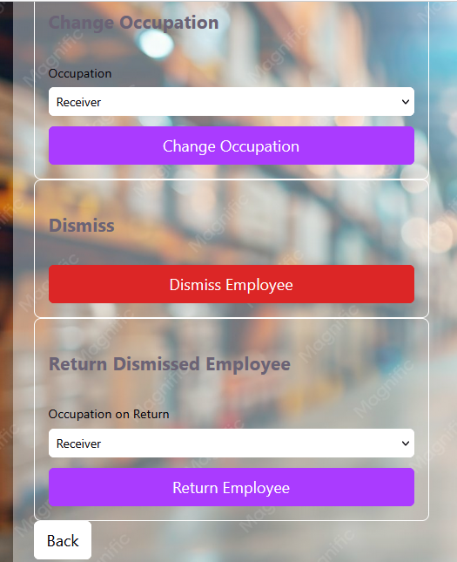
Personnel – update employee`s info, dismiss or return back a dismissed employee
In “Manage” tab you can change Gov ID, Full Name, Date of Birth, set new password, change Occupation, dismiss an employee or return back once dismissed employee

Slide 22
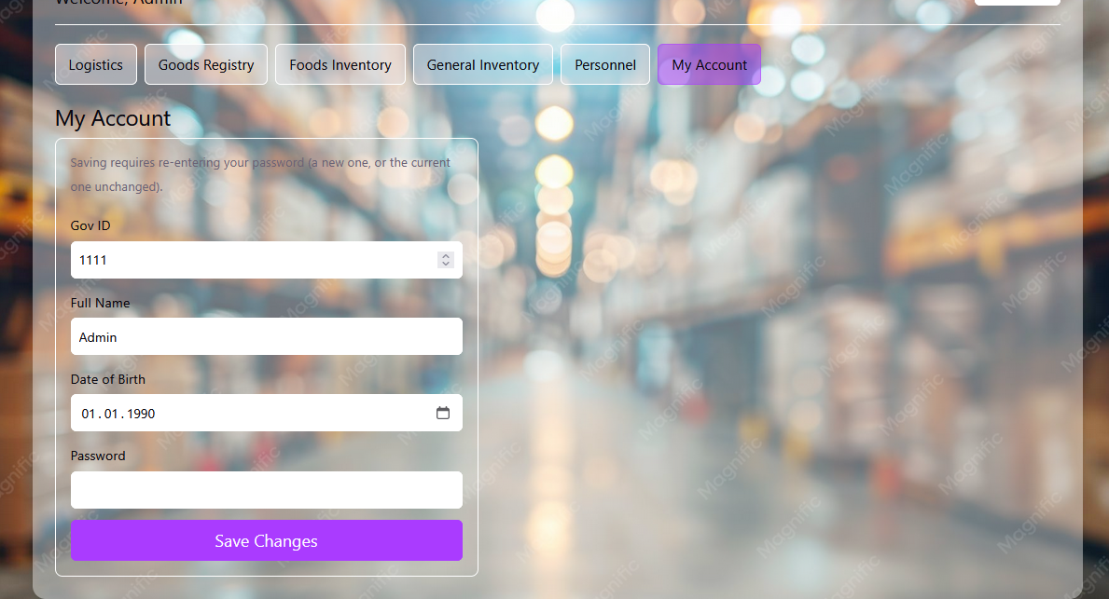
CHAPTER 5. MY ACCOUNT
Available for Manager dashboard only; here you can change your own account`s Gov ID, Full Name, Date of Birth and Password. The occupation change, Dismiss/Return functions can be only triggered from other Manager`s account. For Receivers and General Workers there is only Change Password option available

Slide 23
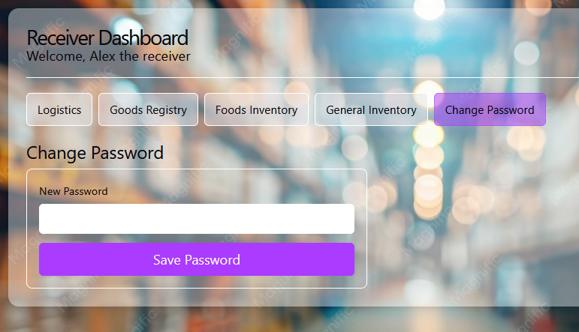
CHAPTER 6. CHANGE PASSWORD
While having an account of Receiver or General Worker, it`s only possible to change own account`s password by clicking on “Change Password” tab`s button; in case if your credentials are misspelled, you should apply to any Manager account holder to change them.

Slide 24
Thank you for watching!
More information about the author:
LinkedIn GitHub

