Slide 1
Cyber Deception AI
Katya Ghanoumi 202402557
Haifa Sidani 202400882
Jana Tabech 202400316
A Machine Learning Approach for Intrusion Detection
Notes:
Katya

Slide 2
Objective
To detect cyber attacks in a dataset using unsupervised and probabilistic machine learning techniques.
Techniques Used:
Hierarchical Agglomerative Clustering (HAC)
K-Nearest Neighbors (KNN)
Bayesian Networks
Dataset: NSL-KDD (network intrusion dataset)
Notes:
katya

Slide 3
Importing Libraries
from sklearn.preprocessing import StandardScaler, LabelEncoder
from scipy.cluster.hierarchy import dendrogram, linkage
import pandas as pd
import numpy as np
import matplotlib.pyplot as plt
from sklearn.impute import SimpleImputer
These libraries handle:
Data manipulation (pandas, numpy)
Plotting (matplotlib)
Clustering (scipy)
Preprocessing (sklearn)
Notes:
katya

Slide 4
Loading the Dataset
df = pd.read_csv("/content/nsl_kdd.csv")
Reads the NSL-KDD dataset from CSV format.
This dataset includes network activity labeled as normal or attack.
Notes:
katya

Slide 5
Data Preprocessing
Loaded NSL-KDD dataset
Normalized numerical data using StandardScaler
Handled missing values
Converted target labels: normal=0, attack=1
Encoded categorical features using
LabelEncoder
Sampled 5000 records to optimize processing
Notes:
katya

Slide 6
Preprocessing Function
def preprocess_data(df, sample_size=5000):
Steps inside the function:
Drop empty columns
df = df.dropna(axis=1, how='all')
2. Fill missing values with 0
df = df.fillna(0)
3. Auto-detect the target column (normal or attack)
target_col = next((col for col in ['class', 'label', 'attack', 'target']
if col in df.columns), df.columns[-1])
print(f"Using '{target_col}' as target column")
Notes:
katya

Slide 7
Preprocessing Function Cont.
4. Sample 5000 rows to speed up clustering
if len(df) > sample_size:
df = df.sample(sample_size, random_state=42)
print(f"Sampled {sample_size} records for clustering")
5. Encode text columns into numbers
cat_cols = df.select_dtypes(include=['object']).columns
for col in cat_cols:
if col != target_col:
df[col] = LabelEncoder().fit_transform(df[col].astype(str))
6. Normalize features
features = df.drop(columns=[target_col], errors='ignore')
X = StandardScaler().fit_transform(features.select_dtypes(include=np.number))
print(f"Final shape: {X.shape}, Attack rate: {y.mean():.2%}")
return X, y
Notes:
katya

Slide 8
Inside Preprocessing
y = np.where(df[target_col].astype(str).str.contains('normal', case=False), 0, 1)
X = StandardScaler().fit_transform(features.select_dtypes(include=np.number))
y: Labels → 0 = normal, 1 = attack
X: Feature matrix, scaled to have mean = 0, std = 1
This prepares the data for machine learning algorithms.
Notes:
katya

Slide 9
Hierarchical Clustering (HAC)
What is HAC?
A bottom-up clustering method that merges the closest clusters step-by-step.
Parameters Used:
1
Method: ward
2
Distance Metric: Euclidean
Output: A dendrogram showing the data grouped into clusters. Used to detect anomaly groupings visually.

Slide 10
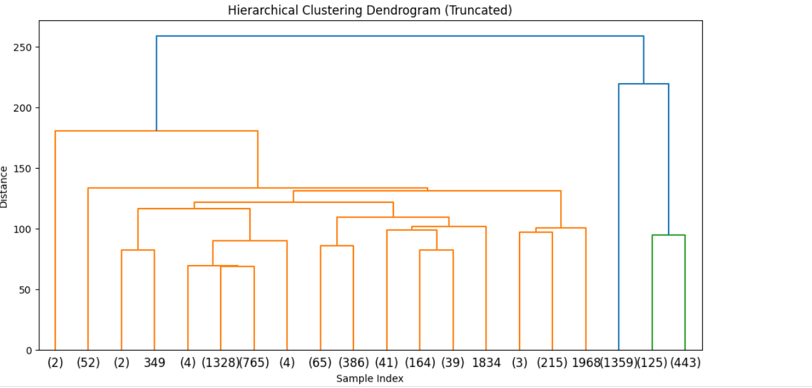
Hierarchical Clustering (HAC) Cont.
linked = linkage(X, method='ward', metric='euclidean', optimal_ordering=True)
plt.figure(figsize=(12, 6))
dendrogram(linked, orientation='top', truncate_mode='lastp', p=20)
...

Slide 11

K-Means Clustering
Goal
Process
Choose 2 clusters: Normal and Attack.
Visualize clusters in a scatter plot
Process
Result
Model performance evaluated using: Precision, Recall, F1-score
Data split: 70% train, 30% test
And train on
Labeled data

Slide 12
K-Means Clustering
Splits data into training and testing (70% / 30%)
Trains K-Nearest Neighbors classifier
n_neighbors=5 means it checks the 5 nearest samples
from sklearn.neighbors import KNeighborsClassifier
from sklearn.model_selection import train_test_split
X_train, X_test, y_train, y_test = train_test_split(X, y, test_size=0.3)
knn = KNeighborsClassifier(n_neighbors=5)
knn.fit(X_train, y_train)

Slide 13
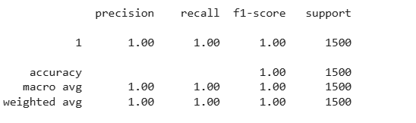
Evaluating KNN
from sklearn.metrics import classification_report
print(classification_report(y_test, knn.predict(X_test)))
Shows:
Precision: Of all the predicted attacks, how many were actually attacks?
Recall: Of all real attacks, how many did we detect?
F1-score: balance between precision and recall (like a smart average)

Slide 14
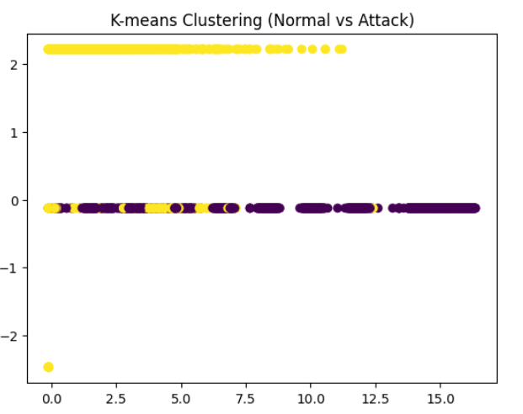
K-Means Clustering (Optional Unsupervised Method)
from sklearn.cluster import KMeans
import matplotlib.pyplot as plt
kmeans = KMeans(n_clusters=2, random_state=42)
clusters = kmeans.fit_predict(X)
# Plot clusters
plt.scatter(X[:, 0], X[:, 1], c=clusters, cmap='viridis')
plt.title("K-means Clustering (Normal vs Attack)")
plt.show()

Slide 15
Bayesian Networks
What is a Bayesian Network?
A probabilistic graphical model that represents conditional dependencies between variables.
Advantages:
1
Good for reasoning under uncertainty
2
Can handle missing or partial data
3
Explains relationships between features

Slide 16
Bayesian Network - Library & Setup
from pgmpy.models import DiscreteBayesianNetwork
from pgmpy.factors.discrete import TabularCPD
from pgmpy.inference import VariableElimination
Uses pgmpy to build Bayesian networks
Models' relationships between variables
Supports inference under uncertainty

Slide 17
Defining the Network Structure
model = DiscreteBayesianNetwork([('NI', 'HT'), ('NI', 'FL'), ('NI', 'UD')])
NI
Network Intrusion (parent node (Network Intrusion))
High Traffic (child node)
HT
FL
Frequent Logins (child node)
Unusual Downloads (child node)
UD

Slide 18
Defining CPDs (Probability Tables)
What Are CPDs?
CPDs define how likely a variable is to be True or False given its parent.
cpd_ni = TabularCPD(
variable='NI',
variable_card=2,
values=[[0.9], [0.1]], # P(NI=False)=90%, P(NI=True)=10%
state_names={'NI': ['False', 'True']}
)
90% chance = No intrusion (False)
10% chance = Intrusion (True)

Slide 19
Defining CPDs (Probability Tables)
cpd_ht = TabularCPD(
variable='HT',
variable_card=2,
values=[[0.8, 0.3], # P(HT=False|NI=False), P(HT=False|NI=True)
[0.2, 0.7]], # P(HT=True|NI=False), P(HT=True|NI=True)
evidence=['NI'],
evidence_card=[2],
state_names={'HT': ['False', 'True'], 'NI': ['False', 'True']}
)
If NI = False (no attack), HT is True only 20% of the time
If NI = True (attack), HT is True 70% of the time

Slide 20
Defining CPDs (Probability Tables)
cpd_fl = TabularCPD(
variable='FL',
variable_card=2,
values=[[0.95, 0.2], # P(FL=False|NI=False), P(FL=False|NI=True)
[0.05, 0.8]], # P(FL=True|NI=False), P(FL=True|NI=True)
evidence=['NI'],
evidence_card=[2],
state_names={'FL': ['False', 'True'], 'NI': ['False', 'True']}
)
FL is very rare if no attack (5%), but common if an attack (80%)

Slide 21
Defining CPDs (Probability Tables)
cpd_ud = TabularCPD(
variable='UD',
variable_card=2,
values=[[0.98, 0.1], # P(UD=False|NI=False), P(UD=False|NI=True)
[0.02, 0.9]], # P(UD=True|NI=False), P(UD=True|NI=True)
evidence=['NI'],
evidence_card=[2],
state_names={'UD': ['False', 'True'], 'NI': ['False', 'True']}
Rarely occurs without an attack (2%)
Very likely during attack (90%)

Slide 22
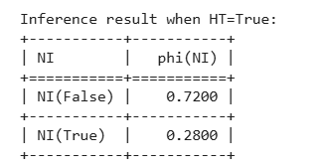
Inference with Bayesian
infer = VariableElimination(bn_model)
result = infer.query(variables=['NI'], evidence={'HT': 'True'})
What It’s Doing:
We're using a technique called Variable Elimination to ask the model a question.
The question is:
"If I know that High Traffic is True (HT=True), what is the probability that there's a Network Intrusion (NI)?“

Slide 23
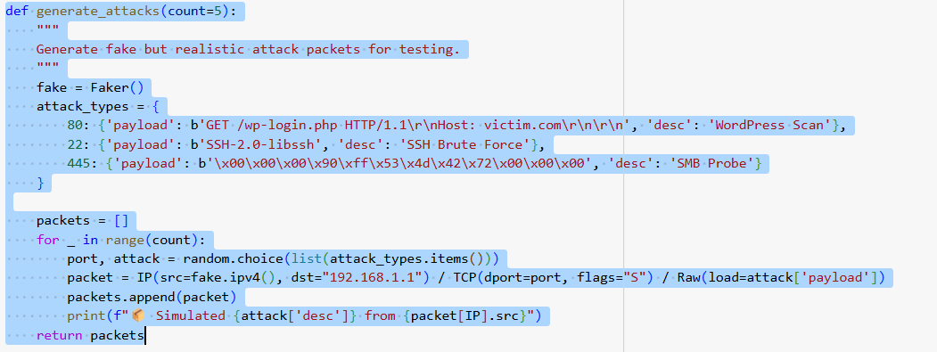
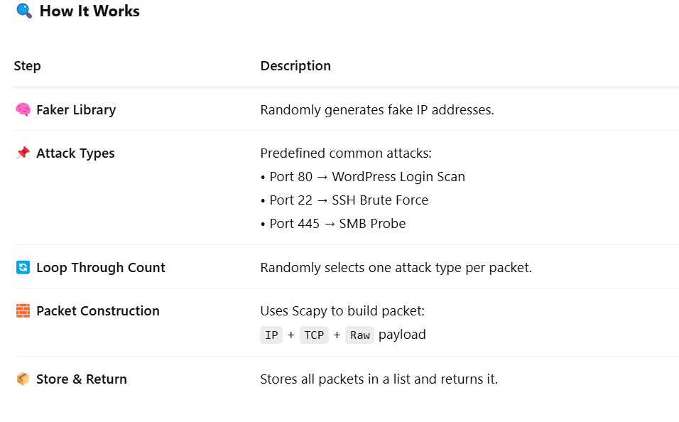
Attack Packet Simulation (generate_attacks)

Slide 24
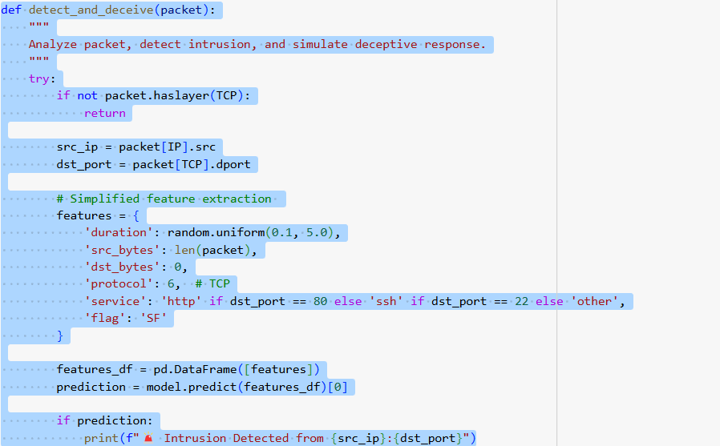
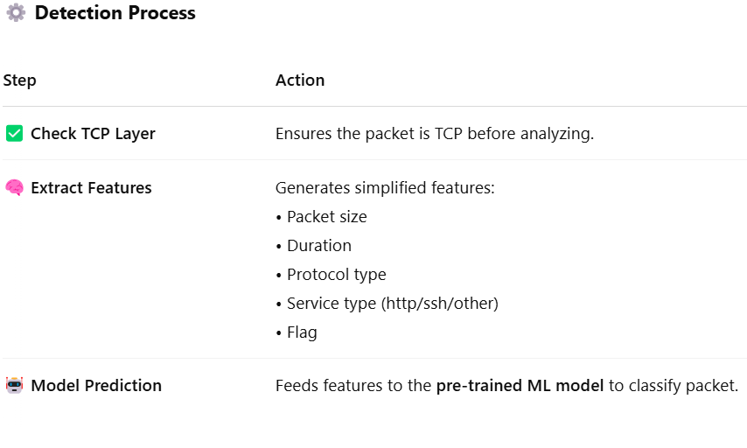
Intrusion Detection & Deception
Notes:
katya

Slide 25
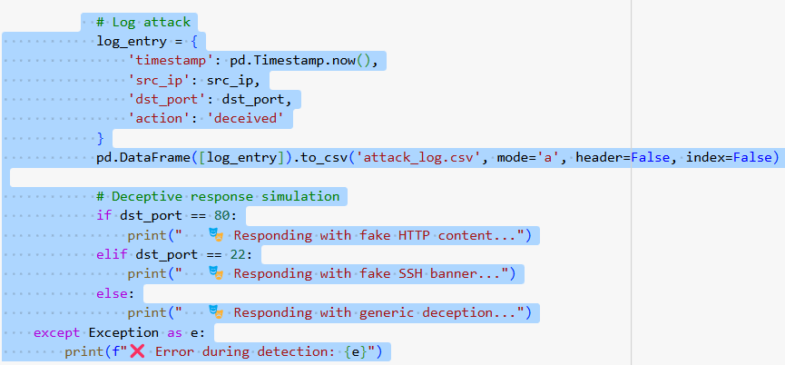
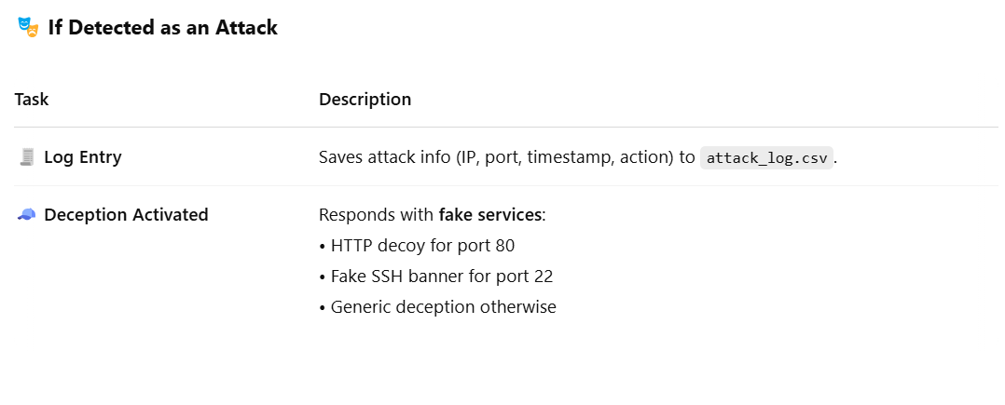
Intrusion Detection & Deception
Notes:
katya

Slide 26
Main Execution – Orchestrating the Attack Simulation
Main Function Flow
This section ties everything together — simulation, detection, deception, and logging.
Start Simulation
print("🚀 Starting attack simulation...\n")
packets = generate_attacks(count=5)
Calls generate_attacks() to simulate 5 fake attack packets
2. Run Detection
for pkt in packets:
detect_and_deceive(pkt)
Loops through each packet and sends it to the detection engine.
Identifies and detects if malicious
Notes:
katya

Slide 27
Main Execution – Orchestrating the Attack Simulation
Main Function Flow
This section ties everything together — simulation, detection, deception, and logging.
3. Show Logs
logs = pd.read_csv('attack_log.csv', names=['timestamp', 'src_ip', 'dst_port', 'action'])
print(logs)
Reads and prints a log of all detected and deceived attacks.
Shows timestamp, src_ip, port, and action.
Notes:
katya

Slide 28
Visualizing Intrusion Patterns
Purpose
To help analyze attack behavior by visualizing logs of simulated intrusions.
How It Works
Log Loading
logs = pd.read_csv(log_file, names=['username', 'password', 'src_ip', 'dst_port’])
Tries to load the attack log from attacker_logs.csv.
If not found, it creates a demo log with fake usernames, passwords, and source IPs.
demo_attacks = {
'username': ['admin', 'root', 'guest', 'test', 'user'],
'password': ['p@ssw0rd', '123456', 'password', 'qwerty', 'letmein'],
'src_ip': ['192.168.1.' + str(i) for i in range(1,6)],
'dst_port': [22, 80, 22, 445, 80] # SSH, HTTP, SSH, SMB, HTTP
}
Notes:
katya

Slide 29
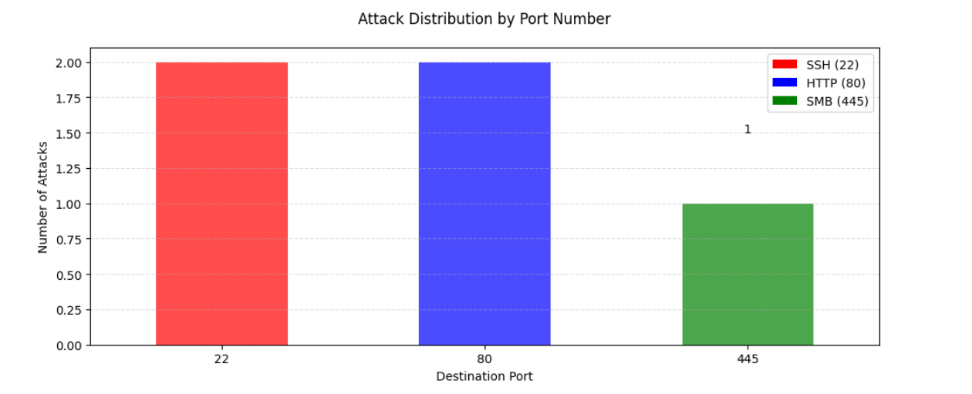
Visualizing Intrusion Patterns
2. Plotting Attack Distribution
Use Matplotlib to show a number of attacks per destination port.
port_counts.plot(kind='bar', color=colors, alpha=0.7)
Colors:
🔴 SSH (Port 22)
🔵 HTTP (Port 80)
🟢 SMB (Port 445)

Slide 30
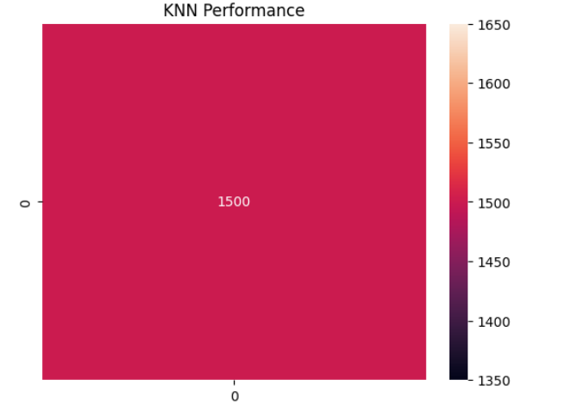
KNN Performance Evaluation
The confusion matrix is used to evaluate the performance of the K-Nearest Neighbors (KNN) model.
It compares the actual values from the test set (y_test) with the predicted values (knn.predict(X_test)).

Slide 31
Simplified Hybrid Detection Logic
The function knn.predict([packet_features]) predicts if the packet is malicious (attack = 1) or benign (attack = 0). The prediction is stored in knn_pred.
The hybrid detection logic combines K-Nearest Neighbors (KNN) and Bayesian Probability to improve the accuracy of detecting attacks. The KNN model makes an initial prediction, and if it detects an attack, a Bayesian model is used to confirm the result based on certain packet features.
KNN Prediction:
The function knn_pred = knn.predict([packet_features])[0]
predicts if the packet is malicious (attack = 1) or benign (attack = 0). The prediction is stored in knn_pred.
2. Bayesian Confirmation (if KNN detects an attack):
If KNN predicts an attack(knn_pred == 1), the Bayesian model is queried to check the probability of an attack based on packet features such as:
high_traffic: High volume of network traffic.
failed_logins: Number of failed login attempts.

Slide 32
Simplified Hybrid Detection Logic
3. Decision:
The Bayesian model returns a probability(bayesian_prob). If the probability of an attack is greater than 50%, the attack is confirmed.
If the probability is less than or equal to 50%, the detection is rejected.

Slide 33
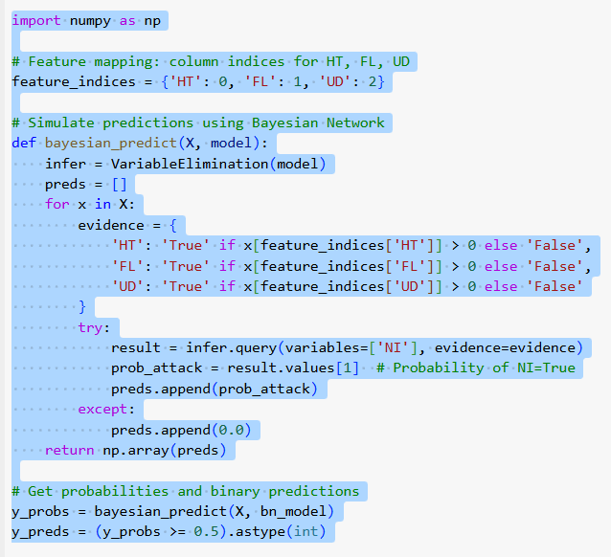
What This Code Does:
This function simulates predictions from a Bayesian Network model using network traffic features.
Input:
Feature matrix X, where each row is a connection and columns are:
HT: Has Header Traffic
FL: Has Failed Logins
UD: Uses UDP
Purpose:
It uses Bayesian inference (VariableElimination) to calculate the probability of attack (NI=True)
Output:
y_probs: Array of probabilities that each connection is an attack.
y_preds: Binary prediction (1 = attack, 0 = normal).

Slide 34
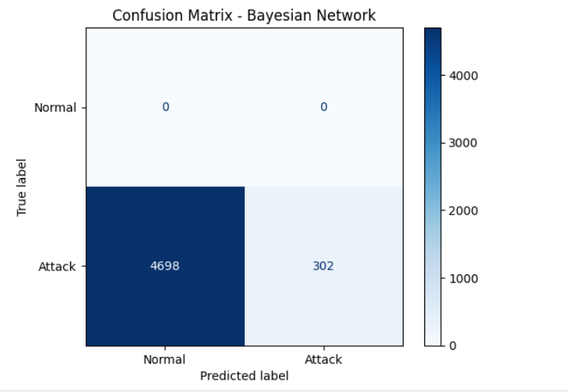
Model Evaluation – Confusion Matrix
✅True Positives (TP):
302→ The model correctly identified 302 attacks.
❌ False Negatives (FN):
4698→ The model missed 4698 attacks and predicted them as normal.
⚠️ True Negatives (TN):
0→ The model never encountered or correctly predicted any normal traffic.
⚠️ False Positives (FP): 0→ No normal traffic was wrongly predicted as an attack.

Slide 35
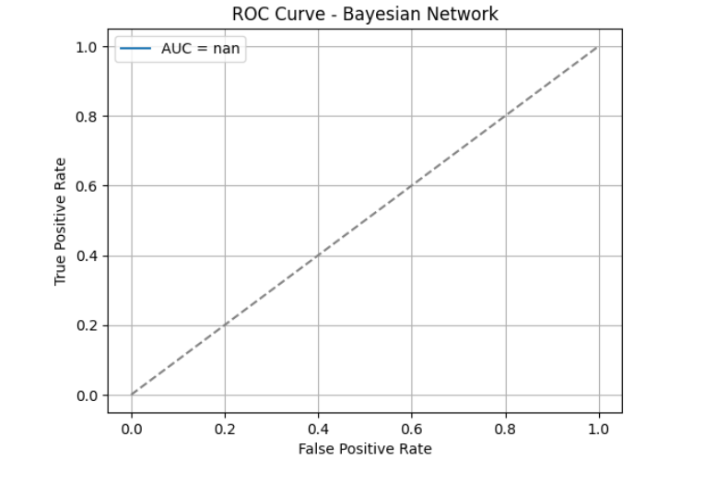
Results – Confusion Matrix (Bayesian Network)
The ROC (Receiver Operating Characteristic) curve evaluates how well a classifier can distinguish between classes at different thresholds.
ROC evaluation becomes invalid because we’re testing only on virus (attack) data. That’s why the curve is flat and AUC is not a number (NaN). ROC needs both positive and negative classes

Slide 36
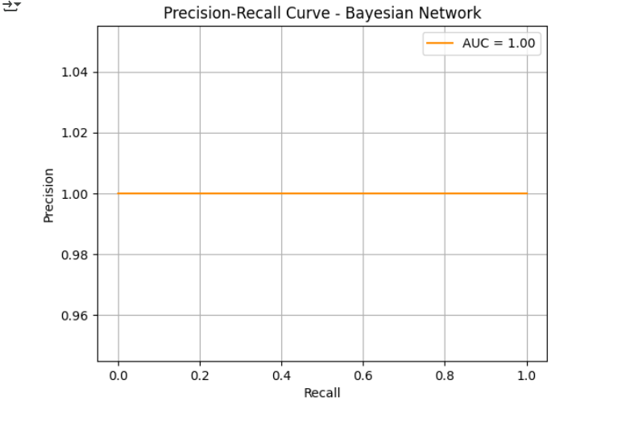
Precision-Recall Curve – Bayesian Network
The Precision-Recall Curve is used to evaluate models on imbalanced datasets.
Precision: How many predicted attacks were attacks?
Recall: How many actual attacks were successfully detected?
The curve is a horizontal line at 1.0, and the AUC is 1.00, meaning: The model predicts all "Attack" labels and never misclassifies any as "Normal”.

Slide 37
Thank you for your attention!
We appreciate your time and interest in our project.

