Slide 1
Efficient Interference Graph Estimation
via Concurrent Flooding
Haifeng Jia*, Yichen Wei*, Zhan Wang, Jiani Jin, Haorui Li, and Yibo Pi
Network Measurement and Systems Lab
University of Michigan - Shanghai Jiao Tong University Joint Institute
Notes:
Hello everyone! I am Haifeng Jia, a PhD student from University of Michigan-Shanghai Jiao tong university Joint institute. Our group is Network Measurement and Systems Lab. The topic of my talk today is efficient interference graph estimation via concurrent flooding. So, let’s get started.

Slide 2
Motivation: Why Interference Graph is Important in Wireless Sensor Network?
Spatial Concurrency Scenario
in a Wireless Sensor Network
Interference Graph (IG)
Channel gain (h)
B
Interference
A
B
Data transmission
C
Tx Power
Tx Power
h
A
Data transmission
h
h
h
Interference
D
C
D
h
If A and C send at the same time, what tx powers should they use?
✅
Resource Allocation
Notes:
Okay, Let me address the motivation of interference graph first. Let’s look at a classic spatial concurrency scenario. In this case, there’re 4 nodes as shown. A is sending to B, and C is sending to D, which will cause interference to each other. So, we want to ask a question here: If A and C want to send data at the same time, what tx power should they use? Specifically, if A increases its Tx power, then D will receive higher interference from A. So does C and B in this case. The problem here is that even if the power consumption of this network is increased, the SINR of the rx nodes is lowered. However, if we could get the interference graph like this, where each edge stands for the channel gain between the nodes, we could easily answer the previous question. In other words, we could find a set of tx power for A and C, so that B and D’s SINR is in the safe region. Literally, this is the basic idea of resource allocation. Note that Interference graph not only estimate communication channel, but also estimate all the possible interference channels, which is different from channel estimation.

Slide 3



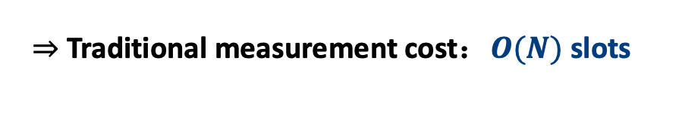
Challenges for Interference Graph Estimation (IGE) in Wireless Sensor Networks
High measurement cost of traditional IGE
Occupy extra time/frequency resources
Delay data transmission
Interference Graph Usage
Interference Graph
Measurement
The current state of art of Interference Graph
$O(N)$ slots are too long for wireless sensor networks!
Network scale：$N$ , Link scale：$O(N^{2})$
Traditional measurement cost：$O(N)$ slots
Notes:
After discussing the benefits of interference graph, let’s move on to discuss the challenges. In terms of the state of art, there are two aspects. One is interference graph usage, and the other is its measurement. For the interference graph usage in the wireless network, many fancy algorithms and ideas have already been proposed, while in terms of IG measurement, there still lacks an efficient method. The cost of traditional measurement is too high. (……), especially for large scale ones. Hence, the scalability of traditional method is really bad.

Slide 4
Our approach: IGE Married with Flooding
Marry IGE with flooding without extra time/frequency resources
Perform
IGE
Flooding
Flooding
IGE
time/freq
Optimize
How could we achieve this?
Key idea: Use power as a new dimension for measurement.
Notes:
Hence, we propose a new approach, (space) where we marry IGE with concurrent flooding without extra time and frequency resources. It means IGE is performed together with flooding, and the results of IGE will help to optimize flooding’s performance in return. (Space) Okay, you might wonder how could we achieve this without extra resources? The key idea is to use power as a new dimension for measurement.

Slide 5
Outline
Motivations, Challenges & Introduction
Interference Graph Estimation (IGE)
Power Linearity
Full-rank Constraint
Practical IGE Scheme
Real-world Experiment
Notes:
Well, after talking about the motivation, challenges and a basic introduction, let’s dive into the details.

Slide 6
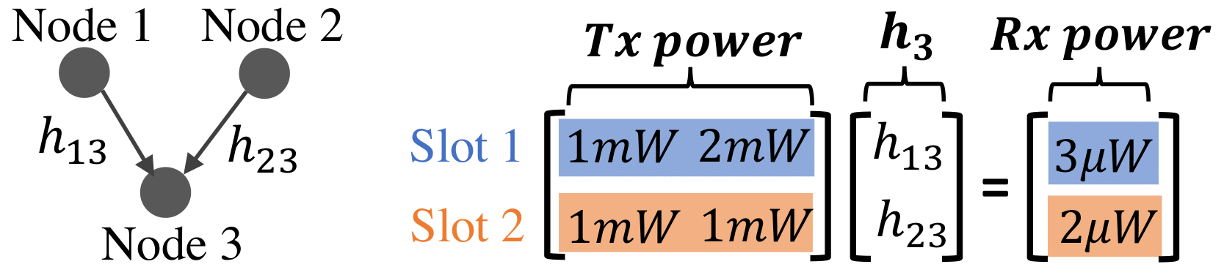
Core Insight by an Example
Key Assumptions
1) Power linearity
2) Full-rank Tx power matrix
Notes:
Let me give you a core insight by an example here. We have 3 nodes in total, 2 transmitters and 1 receiver, so there will be two channels. If we want to solve the two channel gains out, we could differ the node 2’s tx power as 2 milliwatt, and all the other tx powers will be 1 milliwatt. In this case, the tx power matrix is full rank, so the channel gain vector h3 could be solved. (Space) Okay, you could find two key assumptions in the example. One is power linearity, and the other is the full-rank tx power matrix. I will discuss these two assumptions in the upcoming slides.

Slide 7
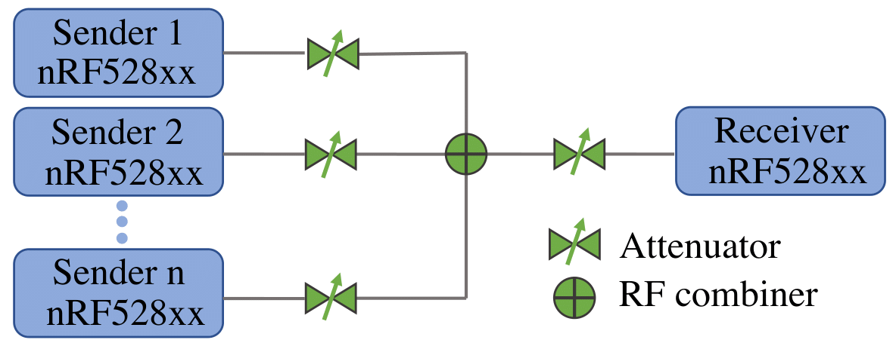
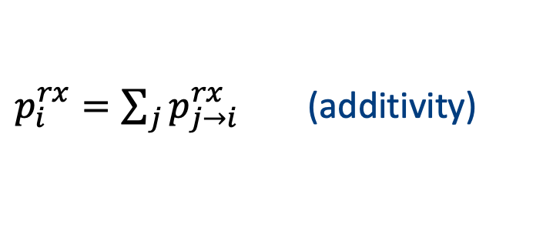
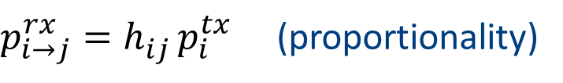
Power Linearity Break Down
$p_{i→j}^{rx}=h_{ij }^{ }p_{i}^{tx}$ (proportionality)
Linearity = Proportionality + Additivity
$p_{i}^{rx}=\sum_{j}{p_{j→i}^{rx}}$ (additivity)
Notes:
Okay, first, let me break down linearity into two parts, one is proportionality and the other is additivity. Proportionality means the rx power is proportional to the tx power. Additivity means the sum of individual rx powers of each tx node equals the rx power when all tx nodes are sending. To verify these two assumptions, we conduct wired experiment on Nordic nRF52 series SoCs, connected by attenuators and RF combiners.

Slide 8
Proportionality between Tx and Rx Powers
Experimental Setup
Attenuator
Transmitter 1
Receiver 1
nRF528xx
nRF528xx
Notes:
For the proportionality, we use one transmitter and one receiver connected by a variable attenuator.

Slide 9
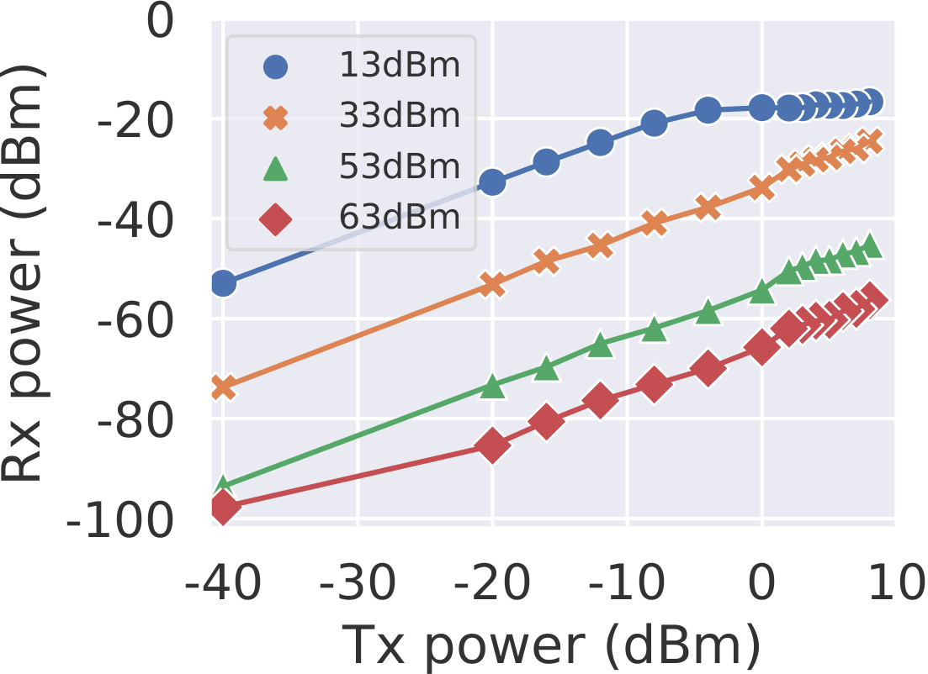
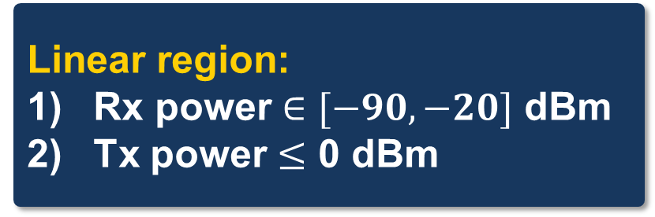
Proportionality between Tx and Rx Powers
Experimental Result
Linear region:
Rx power $∈[−90, −20]$ dBm
Tx power $≤$ 0 dBm
Notes:
Here is the experimental result. We find that there exists a linear region for the SoC, where (……). The insight is that we should control the transmit powers within the linear range.
Backup:
Match the operating range of rx power for nRF52 series
Deviation of tx power above 0 dBm

Slide 10

Additivity of Received Powers
Experimental Setup
Attenuator
Transmitter 1
Power
combiner
nRF528xx
$$⨁$$
Receiver 1
Transmitter 2
nRF528xx
nRF528xx
Notes:
Next is the additivity of received powers. Two transmitters and one receiver are connected by attenuators and power combiner.

Slide 11
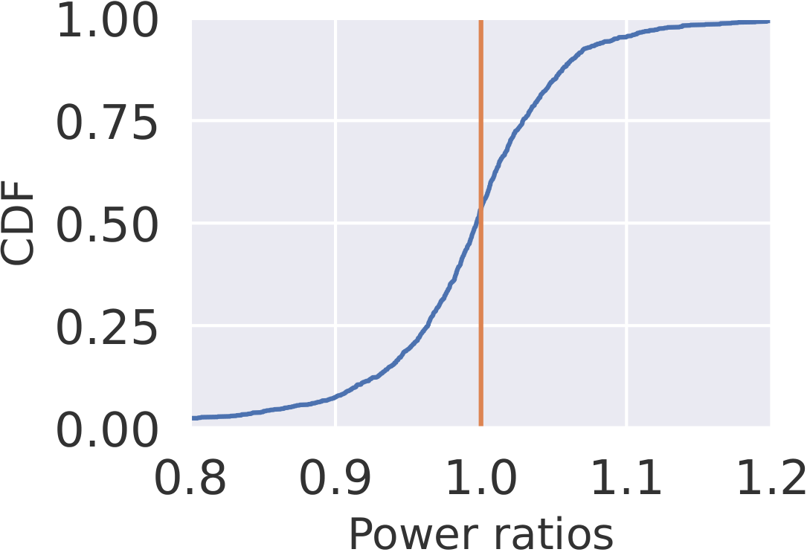
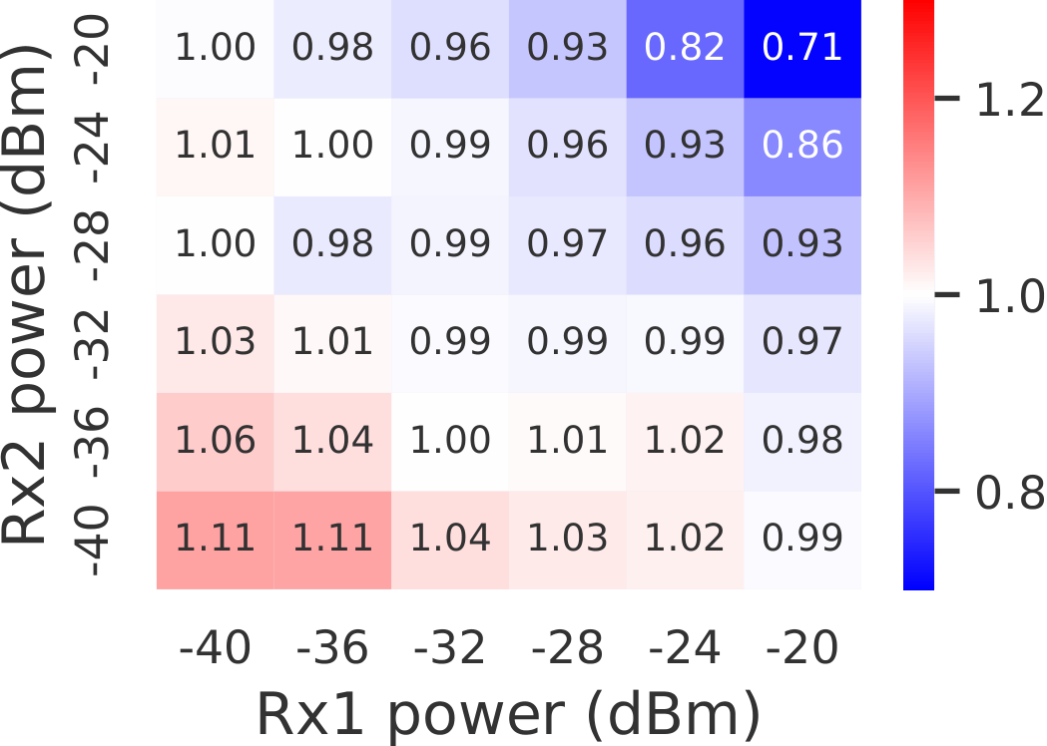
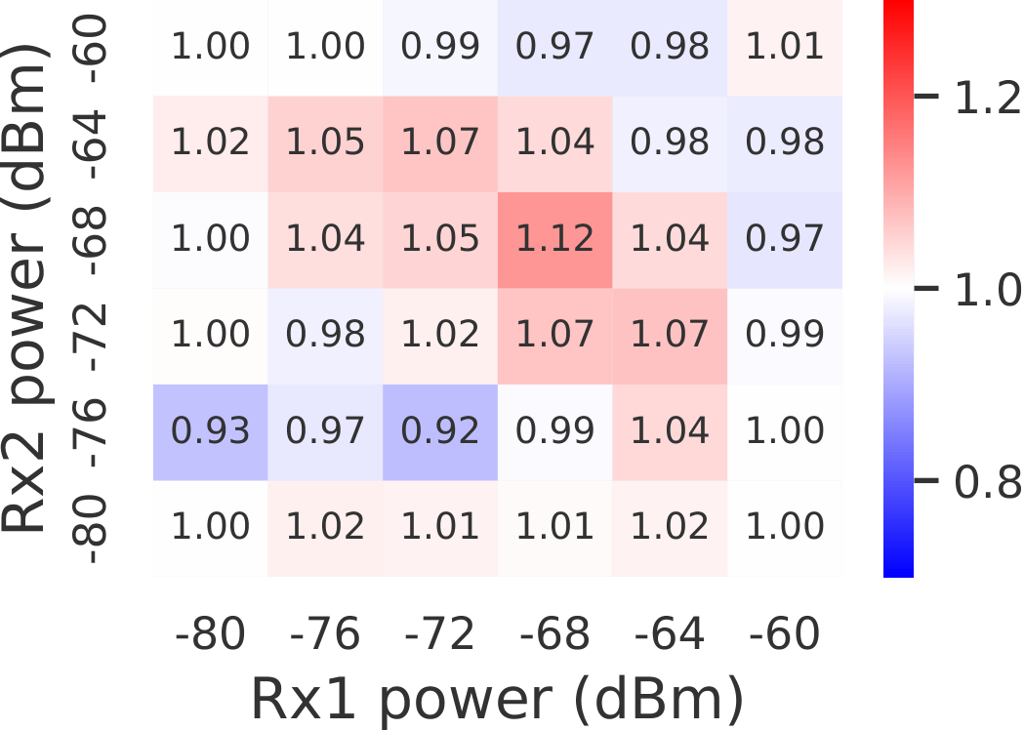

Additivity of Received Powers
Experimental Result
The rx power is saturated
Power ratio = $\frac{Actual rx power }{∑individual rx powers}$
88% of power ratios
fall within 0.9 and 1.1
Power ratios decrease as rx powers increase
Similar additivity except for rx power greater than -24 dBm
Notes:
In terms of the results, we first plot a CDF for the power ratios, whose definition is on the right. The closer the ratio gets to one, the better the additivity will be. Insight is that eighty eight percent of the ratios fall within 0.9 and 1.1, which is great. Then, we plot a heatmap of the ratio to check its relationship with rx power. This one is the heatmap for strong rx powers. We could see that the power ratio decrease as the rx powers increase, especially along the diagonal. Note that the rx power becomes saturated above -24 dBm, so the linearity is bad around this region. We also plot a heatmap for weaker rx powers and find similar additivity with the strong rx power except for those saturated region.

Slide 12

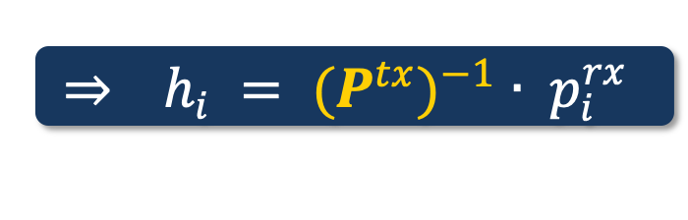
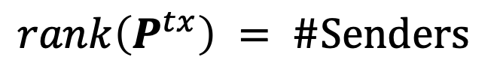
Full-rank Constraint
$$P^{tx} ∙ h_{i} = p_{i}^{rx}$$
$$\underset{⇒}{ } h_{i} = {(P^{tx})}^{−1} ∙ p_{i}^{rx}$$
$rank\left(P^{tx}\right) = \#Senders$
Full-rank constraint
Notes:
Okay. Here is how the full rank constraint works. The idea is that the rank of the tx power matrix should equal the number of senders, such that we could find its reverse or pseudo-reverse to solve the formula. All the tx powers will be assigned for all the nodes by our power control to fulfill this constraint.

Slide 13
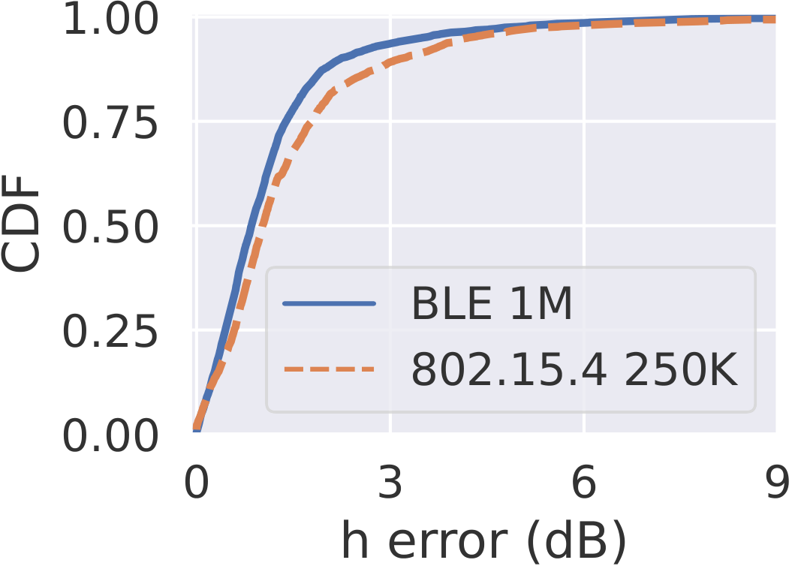
Feasibility of IGE under controlled environment
Experimental Setup
Experimental Result
Transmitter 1
nRF528xx
Transmitter 2
nRF528xx
Transmitter 3
Receiver
nRF528xx
nRF528xx
Transmitter 4
nRF528xx
More than 90% of the h error is under 3dB
Transmitter 5
nRF528xx
Notes:
Just before we test in a real world scenario, we want to verify the feasibility first, under a controlled environment, where we have five transmitters and one receiver. All the five transmitters are synchronized before sending. Here is the result. We find out that more than 90% of the h error is under 3 decibel, indicating the strong feasibility of IGE.

Slide 14
Outline
Motivations, Challenges & Introduction
Interference Graph Estimation (IGE)
Power Linearity
Full-rank Constraint
Practical IGE Scheme
Real-world Experiment
Notes:
Okay! After finishing the IGE details, let me show our practical IGE Scheme.

Slide 15
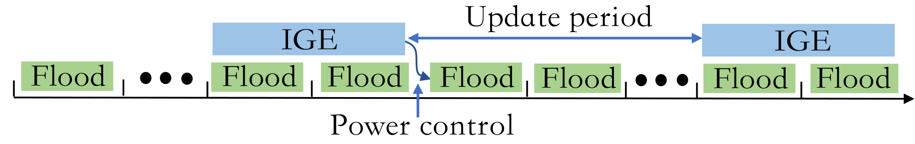
Practical IGE Scheme over Flooding
IGE period + Update period
Power control: allocate tx powers
Notes:
The above is a sequence diagram of the practical IGE scheme, where we perform IGE over concurrent flooding. There are two periods in total: IGE period and update period. Also, the estimated interference graph will be fed into the power control unit to allocate the tx powers.

Slide 16
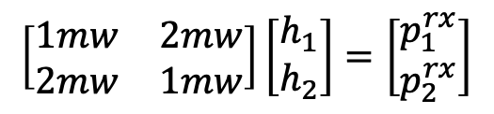
Example of IGE in a Two Hop Flooding Network
Round 1
Round 2
Slot 1
Slot 2
Slot 1
$$\left[\begin{matrix}1mw & 2mw \\ 2mw & 1mw\end{matrix}\right]\left[\begin{matrix}h_{1} \\ h_{2}\end{matrix}\right]=\left[\begin{matrix}p_{1}^{rx} \\ p_{2}^{rx}\end{matrix}\right]$$
Slot 2
1mW
2mW
2mW
1mW
Full-rank
Notes:
Let me demonstrate a visualized example. (Space) We have six nodes, 3-level pyramid topology. (Space) IGE happens within 2 rounds. Each of the round consists of two slots. Okay. Right now, in slot 1, node at the top will be sending. Next, in slot 2, nodes in level 2 will also be sending. By the power linearity we verified before (space), the first node’s power could be cancelled out. (space) The situation is the same with round 2. Besides, we control the power of level 2 nodes to differ, so that the tx power matrix is full-rank. And all the Channel gains could be solved.

Slide 17
Outline
Motivations, Challenges & Introduction
Interference Graph Estimation (IGE)
Power Linearity
Full-rank Constraint
Practical IGE Scheme
Real-world Experiment
Notes:
Alright. Let me discuss the real-world experiment.

Slide 18
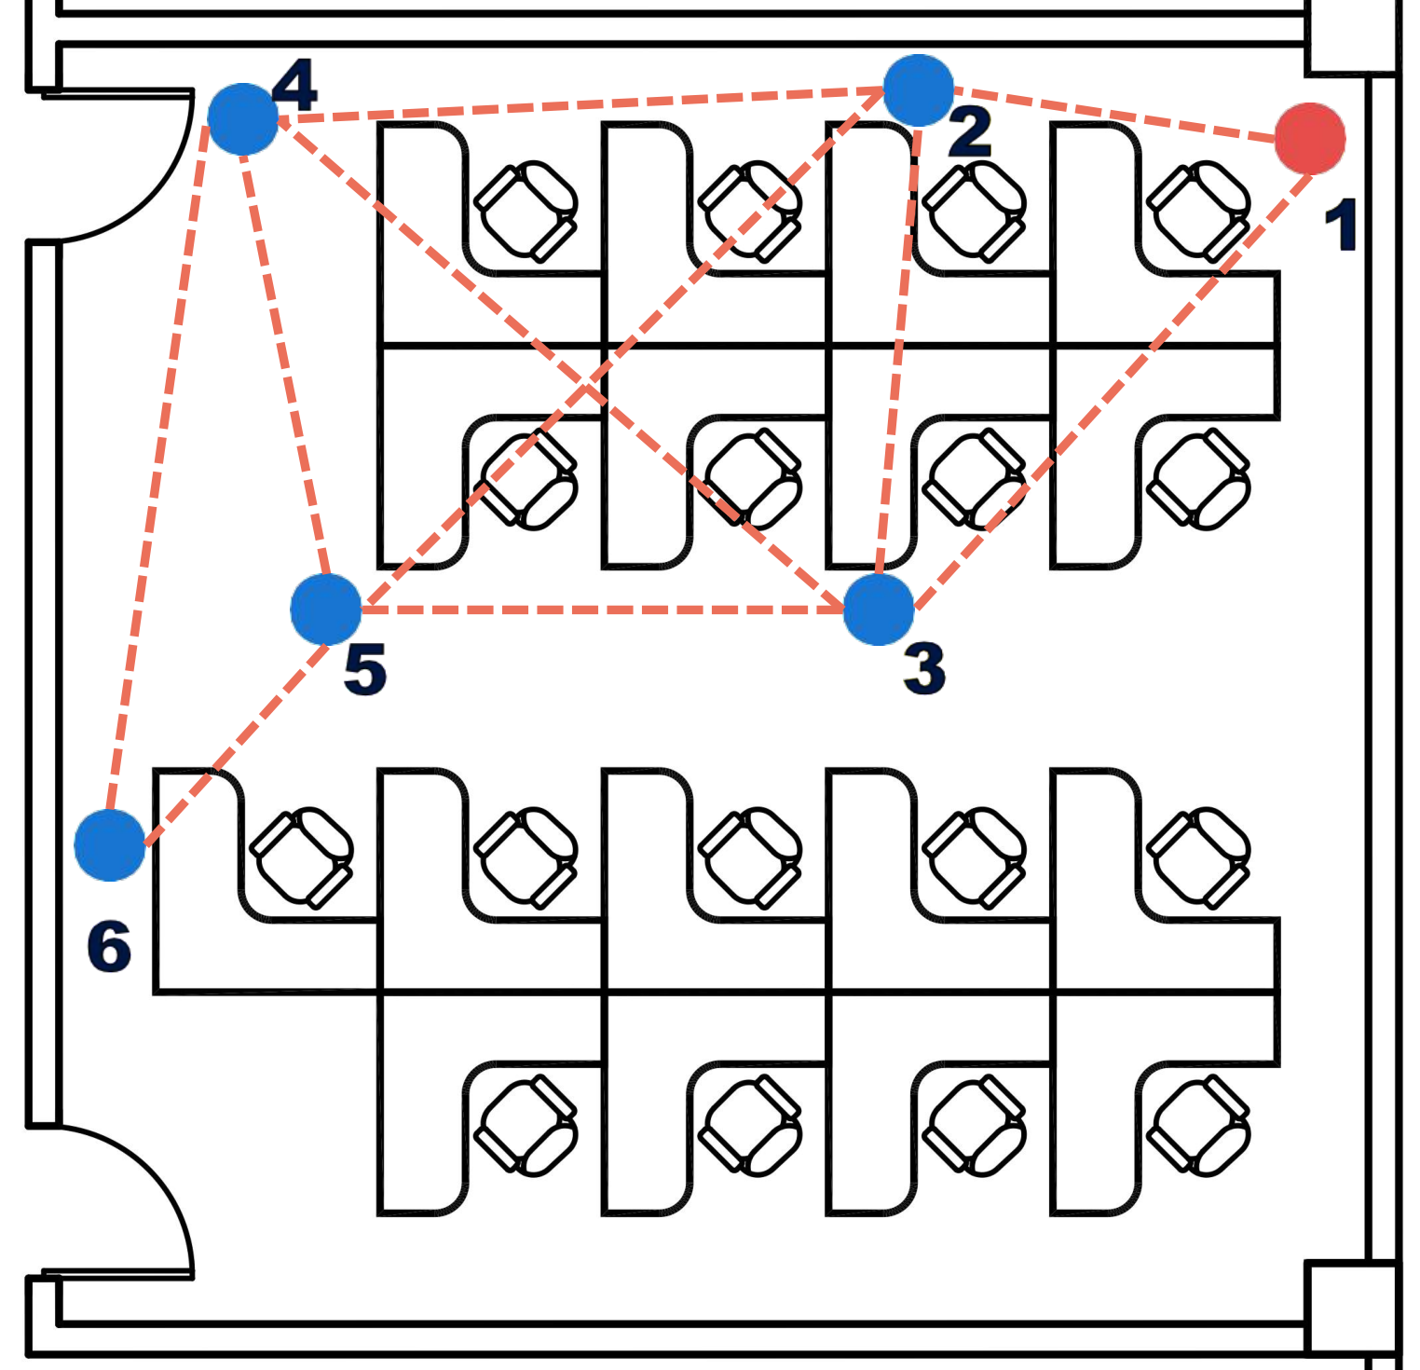
Testbed Setup
Initiator node
Normal nodes
Notes:
We implemented our IGE scheme on BlueFlood and tested on a six-node network with 3 hops. The red node is the initiator.

Slide 19
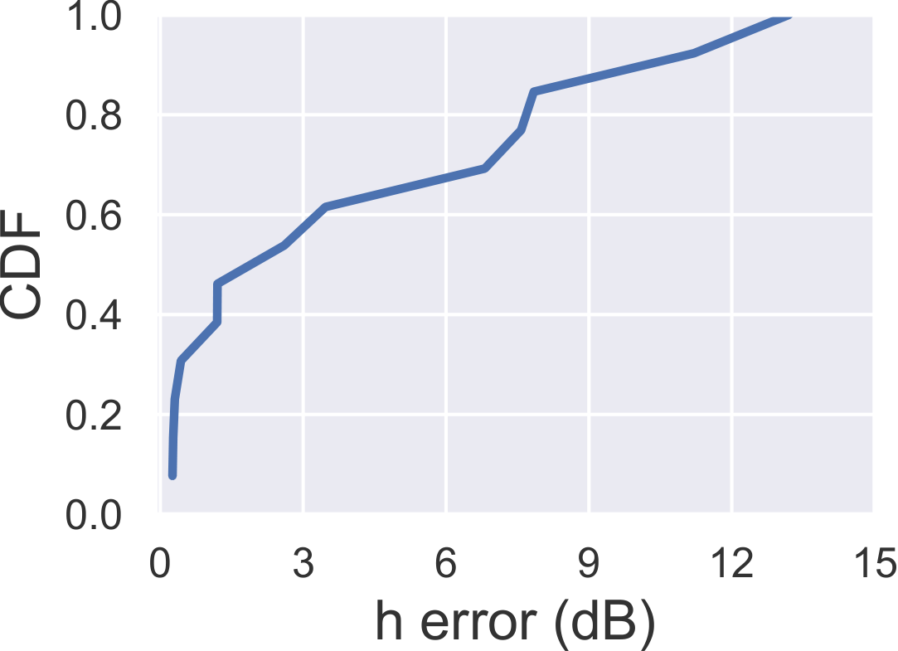
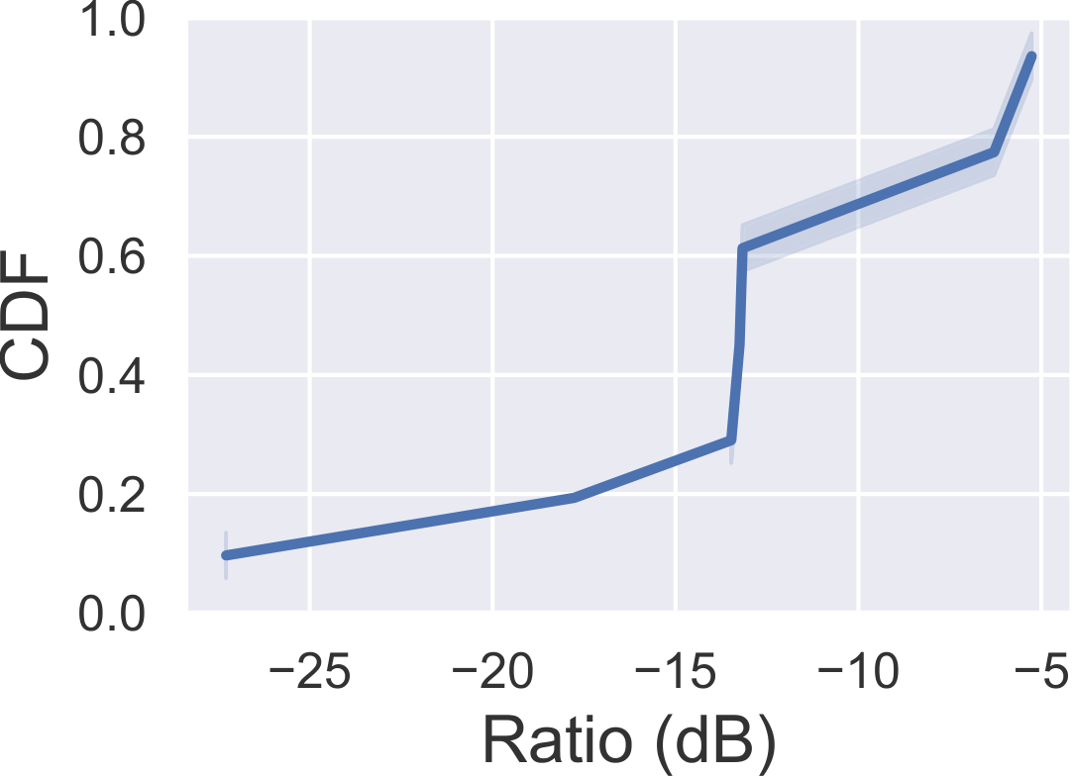
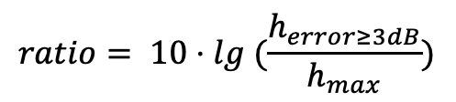
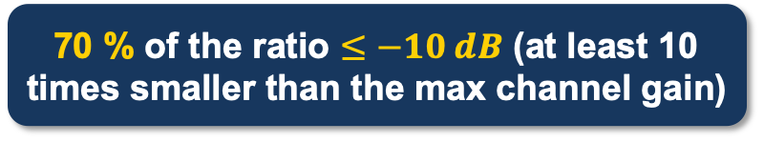
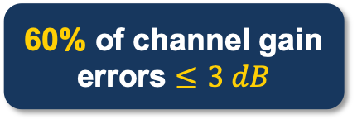
Accuracy of IGE on our testbed
$$ratio= 10⋅lg (\frac{h_{error≥3dB}}{h_{max}})$$
70 % of the ratio $≤−10 dB$ (at least 10 times smaller than the max channel gain)
IGE in real world underperforms controlled experiments, but is still feasible,
where large errors usually occur with small channels.
60% of channel gain errors $≤3 dB$
Notes:
Here are the experimental results. This is the CDF for the channel gain error, (space) and sixty percent of the channel gain error is under 3 decibel. We are curious what happens to those large errors, so we calculate the channel gain with error larger than 3 decibel divided by the maximum channel in the network and plot a CDF for it. We find out seventy percent of the ratio is smaller than negative 10 decibel, namely at least 10 times smaller than the maximum channel. (Space) So we deduce that (……), whose influence is rather little.

Slide 20
Key takeaways
We integrate interference graph estimation (IGE) into data transmission using the same frequency-time resources.
We demonstrate the feasibility of IGE over COTS Nordic nRF52 series SoCs in both controlled and real-world experiments.
Concurrent flooding is a perfect carrier for IGE in wireless sensor networks.
Notes:
Finally, let me wrap up my talk real quick. (…) We find the perfect match between IGE and flooding, and show that (…)

Slide 21

Thank You!
Q&A
Haifeng Jia
Network Measurement and Systems Lab
UM-SJTU Joint Institute
Shanghai Jiao Tong University
https://haifengjia.github.io/
Notes:
Okay, this is the end of my talk. Thank you for your attention, and feel free to ask me questions. BTW, this is my homepage URL and QR code, and you’re welcomed to follow up our future work if you’re interested.

Slide 22
IGE v.s. Channel Estimation
IGE:
Measure all the possible channels to find out the interference, thereby helping to improve SINR.
Channel Estimation:
Only cares about the communication channels.

Slide 23
Possible confusions
Flooding: BlueFlood [1]
We implement our practical IGE scheme on BlueFlood, a flooding protocol upon Contiki OS.
[1] B. Al Nahas, S. Duquennoy, and O. Landsiedel. Concurrent transmissions for multi-hop Bluetooth 5. In EWSN’19, pages 130–141, 2019

Slide 24
Possible confusions
Overhead of IGE :
How the tx powers are distributed?
How the rx powers are reported to the initiator?
Both are collected in a wired way.
Since our focus is on measurement for this paper, the overhead will be considered in the future work.
Scalability?
We will perform experiments on larger scale testbeds in the future. Feel free to follow up our work.
Channel: channel 37, 2402 MHz

Slide 25
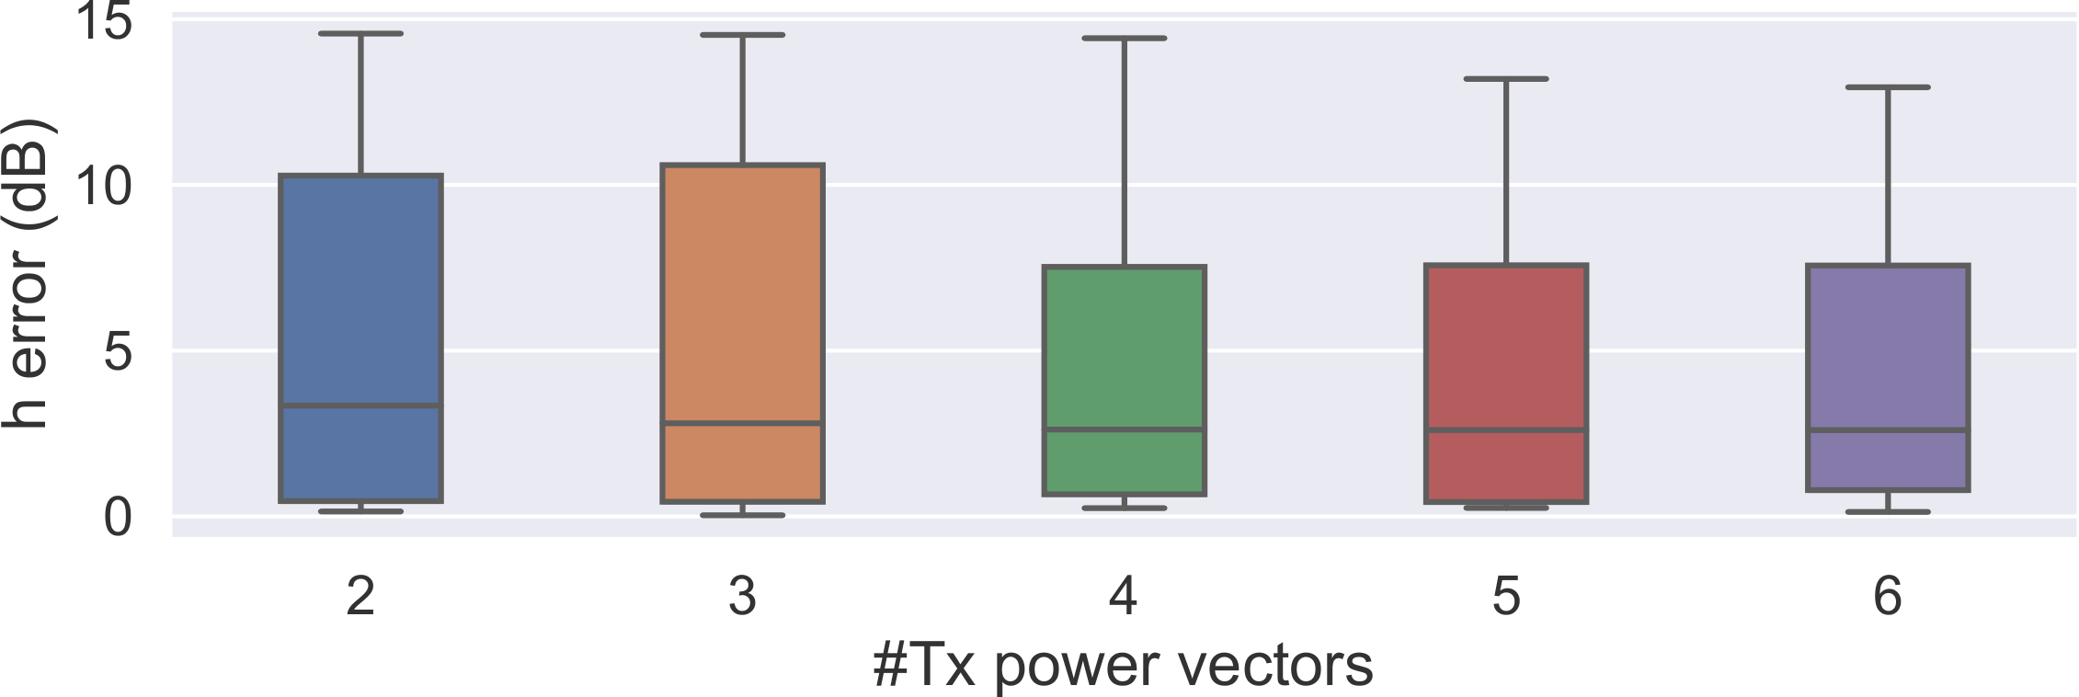
Accuracy of IGE on our testbed
Channel gain error decreases as the tx power vectors increases.
Notes:
backup

