Slide 1

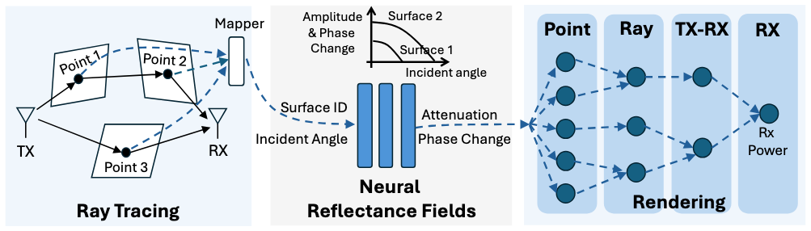

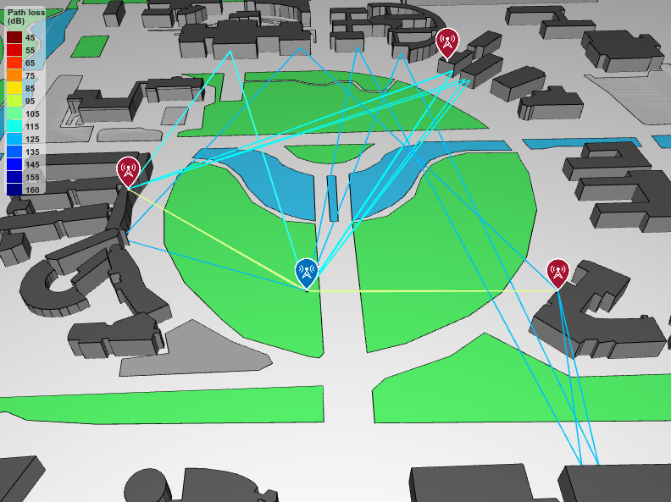
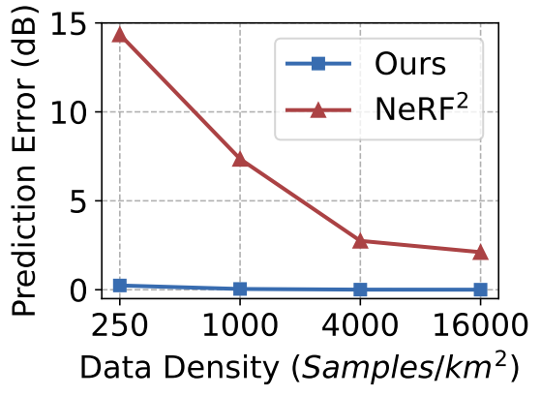
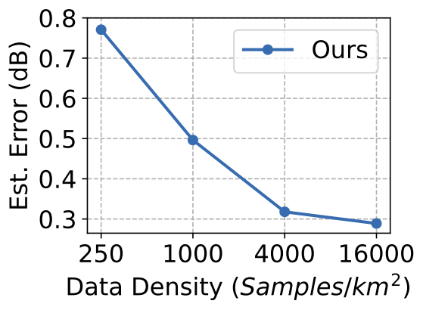
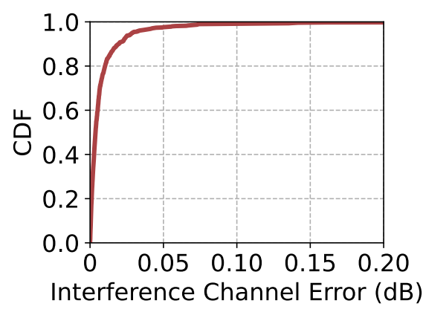
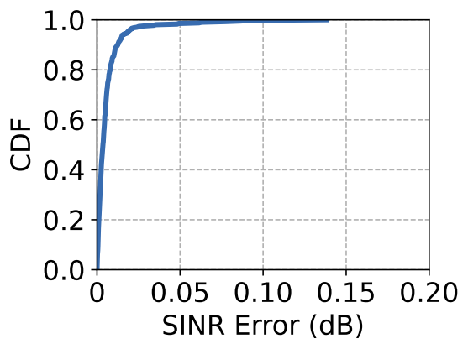
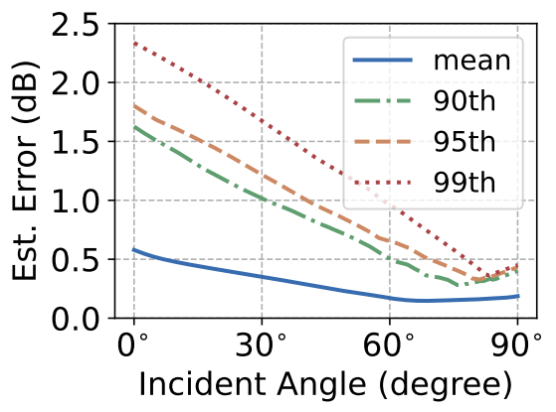
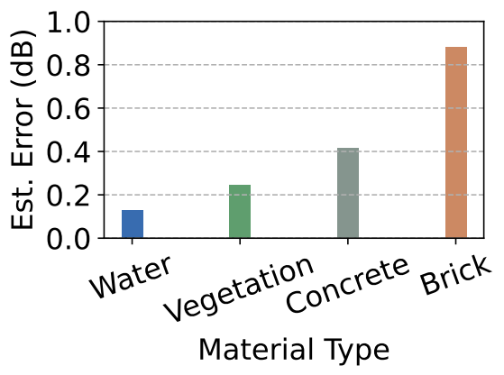

Neural Reflectance Fields for Radio-Frequency Ray Tracing Haifeng Jia, Xinyi Chen, Yichen Wei, Yifei Sun and Yibo Pi*
Radio Frequency Ray Tracing
Our Framework
✅ Scene geometric shapes
❌ Surface material properties.
What material?
Propagation Path
Reflection
Attenuation $δ$
Urgent need for scalable and efficient ways to measure surface material properties!
RX
Via MATLAB
Differentiable RF domain rendering
Implementation
Performance Evaluation
Interference Estimation
SJTU
Open
Street
Map
3 micro-BSs
UE at h=1m
Decompose the superimposed interference signals.
Accurately predict each interference channel gain.
Notes:
Can we prevent such cases from happening? The answer is yes, via the help of ray tracing technology.

Slide 2



Background
5G Base Station
LoS
Reflection
You on the bus
Multipath effects could damage communication quality!
Notes:
Can we prevent such cases from happening? The answer is yes, via the help of ray tracing technology.

Slide 3
Background
Ray Tracing is a great candidate to model such signal propagation,
BUT the performance largely depends on how accurately the target scene can be depicted, which includes:
Scene geometric shapes.
Surface material properties.

Slide 4

Problem Description
Scene geometry. The shape of the environment mainly affects the geometric propagation path of the signal, serving as the backbone.
Wood
Intact
Attenuation $δ$
Target
Scene
Propagation Path
Surface material properties. Material types of the intact points between the EM wave and building surfaces influence the intact attenuation, making up the flesh.
RX

Slide 5
Literature Review & Motivations
State-Of-The-Art (SOTA) existing related solutions
mmSV (MobiCom’23)
NeRF2 (MobiCom’23)
AutoMS (MobiCom’24)

Slide 6

Literature Review & Motivations
Solution | Scene geometry | Surface material properties
mmSV | Open Street Map (OSM) | CV segmentation and identification of the Street View (SV) images
NeRF2 | Implicit neural representation | Implicit voxel attenuation representation
AutoMS | Apple RoomPlan (Lidar + RGB cameras) | Gradient descent optimization for reflection coefficient
Problems with existing solutions
mmSV: CV-based material segmentation and identification are unreliable and effort-consuming.
NeRF2: Implicit neural representation of the scene lacks physical correspondence.
AutoMS: Material reflection coefficients are obtained only at discrete angles ($0^{∘}$, ${10}^{∘}$, ..., ${90}^{∘}$).
OpenStreetMap contributors. 2017. Planet dump retrieved from https://planet.osm.org . https://www.openstreetmap.org.
Apple Developer. RoomPlan API. https://developer.apple.com/augmented-reality/roomplan/, 2023.

Slide 7
Our Solution
The advances in computer vision and LiDAR make scene geometry estimation increasingly accurate, but there still lacks scalable and efficient approaches to estimate the material reflectivity in real-world environment.
Scene geometry.
For both convenience and accuracy, we adopt the Open Street Map (OSM).
Our solution
Surface material properties.
We present Neural Reflectance Fields for general purpose EM waves.

Slide 8
Framework
Mapper
Amplitude
& Phase
Change
Surface 2
Ray
Point
TX-RX
RX
Point 2
Surface 1
Point 1
Incident angle
Surface ID
Attenuation
Incident Angle
Phase Change
Rx
Power
TX
RX
Point 3
Neural
Reflectance Fields
Ray Tracing
Rendering
Ray tracing is based on the OSM.
Neural Reflectance Fields explicitly depict the surface material properties.
RF domain rendering

Slide 9
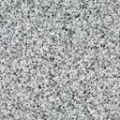




Framework: a toy example
Ray tracing could help to find all propagation paths in the given OSM by Shooting and Bouncing Rays (SBR) method.
Material #2
Intact
Attenuation $δ_{1}$
$$S_{ray1}^{rx}$$
Neural reflectance field indicates the intact attenuation at certain incident angle.
Intact
Attenuation $δ_{2}$
RX
$$S_{ray2}^{rx}$$
With the RF domain rendering, complex signals arriving at the RX from all paths could be obtained.
Material #1

Slide 10
Ray Tracing
Feed SJTU campus OSM into MATLAB ray tracing
Both sub 6GHz channels and mmWave frequencies are both supported.

Slide 11
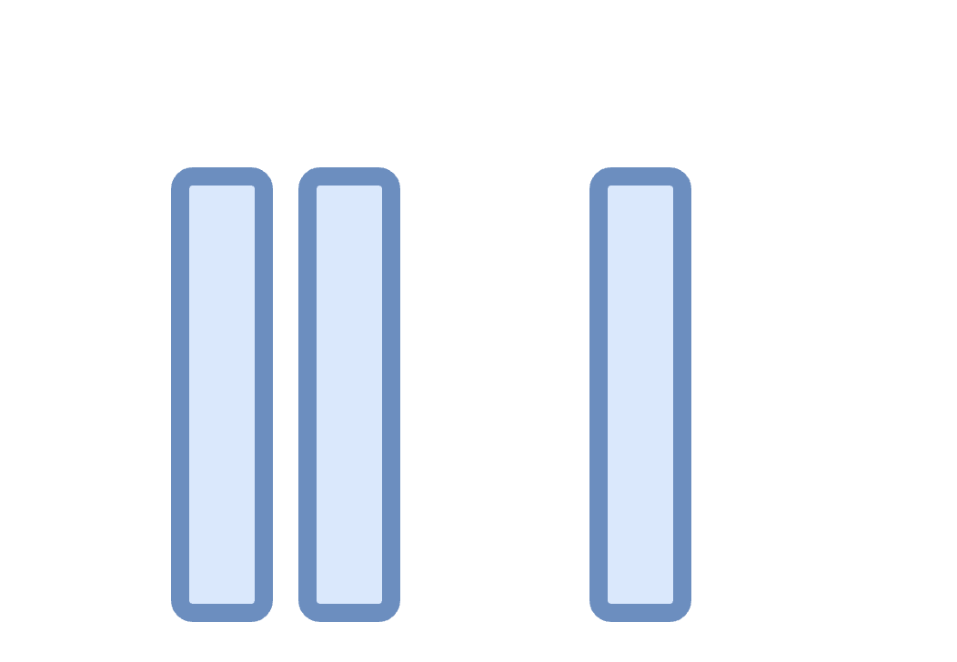

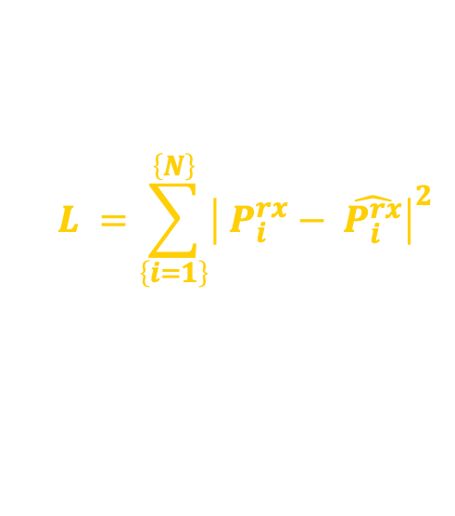




Neural Reflectance Fields
$$(ΔA\left(θ, s\right), ΔΘ\left(θ, s\right))$$
Incident
angle $θ$
RX
RF domain rendering
Real $P^{rx}$
Surface $s$
$$L =\sum_{\left\{i=1\right\}}^{\left\{N\right\}}{{\left| P_{i}^{rx}− \hat{P_{i}^{rx}}\right|}^{2}}$$
Predicted ${\hat{P^{rx}}}^{ }$
Notes:
Note that the rendering process here is differentiable, so that the gradients could be back-propagated.

Slide 12














RF Domain Rendering
?
?
$$δ_{k} =\prod_{\left\{r_{k,l}∈ P_{k}\right\}}{ΔA\left(θ\left(r_{k,l}\right), s\left(r_{k,l}\right)\right)e^{j ΔΘ\left(θ\left(r_{k,l}\right)\right)}}$$
Intact
Attenuation $δ_{1}^{(1)}$
Intact
Attenuation $δ_{1}^{(2)}$
Free Space Path Loss $H_{1}^{FS}$
$$H_{i}^{FS} = \frac{λ_{c}}{4π d_{i}} e^{j\frac{2 π d_{i}}{λ_{c}}}$$
$$S_{ray1}^{rx}$$
Free Space Path Loss $H_{2}^{FS}$
RX
TX #$i$
RX #$d$
$$H_{i,d}=\sum_{k∈R_{i,d}}^{ }{H_{k}^{FS} δ_{k}}$$
$$S_{ray2}^{rx}$$
Intact
Attenuation ${δ_{2}}_{ }$
$$S_{k}^{rx}=\sum_{i∈B}^{ }{\sqrt{P_{i}^{tx}} H_{i,d}}$$
?
Notes:
这里的设定是否合理？好想讲不通

Slide 13
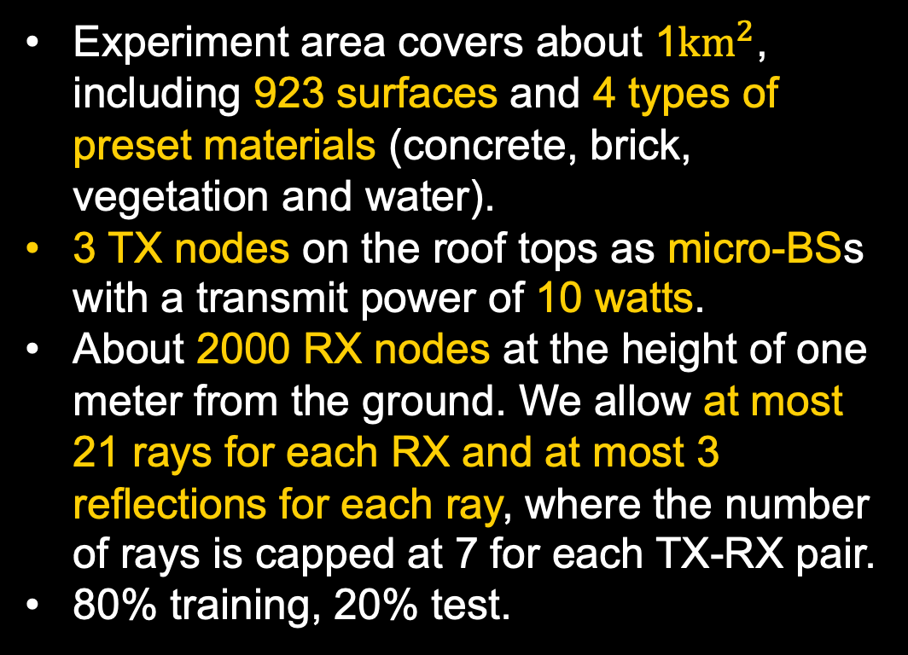
Implementation
Experiment area covers about 1${km}^{2}$, including 923 surfaces and 4 types of preset materials (concrete, brick, vegetation and water).
3 TX nodes on the roof tops as micro-BSs with a transmit power of 10 watts.
About 2000 RX nodes at the height of one meter from the ground. We allow at most 21 rays for each RX and at most 3 reflections for each ray, where the number of rays is capped at 7 for each TX-RX pair.
80% training, 20% test.
Notes:
10 watts合理吗

Slide 14

Evaluation (1): Accuracy of Neural Reflectance Field
Two cases when est. error rises:
Small AoI, large attenuation.
Near-${90}^{∘}$ AoI, almost none attenuation.
99% percentiles for 4 materials.
Ground truth ref. coeff.:
Water < Veg < Concrete < Brick.
The smaller the influence on total signal strength, the larger the estimation error!
Notes:
Fig.~\ref{fig:accu_vs_aoi} shows the mean estimation error and the 90-th, 95-th, and 99-th percentile errors under different angles of incidence, where the angles of incidence are evenly divided into 1000 bins and the percentile is computed for errors in each bin. It can be seen that the 99-th percentile error is below 2.5 dB for all incident angles and the mean error is below 0.6 dB. We can also see that the error decreases as the angle of incidence increases and rebounds when the angle comes near 90$^{\circ}$. Based on our simulated attenuation function, reflection loss is large for small incident angles, resulting in a ray with strength weaker than others. Such weak rays have limited influence to the overall receive power and thus are likely to experience larger estimation errors. When the angle of incidence comes near 90$^{\circ}$, the reflection coefficient is very small, which tends to suffer from large estimation errors.

Slide 15
Evaluation (2): Comparison with Existing Approaches
Prediction error on the test set.
NeRF2 is basically interpolating, but our solution is physically based.
Reflections on the same surface can be used together to train the neural reflectance fields for the surface.
Our neural reflectance field highly outperforms existing approaches.
Notes:
Fig.~\ref{fig:accu_vs_aoi} shows the mean estimation error and the 90-th, 95-th, and 99-th percentile errors under different angles of incidence, where the angles of incidence are evenly divided into 1000 bins and the percentile is computed for errors in each bin. It can be seen that the 99-th percentile error is below 2.5 dB for all incident angles and the mean error is below 0.6 dB. We can also see that the error decreases as the angle of incidence increases and rebounds when the angle comes near 90$^{\circ}$. Based on our simulated attenuation function, reflection loss is large for small incident angles, resulting in a ray with strength weaker than others. Such weak rays have limited influence to the overall receive power and thus are likely to experience larger estimation errors. When the angle of incidence comes near 90$^{\circ}$, the reflection coefficient is very small, which tends to suffer from large estimation errors.

Slide 16
Evaluation (3): SINR and Interference Channel Prediction
Almost all RX nodes have an accurate predicted SINR deviating from the actual one less than 0.05dB.
Only less than 1% of TX-RX pairs having a prediction error greater than 0.05dB.
An accurate reconstruction of RF Field largely facilitates the communication.
Notes:
Fig.~\ref{fig:accu_vs_aoi} shows the mean estimation error and the 90-th, 95-th, and 99-th percentile errors under different angles of incidence, where the angles of incidence are evenly divided into 1000 bins and the percentile is computed for errors in each bin. It can be seen that the 99-th percentile error is below 2.5 dB for all incident angles and the mean error is below 0.6 dB. We can also see that the error decreases as the angle of incidence increases and rebounds when the angle comes near 90$^{\circ}$. Based on our simulated attenuation function, reflection loss is large for small incident angles, resulting in a ray with strength weaker than others. Such weak rays have limited influence to the overall receive power and thus are likely to experience larger estimation errors. When the angle of incidence comes near 90$^{\circ}$, the reflection coefficient is very small, which tends to suffer from large estimation errors.

Slide 17
Conclusion
We point out that the ray tracing performance greatly depends on the target scene depiction, which is composed of scene geometry and surface material properties.
To address this problem, we propose neural reflectance field for the RF domain to learn the reflection coefficients at any angle from the receive power of RF signals.
We designed a differentiable RF ray tracing framework to train the neural reflectance field, of which the performance outperforms existing solutions in our simulation.
Furthermore, our framework demonstrated the ability to predict SINR etc., which has great potentials for resource allocation and scheduling tasks.
Notes:
Tx i, rx d, ray k, reflection l

Slide 18
Thank You!
Q&A
Haifeng Jia
Network Measurement and Systems Lab
UM-SJTU Joint Institute
Shanghai Jiao Tong University

