Slide 1


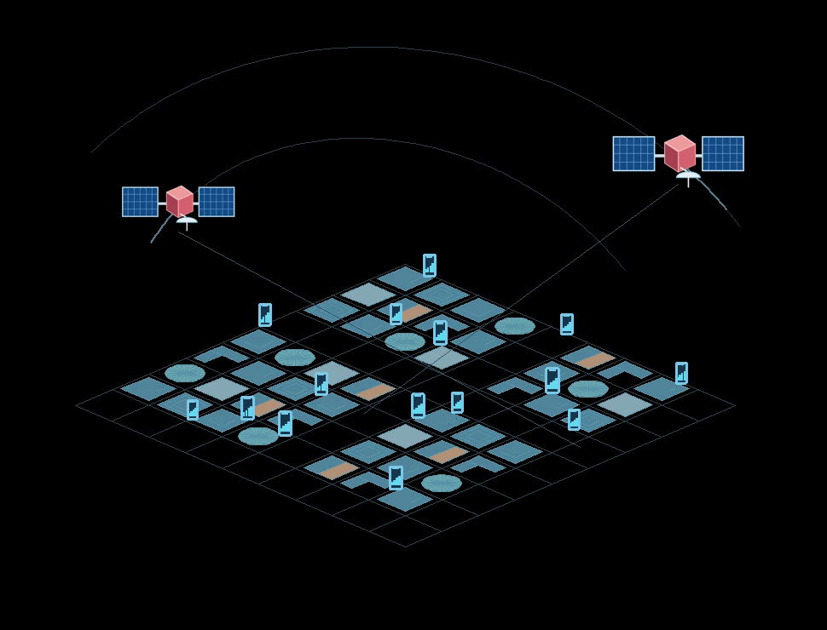
SurfNeHF
Surface-Aware Neural Height Fields for Efficient
3D Urban Mapping Using Crowdsourced GNSS Data
Haifeng (Ethan) Jia#, Xingyuan Ding, Minyang Qu, Yibo Pi*, Cailian Chen
NetSense Lab, Shanghai Jiao Tong University
# Speaker * Corresponding Author
1
Notes:
Target: 13 seconds
Today I will present SurfNeHF, which reconstructs urban building surfaces from crowdsourced GNSS measurements, with lower data and computational cost.
Source: ../3-IMWUT-camera_ready/sample-sigconf.tex. Title and author order from camera-ready. Presenter uses preferred display name Haifeng (Ethan) Jia in orange, underlined, with superscript #; Yibo Pi has superscript * for corresponding author, as requested. NetSense Lab, Shanghai Jiao Tong University retains the correct affiliation. Official conference logo source https://www.ubicomp.org/ubicomp-iswc-2026/wp-content/uploads/2025/12/Ubicomp_2026_logo.png; original glyph mask is retained with native white duotone recoloring on black and moved to the upper-left corner. The centered SurfNeHF wordmark is paired with an original mesh-wave/surfboard icon. Underlines identify Surf from Surface, Ne from Neural, and H/F from Height Fields. City animation keeps two satellites and growth; its GNSS caption is omitted.

Slide 2

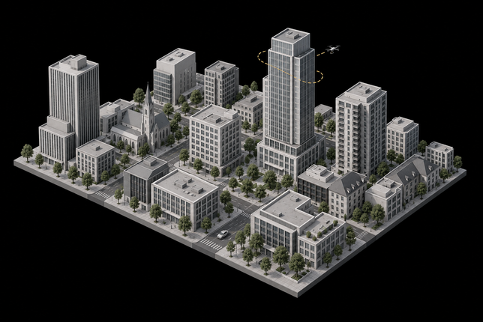
Background: 3D Urban Mapping
SurfNeHF
Smart Cities & Urban Planning
Localization & Navigation
Digital Twins for Wireless Networks
Lack Open-sourced High-fidelity 3D Geospatial Database for Downstream Usage
Especially for Radio Frequency Related
Downstream Applications (Motivations)
2
Notes:
Target: 21 seconds
Three-dimensional urban maps support smart cities and planning, localization and navigation, and cellular or V2X digital twins. Cities change, so maps need timely updates. Public geometry datasets that programs can use also have limited coverage. We need an efficient way to obtain and refresh geometry.
Source: ../3-IMWUT-camera_ready/sample-sigconf.tex. Camera-ready Introduction (lines 251 and 310–325): urban development, navigation, autonomous driving, wireless planning and periodic map updates. The user requested three application categories: smart cities and urban planning; localization/navigation; digital twins for cellular/V2X networks. Downstream RF digital-twin examples: NVIDIA AI Aerial https://developer.nvidia.com/topics/telecommunications/ai-aerial and VaN3Twin https://arxiv.org/abs/2505.14184 . These are motivating applications, not tasks evaluated in this paper. Public geometry availability is a contextual motivation concerning usable geographic coverage, detail, freshness and programmatic access; it is not a claim that no open 3D datasets exist. Open 3DBAG provides regional data and API https://docs.3dbag.nl/en/delivery/webservices/ ; Google 3D Tiles requires API access and licensing/billing https://developers.google.com/maps/documentation/tile/overview . The city illustration is not an experimental reconstruction or Google Earth ground truth. Timely updates do not claim daily-update performance.

Slide 3
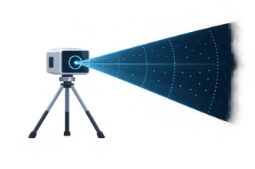


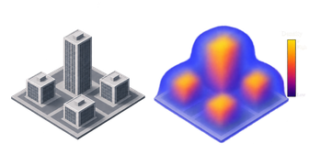
Motivations
SurfNeHF
Dedicated Scanning ^{[1]}
Visual Scanning ^{[2]}
GNSS 3D Mapping ^{[3]}
SurfNeHF: Represent the City through Surfaces Manifolds
Infer surface geometry and material directly from everyday crowdsourced GNSS signals.
Street View
Material Labels
LiDAR & mmWave
Takes Huge amounts of Computational Resources.
SaRF: Satellite Radiance Fields
Costly Repeat Capture
Volumetric Density:
Blurred Boundaries &
Threshold Dependence
[1] Xu et al. Towards Fast and Fully Automatic
Drone Mapping. MobiSys, 2026.
[2] Kamari et al. mmSV. MobiCom, 2023.
DOI: 10.1145/3570361.3613291
[3] Zhao et al. SaRF, UbiComp/IMWUT, 2024.
DOI: 10.1145/3678572
3
Notes:
Target: 17 seconds
Scanning requires repeated collection. Visual-to-RF transfer does not fully describe radio response. SaRF learns volumetric density and radiance, but errors and network compensation blur boundaries and require a density threshold. We instead infer explicit surfaces and reflectance.
Source: ../3-IMWUT-camera_ready/sample-sigconf.tex. Sources [1] Ruisheng Wang, Jiju Peethambaran and Dong Chen. LiDAR Point Clouds to 3-D Urban Models: A Review. IEEE JSTARS 11(2), 606–627, 2018. [2] Kamari, Chae and Pathak. mmSV: mmWave Vehicular Networking using Street View Imagery in Urban Environments. MobiCom 2023. DOI 10.1145/3570361.3613291. [3] Xiaopeng Zhao, Shen Wang, Zhenlin An and Lei Yang. Crowdsourced Geospatial Intelligence: Constructing 3D Urban Maps with Satellitic Radiance Fields. IMWUT 8(3), Article 146, 2024. DOI 10.1145/3678572. Camera-ready Introduction explains blurred air-building density boundaries due to measurement errors and attenuation/radiance compensation. RF volumetric density is not calibrated physical material density. The visual-to-RF limitation is SurfNeHF rationale; do not imply that mmSV itself reports this limitation. The pictures retain the teaser motivation assets.

Slide 4
SurfNeHF Framework Overview
SurfNeHF
SurfNeHF
Forward Rendering
Backpropagation
Disentangled
Neural Representation
Surface-Aware
Ray Sampling
Fully Differentiable
Forward Renderer
Loss
Function
Geometry: NeHF
Surface-Centric
In a Volumetric Rendering Way
Materials: Neural BRDF
Render Signal Power in a Fully Differentiable Manner
Learnable Satellite Configs
3D Urban Map Export
Raw GNSS Signal
Strength Measurements
Data Preprocessing
Pruned GNSS
Measurements
Data Pruning
via SenseMyCity Results
5
Notes:
Target: 18 seconds
Separate neural models describe geometry, materials and sources. Sampling finds surface hits, and the RF renderer predicts power. Pruned observations supervise a loss. Blue arrows indicate forward rendering, orange arrows backpropagation. Optimized geometry exports as surface points or occupancy voxels.
Source: ../3-IMWUT-camera_ready/sample-sigconf.tex. Presentation-specific editable system diagram replacing the original paper framework. Neural Representation groups NeHF geometry, the spatially varying neural BRDF and direction-based satellite-source power. Geometry informs differentiable surface-hit estimation in Surface-Aware Ray Sampling. The RF-domain renderer also queries geometry/visibility, BRDF and satellite-source power; the serial arrows describe computation and do not imply materials are spatially sampled. Blue solid arrows denote forward rendering. Orange dashed backpropagation denotes inverse rendering and joint parameter optimization. Self-consistency-based pruning supplies measured GNSS power as supervision; these observations are not noise-free ground truth. Receiver positions and satellite directions are conditioning inputs to sampling/rendering, omitted from the bird's-eye diagram. The 3D urban map export branch leaves the optimized geometry/NeHF representation, not the renderer or loss. Surface-based point clouds and occupancy voxels illustrate alternative map outputs. The main forward and reverse arrows run in parallel between modules, with blue forward arrows above orange backward arrows. Camera-ready Sections 4–7, framework, ray sampling, neural rendering and surface reconstruction.

Slide 5
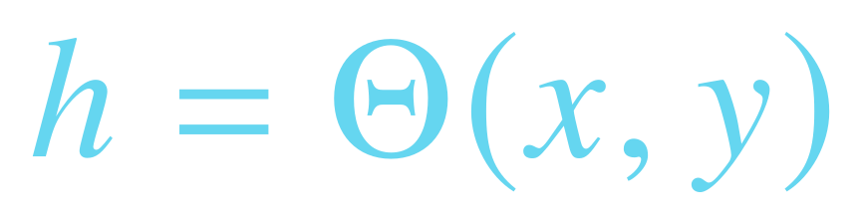
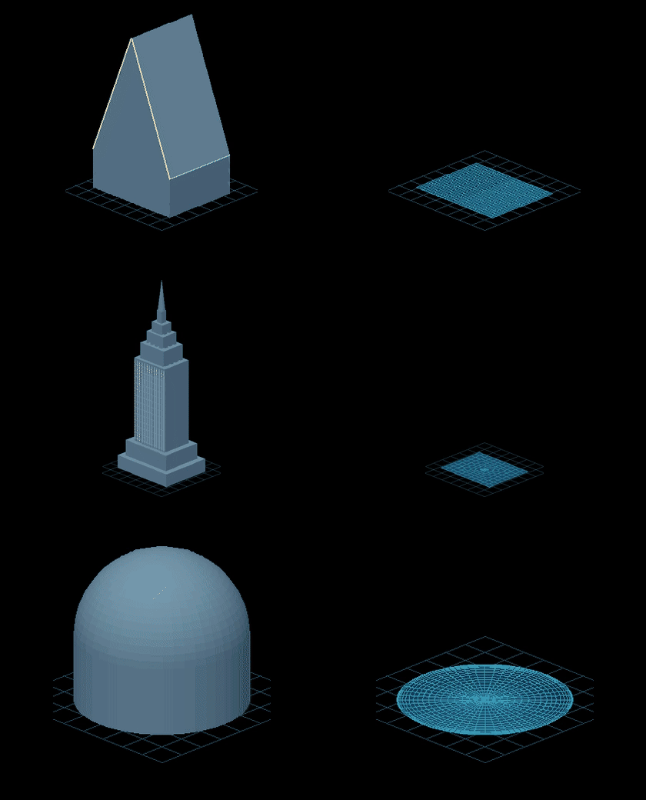


Disentangled Neural Representations:
Neural Height Fields (NeHF)
SurfNeHF
(x, y)
Real
NeHF
NeHF
SIREN-Based MLP ^{[1]}
A-Frame
where the Sine Hidden Layers are
Tower
Surface Normal:
Dome
Temple
Sine Activations Capture Sharp Height Variations
[1] Sitzmann et al. Implicit Neural Representations with Periodic Activation Functions. NeurIPS, 2020.
6
Notes:
Target: 26 seconds
NeHF maps horizontal coordinates to height. The SIREN box composes sine-activated hidden layers with a linear output. Sine activations capture sharp height variations while preserving derivatives. These derivatives give the surface normal below. The three rows on the right compare real shapes with their growing neural height fields.
Source: ../3-IMWUT-camera_ready/sample-sigconf.tex. Camera-ready lines385–406: compact SIREN MLP, sine hidden layers, linear output and horizontal row-vector normal. Same40logicalpx LaTeX scale for all principal equations. Sinusoidal activations model fine geometric variations and are infinitely differentiable, supporting analytic height derivatives; finite SIREN is smooth and does not exactly realize a height discontinuity. No unsupported quantitative superiority to positional encoding is claimed. Layer/unit counts moved to Implementation. Right growth examples retained; labels enlarged. SIREN https://proceedings.neurips.cc/paper/2020/hash/53c04118df112c13a8c34b38343b9c10-Abstract.html .

Slide 6

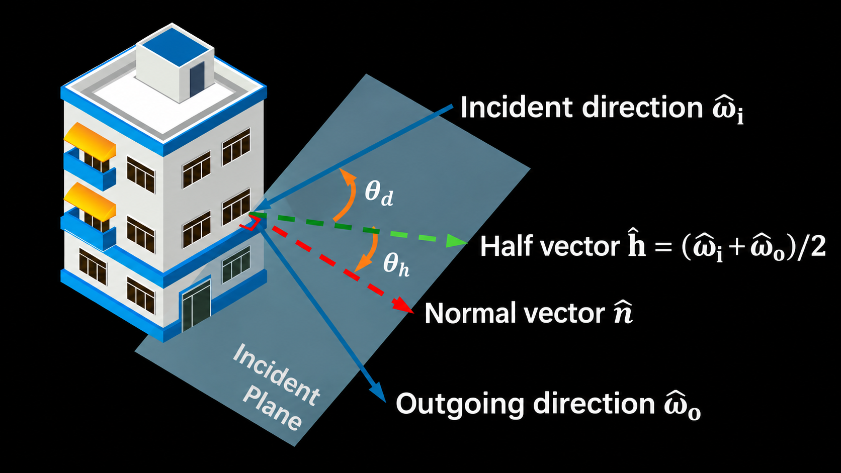

Disentangled Neural Representations :
Bidirectional Reflectance Distribution Function (BRDF)
SurfNeHF
Normal &
Directions
Half-Angle Encoding
Spatially Varying
Reflectance
Surface Position
Positional Encoding
Neural BRDF
Spatially Varying Neural BRDF
Angular-Dependent & Spatially Varying
Material Response Modeling
Half-Angle Encoding
7
Notes:
Target: 24 seconds
Half-angle encoding turns incident and outgoing directions into angular features, as shown in the left diagram. Gamma denotes positional encoding of the surface hit. These angular-dependent and spatially varying features enter the neural BRDF. Its MLP output is multiplied by the incidence dot product shown at the end of the equation.
Source: ../3-IMWUT-camera_ready/sample-sigconf.tex. Camera-ready Signal-Surface Interaction, Figure half-vector-enc (half-vector-encoding.pdf) and Eq half_angle_encoder. The incident and outgoing direction pair defines a half-vector. Theta_h measures its angle to the surface normal; theta_d measures its angle to the incident direction. The two cosine features enter the neural BRDF along with Gamma(p_x), the positional encoding of the three-dimensional surface hit, frequency base 2 and L=10 bands. The BRDF MLP has three layers and 16 hidden units. The right visualization illustrates directional reflection-energy response for three incident elevations, from the teaser BRDF animation. The two lower associations are qualitative response signatures, not quantitative roughness estimation or semantic material classification.

Slide 7
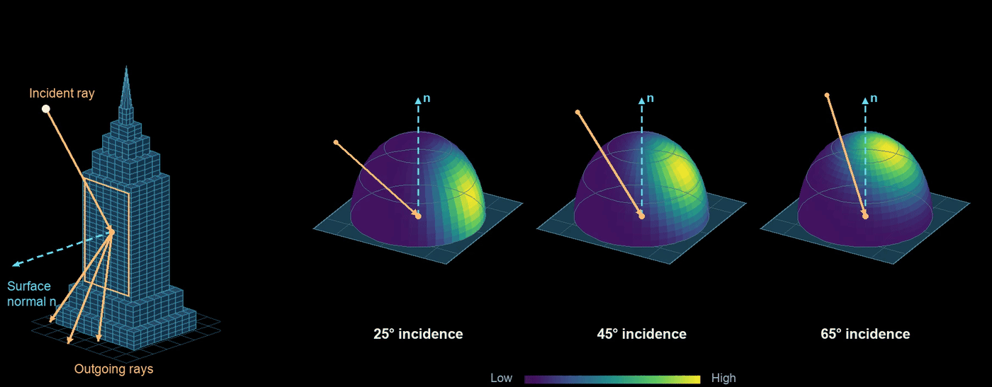
Disentangled Neural Representations :
BRDF Demo
SurfNeHF
Angular Distribution ↔ Surface Roughness
Reflection Strength ↔ Material Type
8
Notes:
Target: 17 seconds
Here is the same directional BRDF response in motion. The angular distribution relates to surface roughness, while reflected strength relates to material response. These are qualitative physical signatures.
Source: ../3-IMWUT-camera_ready/sample-sigconf.tex. Original looping teaser BRDF animation, shown separately after the formulation. Associations with roughness and material response are qualitative; no semantic material-classification claim.

Slide 8




Disentangled Neural Representations :
Satellite Sources
SurfNeHF
Signals from GNSS satellites are modeled as
plane wave with parallel incident rays
RX
Satellite Modeling = ( Direction from Ephemeris ${\hat{ω}}_{s}$ , Learnable Source Power $P_{s}^{tx}$ )
9
Notes:
Target: 21 seconds
The dome shows incoming source directions at different elevations. At a local receiver scale, rays from one distant satellite are parallel, even as the user moves. Omega is the ephemeris-derived direction; P is learnable source power. Satellite motion updates its direction within the same formulation.
Source: ../3-IMWUT-camera_ready/sample-sigconf.tex. Camera-ready satellite-source assumption: over a local receiver region and short interval, each source direction is effectively shared and its rays parallel. Separate source directions have independently learned powers, jointly optimized with NeHF/BRDF. Two asymmetric source cartoons sit on the dome direction boundary; parameters are outside on the corresponding sides. Ray bundles target a small receiver neighborhood centered on the ground-circle center, not one shared convergence point. The dome encodes direction, not true satellite altitude or orbital scale. Satellite movement changes source direction; no stationary-PRN claim.

Slide 9





Surface-Aware Ray Sampling
SurfNeHF
Upper-Hemisphere Angular Sampling
Differentiable Ray–Surface Intersection
h
LOS
NLOS
No Hit
Ray i
Ray i
1
RX
0
x
1
t
$$,$$
Surface-Centric Weighting $α_{i}$
In a Volumetric Rendering Fashion
10
Notes:
Target: 19 seconds
Candidate rays include direct, reflected and no-hit paths. Occupancy and transmittance give differentiable weights, and their weighted position sum gives the first surface hit. Transmittance suppresses later surfaces. Each candidate NLOS path has at most one interaction. Depth samples remain uniform.
Source: ../3-IMWUT-camera_ready/sample-sigconf.tex. Faithful native-shape recreation of camera-ready Figure3 with dark-theme hemisphere/building, LOS/NLOS/no-hit paths, RX, ray i, step height, weight peak, axes and hit marker. Eq alpha, transmittance/weight and phit are copied from camera-ready lines459–484. Equal azimuth/elevation angles and uniform128depth samples per ray. Empty-space contributions are suppressed by occupancy, and transmittance suppresses contributions beyond the first surface; no actual adaptive empty-space skipping is claimed. Each candidate NLOS path has at most one modeled surface interaction. The weighted intersection is differentiable, not a hard geometric exact-hit algorithm.

Slide 10
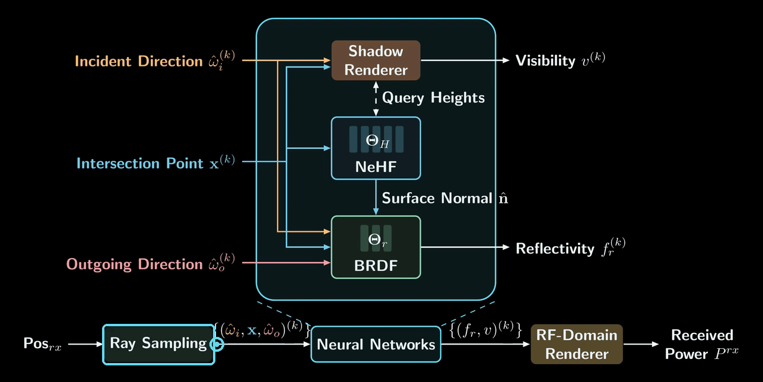

Fully Differentiable Forward Rendering
SurfNeHF
12
Notes:
Target: 21 seconds
The animation assembles sampling, NeHF, shadow and BRDF, and RF-domain power prediction. Source power, surface hits, visibility and reflectivity combine direct and reflected contributions. Every stage is differentiable, so gradients can travel backward through the same pipeline.
Source: ../3-IMWUT-camera_ready/sample-sigconf.tex. Original teaser architecture animation restored from its source; black stage uses approved TikZ architecture while original pulse paths and phase order are preserved. Same modules as camera-ready Figure6. Eq RF render618–634 combines direct k=0 and NLOS rays through hits h, visibility v, BRDF f_r, and source power; LOS h=f_r=1. All stages are differentiable. This page is forward prediction; the following page covers inverse reconstruction.

Slide 11
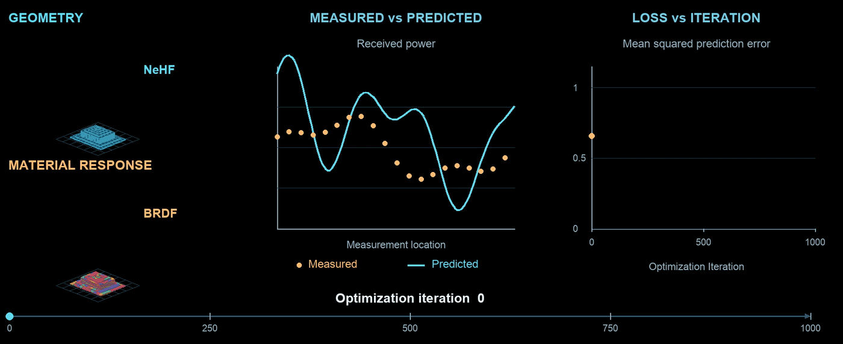
Reconstruction via Inverse Rendering
SurfNeHF
Loss Gradients Refine Geometry, BRDF & Sources
13
Notes:
Target: 25 seconds
Inverse rendering compares predicted and measured GNSS power, then propagates residuals through the renderer. Geometry, reflectance and source power refine jointly. This illustrative animation shows the building taking shape, the reflection lobe developing, predicted power approaching measurements, and loss decreasing on a shared iteration timeline.
Source: ../3-IMWUT-camera_ready/sample-sigconf.tex. Camera-ready joint optimization of NeHF geometry, neural BRDF reflectance and satellite source power through differentiable received-power residuals. Reused teaser illustration shows the coupled process, not measured experimental convergence. No mask-loss or 2D-prior term is included on this presentation page.

Slide 12
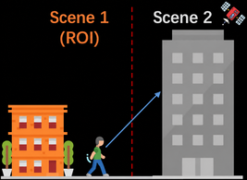
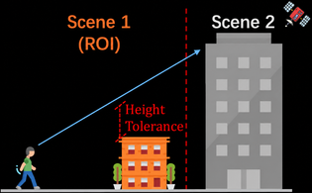
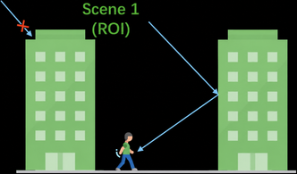
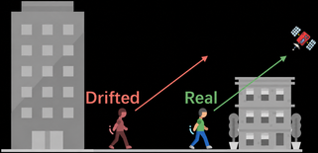

Pre-Processing: Crowdsourced Data Pruning
SurfNeHF
Region of Interests (ROI) Assumptions
Directly Out of ROI
Inter-Scene Occlusion
External Multipath
Low SNR Confidence
Positioning Error
Transient Occlusion
14
Notes:
Target: 16 seconds
The five panels show out-of-region observations, external blockers or reflectors, position drift and transient objects. A coarse map identifies inconsistent measurements. We retain observations suitable for the local static reconstruction and quantify pruning later.
Source: ../3-IMWUT-camera_ready/sample-sigconf.tex. Camera-readyFigure7(a)case2directlyoutofROI(b)case1intersceneocclusion(c)case3externalmultipathandFigure8positioningerror/transientocclusion, all5fullpanels. Externalreflectors require extendingROI to include neighboringbuilding, notsimplydiscardingallmultipath. LowconfidencecomparesSNRwithcoarsegeometrywithheighttolerance.

Slide 13

3D Urban Map Export
SurfNeHF
Optimized NeHF
3D Urban Map Export
Point Clouds / Occupancy
Surface-Based Point Clouds
Voxel-Based Occupancy Map
Complete Front & Side Surface Points
Building = 1 / Air = 0
NeHF Samples
Boundary Fillers
Filled Occupancy beneath the Surface
15
Notes:
Target: 24 seconds
The same learned building gives two outputs. On the left, points cover its complete front, side and rooftop surfaces, including vertical boundary fillers. There are no points in the interior volume. On the right, a voxel-based occupancy map fills occupied building cells while air remains empty. Both outputs preserve the same building geometry.
Source: ../3-IMWUT-camera_ready/sample-sigconf.tex. Native editable 3D side/cross-section schematics follow the building profile of camera-ready Figure Two levels of 3D Urban Mapping, figures/3d-urban-map.pdf and 3d-urban-map_surf.pdf. Surface points densely cover complete visible front facade, side facade and roof; only boundary surfaces contain points, not interior volume. Taller residential-building-like schematic uses the same geometry for both outputs. Occupancy illustration fills the building beneath the recovered height profile, matching the source figure and user-requested cross-section, with air above/outside. The occupancy illustration reproduces the filled Building=1 / outside Air=0 regions shown in the source figure. Sampling is gradient-guided in (x,y) plus vertical fillers; mesh post-processing optional. Not experimental result meshes.

Slide 14
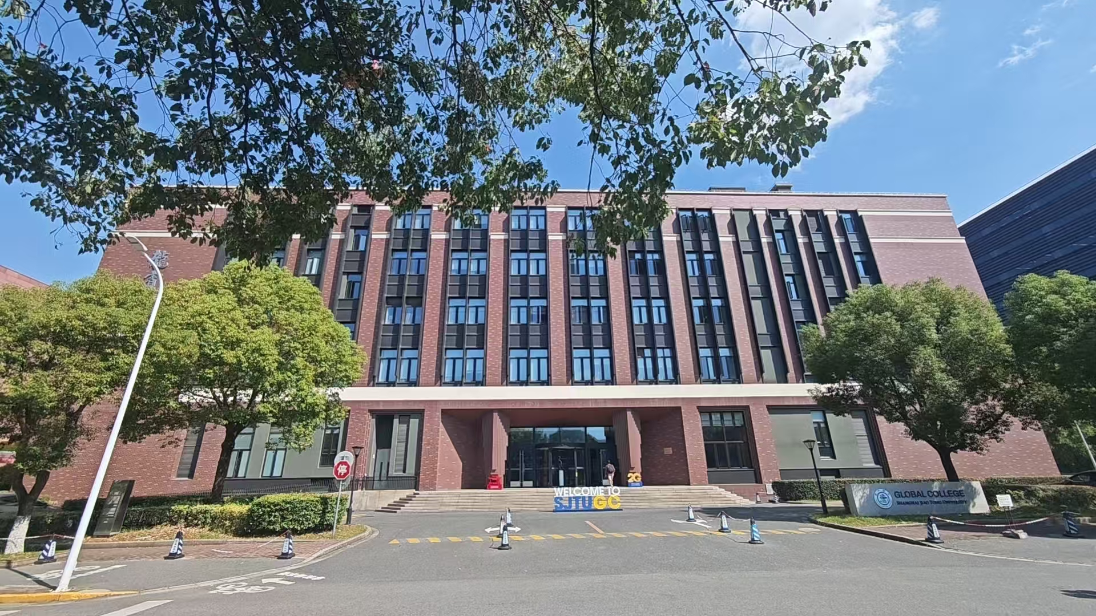
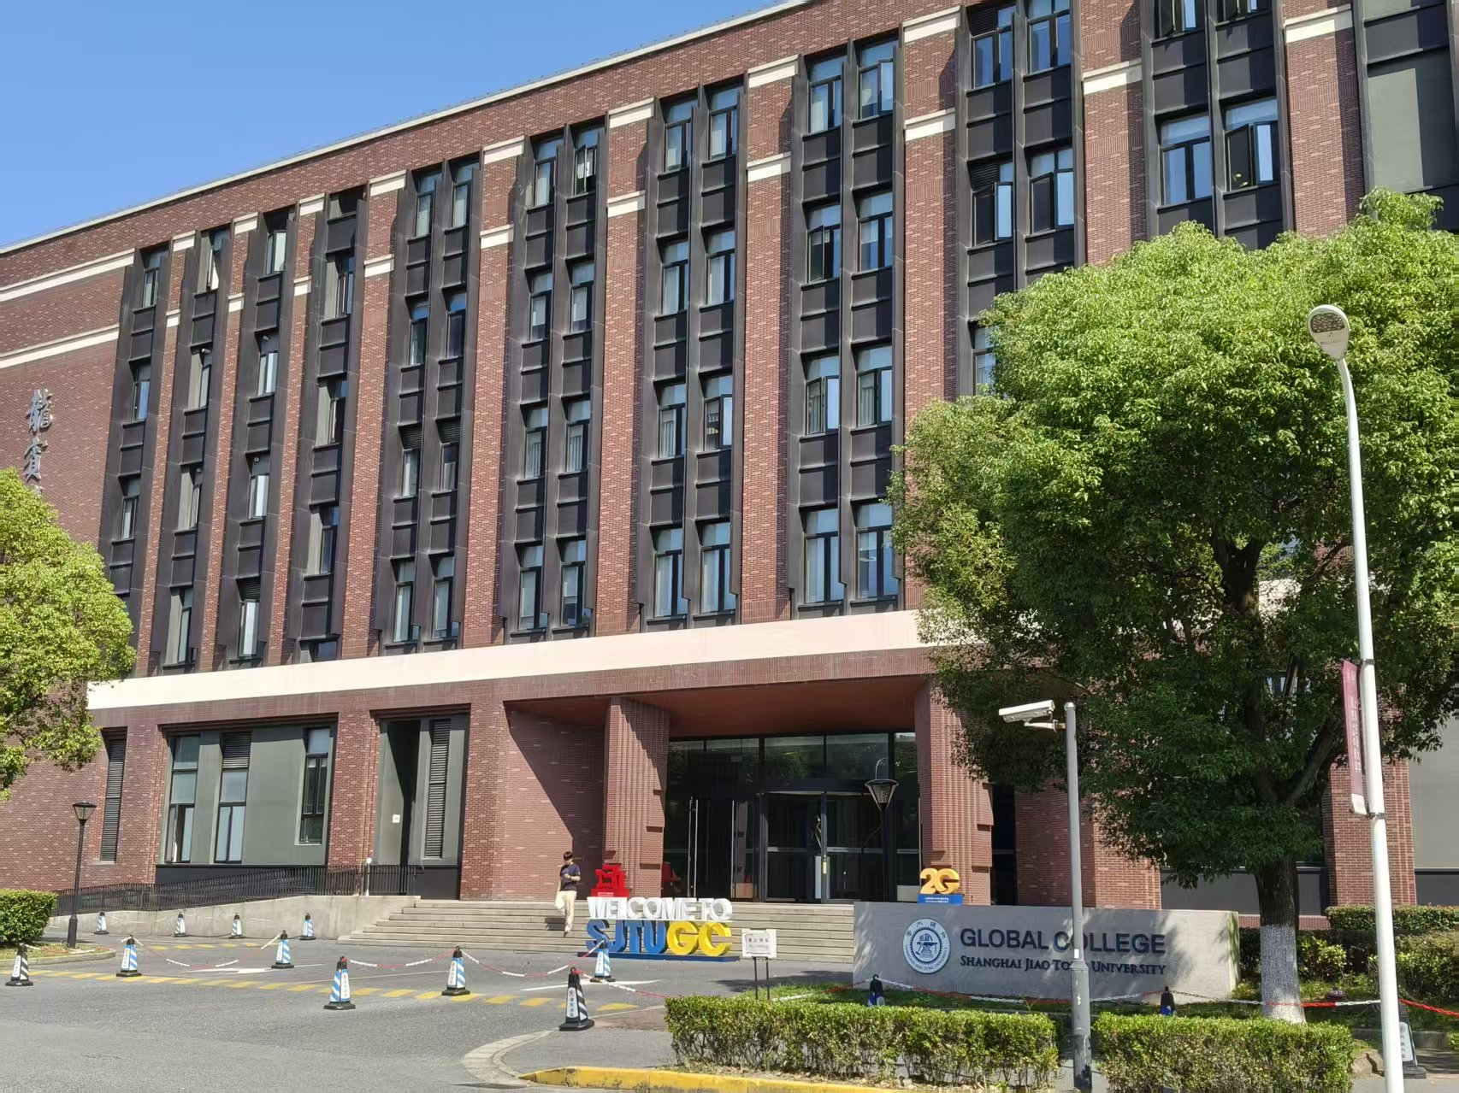
Implementation & Experimental Setup
SurfNeHF
Datasets
Baselines
Scene | Urban Environment | Source
A | Library | SenseMyCity
B | Rectory | SenseMyCity
C | Avenue | SenseMyCity
D | Intersection | SenseMyCity
E | Canyon | SenseMyCity
F | Campus Building | Self-Collected
SaRF (Satellite Radiance Fields) ^{[1]}
Volumetric Radiance & Density Fields
SenseMyCity ^{[2]}
Random-Forest Binary Classification
from Crowdsourced GNSS Traces
Implementation
NVIDIA RTX 3090
SenseMyCity: Labeled Binary Classified Voxels
with a Resolution of 4m (Building or Air)
PyTorch / CUDA 11.8
Scene F: Pixel 4 / 5 / 7, Google GNSS Logger APP
Code & Campus Dataset: Open Source
[1] Zhao et al. SaRF. IMWUT (UbiComp), 2024.
DOI: 10.1145/3678572
[2] Rodrigues & Aguiar. Extracting 3D Maps from Crowdsourced
GNSS Skyview Data. MobiCom, 2019. DOI: 10.1145/3300061.3345456
16
Notes:
Target: 28 seconds
We evaluate five public SenseMyCity scenes and one campus scene. SenseMyCity is both a dataset and a method: the evaluation labels four-metre voxels as building or air. Its baseline uses random forests on crowdsourced GNSS features. SaRF learns volumetric satellite radiance and density fields. Our implementation uses PyTorch, CUDA eleven point eight, and an RTX thirty ninety.
Source: ../3-IMWUT-camera_ready/sample-sigconf.tex. Evaluation Setup lines875–918 and metric definitions966–970/983–994. [1] Zhao, Wang, An and Yang. Crowdsourced Geospatial Intelligence: Constructing 3D Urban Maps with Satellitic Radiance Fields. IMWUT8(3),2024, DOI10.1145/3678572. [2] Rodrigues and Aguiar. Extracting3D Maps from Crowdsourced GNSS Skyview Data. MobiCom2019, DOI10.1145/3300061.3345456. Source ref.bib keys zhao2024crowdsourced and rodrigues2019extracting. Scenes A–E public SenseMyCity, F self-collected Pixel4/5/7,139471 raw samples,70×60×24m building. PyTorch/RTX3090 confirmed by camera-ready; CUDA11.8 supplied by presenter. Metrics on results pages. Code/campus data: https://github.com/SJTU-NetSense-Lab/SurfNeHF . Public A–E datasets require local preparation. SenseMyCity is both the public dataset and a random-forest voxel occupancy baseline (source Section6, line642). Evaluation labels classify 4m voxels as building/air; 4m resolution supplied by presenter. SaRF learns volumetric radiance and density fields.

Slide 15













Voxel-Level Reconstruction
SurfNeHF
GT
SurfNeHF
SaRF
SenseMyCity
Voxel F1 Score (%) ↑
A Library
B Rectory
C Avenue
SurfNeHF
SaRF
SenseMyCity
18
Notes:
Target: 15 seconds
The first three scenes compare visual reconstructions and voxel F one scores. F one combines occupied-voxel precision and recall. SurfNeHF has the highest reported F one in each scene.
Source: ../3-IMWUT-camera_ready/sample-sigconf.tex. Qualitative result PDFs and f1_score.pdf. Plot F1 A–E: Surf94.6/92.3/85.1/84.2/86.0, SaRF84.5/84.3/80.4/69.4/81.5, SMC59.1/72.8/51.7/48.1/73.9. Scene F97.5/76.7/NA from ablation_pruning. Missing SMC is blank, not zero. Mean89.95 rounded90.0 is arithmetic mean of published rounded plotted F1 values, not paper mean94.6 balanced accuracy. Published B plot92.3 differs from F1 derived from its precision/recall; use the published plot value.

Slide 16








Voxel-Level Reconstruction
SurfNeHF
GT
SurfNeHF
SaRF
SenseMyCity
Voxel F1 Score (%) ↑
D
Intersection
E Canyon
SurfNeHF
SaRF
SenseMyCity
SurfNeHF Has the Highest F1 in Scene A~F
18 (Cont.)
Notes:
Target: 13 seconds
The remaining scenes give the same result. SenseMyCity has no reported campus result. The next table includes all balanced accuracy, recall and precision values.
Source: ../3-IMWUT-camera_ready/sample-sigconf.tex. Qualitative result PDFs and f1_score.pdf. Plot F1 A–E: Surf94.6/92.3/85.1/84.2/86.0, SaRF84.5/84.3/80.4/69.4/81.5, SMC59.1/72.8/51.7/48.1/73.9. Scene F97.5/76.7/NA from ablation_pruning. Missing SMC is blank, not zero. Mean89.95 rounded90.0 is arithmetic mean of published rounded plotted F1 values, not paper mean94.6 balanced accuracy. Published B plot92.3 differs from F1 derived from its precision/recall; use the published plot value.

Slide 17
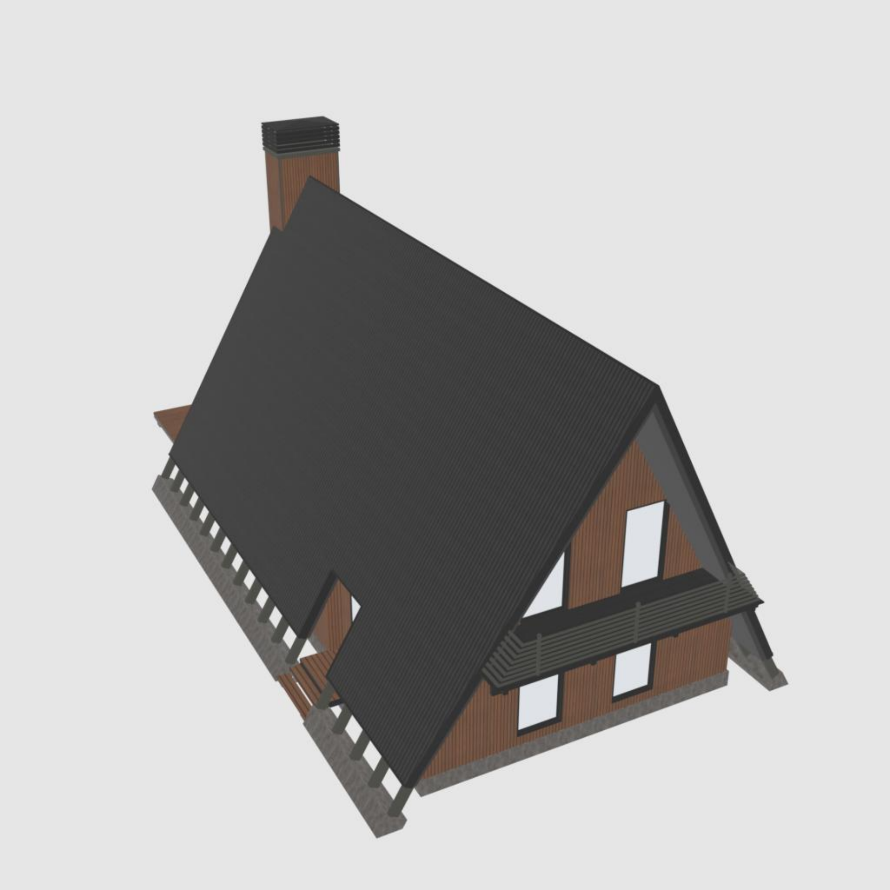
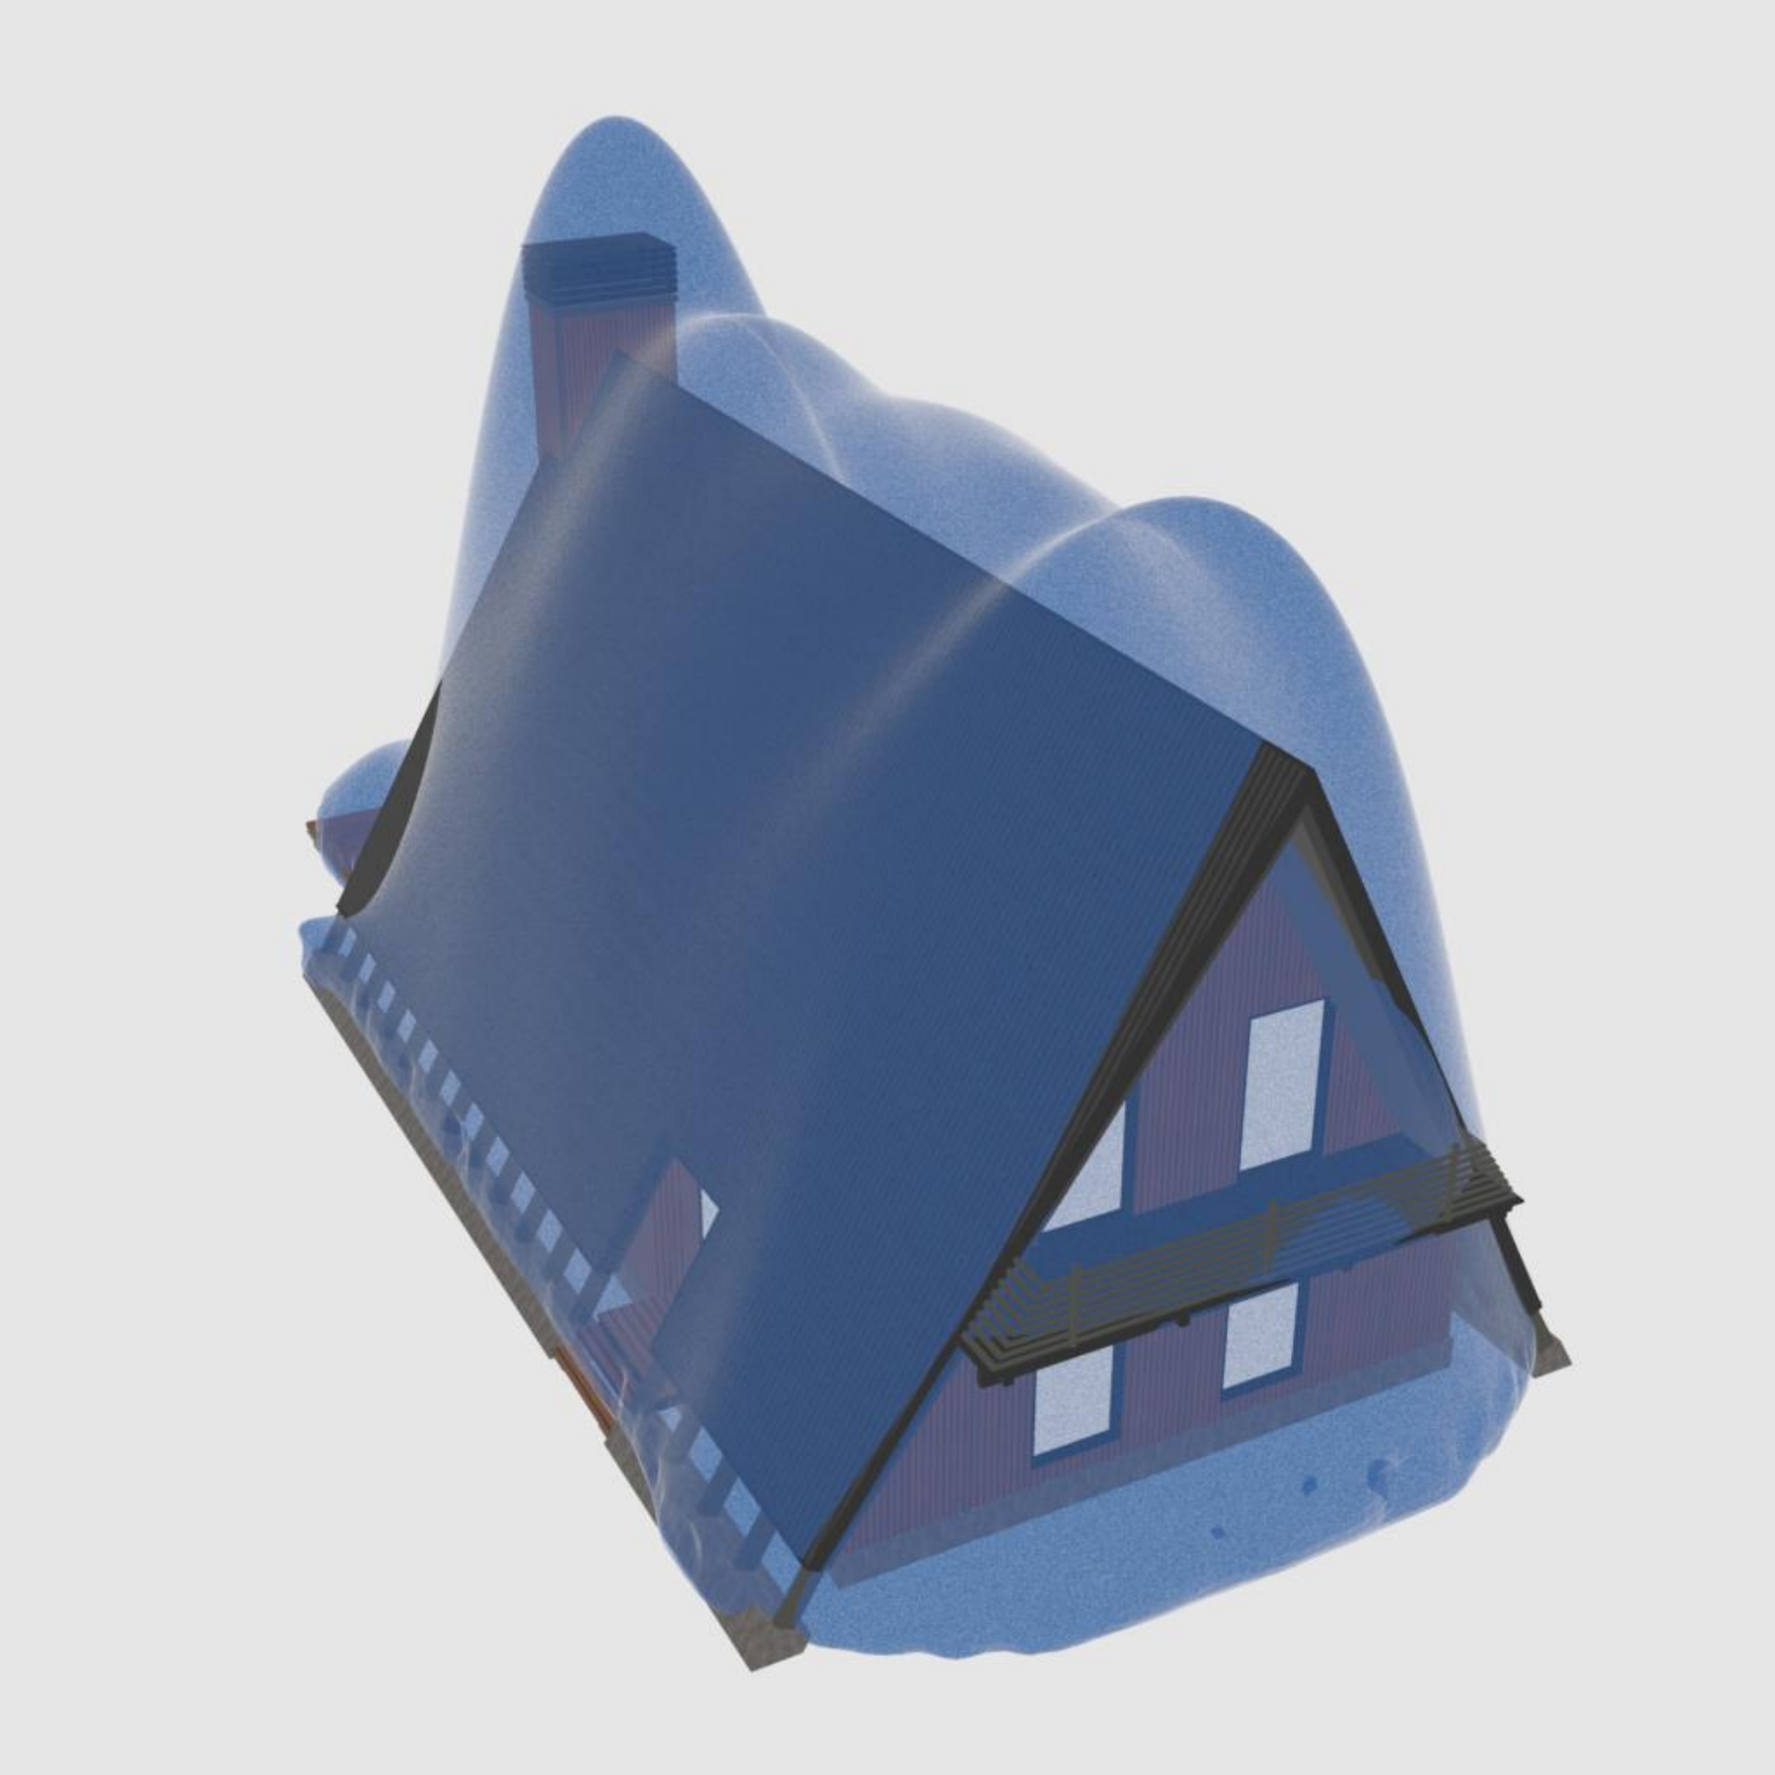
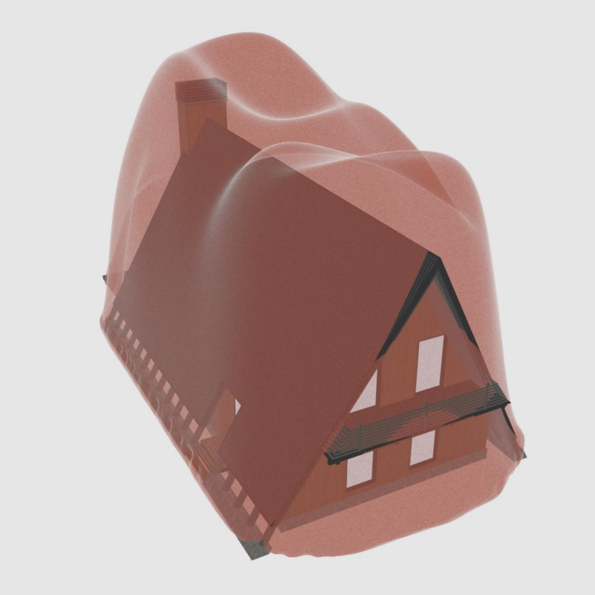
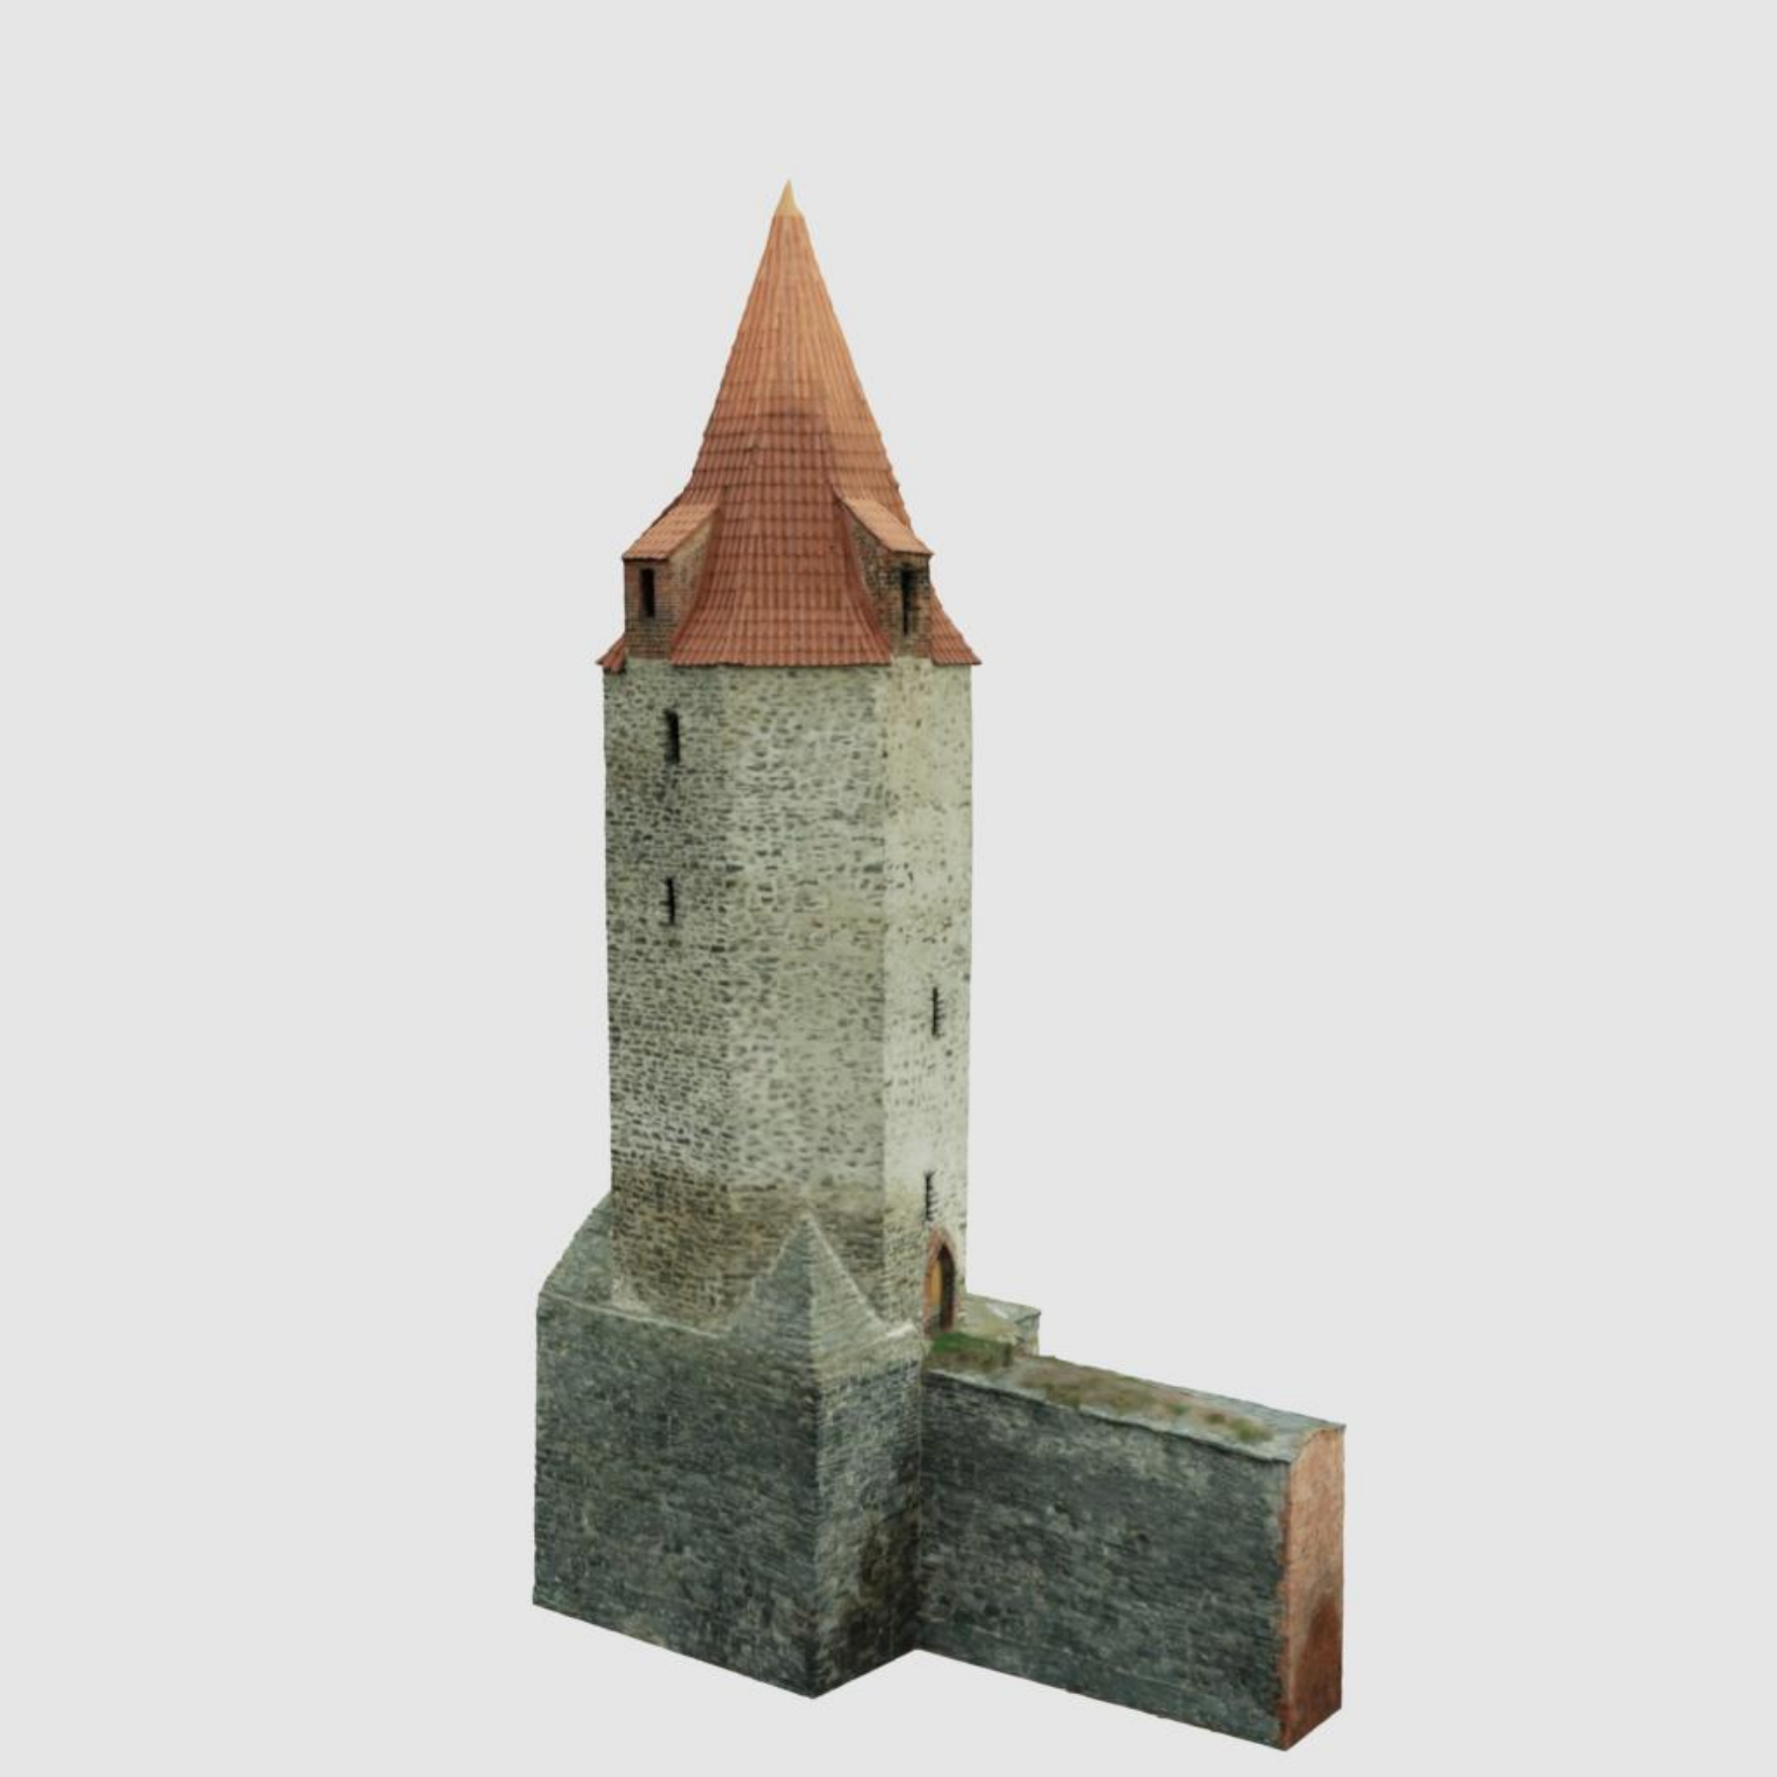
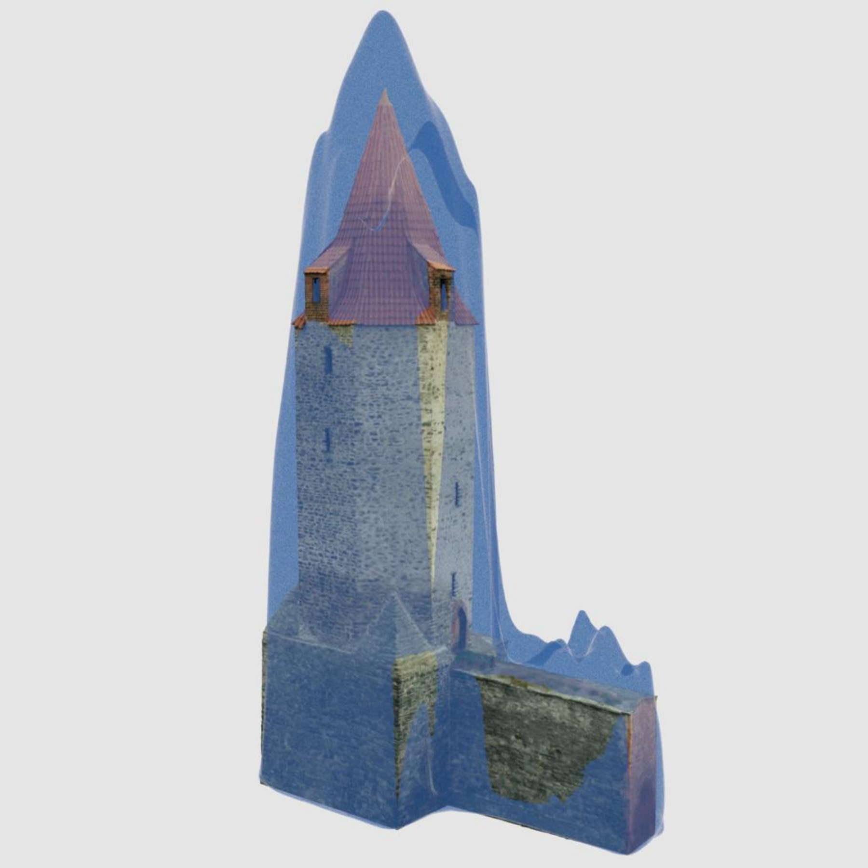
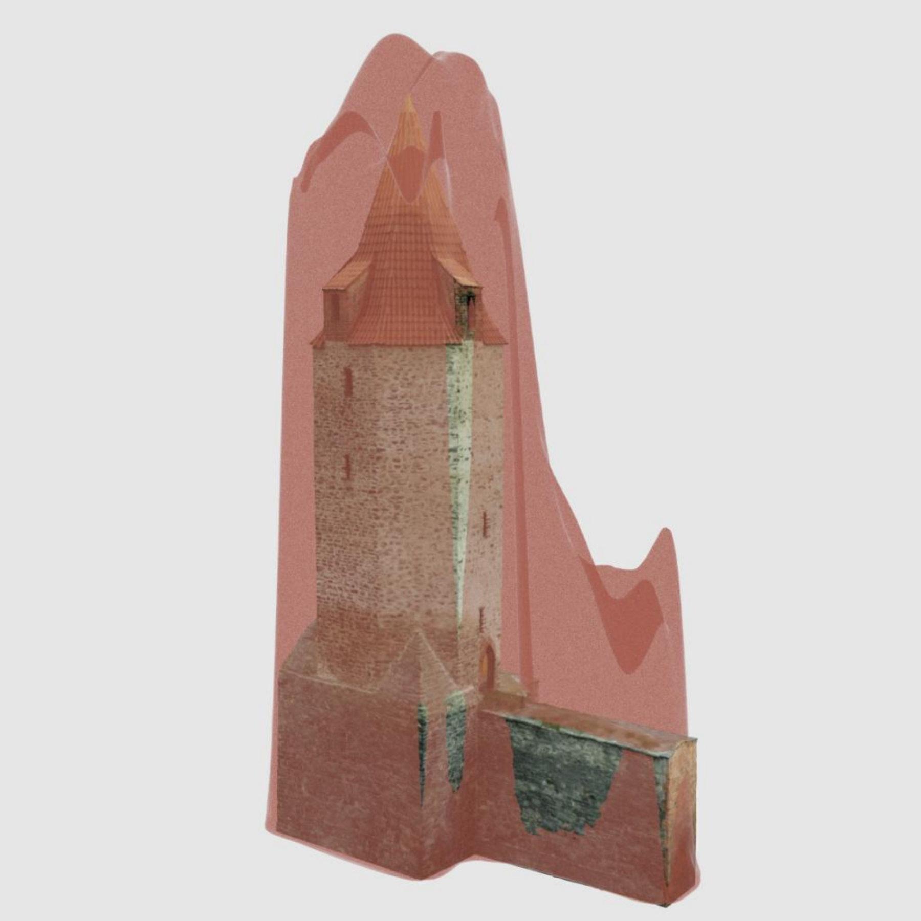
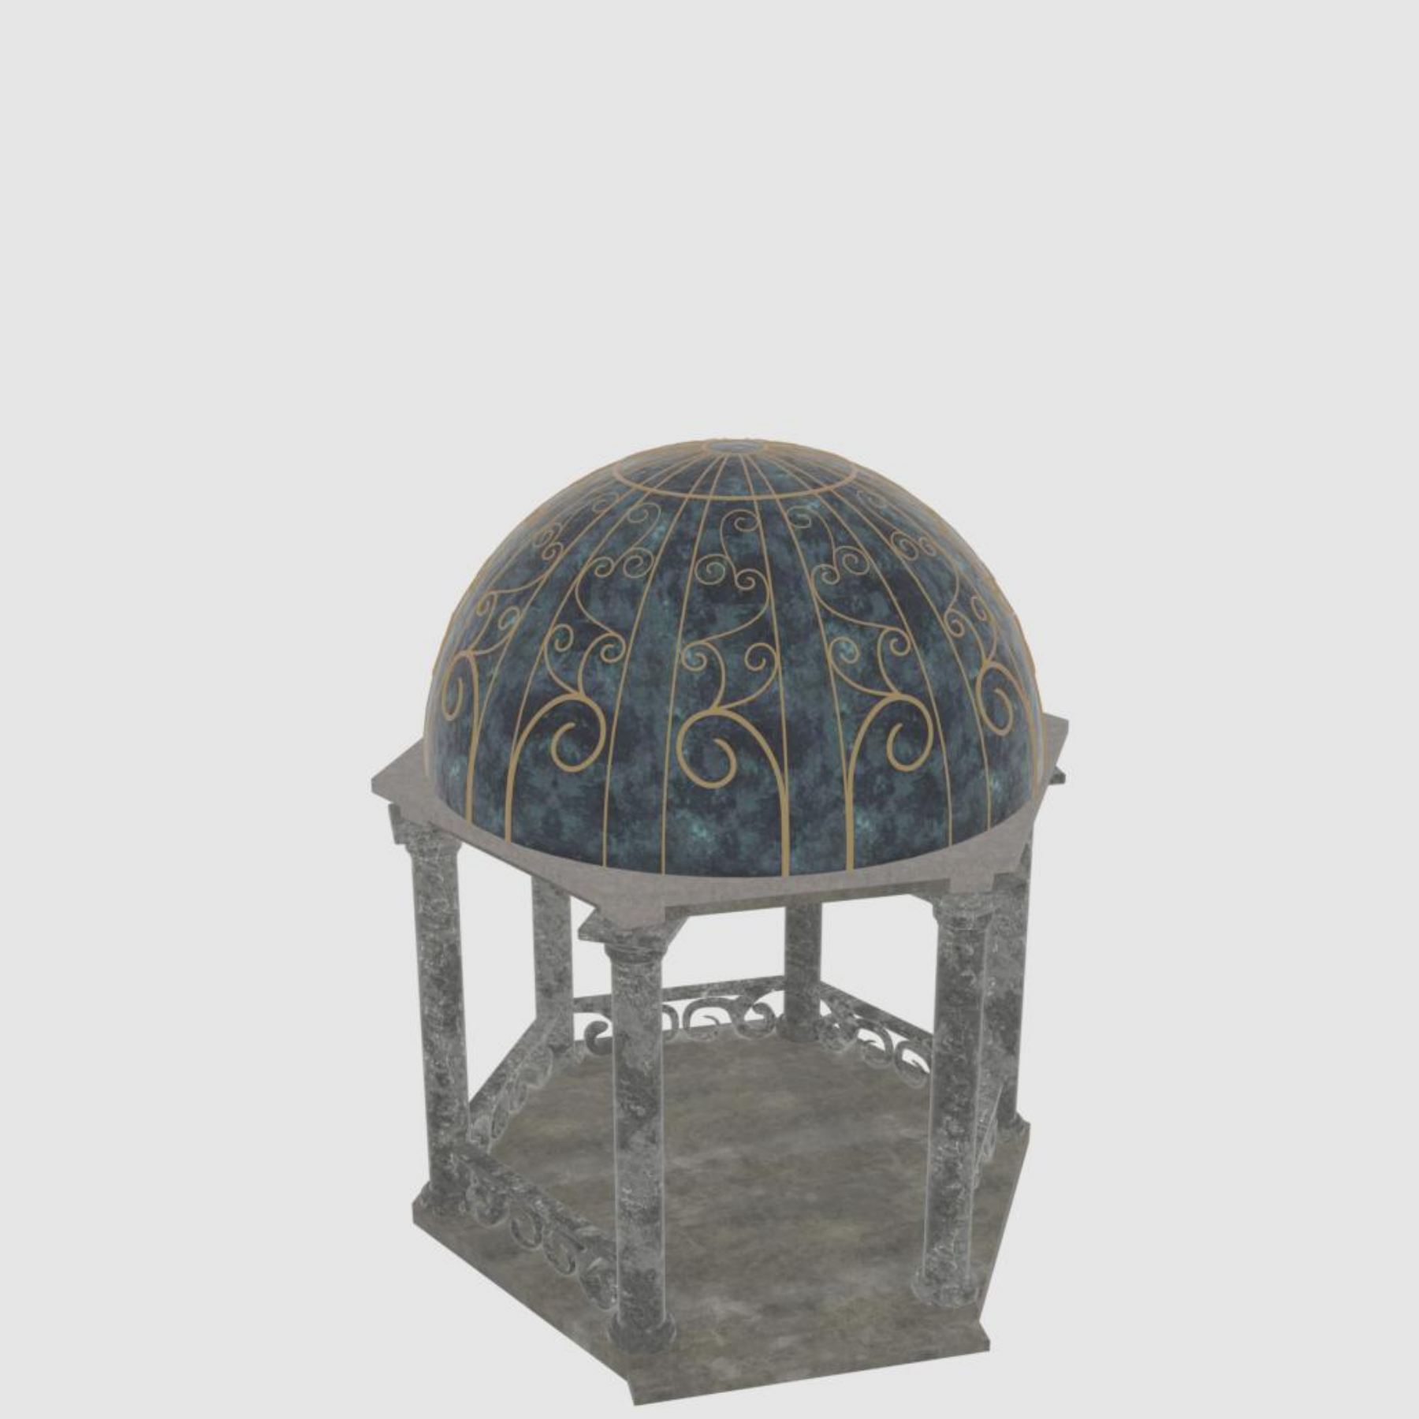
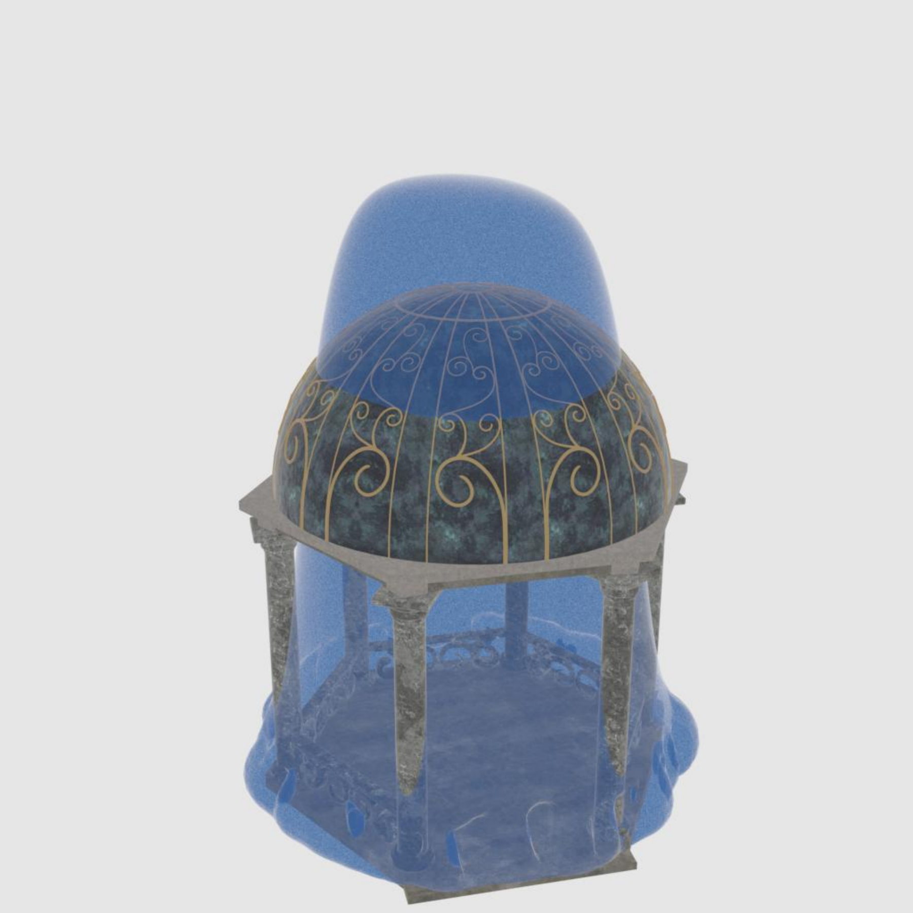
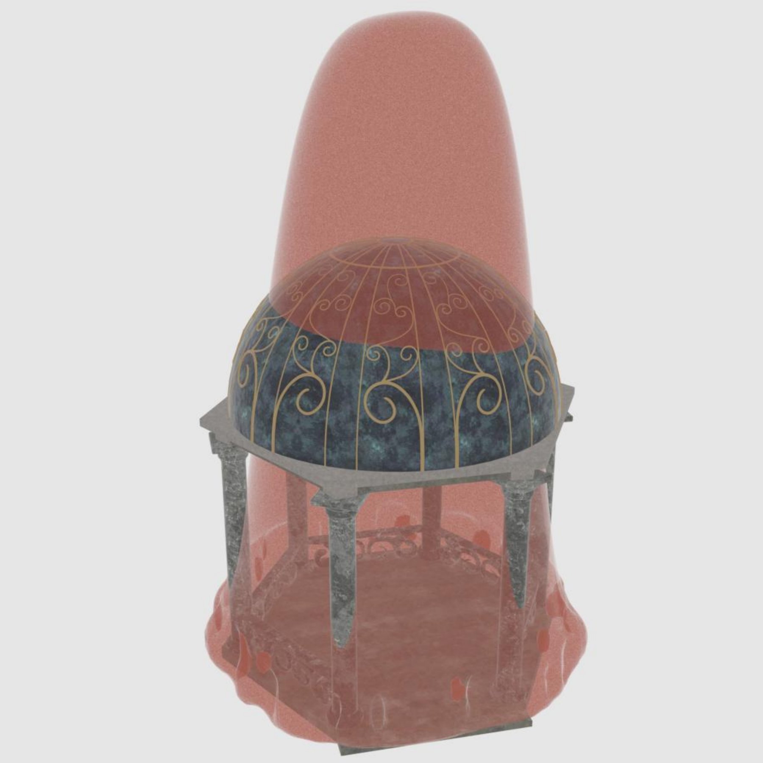
Surface-Level Reconstruction
SurfNeHF
Controlled Experiments in Sionna
Surface-Level Reconstruction Results
GT
Clean
Noisy
Shape / Input | Accu ↑ (%) | F1 ↑ (%) | IoU ↑ (%) | Chamfer L1 ↓ (m)
A-Frame Clean | 94.0 | 84.8 | 73.6 | 1.80
A-Frame Noisy | 85.9 | 72.7 | 57.1 | 2.92
Tower Clean | 94.5 | 88.9 | 80.1 | 0.759
Tower Noisy | 90.6 | 82.6 | 70.4 | 1.13
Temple Clean | 77.3 | 85.7 | 60.1 | 0.531
Temple Noisy | 63.6 | 60.7 | 43.2 | 0.694
A-Frame
Tower
Temple
1.31 m Mean Chamfer L1 across 6 Controlled Scenes in Sionna
20
Notes:
Target: 20 seconds
The controlled shapes now pair with their own clean and noisy results in Table six. All four metrics are shown. Across these six conditions, mean Chamfer distance is 1.31 metres. Noise affects the complex temple more strongly.
Source: ../3-IMWUT-camera_ready/sample-sigconf.tex. Camera-ready Figure 21 controlled-shape GT/clean/noisy images paired only with Table 6 (tab:iou_chamfer_clean_noisy), including all four metrics and six conditions. Noise standard deviations: position 3m, power 3dB, angle 1degree. Mean Chamfer L1 1.3057m, rounded 1.31m. Campus Table 3 is retained on its separate backup page.

Slide 18
Component Ablation Study
SurfNeHF
Results obtained from Scene F, ΔF1 (Percentage Points) = F1 (w/o) − F1 (Full)
Configuration | Accu. ↑ (%) | F1 ↑ (%) | ΔF1 (Points) | Chamfer L1 ↓ (m) | IoU ↑ (%)
Full SurfNeHF | 97.6 | 97.5 | 0.0 | 1.81 | 95.1
w/o Multipath Sampling | 78.0 | 71.7 | −25.8 | 6.82 | 55.9
w/o Spatially Varying Neural BRDF | 79.9 | 74.9 | −22.6 | 6.27 | 59.9
w/o Data Pre-Processing | 89.3 | 86.4 | −11.1 | 5.60 | 76.0
Larger F1 Reductions Indicate Larger Contributions
21
Notes:
Target: 20 seconds
Larger F one reductions show stronger contributions in this campus ablation. Removing multipath costs 25.8 percentage points, replacing the spatially varying neural BRDF costs 22.6, and removing preprocessing costs 11.1. The table includes all reported metrics.
Source: ../3-IMWUT-camera_ready/sample-sigconf.tex. Camera-ready Table5 (tab:ablation_components). Full metrics reproduced and component removals sorted by descending F1 reduction: multipath25.8, spatially varying neural BRDF22.6, preprocessing11.1 percentage points. ΔF1 is ablated minus full, not a relative percent decrease. w/oNeuralBRDF means constant global reflectance, and w/oMultipath uses LOS only. Ranking applies to this Scene F ablation.

Slide 19
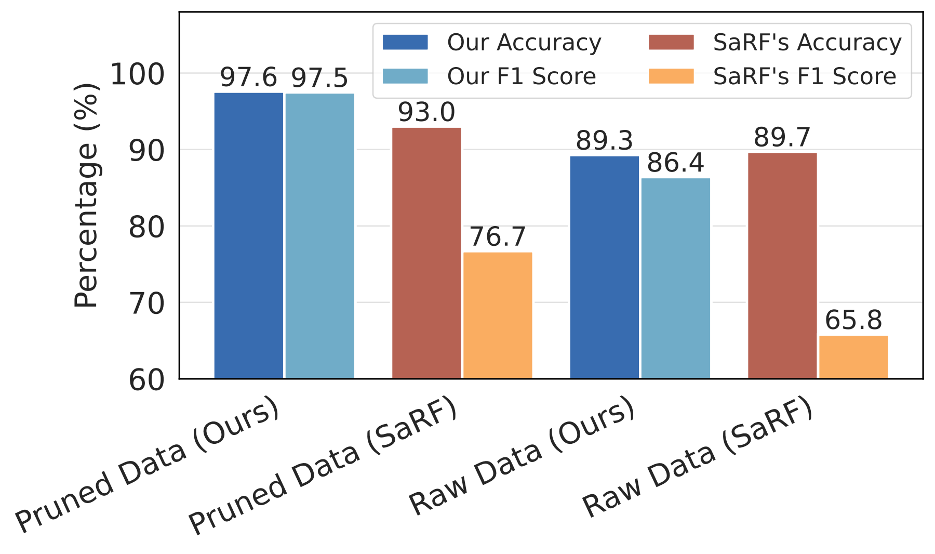
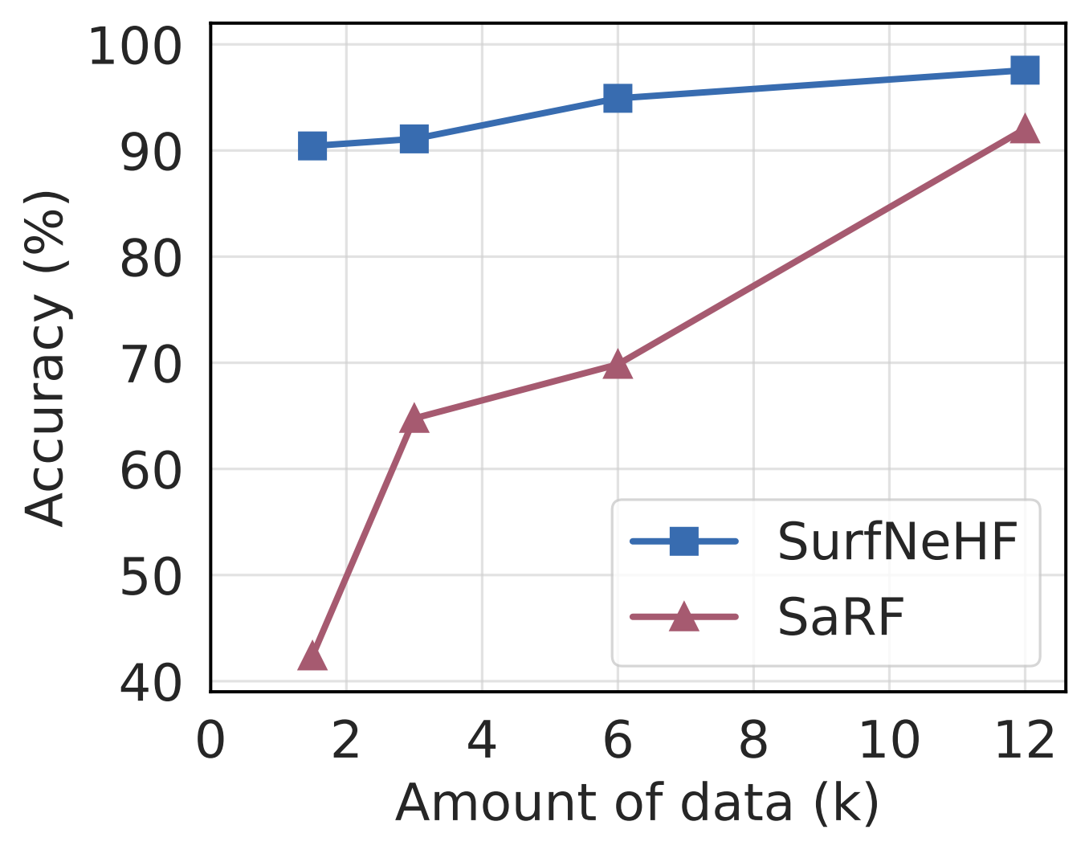
Data Pre-Processing & Data Efficiency
SurfNeHF
Raw vs. Pruned Data: Scene F
Accuracy under Different Data Amounts
Raw SurfNeHF F1: 86.4%
Pruned SaRF F1: 76.7%
Above 90% Balanced Accuracy
with About 1.5k Samples
22
Notes:
Target: 24 seconds
On the left, both methods benefit from pruning, yet raw SurfNeHF still exceeds pruned SaRF in F one. On the right, we vary the amount of pruned training data. About fifteen hundred samples retain over 90 percent balanced accuracy. Our surface representation therefore achieves better data efficiency.
Source: ../3-IMWUT-camera_ready/sample-sigconf.tex. Camera-ready Figure16 ablation_pruning.pdf and ablation_scalability.pdf. Fully pruned SurfNeHFBA97.6/F197.5; prunedSaRFBA93.0/F176.7; rawSurfNeHFBA89.3/F186.4; rawSaRFBA89.7/F165.8. The rawSurfNeHF comparison exceeds prunedSaRF in F1 only, not BA. Right panel is camera-ready Figure19, trained on randomly selected subsets of the pruned Scene F data. More than90% balanced accuracy with around1.5k samples demonstrates data efficiency. Rule breakdown Figure16(b) moved to its own backup.

Slide 20
System Efficiency
SurfNeHF
RTX 3090, Batch 16 Pre-Processing: Takes Only About 87 Seconds
Metric | SaRF | SurfNeHF | Reduction
Training Time (h) | 8.2 | 1.3 | 84.1%
Peak Memory (GB) | 9.90 | 1.87 | 81.1%
Model Size (MB) | 2.41 | 0.027 | 98.9%
Per-Batch FLOPs (G) | 831.34 | 8.58 | 99.0%
Runtime (ms / batch) | 109.78 | 14.97 | 86.4%
1.3 Hours
Lower System Overhead
84.1% Less Training Time
23
Notes:
Target: 23 seconds
Training on Scene F takes 1.3 hours instead of 8.2, an 84.1 percent reduction. Peak memory drops 81.1 percent. Model size, FLOPs and batch runtime also decrease. Comparisons use the same RTX 3090 and batch size; preprocessing adds about 87 seconds.
Source: ../3-IMWUT-camera_ready/sample-sigconf.tex. System Efficiency Table4Section8.3.1. Matchedbatch16RTX3090. Preprocessingnotincludedintraining1.3h, costs0.024h≈87sec. Configs typically1–2hperscene, early>90%accuracy0.2–0.5h. Notcompletecitytime.

Slide 21
Conclusions & Key Takeaways
SurfNeHF
SurfNeHF enables efficient 3D urban mapping from crowdsourced GNSS data.
Fully differentiable RF inverse rendering separately recovers building geometry, surface reflectance and satellite parameters.
Experiments show higher reconstruction accuracy with less training data and lower computational costs.
94.6%
≈8×
−80~90%
Mean Balanced Accuracy
+10.8 Percentage v.s. SOTA
Better Data Efficiency
~1.5k vs. ~12k Samples
at >90% Balanced Accuracy
Lower System Overhead
v.s. SOTA
24
Notes:
Target: 21 seconds
Compact height-field surfaces, disentangled physical factors and differentiable inverse rendering produce both accuracy and efficiency. Mean balanced accuracy is 94.6 percent, 10.8 percentage points above SaRF. Reported training, memory and runtime overhead falls by about 80 to 90 percent.
Source: ../3-IMWUT-camera_ready/sample-sigconf.tex. Camera-ready Abstract: average balanced accuracy94.6% vsSaRF83.8% and80–90% lower computational overhead. +10.8 percentage points is derived from rounded reported means. Overhead range refers to trainingtime84.1%,peakmemory81.1%,runtime86.4%, not modelsize98.9%/FLOPs99.0%. Responseletter attributes advantages to compact surface NeHF, disentangled formulation and fullydifferentiable inverse rendering.

Slide 22



Codes, Data Sets & Contact
SurfNeHF
Thank You!
Q&A
Codes
& Datasets
Haifeng Ethan Jia
Personal Homepage
NetSense Lab
Professor Yibo Pi
https://github.com/
SJTU-NetSense-Lab/SurfNeHF
https://haifengjia.github.io/
https://yibopi.github.io/
25
Notes:
Target: 15 seconds
Thank you. These three QR codes link to our datasets and code, my homepage, and our lab contact through Professor Yibo Pi. I welcome your questions and further discussions.
Source: ../3-IMWUT-camera_ready/sample-sigconf.tex. Exact resource URL payloads: https://github.com/SJTU-NetSense-Lab/SurfNeHF ; https://haifengjia.github.io/ ; https://yibopi.github.io/ . Third URL is the homepage of Prof.Yibo Pi supplied by the presenter as lab contact. All codes use Q error correction and four-module white quiet zones. Resource/contact title in the title band; Thank You and Q&A centered in the main body.

Slide 23


Fully Differentiable RF-Domain Rendering:
Shadow Rendering
SurfNeHF
Soft Visibility $v$
Blocked Path
Visible Path
Surface Hit
where zₕ is Ray Height, and zₛ is NeHF Height
RX
Visibility Determines Whether a Candidate Path Contributes
11
Notes:
Target: 21 seconds
Sampling finds a candidate surface hit. The reflected path still needs a clear segment toward the satellite. Blue shows a valid satellite-to-surface-to-receiver path; orange is blocked. The shadow renderer compares ray and NeHF heights, using sigmoid and softmax to produce continuous visibility and suppress blocked-path power.
Source: ../3-IMWUT-camera_ready/sample-sigconf.tex. Camera-ready Shadow Estimation573–586. Surface-aware sampling has already located a first receiver-surface hit, giving a clear receiver-to-hit segment under the one-interaction model. Shadow renderer additionally queries NeHF along the hit-to-satellite segment; blocking suppresses reflected-path power. Two source rays and one surface-hit/RX pair illustrate clear vs blocked complete paths, not only direct RX LOS. Formula uses u_k to abbreviate source sigmoid; soft visibility is continuous, not exactly Boolean. Same40logicalpx principal equation scale. Receiver is a GNSS device, not a UAV in this paper.

Slide 24
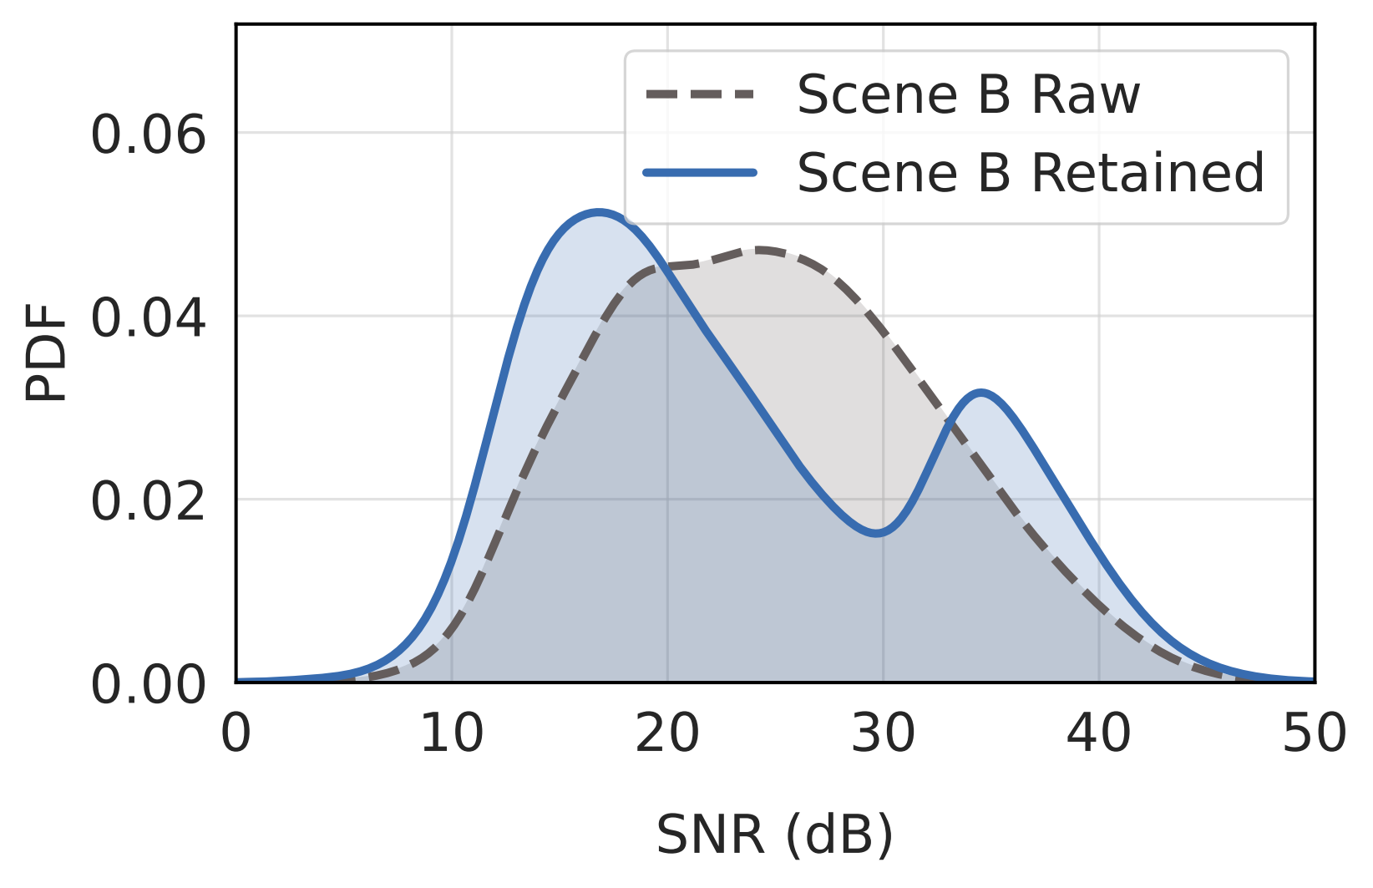
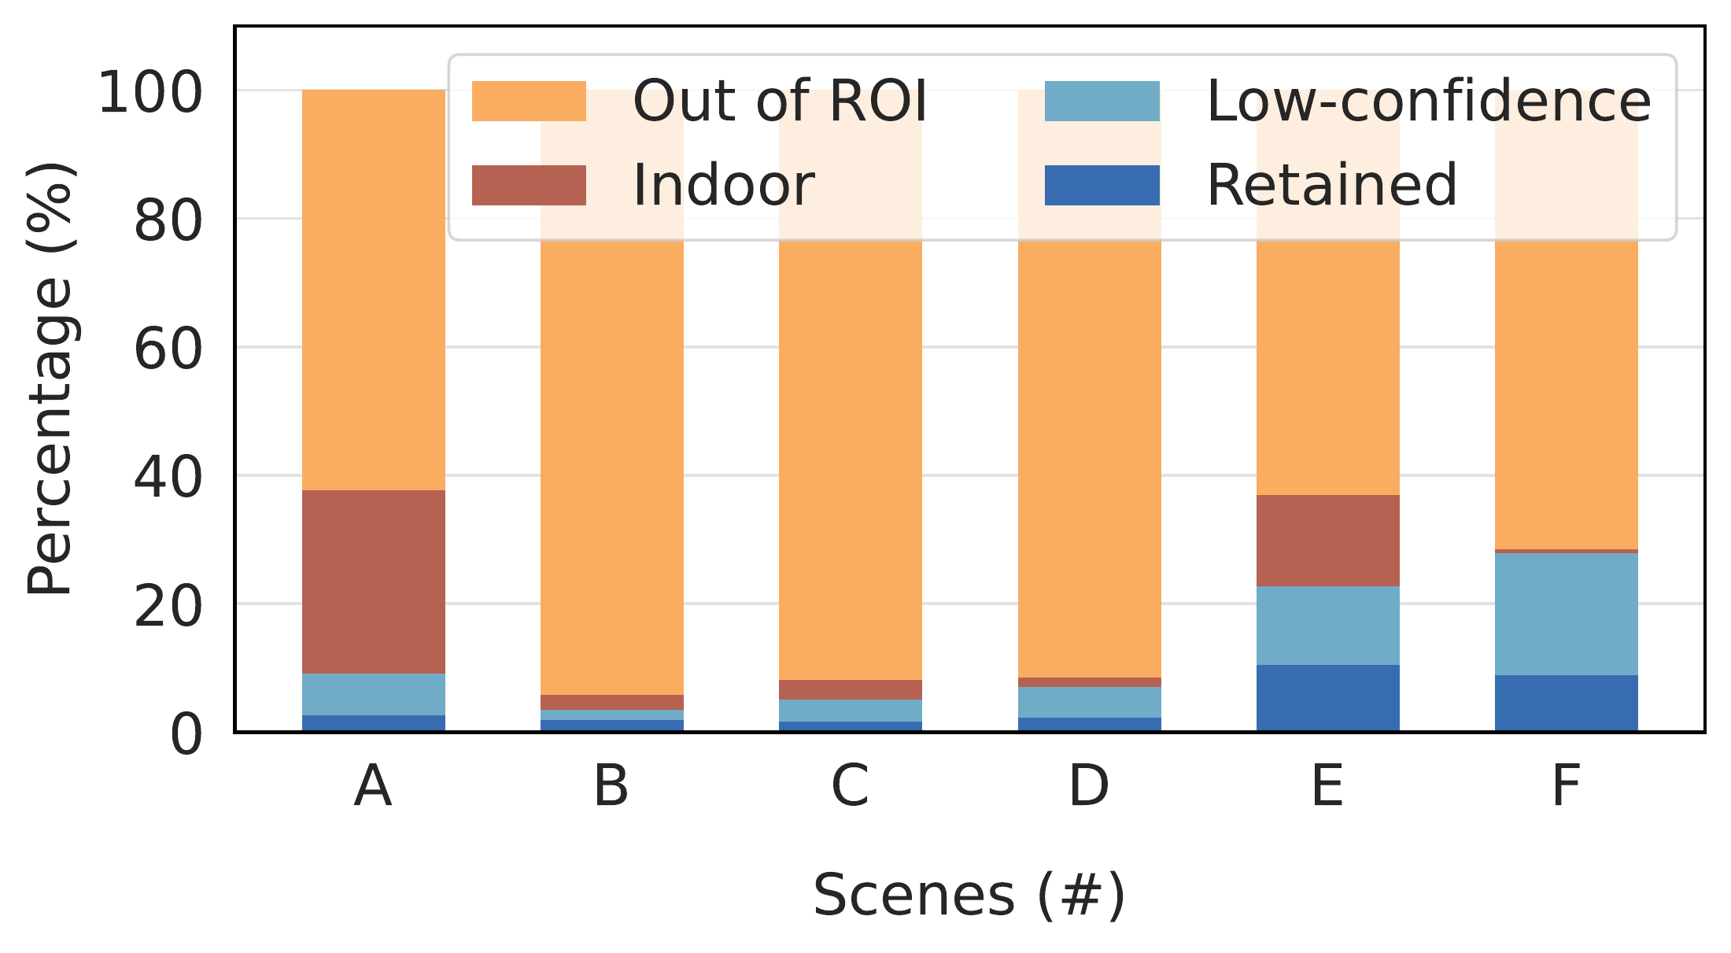
Data Pre-Processing: Quantitative Results
SurfNeHF
SNR Distribution: Raw vs. Retained
Data Sample Composition
Pruning Reveals LOS / NLOS Peaks
Retained Data: 1.6%–10.4%
B02
Notes:
Supplement after Thank You, outside the timed talk
Pruning clarifies the two SNR modes in Scene B. The right plot shows why data are removed across all six scenes. Retention is conservative and includes scope filtering.
Source: ../3-IMWUT-camera_ready/sample-sigconf.tex. Camera-ready Figure 10, labels fig:data-pruning-showcase, fig:data-pruning-1 and fig:data-pruning-2. Exact source PDFs snr_pdf.pdf and pruning_breakdown.pdf. Distribution is Scene B; composition includes A–F. Retention includes ROI and indoor scope filtering, not only erroneous measurements.

Slide 25
Datasets and Retention
SurfNeHF
Scene | Raw Samples | Retained | Retention (%)
A Library | 17,068,583 | 324,539 | 1.90
B Rectory | 2,584,186 | 68,938 | 2.67
C Avenue | 5,804,860 | 97,551 | 1.68
D Intersection | 1,832,374 | 40,693 | 2.22
E Canyon | 121,436 | 12,657 | 10.42
F Campus Facility Building | 139,471 | 12,429 | 8.91
B09
Notes:
Supplement after Thank You, outside the timed talk
The table preserves all six scene sample counts. Retention includes scope filters as well as low-confidence pruning, so all discarded samples must not be described as erroneous.
Source: ../3-IMWUT-camera_ready/sample-sigconf.tex. Table1 datasetpruning. RetentionincludesROI/indoor/lowconfidencecategories.

Slide 26
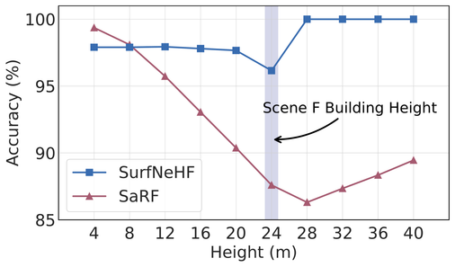
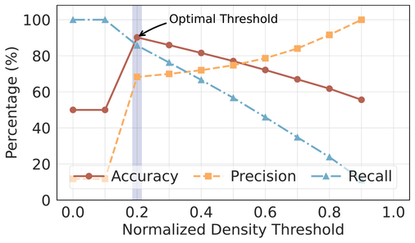
Height Estimation & Threshold Selection
SurfNeHF
Accuracy Across Height Levels: Scene F
SaRF: Sensitivity to Density Threshold
SurfNeHF Preserves Accuracy Across Heights
SaRF Requires Scene-Specific Threshold Selection
B04
Notes:
Supplement after Thank You, outside the timed talk
This tests our motivation: SurfNeHF stays accurate across height levels, while SaRF degrades near the roof and depends strongly on the chosen density threshold. Finding the optimal threshold here requires ground truth. Explicit surfaces avoid this threshold selection.
Source: ../3-IMWUT-camera_ready/sample-sigconf.tex. Camera-readyFigure18 AccuracyofHeightEstimationanditsImpactingFactors. LeftSceneFheightaccuracySurfNeHF/SaRF; rightonlySaRFthresholds. Itsoptimalnormalizeddensitythresholdis0.2forthisscene, groundtruthunavailableforrealdeployment. SurfNeHFdirectlymodelsheightwithoutdensitythreshold.

Slide 27
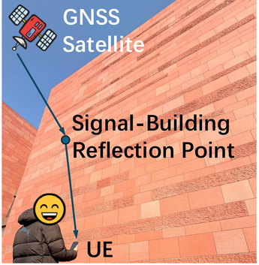
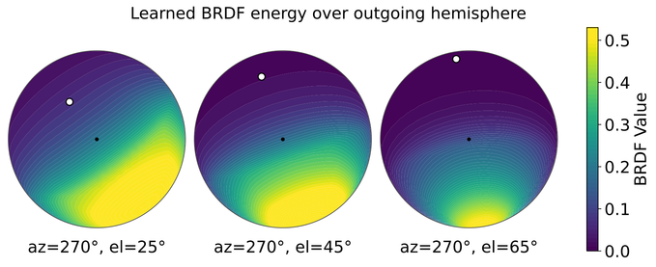
BRDF Interpretation
SurfNeHF
Brick-Wall Reflection
Learned Directional Response
The Reflection Lobe Shifts With Incident Direction
Higher Elevation Produces a Narrower Lobe
B01
Notes:
Supplement after Thank You, outside the timed talk
For a brick-wall reflection, the learned outgoing lobe shifts with incident direction and becomes narrower at higher elevation. This is qualitative physical plausibility, rather than quantitative material ground-truth recovery. It shows meaningful directional behaviour. We next test how much the material model contributes to reconstruction.
Source: ../3-IMWUT-camera_ready/sample-sigconf.tex. BRDF Interpretation Section8.5. Qualitative physical plausibility of learned continuous response, not semantic material classes or quantitative material groundtruth validation. Original azimuth270°, elevations25/45/65°.

Slide 28
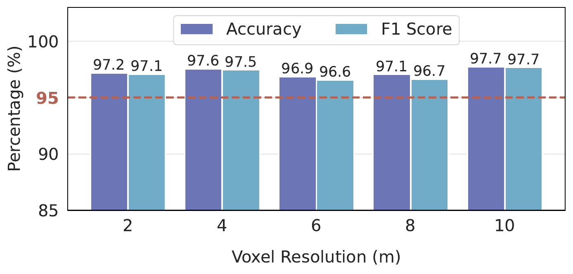
Voxel Resolution Sensitivity
SurfNeHF
Scene F / Evaluation Voxels: 2–10 m
F1 Stays above 96% across the Tested Voxel Resolutions
B05
Notes:
Supplement after Thank You, outside the timed talk
In Scene F, balanced accuracy stays near 97 percent and F one above 96 percent across the tested two-to-ten-metre evaluation voxels. This supplementary result measures sensitivity to evaluation discretization.
Source: ../3-IMWUT-camera_ready/sample-sigconf.tex. Camera-ready Figure20, fig:voxel_resol. Stability across tested2–10m voxels in SceneF. SNR distribution removed from this page and kept with complete Figure10 in the preprocessing-statistics backup.

Slide 29
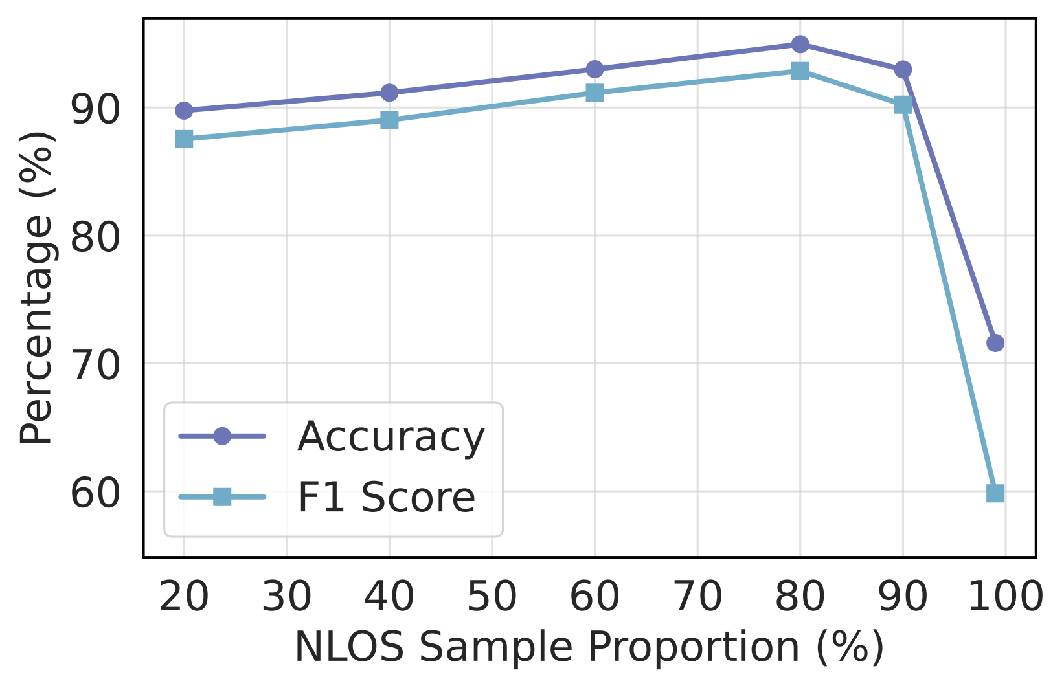
NLOS Proportion Sensitivity
SurfNeHF
NLOS Proportion: Scene B
LOS References Remain Necessary
B06
Notes:
Supplement after Thank You, outside the timed talk
Scene B benefits from reflected observations, but near-complete removal of direct-path references degrades performance. These are the original NLOS-proportion curves; data-amount results appear once in the main talk.
Source: ../3-IMWUT-camera_ready/sample-sigconf.tex. Camera-ready NLOS Sensitivity Section8.2.3. SceneB, peak around80%NLOS and substantial degradation at99%. Data-amount panel is in main and is not repeated here.

Slide 30
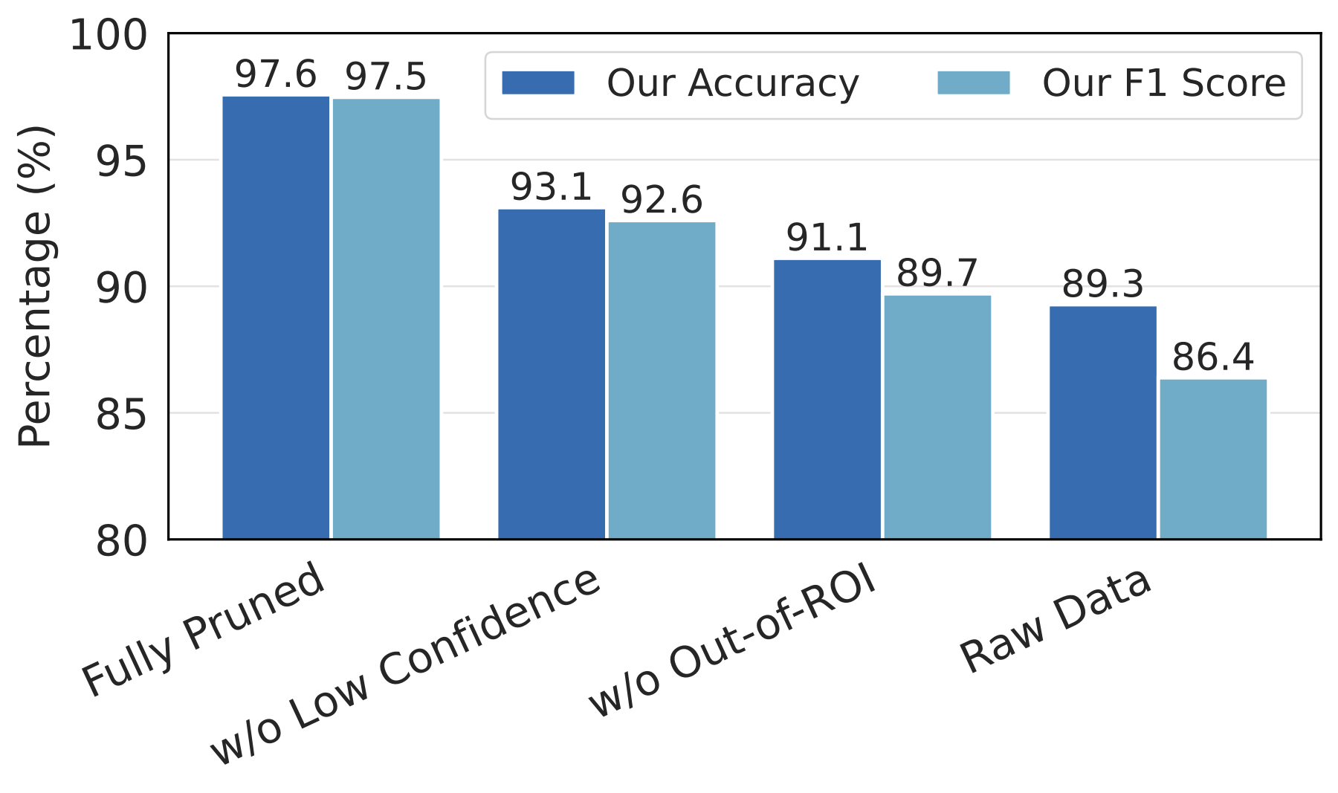
Pruning Rule Ablation Study
SurfNeHF
Scene F: Contribution of Pruning Rules
Each Pruning Rule Contributes to Reconstruction Accuracy
B07
Notes:
Supplement after Thank You, outside the timed talk
Removing low-confidence pruning lowers F one to 92.6 percent; removing out-of-region pruning lowers it to 89.7, compared with 97.5 for the complete preprocessing pipeline. This unique backup breaks down each rule.
Source: ../3-IMWUT-camera_ready/sample-sigconf.tex. Figure16(b), ablation_scalability.pdf. F1 full97.5,w/oLowConfidence92.6,w/oROI89.7,raw86.4. Main page retains only Figure16(a) and data-amount Figure19; no repeated raw/pruned plot here.

Slide 31
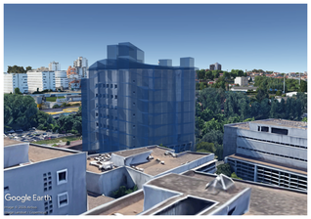
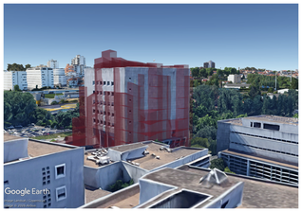
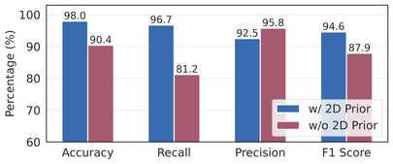
2D Prior Ablation
SurfNeHF
Scene A: Accurate and GNSS-Derived 2D Priors
Accurate 2D Prior
GNSS-Derived Prior
F1 94.6%
F1 87.9%
Coarse Priors Remain Effective
B08
Notes:
Supplement after Thank You, outside the timed talk
On Library, replacing an accurate external footprint map with a coarse GNSS-derived prior lowers F 1 from 94.6 to 87.9 percent, but the reconstruction remains useful. This is not an experiment with absolutely no prior: the coarse prior is still present. It shows that a high-quality external map helps, while GNSS-derived footprints provide an alternative.
Source: ../3-IMWUT-camera_ready/sample-sigconf.tex. 2D Prior Ablation Section8.4.1. The paper plot labelw/o2DPrior means withoutaccurateexternal2Dmap; coarseGNSSderivedpriorstillused. FullSurfF194.6 vscoarse87.9, minus6.7 percentage points in Scene A. Not a zero-prior experiment.

