Slide 1

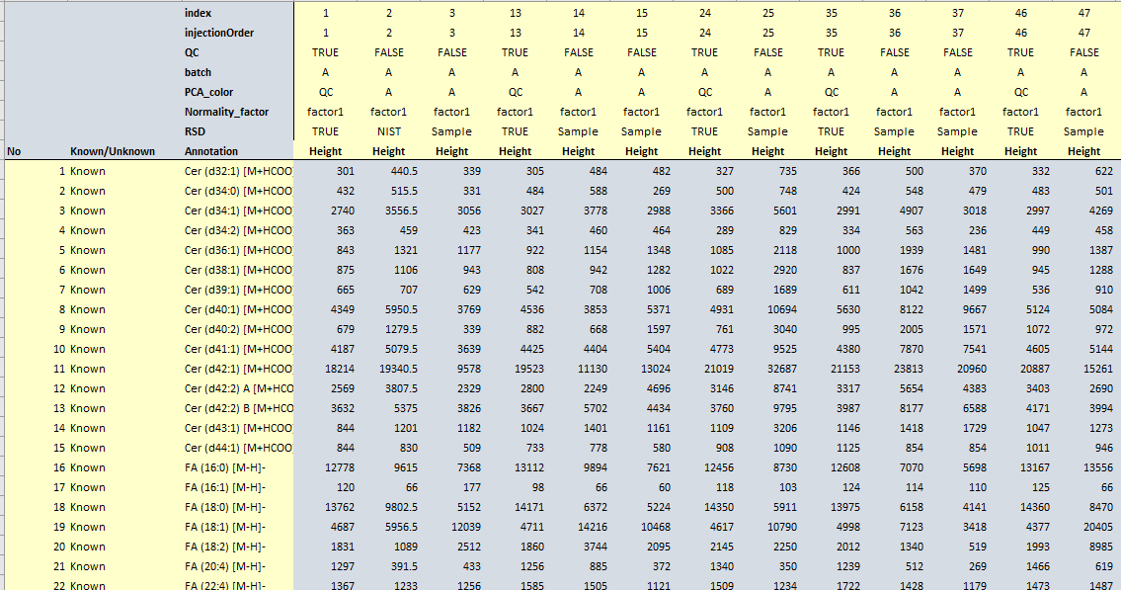
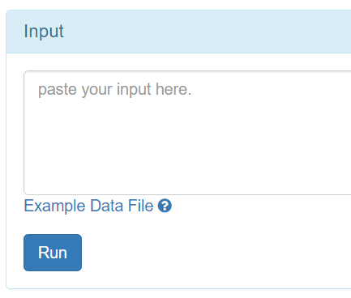
compounds/sample label/index: must have
injectionOrder and QC : for loess normalization (numeric value)
Known/Unknown: for mTIC normalization (TRUE/FALSE)
Batch and QC: for batch normalization
PCA_color: for PCA (character)
Normality_factor: for normality check (character)
RSD: for calculating RSD (TRUE/FALSE)
sample index
compounds index
sample label
1, open any CSV editor.
2, copy data.
3, paste into the box.
Compounds label

Slide 2
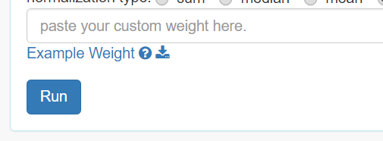
matching sample index
Weight of sample
1, open any CSV editor.
2, copy data.
3, paste into the box.

