Slide 1
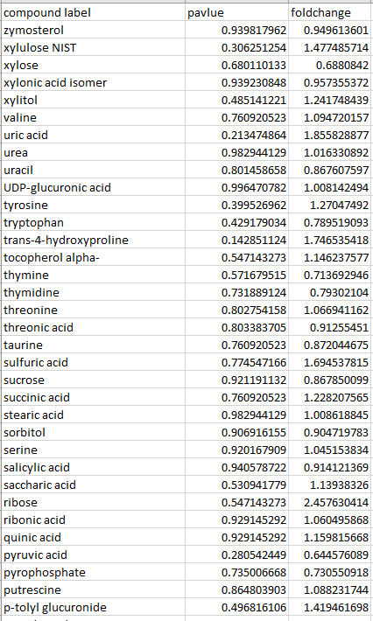

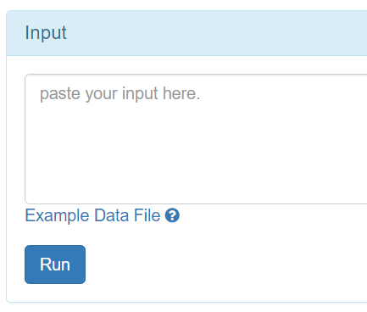
1 compound label
2 p value
3 Fold change
1, open any CSV editor.
2, copy data.
3, paste into the box.

Slide 2
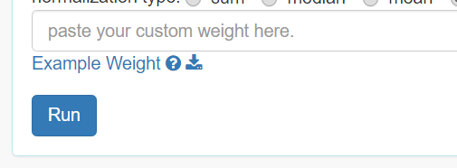
matching sample index
Weight of sample
1, open any CSV editor.
2, copy data.
3, paste into the box.

