Slide 1

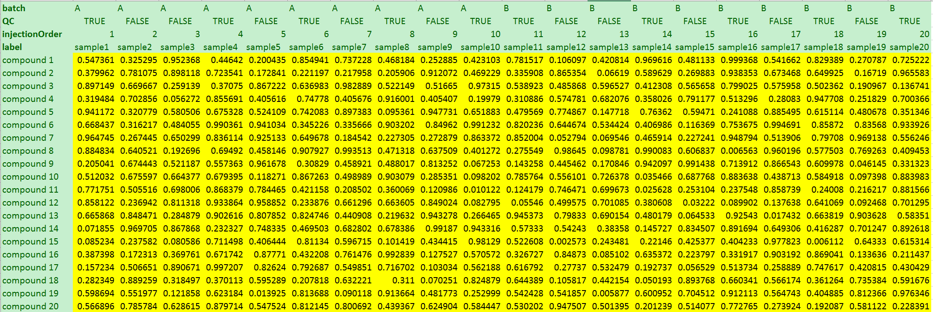
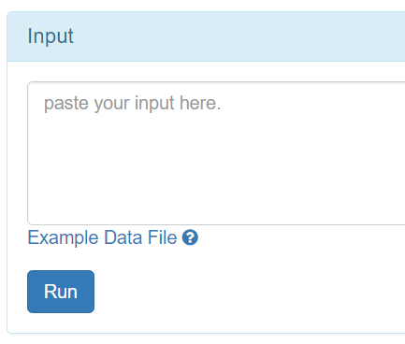
Batch: character
QC: TRUE/FALSE
injectionOrder: numeric
sample label
compound label
1, open any CSV editor.
2, copy data.
3, paste into the box.

Slide 2
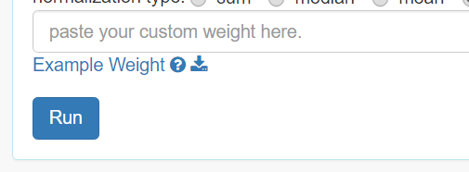
matching sample index
Weight of sample
1, open any CSV editor.
2, copy data.
3, paste into the box.

