Slide 1
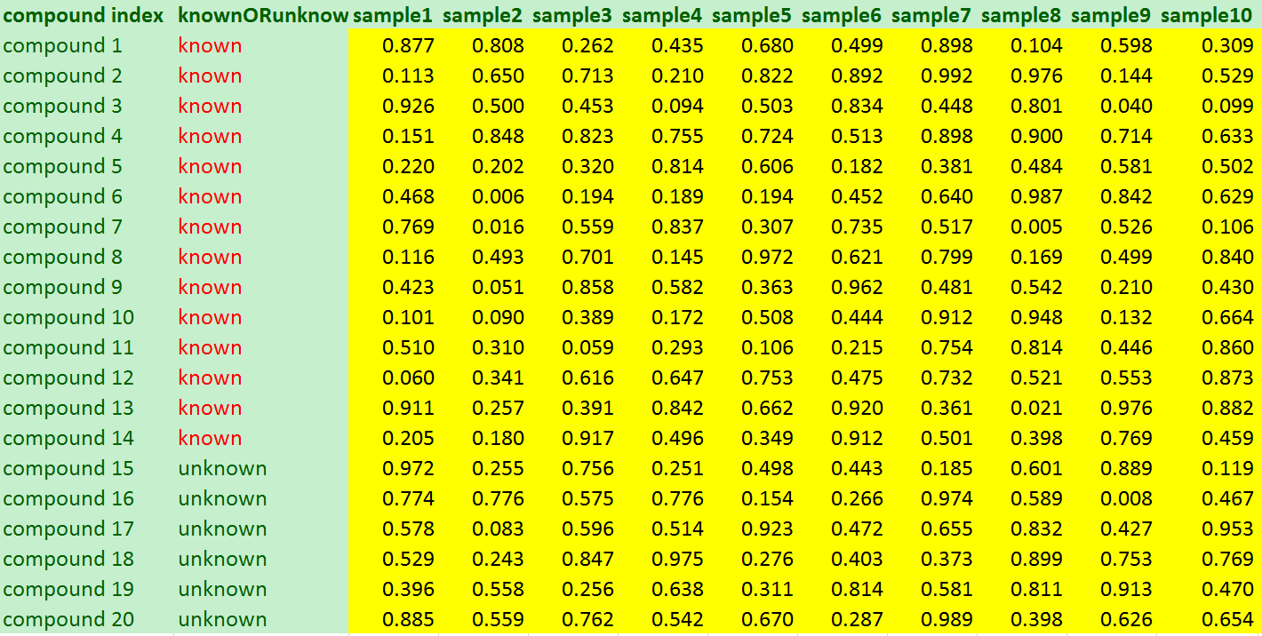

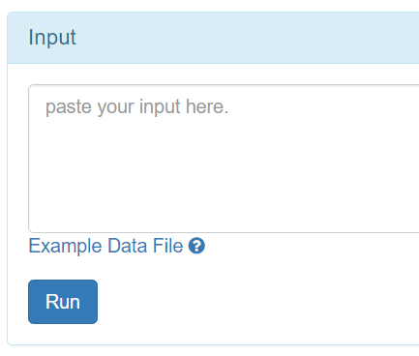
Any compound index
Either known or unknown
Any sample index
1, open any CSV editor.
2, copy data.
3, paste into the box.

