Slide 1

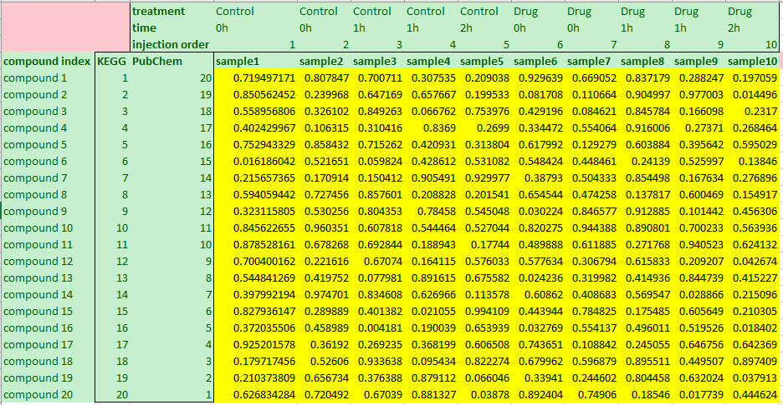
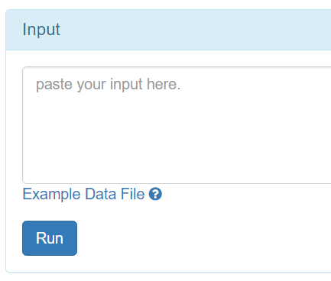
Intentionally left empty
Any compound index
(required)
Any sample info (optional)
Any sample index
1, open any CSV editor.
Any compound info
(optional)
2, copy data.
3, paste into the box.

Slide 2
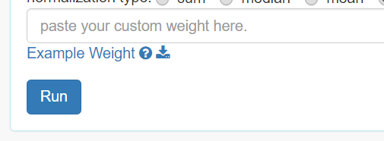
matching sample index
Weight of sample
1, open any CSV editor.
2, copy data.
3, paste into the box.

Slide 3
