Slide 1

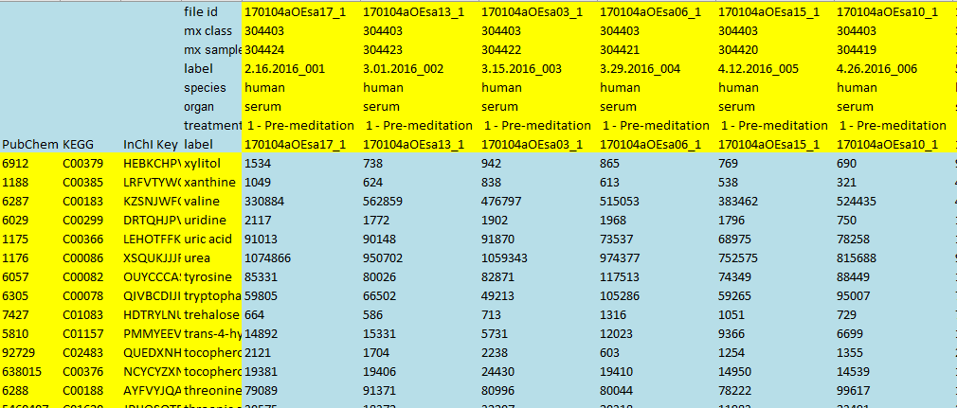
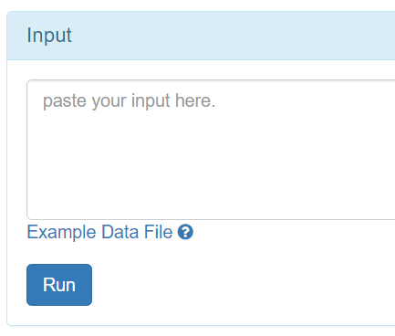
empty
Sample meta-info
Sample label
Feature meta-info
Compound label
1, open any CSV editor.
2, copy data.
3, paste into the box.

Slide 2
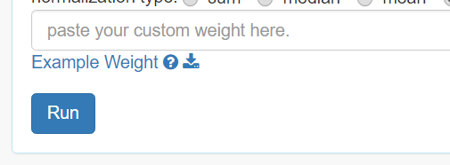
matching sample index
Weight of sample
1, open any CSV editor.
2, copy data.
3, paste into the box.

