Slide 1

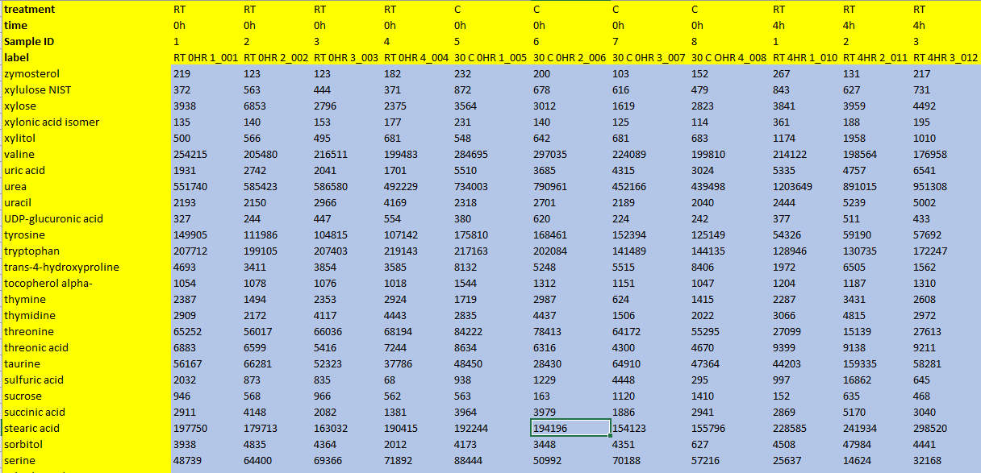
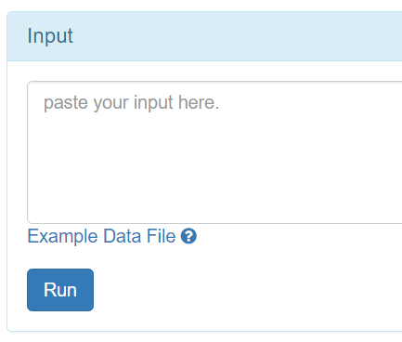
Compound index
Independent factor
Repeated factor
Matching unique sample ID
Sample label
1, open any CSV editor.
2, copy data.
3, paste into the box.

Slide 2
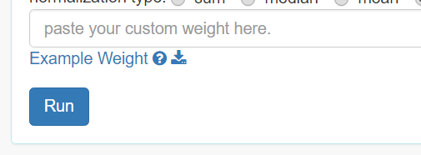
matching sample index
Weight of sample
1, open any CSV editor.
2, copy data.
3, paste into the box.

