Slide 2
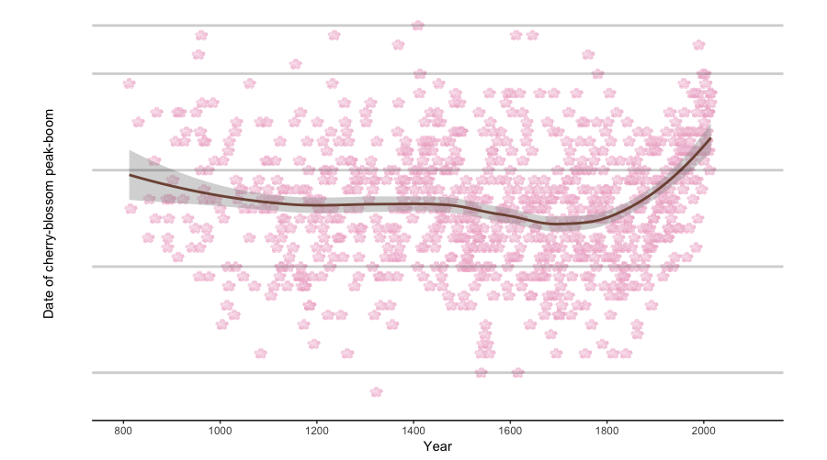
Date of cherry-blossom peak-bloom in Kyoto, Japan 800AD-2016
27th
March
1st
April
10th
20th
1st
May

Slide 3
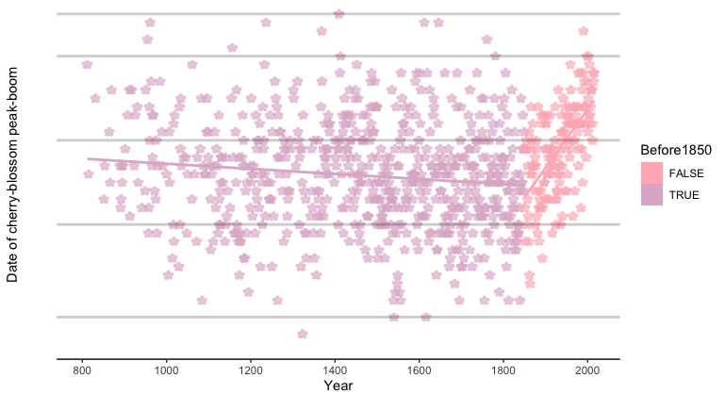
Date of cherry-blossom peak-bloom in Kyoto, Japan 800AD-2016
27th
March
1st
April
10th
20th
1st
May

Slide 4
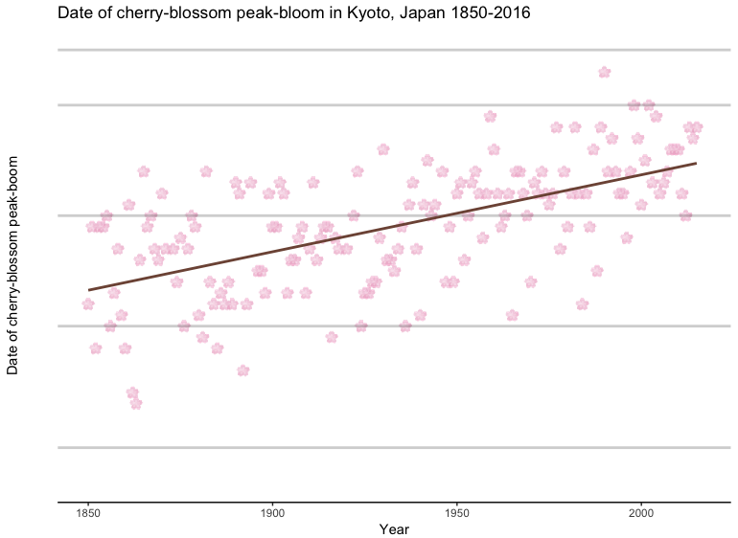
27th
March
1st
April
10th
20th
1st
May

Slide 5
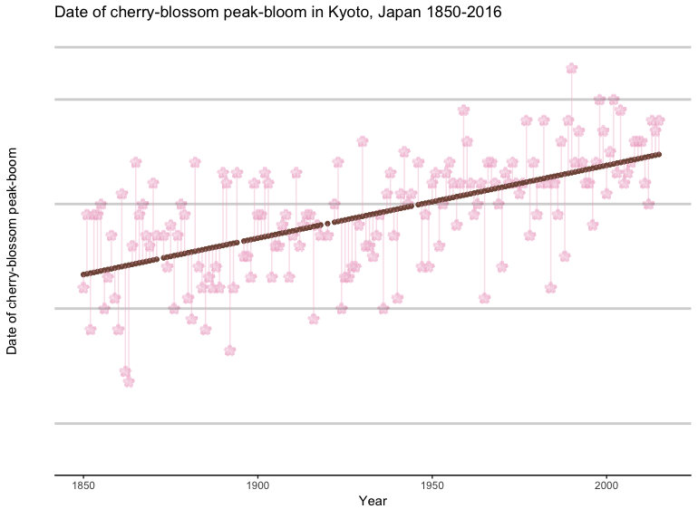
27th
March
1st
April
10th
20th
1st
May

Slide 6
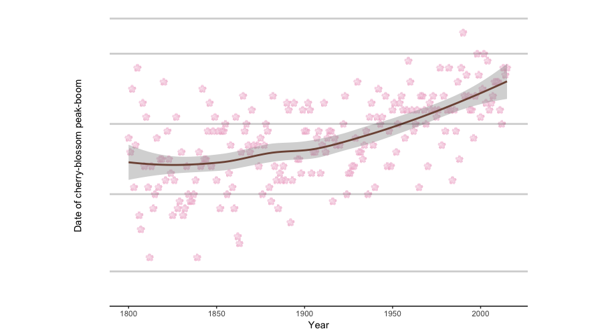
27th
March
1st
April
10th
20th
1st
May

Slide 7
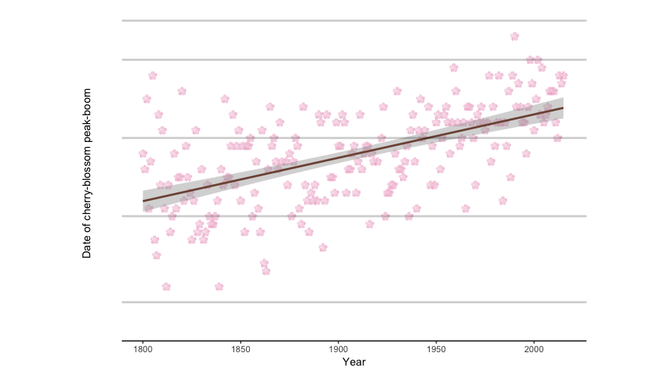
27th
March
1st
April
10th
20th
1st
May

