Slide 1
Resource-Balanced Target Q-coverage in Directional Sensor Networks with an Improved Genetic Algorithm
Authors: Nguyen Thi Hanh, Huynh Thi Thanh Binh, Nguyen Van Son, Ban Ha Bang, Trinh Van Chien
Presenter: Nguyen Van Son

Slide 2
Outline
Introduction
Problem Folmulation
Related Work
Proposed Algorithm
Experiments Results
Conclution

Slide 3
Introduction

Slide 4
1. Introduction Multi-coverage in WSNs Q-coverage
Multi-coverage:
Enhance sensor intensity
Enhance coverage for important targets
Focus on Q-coverage
➔Each sensor having difference coverage requirements
Target
Sensor

Slide 5


1. Introduction Q-coverage in Direction Sensor Network(DSNs)
Direction Sensor
Target
Suit for Video Sensors or Camera Sensors
Enhance sensor intensity
Energy Saving in not rechargeable Networks

Slide 6
1. Introduction Challenges of Q-coverage in DSNs
Cost of Deployment
Power Consuming
Fault-tolerant
Balancing of networks
Coverage Quality
….

Slide 7
2. Problem Folmulation

Slide 8




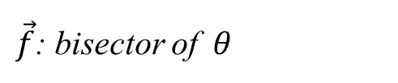

2. Problem Folmulation Direction Sensor Model
$$\vec{f}$$
O
$$θ$$
$$\vec{v}$$
$θ$: Angle of View
$\vec{f}$: bisector of $θ$
$\vec{v}$: vector from O towards target
Sensor : $s=(O\left(x_{s},y_{s}\right), θ,\vec{f})$

Slide 9
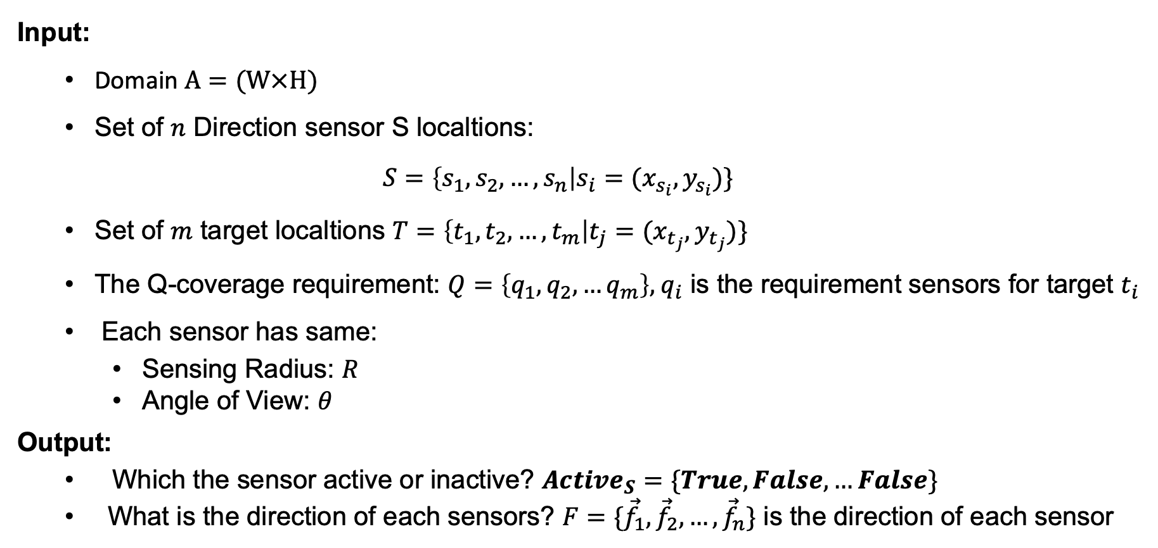
2. Problem Folmulation Sensor Direction Determining Problem
Input:
Domain $A=(W×H)$
Set of $n$ Direction sensor S localtions:
$$S=\left\{s_{1},s_{2},…,s_{n}\right|s_{i}=(x_{s_{i}},y_{s_{i}})\}$$
Set of $m$ target localtions $T=\left\{t_{1},t_{2},…,t_{m}\right|t_{j}=(x_{t_{j}},y_{t_{j}})\}$
The Q-coverage requirement: $Q=\left\{q_{1},q_{2},…q_{m}\right\},{ q}_{i}$ is the requirement sensors for target $t_{i}$
Each sensor has same:
Sensing Radius: $R$
Angle of View: $θ$
Output:
Which the sensor active or inactive? $Active_{S}=\{True,False,…False\}$
What is the direction of each sensors? $F=\{{\vec{f}}_{1},{\vec{f}}_{2},…,{\vec{f}}_{n}\}$ is the direction of each sensor

Slide 10
2. Problem Folmulation Sensor Direction Determining Problem
Objective:
If the number available sensor is under-provision:
Maximize the Q-balancing Index of networks (QBI): represent for the balance of
the coverage rate/ the required coverage among sensors.
If the number available sensor is over-provision:
Minimize the number of the active sensors (No.Active)
Others metric considered: Power Consumming (PC), Distance Index (DI), Coverage Quality (CQ).

Slide 11

2. Problem Folmulation Metrics
Q-Balancing Index: $QBI = \frac{{\left(\sum_{i=1}^{m}{c_{i}}\right)}^{3}}{{\left(\sum_{i=1}^{m}{q_{i}}\right)}^{3}}×\frac{\sum_{i=1}^{m}{q_{i}^{2}}}{\sum_{i=1}^{m}{c_{i}^{2}}}$ ${,c}_{i},q_{i} is actual coverage and required coverage of target i$
Power Consumming: $PC=No.Ss×p_{s}+No.As×p_{a}+No.Is×p_{i};$ $p_{s},p_{a}, p_{i} are pc of sleep, active$ and idle mode.
Distance Index: $DI=$ $\frac{\sum_{i=1}^{m}{q_{i}^{2}} − \sum_{i=1}^{m}{{\left(q_{i}−c_{i}\right)}^{2}}}{\sum_{i=1}^{m}{q_{i}^{2}}}$
Coverage Quality:
$CQ=$ $\sum_{i=1}^{n}{\sum_{k=1}^{m}{cq(i,k)}}$
$cq\left(i,k\right)= \left\{\begin{aligned}1−\frac{\left\|{\vec{v}}_{i,k}\right\|}{R} \\ 0\end{aligned}\right., if s_{i} cover t_{k}$

Slide 12
3. Related Work

Slide 13
3. Related Work
[1] Folmulate the Q-coverage problem with minimum sensors and high balance covered in DSNs:
Proposed a ILP model for simple solutions
Proposed a IQP folmular to minimize the Euclidean distance between the required vector for coverage and obtained vector
Proposed a Greedily-method to solve the mimize IQP and maximum the balance in the network when under-provision
[2] Proposed two GA-based Alogrithms to solve the Q-coverage problem with minimum sensors, and maximum the balancing coverage in DSNs:
Proposed QBI metric to estimate the balancing of coverage in networks
Solving the critical target coverage firstly.
[1] Al Zishan, A., et al., Maximizing heterogeneous coverage in over and under 916 provisioned visual sensor networks. 124 (2018) 44-62
[2] allah Mottaki, Nemat, Homayun Motameni, and Hosein Mohamadi. "A genetic algorithm-based approach for solving the target Q-coverage problem in over and under provisioned directional sensor networks." Physical Communication 54 (2022): 101719.

Slide 14
3. Related Work
[1],[2] Only using the simply method to solve this problem, the solution has not been effective.
Propose an Improved GA to solve the Q-coverage problem with minimum no.sensor and maximum balancing
[2] Can not determine the area is under-provision or over-provision, solve must using 2 GA algorithm for each domain.
Propose a combination of checking the “status” of networks and solving the problem in each status.
Besides that,
Solving the Q-coverage problem in the other mode of sensor: Adjustable-orientation (ADODSN)
[1] Al Zishan, A., et al., Maximizing heterogeneous coverage in over and under 916 provisioned visual sensor networks. 124 (2018) 44-62
[2] allah Mottaki, Nemat, Homayun Motameni, and Hosein Mohamadi. "A genetic algorithm-based approach for solving the target Q-coverage problem in over and under provisioned directional sensor networks." Physical Communication 54 (2022): 101719.

Slide 15
4. Proposed Algorithm

Slide 16
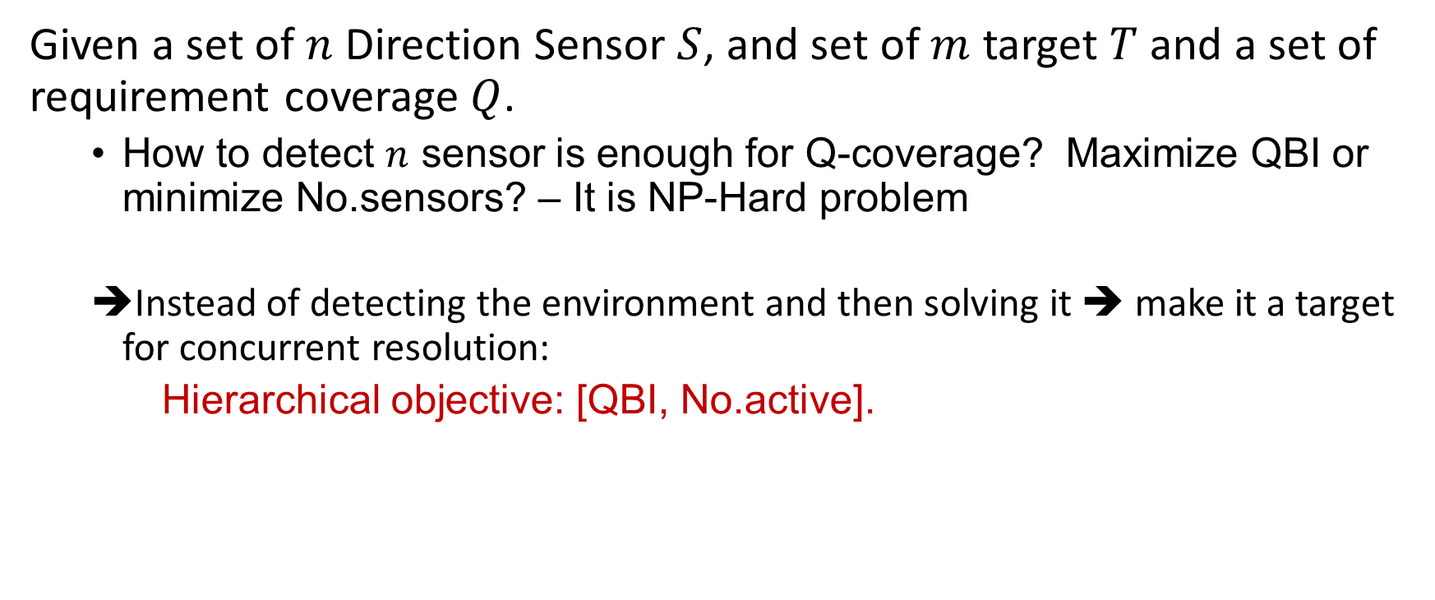
4. Proposed Algorithm IGA solving the Sensor Direction Determining
Given a set of $n$ Direction Sensor $S$, and set of $m$ target $T$ and a set of requirement coverage $Q$.
How to detect $n$ sensor is enough for Q-coverage? Maximize QBI or minimize No.sensors? – It is NP-Hard problem
Instead of detecting the environment and then solving it ➔ make it a target for concurrent resolution:
Hierarchical objective: [QBI, No.active].

Slide 17
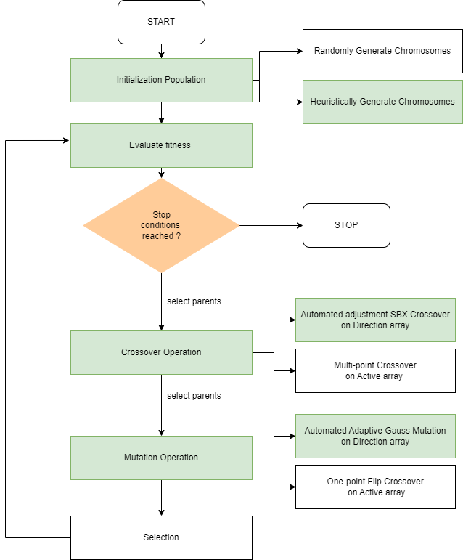
4. Proposed Algorithm SSD-IGA overviews
SSD-IGA is based on a hypothesis: the ”health” of the individuals is very importance with the mutation and crossover.

Slide 18
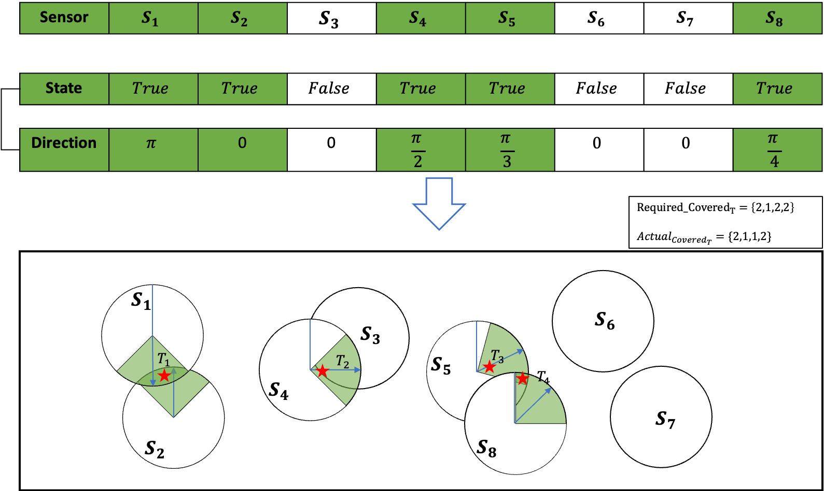
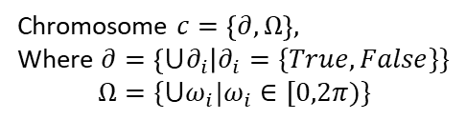
4. Proposed Algorithm SSD-IGA Chromosome representation
Chromosome $c=\left\{∂, Ω\right\},$
Where $∂=\left\{{⋃∂}_{i}\right|∂_{i}=\{True,False\}\}$
$$Ω=\{⋃ω_{i}|ω_{i}∈[0,2π)\}$$
Direction Sensor
Target

Slide 19
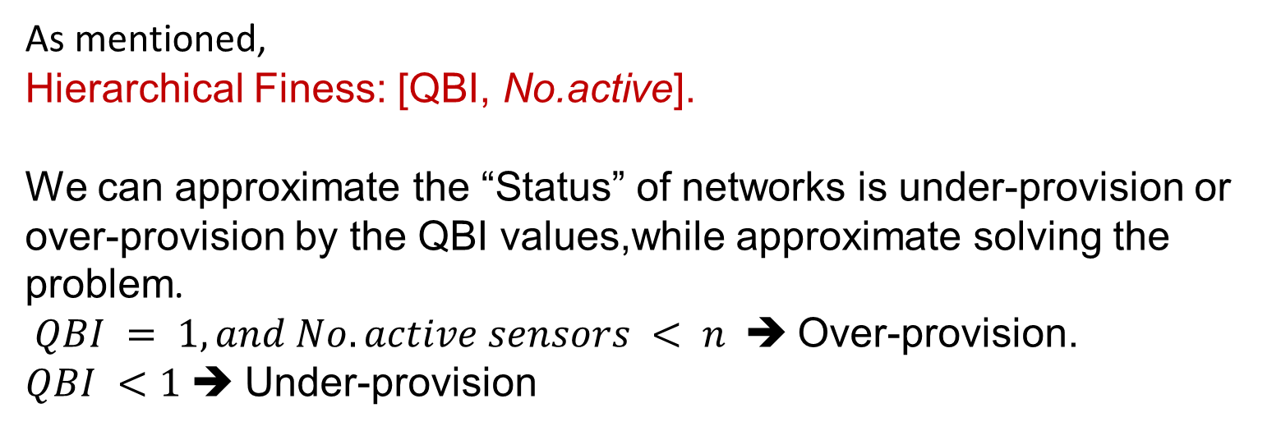
4. Proposed Algorithm SSD-IGA Fitness Function
As mentioned,
Hierarchical Finess: [QBI, No.active].
We can approximate the “Status” of networks is under-provision or over-provision by the QBI values,while approximate solving the problem.
$QBI = 1, and No.active sensors < n$ ➔ Over-provision.
$QBI <1$ ➔ Under-provision

Slide 20
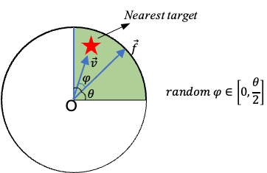
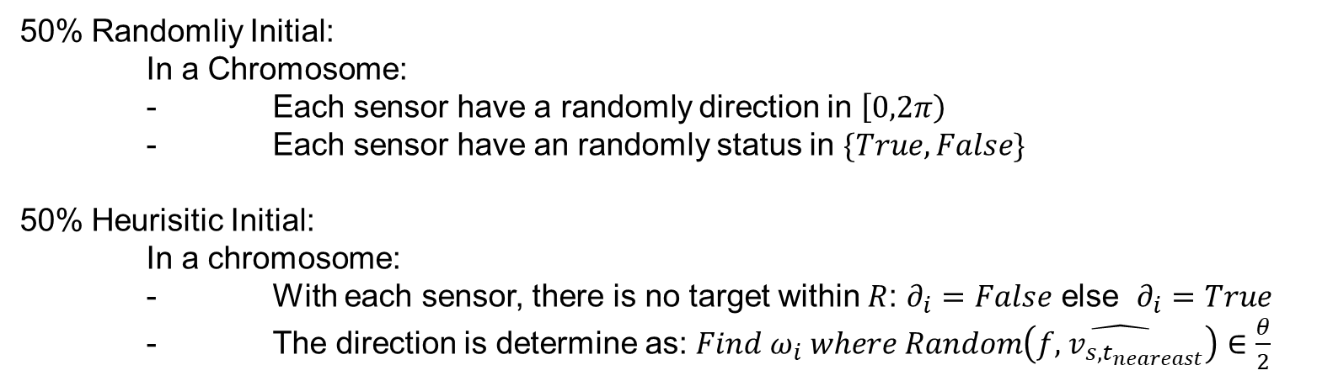
4. Proposed Algorithm SSD-IGA Initialization Population
50% Randomliy Initial:
In a Chromosome:
- Each sensor have a randomly direction in $\left[0,2π\right)$
- Each sensor have an randomly status in $\{True, False\}$
50% Heurisitic Initial:
In a chromosome:
- With each sensor, there is no target within $R$: $∂_{i}=False$ else $∂_{i}=True$
- The direction is determine as: ${Find ω}_{i} where Random\left(\hat{f,{ v}_{s,t_{neareast}}}\right)∈\frac{θ}{2}$

Slide 21
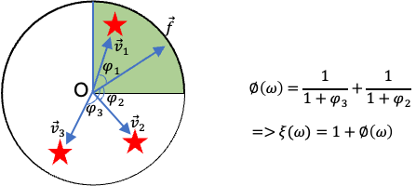

4. Proposed Algorithm SSD-IGA : Coverage quality difference of 2 direction
With a sensor have a direction $ω$ ,estimate $ξ\left(ω\right) is the coverage quality as figure:$
The Coverage quality difference (CQD) of 2 direction:

Slide 22
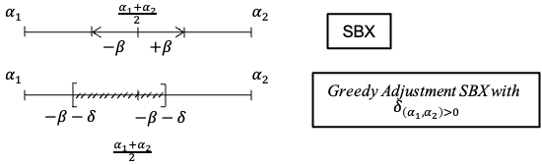
4. Proposed Algorithm SSD-IGA : Crossover opreation
On State array: using multi-point crossover
On Direction array: Greedily-tuned SBX Crossover base on CQD value:

Slide 23


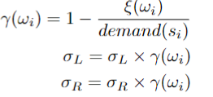
4. Proposed Algorithm SSD-IGA : Mutation opreation
On State array: one point crossover
On Direction array: Adaptive Polynomial Mutation based on CQD value:
The base Polynomial Mutation:
The Adaptive Polynomial Mutation:

Slide 24
4. Proposed Algorithm SSD-IGA : Selection
Combination of:
Oulette wheel selection
Elite selection technique

Slide 25
5. Experiments and Results

Slide 26
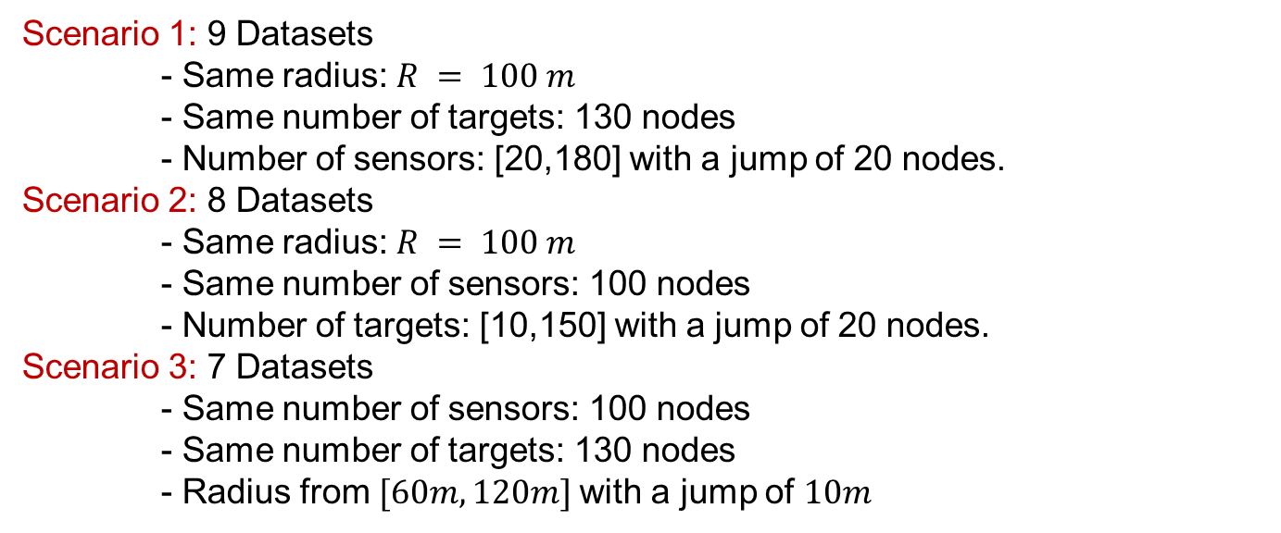
5. Experiments and Results Problem instances
Scenario 1: 9 Datasets
- Same radius: $R = 100 m$
- Same number of targets: 130 nodes
- Number of sensors: [20,180] with a jump of 20 nodes.
Scenario 2: 8 Datasets
- Same radius: $R = 100 m$
- Same number of sensors: 100 nodes
- Number of targets: [10,150] with a jump of 20 nodes.
Scenario 3: 7 Datasets
- Same number of sensors: 100 nodes
- Same number of targets: 130 nodes
- Radius from $[60m,120m]$with a jump of $10m$

Slide 27
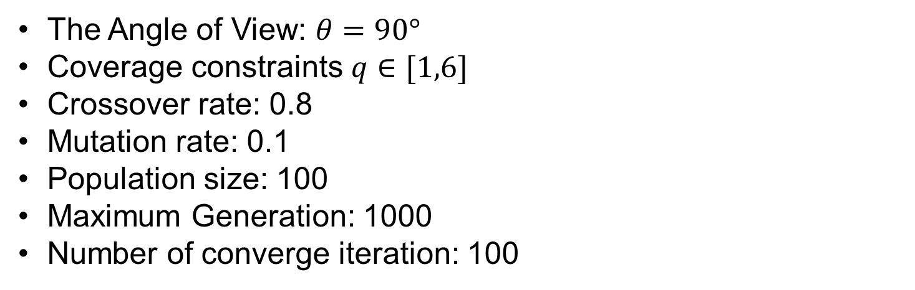
5. Experiments and Results Algorithm Parameters
The Angle of View: $θ=90°$
Coverage constraints $q∈[1,6]$
Crossover rate: 0.8
Mutation rate: 0.1
Population size: 100
Maximum Generation: 1000
Number of converge iteration: 100

Slide 28
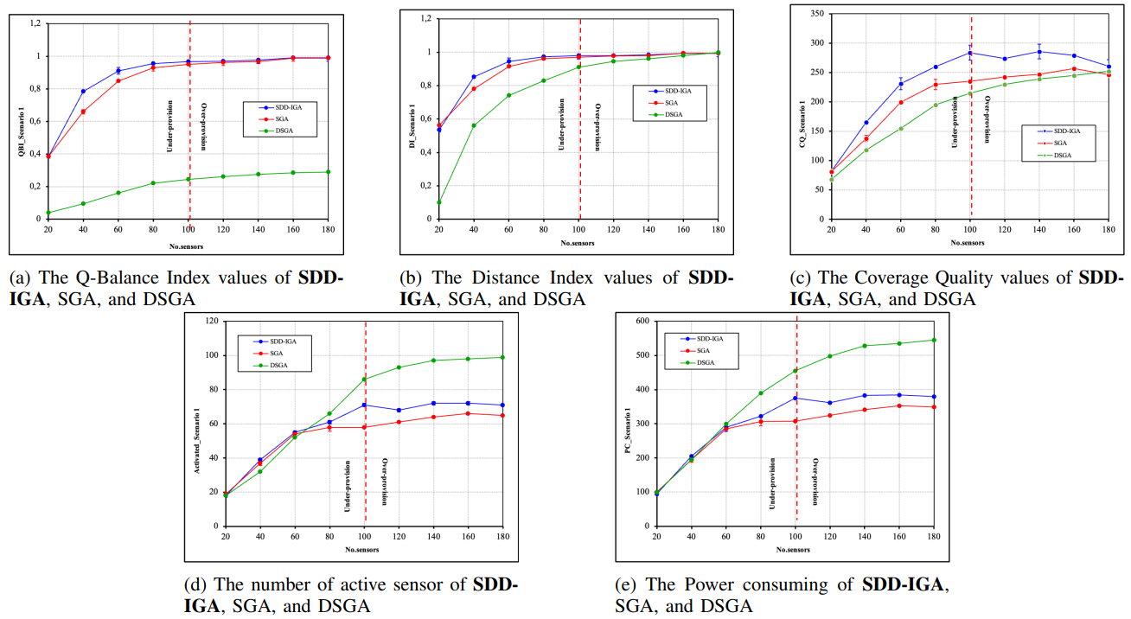
5. Experiments and Results Results Experiment 1

Slide 29
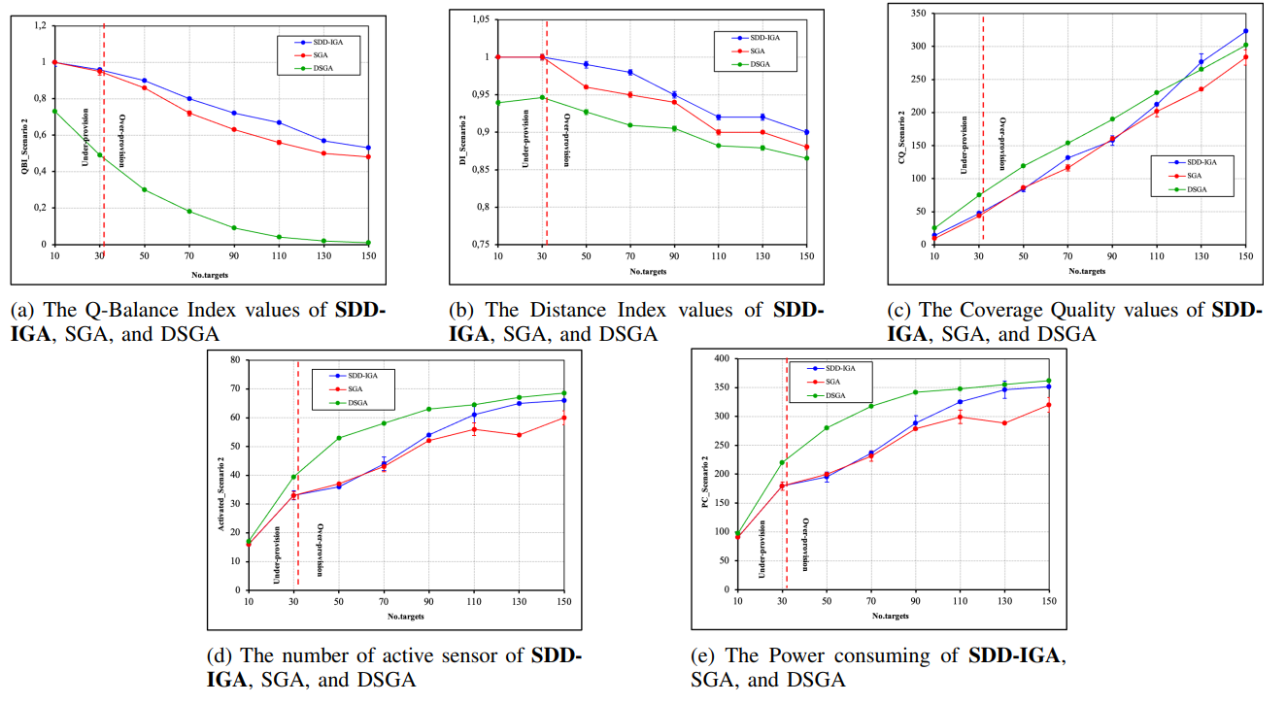
5. Experiments and Results Results Experiment 2

Slide 30
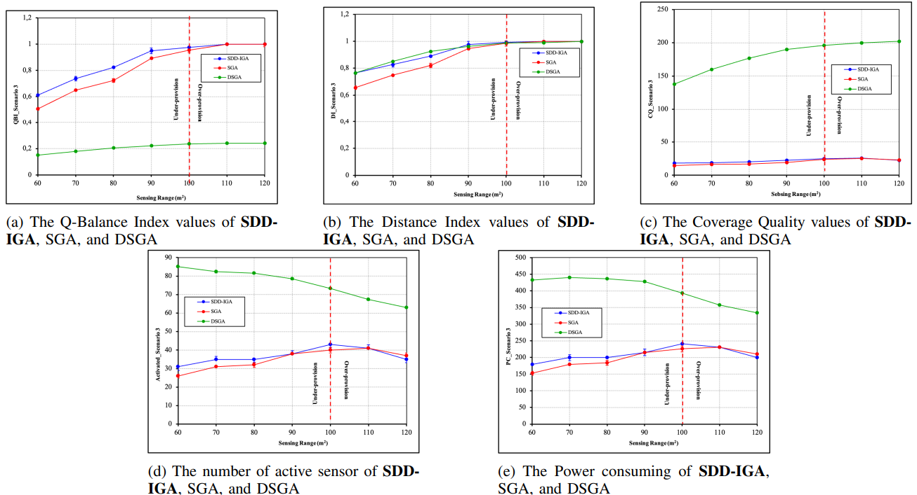
5. Experiments and Results Results Experiment 3

Slide 31
6. Conclusion

Slide 32
6. Conclusion
In this work, we study the Q-coverage problem, which is one of the main challenges in DSNs:
Proposed SDD-IGA for both over-provisioned and under-provisioned environments.
Various experiments based on multiple scenarios
Ours technique could efficiently solve problems and outperform the latest works
Testing the “health” hypothesis with SDD-IGA algorithm and demonstrate it is effective to improve the solution
Future works:
Expanding our research to deal with the simultaneous placement of sensors and adjustment of the orientation angle of the sensors
Real-time coverage for moving targets

