Slide 1


Slide 2

“Automate Anything You See”
Uses image recognition to identify and control GUI components
Useful when there is no easy access to a GUI's internal or source code.
“God’s eye”
Notes:
Briefly introduce that sikuli is a script language that simulates mouse and keyboard actions
Talk about that it is useful when we want to manipulate GUI components but can’t do it through API. Can say that the reason we are using it for AMX is that we don’t have access to the AMX web control API.
In some Mexican language Sikuli means God’s eye

Slide 3

How Sikuli Works?
Simple and clear function calls with image file names as parameters.
Determines the position of GUI elements by taking a screenshot and matches the image using open source computer vision algorithm.
Once the position is known, Sikuli creates keyboard and mouse events.
Notes:
Say that sikuli scripts is organized by a set of simple and clear functions like “click” “wait” “exist” “type”. The user needs to provide these functions with a image of the GUI component to manipulate. These functions will take in the GUI component image as a parameter, and match the image pattern on the current computer screen to determine the location of the GUI component. Then it will perform the action for that specific location.

Slide 4
Sikuli IDE- Hello World Example
Opens up a command line prompt by clicking the “start” icon and typing “cmd + ENTER”.
Uses sikuli IDE
Key functions:
click(), wait(), type(), *sleep()
Notes:
I believe it’s easier to understand by looking at an example. So here I will show a really simple example (helloworld.sikuli) and introduce some key functions. I’ll also mention the sikuli IDE which is useful for taking screen shots and manage sikuli functions. They’ll also have a taste of how easy the sikuli can fail (basically if I don’t have the sleep(1) it won’t work since sikuli will be typing the Enter too fast for the computer to catch it)
This example will also make the next part easy since we’ll have some concrete files to talk about

Slide 5
Demonstrating – Next level to Hello World
A slightly more complicated example:
Open up the outlook, create new mail, type the subject – send mail
Key functions used:
click(), type(), wait()
Image offset
Notes:
Here I want to show another example, what I plan to do is to log on to connectCarolina but I don’t want to show my password. So anyone have any ideas about a good substitute?

Slide 6
How Sikuli Works? --- More Detail
Sikuli scripts are organized in “.sikuli folders”
The folder contains images (.png) we would like the scripts to use and a Python source file (.py)
Sikuli is really a Jython and Java library.
sikuli-java.jar, sikuli-ide.jar
The .py file is extended by the java library; then interpreted and executed in JRE with the image resources
Notes:
Once we shown the example, we’ll have a .sikuli folder created. I’ll use that to illustrate the points here. First show the content of the helloworld.sikuli folder, which will contain the screenshots and the Python source file.
Then we’ll show the two jar files which is created when installing Sikuli. This part is pretty straightforward.

Slide 7
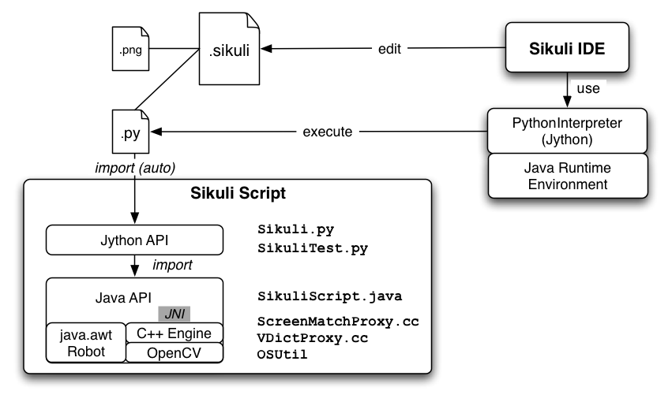
How Sikuli Works? --- More Detail
Notes:
On this slide, first continue to talk about the file structure of the .sikuli folder. At this point only refer to the top half of this diagram and treat the box “Sikuli Script” as a black box that does magic. So basically the IDE will create and edit the .sikuli folder, which will contain the images and the .py source file. The source file will automatically import the sikuli library and be interpreted by PythonInterpreter. And then it will run in JRE.

Slide 8
How Sikuli Works? ---At a Lower Level
Java.awt.Robot
Delivers mouse and keyboard event to appropiate location
C++ Engine and OpenCV
Searches the given image pattern on screen
C++ is connected to Java via JNI
Jython API on top of all these to create a set of simple and clear functions
Notes:
Here’s when it gets messy, at this slide we should constantly refer back to the previous slide. But now focus on the bottom half about the “blackbox” of the sikuli library. I don’t really know much about this since this is deep level stuff. Here’s what I got from the official sikuli website:
Sikuli Script is a Jython and Java library that automates GUI interaction using image patterns to direct keyboard/mouse events. The core of Sikuli Script is a Java library that consists of two parts: java.awt.Robot, which delivers keyboard and mouse events to appropriate locations, and a C++ engine based on OpenCV, which searches given image patterns on the screen. The C++ engine is connected to Java via JNI and needs to be compiled for each platform. On top of the Java library, a thin Jython layer is provided for end-users as a set of simple and clear commands. Therefore, it should be easy to add more thin layers for other languages running on JVM, e.g. JRuby, Scala, Javascript, etc.
It should be enough but I do think we could add more details about the image recognition? Since it is supposed to be interesting.

Slide 9
Run Sikuli in command line
C:\Users\py266t>C:\SikuliX\runsikulix.cmd -r "C:\Users\py266t\Dropbox\Official\All ATT Data\Trainings\Sikuli\Sikuli Repo\open_outlook.sikuli"
Allows you to execute without opening the editor. (Show Demo) – Useful when you want to run Sikuli Job like “CRON / Scheduler”
Can specify additional command line arguments with --args
Notes:
Say that sikuli can also be invoked from command line. This is important since it does not open up the IDE window, which saves some time (not a lot). Do a demo on the helloworld.sikuli, run it from command line. Could possibly play around with other options as well.

Slide 10
How to Install & Run Sikuli
Installation of Sikuli
Run Sikuli IDE
Create a small program
Explain folder & files structure
Open Python program or Ctrl+t in Editor
Notes:
And finish

Slide 11
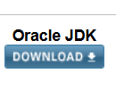
Java installation
https://www.oracle.com/technetwork/java/javase/downloads/index.html
https://launchpad.net/sikuli/sikulix
C:\sikulix
C:> java –jar sikulix.jar (to get ide)
Notes:
And finish

Slide 12
Summary
Sikuli Script is a Jython and Java library that automates GUI interaction using image patterns to direct keyboard/mouse events.
Mostly used as
Automated test tools for GUI components
Automate repetitive IT Tasks
https://betsol.com/2017/03/how-to-get-started-with-sikuli-for-test-automation/
Notes:
And finish

