Slide 1
Enabling Kubeflow With Enterprise Grade Auth for On-Prem Deployments
Yannis Zarkadas, Arrikto
Krishna Durai, Cisco
Notes:
This talk is about how we designed and implemented authentication and authorization for Kubeflow, a Machine Learning platform built ontop of Kubernetes

Slide 2


What is Kubeflow?
Kubeflow is the machine learning toolkit for Kubernetes.
ML Workloads
(Modelling, training, roll-out, serving, …)
Infrastructure
(Cloud/On-Prem)

Slide 3
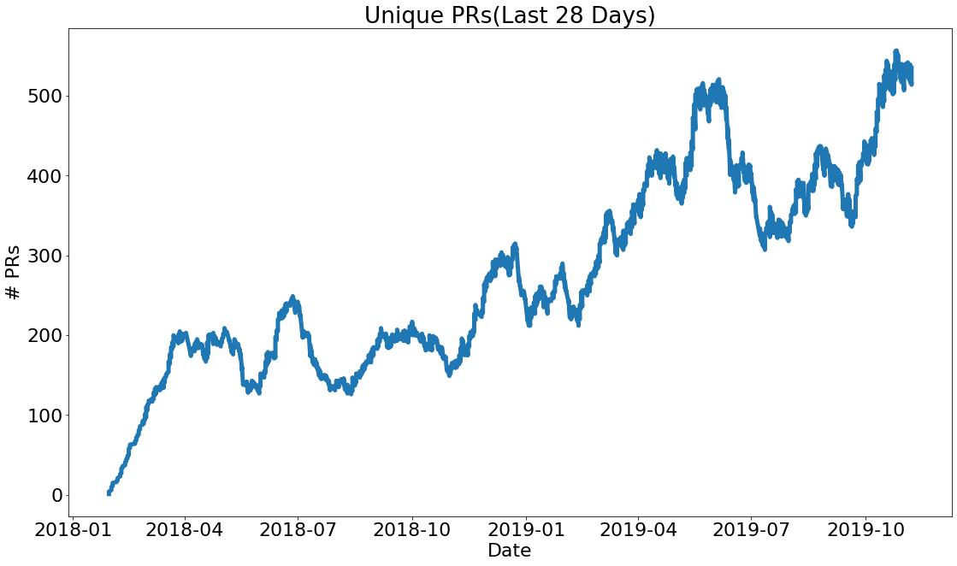





















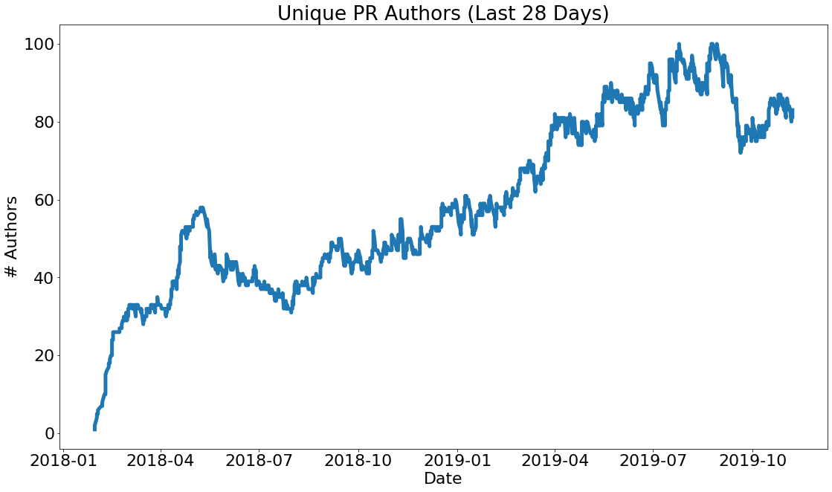





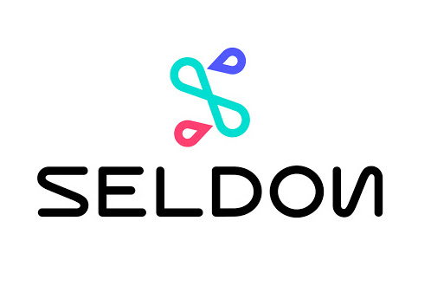





Community!
Notes:
OSS is Powerful model for collaboration
Foster ML innovation
Support a large "surface area" ecosystem
150+ Community contributors
30+ Companies contributing

Slide 4
An Overview of Kubeflow
Kubeflow is composable
Leverage Kubeflow native & non Kubeflow components:
Low Level Services: Custom Resources
Higher Level Services: Web UI and other APIs
Data Ingestion
Data Analysis
Data Transform -ation
Data Validation
Data Splitting
Trainer
Building a Model
Model Validation
Training At Scale
Roll-out
Serving
Monitoring
Logging

Slide 5
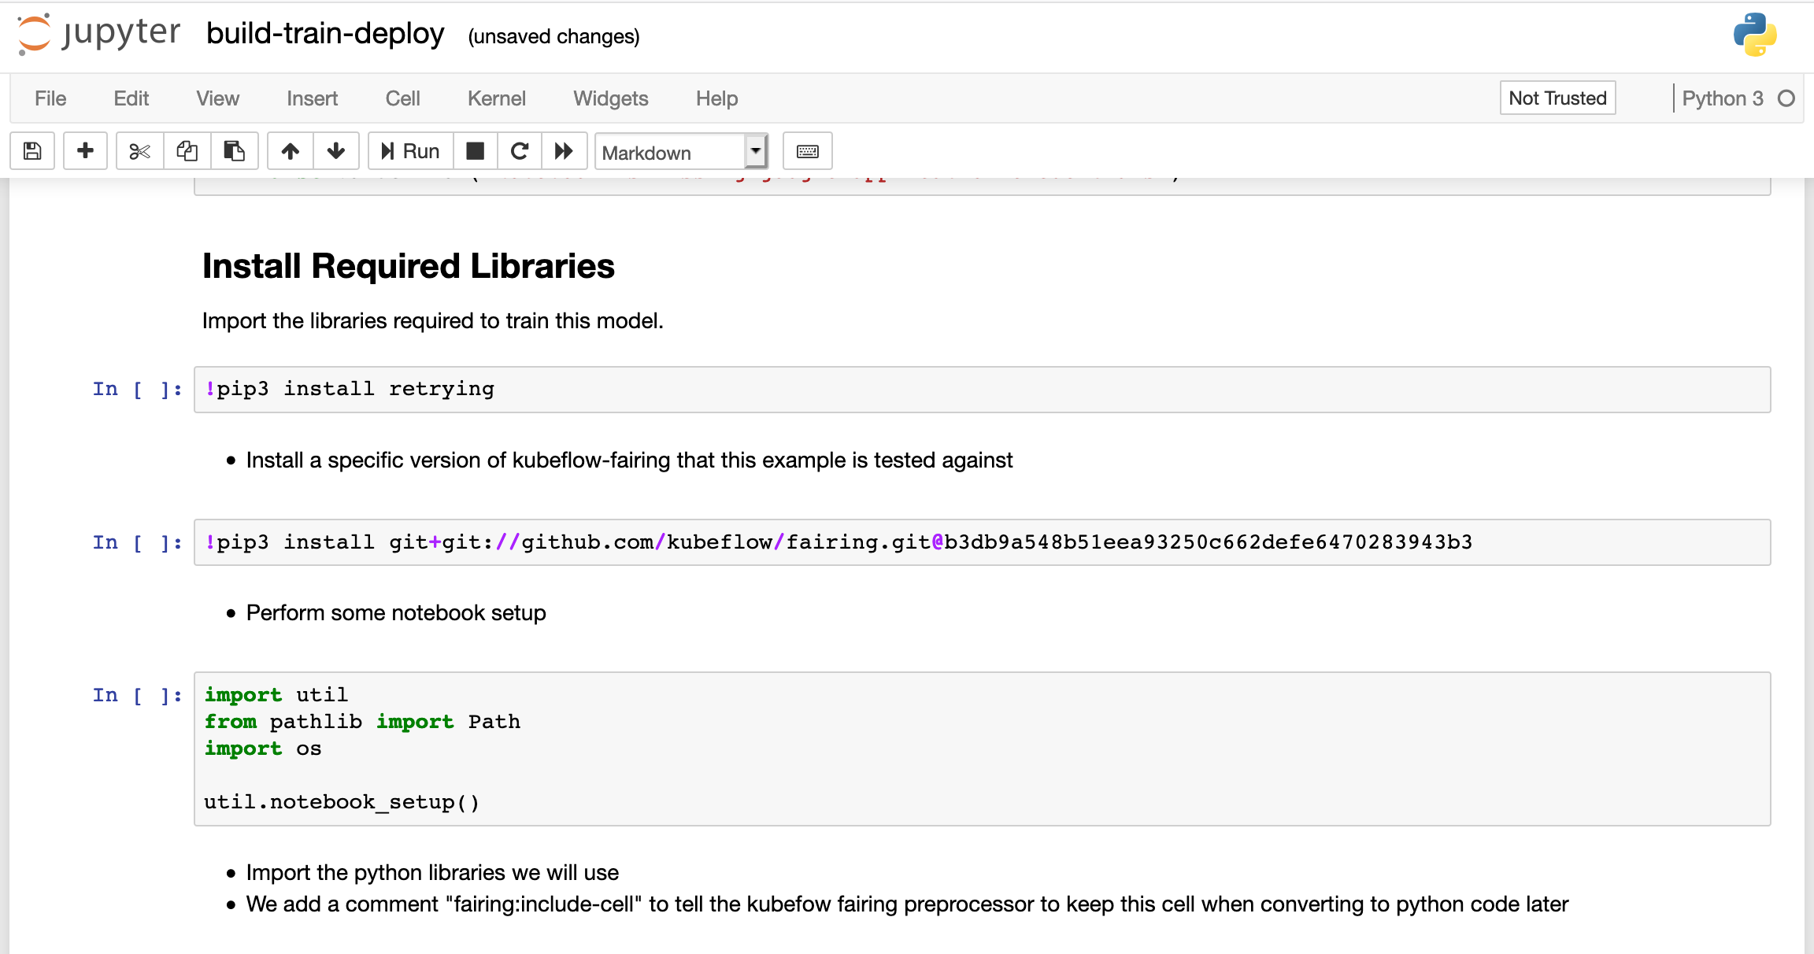
Kubeflow Services
kubectl apply -f tfjob
High Level Services
Kubernetes API Server
Notebooks
Low Level APIs / Services
Pipelines
TFJob
PyTorchJob
Pipelines CR
Istio Mesh and Gateway
KFServing
Argo
Jupyter CR
MPIJob
Katib
Seldon CR
Study Job
Spark Job
Kubebench
TFX
Developed By Kubeflow
Developed Outside Kubeflow
Adapted from Kubeflow Contributor Summit 2019 talk: Kubeflow and ML Landscape (Not all components are shown)

Slide 6
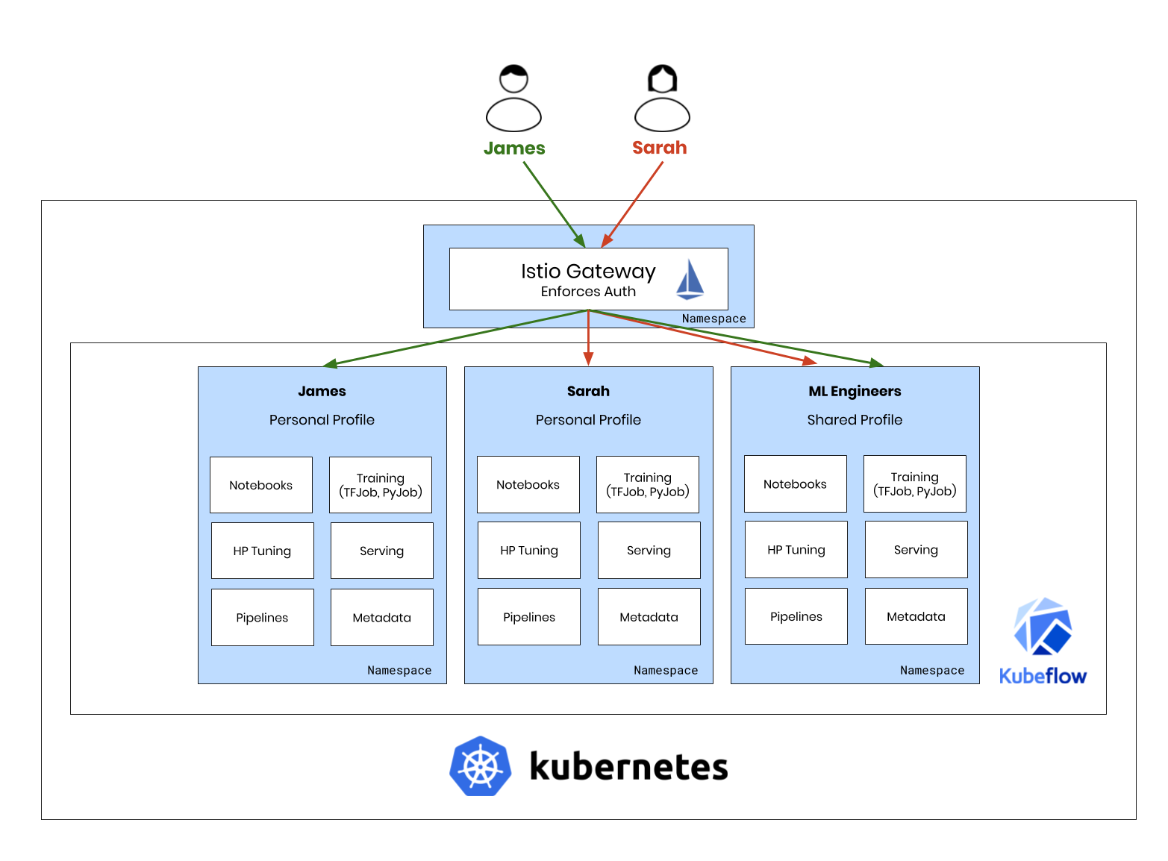
Multi-User Isolation
Authentication?
Authorization?
Notes:
Data Scientists need a Self-Serve Environment
Isolation between Users/Teams
Only Grant Necessary Privileges for Operation
Namespaces as units of isolation
Authentication? Authorization?
This talk is all about that...

Slide 7
Agenda
Overview of Kubeflow
High Level Services: Auth Solution
High Level Services Demo
Overview of Auth Design
Low Level Services: Auth Solution
Low Level Services Demo
Alternative Kubernetes Authentication Techniques
Takeaways
Notes:
Instead of having title slides, maybe we could show the agenda again with the current item in bold.

Slide 8




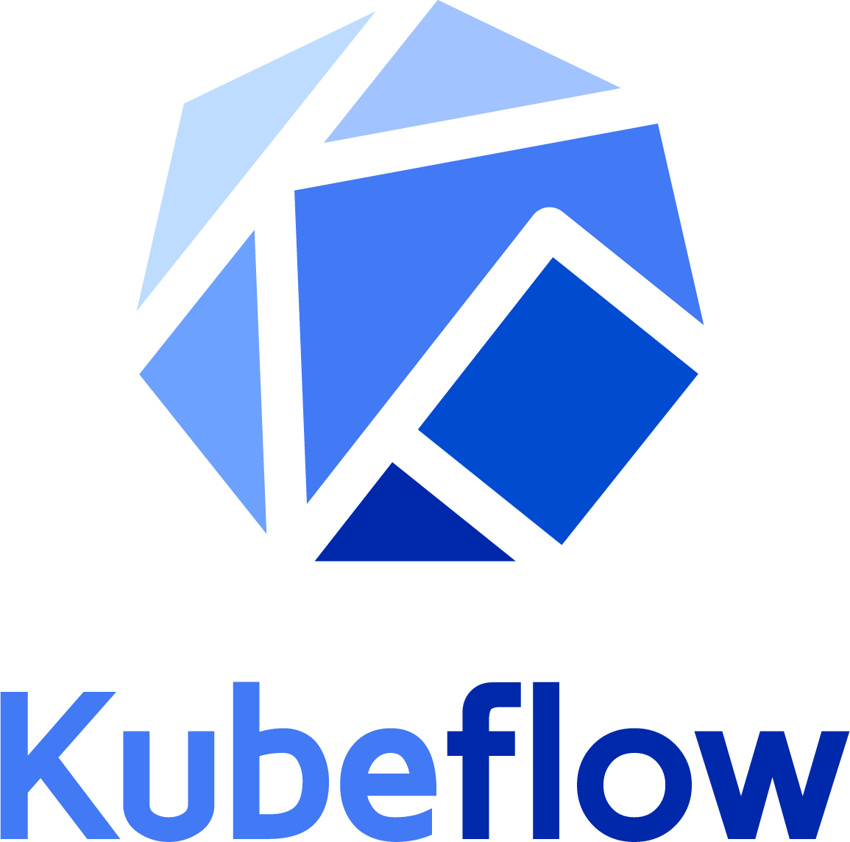

High Level Service Solution
Cookie
External IdP (Google, LinkedIn, …)
Istio Gateway Enforces Auth
Envoy filter
OIDC AuthService
ext_authz
Static Password File
Header: KUBEFLOW_USERID
LDAP / AD
SubjectAccessReview
Notes:
Kubernetes as an authorization database.

Slide 9
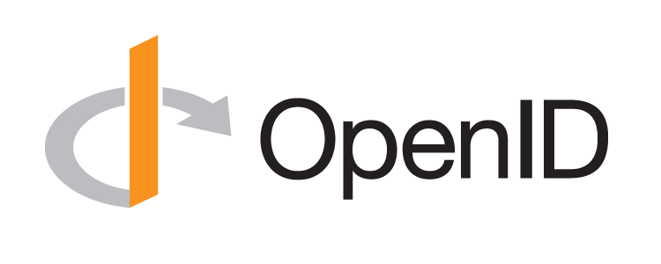
Design Decision I: Authentication using OIDC Protocol
Open & Standardized OAuth Flow
Objective: Get the User’s Identity (username, groups)
Popular and Secure

Slide 10

Design Decision II: Istio Mesh
Why Istio?
HTTP Routing
/notebooks
/pipelines
...
RBAC Authorization
Only user “sarah” can access path “/notebooks/sarah/my-notebook”
Explicit access to all resources of a namespace
Implicit rule to deny access to other namespaces
Extensible & Full-Featured

Slide 11
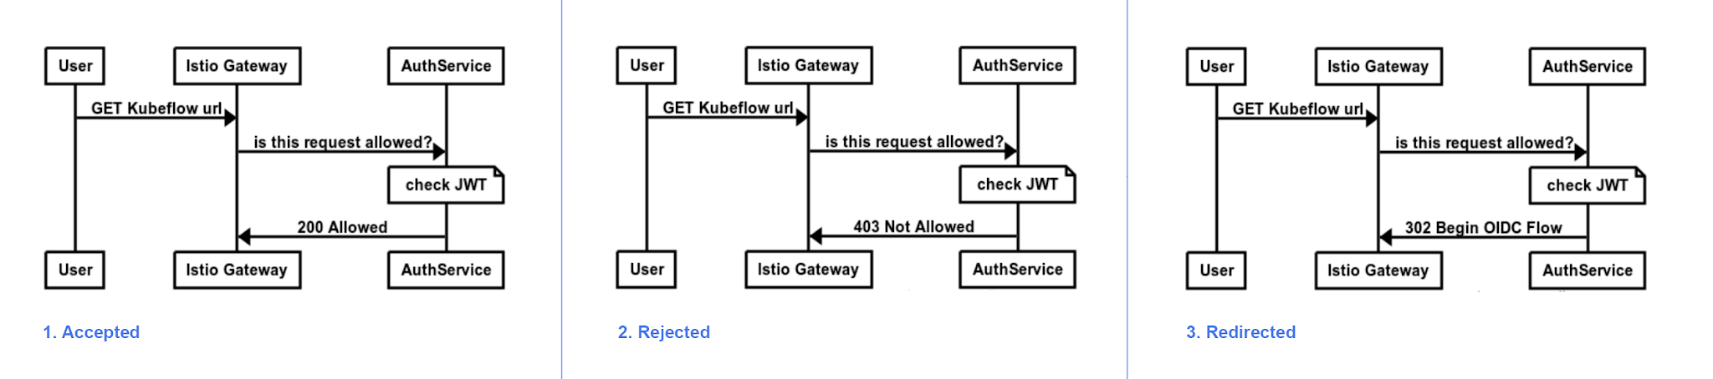
Design Decision II: Istio Mesh
OIDC with Istio ?
No baked-in support
Solution: EnvoyFilter with ext.authz filter

Slide 12
Design Decision III: Identity Provider
External IdP (Google, LinkedIn, …)
Static Password File
OIDC Provider
Interface
LDAP / AD

Slide 13
Agenda
Overview of Kubeflow
High Level Services: Auth Solution
High Level Services Demo
Overview of Auth Design
Low Level Services: Auth Solution
Low Level Services Demo
Alternative Kubernetes Authentication Techniques
Takeaways and Next Step
Notes:
Instead of having title slides, maybe we could show the agenda again with the current item in bold.

Slide 14
Agenda
Overview of Kubeflow
High Level Services: Auth Solution
High Level Services Demo
Overview of Auth Design
Low Level Services: Auth Solution
Low Level Services Demo
Alternative Kubernetes Authentication Techniques
Takeaways and Next Step
Notes:
Instead of having title slides, maybe we could show the agenda again with the current item in bold.

Slide 15
Part I: High Level Services Solution
(Dex) Connector
Incoming Kubeflow request
OIDC AuthService
IdP
Kubeflow Gateway with Istio
LDAP
External Auth GitHub ...
kubectl Incoming K8s API request
High Level Service
Authorization (Istio RBAC)
Kubernetes API
Authorization (K8s RBAC)
Low Level Service
Notes:
This is where we’re at.

Slide 16
High Level Diagram for Auth Design
(Dex) Connector
Incoming Kubeflow request
OIDC AuthService
IdP
Kubeflow Gateway with Istio
LDAP
External Auth GitHub ...
kubectl Incoming K8s API request
High Level Service
Authorization (Istio RBAC)
Kubernetes API
Authorization (K8s RBAC)
Low Level Service
Notes:
This is where we want to go.

Slide 17
Part II: Low Level Services Solution
(Dex) Connector
Incoming Kubeflow request
OIDC AuthService
IdP
Kubeflow Gateway with Istio
LDAP
External Auth GitHub ...
kubectl Incoming K8s API request
High Level Service
Authorization (Istio RBAC)
Kubernetes API
Authorization (K8s RBAC)
Low Level Service

Slide 18
Agenda
Overview of Kubeflow
High Level Services: Auth Solution
High Level Services Demo
Overview of Auth Design
Low Level Services: Auth Solution
Low Level Services Demo
Alternative Kubernetes Authentication Techniques
Takeaways and Next Step
Notes:
Instead of having title slides, maybe we could show the agenda again with the current item in bold.

Slide 19
Design Decisions: CRDs and Kubernetes API
Kubernetes API Server
Authentication
Low Level APIs / Services
Custom Resources
+ Controllers
Authorization
Using RBAC

Slide 20

Low Level Service Authentication
Kubernetes cluster
Identity at High Level = Low Level
Client
1 Run
11 Request with token
Enable Authentication on K8s API
OIDC Plugin
Kube-OIDC-Proxy
ServiceAccount JWT to RBAC
kubectl
kube-apiserver
15 Response
14 Response
2 Run
10 Token
12 Get
13 Certificate
8 Token Request
login client
OpenID Connect Provider
5 Authenticate
9 Token Response
3 Open
7 Authn
response
4 Authn Request
Browser
5 Authenticate
6 Authn Response
Adapted from https://github.com/int128/kubelogin

Slide 21
Low Level Service Authorization through RBAC I
Kubeflow defines Aggregated ClusterRoles:
kubeflow-admin
kubeflow-edit
kubeflow-view
Each low level service defines its own kubeflow-<service>-<role> cluster role
apiVersion: rbac.authorization.k8s.io/v1 kind: ClusterRole metadata: name: kubeflow-tfjobs-view labels: rbac.authorization.kubeflow.org/aggregate-to-kubeflow-view: "true" rules: - apiGroups: ["kubeflow.org"] resources: ["*"] verbs: - get - list - watch

Slide 22
Low Level Service Authorization through RBAC II
kubeflow-tfjobs-admin
TFJob
kubeflow-tfjobs-edit
kubeflow-tfjobs-view
kubeflow-admin
kubeflow-pyjobs-admin
PyTorchJob
kubeflow-edit
kubeflow-pyjobs-edit
kubeflow-pyjobs-view
kubeflow-view
kubeflow-spkjob-admin
Spark Job
kubeflow-spkjob-edit
kubeflow-spkjob-view
Developed By Kubeflow
Developed Outside Kubeflow

Slide 23
Low Level Service RBAC Usage
High Level Access
Low Level Access
kubectl access
Profile’s Isolated Namespace
Profile service creates a RoleBinding for each User
kind: RoleBinding
metadata:
name: username-clusterrole-edit
namespace: profile-ns
roleRef:
apiGroup: rbac.authorization.k8s.io
kind: ClusterRole
name: kubeflow-edit
subjects:
- apiGroup: rbac.authorization.k8s.io
kind: User
name: username@domain.com
Jupyter Notebook
RoleBinding
RoleRef: KF ClusterRole Subject: ServiceAccount
Role Based Service Account
Kubernetes API

Slide 24
Agenda
Overview of Kubeflow
High Level Services: Auth Solution
High Level Services Demo
Overview of Auth Design
Low Level Services: Auth Solution
Low Level Services Demo
Alternative Kubernetes Authentication Techniques
Takeaways and Next Step
Notes:
Instead of having title slides, maybe we could show the agenda again with the current item in bold.

Slide 25
Agenda
Overview of Kubeflow
High Level Services: Auth Solution
High Level Services Demo
Overview of Auth Design
Low Level Services: Auth Solution
Low Level Services Demo
Alternative Kubernetes Authentication Techniques
Takeaways and Next Step
Notes:
Instead of having title slides, maybe we could show the agenda again with the current item in bold.

Slide 26
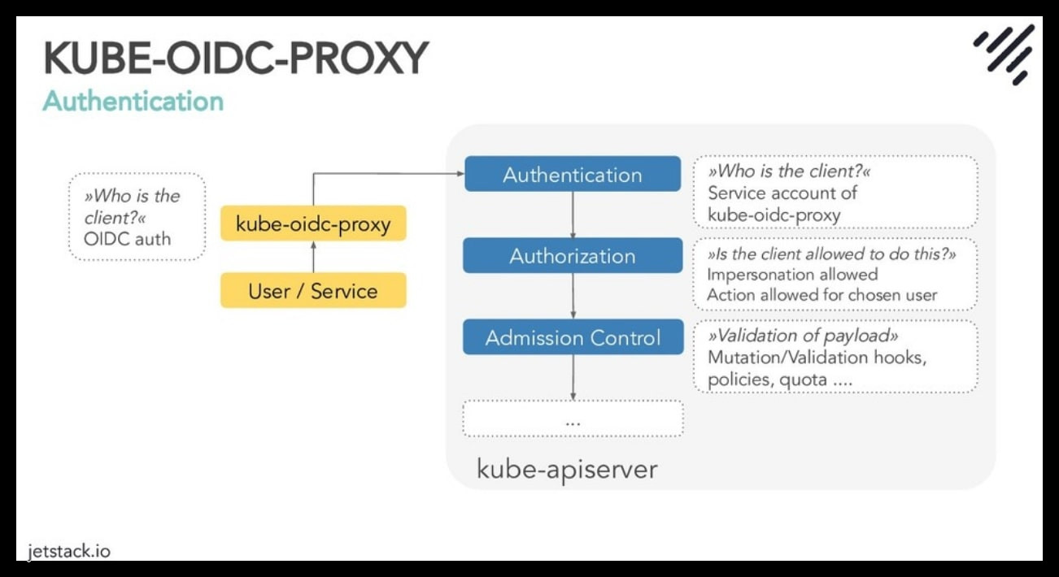
Low Level Service Authentication - OIDC Proxy
OIDC Proxy
Authenticates with OIDC
Impersonates requests to the API Server
kube-oidc-proxy by Jetstack (github.com/jetstack/kube-oidc-proxy)
Works in every cluster
Adopted from: https://jetstack.io/talks/

Slide 27
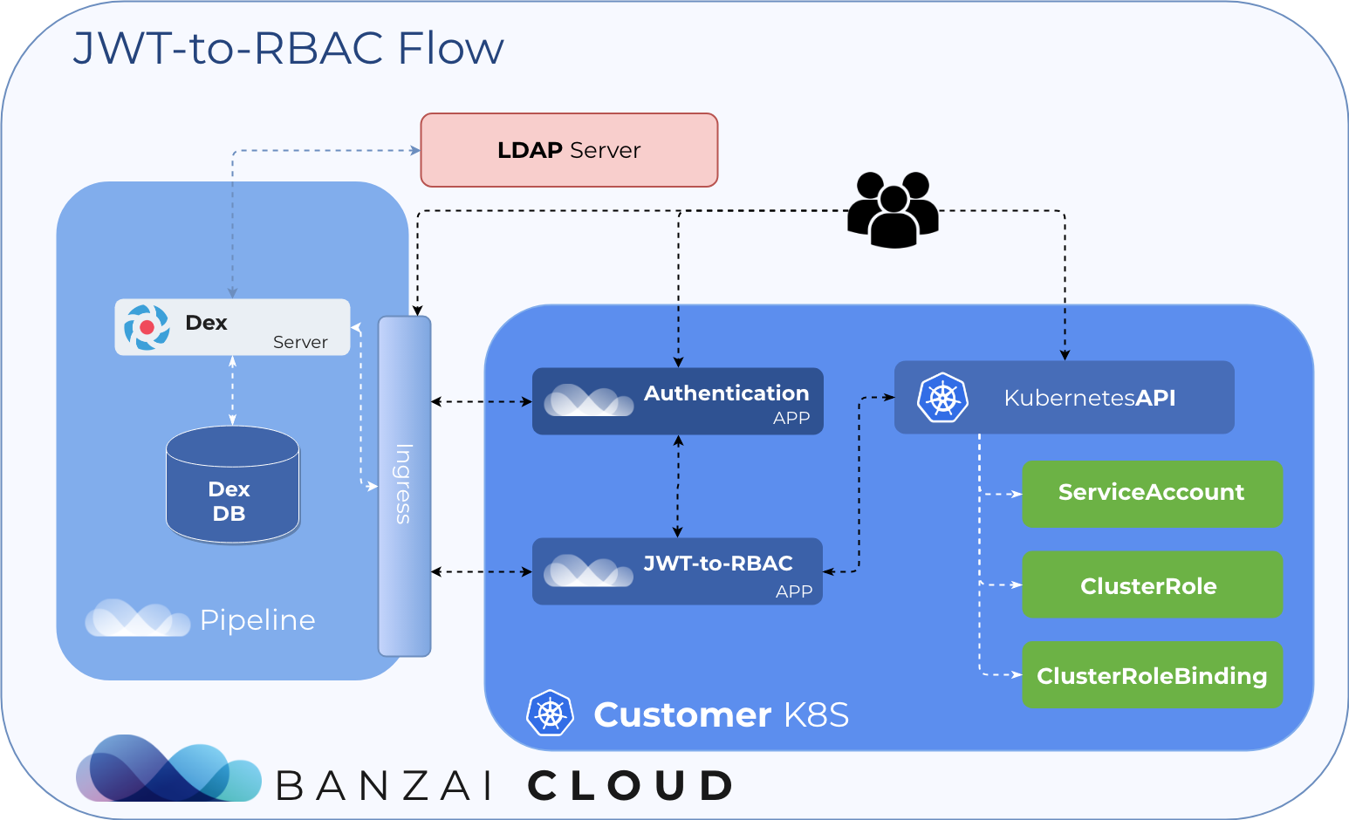
Low Level Service Authentication - ServiceAccount
ServiceAccount
Map Identity to ServiceAccount Token
Use ServiceAccount Token for kubectl access
No Groups support, so permissions must be resolved
Example implementation by Banzai Cloud: JWT-to-RBAC
Adopted from: https://banzaicloud.com/blog/k8s-rbac/

Slide 28
Agenda
Overview of Kubeflow
High Level Services: Auth Solution
High Level Services Demo
Overview of Auth Design
Low Level Services: Auth Solution
Low Level Services Demo
Alternative Kubernetes Authentication Techniques
Takeaways and Next Steps
Notes:
Instead of having title slides, maybe we could show the agenda again with the current item in bold.

Slide 29
Takeaways
Kubeflow ML Platform on top of Kubernetes
Authentication layer using Istio + OIDC
Authorization (network) by Istio RBAC
Authorization (k8s) delegated with SubjectAccessReview
Multiple ways for kubectl access
You can apply these techniques to other platforms as well
Take advantage and build on existing open source:
Istio, Dex, OIDC AuthService, Kubernetes Auth, ...

Slide 30
Next Steps
Kubeflow v0.7 | High level services Auth with Istio + OIDC + LDAP + Dex
Kubeflow v1.0 (Q1 2020) | Low level services Auth + Kubectl access

Slide 31


Thank you! Questions?
Yannis Zarkadas
Krishna Durai
yanniszark@arrikto.com
duselvar@cisco.com
@yanniszark
@krishnadurai20
Notes:
Final thank you slide

