Slide 2
Fine Grained
Mesh Metrics
{kuat,gargnupur,mjog}@google.com
Notes:
Thursday, November 21 • 4:25pm - 5:00pm
Knowing granular traffic patterns is crucial in understanding the functioning and health of a service mesh. The existing Envoy extensions collecting metrics are either not granular enough or can consume too many resources.
In this session, attendees will learn about an efficient way of producing granular metrics. This method introduces a new metadata exchange protocol between peer workloads and uses the new Envoy/WASM metrics API to produce richly dimensioned metrics based on the exchanged metadata.
The operator can add arbitrary peer dimensions like availability zones and locality to get additional insights into the traffic. Istio will use this technique to efficiently produce highly dimensioned Istio standard telemetry.
Attendees will see a demo of rich telemetry collection to Prometheus at near native performance.
: Who is here to learn about “Fine grained mesh metrics”? you are in the right place.
: Hi My name is Mandar, I am an Istio maintainer at Google.

Slide 3
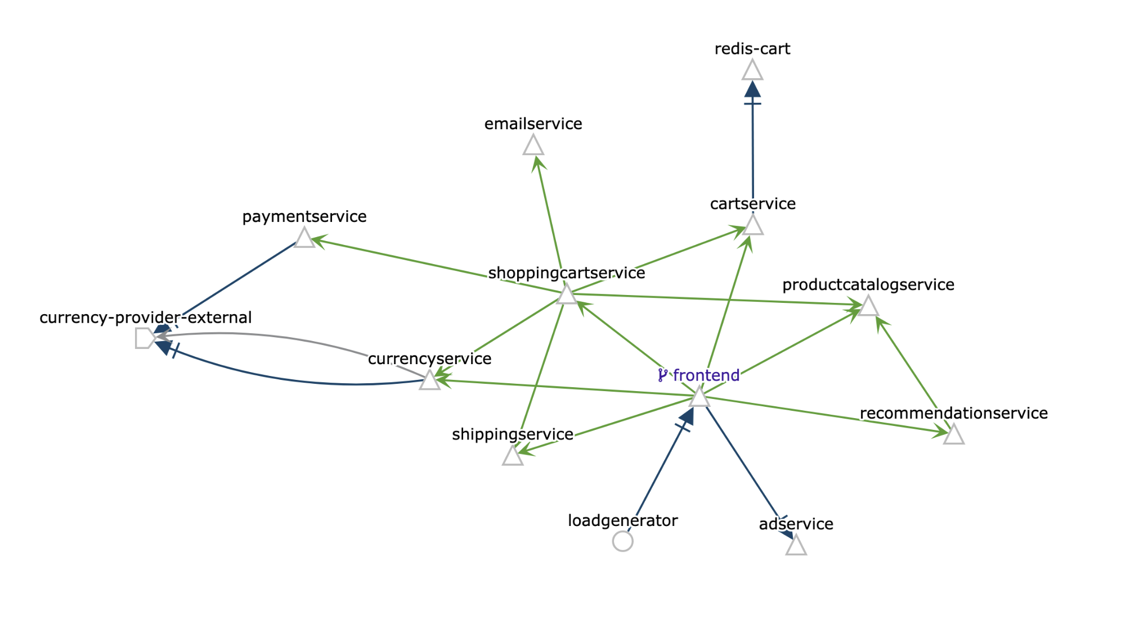
Outline
Why service mesh?
Why granular telemetry?
What is available today ?
What are we adding ?
Notes:
Since this is about mesh metrics lets first answer some preliminary questions.

Slide 4
Why Service Mesh?
More services = more complexity
Need consistent metrics aggregation (track latency, error rate, throughput)
Need consistent policy enforcement
(retry logic, encryption, authz, rollouts)
A service mesh provides a transparent and language-independent way to flexibly and easily automate application network functions.
Notes:
Context
consider: This graph represents a monolithic application
Modules become services as you move to k8s
A whole new class of problems emerged since an in-memory function call was replaced by a network call.
reliable, secure and fast
less reliable, less secure and slower → Now we want to measure this, we want more visibility
This is why we need a service mesh, to restore the qualities we lost by moving to microservices.
next: istio service mesh

Slide 5


Istio Service Mesh
Envoy: an open-source, high performance, dynamically configurable L7 proxy
Istio: an open-source service mesh. Injects a "sidecar" Envoy proxy into Kubernetes pods. Proxies mediate all traffic. Istio configures Envoys, collects metrics.
Notes:
Istio is one such service mesh, that we love :-)
next: We will see how a service mesh is realized.

Slide 6

No Service Mesh
K8s Deployment: Workload
K8s Pod:
Workload Instance
Shopping Service
Product Service
Shipping Service
Notes:
Start with 3 application or services. Shopping product, and shipping.
Every box represents a pod.
describe calling.

Slide 7
Service Mesh
Prometheus
Data
Plane
Shopping
Service
Product
Service
Shipping
Service
Envoy Sidecar
Envoy Sidecar
Envoy Sidecar
Notes:
magic - we injected a sidecar proxy in every pod.
Prometheus makes an appearance, it will be important later.
There are many ways to ensure that a proxy is on the way, iptables magic, using HTTP_PROXY variable.
Once we have a sidecar injected in every request flow, we can provide the 3 pillars
routing
security
observability
Note on Upstream and DownStream nomenclature.
Arrows point upstream. Product Service is upstream of Shopping and conversely.
next: we need to dynamically and continually configure the data plane.

Slide 8
Service Mesh
Service Mesh Control Plane
Prometheus
XDS Protocol
Data
Plane
Shopping
Service
Product
Service
Shipping
Service
Envoy Sidecar
Envoy Sidecar
Envoy Sidecar
Notes:
Full service mesh including control plane.
There are many control planes out there. Istio-Pilot is in the OSS.
Many cloud vendors including google have their managed control planes, Traffic Director for Google.
They all use the same API to configure Envoy.
We are going to talk about work being done in the Istio project.

Slide 9
Observability Questions
Who is calling whom? Whole mesh perspective…
Who is calling me? (I am the Product service)
What is the request rate?
What is the error rate?
Which caller is experiencing the highest latency?
The RED metrics
Notes:
SRE is monitoring the mesh, would like to look at service graph, and find out heavily loaded services.
SRE sees that the product service is very heavily loaded and showing increased response times.
RED - rates errors and durations
I am the service owner for “product service”, I want to know who is calling me.
What is the typical rps and response times for my consumer workloads.
When there is a problem, can I get pod to pod metrics ?
next: how we answer these questions with envoy native telemetry ...

Slide 10
Envoy Stats
upstream_rq_total{
response_code_class="2xx",
cluster_name="product_svc"} 116987
Client Stats
Upstream Cluster Stats
Listener Stats
Product SVC
SERVER
APP: Product
Version: V2
Shopping SVC
CLIENT
APP: Shopping
Version: V1
cluster: product_svc
listener: 10.22.14.11:80
downstream_rq_total {
listener=”10.22.14.11_80”, response_code_class="2xx"} 221015
Server Stats
Notes:
Envoy maintains 2 sets of stats
The endpoint set (known as upstream cluster) that the traffic is routed to are collected as “cluster” stats
The listener on which traffic is received maintains listener metrics. These are called “downstream” stats
next: Consider the client side first.

Slide 11
Envoy Client Stats
upstream_rq_total{
response_code_class="2xx",
cluster_name="product_svc"} 116987
Client Stats
Upstream Cluster Stats
Listener Stats
Product SVC
SERVER
APP: Product
Version: V2
Shopping SVC
CLIENT
APP: Shopping
Version: V1
cluster: product_svc
listener: 10.22.14.11:80
downstream_rq_total {
listener=”10.22.14.11_80”, response_code_class="2xx"} 221015
Server Stats
Notes:
Stats here are expressed in Prometheus format.
The upstream_rq_total stat is dimensioned by the cluster_name and response code.
If we track this metric on Prometheus we can know request rate error rates to a specific destination.
note: what is shown there.
The cluster name is set by the control plane; if it is set to something meaningful like “product_svc”, then metrics are useful.
next: What is missing? Perhaps you want to know requests that ended up in a different zone.

Slide 12
Envoy Client Stats
upstream_rq_total{
response_code_class="2xx",
cluster_name="product_svc",
zone=”us-west1-a” } 116987
Client Stats
Upstream Cluster Stats
Listener Stats
Product SVC
SERVER
APP: Product
Version: V2
Shopping SVC
CLIENT
APP: Shopping
Version: V1
cluster: product_svc
listener: 10.22.14.11:80
downstream_rq_total {
listener=”10.22.14.11_80”, response_code_class="2xx"} 221015
Server Stats
Notes:
How do you add zone dimension if your cluster includes endpoints from different availability zones.
This is not uncommon , especially in failover scenario
If you need to add a dimension that is the “property” of a cluster, control plane can easily add it.
But if an upstream cluster contains multiple avaialbility zones, how do I know where my traffic went?
I need support from the data plane.

Slide 13
Envoy Server Stats
upstream_rq_total{
response_code_class="2xx",
cluster_name="product_svc"} 116987
Client Stats
Upstream Cluster Stats
Listener Stats
Product SVC
SERVER
APP: Product
Version: V2
Shopping SVC
CLIENT
APP: Shopping
Version: V1
cluster: product_svc
listener: 10.22.14.11:80
downstream_rq_total {
listener=”10.22.14.11_80”, response_code_class="2xx"} 221015
Server Stats
Notes:
Now consider the question, who is calling me, the Product Service.
This is answered by the listener stats.
We know the IP and port because it was encoded by the control plane. We also know the response code.
Do I know who called me? Not really ...
As you can see downstream stats are a bit sparse.

Slide 14

Envoy Stats
Envoy native stats have (some) coverage on the client side.
Less coverage on the server side.
Notes:
https://pixabay.com/photos/auto-racing-nascar-car-sport-583517/
You can add more labels from the control plane on the client side.

Slide 15
Envoy Stats
Very fast.
Purpose built
Notes:
https://pixabay.com/photos/auto-racing-nascar-car-sport-583517/
Next: We want something that can turn left, right and move fast.
audience hint: What do you think the next slide is? what can top a nascar ?

Slide 16
Envoy Stats
Very fast.
Purpose built
Only turns left :-)
Notes:
https://pixabay.com/photos/auto-racing-nascar-car-sport-583517/
Next: We want something that can turn left, right and move fast.
audience hint: What do you think the next slide is? what can top a nascar ?

Slide 17

Envoy Stats Wishlist
Notes:
https://pixabay.com/photos/car-racing-barcelona-formula-1-1404060/

Slide 18
Envoy Stats Wishlist
Peer aware - Metric dimensions based on Peer.
downstream_rq_total {
listener=”10.22.14.11_80”, response_code_class="2xx", caller=”product_svc”}
Notes:
https://pixabay.com/photos/car-racing-barcelona-formula-1-1404060/

Slide 19
Envoy Stats Wishlist
Metric dimensions based on traffic.
downstream_rq_total {
listener=”10.22.14.11_80”, response_code_class="2xx", caller=”product_svc”,
api_method=”buy_product”}
Notes:
https://pixabay.com/photos/car-racing-barcelona-formula-1-1404060/
perhaps you are using open API and classifying api methods. It is possible, but tedious done using control plane.
Even for client side metrics, we have to rely on information that the controlplane programs. How to support multiple control planes?
Next: How so we impart peer awareness ?
What are our options?

Slide 20
HTTP Exchange
GET / HTTP/1.1
Host: …
X-Peer-Metadata: <base-64 protobuf message>
X-Peer-Metadata-Id: <string id>

Slide 21
HTTP Exchange
GET / HTTP/1.1
Host: …
X-Peer-Metadata: <base-64 protobuf message>
X-Peer-Metadata-Id: <string id>
...
HTTP/1.1 200 OK
X-Peer-Metadata: <base-64 protobuf message>
X-Peer-Metadata-Id: <string id>
Notes:
Simplest exchange protocol
Fully stateless
Inefficient ? In most cases exchanging the same metadata over and over.
adds to CPU + latency
Transition: kuat

Slide 22
Peer-to-Peer Metadata Exchange
Client Envoy sidecar
Server Envoy sidecar
{
POD_NAME: *,
NAMESPACE: *,
LABELS: *
}
{
POD_NAME: *,
NAMESPACE: *,
LABELS: *
}
Notes:
What we just saw is an instance of a basic idea: let’s supply each proxy with metadata, injected into the proxy startup.
Whenever two proxies communicate, they exchange this metadata between each other. Using HTTP headers is one way to achieve this.
Basic principle:
proxy starts with a metadata in its bootstrap
proxy sends the metadata to peer proxies
proxy receives the metadata from peer proxies
Requires designator:
outbound/inbound
Benefits:
self-sufficient, does not require Control Plane coordination
Need to mention that we inserted extensions into envoy on both sides

Slide 23
HTTP Exchange (cont.)
Performance optimizations:
Caching and side-lookups: split KEY vs PAYLOAD, exchange keys only between extensions and maintain caches from KEY->PAYLOAD
HTTP/2 upgrade between sidecars for binary encoding
HTTP/2 METADATA frames (type=0x4D), per-stream and per-connection (limited proxy support)
Re-use for HTTP/gRPC generic tunnelling (e.g. HTTP CONNECT method)
Send raw data over TCP...
Notes:
The basic HTTP exchange protocol is very robust, since it is stateless but it causes a significant overhead since every request and response pair has extra metadata. To improve upon this situation, we apply a few techniques:
First, we split the metadata into a a key and a payload. Then each proxy can maintain a cache for results for any computation over the payload using the key as the primary key.
Second, since we control both sides of the connections, we can upgrade to h2 protocol. This has an added benefit of supporting METADATA frames, which can bound to individual HTTP streams or, better, the entire connections. Coupled with the connection pools between proxies, we can send metadata once between two proxies. The downside is the limited support for METADATA frames by h2 proxies.
But what about other non-HTTP protocols? If we can tunnel through HTTP (for example, CONNECT method), then we can-reuse the HTTP exchange protocol. But what if we don’t

Slide 24
TCP Exchange
...
Metadata
BinHeader
Client sidecar
Server sidecar
TCP upstream extension
TCP downstream extension
TCP stream
BinHeader
Metadata
...
Source of prior knowledge:
control plane supplies a bit indicating presence of Envoy sidecar on the other side
peer-to-peer negotiated using TLS extensions
Notes:
We can use a simple prefix-based protocol to forward peer metadata as follows.
Whenever a TCP connection is established, a proxy extension sends a small header and metadata payload at first, and expects to receive this payload from the other side.
What is the issue with this protocol? It depends on both proxies agreeing to strip the prefix from raw TCP data.
This agreement can be established from the central control plane, e.g. the control plane distributing the bit saying whether a host has an Envoy sidecar. Unfortunately, that require coordination between sidecar injections and the control plane.
Instead, we rely on the fact that sidecar communication can be secured with mTLS.
Mention EDS for prior knowledge
Prefix-based exchange
Proxies block until receiving the expected prefix before sending the rest of the data: why do proxies block:
Headers is magic number + length
Next: What are other ways to inform peer that you are using this protocol ?

Slide 25
TLS Exchange with ALPN
ClientHello (ALPN: [Istio2, … ])
Client sidecar
Server sidecar
ServerHello (ALPN: [Istio2, ….])
TCP upstream extension
(verifies ALPN)
TCP downstream extension
(verifies ALPN)
...
Metadata
MetadataExchangeInitialHeader
TCP stream
MetadataExchangeInitialHeader
Metadata
...
Notes:
In TLS, the first messages from both sides are “hello” messages. One of the fields in the hello message is called ALPN (application layer protocol negotiation). It’s list of protocols that the proxy supports, and the proxies pick the first common protocol. If we insert a new special protocol e.g. istio2, we can make sure that the proxies negotiate the support as part of the TLS handshake.
Rely on TLS handshake to select common ALPN protocol
Mention control plane for prior knowledge
Prefix-based exchange
Headers is magic number + length(Datasize)
Metadata is (Google Any) (0...DataSize)
magic_number = 0x3D230467; // decimal 1025705063
Next Transition: Mandar - Evolution of Istio Telemetry

Slide 26
Evolution of Istio Telemetry
Telemetry V1
Envoy
Mixer extension
Istio telemetry
Stats extension
Prometheus
Envoy
Mixer extension
Istio telemetry
Stats extension
Envoy
Mixer extension
Istio telemetry
Stats extension
Envoy
Istio extension
Istio mixer
Stats extension
Envoy
Stats extension
Envoy
Stats extension
Envoy
Stats extension
Envoy
Stats extension
Telemetry V2
Notes:
Let’s step back a bit and recall why we’re doing this work. Istio is in the process of transitioning from an architecture where extensions are hosted centrally in a service called mixer. Proxies forward metadata from the proxies to Mixer which maintains a kubernetes cache to supplement metadata about workloads, and runs a prometheus extensions which is scraped by prometheus. The new architecture moves those extensions directly into the proxy.
Metadata exchange is a basic block extensions which allows us avoid maintaining the entire kubernetes cache inside each proxy.
So far we have been discussing envoy filters and telemetry.
However all this work is being done as a part of the istio telemetry effort.
In telemetry V1, we use a centralized architecture: Envoy sends data to Istio Mixer, which synthesises metrics that prometheus scrapes.
We experienced performance issues with this architecture,
Istio V1 defined istio standard metrics which are very granular.
We are moving towards Telemetry V2 model. 1.4 Istio supports granular istio telemetry generated straight from the proxy.
This work uses the upcoming Envoy WASM sandbox.
next: We will cover some details of that work.

Slide 27
WebAssembly Extensions
Portable binary format.
A memory-safe, sandboxed execution environment separated from the host runtime.
A compilation target for C++/AssemblyScript/Rust/TinyGo.
Our team is working on adding Wasm support to Envoy. https://github.com/envoyproxy/envoy-wasm
Filters implemented using Envoy Sandbox API.
Notes:
By moving extensions into Envoy, we also would like to leverage Wasm as a runtime execution environment. If you are not familiar with Wasm, Wasm is an open standard that has sandboxed execution environments, and can be used as a compilation target for many languages, C++, tiny go, assemblyscript, rust.
Our team has been working hard on adding Wasm support to Envoy as part of a repo under envoy org.

Slide 28
Envoy WebAssembly Support
Envoy Filter lifecycle
onSTART
onConfigure
onHeaders
onLog
onRequestBody
Call out API
GrpcCall
HttpCall
Extension uses sandbox API
WASM sandbox (V8)
CEL evaluation API
Extension implements Filter SPI
WASM filter extension
Stats and Logging API
Header and Trailer access API
getRequestHeaders, setRequestHeaders…
Request Metadata access API
getRequestMetadata, setRequestMetadata…

Slide 29
Envoy Runtime Extensions
Envoy
native
protocol
stack
Envoy Wasm/C++ Sandbox API
Runtime capabilities:
receive callbacks for HTTP: onHeaders, onData
receive callbacks for TCP: onConnect, onData
shared request context: get/setProperty
async gRPC/HTTP side calls
stats, logging
Stats
Wasm/C++ extension
Metadata exchange
Wasm/C++ extension
NullVM
V8
Envoy sidecar container
Kubernetes pod
Notes:
In this new world, the architecture relies on an Envoy runtime. The extensions are basically what Envoy calls filters, and they support a few capabilities:
they allow registration for callbacks to process headers, data, new connections, etc
they allow sharing data between extensions using a simple request context
the runtime allows making asynchronous side-calls over gRPC/HTTP
and finally, they support logging and metrics using Envoy stats and logging sub-systems.
The important bit to note there is that the runtime API can be used from any language toolchain that supports Wasm output.
Envoy can execute these extensions using its Wasm runtime, or alternatively, these extensions can be compiled directly by statically linking against this API.
Envoy is the runtime to execute custom extensions.
Our extensions are written against Wasm/C++ runtime API, which allows two ways to execute custom extensions: C++/Wasm.
Easy to switch to WASM runtimes.
Runtime is sandboxed.
Compile once, run everywhere,

Slide 30
Extension Interoperability API
auto bytes = getProperty({
“filter_state”,
“envoy.wasm.metadata_exchange.upstream”})
Envoy in-process
request context
upstream metadata | <proto bytes>
downstream metadata | <proto bytes>
node metadata | <proto bytes>
request. headers | string map
Metadata exchange Wasm/C++ extension
Stats
Wasm/C++ extension
Notes:
The workflow is the following. Metadata exchange extensions implements the peer metadata exchange protocol, and stores the received peer metadata into the request context. The data is copied in-and-out of the extensions due to Wasm model. For efficiency, the runtime treats the metadata as raw bytes.
Gets executed in order
use ABI to save and exchange blobs of data
Data is copied to support Wasm model.
format is known to extensions, raw bytes for performance

Slide 31
Stats Extension
// Allocate a dimensioned stats metric
Metric requests_total(MetricType::Counter,
{{“source_workload”,TagType::String},
{“destination_service”, TagType::String}, ...});
// Populate dimension labels computed from node metadata
vector<string> values = {“pod-1ac5e”, “ratings”, …};
// Resolve a stats metric ID
auto metric_id = requests_total.resolveWithFields(values);
// Emit value
recordMetric(metric_id, 1)
Notes:
This is pseudocode for a simple stats extension in the runtime API.
It follows a common pattern, where we first declare a metric with a set of dimensions, populate the labels using various metadata, including the exchanged metadata. Some labels are computed, And finally we emit a value for the metric.

Slide 32
Stats Extension (cont.)
Gotchas:
Envoy stats subsystem is statsd-style and linearizes all dimensions into a single string:
requires regex on export to Prometheus
Envoy stats are coupled to xDS resources
Notes:
There are a few things to watch out for due to our use of envoy stats sub-system
First, there is an unexpected performance hit since Envoy collapses all labels into a single string which requires parsing with regex during prometheus export.
Second, we are still working on aligning the lifecycles of extensions and internal Envoy resources. Envoy couples the internal resources with stats scopes.
That means that extensions that last beyond lifetime of some xDS resources such as listeners, require care in making sure stats are not garbage collected.

Slide 33
xDS Configuration
Activated in Istio using xDS patching configuration a.k.a EnvoyFilter:
apiVersion: networking.istio.io/v1alpha3
kind: EnvoyFilter
metadata:
name: metadata-exchange
spec:
configPatches:
- applyTo: HTTP_FILTER
match:
context: ANY # inbound, outbound, and gateway
listener:
filterChain:
filter:
name: "envoy.http_connection_manager"
patch:
operation: INSERT_BEFORE
value:
name: envoy.filters.http.wasm
config:
config:
vm_config:
runtime: envoy.wasm.runtime.null
code: { inline_string: envoy.wasm.metadata_exchange }
Notes:
Finally, to activate these extensions we use an Istio resources called EnvoyFilter. This is essentially a static xDS patch.
The important bit is that the selection of a runtime is controlled by a singular field “runtime”. So swithching between a statically linked extensions vs using Wasm is a simple switch.
Next: transition - Mandar performance.

Slide 34
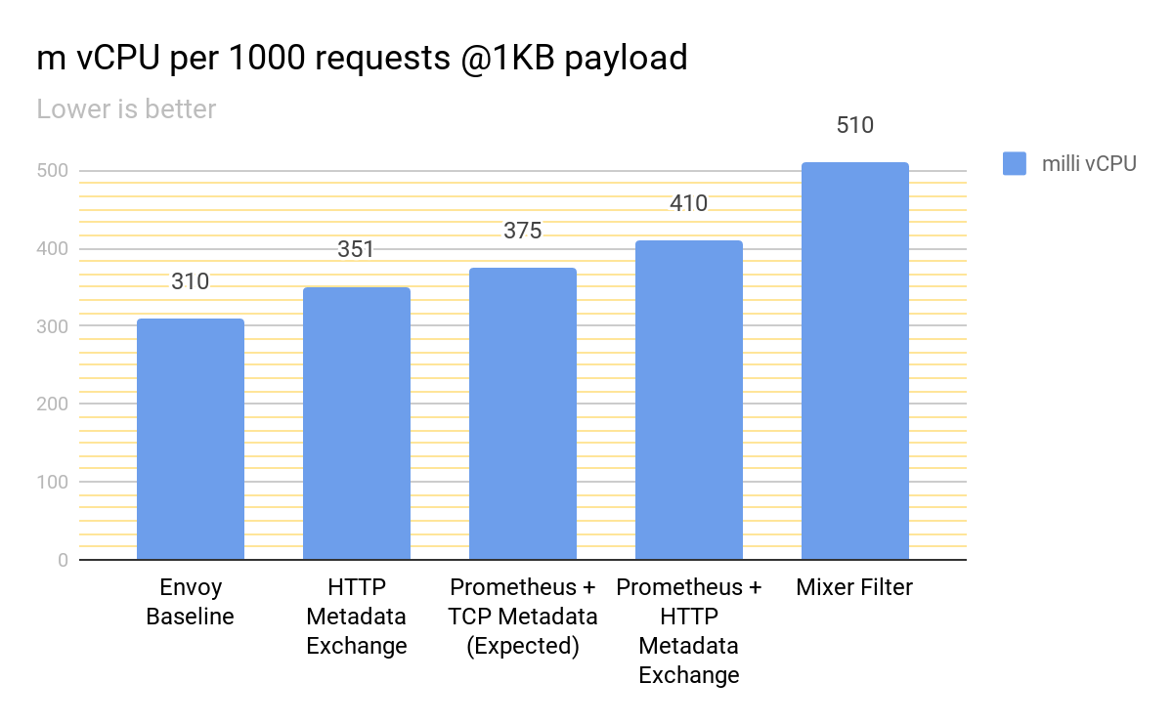
Performance: Proxy CPU
Notes:
Results in Istio 1.4
For Istio standard perf tests, cut average overage from 200mCPU to 100mCPU.
When TCP mx is added it will be down to 60mCPU.
Many things optimizations to come.
next: latency

Slide 35
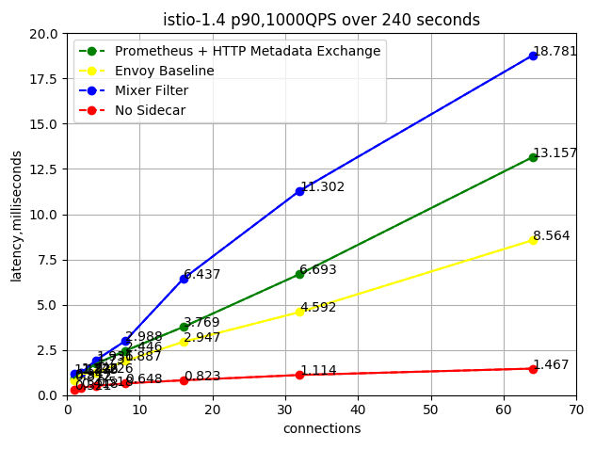
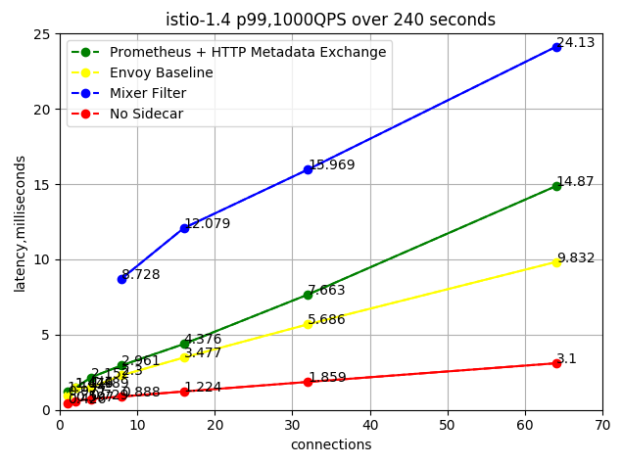
Performance: Latency
Notes:
We track P90 and P99 latency, and v2 has reduced it by 10ms at p99.

Slide 36
Future direction
Release Wasm Sandbox API for extension developers:
Full filter support (network, TLS ALPN, etc)
Improve language bindings (OpenTelemetry C++ API)
Integrate OpenTelemetry on the host.
Make it the default extension model in Istio.
Notes:
Emphasize:
We finish Wasm sandbox API
Integrated the telemetry pipeline - dashboards alerts
https://snapshot.raintank.io/dashboard/snapshot/10ARBVikbzUVAKFdZ3wlSOIaQzkLHbhn
http://grafana.cls1409.v14.qualistio.org/dashboard/snapshot/FBNOFVaRWb2Bm2oxGV3qhxAGG6sKCy1a

Slide 37
Summary
Efficient metadata exchange imparts peer awareness.
Istio telemetry v2 makes greats gains in performance.
Google Istio team is adding WebAssembly support to Envoy.

