Slide 1
Policy Enforcement Using OPA & Policy As Code At Goldman Sachs

Slide 2

Who Am I?
Miguel Uzcategui
Technology Associate
@ Goldman Sachs
Miguel.Uzcategui@ny.email.gs.com

Slide 3
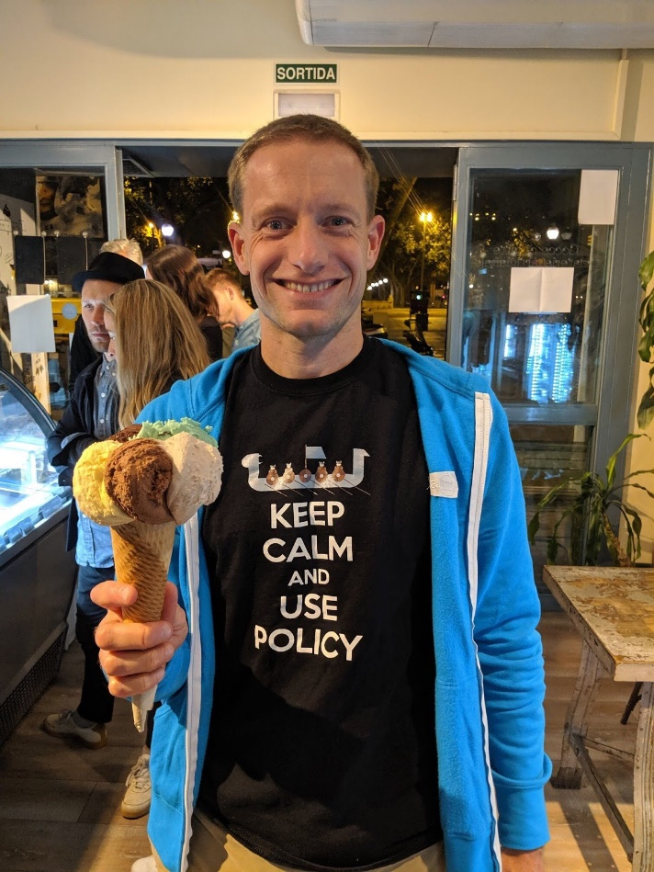

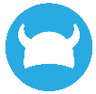


Who Am I?
Tim Hinrichs
Co-creator of Open Policy Agent
CTO @ Styra
@tim on OPA slack
@tlhinrichs on Twitter

Slide 4
Outline
Why Are We Having This Talk?
Kubernetes Policy at Goldman Sachs
Approach: OPA-driven Admission control + Provisioning
Architecture
Future Work
Lessons Learned
Questions

Slide 5

Why Are We Having This Talk?

Slide 6


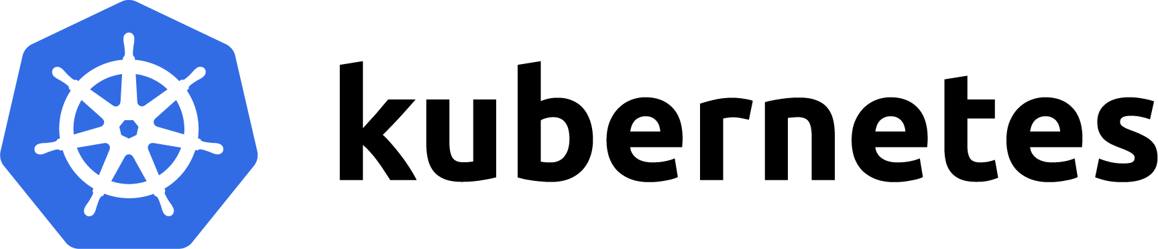
Kubernetes at Goldman Sachs
Statistics
12 total shared clusters
Clusters running on VMs
Average of 150 namespaces per cluster
Namespace names have meaning
Common software
Prometheus
Grafana
Ceph/Rook
CoreDNS
Multiple inventory systems
Group roles
Compute capacity
Production access control
Multitenancy
Multitenant clusters isolate tenants at the namespace level
Namespace 1
Namespace 2
Namespace 3

Slide 7
Policies for Namespaces
RBAC
Role/Rolebinding setup for admin access at the namespace level where admin data comes from inventory systems
Quotas
Resourcequota setup based on capacity data coming from capacity inventory
Storage
Create PV/PVC to mount NFS share volumes based on the namespace you are on
Ingresses
No two ingresses may have the same target host

Slide 8


Two-part Policy Implementation
Admission Control
Provisioning
API Server
Authentication
Authorization
Namespace 1
Namespace 2
New Namespace
Admission
Prohibit changes via admission control
Ingresses with same hostnames
Ingresses with incorrect domain names
When namespaces are created,
populate them with required resources
Roles, Rolebindings, PV, PVC, Resourcequotas

Slide 9


Validating Admission Control with OPA
Authentication
Authorization
Admission
API Server
OPA
Examples: No conflicting ingresses, images from trusted registry, …
package kubernetes.admission
import data.kubernetes.ingresses
deny[msg] {
input.request.kind.kind == "Ingress"
newhost := input.request.object.spec.rules[_].host
oldhost := data.kubernetes.ingresses[namespace][name].spec.rules[_].host
newhost == oldhost
msg := sprintf("host conflicts with ingress %v/%v", [namespace, name])
}

Slide 10

What Is Open Policy Agent
Open source policy engine (CNCF incubating)
Custom Declarative Language, REGO
Rules are treated as code
Any Input / Any Output
External data for context
Architecture
In memory cache for data and policies
Quick lookups and evaluation
Sidecar, daemon, library, WASM
Tooling: unit tests, profiling, Vscode plugin, …
Management
Prometheus Metrics
Periodic policy downloads (“Bundles”)
Log decisions as first-class citizens (“Decision Log”)
Service
Policy
Query
(Any JSON)
Policy
Decision
(Any JSON)
OPA
Policy (Rego)
Data
(JSON)

Slide 11

OPA Example
package kubernetes.admission
import data.kubernetes.ingresses
deny[msg] {
input.request.kind.kind == "Ingress"
newhost := input.request.object.spec.rules[_].host
oldhost := data.kubernetes.ingresses[namespace][name].spec.rules[_].host
newhost == oldhost
msg := sprintf("host conflicts with ingress %v/%v/%v", [namespace, name, oldhost])
}
Policy
apiVersion: admission.k8s.io/v1beta1
kind: AdmissionReview
request:
kind:
kind: Ingress
spec:
rules:
- host: initech.com
...
apiVersion: extensions/v1beta1
kind: Ingress
spec:
rules:
- host: initech.com
...
Input
Data
Output
Host conflicts with ingress foo/bar/hooli.com
Host conflicts with ingress baz/qux/initech.com

Slide 12



Admission is not Enough…Every Namespace Must Include
When namespaces are created, need to provision the following resources:
RBAC
Volumes
Quotas
PSP
Roles
Rolebindings
Clusterroles
Clusterrolbindings
pv
pvc
resourcequotas
limitranges
Role/Rolebinding setup for admin access at the namespace level where admin data comes from inventory systems
Create PV/PVC to mount NFS share volumes based on the namespace you are on
Resourcequota setup based on capacity data coming from capacity inventory

Slide 13


Initial Approach to Provisioning
Logic was embedded in custom controller written in GO
Inflexible
Rules were unclear
Hard to test
Production releases were needed for
Change in API definitions for resources required code change
Managing a new type of resources
Users had almost no input in the process
Controller Manager

Slide 14

Where We Wanted To Get
Policy should be simple to understand and granular
Tests should back up our releases
Change in policy should take minutes to apply to all the clusters
Users should be able to define their own policy
No GO code should be changed when we needed to manage a new type of resource

Slide 15

OPA Approach
Controller Manager
Decouple decision logic
Offload decisions about what resources should exist in each namespace to OPA.
Interaction
Controller Manager periodically asks OPA if any resources need to be provisioned
OPA responds with the actual resources to create/update
Controller Manager creates those resources on k8s
Benefits
Dynamism: Policy can be dynamically changed without rolling out new Go code
Policy-as-code: Policy can be stored in source-control, and developers can open PRs with new rules
Can leverage data from external Goldman inventory systems to make policy decisions.
Group roles: k8s namespaces are assigned to groups; RBAC rules are generated from group-roles
Capacity inventory: k8s resourcequotas are generated based on capacity inventory system
Storage inventory: k8s pv/pvcs are generated based on storage inventory system

Slide 16
ResourceQuota Example
package company.quotas
import data.common.is_valid_did_namespace
import data.cache.capacity_inventory
k8s_resourcequotas_update[rsq] {
is_valid_did_namespace
rsq = {
"apiVersion": "v1",
"kind": "ResourceQuota",
"metadata": {
"name": "compute-resources",
"namespace": input.namespace,
},
"spec": {"hard": capacity_inventory[input.namespace]},
}
}

Slide 17
Rolebinding Example
Special rule for team X
package company.rbac
import data.cache.team_x_namespaces
import data.cluster_name
# rule to generate special rolebinding for team_x
k8s_rolebinding_update[rb] {
input.namespace == team_x_namespaces[cluster_name][_]
rb := {
"apiVersion": "rbac.authorization.k8s.io/v1",
"kind": "RoleBinding",
"metadata": {
"name": "psp-ingress",
"namespace": input.namespace,
},
"roleRef": {
"apiGroup": "rbac.authorization.k8s.io",
"kind": "ClusterRole",
"name": "psp-ingress",
},
"subjects": [{
"kind": "ServiceAccount",
"name": "team_x_service_account",
"namespace": input.namespace,
}],
}
}
Baseline rule
package company.rbac
import data.common.is_valid_namespace
import data.cache.role_inventory
# rule to generate the admin rolebinding for a
# valid namespace
k8s_rolebinding_update[rb] {
is_valid_namespace
rb := {
"apiVersion": "rbac.authorization.k8s.io/v1",
"kind": "RoleBinding",
"metadata": {
"name": "admin",
"namespace": input.namespace,
},
"roleRef": {
"apiGroup": "rbac.authorization.k8s.io",
"kind": "ClusterRole",
"name": "admin",
},
"subjects": role_inventory[input.namespace],
}
}

Slide 18



Policy Updates
Policy (Rego)
Policy checked into Gitlab and replicated into each k8s
Kube-mgmt replicates policy from k8s into OPA
Policy/Data
Policy
update notification
CI/CD
Controller Manager
Kube-mgmt

Slide 19

Data Updates
Policy (Rego)
Feeder receives notifications from K8s about namespaces and queries GS for namespace specific data
OPA downloads info as a Bundle
Policy/Data
Data update
notification
CI/CD
Policy and state
update notification
Request data
GS Feeder
Controller Manager
Data updates
via OPA Bundle
Kube-mgmt

Slide 20
Provisioning
Policy (Rego)
Controller Manager queries OPA for required changes and applies them to Kubernetes
Policy/Data
Data update
notification
Policy and state
update notification
CI/CD
Provision
Request data
GS Feeder
Controller Manager
Data updates
via OPA Bundle
Kube-mgmt

Slide 21
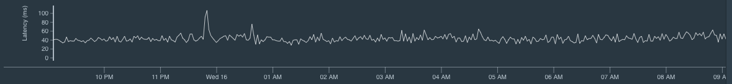
Metrics & Monitoring
OPA Metrics (e.g. Prometheus)
Go routine and thread counts
Memory in use (stack vs heap)
Memory allocated (stack vs heap)
GC stats
Pointer lookup count
Monitoring examples
Roundtrip time by http method
GCC time
Percentage of requests under 500ms, 200ms, 50ms
Mean API request latency
Recommendations for alerting
Number of OPA instances up at any given time
OPA responding under 200ms for 95% of requests
Notes:
Discuss with the OPA guys whether they want to take metrics.

Slide 22
Evaluation of Results
We now have a 5 minute turnaround on global policy application when some administrative changes are done
Scale
Mean Request Rountrip times < 30 ms
24 rules being evaluated per namespace
Average data sizes
1MB GS data: group-membership, resource-allocation inventory
2MB kubernetes data: namespaces, pvs, pvcs, ingresses
Cluster State fixed within 2 to 5 minutes
Running in production
1.5 years as a validating webhook
11 months as a policy enforcer for namespace provisioning
Maintenance on a weekly basis is not needed
Teams which require special policies are quite happy with our turnaround time

Slide 23
Lessons Learned
Pull model using OPA bundles is more scalable than push model using OPA API
Create metrics dashboard before productionizing
Secure your OPA deployment
Do not upload static data as rego
Performance tune & unit test your policies
Use version control for your policies
Have appropriate CI/CD pipelines to rollout/rollback changes

Slide 24
Future Work
New use cases
Control production access through leases
Collaborative management of ConfigMaps for applications
Implementation
Allow horizontal scaling of controller-manager and feeder
Consider making controller-manager an operator
Create metrics around feeder and controller-manager
Make controller-manager open source

Slide 25
THANK YOU

